Slide 1
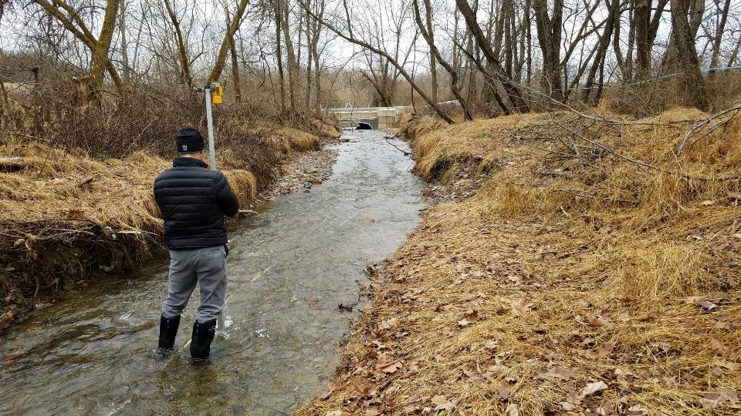
Survey Basics and Longitudinal Profile

Slide 2
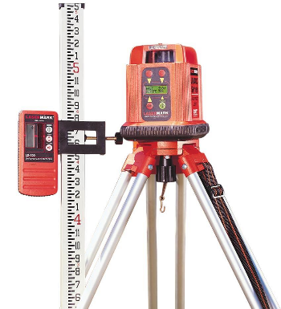
Survey basics - Introduction
Stream Survey Equipment
Total Station
Hand Level
Dumpy Level
GPS Survey
Laser Level
Tape Measure

Slide 3
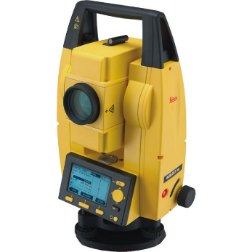
Survey basics - Introduction
Stream Survey Equipment
Total Station
Slope
Elevation
Data Collector

Slide 4
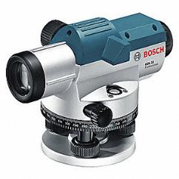
Survey basics - Introduction
Stream Survey Equipment
Hand Level
Dumpy Level
Hand Held
Quick to use
Cheap
Not as accurate
Need 2 People
1 for Rod & 1 for Level

Slide 5
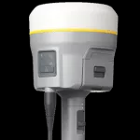
Survey basics - Introduction
Stream Survey Equipment
GPS Survey
Consultant
High accuracy
Elevation
Slope
Angle
Reserve for complicated sites
Be on-site when survey is performed

Slide 6
Survey basics - Introduction
Stream Survey Equipment
Laser Level
Transmitter & Receiver
Most are self leveling
Some can do slope
Can be used by one person
Sight limitations
Vegetation, slope & elevation
Need to be able to see the Transmitter

Slide 7
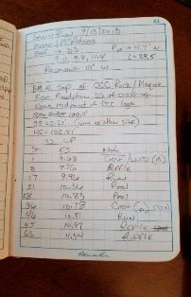
Survey basics - Introduction
Stream Survey Equipment
Measuring Rods
Tenths vs. Feet
Tape Measure
Recommend 200 ft. tape
Field Books
Write everything down in the field.
Flagging, Stakes, Hammer, Marker, Paint, etc.

Slide 8
Survey basics - Terms
Benchmark (BM) – A point of known or assumed permanent elevation.
Brass pin, nail in a tree, or cap in concrete
A lone metal stake
Turning Point (TP) – A point on which the elevation is determined in the process of leveling, but which is no longer needed after necessary readings have been taken.
Should be located on a firm object such as a stone, fence post, etc.
NRCS Part 650 Engineering Field Handbook
Chapter 1 - Surveying

Slide 9
Survey basics - Terms
Backsight (BS) - A rod reading taken on a point of known elevation. It is the first reading taken on a Benchmark or Turning Point.
Foresight (FS) – Rod reading taken on any point on which an elevation is to be determined. Only one BS is taken during each setup. All other readings are FS.
NRCS Part 650 Engineering Field Handbook
Chapter 1 - Surveying

Slide 10
Survey basics - Terms
Height of Instrument (HI) – The elevation of the line of sight. Determined by adding the BS rod reading to the known elevation of the Point on which the BS was taken.
Side Shot (SS) – A reading to locate a point that is off the traverse or that is not intended to be used as a base of the survey. Usually to determine position of object to reference on drawing.
NRCS Part 650 Engineering Field Handbook
Chapter 1 - Surveying

Slide 11
Survey basics - Terms
Longitudinal Profile (Long-Pro) – Typically measured from upstream to downstream in the channel thalweg, characterizes the average stream slope and depths of riffles, pools, runs, glides, step/pools.
Cross Section (CS) – Profile made perpendicular to the center line of the survey, extending a sufficient distance on each side of the center line to provide a view of the surrounding terrain.
NRCS Part 650 Engineering Field Handbook
Chapter 1 - Surveying

Slide 12
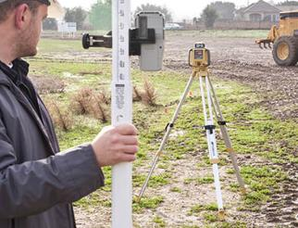
Survey basics – Laser level
Choosing Location
-Site Distance
Set-Up & Leveling
-Solid Ground – No Movement!
Rod Assembly
-Securely Attach Receiver

Slide 13
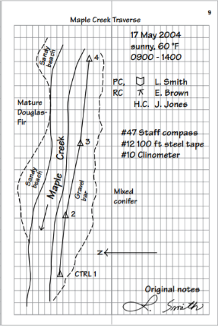
Survey basics – Laser level
Setting Up Field Book
Record Site Location
Project Name
Address
People Present & Task
Date
Field Conditions
Equipment Used
North Arrow

Slide 14
Some suggestions on taking field survey notes
Concise, yet complete
Who, where, when, etc…
Shoot a benchmark and document location (photo helps)
Record Height of Instrument (HI)
Every survey point needs 3 pieces of information
Distance on tape / station (ST)
Foresight / rod reading (FS)
Note (describe what your data point represents)
More to come next week in the field!!

Slide 15
Stream morphology
Fluvial Processes and channel characteristics for longitudinal survey

Slide 16
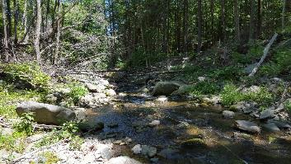
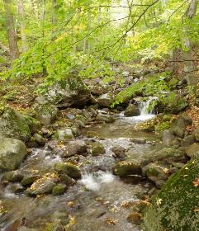
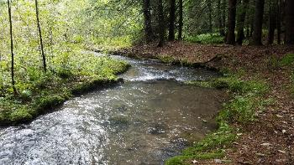
Stream morphology
Slope dictates dominant bedform type and length and spacing of bed features
‘pocket-water’
3.2 %
step / plunge pool
6.1 %
riffle / pool
1.2 %

Slide 17
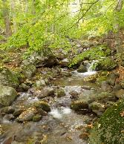
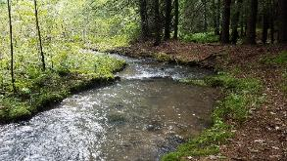
Energy dissipation mechanism varies by slope….
High-gradient vertical (plunge pools)
Low-gradient floodplain
Wildland Hydrology

Slide 18
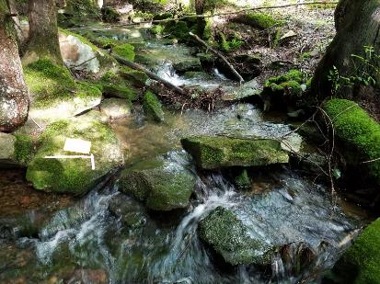
Slope is the key
Channel Slope
dictates dominant bedform & grade controls
drives bed shear and entrainment
Maintains substrate transport and stability
(balance)
As channel slope increases…
channels become less sinuous
energy dissipation more vertical
grade control more frequent and robust

Slide 19
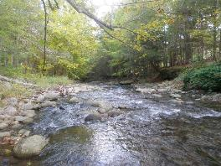
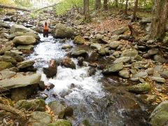
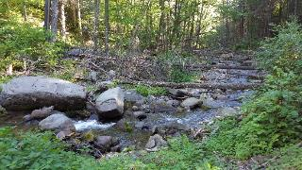
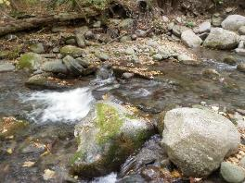
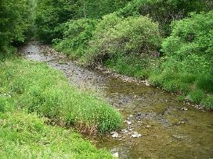
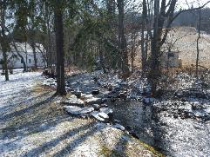
Natural grade control maintains channel slope and stability.

Slide 20
Slope is the key.
ideal, preferred setting
potential headcut
uniform
convex
Zone of deposition
Zone of deposition
potential headcut
concave
concave/convex
vertical offset

Slide 21
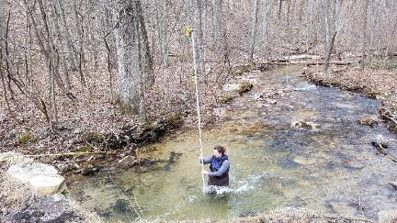
Geomorphic site assessment is essential for success.
If we don’t know what’s broken, how can we fix it?
A different way of thinking (what does the stream need?)
Continuity, functionality, and longevity (not just replace, but maintain)
Wildland Hydrology

Slide 22
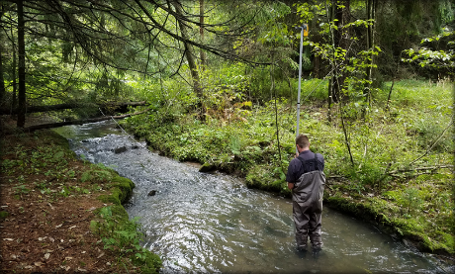
Longitudinal Profile
Slope of upstream and downstream channels
Existing invert elevations
Type, spacing, and length of bed features
Grade controls
- Relative stability (tie-in points)
Pool depth
Road-surface elevations
- Minimum coverage over new culvert

Slide 23
Key bed features
- Steps and Pools
- Riffles and Pools
- Large Woody Debris
- Transverse Ribs
- Particle Clusters
- Gravel Bars
step
step
pool
step
pool
pool
step
pool
riffle
pool
riffle
riffle crest
pool
pool
riffle crest
transverse rib
particle cluster
riffle

Slide 24
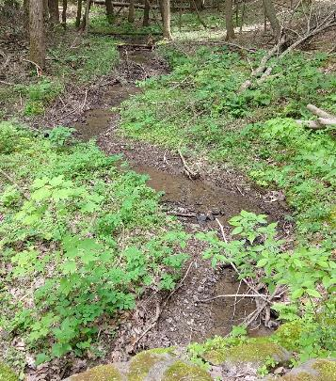
Typical Measuring Points for Longitudinal Profiles
Transitional points along the channel profile
Riffle crests
Top and base of steps, cascades & LWD
Bed feature between grade control crests (one point at minimum)
Rock clusters (‘key pieces’) or transverse ribs (extended riffles & ‘pocket water’)
Other notable features (bedrock, etc.)

Slide 25
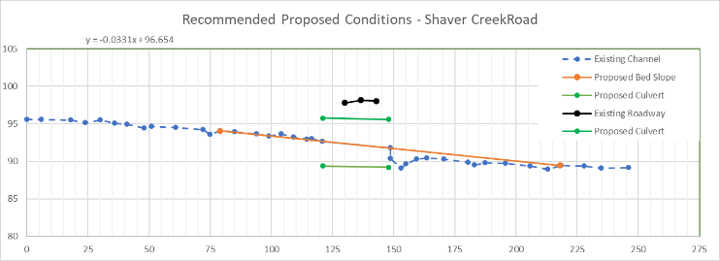
Connecting the dots…
Objective is to re-establish channel continuity
minimize channel adjustment (erosion and sedimentation)
increase longevity of the new crossing (flood resiliency)
maintain AOP
Plunge pool disrupting continuity

Slide 26
Pools matter, too…
Bedform variability
Vertical adjustment potential
Needed for streambed stability and AOP
Influences structure bury depth, structure type, bottom vs. bottomless
FLOW
riffle crest
riffle crest
pool
pool
6”
24”
CULVERT INVERT
Notes:
Introduce project partners

Slide 27
Stability of grade controls
Needed to inform tie-in points
Rate relative stability (good, moderate, poor)
Based on what’s typical
Use your best judgement
Woody debris
Rock cluster

Slide 28
Questions ?

