Slide 1
Administrative Training Dirt, Gravel, and Low Volume Road Program
PA State Conservation Commission
Justin Challenger, Director of Financial and Technical Assistance Programs
Sherri Law, Conservation Program Specialist
Andy Mickey, Conservation Program Specialist

Slide 2
Introduction
Justin Challenger
PROGRAM Manager
State Conservation Commission
Pa Department of Agriculture
jchallenge@pa.gov
717-772-4187
Sherri Law
State Conservation Commission
Pa Department of Agriculture
shlaw@pa.gov
223 – 666 – 2567 / Cell: 717-480-2303
Andy Mickey
State Conservation Commission
Pa Department of Agriculture
anmickey@pa.gov
717-257-6549/ Cell: 717-645-0075
Steve Bloser
CENTER Director
PSU Center for Dirt and Gravel Roads
smb201@psu.edu
814-865-5355

Slide 3
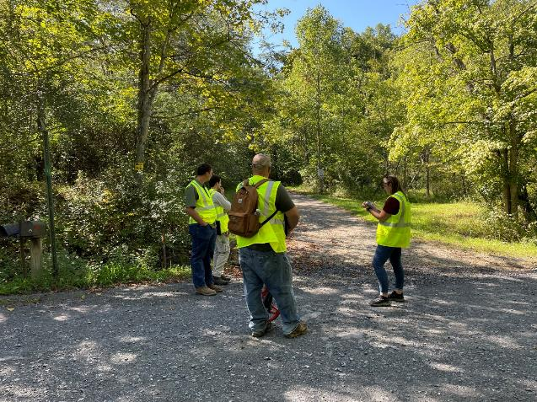
Introduction
Goals today:
Provide guidance for conservation districts to run their Program.

Slide 4
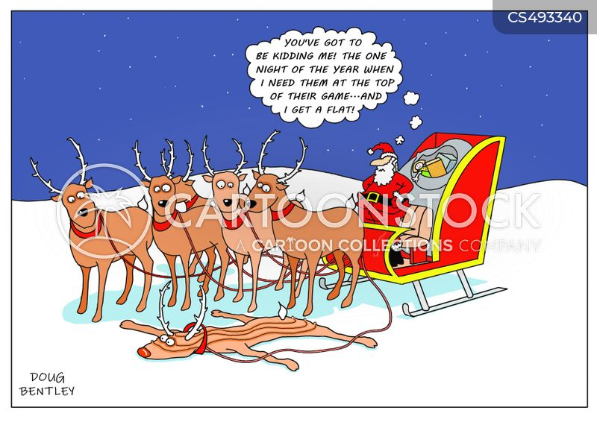
https://www.cartoonstock.com/directory/s/sleigh.asp

Slide 5
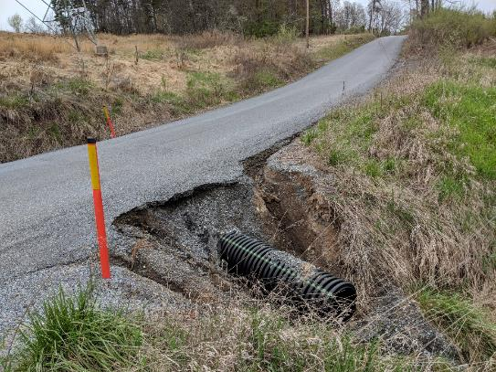
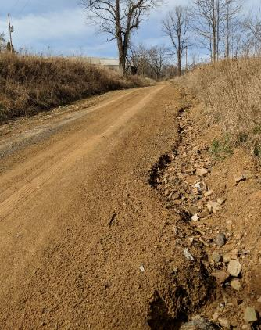
DGLVR Program History
Excess or poorly managed water washes away road material
Road damage is dangerous and expensive to fix

Slide 6
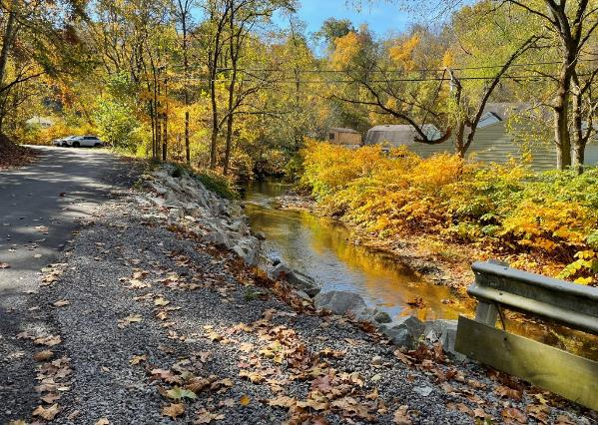
DGLVR Program History
Many PA roads run alongside or across streams

Slide 7
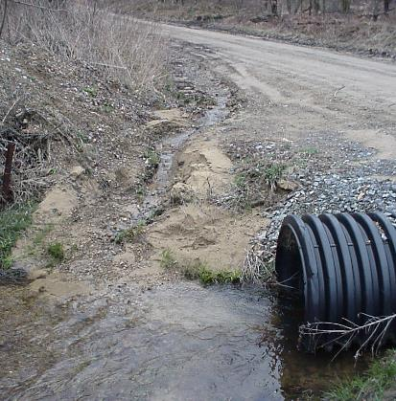
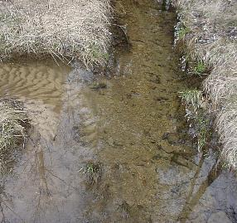
DGLVR Program History
Sediment from roads ends up in streams
Extra sediment in streams is a pollutant
Smothers fish and insect habitat
Changes flow paths and causes flooding
Expensive to remove from drinking water

Slide 8
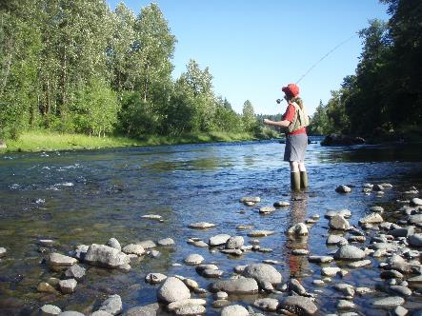
DGLVR Program History
1991: Trout Unlimited (TU) brought the problem of unpaved road runoff into the spotlight
1993: A Task Force on Dirt and Gravel Roads was created
1996-98: TU volunteers identified 900+ pollution sites on dirt and gravel roads (focus on HQ and EV watersheds)
1997: Dirt and Gravel Road Maintenance Program created
A law was enacted to establish the program: Section 9106 of the PA Vehicle Code
https://commons.wikimedia.org/wiki/File:Fly_fishing_on_the_South_Santiam.jpg

Slide 9
DGLVR Program History
Section 9106 of the PA Vehicle Code
Non-lapsing annual allocation of
$5 million for the DGR Program
$4 million: PA State Conservation Commission (SCC)
$1 million: PA Department of Conservation and Natural Resources (DCNR)
State Conservation Commission (SCC)
14-member board in PA Department of Agriculture
Doug M. Wolfgang: Executive Secretary
Justin Challenger: Director of Technical and Financial Assistance Programs
Sherri Law: DGLVR Staff
Andy Mickey: DGLVR Staff
Ryan Ling | Infrastructure Program Specialist
PA Department of Conservation and Natural Resources
Bureau of Forestry, Division of Operations and Recreation
400 Market Street | Harrisburg, PA 17101
Mobile:814.592.9768
E-mail:ryling@pa.gov

Slide 10
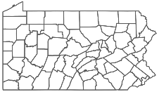
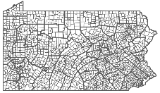
DGLVR Program History
State Conservation Commission:
Establishes statewide DGLVR policy
provides funding to county conservation districts
$
County Conservation Districts:
Establishes local policy
Runs local grant program
Provides grant funds to road owners
$
Local Road Owners:
Apply to conservation district for DGLVR grants
Receive grant funds from conservation district
Construct road project or hire a contractor

Slide 11
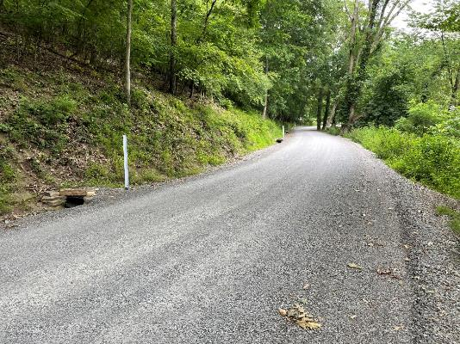
DGLVR Program History
The DGLVR Program provides education and grant funding to local road owners
Goal: Environmentally Sensitive Road Maintenance (ESM)
Spread out and slow down storm water
Reduce road erosion
Keep sediment out of streams

Slide 12
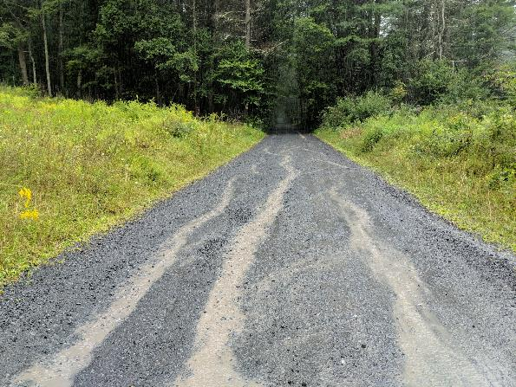
DGLVR Program History
BEFORE
Stream
Water Flow
Notes:
When the road is the low spot, water collects there and washes out the road surface.

Slide 13
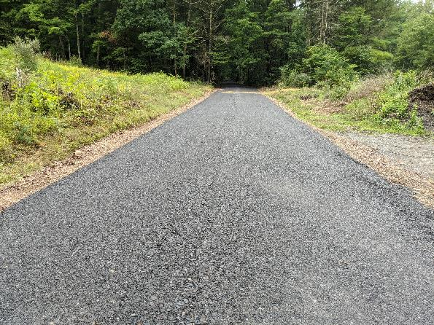
DGLVR Program History
BEFORE
Stream
AFTER
Water Flow
Water Flow
Notes:
Raising the road and creating crown forces water off the road

Slide 14
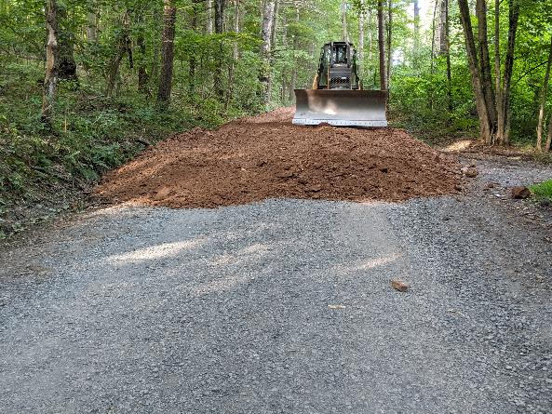
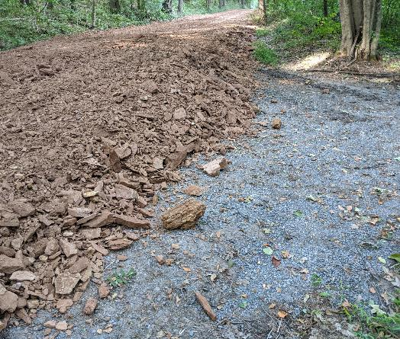
DGLVR Program History
Notes:
Shale road fille being placed to raise and crown the road

Slide 15
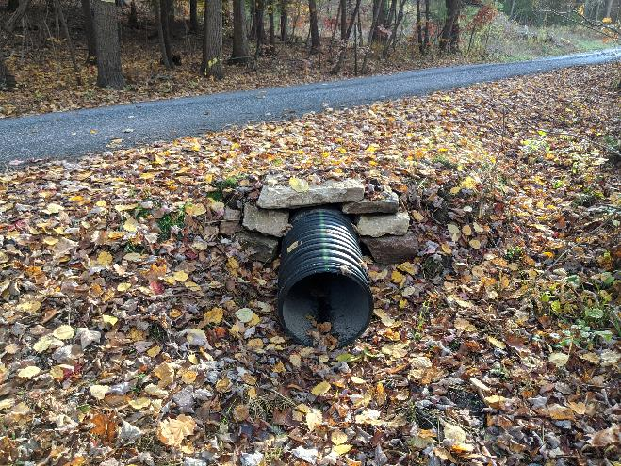
DGLVR Program History
Notes:
New shallow cross pipes are also installed to make sure there isn’t too much water in the roadside ditches

Slide 16
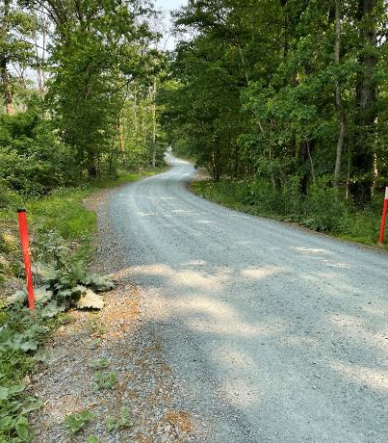
DGLVR Program History
Better Roads, Cleaner Streams
Benefits:
Reduce time and money needed for long term road maintenance
Improve water quality
Better roads for everyone to drive on

Slide 17
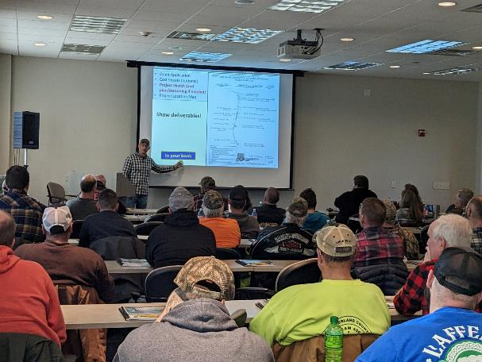
DGLVR Program History
2000: conservation districts identify 12,000+ pollution sites in all watersheds
2001: PSU Center for Dirt and Gravel Road Studies created to conduct training, outreach, and technical assistance

Slide 18
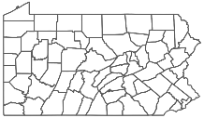
DGLVR Program History
State Conservation Commission
Penn State Center for Dirt and Gravel Road Studies:
Receives funding from SCC DGLVR Program
$
$
County Conservation Districts
training
$
Provides education and outreach for the DGLVR Program, including:
ESM Training for grant applicants
Trainings for conservation districts
Technical assistance for conservation districts
training
Local road owners

Slide 19
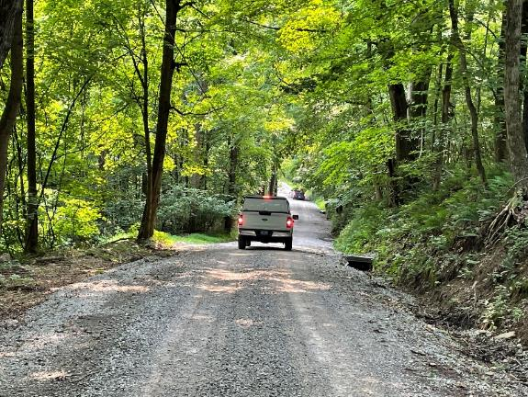
DGLVR Program History
2000: conservation districts identify 12,000+ pollution sites in all watersheds
2001: PSU Center for Dirt and Gravel Road Studies created to conduct training, outreach, and technical assistance
2008: Second state-wide assessment increases pollution sites to 16,500+
2009: 2,000th project completed
2013: Act 89 increases funding from $5 million to $35 million annually and adds low volume roads to the program

Slide 20
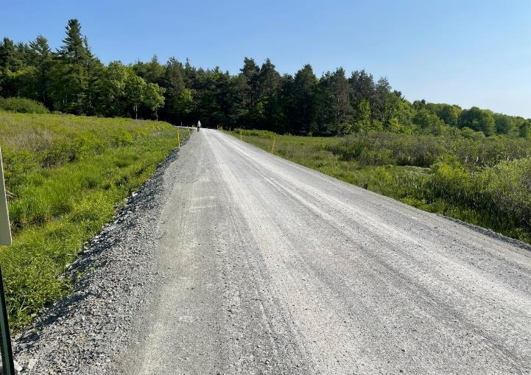
DGLVR Program History
Dirt and Gravel Roads
Unpaved surface of natural material or rock aggregate with no binder

Slide 21
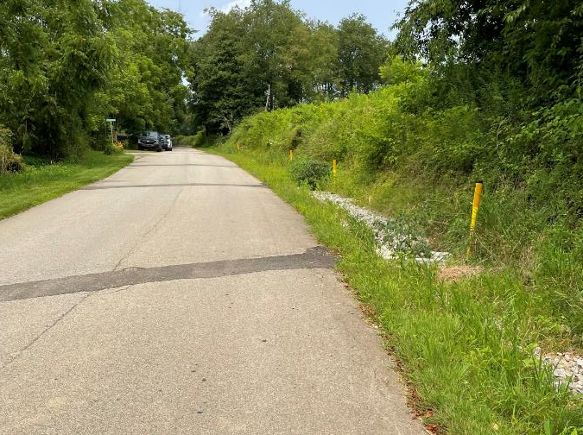
DGLVR Program History
“Low Volume” Roads
Paved or sealed (includes “tar and chip”)
Have low traffic volume:
500 or less vehicles per day

Slide 22
DGLVR Program History
Section 9106 of the PA Vehicle Code
Non-lapsing annual allocation of $35 million for the DGR Program
$28 million: PA State Conservation Commission (SCC)
$ 8 million for Low Volume Roads
$20 million for Dirt and Gravel Roads
$7 million: PA Department of Conservation and Natural Resources (DCNR)

Slide 23
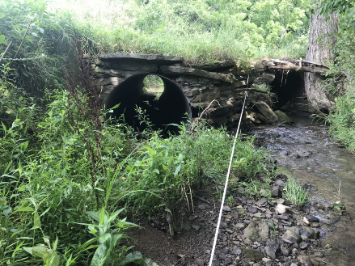
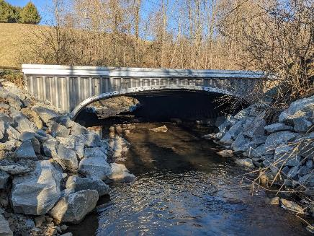
DGLVR Program History
2015: first 74 paved LVR contracts completed. DGR contracts pass 3,000
2021: Program completes 6,000th project
2022: CD spending passes $250 million
Before
After
Notes:
Funding increase provided enough funding to be able to afford larger, more complex projects such as stream crossing replacements. Photos are from Wilhelm Rd, Washington County, completed 2023 (pre-standard but incorporated updated guidance)

Slide 24
Introduction
Program Fundamentals
Focus on environmental and road improvement projects
Local control
Conservation District runs local Program
Quality Assurance Boards at County
State guidance and local policies
Application and Grant Process, 90%+ of applicants are townships.

Slide 25
Introduction
What do we mean by “Local Control”?

Slide 26
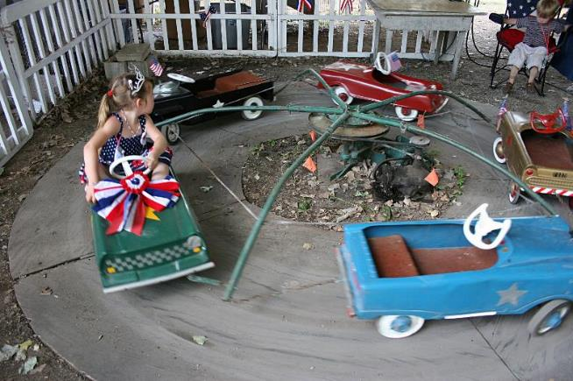
Introduction
What do we mean by “Local Control”?
0% Local Control

Slide 27
Introduction
What do we mean by “Local Control”?
100% Local Control

Slide 28
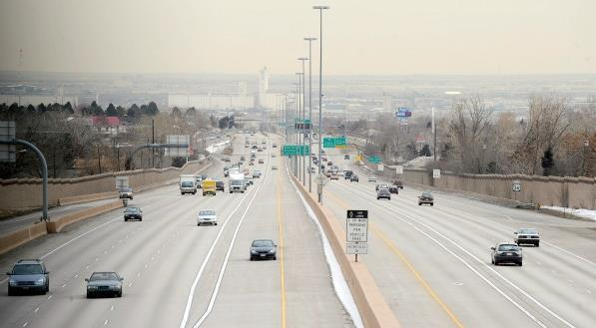
Introduction
What do we mean by “Local Control”?
Effective Local Control

Slide 29
Introduction
Overall balancing act
Need for Increased Accountability
Simplicity and Local Control

Slide 30
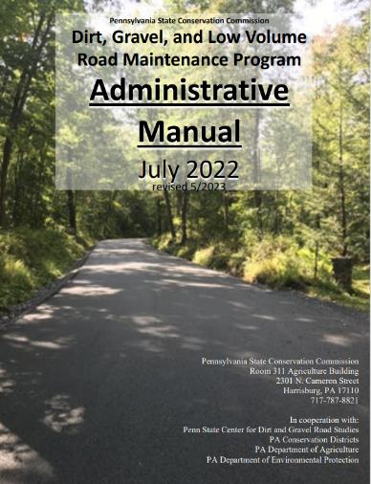
Introduction
DGLVR Administrative Manual
Approved by SCC 5/10/22
Introduction
SCC Role
Conservation District Role
Quality Assurance Board Role
Applicant Role
Center for Dirt and Gravel Roads
Additional Policies
Permits and Other Requirements
Appendices
Available online.
Hard copies sent on request.
Training Follows Manual!

Slide 31
Introduction
DGLVR Administrative Manual
Approved by SCC 5/10/22
Introduction
SCC Role
Conservation District Role
Quality Assurance Board Role
Applicant Role
Center for Dirt and Gravel Roads
Additional Policies
Permits and Other Requirements
Appendices
Available online.
Hard copies sent on request.
Introduction
6-page “Abstract” of the Program and the rest of the manual.
Program Structure
Program History
ESM Overview
Training Follows Manual!

Slide 32
Introduction
DGLVR Administrative Manual
Approved by SCC 5/10/22
Introduction
SCC Role
Conservation District Role
Quality Assurance Board Role
Applicant Role
Center for Dirt and Gravel Roads
Additional Policies
Permits and Other Requirements
Appendices
Available online.
Hard copies sent on request.
2) SCC Role
4-page summary of SCC role
SCC Structure
Program Administration
QAQC
Training Follows Manual!

Slide 33
Introduction
DGLVR Administrative Manual
Approved by SCC 5/10/22
Introduction
SCC Role
Conservation District Role
Quality Assurance Board Role
Applicant Role
Center for Dirt and Gravel Roads
Additional Policies
Permits and Other Requirements
Appendices
Available online.
Hard copies sent on request.
3) District Role
Over ½ of manual
Receiving Funds
Accounting for Funds
Dispersing Funds to Grantees
CD Educational Opportunities
Education/Training by CDs
Program Eligibility
Administering Projects
GIS system
Quarterly Reports
Annual Reports
More details in Financial Training!
Training Follows Manual!

Slide 34
Introduction
DGLVR Administrative Manual
Approved by SCC 5/10/22
Introduction
SCC Role
Conservation District Role
Quality Assurance Board Role
Applicant Role
Center for Dirt and Gravel Roads
Additional Policies
Permits and Other Requirements
Appendices
Available online.
Hard copies sent on request.
4) QAB Role
Defines composition and function of QAB
Composition
Meeting Requirements
QAB Role in Projects
QAB Role in Policy
Training Follows Manual!

Slide 35
Introduction
DGLVR Administrative Manual
Approved by SCC 5/10/22
Introduction
SCC Role
Conservation District Role
Quality Assurance Board Role
Applicant Role
Center for Dirt and Gravel Roads
Additional Policies
Permits and Other Requirements
Appendices
Available online.
Hard copies sent on request.
5) Applicant Role
Intentionally repeats previous material
Written “to” the applicant audience
Intended to be standalone to give to applicants.
Training Follows Manual!

Slide 36
Introduction
DGLVR Administrative Manual
Approved by SCC 5/10/22
Introduction
SCC Role
Conservation District Role
Quality Assurance Board Role
Applicant Role
Center for Dirt and Gravel Roads
Additional Policies
Permits and Other Requirements
Appendices
Available online.
Hard copies sent on request.
6) Center Role
3-page overview of Center role and available services
Education
Outreach
Technical Assistance
Documentation
Training Follows Manual!

Slide 37
Introduction
DGLVR Administrative Manual
Approved by SCC 5/10/22
Introduction
SCC Role
Conservation District Role
Quality Assurance Board Role
Applicant Role
Center for Dirt and Gravel Roads
Additional Policies
Permits and Other Requirements
Appendices
Available online.
Hard copies sent on request.
7) Additional Policies
Policies that apply to certain circumstances:
Stream Crossing Replacement
Driving Surface Aggregate
Paved LVR-Specific Policies
Full Depth Reclamation
Training Follows Manual!

Slide 38
Introduction
DGLVR Administrative Manual
Approved by SCC 5/10/22
Introduction
SCC Role
Conservation District Role
Quality Assurance Board Role
Applicant Role
Center for Dirt and Gravel Roads
Additional Policies
Permits and Other Requirements
Appendices
Available online.
Hard copies sent on request.
8) Permits
Brief overview of permit issues related to Program projects.
Training Follows Manual!

Slide 39
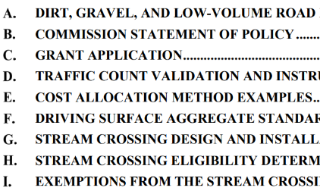
Introduction
DGLVR Administrative Manual
Approved by SCC 5/10/22
Introduction
SCC Role
Conservation District Role
Quality Assurance Board Role
Applicant Role
Center for Dirt and Gravel Roads
Additional Policies
Permits and Other Requirements
Appendices
Available online.
Hard copies sent on request.
Appendices
Program forms and policies…
Training Follows Manual!

Slide 40
Administrative Manual
Introduction
SCC Role
Conservation District Role
Quality Assurance Board
Applicant Role
Center for Dirt and Gravel Roads
Additional Policies
Permits and Other Requirements
Appendices

Slide 41
Chapter 1: Introduction
1.1 Program Purpose
1.2 Program Structure
1.3 Program History
1.4 Worksites
Topic List:
Program Overview

Slide 42
Chapter 1: Introduction
Introduction chapter contains:
Overview of Program and rest of manual
Brief Program history
Explanation of Worksites
Brief Explanation of Environmentally Sensitive Maintenance practices

Slide 43
Chapter 1: Introduction
Introduction chapter contains:
Overview of Program and rest of manual
Brief Program history
Explanation of Worksites
Brief Explanation of Environmentally Sensitive Maintenance practices
Note manual section and title on top of slide. Follow along or take notes in manual.

Slide 44
Administrative Manual
Introduction
SCC Role
Conservation District Role
Quality Assurance Board
Applicant Role
Center for Dirt and Gravel Roads
Additional Policies
Permits and Other Requirements
Appendices

Slide 45
Chapter 2: SCC Role
Chapter 2 covers:
SCC Structure
Program Coordinator
Allocations
Replenishments
Establishing Policy
Quality Assurance / Quality Control

Slide 46
Chapter 2: SCC Role
Quality Assurance / Quality Control (QAQC)
The SCC is responsible for making sure funding is spent appropriately
Funding needs to be properly accounted for
Funding needs to be spent on eligible expenses
Educational opportunity:
Allows SCC to assess district staff understanding of Program goals, policies, technical skills, etc.
Districts are educated about what they are doing well and areas for improvement
Districts provide feedback to SCC on how the Program is working

Slide 47
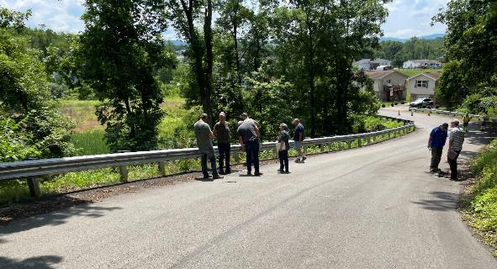
Chapter 2: SCC Role
Quality Assurance / Quality Control (QAQC)
1-2 day visit to review county Program.
Financial, Administration & Functionality, Projects.
Involves SCC, Center, and DEP Field Reps.
Visit ~22 districts annually.

Slide 48
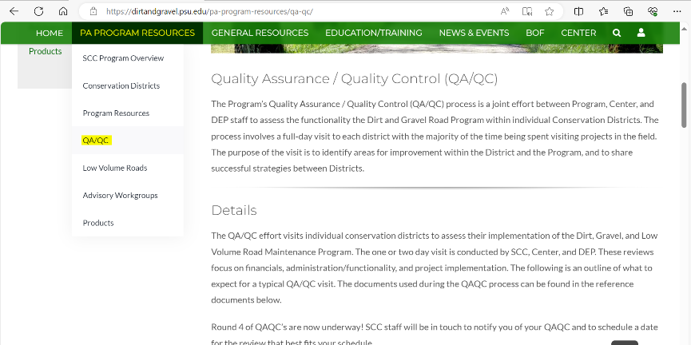
Chapter 2: SCC Role
Preparing for a QAQC
Pre-visit letter (email) includes checklist, overview of ratings, etc. (Attachments A-D)
All documents available online: https://dirtandgravel.psu.edu/pa-program-resources/qa-qc/

Slide 49
Chapter 2: SCC Role
QAQC Round 1:
Every County visited 2003-2011
QAQC Round 2:
Every County visited 2015-2017
QAQC Round 3:
Every County visited 2018-2020
QAQC Round 4:
Every County visited 2021-2023
QAQC Round 5:
22 visits completed in 2024

Slide 50
Chapter 2: SCC Role
How to do well on a QAQC?
Attend DGLVR trainings regularly
Keep up with webinars
Commit enough time to the DGLVR Program
Develop ESM practice expertise
Reach out when you need help
“You learn more by asking than assuming”
Notes:
Quote from Dave Morrison, Center for Dirt and Gravel Road Studies

Slide 51
Chapter 2: SCC Role
Recorded webinar:
April 11, 2024: QAQC Round 4 Summary and Updates
Each conservation district administering the DGLVR Program receives a Quality Assurance/Quality Control (QAQC) visit once every three years. These visits are to ensure that funds are spent appropriately, and the Program is being administered correctly, as well as to provide an educational opportunity. This webinar reviewed the overall results and themes from the 4th round of QAQCs recently completed in 2023, as well as discussed changes to the QAQC process for 2024.
Webinar Download (85.1 MB): MP4 format (~57 minutes)
Presentation Downloads:
Adobe PDF (4.91 MB)
MS Powerpoint (8.27 MB)

Slide 52
Administrative Manual
Introduction
SCC Role
Conservation District Role
Quality Assurance Board
Applicant Role
Center for Dirt and Gravel Roads
Additional Policies
Permits and Other Requirements
Appendices

Slide 53
Chapter 3: Conservation District Role
District Role:
Run the Program within each County.
Receive $ from SCC
Provide grants to applicants

Slide 54
Chapter 3: Conservation District Role
3.1 CD Structure
3.2 Overview
3.3 Receiving Funds from SCC
3.4 Accounting of funds at CD
3.5 Dispersing funds to Grant Recipients
3.6 CD Educational opportunities
3.7 Program Eligibility
3.8 Administering Projects
3.9 GIS System
3.10 Quarterly Reports
3.11 Annual Summary Reports
Topic List:
Follow the money

Slide 55
Chapter 3: Conservation District Role
3.1 CD Structure
3.2 Overview
3.3 Receiving Funds from SCC
3.4 Accounting of funds at CD
3.5 Dispersing funds to Grant Recipients
3.6 CD Educational opportunities
3.7 Program Eligibility
3.8 Administering Projects
3.9 GIS System
3.10 Quarterly Reports
3.11 Annual Summary Reports

Slide 56
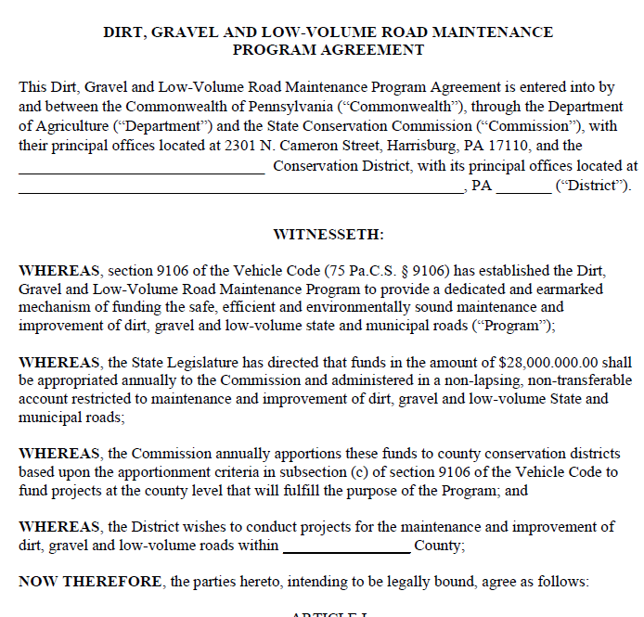
3.3: Receiving Funds from SCC
Receiving Funds from SCC
Conservation districts enter into a 5-year agreement with the State Conservation Commission (SCC).
Allows the CD to run the DGLVR Program locally and receive annual allocations with limited annual paperwork.
Currently, we’re in year 2 of the new Five-Year Agreement (2023-2028)

Slide 57
3.3: Receiving Funds from SCC
Receiving Funds from SCC
Timeline for FY 2024-25 allocations
Approved by SCC in July
Approved in State Budget for July 1
Advances received by CDs late summer/fall each year
July = month 1

Slide 58
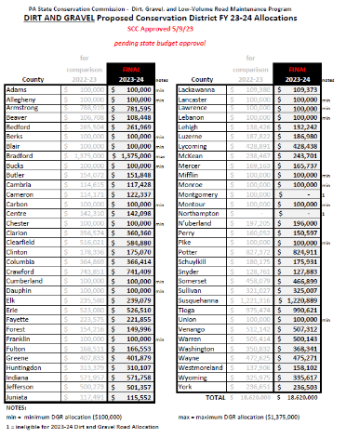
3.3: Receiving Funds from SCC
Receiving Funds from SCC
Allocations are formula-based:
DGR:
miles of unpaved roads and worksites and proximity to streams
LVR:
miles of urban and non-urban roads and proximity to streams
Complete details: www.dirtandgravelroads.org

Slide 59
3.3: Receiving Funds from SCC
The DGLVR Program does NOT reimburse conservation districts
We do something better!
We provide funds before conservation districts spend it

Slide 60
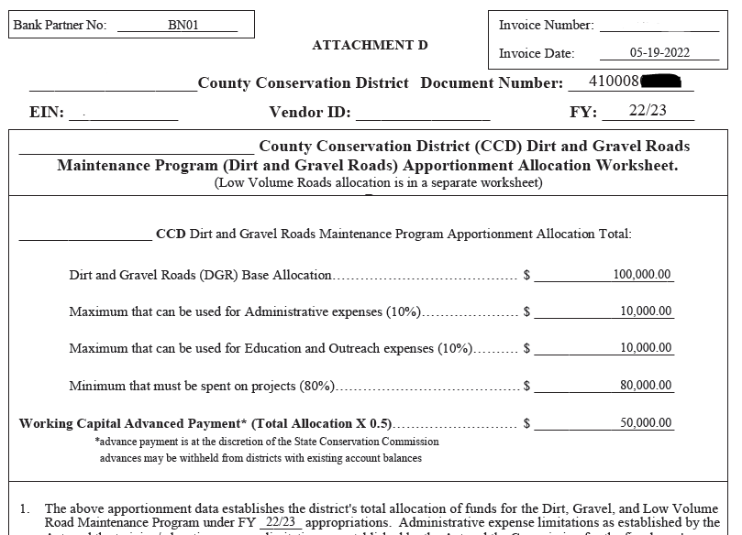
3.3.2: Advanced Working Capital
Advanced Working Capital
50% of allocations advanced to districts
Will come as separate deposits (DGR and LVR)
Schedule D explains breakdowns

Slide 61
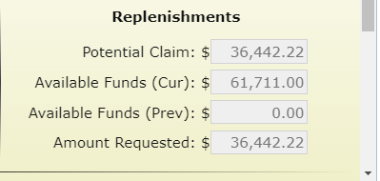
3.3.3: Replenishment of Working Capital
Districts receive replenishments of remaining 50% of funds based on actual spending
Replenishments handled in GIS quarterly reporting system
Automatically generated each quarter
DGR and LVR replenishment will come in separate deposits

Slide 62
3.3.3: Replenishment of Working Capital
Spending Requirements
DGLVR funds must be spent within specific time frames
DGR and LVR spending tracked separately.
Can meet DGR spending requirement but not LVR, and vice versa
If a District misses a year, can be eligible in future years if they meet future requirements.

Slide 63
3.3.4: Spending Requirements
DGR (or LVR) Allocation
Must be spent in 2 years
Districts are required to spend their entire allocation:
within two years of state budget approval
to be eligible for future allocations.
100% can be used for Projects

Slide 64
3.3.4: Spending Requirements
DGR (or LVR) Allocation
Available in the first year of an allocation
2. Admin and edu funds must be spent within one year.
Max 10% can be Admin
Max 10% can be Edu
Minimum 80% Project Funds

Slide 65
3.3.4: Spending Requirements
DGR (or LVR) Allocation
Can use less than 10% of allocation for admin and 10% of allocation for edu
2. Admin and edu funds must be spent within one year.
Admin
Edu
Minimum 80% Project Funds

Slide 66
3.3.4: Spending Requirements
DGR (or LVR) Allocation
Unused admin & edu allowance become project funds
2. Admin and edu funds must be spent within one year.
Admin
Edu
Minimum 80% Project Funds

Slide 67
3.3.4: Spending Requirements
DGR (or LVR) Allocation
All funds must be spent in 2 years
Admin
Edu
Minimum 80% Project Funds

Slide 68
3.3.4: Spending Requirements
2023 2024 2025 2026 2027 2028
FY 2023-24 funds
Admin/Edu
FY 2024-25 funds
Admin/Edu
FY 2025-26 funds
Admin/Edu

Slide 69
3.3.4: Spending Requirements
Spending Requirements
At the end of the 5-year agreement
Districts have 12 months to finish spending funds from that 5-year agreement

Slide 70
3.3.4: Spending Requirements
2018 2019 2020 2021 2022 2023 2024 2025 2025 2027 2028
Previous 5-year
Previous 5-year:
Began 7/1/2018 & ended 6/30/2023

Slide 71
3.3.4: Spending Requirements
2018 2019 2020 2021 2022 2023 2024 2025 2025 2027 2028
Previous 5-year
Extra Year
Previous 5-year:
Began 7/1/2018 & ended 6/30/2023
Extra year written into contract to spend funds. All funds must be spent by 6/30/2024.

Slide 72
3.3.4: Spending Requirements
2018 2019 2020 2021 2022 2023 2024 2025 2025 2027 2028
Previous 5-year
Extra Year
New 5-year
Previous 5-year:
Began 7/1/2018 & ended 6/30/2023
Extra year written into contract to spend funds. All funds must be spent by 6/30/2024.
New Agreement began 7/1/2023.

Slide 73
3.3.4: Spending Requirements
Two fiscal years only span one continuous calendar year
Jan-June: difficult to get construction started in the few spring months
July 1
2022 2023 2024 2025 2026 2027
FY 2023-24 funds
FY 2024-25 funds
July-Dec: difficult to prepare, start, and complete a project before it gets too cold
FY 2025-26 funds

Slide 74
3.3.4: Spending Requirements
Prepare projects the calendar year before they go to construction
Be ready to contract projects with 2024-25 funds as soon as the 2024-25 FY starts
Work proactively, not reactively!
2022 2023 2024 2025 2026 2027
FY 2023-24 funds
FY 2024-25 funds
July 1
Use 2024 to prepare for projects that will be constructed in 2025
FY 2026-27 funds
Notes:
Have grant applications ranked and ready for QAB recommendation with the intent of using those applications to commit the upcoming allocation immediately.

Slide 75
3.3.4: Spending Requirements
2024
2025
2026
Today
Jan April July Oct Jan April July Oct Jan April July Oct Jan
Pre-app meetings (start previous fall)
QAB & CD board meetings
Contract 24-25 funds
Design, permitting, bidding
construction
Completion & final payment
Notes:
This is an example timeline of a district that has already contracted FY 24-25 funds, and what their timeline looks like moving forward to plan for projects that will be funded with the FY 25-26 funds.

Slide 76
3.3.4: Spending Requirements
2024
2025
2026
Today
Jan April July Oct Jan April July Oct Jan April July Oct Jan
Pre-app meetings (start previous fall)
Pre-app meetings
QAB & CD board meetings
Apps due
Rank apps
QAB & CD board meetings
Contract 24-25 funds
Contract 25-26 funds
Design, permitting, bidding
Prep for & complete construction
Completion & final payment
construction
Completion & final payment
Notes:
Sample Timeline
Summer/Fall 2024 – Complete pre-application meetings
Winter 2025 – Accept applications
Spring 2025 – Rank project applications
May 2025 – find out FY 25-26 allocation
June/July 2025
Once new allocation amount is known, hold QAB meeting and recommend projects for funding
Approve projects at District Board meeting
Contract the new projects with FY 25-26 funds
July 2025 – October 2026 – Complete Construction
November/December 2026 – Close out project including reimbursement to project participant

Slide 77
3.3.4: Spending Requirements
2024
2025
2026
Today
Jan April July Oct Jan April July Oct Jan April July Oct Jan
Pre-app meetings
QAB & CD board meetings
Contract 24-25 funds
Prep for & complete construction
Completion & final payment
Notes:
It’s fall 2024. If you haven’t allocated your FY 24-25 funds yet, you can of course still do so and complete projects within 2 years, but there is less time from when the contract is signed to the spending deadline.

Slide 78
3.3.4: Spending Requirements
How to stay on track with spending requirements
Run an annual grant program
Be up front with program participants about the required timelines
Fund projects that can be completed in the allotted time
Fund a variety of project types
Make sure you know how much money you need to spend (use GIS)
Budget well so you don’t have extra money leftover
If anything comes in underbudget, reallocate that funding ASAP

Slide 79
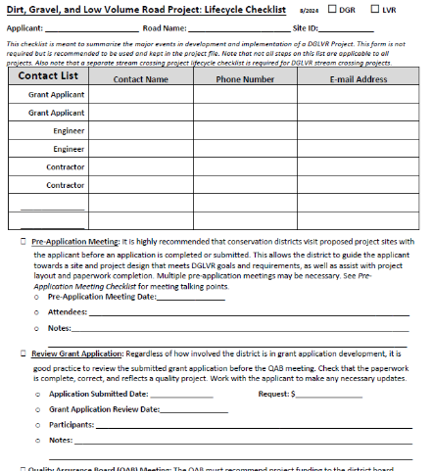
3.3.4: Spending Requirements
Communication
Discuss DGLVR requirements:
Frequently
At each stage of the project
When new people get involved in the project
With all relevant parties
grant recipients, landowners, engineer, permit reviewer, contractor, etc.
In an effective format
In person or on the phone
Provide key info in writing

Slide 80
3.3.4: Spending Requirements
Recorded webinars at https://dirtandgravel.psu.edu/education-training/webinars/past-webinars/
April 25, 2024: Tips For Keeping Up With Spending Requirements
July 6, 2023: End of FY Guidance and Discussion
Dec 14, 2023: DGLVR Spending Update and Annual Summary Report Refresher
Financial training – more details later

Slide 81
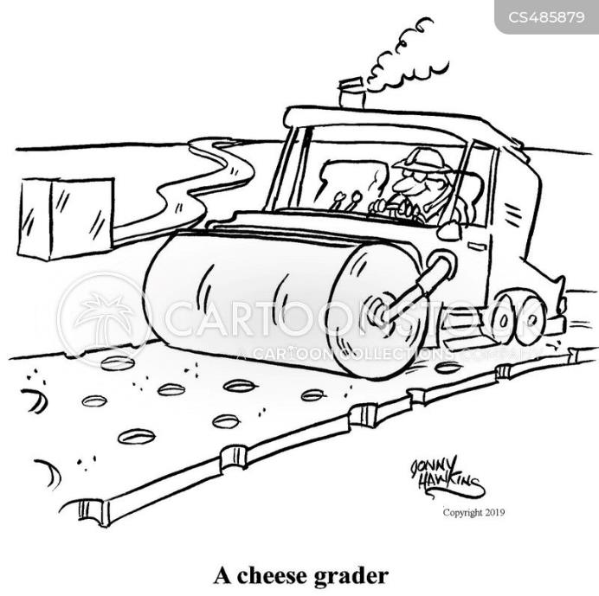
https://www.cartoonstock.com/directory/c/cheese_grader.asp

Slide 82
Chapter 3: Conservation District Role
3.1 CD Structure
3.2 Overview
3.3 Receiving Funds from SCC
3.4 Accounting of funds at CD
3.5 Dispersing funds to Grant Recipients
3.6 CD Educational opportunities
3.7 Program Eligibility
3.8 Administering Projects
3.9 GIS System
3.10 Quarterly Reports
3.11 Annual Summary Reports

Slide 83
3.4.1: Separate Accounting
DGLVR funds must be in an interest-bearing Federal Deposit Insurance Corporation or equivalent insured account
Districts must ensure that account balances in excess of $250,000 are also insured or otherwise collateralized
District records relating to the DGLVR Program must be kept for a minimum of 7 years

Slide 84
3.4.1: Separate Accounting
Separate Accounting:
Dirt and Gravel Roads funds (Project, Admin, and Edu)
to be used solely for Dirt and Gravel Road Program expenses
must be accounted for separate from the Low Volume Roads funds
Low Volume Roads funds (Project, Admin, and Edu)
to be used solely for Low Volume Road Program expenses
must be accounted for separate from the Low Volume Roads funds

Slide 85
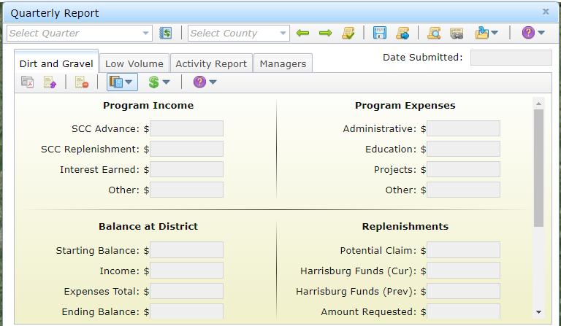
3.4.1: Separate Accounting
Categories of income and expenses to track are in the quarterly report
“Other”
Should be rare

Slide 86
3.4.2-4: Spending Categories
Spending Policies
https://www.istockphoto.com/illustrations/money-falling

Slide 87
3.4.2-4: Spending Categories
Guidelines for Administrative and Education Funds
Must be spent on eligible expenses as they are incurred.
Must be incurred within the allotted fiscal year (1 year spending limit)
“Banking” of funds is not permitted

Slide 88
3.4.3&4: Administrative and Education Funds
Admin and Edu funds are not the same
Admin
Edu
Primarily to allow
the district to attend and provide trainings and educational events
Primarily to ensure adequate funding for technical staff who work on the Program

Slide 89
3.4.3: Administrative Funds
Expenses that can be paid for with Admin funds:
Salary, benefits, and travel for the DGLVR Program
Equipment for CD use
Levels, tape measures, survey equipment, safety equipment, etc.
Office Expenses
Includes computers, printers, internet service, office supplies like paper, etc.
Overhead costs (insurance, utilities, rent)
Aggregate testing
Consulting services
Typically paid with project funds for specific projects
For consulting services needed outside of a standard project contract, contact the SCC

Slide 90
3.4.4: Education Funds
Expenses that can be paid for with Edu funds:
Salary, benefits, and travel for DGLVR educational activities
Equipment for loan/rental to applicants
Note that equipment for applicants to own is not an eligible DGLVR Expense
Training Costs
Including facility rental, food, educational materials, providing transportation, etc.
Promotional Materials
Advertisements, reports, websites, project signage
Promotional items (pens, hats, etc. given away to Program participants)
limited to $1,000/year
Participation Incentives
Paying travel costs related to education activities for applicants or QAB members

Slide 91
3.4.3 & 4: Administrative and Education Funds
Salary and Benefits:
Salary can only be claimed for time spent working directly on administration or education/training efforts for the DGLVR program.
Tracking can be done on an hourly basis, a percent effort basis, or some other method that allocates salary in accordance with time spent on the Program.
Conservation districts must be able to document that staff time claimed as administrative time is spent on eligible administrative activities and staff time claimed as education time is spent on eligible education activities.

Slide 92
3.4.3 & 4: Administrative and Education Funds
Example administration activities include:
site inspections, meetings, completing paperwork, communications, etc. related to DGLVR Projects.
QAB meetings and Conservation District Board of Director meetings
Reviewing DGLVR applications
Follow up visits to previously contracted DGLVR worksites for the purpose of ranking new grant applications or implementing local policies.

Slide 93
3.4.3 & 4: Administrative and Education Funds
DGLVR educational activities include:
Training new conservation district staff on DGLVR topics.
Attending or hosting trainings, conferences, field days, workshops, technical assistance, or other outreach activities.
Teaching individuals or small groups about the DGLVR Program in regard to potential DGLVR Project sites without a current contract for DGLVR funds. This includes working with potential grant applicants to develop an application for DGLVR funds, such as pre-application meetings.
Teaching individuals or small groups about the DGLVR Program on completed DGLVR sites.

Slide 94
3.4.3 & 4: Administrative and Education Funds
DGLVR educational activities do NOT include:
Administering DGLVR Projects with a current DGLVR Contract
Ranking received applications.
Administering the DGLVR Program, including QAB meetings, Conservation District Board of Director meetings, and reviewing DGLVR applications.

Slide 95
3.4.3 & 4: Administrative and Education Funds
Staff time tracking:
This should be a time sheet and/or report that includes details of the activity, including:
the date
activity description
staff member(s)
amount of time
road name & road owner
how the activity qualifies as a DGLVR admin or edu activity
or some other method that documents that admin or edu time is spent on eligible admin or edu activities, respectively.

Slide 96
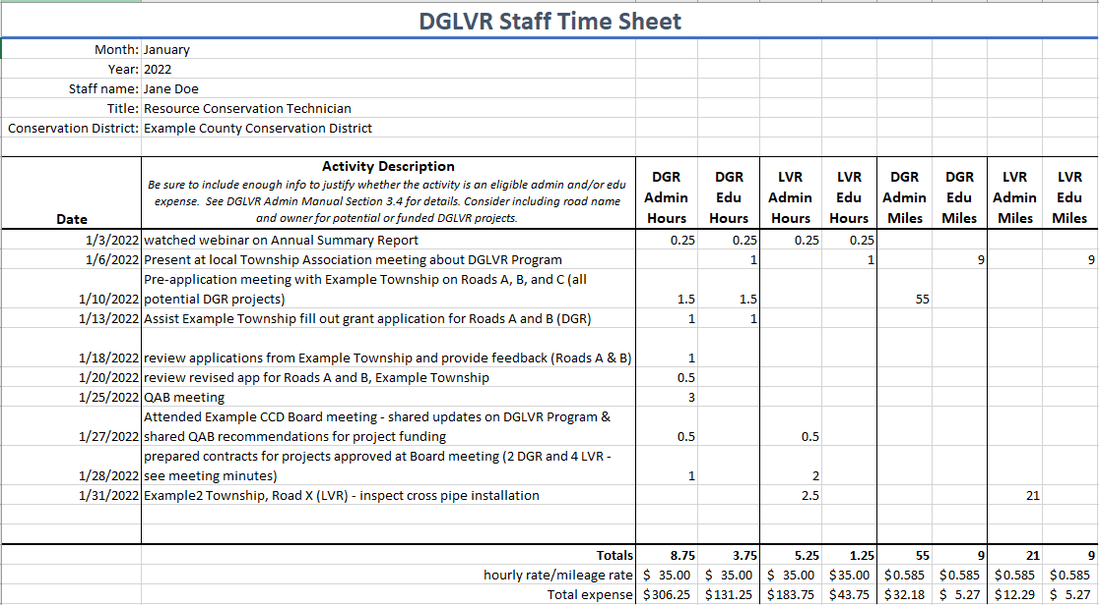
3.4.3 & 4: Administrative and Education Funds
Template Available as an Excel Document

Slide 97
3.4.3 & 4: Administrative and Education Funds
Using admin & Edu funds for travel:
All travel expenses for the DGLVR Program can be paid for with administrative DGLVR funds
Use DGR admin funds for DGR travel expenses
Use LVR admin funds for LVR travel expenses
Travel to field sites, meetings, trainings, vehicle costs, per-diems, parking, etc.
Edu funds can be used to pay for all travel expenses directly related to education activities for the Program such as:
travel to training and workshops, and travel to set up trainings, workshops, and demonstrations for local stakeholders.

Slide 98
3.4.3 & 4: Administrative and Education Funds
Using admin & Edu funds for travel:
That the federal mileage rate is based on the average costs of operating a vehicle in the United States
intended to cover expenses including, but not limited to fuel, tires, maintenance, registration, and insurance.
When mileage driven for the DGLVR Program is compensated using the mileage rate method, individual vehicle expenses are not eligible DGLVR expenses, and vice versa.

Slide 99
3.4.3 & 4: Administrative and Education Funds
Ineligible admin & Edu expenses:
Funds can NOT be used to purchase tools or equipment for townships or other applicants, including cost-sharing on tools or equipment.
Non-DGLVR expenses, such as expenses related to other conservation district programs
If an expense is shared by DGLVR and non-DGLVR Programs, then only a portion of the expense is an eligible DGLVR expense
Why?
DGR funds can only be used for DGR expenses
LVR funds can only be used for LVR expenses

Slide 100
3.4.2: Cost Allocation Methods
How do we determine what portion of shared expenses are eligible DGR and LVR expenses?
Cost Allocation Method (CAM):
Method for splitting shared costs proportionately between multiple programs
Splitting a dinner bill with friends is a cost allocation method
You only pay for what you ate

Slide 101
3.4.2: Cost Allocation Methods
Cost Allocation Method Policy
Must be utilized for shared district expenses, such as vehicles, rent, office supplies, phone/Internet, etc.
Must be available to the SCC upon request
The cost allocation method used must be based on how much of the shared expense is actually used for the DGLVR Program.

Slide 102
3.4.2: Cost Allocation Methods
Cost Allocation Method Policy
The percent of shared expenses that are eligible DGR expenses are equal to the percent of the expense used for DGR activities.
The percent of shared expenses that are eligible LVR expenses are equal to the percent of the expense used for LVR activities.
If the CAM is based on staff time:
The percent of shared expenses that are eligible DGR expenses are equal to the percent of staff time spent on DGR activities.
The percent of staff time spent on DGR activities must be calculated compared to the total staff time spent on all programs/activities sharing the expense.

Slide 103
3.4.2: Cost Allocation Methods
Unacceptable Expense / Cost Allocation Method Examples:
District utilizes only DGLVR program funds to purchase a vehicle and pay for vehicle expenses, but the vehicle is shared by all district programs
District technician spends 5% of their time on DGR and 3% of their time on LVR, but 50% of their salary and benefits are paid for with DGLVR funds
A District spends 15% of their total staff time on DGR activities. 15% of a new backhoe for an applicant is paid for with DGR funds. (DGLVR funds cannot be used to buy equipment for applicants)

Slide 104
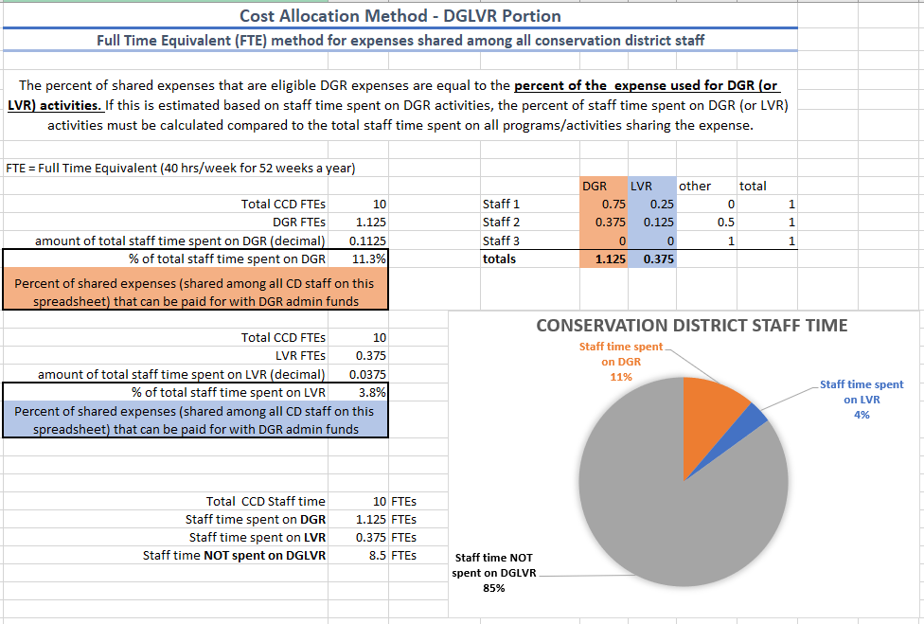
3.4.2: Cost Allocation Methods
Need help with CAMs?
Attend financial training!
Contact the SCC for assistance
Examples
Appendix E of Admin Manual
Spreadsheet template available

Slide 105
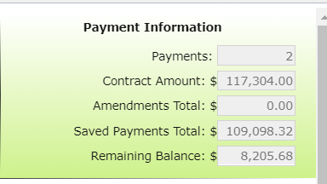
3.4.5: Project Funds
Project Funds
At least 80% of funds must go to projects.
Project funds are totaled by the GIS system from the information a District submits for each project
Eligible project expenses outlined in Section 3.7

Slide 106
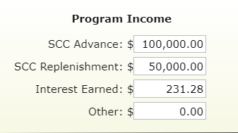
3.4.6: Interest Funds
Interest Funds
ALL interest accrued on ALL categories of DGLVR funds (even admin and edu) must be spent on DGLVR projects.
DGR interest must go to DGR projects and LVR interest must go to LVR projects.
Interest tracked in quarterly reporting

Slide 107
3.4.7: Demonstration Projects
Demonstration Projects
District-funded outside of ranking system.
Showcase new technology, education site, etc.
Only education or administrative funds can be used.
Must follow existing Program policies: be on an eligible public road; have off ROW permissions; have environmental benefit; meet LVR traffic counts; etc.
Must have QAB and district board Approval.
Must have a contract, MOU, or other agreement with the road-owning entity.
Contact Center or Commission staff before contracting a Demo project.

Slide 108
3.4.7: Demonstration Projects
Demonstration Projects
Do not use to circumvent standard training requirements and normal project agreements.
Regular project (application, ranking) - any funds
Demo Project – admin/edu funds only
You can do “education and outreach” efforts on any project.

Slide 109
3.4: Accounting of Funds
Verifying Funds
QAQC team will request itemized documentation of DGLVR income and expenses
DGR and LVR will both be checked
These funds will be cross referenced with figures entered (by the District) into the GIS system.
Check that quarterly report figures are accurate
District will be asked to provide sufficient evidence of actual expenditures (QuickBooks, Copy of checks, invoices, etc.)
Check that expenses are eligible

Slide 110
3.5: Dispersing Funds to Grant Recipients
Dispersing Funds to Grant Recipients
Districts can advance up to 50% of funds to grant recipients
Up to 70% of grant can be paid on a cash-expended basis
Receipts/invoices required to show advance and additional funds were spent on eligible expenses
At least 30% of grant must be retained until project completion
Conservation districts should develop individual policies regarding payment to grantees
Written schedule of payments is included in contract

Slide 111
3.5.3: Contract Amendments
In some cases, the grant recipient may request additional time or addition funding above the contracted amount to complete a project.
Approval is at the discretion of the district board, based either on a case-by-case basis or by county policy.
Districts may develop their own policies for handling cost overruns and time extensions, provided they are consistent with Commission policy.
It is up to the discretion of the conservation district board if amendments to existing contracts must be recommended by the QAB.
Options include but are not limited to: requiring district board approval; requiring QAB and district board approval; empowering CD staff to approve amendments, etc. There is no additional funding from the Commission to pay for cost overruns.
Amendments must be approved by the district board according to policies they establish.

Slide 112
3.5.3: Contract Amendments
Amendment maximum: 40 percent or less of the initial contract amount
Multiple amendments may be granted, provided the total of all amendments is not more than 40 percent of the initial contract amount.
For contract amendments over 40 percent, written approval is required from the State Conservation Commission.
Handled in GIS

Slide 113
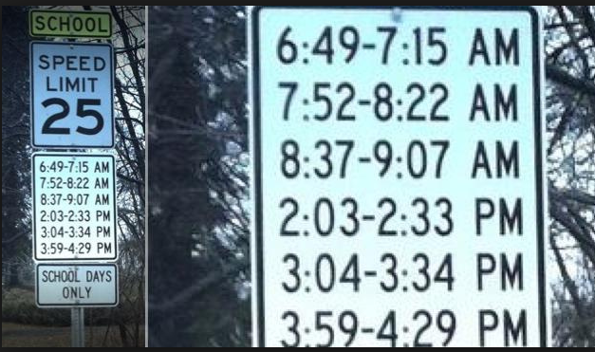
Has to be a lawyer involved…
http://www.rd.com/slideshows/funny-road-signs/

Slide 114
Chapter 3: Conservation District Role
3.1 CD Structure
3.2 Overview
3.3 Receiving Funds from SCC
3.4 Accounting of funds at CD
3.5 Dispersing funds to Grant Recipients
3.6 CD Educational opportunities
3.7 Program Eligibility
3.8 Administering Projects
3.9 GIS System
3.10 Quarterly Reports
3.11 Annual Summary Reports

Slide 115
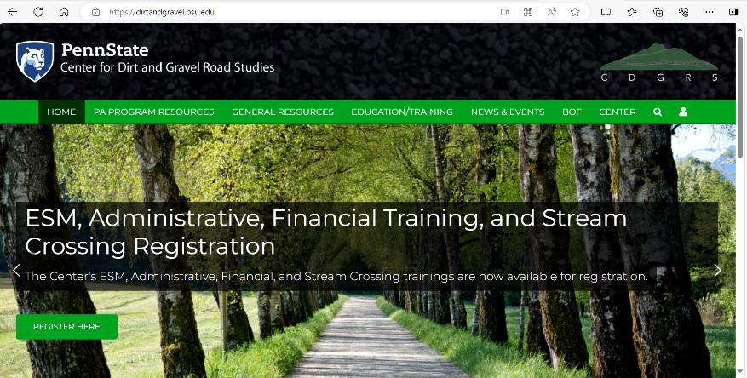
3.6: District Educational Opportunities
https://dirtandgravel.psu.edu/

Slide 116
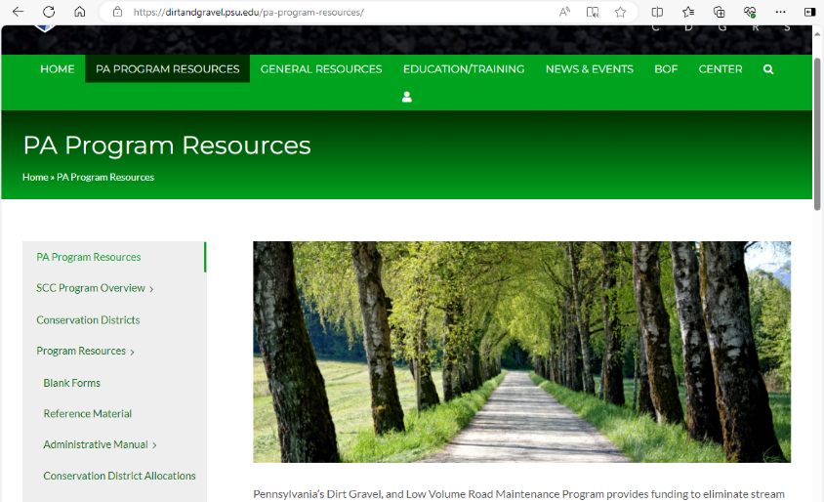
3.6: District Educational Opportunities
https://dirtandgravel.psu.edu/pa-program-resources/
PA Program Resources
Standard forms
Blank forms
Example/sample forms
Reference documents
Admin Manual

Slide 117
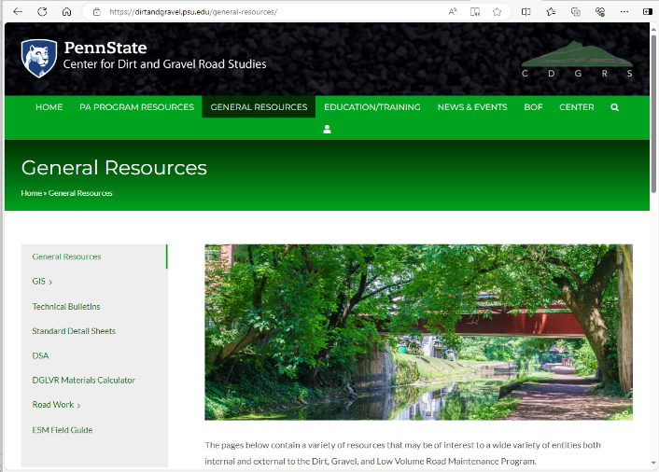
3.6: District Educational Opportunities
https://dirtandgravel.psu.edu/pa-program-resources/
General Resources
GIS
Materials Calculator
Technical Bulletins
DSA
Stream Crossings
Standard details

Slide 118
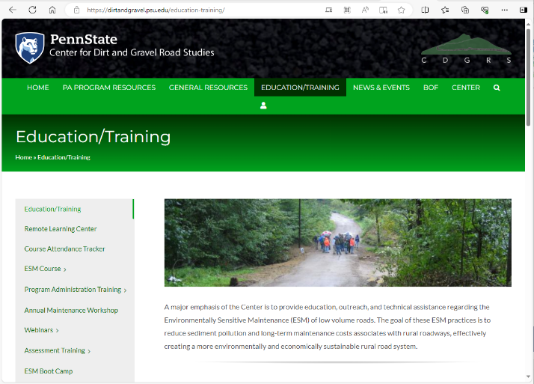
3.6: District Educational Opportunities
https://dirtandgravel.psu.edu/education-training/
Education/Training
Remote Learning Center
Course Attendance Tracker
Webinars
Registration for trainings

Slide 119
3.6: District Educational Opportunities
https://dirtandgravel.psu.edu/education-training/
Program Administrative Training
Slides from this presentation
Financial training hand outs
Register for Admin and Financial Trainings

Slide 120
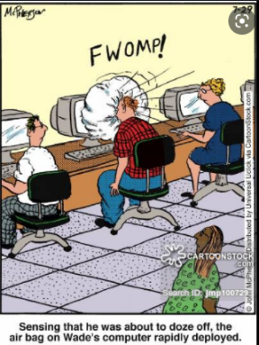
3.6: District Educational Opportunities
Admin Training (ZZZzzzzz…)
Covers administrative policies and guidance provided in the admin manual
Required for staff persons most involved with the program
Required Every 3 years
2024 Admin Trainings:
March (Berks County)
May (Westmoreland County)
July (Centre County)
October (Luzerne County)
December (Venango County)
Registration: https://dirtandgravel.psu.edu/education-training/program-administration/admin-training/
http://anintrospectiveworld.blogspot.com/2012/08/sleeping-in-class.html

Slide 121
3.6: District Educational Opportunities
Financial Training
Highly recommended that at least one CD staff per county attend. Geared towards admin staff but all CD roles welcome.
Covers: financial policy, QAQC financial review, budgeting, documenting funds, spending requirements, reconciling local and GIS account balances, GIS financial tools, and more!
2024 Financial Trainings:
March (Berks County)
May (Westmoreland County)
July (Centre County)
October (Luzerne County)
December (Venango County)
Registration: https://dirtandgravel.psu.edu/education-training/program-administration/financial-training-registration/
https://en.wikipedia.org/wiki/File:Happy_Man_Throwing_Money_Cartoon.svg https://commons.wikimedia.org/wiki/File:Cartoon_Woman_Looking_Enjoying_The_Flying_Money_Around_Her.svg

Slide 122
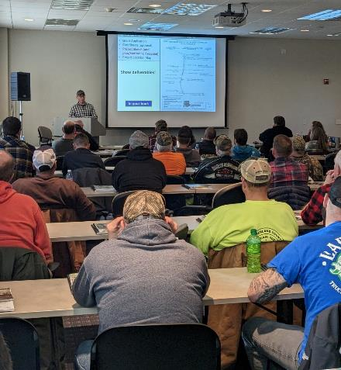
3.6: District Educational Opportunities
ESM Training
Training course that covers road maintenance principals
Mandatory for district staff involved with the program
Mandatory for at least one district QAB member
Highly recommended for everyone involved in the program
Certification valid for 5 years (expires 12/31 of 5th year)
12 scheduled each year around the state
https://dirtandgravel.psu.edu/education-training/esm-course/in-person-esm-trainings/

Slide 123
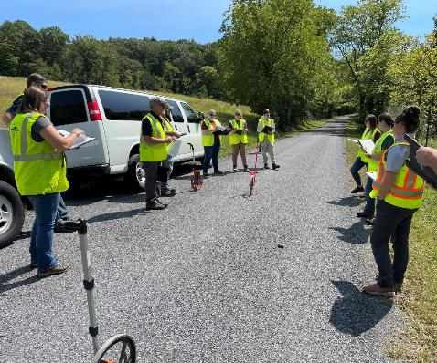
3.6: District Educational Opportunities
ESM Boot Camp
Two scheduled in 2024: Sept 3-5 and Sept 17-19, State College area
Multi day training geared towards new DGLVR technicians at conservation districts
Construction basics, project design, in-depth advice for installing ESM practices, and more!
https://dirtandgravel.psu.edu/education-training/esm-boot-camp/

Slide 124
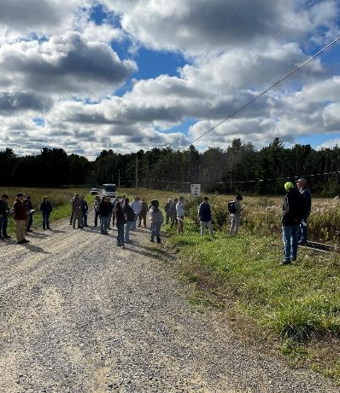
3.6: District Educational Opportunities
Annual Maintenance Workshop
Break out classes, field tour, vendor reception, banquet
ESM certified individual may attend annual workshop at least once every 5 yrs. in lieu of ESM training, provided their certification is not expired.
Highly recommended that all conservation district staff involved in DGLVR Program attend.
2024 workshop: Dubois, PA Oct 8-10

Slide 125
3.6: District Educational Opportunities
Stream Crossing Certification
CD staff must be certified before the QAB can recommend or the conservation district can approve a contract for a project involving a stream crossing.
Certification valid for 3 years
4-day, in person in Centre County area
Walks through project lifecycle
https://dirtandgravel.psu.edu/education-training/stream-crossings/

Slide 126
3.6: District Educational Opportunities
Technical Assistance
Conducted primarily by Center staff
Initiated by districts
Small group training for districts and municipalities
Help with:
Project design / layout
Meet with applicants
Aggregate placement
Project implementation
Whatever the conservation
district needs!
Notes:
Also please contact SCC staff as needed for admin & financial assistance, such as help budgeting, prepping for QAB meetings, reviewing completion report invoices, reviewing received applications, etc.

Slide 127
3.6: District Educational Opportunities
Education by Districts for applicants:
Participate in existing events
Municipal Conventions
Contractor Workshops
Legislative Breakfasts
Municipal Visits
Hold new events
Demo Days
Program Update Sessions
Project tours
Promotion: press releases, signs, emails

Slide 128
3.6: District Educational Opportunities
Education by Districts for applicants:
New flyers available for CD use:
On Blank Forms webpage (scroll down to “Example Forms”)
Blank Forms - Center for Dirt and Gravel Road Studies
DGLVR Handout for New Participants: This 2-page flyer provides a brief overview and introduction to the DGLVR Program. It is geared towards an audience of potential grant applicants to get them interested in the program and provide the first steps to getting involved.
Example DGLVR Projects: This 2-page flyer shows example before and after pictures of completed DGLVR projects and frequent issues addressed by the DGLVR Program. This document is intended for conservation districts to share with potential grant applicants to help illustrate what types of road issues may be a good fit for Program funding.

Slide 129
http://www.shiply.com/blog/uploaded_images/funny_road_signs_21-746380.jpg

Slide 130
Chapter 3: Conservation District Role
3.1 CD Structure
3.2 Overview
3.3 Receiving Funds from SCC
3.4 Accounting of funds at CD
3.5 Dispersing funds to Grant Recipients
3.6 CD Educational opportunities
3.7 Program Eligibility
3.8 Administering Projects
3.9 GIS System
3.10 Quarterly Reports
3.11 Annual Summary Reports

Slide 131
3.7.1: Eligible Applicants
Eligible Applicants
Public entities that own roads
Person in charge of the project must be ESM certified to apply
Municipalities (1400+ twps, 800+ boroughs, 50+ cities)
State entities such as:
PennDOT, Fish & Boat
County and other Government entities
Federal roads and private roads are NOT eligible
All public roads are “born” in legislation

Slide 132
3.7.1: Eligible Applicants
Ineligible Entities
Federal Government
National Parks and Forest Roads
US Army Corps of Engineers (ACOE) Lands
Private Road Owners:
Homeowners Associations
Conservancies
Non-Profits
Etc.
PA Game Commission - new

Slide 133
3.7.1: Eligible Applicants
Eligible Applicants
Public entities that own roads

Slide 134
3.7.1.3: Determining Road Ownership
The entity that owns the “right of way” is the determining factor, not who owns the adjacent land
Contracts and payments can only be made with the entity that owns the road
Questionable situations?
Check for liquid fuels funding
Courthouse records
Responsibility of the applicant to prove ownership

Slide 135
3.7.2: Eligible Roads
Dirt and Gravel Road
“Unbound” surfaces
“gradable”
Paved Low Volume Road
Surface bound with asphalt, oil, or other binder
Includes “tar and chip”
500 vehicles a day or less – traffic count required
The source of project funding (DGR vs LVR) is determined based on the existing surface of the road.

Slide 136
3.7.2: Eligible Roads
Surface Conservations
Converting poorly constructed LVR into a DGR may utilize either LVR or DGR funding
old chip seal
DSA

Slide 137
3.7.3: Eligible Projects
Eligible Projects
Focus on environmental and road improvements

Slide 138
3.7.3: Eligible Projects
Eligible Projects
Use ESM practices as described in section 1.4
Spread out and slow down storm water
Reduce sediment
Reduce concentrated drainage
Program focus is on long-term environmental and road improvements
“routine maintenance” is not eligible for funding
Crack sealing
Grading roads
Bridge repairs, work on undersized stream crossings

Slide 139
3.7.3: Eligible Projects
Eligible Projects
Use ESM practices as described in section 1.4
Spread out and slow down storm water
Reduce sediment
Reduce concentrated drainage
Program focus is on long-term environmental and road improvements
“routine maintenance” is not eligible for funding
Crack sealing
Grading roads
Bridge repairs, work on undersized stream crossings

Slide 140
3.7.3: Eligible Projects
Eligible Project Expenses
No program specific purchase requirements (use applicant’s established procedures for bidding and purchasing)
Records of purchases must be kept (by the grant recipient) for 7 years from project completion
Applicants can apply for the full cost of all materials, equipment, and labor

Slide 141
3.7.3: Eligible Projects
Municipal Purchasing webinars
April 14, 2020: Municipal Bidding
This webinar reviewed various aspects of the municipal bidding process as it relates to municipal projects funded through the DGLVR Program. It covered an overview of the bidding process and provided additional resources.
Webinar Download (66.3 MB): MP4 format (~ 1 hour 8 minutes)
Presentation Downloads:
Adobe PDF (8.81 MB)
MS Powerpoint (16.9 MB)
June 9, 2020: COSTARS and Purchasing
As part of the 4/14/20 “Municipal Bidding” webinar, there was some discussion and a request for more information about the COSTARS program, a cooperative purchasing program designed to make purchasing both easier and price competitive for public entities. Felicia Campbell & Kim Bullivant, two representatives from COSTARS, presented information and answered available for questions.
Webinar Download (178 MB): MP4 format (~ 1 hour 19 minutes)
Presentation Downloads:
Adobe PDF (7.3 MB)
MS Powerpoint (8.72 MB)

Slide 142
3.7.4: Eligible Project Expenses
Materials
Typical materials include pipe, stone, fabric, etc.
Products with leaching potential must meet SCC standards for non-pollution. Approved products list on www.dirtandgravelroads.org.

Slide 143
3.7.4: Eligible Project Expenses
Materials
Inlets and outlets of all cross pipes must have erosion protection, such as headwalls, endwalls, drop inlet boxes, and/or rip rap. All stream crossing structures must have a headwall and endwall.

Slide 144
3.7.4: Eligible Project Expenses
Equipment
Reimbursement of applicant owned equipment is eligible (@ FEMA rates)
Equipment can be rented, in which FEMA rates do not apply (use actual rental cost)

Slide 145
3.7.4: Eligible Project Expenses
Equipment
Contact Commission or Center staff for questions about equipment without listed FEMA rates.
Where FEMA rates do not accurately reflect local equipment costs, applicants may request approval to use other rates, if written documentation can be provided.

Slide 146
Does this go under equipment, or labor???

Slide 147
3.7.4: Eligible Project Expenses
Labor
Reimbursement of labor and equipment operators is an eligible expense.
Labor rates may include wage and benefits.

Slide 148
3.7.4: Eligible Project Expenses
Municipal Labor
Reimbursement of labor and equipment operators is an eligible expense
Labor rates may include wage and benefits.
PREVAILING WAGE: Does not apply to projects done with Municipal labor force.

Slide 149
3.7.4: Eligible Project Expenses
Contractors
Projects may be completed in whole or in part by contractors
Grant recipients use their standard bidding procedures
Districts must make payments to the grant recipient, not the contractors

Slide 150
3.7.4: Eligible Project Expenses
PREVAILING WAGE: Projects where the estimated total project cost exceeds $25,000 (NOT $100,000) are subject to the prevailing wage act for contracted labor.
It is the responsibility of the grant recipient:
To obtain the Prevailing Wage Act scale for the area (from the Prevailing Wage Division of the Pennsylvania Department of Labor and Industry)
Include the PW wage scale in any proposal to solicit bids for the contract.
If the Prevailing Wage Act applies, the advertisement shall also note this fact.

Slide 151
3.7.4: Eligible Project Expenses
PREVAILING WAGE: Projects where the estimated total project cost exceeds $25,000 (NOT $100,000) are subject to the prevailing wage act for contracted labor.
Total Project Costs: include other grant sources and in-kind material (not equipment/labor).
Cannot “split” projects to avoid PW.
PW does not apply to municipal labor.
PW must be documented in project file

Slide 152
3.7.4: Eligible Project Expenses
PREVAILING WAGE FAQ: 19 Q&As

Slide 153
3.7.4: Eligible Project Expenses
PREVAILING WAGE FAQ: 19 Q&As

Slide 154
3.7.4: Eligible Project Expenses
PREVAILING WAGE DGLVR Documents
PW Notification Letter (F)
Required for all projects
Ensures grant recipient knows PW requirements
Must be signed when contract is signed
PW Certification (G) two pages
Required for all projects where PW applies
Required before making final payment
Attachments F and G to Contract
(Contract and attachments are automatically generated in GIS)

Slide 155
3.7.4: Eligible Project Expenses
3.7.4.5 Prevailing Wage Documentation
If federal funds are involved in a project, federal prevailing wage requirements (Davis Bacon Act) often supersedes PA prevailing wage.
Davis Bacon requirements are acceptable to the DGLVR program in this case, and Certified Payroll forms accepted by the US Department of Labor must be completed and kept in the project file.

Slide 156
3.7.4: Eligible Project Expenses
https://www.dirtandgravel.psu.edu/education-and-training/webinars/past-webinars
January 27, 2022: Prevailing Wage
This webinar provided an overview of Prevailing Wage requirements for DGLVR Program with some updated examples.
Webinar Download (72.2 MB): MP4 format (~34 minutes)
April 7, 2022: Prevailing Wage II
This webinar was the second part of an earlier PW webinar this spring, with this webinar involving invited speakers. Speakers from the U.S. Department of Labor and PA Department of Labor and Industry joined this webinar to discuss Prevailing Wage and answer questions related to the DGLVR Program.
Webinar Download (344 MB): MP4 format (~1 hour, 37 minutes)

Slide 157
3.7.4: Eligible Project Expenses
Additional Information:
Brian Smolock, Labor Law Investigator
PA Department of Labor and Industry
717-787-0606
bsmolock@pa.gov

Slide 158
3.7.4: Eligible Project Expenses
In Kind Contributions
In-Kind: materials, equipment, and labor funded by other sources, typically the applicant
No Statewide requirement for in kind amounts
Only contributions that meet all Program policies may be counted as in-kind contributions.
Stream crossings, DSA, FDR are most common

Slide 159
3.7.4: Eligible Project Expenses
3.7.4.7 Consultants, Engineering, and Permitting Costs
Program funds can be used to cover engineering, permitting, or similar consultant costs, but such costs are limited:
to a maximum of 20 percent of the total contract amount between the district and the grant recipient,
with a maximum of $25,000 total for engineering, permitting, or similar consultant costs.
Note this limit is defined as up to 20 percent of the contract amount (Program contracted funds), not 20 percent of the total project value (which could include in-kind or other funds).
If the DGLVR project is not completed, consultant, engineering, and permitting costs are not an eligible DGLVR expense.

Slide 160
3.7.4: Eligible Project Expenses
3.7.4.7 Consultants, Engineering, and Permitting Costs
Example 1: a $30,000 contract on a project totaling $50,000 is limited to 20% of the contract, or $6,000, for engineering and permitting.
Example 2: For a $140,000 contract, 20% of the contract would be $28,000, but the program will only fund up to the maximum of $25,000.
Preparation or design costs such as engineering or surveying that are incurred before the contract is signed are not eligible for grant reimbursement but can be counted as in-kind.

Slide 161
Speaking of Engineering…
http://www.rd.com/slideshows/funny-road-signs/

Slide 162
3.7.4.8: Working off the Right-of-Way
Right-of-way:
Publicly owned road corridor.
Typically 33’ width (16.5’ from road Centerline) for municipal roads.
Exceptions do apply, sometime up to 50’.
http://old.mcallen.net/landingpages/lp_engineering/roa_permits.aspx

Slide 163
3.7.4.8: Working off the Right-of-Way
Written permission from landowners is required when working outside the right-of-way.
Districts can use their own form, or the example provided in manual, but must use something!
Word Version Available Online
www.dirtandgravelroads.org

Slide 164
3.7.4.8: Working off the Right-of-Way
Working outside the right-of-way is permissible with DGLVR funds only under certain conditions:
Must be directly necessary to the successful completion of the project on a public road.
Limited in scope to cost effective practices that directly reduce road impacts
Grant recipient MUST obtain written permission before starting the project
Districts must keep a copy of written permission in the project file

Slide 165
3.7.4.8: Working off the Right-of-Way
3.7.4.8 Working Off Right-of-Way
Landowner permission should be sought as early as possible in the funding process, ideally before contracting, to ensure the project can be implemented as planned.
In some cases, landowner permission may be instrumental to implementing a successful DGLVR project (additional culvert outlets for example).

Slide 166
3.7.4.8: Working off the Right-of-Way
3.7.4.8 Working Off Right-of-Way
What happens if a landowner does not provide permission?
In some cases, a viable alternative may exist to implement a successful plan without landowner permission
In other cases, sufficient water quality improvements cannot be made due to landowner constraints. In such cases, DGLVR funding may be better spent on a different project location.
Contact the SCC in questionable circumstances where a lack of landowner permission may hinder successful project implementation.

Slide 167
3.7.4.8: Working off the Right-of-Way
In certain situations, off-right-of-way work requires the prior written approval from the SCC before a contract can be signed:
Where off-right-of-way work is more than 35% of the total project costs (including program funds and in-kind contributions)
Where work extends more than 500 feet off of the right-of-way.

Slide 168
3.7.4.8: Working off the Right-of-Way
Landowner permission is suggested when off-right-of-way impacts are expected, even if work is done within right-of-way.
New pipes and turnouts.
Subsurface drainage
French mattress
Driveway issues.
Road fill jobs.

Slide 169
3.7.4.9: Combined Funds
Program funds may be combined with other funds to pay for a project.
Detailed accounting of which funds were spent on which portions of the project must be maintained
Other funding sources may be used as matching funds, provided the program funds are used on eligible projects
Must still adhere to non-pollution standards and ESM practices

Slide 170
3.7.4.9: Combined Funds
Recorded webinar on combining funds:
March 9, 2023: Leveraging Other Funding with DGLVR funds
With over $20 million going on the ground with DGLVR projects every year, there are numerous opportunities to use money spent on DGLVR projects as in-kind to obtain additional funding from a variety of sources. This webinar covered those opportunities.
Webinar Download (125 MB): MP4 format (~55 minutes)
Presentation Downloads:
Adobe PDF (2.54 MB)
MS Powerpoint (5.94 MB)

Slide 171
Chapter 3: Conservation District Role
3.1 CD Structure
3.2 Overview
3.3 Receiving Funds from SCC
3.4 Accounting of funds at CD
3.5 Dispersing funds to Grant Recipients
3.6 CD Educational opportunities
3.7 Program Eligibility
3.8 Administering Projects
3.9 GIS System
3.10 Quarterly Reports
3.11 Annual Summary Reports

Slide 172
Chapter 3: Conservation District Role
3.8 Administering Projects
3.8.1 Notification to Applicants
3.8.2 Pre-Application Site Visit
3.8.3 Pre-Design Site Visit
3.8.4 Receiving Grant Applications
3.8.5 Contracting
3.8.6 Pre-Project Logistics
3.8.7 Project Oversight
3.8.8 Contract Amendments
3.8.9 Project Completion
3.8.10 Project File Retention

Slide 173
3.8: Administering Projects
Sample Timeline
Summer/Fall 2024 – Complete pre-application meetings
Winter 2024 – Accept applications
Spring 2025 – Rank project applications
June/July 2025
Once new allocation amount is known, hold QAB meeting and recommend projects for funding
Approve projects at District Board meeting
Contract the new projects
July 2025 – October 2026 – Complete Construction
November/December 2026 – Close out project including reimbursement to project participant
Run an annual grant program!

Slide 174
3.8: Administering Projects
Key to successful DGLVR Projects:
Communication
More district involvement throughout the project lifecycle
=
better projects

Slide 175
3.8: Administering Projects
Key to successful DGLVR Projects:
Check in with grant applicants at each stage of the project
Make sure they are making progress on the project
Make sure the project meets DGLVR policy
It saves time and effort to prevent issues from happening instead of trying to fix them later
Reach out to SCC and Center ASAP if you have questions
“You learn a lot more by asking than assuming”

Slide 176
3.8: Administering Projects
Key to successful DGLVR Projects:
Communication
Reach out to SCC and Center as early in the project lifecycle as possible if you need assistance
https://core-services.org/core-skills-needed-to-manage-your-team/

Slide 177
3.8.1: Notification to Applicants
Notifying Applicants
Districts are responsible for informing all potential applicants of:
funding availability
Application deadlines
Other information necessary for Program Participation
Districts should work with their QAB to develop strategies for insuring equal access and notifications

Slide 178
3.8.2: Pre-application site visit
Pre-app site visit
Districts should meet with potential applicants on site BEFORE an application is submitted
Early discussion of potential problems (permitting, funding availability, etc.)
Best interest of both parties.
Look at potential landowner or off-ROW issues
Checklist available

Slide 179
Checklists & Tools
Project lifecycle checklist
Pre-application Checklist
Bid Package Review Checklist
Pre-construction Checklist
Project Hard File Checklist
Project Narrative
Project Timeline
NOT REQUIRED, for your benefit
https://dirtandgravel.psu.edu/pa-program-resources/program-specific-resources/blank-forms/

Slide 180
Checklists & Tools
Project lifecycle checklist
Pre-application Checklist
Bid Package Review Checklist
Pre-construction Checklist
Project Hard File Checklist
Project Narrative
Project Timeline
NOT REQUIRED, for your benefit

Slide 181
Checklists & Tools
Project lifecycle checklist
Pre-application Checklist
Bid Package Review Checklist
Pre-construction Checklist
Project Hard File Checklist
Project Narrative
Project Timeline
NOT REQUIRED, for your benefit

Slide 182
3.8.3: Pre-Design site visit
Pre-design site visit
If a project requires engineering
It is highly recommended that districts meet with the grant recipient and engineer on site BEFORE design work is started
Make sure the engineer understands DGLVR requirements
Early discussion of potential problems (permitting, funding availability, etc.)
Best interest of both parties.
Keep in mind that engineering expenses incurred before a contract is signed are NOT eligible for reimbursement with DGLVR funds

Slide 183
3.8.3: Pre-Design site visit
Pre-design site visit
For stream crossing design:
Recommended to use the Request for Proposals (RFP) to select an engineer or at least communicate to the engineer what is being asked of them
Pros:
Clearly define stream restoration design requirements
Receive itemized cost proposal
Set timeline expectations

Slide 184
Checklists & Tools
Project lifecycle checklist
Pre-application Checklist
Bid Package Review Checklist
Pre-construction Checklist
Project Hard File Checklist
Project Narrative
Project Timeline
NOT REQUIRED, for your benefit

Slide 185
Checklists & Tools
Bidding Resources
Road Fill RFQ (Blank Forms Page): This optional Request for Quote allows users to specify the type or quality of material for use as road fill in projects. The RFQ is provided in an editable format and can be customized by users.
DSA Sample Request for Quote and Quote Form (DSA webpage/DSA handbook appendix E): Use is optional to assist in bidding process. MS Word document.

Slide 186
Checklists & Tools
Project lifecycle checklist
Pre-application Checklist
Bid Package Review Checklist
Pre-construction Checklist
Project Hard File Checklist
Project Narrative
Project Timeline
NOT REQUIRED, for your benefit

Slide 187
Checklists & Tools
Project lifecycle checklist
Pre-application Checklist
Bid Package Review Checklist
Pre-construction Checklist
Project Hard File Checklist
Project Narrative
Project Timeline
NOT REQUIRED, for your benefit

Slide 188
Checklists & Tools
Project lifecycle checklist
Pre-application Checklist
Bid Package Review Checklist
Pre-construction Checklist
Project Hard File Checklist
Project Narrative
Project Timeline
NOT REQUIRED, for your benefit

Slide 189
Checklists & Tools
Project lifecycle checklist
Pre-application Checklist
Bid Package Review Checklist
Pre-construction Checklist
Project Hard File Checklist
Project Narrative
Project Timeline
NOT REQUIRED, for your benefit

Slide 190
Chapter 3: Conservation District Role
3.8 Administering Projects
3.8.1 Notification to Applicants
3.8.2 Pre-Application Site Visit
3.8.3 Pre-Design Site Visit
3.8.4 Receiving Grant Applications
3.8.5 Contracting
3.8.6 Pre-Project Logistics
3.8.7 Project Oversight
3.8.8 Contract Amendments
3.8.9 Project Completion
3.8.10 Project File Retention

Slide 191
3.8.4: Receiving Grant Applications
Process
Receive Applications
Work with applicants to revise if needed.
Review for completeness and accuracy.
Completed applications get forwarded to QAB for review and ranking.
QAB recommendations taken to District Board for action
Contract can then be made with grant recipient.

Slide 192
3.8.4: Receiving Grant Applications
Receiving Grant Apps
Districts may set application periods, or they may have an open application period
Recommended to prepare applications that can be constructed the first full calendar year of the allocation
One page application
Districts may develop their own policy for unfunded applications
Disapprove
Retain
Resubmit

Slide 193
3.8.4: Receiving Grant Applications
Grant app and forms used to apply to CD
Project-specific Grant Application
Optional cost summary forms
Project Sketch (back of grant app)
Instructions for all forms

Slide 194
3.8.4: Receiving Grant Applications
Grant Application (front)
Attachment A to Contract
(Grant application is appendix C in admin manual. Contract available at https://dirtandgravel.psu.edu/)

Slide 195
Grant App - Top
District Use Only Box
3.8.4: Receiving Grant Applications
Applicant Info
Project Info

Slide 196
Grant App - Bottom
3.8.4: Receiving Grant Applications
Grant Request $
In-Kind $
Additional Cost Sheets Available

Slide 197
OPTIONAL cost details
3.8.4: Receiving Grant Applications
Attachment A to Contract
(Grant application is appendix C in admin manual. Contract available at https://dirtandgravel.psu.edu/)

Slide 198
Grant App - Bottom
3.8.4: Receiving Grant Applications
Bottom of Grant Application

Slide 199
OPTIONAL cost details
3.8.4: Receiving Grant Applications
Attachment A to Contract
(Grant application is appendix C in admin manual. Contract available at https://dirtandgravel.psu.edu/)

Slide 200
OPTIONAL cost details
3.8.4: Receiving Grant Applications
Bottom of Grant Application

Slide 201
Project Sketch
(back of grant app)
3.8.4: Receiving Grant Applications
Attachment A to Contract
(Grant application is appendix C in admin manual. Contract available at https://dirtandgravel.psu.edu/)

Slide 202
3.8.4: Receiving Grant Applications

Slide 203
3.8.4: Receiving Grant Applications
GIS Project Sketcher
Separate App from “GIS Mapper”
Login through CDGRS website
Can print out plans, attach to grant application.
Plans can be saved and “tweaked” to create “as-builts” or reflect project changes.

Slide 204
3.8.4: Receiving Grant Applications
GIS Project Sketcher – Webinar
June 13, 2023: DGLVR Project Work Plan Application
Since debuting the idea at the 2022 workshop, we have been working with developers to create a “Project Sketch Application” in the DGLVR GIS system. The propose of this application is to allow CDs (and applicants and others) to create simple project layout maps to accompany grant applications for the DGLVR Program. This webinar served as a demonstration/mini-training on the sketcher, and CDs were provided access to the sketcher app immediately after the webinar.
Webinar Download (191 MB): MP4 format (~57 minutes)
Presentation Downloads:
Adobe PDF (6.42 MB)
MS Powerpoint (3.86 MB)
Project Work Plan Application Quick Guide (583 KB): This guide will provide the basics steps needed to create a Work Plan suitable for a Grant Application.

Slide 205
3.8.4: Receiving Grant Applications
Grant App Instructions, Sample Sketch
Attachment A to Contract
(Grant application is appendix C in admin manual. Contract available at https://dirtandgravel.psu.edu/)

Slide 206
3.8.4: Receiving Grant Applications
Grant forms available online
With or without instructions

Slide 207
3.8.4: Receiving Grant Applications
January 12, 2023: Better Grant Applications
This webinar discussed some common shortcomings of grant applications from applicants and considerations for improvement.
Webinar Download (75.6 MB): MP4 format (~47 minutes)
Filling out grant application paperwork.
Intended audience: Potential Applicants (and CD staff).
This presentation walks through how to fill out the grant application paperwork. Guidance is also provided on eligibility, preparing to fill out the grant application, and what to do if you if you have questions. This presentation will be helpful for applicants as well as conservation district staff administering the DGLVR Program.
Webinar Download (92.4 MB): MP4 format (~43 minutes)
Reviewing grant applications.
Intended audience: Conservation Districts.
This presentation explains what conservation districts should do after DGLVR grant applications are received and before the QAB meeting where applications are ranked. Conservation district staff of varying experience levels will benefit from this presentation.
Webinar Download (98.5 MB): MP4 format (~53 minutes)

Slide 208
http://www.shiply.com/blog/uploaded_images/funny_road_signs_21-746380.jpg

Slide 209
Chapter 3: Conservation District Role
3.8 Administering Projects
3.8.1 Notification to Applicants
3.8.2 Pre-Application Site Visit
3.8.3 Pre-Design Site Visit
3.8.4 Receiving Grant Applications
3.8.5 Contracting
3.8.6 Pre-Project Logistics
3.8.7 Project Oversight
3.8.8 Contract Amendments
3.8.9 Project Completion
3.8.10 Project File Retention

Slide 210
3.8.5: Contracting
Contracting
Contract must be in place before anything happens
No fund advances can take place without a contract
No work can begin without a contract
No expenses, such as engineering costs, can be incurred before a contract is signed
CDs can add provisions to contract
Need to be approved by your solicitor.
Need to notify SCC.

Slide 211
3.8.5: Contracting
Available at
https://dirtandgravel.psu.edu/ and generated in GIS

Slide 212
3.8.5: Contracting
2-page contract between CD and grantee
Other documents attached to contract:
Must Generate Contract using the GIS System

Slide 213
3.8.5: Contracting
50% max
30% min
Available Online
www.dirtandgravelroads.org
Must Generate in GIS

Slide 214
3.8.8: Contract Amendments
If needed, a simple one-page amendment form can be used to:
increase contract by up to 40% (total of original contract)
extend completion date
Increase both funds and time
Must Generate in GIS
Available at
https://dirtandgravel.psu.edu/ and generated in GIS

Slide 215
3.8.8: Contract Amendments
Limited to 40% of contract
Can be used to extend completion date.
Available at
https://dirtandgravel.psu.edu/ and generated in GIS

Slide 216
3.8.8: Contract Amendments
Amendment Instructions
Available at
https://dirtandgravel.psu.edu/

Slide 217
3.8.5: Contracting
Cancelling a contract
If a contract cannot be completed in a reasonable timeframe (2+ years), the district should consider closing out or canceling the contract.
Districts who maintain open contracts for multiple years may see reduced allocations in future years at the discretion of the State Conservation Commission.

Slide 218
How to Cancel a Contract?
Reach out to SCC
Document in writing the request to cancel the contract and acceptancy by the other party
Letters, emails, board meeting minutes
Any advanced funds not spent on eligible expenses must be returned to the CD
CD may request interest as well
Report returned funds in GIS
Work with Ken

Slide 219
Chapter 3: Conservation District Role
3.8 Administering Projects
3.8.1 Notification to Applicants
3.8.2 Pre-Application Site Visit
3.8.3 Pre-Design Site Visit
3.8.4 Receiving Grant Applications
3.8.5 Contracting
3.8.6 Pre-Project Logistics
3.8.7 Project Oversight
3.8.8 Contract Amendments
3.8.9 Project Completion
3.8.10 Project File Retention

Slide 220
3.8.6 Pre-Project Logistics
Pre project logistics
It is the responsibility of the grant recipient to ensure that all necessary permits are obtained and any other pre-project requirements are met (1-call, PNDI, etc.)
It is the responsibility of the district to verify that permits have been obtained before work can begin on the portion of the project that requires a permit.

Slide 221
3.8.6 Pre-Project Logistics
Pre project logistics
Pre-project meeting (separate from pre-application meeting)
Grant recipients MUST notify the conservation district before beginning work on a project.
The amount of notice is spelled out in the contract with the district.
Contractors and sub-contractors are strongly encouraged to attend.
Notify Center of planned DSA placements.
Checklist available

Slide 222
Chapter 3: Conservation District Role
3.8 Administering Projects
3.8.1 Notification to Applicants
3.8.2 Pre-Application Site Visit
3.8.3 Pre-Design Site Visit
3.8.4 Receiving Grant Applications
3.8.5 Contracting
3.8.6 Pre-Project Logistics
3.8.7 Project Oversight
3.8.8 Contract Amendments
3.8.9 Project Completion
3.8.10 Project File Retention

Slide 223
3.8.7 Project Oversight
Project Oversight
District must ensure that project work is performed in accordance with contract and attachments, as well as Program policy and standards:
Stay involved
Have an on-site presence
Pay attention
Call Center/SCC for help if needed
No excuses!
When it comes to project oversight, remember…

Slide 224
“You get what you inspect,
not what you expect”
3.8.6 Pre-Project Logistics
More involvement = better projects

Slide 225
3.8.7 Project Oversight
Project Oversight
Make sure you are on site:
First day(s) of project work
When project moves to a new phase or practice
When critical practices or practices new to the applicant are being installed
For regular check-ins
https://melmagazine.com/en-us/story/sunday-funnies-trapped-at-the-office

Slide 226
3.8.7 Project Oversight
Project Oversight
Be confident asking the road crew/contractor to build ESM practices
This is an educational program
This is a grant program, and the CD holds the purse strings
Ensure work is done properly
Require remediations where necessary
Don’t pay for subpar work

Slide 228
Chapter 3: Conservation District Role
3.8 Administering Projects
3.8.1 Notification to Applicants
3.8.2 Pre-Application Site Visit
3.8.3 Pre-Design Site Visit
3.8.4 Receiving Grant Applications
3.8.5 Contracting
3.8.6 Pre-Project Logistics
3.8.7 Project Oversight
3.8.8 Contract Amendments
3.8.9 Project Completion
3.8.10 Project File Retention

Slide 229
3.8.9 Project Completion
Prior to final payment, the following are required:
Final onsite inspection
Signed project completion report
Summarizes funding
Summarizes work
Signed by CD and grantee
Must be signed and retained with project files.
Receipts for all grant expenditures

Slide 230
3.8.9 Project Completion
3.8.9.1 Final Inspection
A final inspection must be completed onsite involving the district and grant recipient
Verify the project is completed in accordance with Program standards and to the satisfaction of the district.
Including in-kind work, work proposed in work plan, etc.
Allows the district to summarize the project work elements and costs on the project completion report.
Document any changes made from the grant application that have not already been documented.

Slide 231
3.8.9 Project Completion
3.8.9.2 Final Project Remediation (if necessary)
Remediation work may be required before the project can be consider “complete”
The district should verify remediation work meets Program standards prior to making final payment

Slide 232
3.8.9 Project Completion
Project Info
Financial Summary
ESM Practice Summary
Available at
https://dirtandgravel.psu.edu/ and generated in GIS
Notes and Signatures

Slide 233
3.8.9 Project Completion
Other documentation may also be required:
File checklist summarizes required paperwork
Recommend to collect documentation throughout the project, don’t just wait until the end
Needed prior to making final payment to the grant recipient

Slide 234
Chapter 3: Conservation District Role
3.8 Administering Projects
3.8.1 Notification to Applicants
3.8.2 Pre-Application Site Visit
3.8.3 Pre-Design Site Visit
3.8.4 Receiving Grant Applications
3.8.5 Contracting
3.8.6 Pre-Project Logistics
3.8.7 Project Oversight
3.8.8 Contract Amendments
3.8.9 Project Completion
3.8.10 Project File Retention

Slide 235
3.8.10 Project File Retention
All records relating to the Program must be kept for a minimum of 7 years from the date of final payment on a project
See File Checklist for paperwork required to be in project file
It is recommended to keep additional relevant documentation beyond the minimum required to be in the hard file
Communications with project participants, photos, bid documents if applicable, etc.

Slide 236
Chapter 3: Conservation District Role
3.1 CD Structure
3.2 Overview
3.3 Receiving Funds from SCC
3.4 Accounting of funds at CD
3.5 Dispersing funds to Grant Recipients
3.6 CD Educational opportunities
3.7 Program Eligibility
3.8 Administering Projects
3.9 GIS System
3.10 Quarterly Reports
3.11 Annual Summary Reports

Slide 237
3.9 GIS
GIS reporting
CDs use customized Geographical Information System (GIS) to track all project location, deliverables and spending.
Use system to generate quarterly reports to SCC.

Slide 238
3.9 GIS
GIS Reporting
ALL Program reporting done in GIS
Please attend a GIS training if you are responsible for record keeping and reporting for Program.
Scheduled one-on-one with Ken Corradini
Abbreviated GIS training offered for Manager GIS role

Slide 239
3.9 GIS
All contracts, amendments, and completion reports must be generated using the GIS system.
All funded projects are required to be filled out in the GIS to the extent practical including:
Assessment (if applicable)
Grant application
Contract
Amendments (if applicable)
Payment(s)
Completion report
Photos (if applicable)
Any additional supporting files

Slide 240
3.10 Quarterly Reports
Districts must keep documentation for all Program expenses and income according to section 3.4
Financial staff involved in the DGLVR Program must complete a quarterly report GIS training to gain access to the quarterly report system.

Slide 241
3.10 Quarterly Reports
In order to submit quarterly reports, the following must be completed:
All income (advances, replenishments, interest) and expenses (project, administrative, and education/training) must be entered
Local and GIS account balances must match before the quarterly report is submitted each quarter
Information on funded projects is also required, including checking that all currently open contracts are in good standing and are not expired. The GIS includes a contract verifier tool that can be used during this process.
Complete the summary of Program activities from district staff for the quarter.
The Conservation District Manager, or its approved designee, is required to submit the report.

Slide 242
3.10 Quarterly Reports
DGLVR Quarterly Report “Quick Guide” available
Contact the SCC and CDGRS for assistance with quarterly reports

Slide 243
3.11 Annual Reports
Completing the Annual Summary Report includes:
Ensuring all quarterly reports are submitted and accepted
Entering average limestone DSA cost
Managing project errors.
The average cost of limestone aggregate (DSA) delivered (not placed) is a small factor in District Allocations
in accordance with section 9106, the law that created the Dirt and Gravel Road Program.
An annual December webinar walks through how to complete the ASR

Slide 244
3.11 Annual Reports

Slide 246
Administrative Manual
Introduction
SCC Role
Conservation District Role
Quality Assurance Board
Applicant Role
Center for Dirt and Gravel Roads
Additional Policies
Permits and Other Requirements
Appendices

Slide 247
4.0 Quality Assurance Board
Quality Assurance Board -§ 9106, (E)
Within the conservation district a Quality Assurance Board shall be impaneled to establish and administer the grant program. The four-member QAB is to be comprised of a nonvoting chairman appointed by the conservation district directors and one local representative appointed by each of the following entities:
(1) The Federal Natural Resource Conservation Service
(2) The Pennsylvania Fish and Boat Commission
(3) The county conservation district
If circumstances require, the chairman may vote to decide a tie vote.

Slide 248
4.0 Quality Assurance Board
Quality Assurance Board Why?

Slide 249
4.0 Quality Assurance Board
Quality Assurance Board Why?
Local Involvement and Control
NRCS – Federal: conservation and erosion
PAFBC – State: aquatics and hydrology
District – County: conservation multi-discipline
Who knows best for the County?
People in the County!

Slide 250
4.0 Quality Assurance Board
Local control within guidelines established by the commission.
QAB’s purpose is to advise and assist the conservation district board.
QAB is advisory only
District Board has the final say

Slide 251
4.1 QAB Composition
Composition of the QAB is established by law:
Only 4 members
Non-voting chair appointed by district board
One voting member appointed by the district board
One voting member appointed by Fish and Boat commission
One voting member appointed by NRCS
Chairman may only vote to decide a tie
Voting members appointed by the agencies do not have to be employees
All QAB members are strongly encouraged to take ESM training
At least one district member must take ESM training
QAB can have as many advisors as they deem necessary, but advisors are non-voting

Slide 252
4.1 QAB Composition
NRCS and PAFBC (not CD) designate their QAB appointees
Does not have to be NRCS/PAFBC employee.
Can also designate an alternate.
Alternates only vote if the voting member for that agency cannot attend a meeting
Should have appointment in writing
Sample appointment letter:

Slide 253
4.1 QAB Composition
Sample appointment letter
Word Version Available online

Slide 254
4.2 QAB Meetings
On a regular schedule or as needed
Common action items at a QAB:
Review grant applications
Recommend projects for funding to the district board
Review completed projects
Recommend local policies to district board
At least 2 of the 3 voting members (quorum) on any recommendations to the district board

Slide 255
4.2 QAB Meetings
QAB Meetings must be Sunshined
The Pennsylvania Sunshine Act requires all public agencies to take all official actions and conduct all deliberations leading up to official actions at public meetings. The Act covers all such actions by municipal governing bodies, committees of these governing bodies and municipal boards and commissions.
-Open Meetings, the Sunshine Act (Pennsylvania)
Agenda posting requirements added in 2021
https://commons.wikimedia.org/wiki/File:Sun_wearing_sunglasses.svg

Slide 256
4.3.1 Project Ranking / Sunshine Act
Cannot vote via email
Can vote in a virtual meeting or conference call if the public has access to join
Field visits by the QAB are not subject to Sunshine Act requirements as long as no deliberations of QAB business occurs and no official actions or recommendations are made during the visit.
https://www.agriculture.pa.gov/Pages/Sunshine-Act.aspx
https://www.openrecords.pa.gov/SunshineAct.cfm

Slide 257
4.3 QAB Role in Projects
QAB members should become familiar with applicant’s worksites:
Site visits as a group
Site visits individually
Photo tour from District staff
Paper application review only
Throw darts at “application dartboard”
Best option
Not recommended

Slide 258
4.3 QAB Role in Projects
Each County must have written Project Ranking Criteria
Based on local priorities.
Can have separate DGR and LVR or combined.
Must provide for equal access.
Example template available on Center’s website.

Slide 259
4.3 QAB Role in Projects
Solution
Application Validation
Misc
Problem
Other thoughts
Ranking Criteria Webinar Recorded 12/11/14
Recording and PowerPoint available online
www.dirtandgravelroads.org

Slide 260
4.3 QAB Role in Projects
QAB makes funding recommendations based on the ranking criteria it establishes
District board then considers QAB recommendations
When the district board approves an application, district staff may then develop and secure a contract.

Slide 261
4.3 QAB Role in Projects
After contract is secured, district staff is responsible for project administration, oversight, and inspection.
Future funding decisions for the project may be made by the board with minimal QAB involvement.
i.e. District board could approve a contract amendment without QAB involvement

Slide 262
4.3 QAB Role in Projects
Developing local policy is a major function of the QAB:
QABs develop policy
District board adopts policy
Required Local Policies
Equal Access
Conflict of Interest
Project Ranking
Incentives for training
Non-pollution standards

Slide 263
4.3 QAB Role in Projects
Optional Local Policies
QAB can recommend policies for use within County Program.
Can be “more stringent” than Statewide policy.
Cannot conflict with Statewide policy.
Examples:
Deadlines for applications
Limiting use of DSA or number of stream crossings
Ongoing maintenance requirements

Slide 264
4.3 QAB Role in Projects
Individual County pages have contact info and policies
http://www.dirtandgravel.psu.edu/pa-program-resources/conservation-districts

Slide 265
4.3 QAB Role in Projects
Recorded QAB training:
Geared towards QAB members
Largely a repeat of this section of Admin Training
https://dirtandgravel.psu.edu/education-training/program-administration/
Quality Assurance Board (QAB) overview.
This presentation reviews the role of the county Quality Assurance Board (QAB) in local DGLVR Programs, including QAB composition, meeting guidelines, role in project ranking, and role in local policy. This is a great introduction for new QAB members as well as a useful refresher for experienced QAB members. Conservation district staff administering the DGLVR Program will also benefit from this QAB overview.
Webinar Download (98.5 MB): MP4 format (~36 minutes)

Slide 266
https://www.flickr.com/photos/halfbyte/2649002573

Slide 267
Administrative Manual
Introduction
SCC Role
Conservation District Role
Quality Assurance Board
Applicant Role
Center for Dirt and Gravel Roads
Additional Policies
Permits and Other Requirements
Appendices

Slide 268
5.0 Applicant Role
Designed as standalone section you can copy and give to new potential applicants.
Most information is repetitive from SCC and District section, just written with applicants in mind.

Slide 269
Administrative Manual
Introduction
SCC Role
Conservation District Role
Quality Assurance Board
Applicant Role
Center for Dirt and Gravel Roads
Additional Policies
Permits and Other Requirements
Appendices

Slide 270
6.0 Center Role
Dirt and Gravel Road PROGRAM
Education
2 day ESM training
Annual Workshops
Demonstration Days
Outreach
- Technical Documentation
- Website
Newsletter
Interagency cooperation
Program Support
Advisory Groups
Technical Assistance to Districts
Quality Assurance effort
Geographic Information Systems
Funding Support
Guidance
Make Policy
“Administer” Program
QAQC
Coordinate with legislatures and other agencies

Slide 271
6.0 Center Role
Dirt and Gravel Road PROGRAM
Got a Question? Who to ask:
Policy
Legal
Allocation/replenishment
QAQC
General Questions
Trainings
Technical Assistance
Outreach
GIS/Reporting
General Questions

Slide 272
Administrative Manual
Introduction
SCC Role
Conservation District Role
Quality Assurance Board
Applicant Role
Center for Dirt and Gravel Roads
Additional Policies
Permits and Other Requirements
Appendices

Slide 273
7.0 Additional Program Policies
Some policies that don’t necessarily apply to every project:
7.1 Stream Crossing Replacement Policy
7.2 Driving Surface Aggregate
7.3 Full Depth Reclamation
7.4 LVR Policies
7.5 Traffic Counts

Slide 274
7.1 Stream Crossing Replacement
Policy for replacing culverts and bridges.
Applies to both DGR and LVR projects.
Limits replacements to areas where structure is causing problem with stream.
Existing structures must be undersized and causing stream instabilities.
New structures must be sized to properly accommodate stream flow, bed load, and achieve stream continuity through the roadway.

Slide 275
7.1 Stream Crossing Replacement
Undersized Structures cause stream instability
Gravel deposition upstream (constant “cleaning”)
“Firehose effect” erosion downstream
Often barriers to aquatic life

Slide 276
Low Flow conditions
(has not rained in a while)
Road
Stream Flow

Slide 277
Road
Stream Flow

Slide 278
Road
Stream Flow

Slide 279
Road
Stream Flow

Slide 280
Road
Stream Flow

Slide 281
Road
Stream Flow

Slide 282
Road
Stream Flow

Slide 283
Road
Stream Flow

Slide 285
7.1 Stream Crossing Replacement
BANKFULL
WIDTH
Bankfull Width: Width of channel at bankfull elevation
Bankfull Elevation: the point at which the stream typically accesses the floodplain. Channel dimensions at this elevation convey the channel-forming or dominant discharge.

Slide 286
Road
Stream Flow

Slide 287
Road
Stream Flow

Slide 288
Road
Stream Flow

Slide 289
Road
Stream Flow

Slide 290
Road
Stream Flow

Slide 291
Road
Stream Flow

Slide 292
Road
Stream Flow

Slide 293
Road
Stream Flow

Slide 294
Road
Stream Flow

Slide 295
Road
Stream Flow

Slide 296
Road
Stream Flow

Slide 298
7.1 Stream Crossing Replacement
How to best fix undersized stream crossing?
Restore a functional stream channel and ensure it has enough space to pass under the road
Neither the road nor stream should “know” the other is there
Build a better road AND build a natural stream
How to build a natural stream?

Slide 299
7.1 Stream Crossing Replacement
Old stream crossing policy was insufficient to build stable, functional streams

Slide 300
7.1 Stream Crossing Replacement
How to build a natural stream?
USDA Forest Service “Stream Simulation”

Slide 301
7.1 Stream Crossing Replacement
Many others have followed in the Forest Service Stream Simulation footsteps:
Vermont
Connecticut
Massachusetts
New Hampshire
North Atlantic Aquatic Connectivity Collaborative
Stream Smart Initiative
New York State Dept. Of Environmental Conservation
US Army Corps of Engineers, New England District
PA Fish and Boat Aquatic Connectivity Team

Slide 302
7.1 Stream Crossing Replacement
One of the Program’s major goals for stream crossings is to ensure the structures funded by the DGLVR Program are designed and implemented to achieve stream continuity
What is stream continuity?
Connectivity and continuation of typical streambed features upstream, downstream and through the crossing
Slope
Width
Bed composition
Grade controls, pools
profile

Slide 303
7.1 Stream Crossing Replacement
Before
After

Slide 304
7.1 Stream Crossing Replacement
Replacement Structures
Wide enough to allow for construction of a functional stream channel
Including bank margins, low flow channel
Grade controls
Proper cross section

Slide 305
7.1 Stream Crossing Replacement
Bankfull width stream channel built through a wider than bankfull crossing
Accommodates the hydraulic capacity of the stream
Better stream function
Flood resiliency
Sediment and debris transport
Full Aquatic Organism Passage

Slide 306
7.1 Stream Crossing Replacement
7.1.2.1 Policy for Structure Installation
All stream crossing replacements funded in whole or in part with DGLVR funds, or listed as in-kind on a DGLVR Project, must follow the DGLVR Stream Crossing Design & Installation Standard
unless an exemption is applicable (7.1.3)

Slide 307
7.1 Stream Crossing Replacement
Stream Crossing Replacement Technical Manual

Slide 308
7.1 Stream Crossing Replacement
Chapter 2 of the Stream Crossing Replacement Technical Manual
Covers the Design and Installation Standard thoroughly

Slide 309
7.1 Stream Crossing Replacement
https://www.dirtandgravel.psu.edu/education-and-training/webinars/past-webinars
May 27, 2022: Stream Technical Manual: Overview and Q&A on DGLVR Stream Crossing Replacement Technical Manual
Webinar Download (57.6 MB): MP4 format (~34 minutes)
May 26, 2022: Stream Standard: Overview and Q&A on DGLVR Stream Crossing Design and Replacement Standard
Webinar Download (182 MB): MP4 format (~41 minutes)
May 25, 2022: Stream Policy: Overview and Q&A on DGLVR Stream Crossing Replacement Policy
Webinar Download (148 MB): MP4 format (~41 minutes)

Slide 310
7.1 Stream Crossing Replacement
7.1.2.2 Existing Structure Eligibility for Replacement
Small Pipes
Existing crossing with an opening width less than or equal to 48” are automatically eligible for replacement
Multiple Pipes
Existing crossing consisting of multiple (side by side) pipes are automatically eligible for replacement
Only applies to pipes, not multiple cell bridges

Slide 311
7.1 Stream Crossing Replacement
7.1.2.2 Existing Structure Eligibility for Replacement
All other structures
Existing crossing with an opening width over 48” must have a “structure opening width to bankfull channel width” ratio of 75% or less
SCC notification
Districts must notify the SCC of proposed stream crossing replacements as soon as practical before a contract is signed
Available on the GIS system

Slide 312
7.1 Stream Crossing Replacement
CDs are required to notify SCC of planned stream crossing replacement before signing a contract
Access notification by logging into CDGS website:

Slide 313
7.1 Stream Crossing Replacement
Where does stream crossing policy apply?
Applies to situations where streams, including intermittent channels, with identified bed and banks are flowing into the road or the uphill ditch.

Slide 314
7.1 Stream Crossing Replacement
Example 1
Looking upslope from road

Slide 315
7.1 Stream Crossing Replacement
Example 2
Looking upslope from road

Slide 316
7.1 Stream Crossing Replacement
Example 3
Looking upslope from road

Slide 317
7.1 Stream Crossing Replacement
Example 4
Looking upslope from road

Slide 318
7.1 Stream Crossing Replacement
Identifying small channels
Maps: StreamStats
USGS web tool
https://www.usgs.gov/streamstats
DGLVR GIS references StreamStats when identifying drainage area
Shows more detail than typical stream maps
Check out these spots to see if there’s bed and bank coming to the road

Slide 319
7.1 Stream Crossing Replacement
Identifying small channels
Maps: Wetness Index
Specific to DGLVR GIS
Shows low spots in the landscape where water is expected to flow
Check out these spots to see if there’s bed and bank coming to the road

Slide 320
7.1 Stream Crossing Replacement
Recorded webinars
2/8/2024: Stream Crossings – Status Update and Emerging Issues
Status update on the implementation of the new stream crossing standard. Included a review of some recent issues encountered on projects and conservation district responsibilities. Includes discussion of small channels.
Webinar Download (133 MB): MP4 format (~1 hour, 19 minutes)
12/17/2020: GIS Updates: Topographic Wetness Index, Project Error Checker, Financial Updates
Some of you may have noticed a new “topographic wetness index” layer has been added to the GIS. CD staff will likely find this layer useful in many of the programs they administer. This webinar introduced that layer and go over some basics of how it was made and how it can be of use. It also demonstrated a new “Project Error Checker” tool designed to catch data entry errors for completed projects, along with a brief discussion on Administrative and Education spending.
Webinar Download (200 MB): MP4 format (~ 55 minutes)
1/5/2023: Stream Crossing Exemptions and Notifications
This webinar reviewed the notification and exemption process for stream crossings with some examples. Includes info about StreamStats in DGLVR GIS. Webinar Download (112 MB): MP4 format (~41 minutes)

Slide 321
7.1 Stream Crossing Replacement
7.1.2.4 Policy Limiting Engineering and Consulting Costs
Overviewed in 3.7.4.2
Limited to 20% of the total contract amount
Not to exceed $25,000

Slide 322
7.1 Stream Crossing Replacement
7.1.2.5 Conservation District Education Requirements
Effective July 1, 2023
At least one district staff member must have completed the stream crossing replacement certification training
Must be completed prior to QAB recommending or District Board approving a project with a stream crossing
Required every 3 years
Does not apply to automatic exemptions

Slide 323
7.1 Stream Crossing Replacement
7.1.2.6 Conservation District Requirements
Key to successful DGLVR Projects:
Communication
More district involvement throughout the project lifecycle
=
better projects

Slide 324
7.1 Stream Crossing Replacement
Key to successful DGLVR Projects:
Check in with grant applicants at each stage of the project
Make sure they are making progress on the project
Make sure the project meets DGLVR policy
It saves time and effort to prevent issues from happening instead of trying to fix them later
Reach out to SCC and Center ASAP if you have questions
“You learn a lot more by asking than assuming”

Slide 325
7.1 Stream Crossing Replacement
7.1.2.6 Conservation District Requirements
Districts are required to hold meetings including:
Pre-application meeting
District and Grant Applicant
Pre-design meeting
Required if engineer is required
District, grant recipient, and Design Engineer
Pre-construction meeting
District, grant recipient, engineer, and contractor

Slide 326
7.1 Stream Crossing Replacement
7.1.2.6 Conservation District Requirements
Districts are required to attend a bid site showing if applicable
A stream crossing eligibility determination must be completed and kept in the project file

Slide 327
7.1 Stream Crossing Replacement
7.1.2.6 Conservation District Requirements
Off Right-of-way
Stream crossings nearly always extend outside the right-of-way
Applicants are strongly encouraged to get permission from landowners prior to contracting the project
If landowner permission is necessary to achieve continuity and meet the standard but cannot be obtained, the project cannot be completed.

Slide 328
7.1 Stream Crossing Replacement
7.1.2.6 Conservation District Requirements
Site Assessment
Must be completed for each stream crossing prior to the QAB recommending a project for funding.
Used to support development of cost estimates and the grant application

Slide 329
7.1 Stream Crossing Replacement
7.1.2.6 Conservation District Requirements
Site Assessment
Includes obtaining a longitudinal profile and a minimum of 2 cross-sections of the existing stream
Will be utilized for review of future surveys and project plans to ensure they meet the standard
Must meet section IV.K of the Design and Installation Standard

Slide 330
7.1 Stream Crossing Replacement
7.1.2.6 Conservation District Requirements
District must be onsite while the engineer/surveyor is completing their site assessment for the project
Observe and assist with longitudinal profile and cross sections and ensure all important data points are obtained

Slide 331
7.1 Stream Crossing Replacement
7.1.2.6 Conservation District Requirements
Plan Reviews
All permit applications, site assessment, and design plans and specifications must be submitted to the conservation district
The District must review the documents and provide written confirmation to the grant recipient or engineer that these document comply with DGLVR policy and Standards before they are submitted for permit review.
Purpose is to verify consistency with Program policy and standards
Not to review engineering calculations or permit completeness.
Form letters available on the Center’s Website

Slide 332
7.1 Stream Crossing Replacement
7.1.2.6 Conservation District Requirements
Bid Review
If a project is required to be bid out for construction:
The grant recipient or engineer must provide all draft bid packages to the district
The district must review the draft documents and provide written confirmation that the bid documents comply with DGLVR policy and standards prior to being put out to bid
It is up to the grant recipient to ensure applicable bidding requirements are followed.

Slide 333
7.1 Stream Crossing Replacement
7.1.2.6 Conservation District Requirements
Site inspections
District must be onsite regularly during construction to ensure Program policies and standards are being met

Slide 334
7.1 Stream Crossing Replacement
7.1.2.6 Conservation District Requirements
Site inspections
At minimum, must be onsite for the critical stages outlined in the Standard

Slide 335
7.1 Stream Crossing Replacement
7.1.2.6 Conservation District Requirements
Districts must complete the “Project Lifecycle Checklist” (Appendix J), which must be kept in the project file

Slide 336
7.1 Stream Crossing Replacement
Engineer Certification
Standard section VII.F
The engineer shall provide the project owner a signed and sealed certification form (Attachment B) indicating that the critical stages of construction outlined in Section VII.D were inspected and installed in accordance with the construction documents and DGLVR Stream Crossing Standard.
The engineer must also provide the project owner with red-lined construction documents that indicate any changes in the as-built conditions of the project compared to the design plans.

Slide 337
7.1 Stream Crossing Replacement
7.1.3 Exemptions from the Standard
It is not always practical, cost effective, or biologically beneficial to complete a comprehensive stream continuity project
Stream crossings vary greatly across the state
Exemptions are designed to provide maximum leeway for the district and SCC to adapt to unique circumstances

Slide 338
7.1 Stream Crossing Replacement
7.1.3.1 Automatic Exemptions
Automatic Exemptions can be granted at the discretion of the conservation district
Must have a bankfull width of 4’ or less and:
Defined bed and bank no more than 500’ upslope of the road, or
Drainage area of 20 acres or less
Complete the Automatic Exemption form (Appendix I) and keep it in the project file

Slide 339
7.1 Stream Crossing Replacement
7.1.3.22 SCC Approval for Exemptions
Used for projects that do not qualify for an automatic exemption
Small channels that fall outside the automatic exemption
Extensive outlet drops that make connectivity impossible or prohibitively expensive
Other crossings with special circumstances
SCC Exemption from the DGLVR Stream Crossing Standard form must be obtained from the SCC and kept in the project file

Slide 340
7.1 Stream Crossing Replacement
7.1.3.3 What is waived with an Exemption
The need to follow the DGLVR Stream Crossing Design and Installation Standard
The need to achieve stream continuity as it relates to slope, streambed material depth, and establishing grade controls within the structure

Slide 341
7.1 Stream Crossing Replacement
7.1.3.3 Requirements for projects covered by an Exemption
Any local, state, and federal laws and all applicable permits are not waived
New structures must span a minimum of 1.25x (125%) of the bankfull width of the stream
Upstream: Grade controls required immediately upstream of the inlet
Outlet stabilization required in the form of grade controls, bank armoring, or filling scour holes.

Slide 342
7.1 Stream Crossing Replacement
7.1.3.3 Requirements for projects covered by an Exemption
New structures must be properly aligned with the channel
Consider floodplain connectivity
Districts are required to review permits and engineered plans if they are required for the project
Divert surface runoff and roadway drainage away from the stream and structure
Other site-specific requirements may apply as identified by the SCC on a project-specific basis

Slide 343
7.1 Stream Crossing Replacement
7.1.3.3 Requirements for projects covered by an Exemption
January 5, 2023: Stream Crossing Exemptions and Notifications
This webinar reviewed the notification and exemption process for stream crossings with some examples.
Webinar Download (112 MB): MP4 format (~41 minutes)

Slide 344
7.1 Stream Crossing Replacement

Slide 345
Not eligible…

Slide 346
7.0 Additional Program Policies
Some policies that don’t necessarily apply to every project:
7.1 Stream Crossing Replacement Policy
7.2 Driving Surface Aggregate
7.3 Full Depth Reclamation
7.4 LVR Policies
7.5 Traffic Counts

Slide 347
https://en.thefunpost.com/40-funny-things-we-found-on-the-road

Slide 348
7.2 Driving Surface Aggregate (DSA)
Driving Surface Aggregate
Specific mixture of stone designed as a wearing course for unpaved roads.

Slide 349
7.2 Driving Surface Aggregate (DSA)
Photos of DSA being made:
Powdery “fines” mixed into 2A pile
These small particles hold the aggregate together, making it erosion resistant

Slide 350
7.2 Driving Surface Aggregate (DSA)
Only approved aggregate for surfacing unpaved roads with DGLVR funds
All drainage and road base issues must be addressed before DSA is paid for/placed with DGLVR funds
DSA placement required to be April 1 – Sep 30.
Paver Placement is required for contracts including over 500 tons of DSA

Slide 351
7.2 Driving Surface Aggregate (DSA)

Slide 352
7.2 Driving Surface Aggregate (DSA)
Paver must be in good working order and be of sufficient horsepower to be capable of pushing loaded trucks uphill while placing material in a full width pass at the required minimum depth stipulated in the contract.

Slide 353
7.2 Driving Surface Aggregate (DSA)
If the total tonnage is less than 500 tons, the DSA must be paver placed or placed by tailgating and groomed with a road grader equipped with a carbide-tipped grader blade. A track mounted paver is preferred.

Slide 354
7.2 Driving Surface Aggregate (DSA)
7.2.3 Exception to using DSA on Fill Projects
Driving surface aggregate meeting the Commission’s specification is the only approved road surface material that may be purchased (for DGR projects) with Program funds. The only exception to this is on road fill projects.

Slide 355
7.2 Driving Surface Aggregate (DSA)
7.2.3 Exception to using DSA on Fill Projects (continued)
Road fill projects are defined as projects which install an average compacted thickness of 12-inches or more of fill material, not including the driving surface, to allow for proper drainage and/or strengthen the existing road base.

Slide 356
7.2 Driving Surface Aggregate (DSA)
7.2.3 Exception to using DSA on Fill Projects (continued)
Road fill projects must be capped with DSA or an alternative aggregate at a minimum depth of 6-inches. Shale or bank-run gravel may not be used as the final driving surface. This exception is not meant to replace DSA with fill.
Shale is not an eligible driving surface

Slide 357
7.2 Driving Surface Aggregate (DSA)
DSA Details and Resources at www.dirtandgravelroads.org

Slide 358
7.2 Driving Surface Aggregate (DSA)
DSA Resources: DSA Handbook

Slide 359
7.2 Driving Surface Aggregate (DSA)
DSA is major Program expense
Center’s “DSA Clearinghouse” designed to improve aggregate and job quality.

Slide 360
7.2 Driving Surface Aggregate (DSA)
Bidding DSA:
DSA Specification and Standard should be included
Template “Request for Quotes” (RFQ) form available and highly recommended
Recommended to set completion date at 8/31
Editable word document
DSA - Center for Dirt and Gravel Road Studies

Slide 361
7.2 Driving Surface Aggregate (DSA)
Bidding Road Fill:
Template “Request for Quotes” (RFQ) form available and highly recommended
Editable word document
Blank Forms - Center for Dirt and Gravel Road Studies

Slide 362
7.2 Driving Surface Aggregate (DSA)
What conservation districts must do:
Ensure DSA pile is tested by independent lab and meets specification
Keep test results in project file

Slide 363
7.2 Driving Surface Aggregate (DSA)
If a CD would like the CDGRS to do this:
Contact CDGRS ASAP once the DSA supplier is chosen and at least 30 days before proposed placement date
Fill out the DSA Notification Form on the CDGRS website and email to DSAtesting@psu.edu

Slide 364
7.2 Driving Surface Aggregate (DSA)

Slide 365
7.2 Driving Surface Aggregate (DSA)
What conservation districts must do:
2. Collect DSA Certification Form from first load delivered to the work site
Needs to match pre-construction testing

Slide 366
7.2 Driving Surface Aggregate (DSA)
What conservation districts must do:
3. Ensure the DSA placement meets DGLVR Program requirements
See CDGRS Website and DSA Handbook for additional guidance
DSA Technical Bulletin →

Slide 367
7.2 Driving Surface Aggregate (DSA)
March 21, 2024: DSA Season Primer
With DSA season officially opening in just a few weeks, this webinar provided a refresher on DSA testing, purchasing, and placement.
Webinar Download (95.9 MB): MP4 format (~1 hour, 5 minutes)
Presentation Downloads:
Adobe PDF (6.53 MB)
MS Powerpoint (3.45 MB)

Slide 368
7.0 Additional Program Policies
Some policies that don’t necessarily apply to every project:
7.1 Stream Crossing Replacement Policy
7.2 Driving Surface Aggregate
7.3 Full Depth Reclamation
7.4 LVR Policies
7.5 Traffic Counts

Slide 369
7.3 Full Depth Reclamation (FDR)
Full Depth Reclamation
FDR is a major rehabilitation technique in which the full depth (minimum 6") of the surface and predetermined portion of the underlying base is uniformly pulverized and blended to provide a stronger, homogeneous road base

Slide 370
7.3 Full Depth Reclamation (FDR)
Full Depth Reclamation
Shallow surface grinds for the purpose of road resurfacing are not considered FDR projects.
FDR is a base stabilization technique and does not provide a final driving surface.
FDR is an eligible expense in the DGLVR Program, at the discretion of individual Conservation Districts, for use on paved Low Volume Road (LVR) projects.
FDR is not an eligible expense on unpaved roads

Slide 371
7.3 Full Depth Reclamation (FDR)
Full Depth Reclamation
The Center must be made aware of any proposed FDR project before a contract is signed.
FDR must follow specifications in PennDOT Publication 447 (Approved Projects for Lower Volume Local Roads)
The mix design for FDR projects must be determined by an independent third-party.
Any additives or binding agents used in chemical stabilization must be on the Program’s “Approved Products” list (detailed on the Center’s website)

Slide 372
7.0 Additional Program Policies
Some policies that don’t necessarily apply to every project:
7.1 Stream Crossing Replacement Policy
7.2 Driving Surface Aggregate
7.3 Full Depth Reclamation
7.4 LVR Policies
7.5 Traffic Counts

Slide 373
7.4 Low Volume Roads (LVR)
Low Volume Roads (LVR)
Paved or sealed with <500 vehicles per day.
Note “tar and chip” or “chip-sealed” = paved
More on traffic counts in a minute

Slide 374
7.4 Low Volume Roads (LVR)
Low Volume Roads (LVR)
ESM Principals
Benefit to both road and environment
Focus on long term improvements
Not for routine maintenance such as cleaning inlets, street sweeping, etc.
Not for neglected maintenance with no road improvements
Must provide a long-term benefit to the road and to the environment

Slide 375
7.4 Low Volume Roads (LVR)
Low Volume Roads (LVR)
What to do when you cannot spread out stormwater?
Get creative!
collect water and stabilize conveyance and outlet
Infiltration and detention cleans water before it is discharged to the stream

Slide 376
7.4 Low Volume Roads (LVR)
Permeable pavement
Infiltration basin
Storm sewer systems
Outlet protection
Rain garden
Water quality inlets
…and more!

Slide 377
7.4 Low Volume Roads (LVR)
February 15, 2024: ESM Spotlight – Underdrain, Infiltration, and Storm Sewers
Building off a presentation done at the 2023 workshop, the Center has developed a new technical bulletin about the use of underdrain, infiltration, and storm sewer systems. This webinar reviewed the new technical bulletin which will be made available.
Webinar Download: MP4 format (~1 hour, 6 minutes)

Slide 378
7.4 Low Volume Roads (LVR)
Paying for re-paving
Drainage issues must be addressed first
Base instability issues must be addressed first
Other necessary ESM principals must be addressed first (Bank stability, road entrenchment, etc.)
At discretion of individual CDs if and to what extent you will pay for paving.
Chip Seal placement

Slide 379
7.4 Low Volume Roads (LVR)
Asphalt and chip seal (“tar and chip”) must conform to PennDOT Pub 408 or Pub 447.
Note that the use of petroleum solvent based “cutback asphalts” such as MC-30 and MC-70 and NOT allowed for use in the Program.
Chip Seal placement

Slide 380
For example, paying for patchwork only…
http://www.pinterest.com/pin/569072102885936345/

Slide 381
7.4 Low Volume Roads (LVR)
Paving Gravel Roads:
Program funds may not be used to convert unpaved roads to paved
If you have steep or high traffic roads that would benefit from being sealed, contact SCC for potential pilot project.

Slide 382
7.4 Low Volume Roads (LVR)
Reclaiming paved roads
Districts, at their discretion, may fund a project to convert a paved road back to DGR.
Either funding source may be used

Slide 383
7.0 Additional Program Policies
Some policies that don’t necessarily apply to every project:
7.1 Stream Crossing Replacement Policy
7.2 Driving Surface Aggregate
7.3 Full Depth Reclamation
7.4 LVR Policies
7.5 Traffic Counts

Slide 384
7.5 Traffic Counts
DGLVR Law:
“ To fund safe, efficient, and environmentally sound maintenance of sections of low volume roads that are sealed or paved with an average daily traffic count of 500 vehicles or less.”
(Unpaved road do not need traffic counts!)

Slide 385
7.5 Traffic Counts
Responsibility
Applicant is responsible for providing traffic counts before a contract can be signed.
Conservation District is responsible for verifying that a count exists, and that the count meets the criteria established in state and local policy.

Slide 386
7.5 Traffic Counts
Traffic Count Methods
Use existing data.
Level 1 count (2 hour).
Level 2 count (24 hour).
This policy sets the minimum statewide Program standard. Your County can enact stricter count standards.

Slide 387
7.5 Traffic Counts – Existing Data
200
150
250
600
300
250
850
2000
“skytop”
99/220/322
P. Matilda
St. College

Slide 388
7.5 Traffic Counts – Existing Data
200
150
250
600
300
250
850
2000
“skytop”
99/220/322
P. Matilda
St. College

Slide 389
7.5 Traffic Counts – Existing Data
200
150
???
250
600
300
<500
250
850
>500
2000
“skytop”
99/220/322
P. Matilda
St. College

Slide 390
7.5 Traffic Counts
Level 1 Counts
2-hour Manual, video, or counter.
Seasonal, day of week, and time constraints.
March 1 – week before Thanksgiving
Tues, Wed, or Thurs
2 consecutive hours between 3 pm and 6 pm
Not on a holiday or the day before or after a holiday
Provides an overestimate, so may not necessarily eliminate a site.

Slide 391
7.5 Traffic Counts
Level 2 Counts
24-hour automatic counter.
Seasonal, day of week, and time constraints.
March 1 – week before Thanksgiving
Between 12 AM Tuesday and 12 AM Friday
Minimum 24 consecutive hours
Not on a holiday or the day before or after a holiday
Can be conducted by grant applicants, contracted out, assisted by conservation district

Slide 392
7.5 Traffic Counts
Conservation Districts may, at their discretion, use administrative and education funding to facilitate or support traffic counts for applicants.
Buying and loaning counters.
Paying for third party counts.
Districts should ensure that all potential applicants have equal access to any traffic count facilitation measures they may employ.

Slide 393
7.5 Traffic Counts
Road Information
Traffic Count Validation Form
Standard Form
Keep with Project files
Use Existing Traffic Data
Level 1 Count
Appendix D
in manual
Level 2 Count
Validation

Slide 394
Administrative Manual
Introduction
SCC Role
Conservation District Role
Quality Assurance Board
Applicant Role
Center for Dirt and Gravel Roads
Additional Policies
Permits and Other Requirements
Appendices

Slide 395
As clear as the permit process…
http://www.shiply.com/blog/uploaded_images

Slide 396
8.0 Permits
All necessary permits must be obtained before work can begin on the portion of the project requiring a permit.
Can for example, do drainage work while waiting on a permit to replace stream crossing.

Slide 397
8.0 Permits
SCC GP-11 Clarification Memo
Streamlined reviews
Crossing realignments
Raising road elevation
Permit cover letter template references memo

Slide 398
8.0 Permits
December 5, 2023: DEP GP11 Stream Crossings for Engineers
DEP central office staff presented this webinar directly to engineers who attended one of the 1.5-day DGLVR “Stream Crossing for Engineers” trainings in 2023. The webinar included presentation and discussion on often questioned topics related to the GP11 such as raising the road elevation, stream realignments, and channel work further away from the structure.
Webinar Download (218 MB): MP4 format (~2 hours, 24 minutes)
Presentation Downloads:
Adobe PDF (12.7 MB)
July 11, 2023: DEP Chapter 105 Permitting Examples
Building off the 3/30/23 webinar, DEP staff expanded on some of the common issues and questions related to GP-11 and stream crossing replacements. This session focused mostly on DEP permit expectations and example situations.
Webinar Download (112 MB): MP4 format (~58 minutes)
No Presentation Downloads

Slide 399
Administrative Manual
Introduction
SCC Role
Conservation District Role
Quality Assurance Board
Applicant Role
Center for Dirt and Gravel Roads
Additional Policies
Permits and Other Requirements
Appendices

Slide 400
Appendices

Slide 401
http://www.demoties.com/wp-content/uploads/2011/10/Road-signs-Demotivational-poster.jpg

Slide 402
Justin Challenger
PROGRAM Coordinator
State Conservation Commission
Pa Department of Agriculture
jchallenge@pa.gov
717-772-4187
Steve Bloser
CENTER Director
PSU Center for Dirt and Gravel Roads
smb201@psu.edu
814-865-5355
Got a Question? Who to ask:
Policy
Legal
Allocation/replenishment
QAQC
General Questions
Trainings
Technical Assistance
Outreach
GIS/Reporting
General Questions

