Slide 1
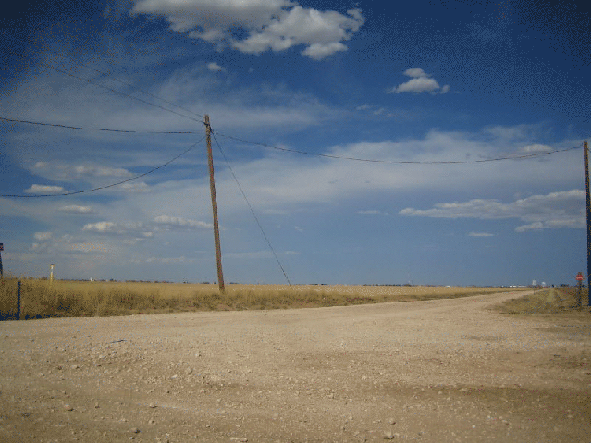
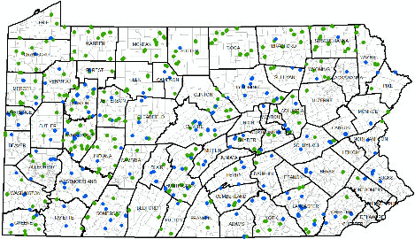
DGLVR Webinar
2018
Annual Summary
3/6/2019
Starts at 9am
If you are reading this, then you are successfully seeing the webinar video. Webinar audio should be automatic through your computer, and options can be accessed in the “audio options” button on the bottom left. If you are having audio issues, or are in a location where listening via phone is preferable, audio is also available on the CDGRS conference line at:
866-823-7699.
For technical assistance, call: 814-865-5355

Slide 2
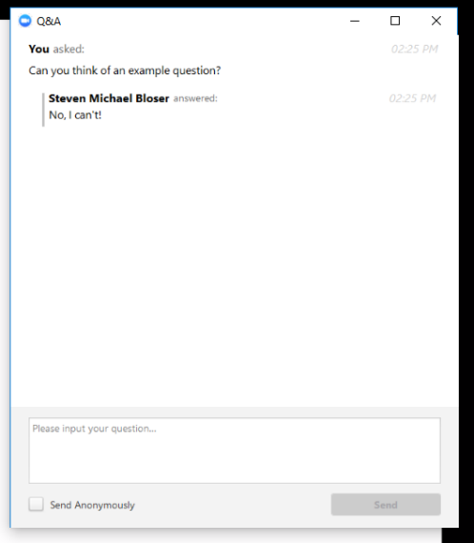
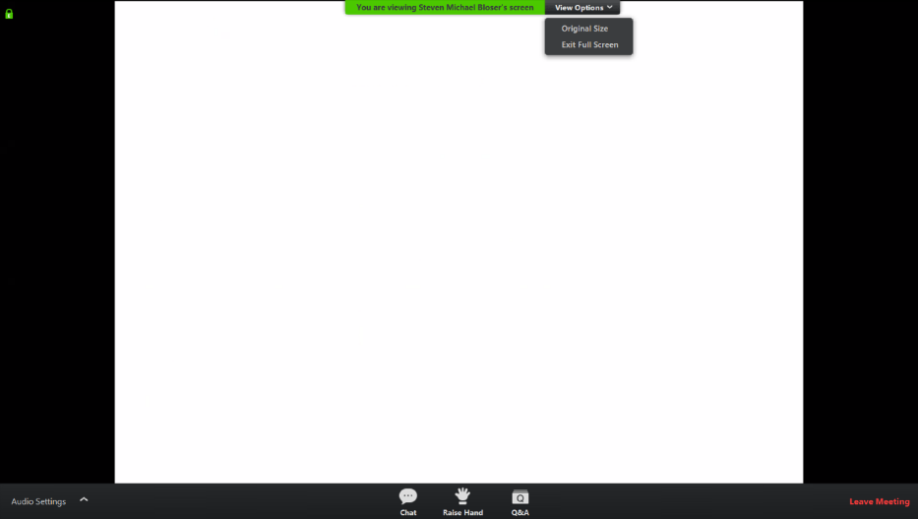
Q&A
Note you can ask a question anonymously
Q&A
For audio via phone: 866-823-7699
For technical assistance: 814-865-5355
Slide #

Slide 3
Annual Summary Report Details
Purpose:
Pause a minute, step back, and look at the big picture of what is being done by the Program.
A lot of figures and stats coming up fast:
Webinar recording and ppt slides available at www.dirtandgravelroads.org
Printed Annual Summary Report available soon.

Slide 4
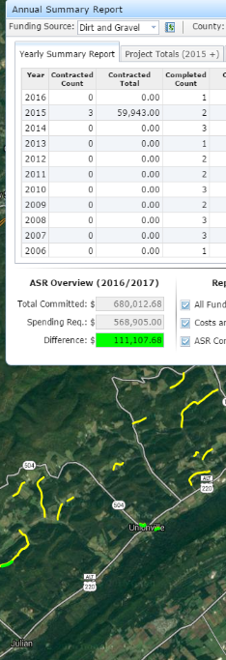
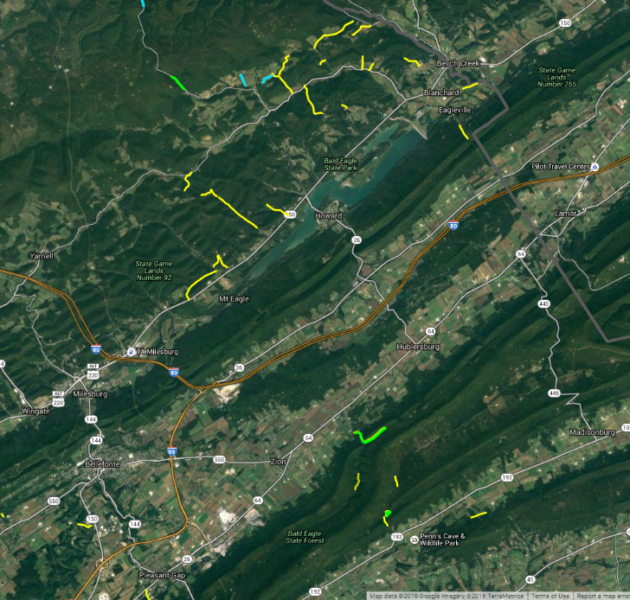
Annual Summary Report Details
ESM Trainings
Project Spending
Project Deliverables
Audio also available via phone: 866-823-7699
For assistance, call: 814-865-5355

Slide 5
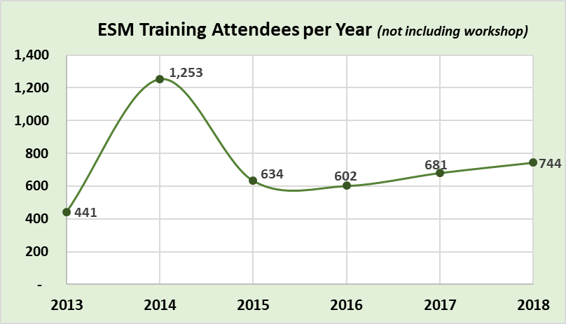
DGLVR Update
Annual Summary Report

Slide 6
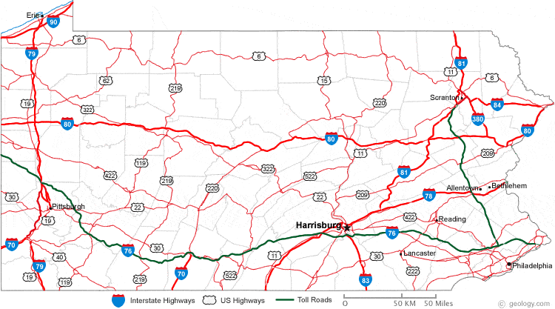
DGLVR Program
ESM Trainings
2019 ESM Trainings
8/21
10/8
5/8
9/4
7/10
10/30
10/23
4/2
4/24
3/26
11/19
5/21
For audio via phone: 866-823-7699
For technical assistance: 814-865-5355

Slide 7
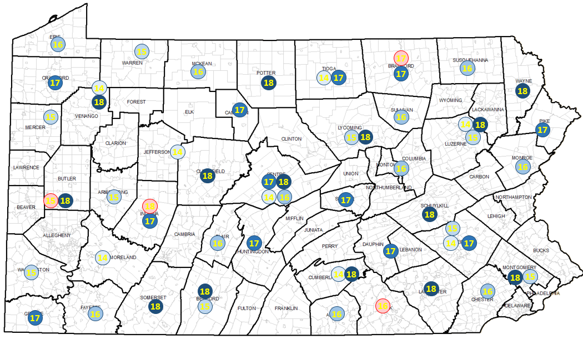
DGLVR Program
ESM Trainings
2019 ESM Trainings
8/21
10/8
5/8
9/4
7/10
10/30
10/23
4/2
4/24
3/26
11/19
5/21
For audio via phone: 866-823-7699
For technical assistance: 814-865-5355
ESM Training Schedule Changes:
Venango County: rescheduled from July to April 10 & 11, 2018 (all current registrations for this course have been notified and switched to the new dates)
Cross Creek Golf Course & Conference Center, 3815 PA 8, Titusville, PA 16354
814-827-9611 – Room Block: Center for Dirt and Gravel Roads, $65/night
Centre County: NEW added training – April 3 & 4, 2018 (Tuesday/Wednesday)
Ramada State College Hotel & Conference Center, 1450 S. Atherton Street, State College, PA
814-238-3001 -- Room Block: Center for Dirt and Gravel Roads, $73/night || valid until March 15, 2018
Luzerne County: NEW added training – May 1 & 2, 2018 (Tuesday/Wednesday)
Woodlands Inn & Resort, 1073 Highway 315, Wilkes-Barre, PA 18702
570-824-9834, Room Block: Dirt & Gravel Roads Training, $83/night || valid until Apr. 15, 2018

Slide 8
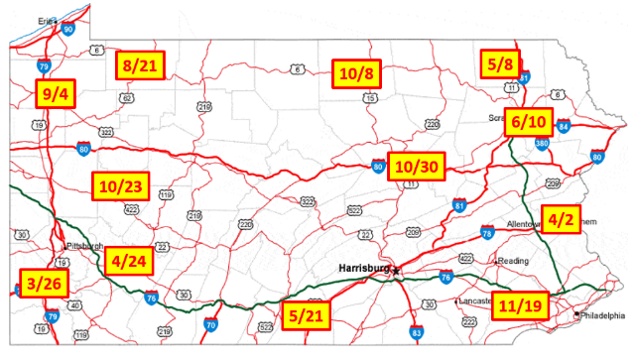
DGLVR Program
ESM Trainings
Schedule is updated and registration is open for all courses at www.dirtandgravelroads.org
ESM Trainings:
3/26-27: Washington
4/2-3: Northampton
4/24-25: Westmoreland
5/8-9: Susquehanna
5/21-22: Franklin
7/10-11: Lackawanna
8/21-22: Warren
9/4-5: Crawford
10/8-9: Tioga
10/23-24: Armstrong
10/30-31: Montour
11/19-20: Chester

Slide 9
ASR Details
ESM Trainings
ESM Changes for 2019
Major updates to “Surface Drainage” and “Surface Maintenance” to condense, update, and reduce repetition
Minor updates to “Banks”, “Ditches”, “Off-ROW”, and “Streams”
Incorporation of many new project pictures throughout
For audio via phone: 866-823-7699
For technical assistance: 814-865-5355

Slide 10
Annual Summary Report Details
ESM Trainings
Project Spending
Project Deliverables
Audio also available via phone: 866-823-7699
For assistance, call: 814-865-5355

Slide 11
ASR Details
GIS
GIS
All Annual Reports done by Jan 25th
Currently in System: $128 $160 million spent/committed
$98 $124 Million in completed projects (DnG & LVR combined)
$30 $35 Million in contracted projects (DnG & LVR combined)
Audio also available via phone: 866-823-7699
For assistance, call: 814-865-5355

Slide 12
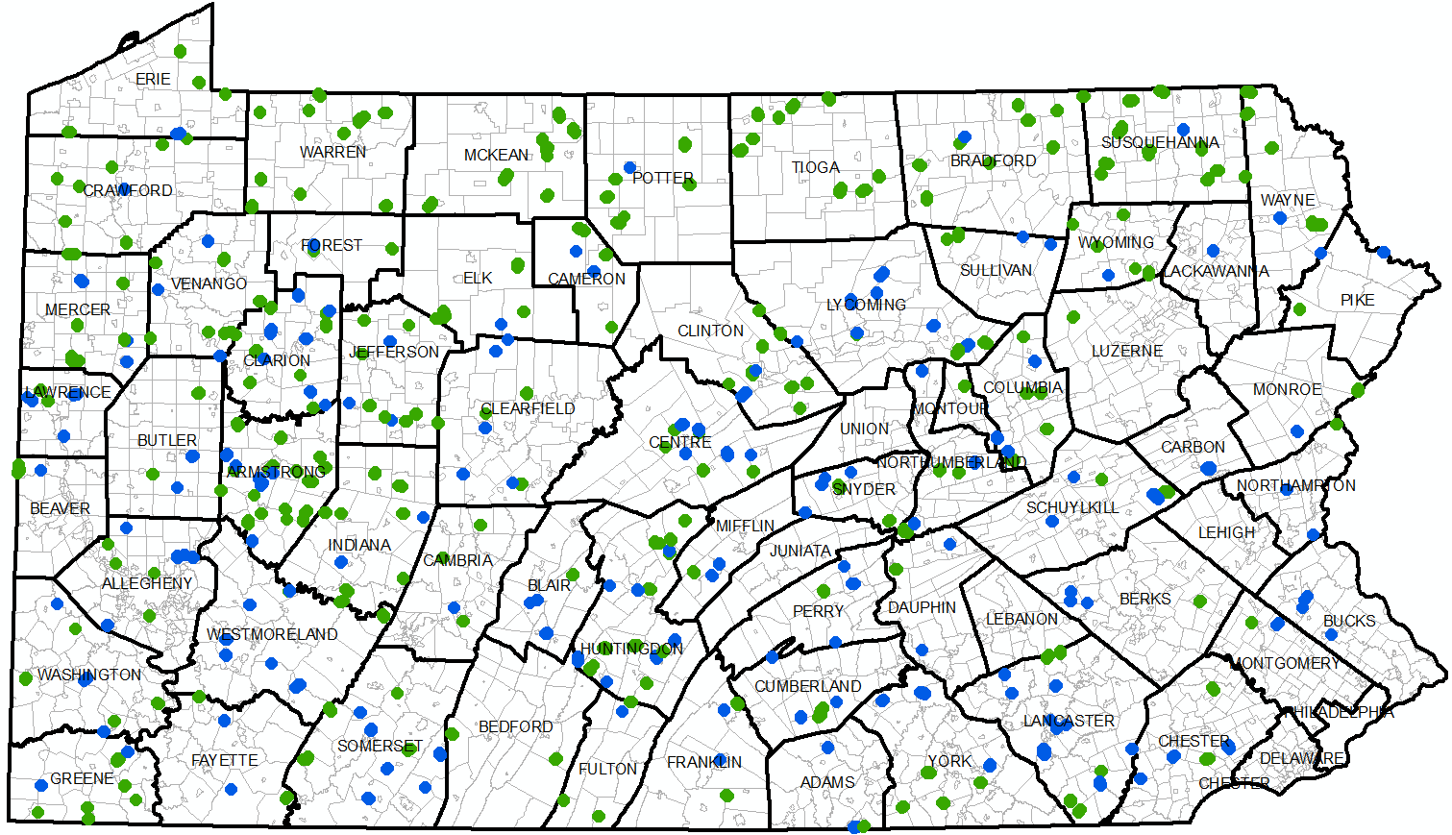
Contracts Completed in 2018:
262 Dirt and Gravel
168 Paved LVR
DnG
LVR

Slide 13
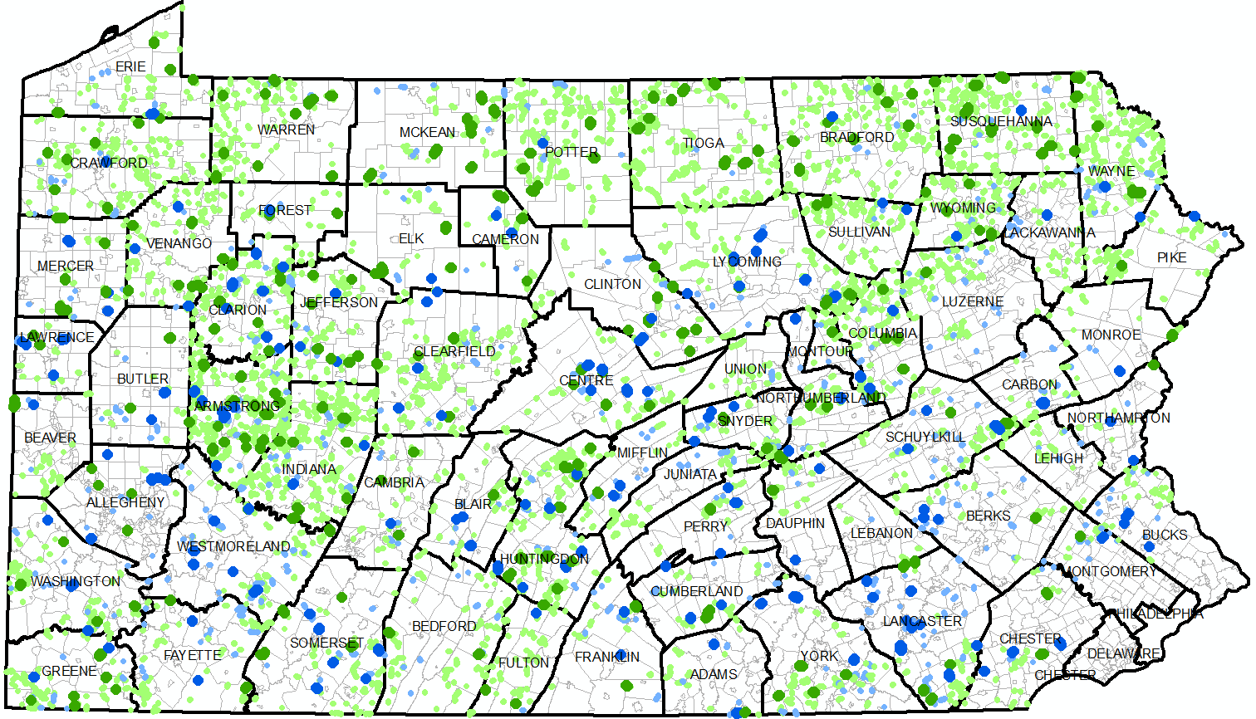
Contracts Completed since 1998:
4,300 Dirt and Gravel
530 Paved LVR
DnG
LVR

Slide 14
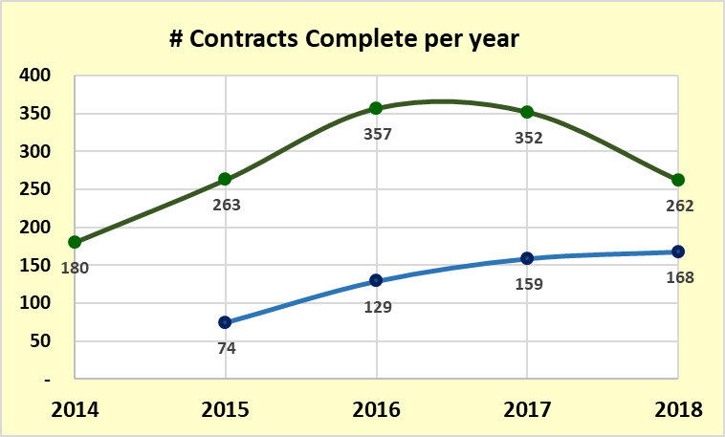
ASR Details
Spending
Dirt and Gravel
Low Volume
$4 million
$28 million
# DnG Contracts decreased…but…

Slide 15
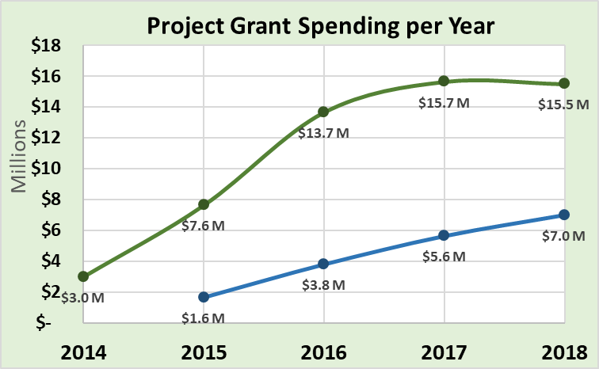
ASR Details
Spending
$4 million
$28 million
Dirt and Gravel
Dirt and Gravel
Low Volume
Low Volume
DnG spending lower than expected
LVR still rising, DnG was same as 2017

Slide 16
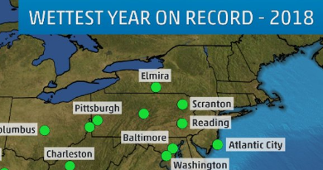
ASR Details
Spending
Hopefully…this is the reason for reduced
project completion in 2018
and hopefully March-June 2019 is much drier!!!
https://www.wearecentralpa.com/weather/2018s-precipitation-records-on-one-map/1655793053

Slide 17
ASR Details
Spending
Dirt and Gravel
Likely Spending Equilibrium
Dirt and Gravel
Low Volume
Low Volume
DnG spending lower than expected
LVR still rising, DnG was same as 2017

Slide 18
ASR Details
Spending
Dirt and Gravel
Likely Spending Equilibrium
Spending shortfalls since 2015
Dirt and Gravel
Low Volume
Low Volume
DnG spending lower than expected
LVR still rising, DnG was same as 2017

Slide 19
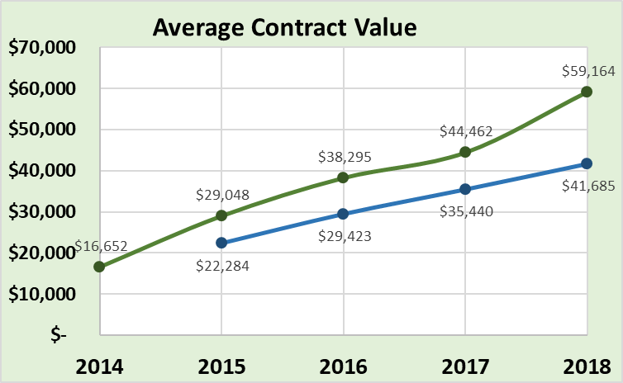
ASR Details
Spending
(no in-kind)
Dirt and Gravel
Low Volume
‘97-’14 average/yr
Avg DnG contract increased 104% from 2015-2018
Avg LVR contract increased 87% from 2015-2018

Slide 20
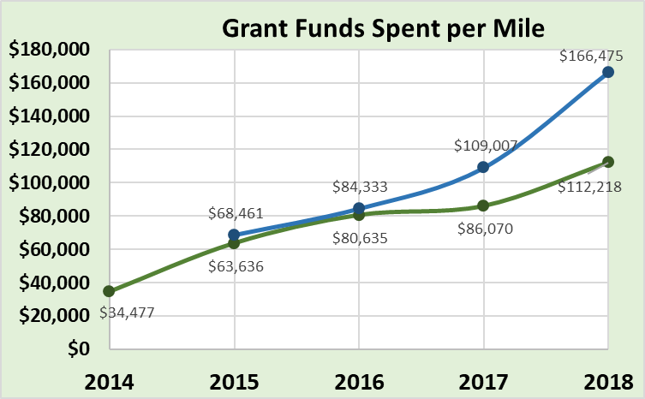
ASR Details
Spending
Low Volume
Dirt and Gravel
Per mile grant spending increasing rapidly
Standalone stream crossings are major factor (big $ in small site)

Slide 21
ASR Details
Spending
Dirt and Gravel: 389 Contracts, $24.3 million committed
Low Volume: 226 Contracts, $12 million committed
Currently Contracted: $36,300,000 (3/4/19)

Slide 22
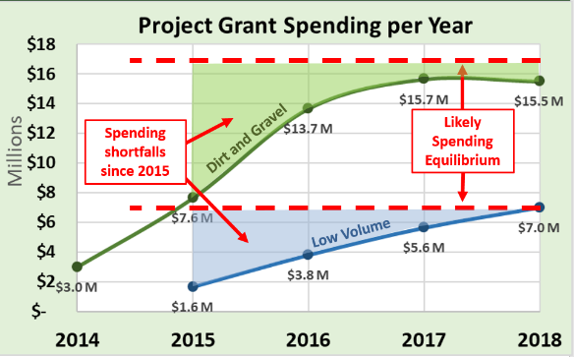
ASR Details
Spending
Dirt and Gravel: 389 Contracts, $24.3 million committed
Low Volume: 226 Contracts, $12 million committed
Currently Contracted: $36,300,000 (3/4/19)
~ $15,000,000 of that is old money (past 5-year agreement)

Slide 23
ASR Details
Spending
Dirt and Gravel: 389 Contracts, $24.3 million committed
Low Volume: 226 Contracts, $12 million committed
Currently Contracted: $36,300,000 (3/4/19)
~ $15,000,000 of that is old money (past 5-year agreement)
116 Days
left to spend funds before June 30th

Slide 24
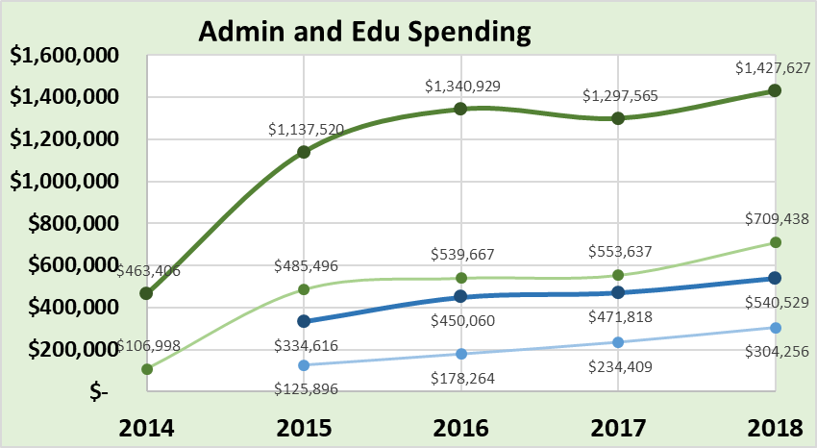
ASR Details
Spending
DnG Admin
DnG Edu
LVR Admin
LVR Edu
DGLVR Admin spending increased 11% in 2018
DGLVR Education spending increased 29% in 2018

Slide 25
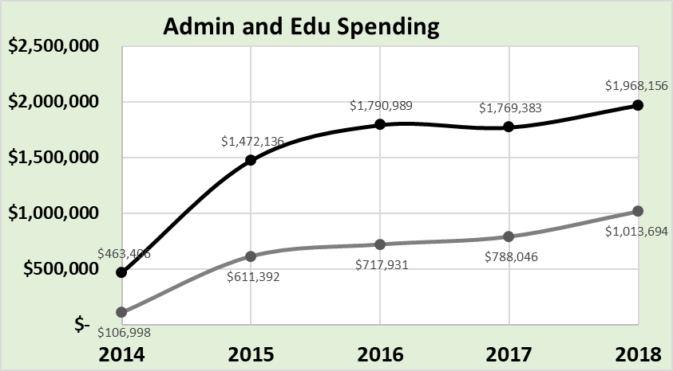
ASR Details
Spending
DGLVR Administration
DGLVR Education
DGLVR Admin spending increased 11% in 2018
DGLVR Education spending increased 29% in 2018

Slide 26
ASR Details
Spending
10% cap for each
DGLVR Administration
DGLVR Education
2018: CDs spent 7.6% on admin statewide (limit 10%)
2018: CDs spent 3.9% on edu statewide (limit 10%)

Slide 27
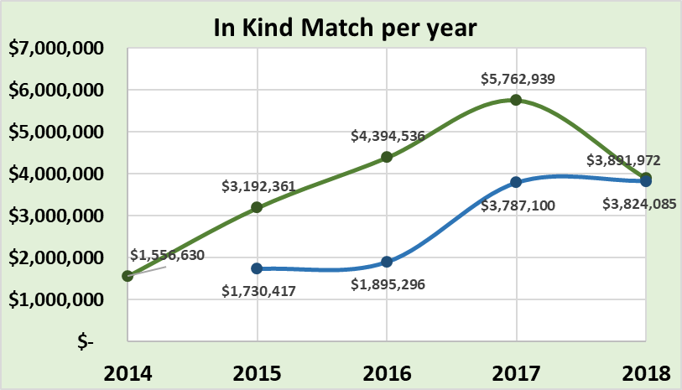
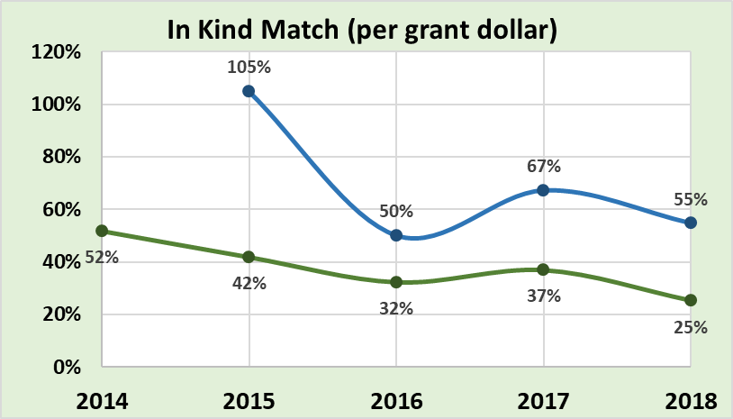
ASR Details
Spending
In-Kind
Total contributions: $7.7 million in 2018
Marked decrease from 2017
2018 averaged $0.34 in-kind for each Program Dollar.
Dirt and Gravel
Low Volume
Low Volume
Dirt and Gravel
34% avg

Slide 28
ASR Details
Spending
SPENDING Take home points
DnG Spending held constant in 2018
LVR spending increased, finally hit “equilibrium”
$36 million currently under contract ($15M is old money)
116 days left to spend old money before June 30th
Get busy!
Hope for good weather!
Call early for assistance!

Slide 29
Annual Summary Report Details
ESM Trainings
Project Spending
Project Deliverables
Audio also available via phone: 866-823-7699
For assistance, call: 814-865-5355

Slide 30
ASR Details
Deliverables
Project Deliverables:
Purpose: To provide a “quick summary” of some of the major deliverables reported by CDs
More details will be included in written Annual Report.

Slide 31
ASR Details
Deliverables
Accuracy note:
Corrections are made each year, and some assumptions have to be made, so figures for many items may change over time.
We will be contacting CDs about updating errors, about 80 in all:
For example:
One project reported 60 pipes installed. Was likely 2 pipes totaling 60 feet.
One project reported 14 stream crossings installed. Was likely one 14’ diameter opening.
Also: deliverables include in-kind

Slide 32
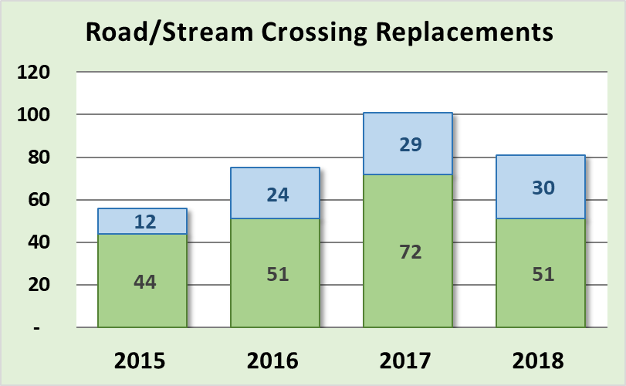
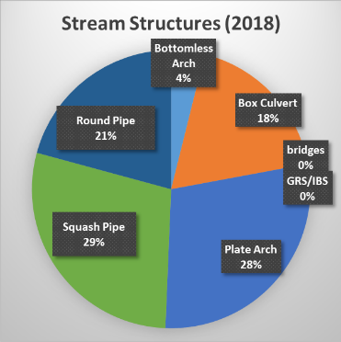
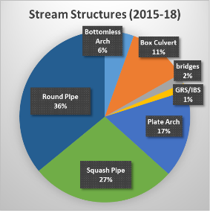
ASR Details
Deliverables
Stream Crossings
Decrease from 2017
~80 in 2018
Wet year?
LVR
DnG

Slide 33
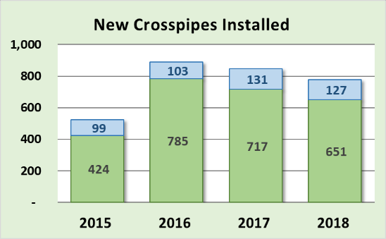
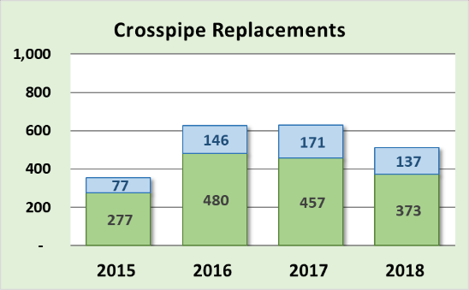
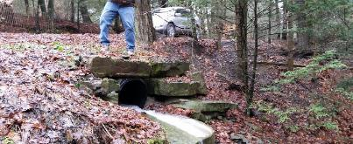
ASR Details
Deliverables
Drainage Crosspipes:
Similar to 2017 numbers
More replacements than new on LVRs
812
LVR
In 2018 alone:
~4.4 miles of new pipe
~ 2.9 miles of pipe replaced
(assuming 30’ avg length)
DnG

Slide 34
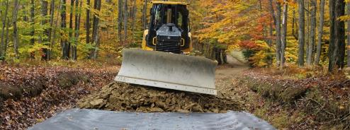
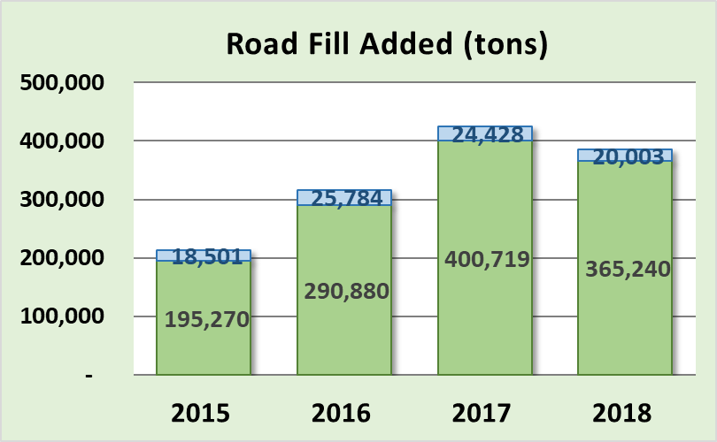
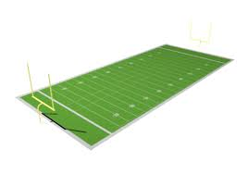
ASR Details
Deliverables
Road Fill Added:
Slight decrease from 2017
Under-used in LVR
In 2018 alone:
Would cover the playing surface of a football field 146’ deep
385,200
146’
LVR
DnG

Slide 35
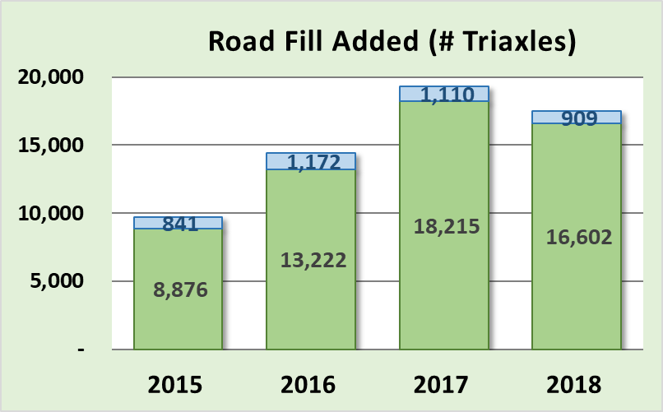
ASR Details
Deliverables
Road Fill Added:
Slight decrease from 2017
Under-used in LVR
17,500
In 2018 alone:
83 miles of triaxle trucks, bumper to bumper

Slide 36
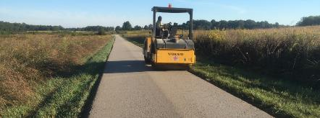
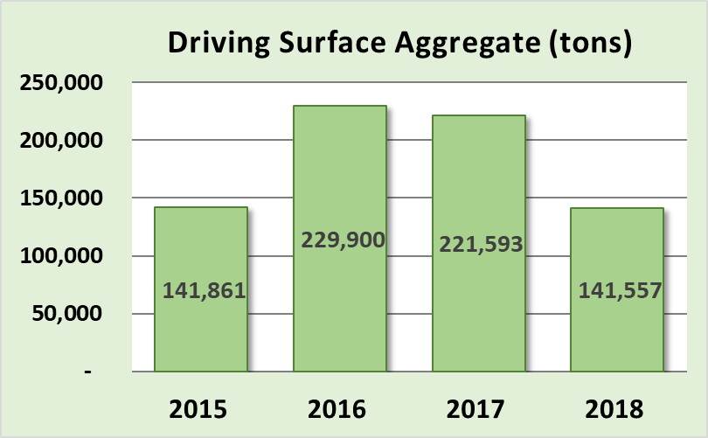
ASR Details
Deliverables
Driving Surface Aggregate:
Decrease from 2017
In 2018:
~56 Miles of road
In 2018 alone:
141,557 tons @ $25-$30 a ton =
$3.5-$4.5 million on DSA

Slide 37
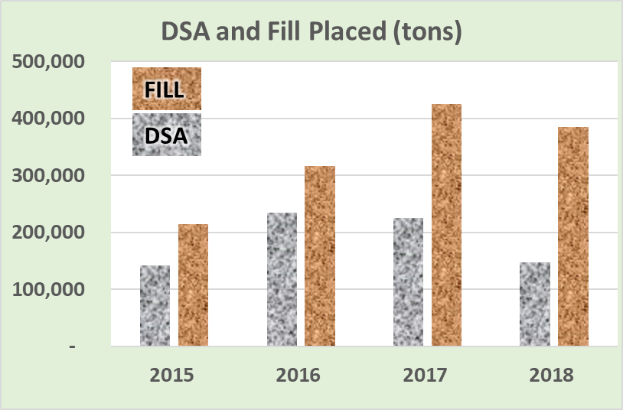
ASR Details
Deliverables
Trends: More fill than DSA 2nd year in a row!
Road Fill increasing
DSA decreasing
(tons)

Slide 38
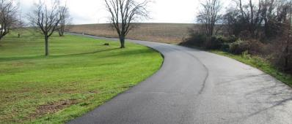
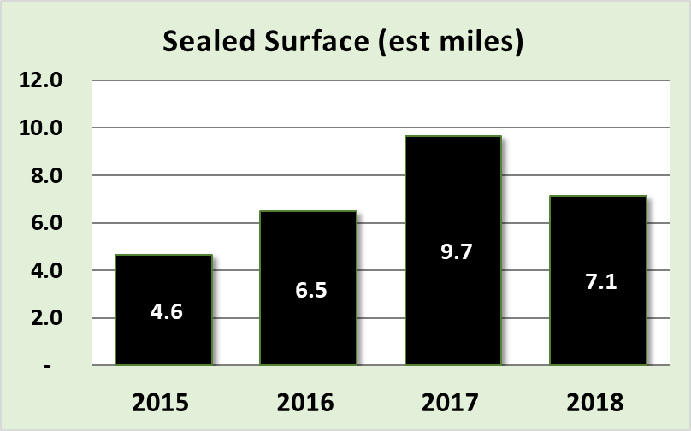
ASR Details
Deliverables
Paving (LVR Only):
Minor expense
Note some of this was funded as in-kind

Slide 39
ASR Details
Deliverables
Deliverables Take Home:
81 less projects reported complete in 2018
Most deliverables steady or down slightly
Wet weather likely (hopefully) delayed completion of many projects
Hope for a dry spring and early summer!
Need help: ask early, going to be busy 4 months!

Slide 40
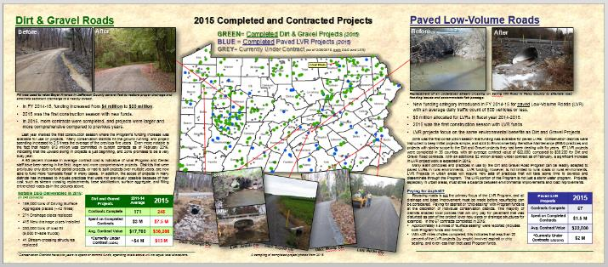
ASR Details
Deliverables
More details in 2018 annual report,
available this Spring.
Let us know if you have any questions or suggestions for analysis of spending or deliverables.

Slide 41
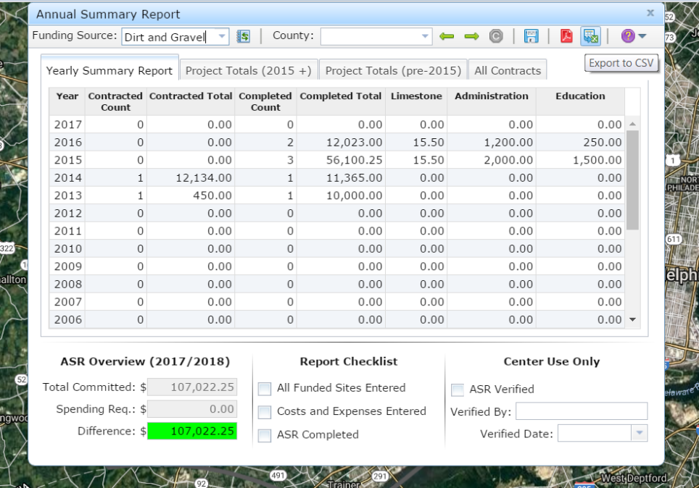
Interested in compiling data like this and more for your county?
You already have the power!
Join tomorrow’s webinar for a walkthrough of data and analysis potentials already built into your GIS system.

