Slide 1
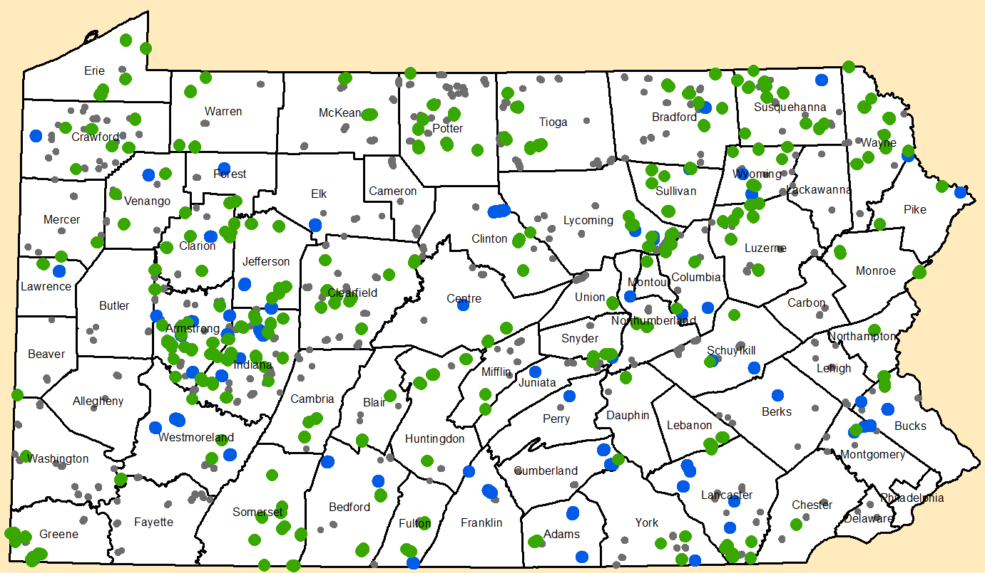
Annual Summary Report
Refresher
Toggle Fullscreen
mode with this button above
12/12/17
Starts at 10 am
GREEN= Completed D&G (2015) BLUE = Completed LVR (2015)
GREY= Contract (as of 2/26/2016, both D&G and LVR)
Use Chat box to ask Questions
http://metrocount.com
If you are reading this, then you are successfully seeing the webinar video. In addition to audio on the webinar, we have opened a phone conference line to allow attendees to listen and ask questions directly: 866-823-7699. Please use either the webinar audio or conference line, but not both (will produce feedback).
Audio also available via phone: 866-823-7699
For assistance, call: 814-865-5355

Slide 2
Toggle Fullscreen
mode with this button
above
Participant phone lines will be muted until after initial presentation
Use Chat box to ask Questions
http://metrocount.com
Audio also available via phone: 866-823-7699
For assistance, call: 814-865-5355

Slide 3
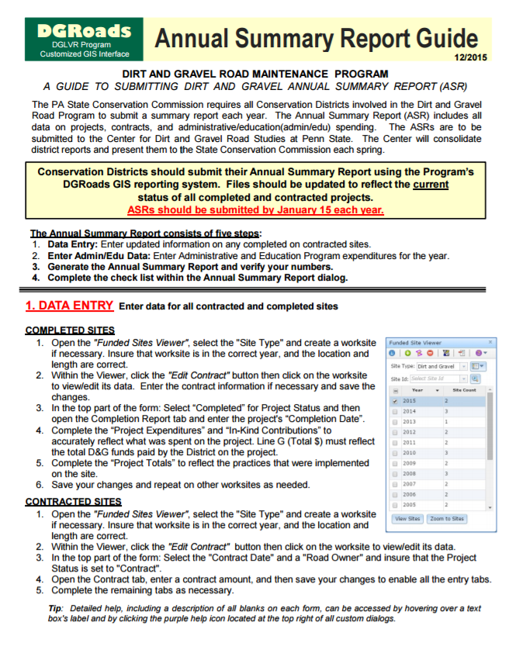
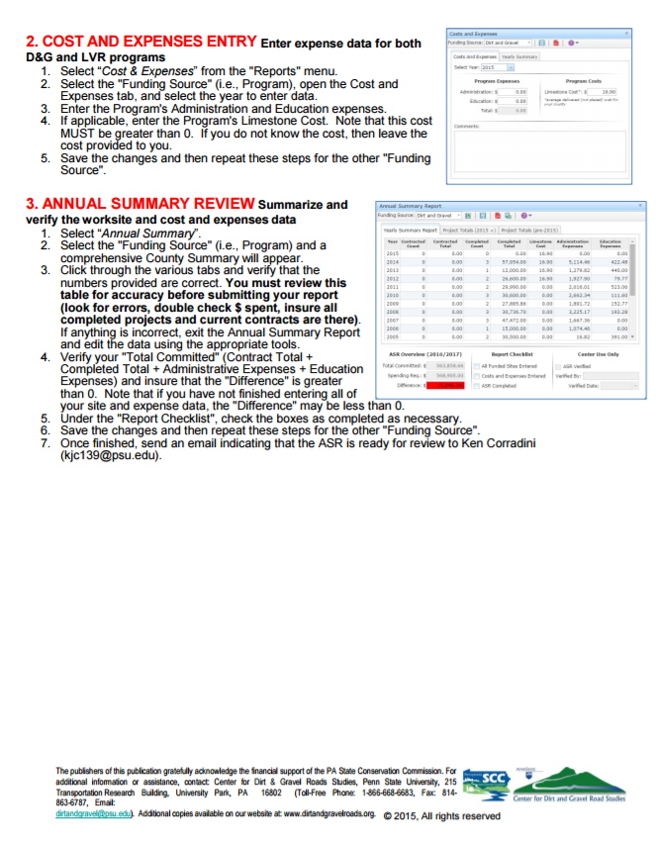
DGLVR
Annual Summary Reports
Purpose:
Provide Conservation Districts with a “refresher” on completing the DGLVR Annual Summary Report, due 1/15/2018.
Download:
Annual Summary Report Guide

Slide 4
DGLVR
Annual Summary Reports
Agenda:
Review of Annual Report Steps, with reference to guide and GIS
GIS Demo of ASR steps

Slide 5
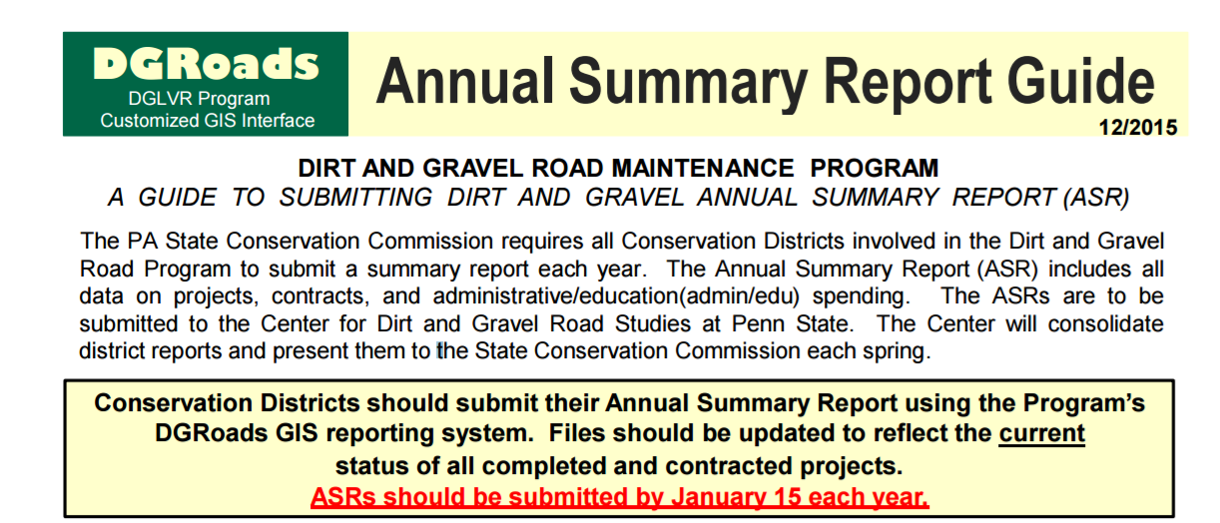
DGLVR
Annual Summary Reports
Annual Summary Reports
Due from CD January 15, 2018.
Summarize projects and spending through 2017.
from ASR Guide
Audio also available via phone: 866-823-7699
For assistance, call: 814-865-5355

Slide 6
DGLVR
Annual Summary Reports
Annual Summary Report
Enter all contracted and completed projects (D&G and LVR)
Enter annual Administrative and Educational spending
Generate Annual Summary Report and verify
Mark report as done in GIS, e-mail Ken.
from ASR Guide
Audio also available via phone: 866-823-7699
For assistance, call: 814-865-5355

Slide 7
DGLVR
Annual Summary Reports
Project Data Entry:
Enter all contracted and completed D&G and LVR projects.
Audio also available via phone: 866-823-7699
For assistance, call: 814-865-5355

Slide 8
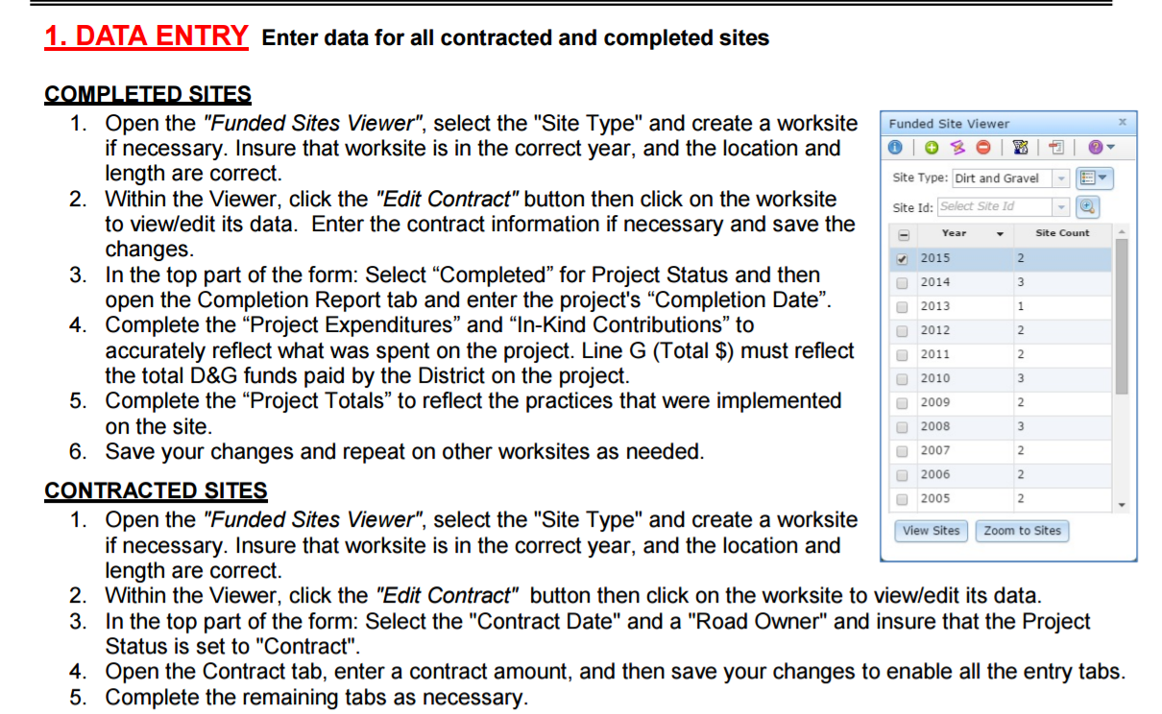
DGLVR
Annual Summary Reports
Project Data Entry:
Enter all contracted and completed D&G and LVR projects.
GIS Screenshot
from ASR Guide
Audio also available via phone: 866-823-7699
For assistance, call: 814-865-5355

Slide 9
DGLVR
Annual Summary Reports
2. Admin / Edu Spending:
Enter 2017 calendar year admin/edu spending
Audio also available via phone: 866-823-7699
For assistance, call: 814-865-5355

Slide 10
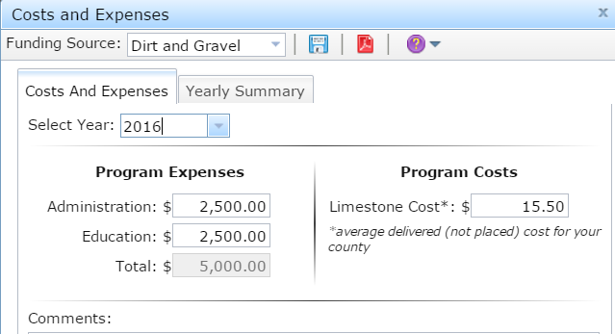
DGLVR
Annual Summary Reports
2. Admin / Edu Spending:
Enter 2017 calendar year admin/edu spending
For both D&G and LVR
from ASR Guide
GIS Screenshot
Audio also available via phone: 866-823-7699
For assistance, call: 814-865-5355

Slide 11
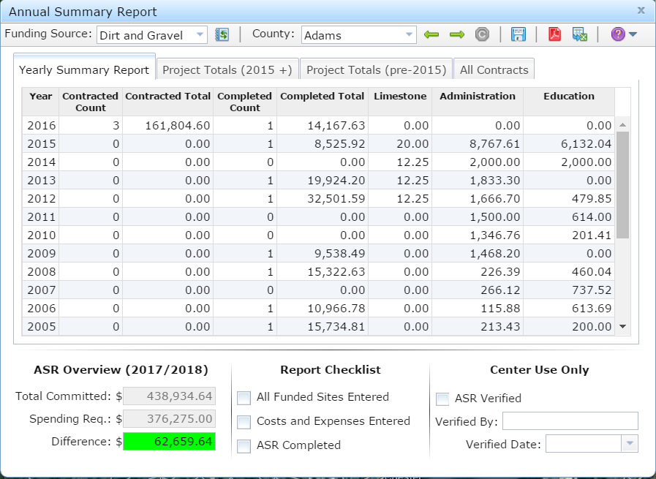
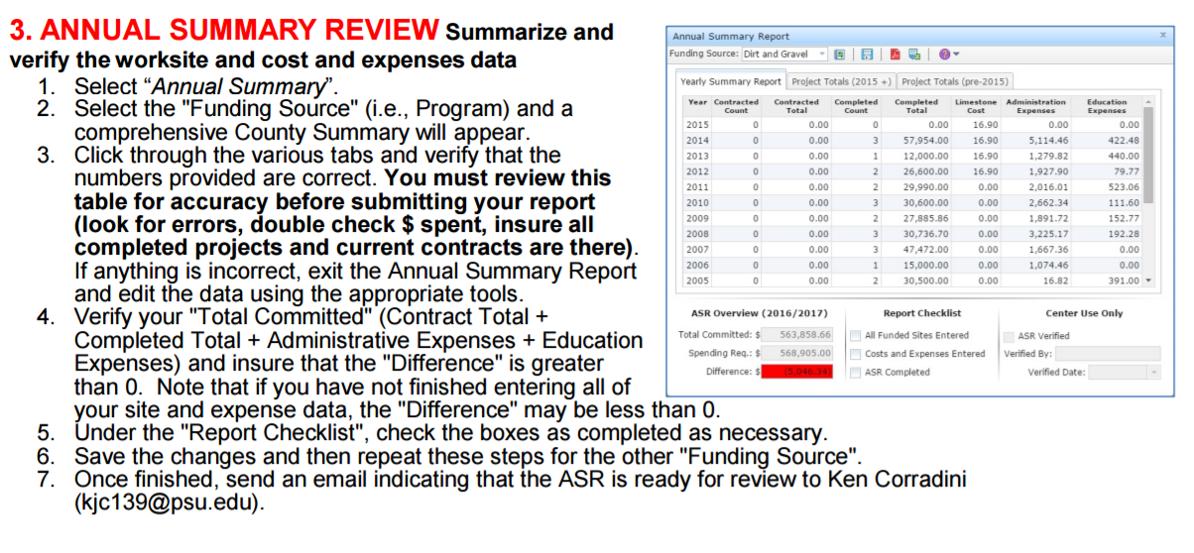
DGLVR
Annual Summary Reports
3. Generate ASR:
Generate report, and confirm numbers for D&G and LVR spending
Audio also available via phone: 866-823-7699
For assistance, call: 814-865-5355

Slide 12
DGLVR
Annual Summary Reports
3. Generate ASR:
Generate report, and confirm numbers for D&G and LVR spending
For both D&G and LVR
GIS Screenshot
from ASR Guide

Slide 13
DGLVR
Annual Summary Reports
3. Generate ASR: Generate report, and confirm numbers for D&G and LVR spending
For both D&G and LVR
GIS Screenshot

Slide 14
DGLVR
Annual Summary Reports
3. Generate ASR: Generate report, and confirm numbers for D&G and LVR spending
For both D&G and LVR
GIS Screenshot
Does that sound right? 3 D&G active contracts for $161,804 and one project completed in 2016 for $14,167

Slide 15
DGLVR
Annual Summary Reports
3. Generate ASR: Generate report, and confirm numbers for D&G and LVR spending
For both D&G and LVR
GIS Screenshot
more details
Does that sound right? 3 D&G active contracts for $161,804 and one project completed in 2016 for $14,167

Slide 16
DGLVR
Annual Summary Reports
3. Generate ASR: Generate report, and confirm numbers for D&G and LVR spending
For both D&G and LVR
GIS Screenshot
more details
Does that sound right? 3 D&G active contracts for $161,804 and one project completed in 2016 for $14,167
Spending Status

Slide 17
DGLVR
Annual Summary Reports
4. Mark Report as Complete
GIS Screenshot
Mark ASR Complete

Slide 18
DGLVR
Annual Summary Reports
Annual Summary Reports due 1/15/18
Enter all contracted and completed projects (D&G and LVR)
Enter annual Administrative and Educational spending
Generate Annual Summary Report and verify
Mark report as done in GIS, e-mail Ken.
Help
ASR Guide: www.dirtandgravelroads.org: General Resources, GIS
In-GIS help:
Contact Ken: kjc139@psu.edu 814-865-6966
Live Demo

