Slide 1
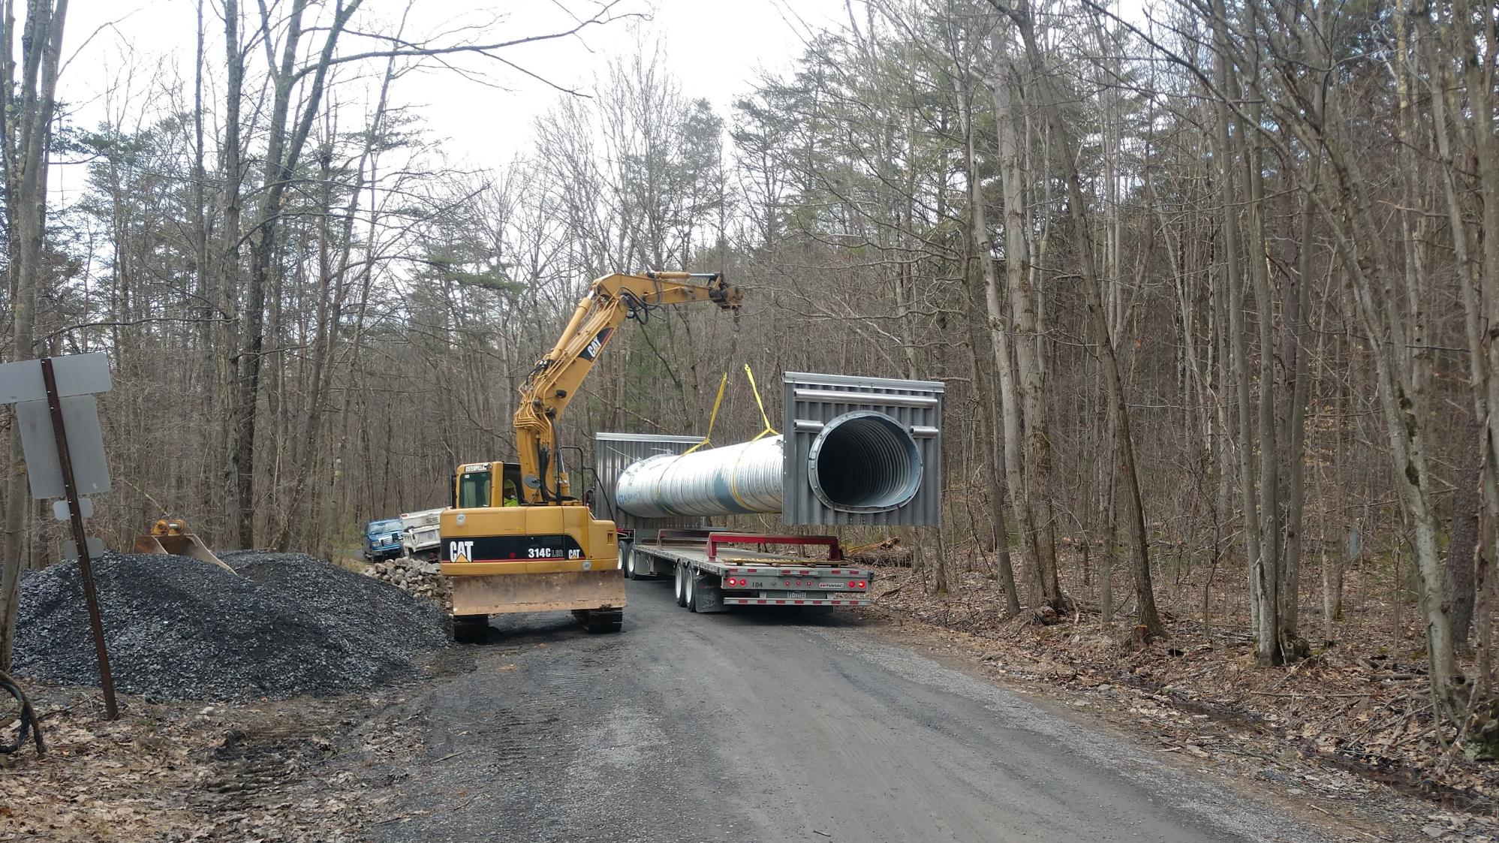
Dirt Gravel and Low Volume Road Program
WEBINAR
3/11/21
Starts 9am
2020 Annual Summary Report
Note this same presentation was given to the SCC at their 3/9/21 remote meeting
Roy Richardson
SCC
rrichardso@pa.gov
Steve Bloser
CDGRS
smb201@psu.edu
If you are reading this, then you are successfully seeing the webinar video. Webinar audio should be automatic through your computer (or click “join audio”), and options can be accessed in the “audio options” button on the bottom left. If your computer audio is not working, you can listen on your phone by dialing 646-876-9923.

Slide 2
Purpose
Summarize 2020 Program Status
Stop, step back, and look at the “Big Picture” Program overview of spending and deliverables

Slide 3
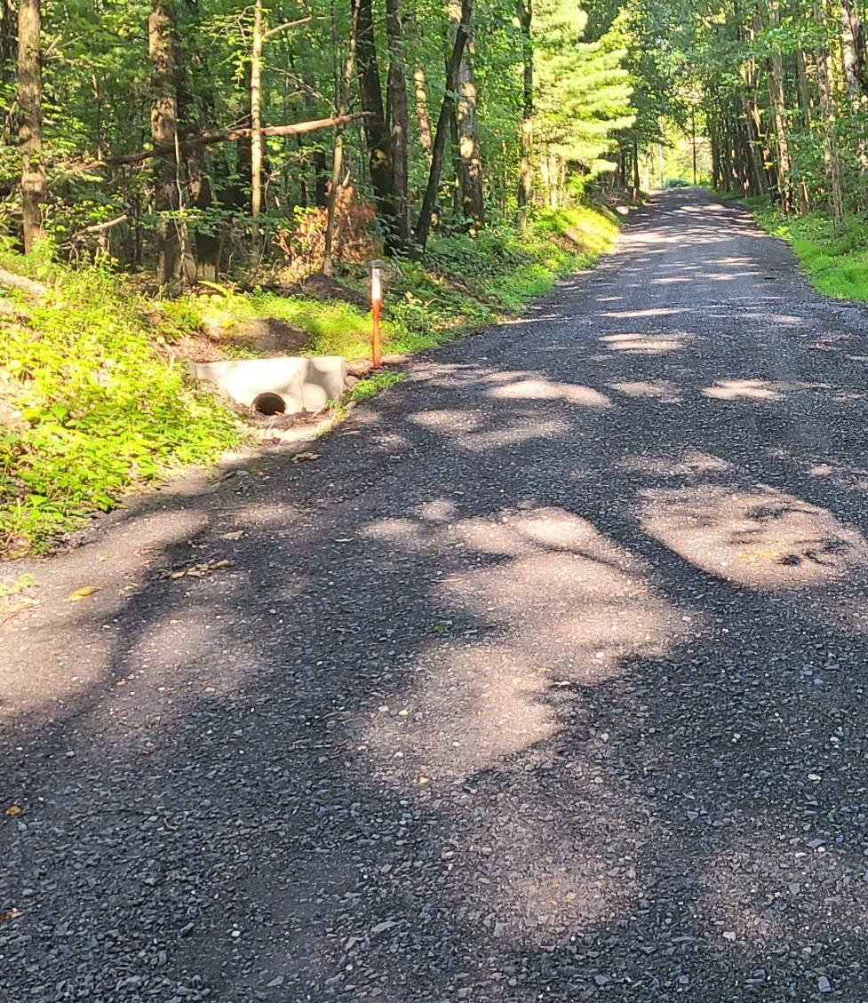
2020 Annual Summary Report
Annual Report: Financial
Annual Report: Deliverables
CD Financial Status
CD Allocation Eligibility

Slide 4
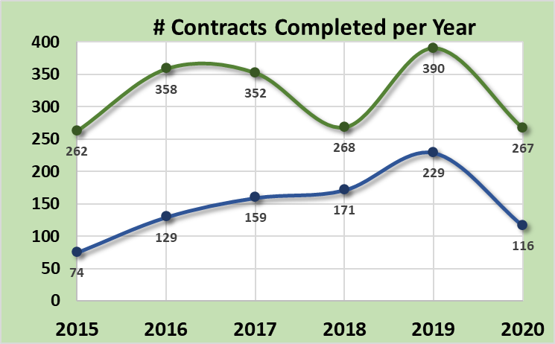
Annual Summary Report: Financial
383 Projects Completed
Down from 619 in 2019
488 past 5-year average
Dirt and Gravel
Note: 2020 numbers down from 2019
July 2019 was big spending push at end of 5-year contract
Only minor COVID issues (est <10% of projects delayed)
Paved Low-Volume
ASR data as of 12/31/2020
www.dirtandgravelroads.org

Slide 5
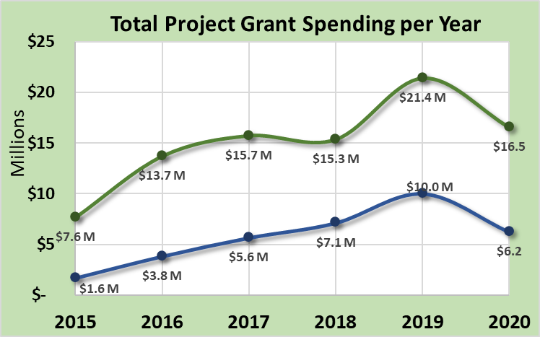
Annual Summary Report: Financial
$22.7M Spent on Completed Projects
Down from $31.4M in 2019
$23.1M past 5-year average
Note: 2020 numbers down from 2019
July 2019 was big spending push at end of 5-year contract
Only minor COVID issues (est <10% of projects delayed)
Dirt and Gravel
Paved Low-Volume
ASR data as of 12/31/2020
www.dirtandgravelroads.org

Slide 6
Annual Summary Report: Financial
$22.7M Spent on Completed Projects
Down from $31.4M in 2019
$23.1M past 5-year average
Where should spending be?
Dirt and Gravel
Likely Spending Equilibrium
Paved Low-Volume
ASR data as of 12/31/2020
www.dirtandgravelroads.org

Slide 7
Annual Summary Report: Financial
$22.7M Spent on Completed Projects
Down from $31.4M in 2019
$23.1M past 5-year average
In Addition, as of 3/1/2021:
120 contracts reported complete so far in 2021 for $6.2M
415 current contacts worth $29.5M
ASR data as of 12/31/2020
www.dirtandgravelroads.org

Slide 8
Annual Summary Report: Financial
In-Kind: goods or services incurred by participant but not reimbursed through DGLVR funds
$7.7M In-Kind Spent on Completed Projects
Down from $11M in 2019
$8.4M past 5-year average
34% In-Kind per Project Dollar
Compared to 35% in 2019
37% past 5-year average
Dirt and Gravel
Paved Low-Volume
Paved Low-Volume
Dirt and Gravel
ASR data as of 12/31/2020
www.dirtandgravelroads.org

Slide 9
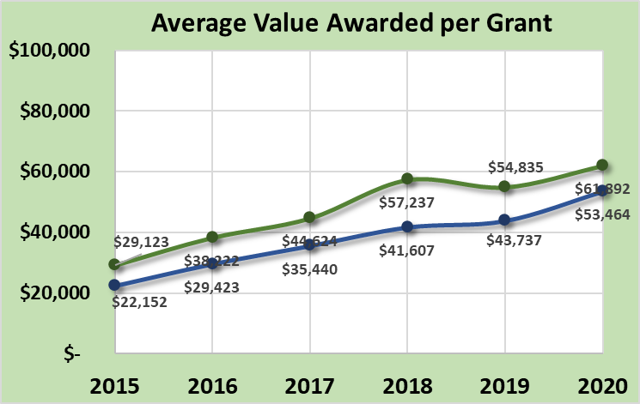
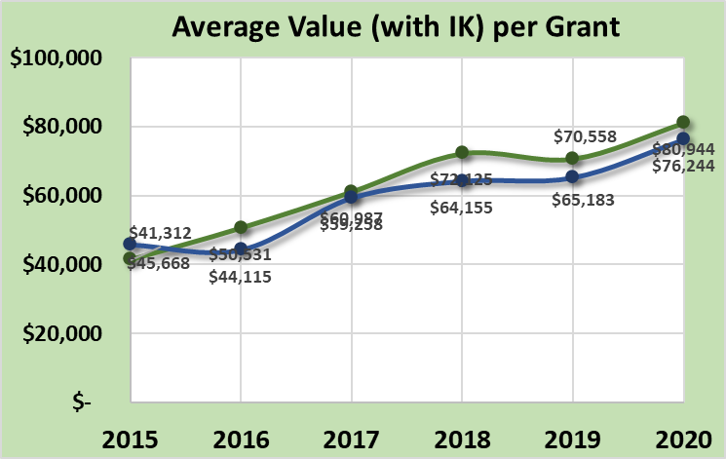
Annual Summary Report: Financial
Average Project Size:
Average per completed contract:
$59K in 2020 (DGLVR funds only)
$79K in 2020 (including in-kind)
Steadily rising since 2014 funding increase:
Larger scale projects
More complex and costly projects
Dirt and Gravel
Paved Low-Volume
Dirt and Gravel
Paved Low-Volume
ASR data as of 12/31/2020
www.dirtandgravelroads.org

Slide 10
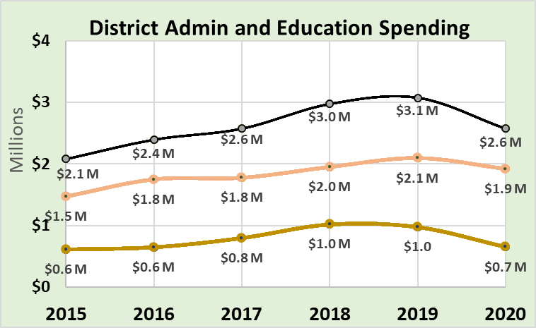
Annual Summary Report: Financial
Admin / Education Spending by CDs
Administration
10% maximum Allowable
7.4% in 2020
7.3% over 5-year average
Education
10% maximum Allowable
2.5% in 2020
3.1% over 5-year average
Total
Administration
Education
ASR data as of 12/31/2020
www.dirtandgravelroads.org

Slide 11
Annual Summary Report: Financial
Financial Summary
383 sites completed in 2020 with $23M spent on them
Down from last year’s spending push, but no significant “COVID dip”
In line with long-term expected spending averages
Currently Contracted: 412 contracts for $30M (~1.25 years of project funding)
Average grant values: continues to increase, nearly $60,000 in 2020
In-Kind: average settling in at around $0.35 per $1 of grant funds (no statewide in-kind requirement)
ASR data as of 12/31/2020
www.dirtandgravelroads.org

Slide 12
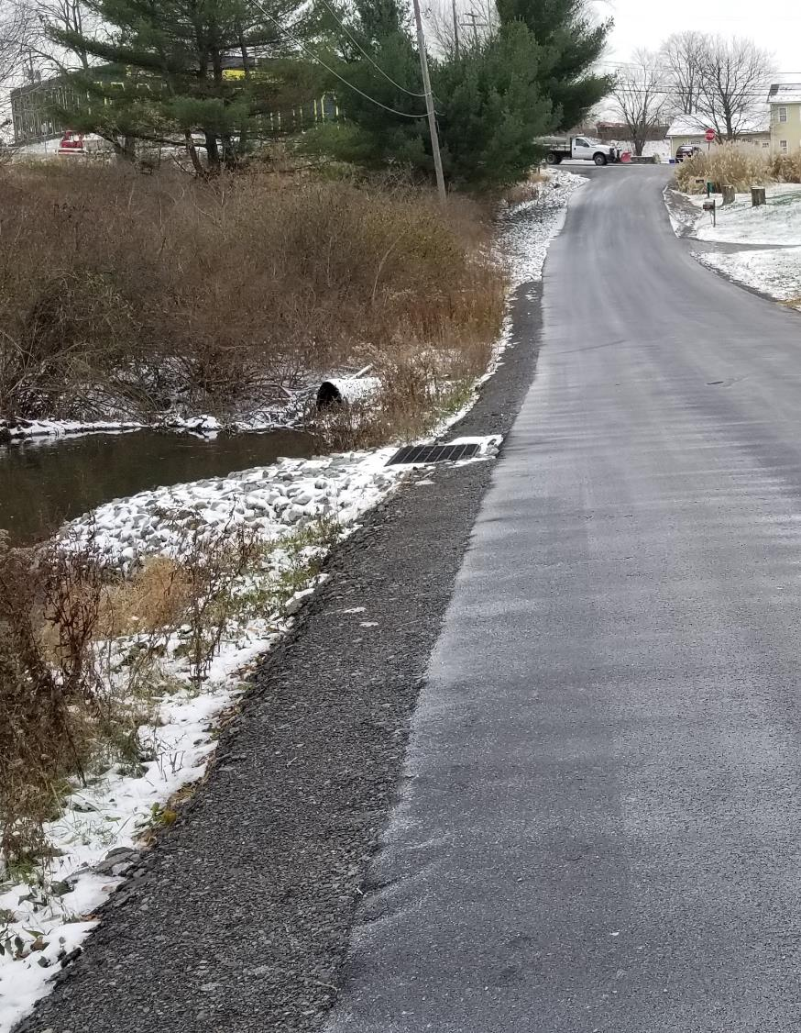
2020 Annual Summary Report
Annual Report: Financial
Annual Report: Deliverables
CD Financial Status
CD Allocation Eligibility

Slide 13
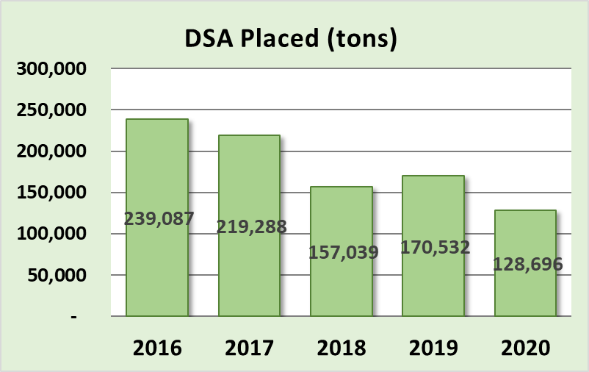
Annual Summary Report: Deliverables
Driving Surface Aggregate
Only approved surface with DGLVR funds
Should be used only after drainage and base improvement are made
Decreasing 5-year trend, may be stabilizing
Actual Totals in Tons
$21.4M $16.5M
But that does not account for annual spending variability
www.dirtandgravelroads.org

Slide 14
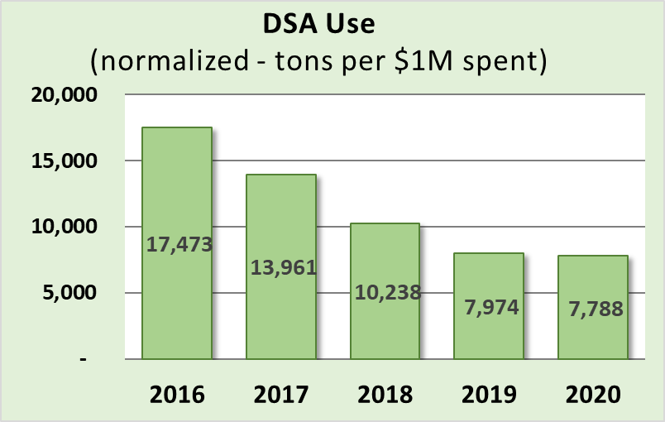
Annual Summary Report: Deliverables
Driving Surface Aggregate
Only approved surface with DGLVR funds
Should be used only after drainage and base improvement are made
Decreasing 5-year trend, may be stabilizing
Actual Totals in Tons
But that does not account for annual spending variability
Normalized by annual spending
www.dirtandgravelroads.org

Slide 15
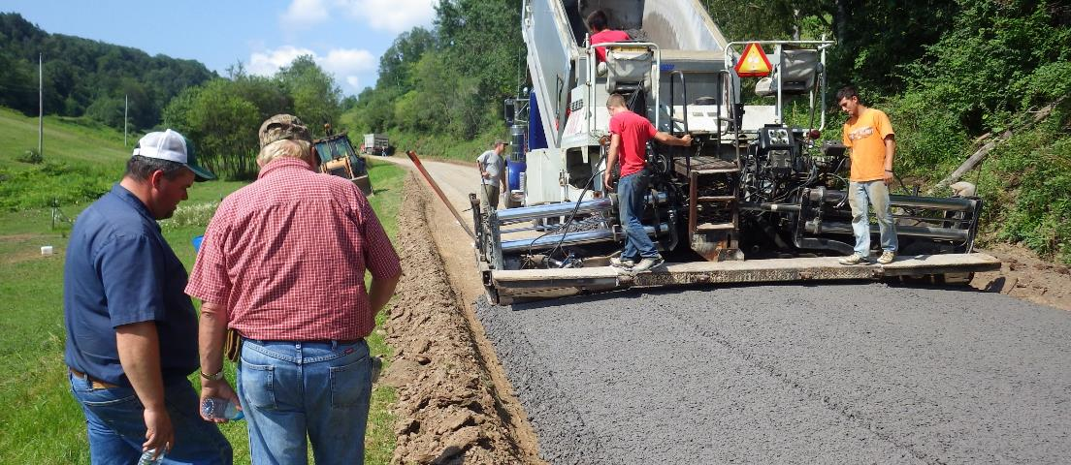
Annual Summary Report: Deliverables
Driving Surface Aggregate
Only approved surface with DGLVR funds
Should be used only after drainage and base improvement are made
Decreasing 5-year trend, may be stabilizing
ASR data as of 12/31/2020
www.dirtandgravelroads.org

Slide 16
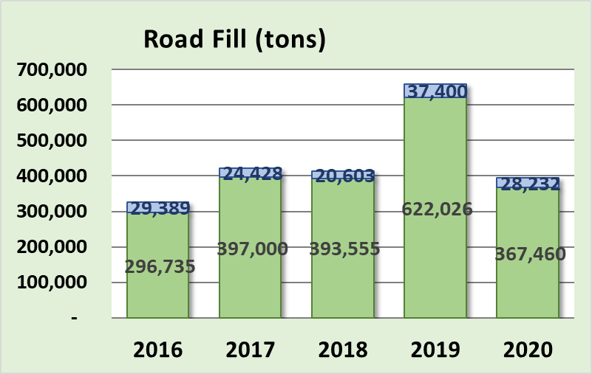
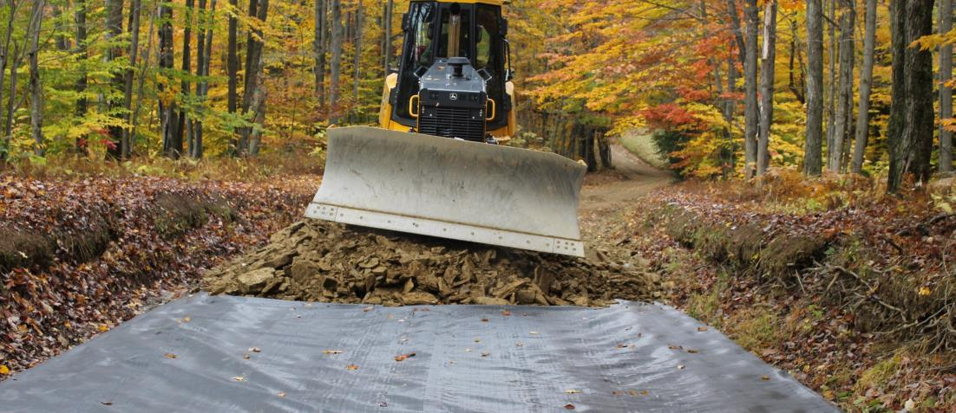
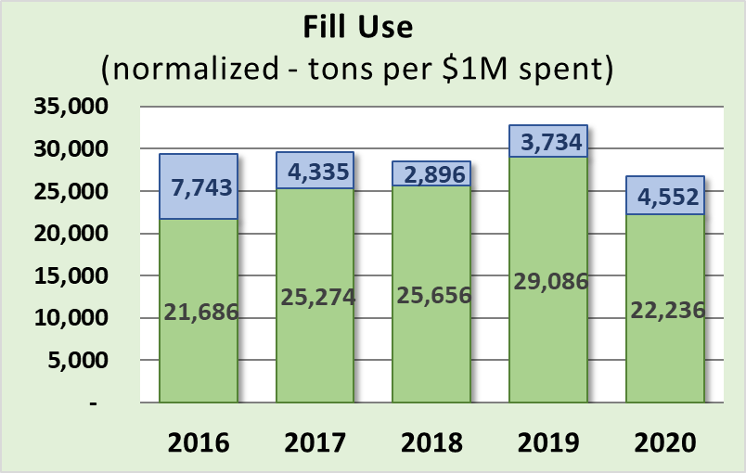
Annual Summary Report: Deliverables
Road Fill
Used to elevate entrenched roads
Continual point of emphasis as it fixes many drainage and base issues
Fairly consistent 5-year trend
Dirt and Gravel
Paved Low-Volume
www.dirtandgravelroads.org

Slide 17
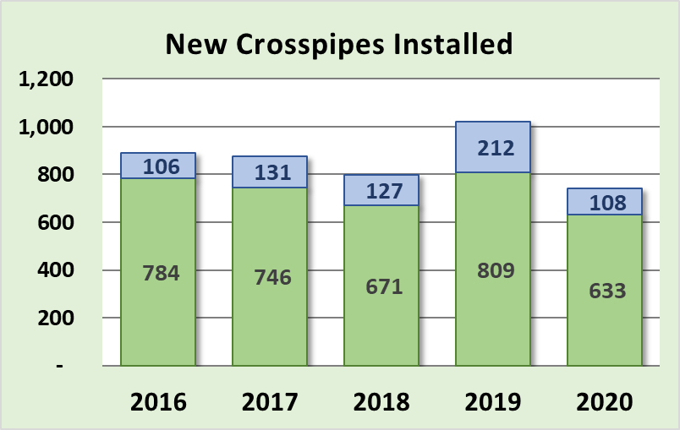
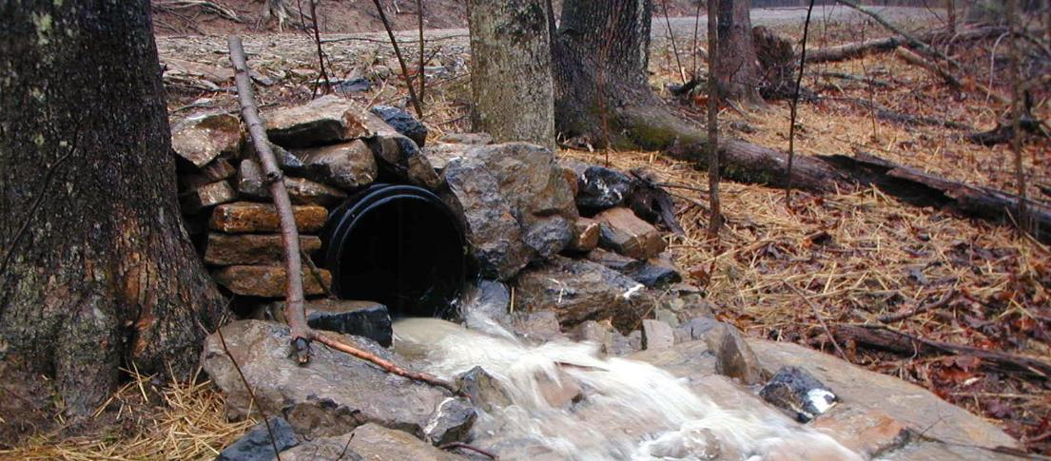
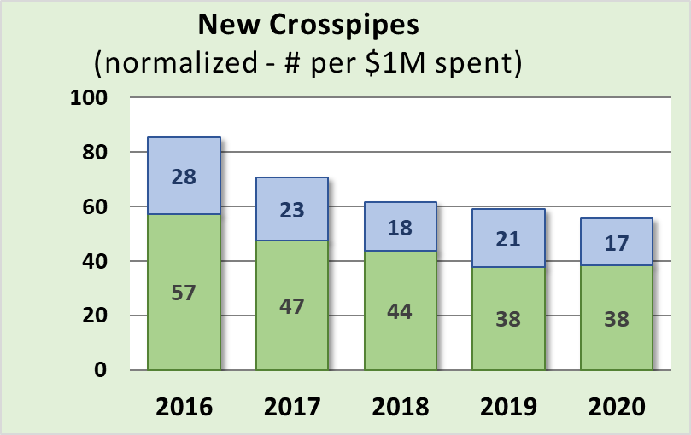
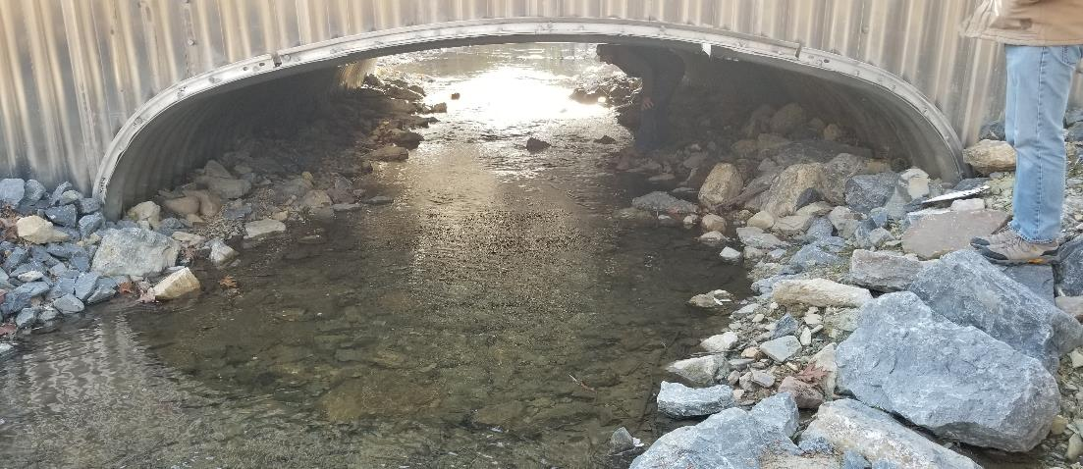
Annual Summary Report: Deliverables
New Crosspipes Installed
Most fundamental tool to disconnect road drainage
Slightly decreasing over time
Dirt and Gravel
Paved Low-Volume
www.dirtandgravelroads.org

Slide 18
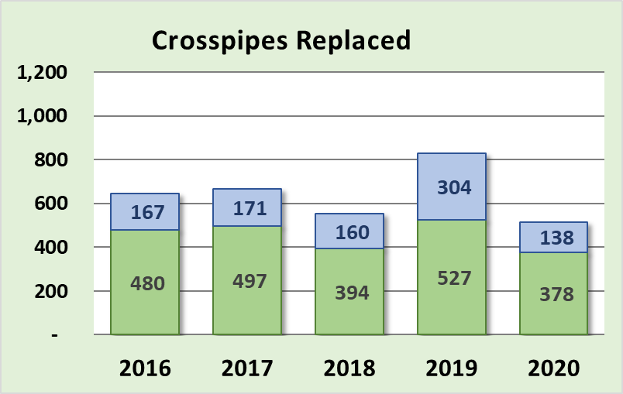
Annual Summary Report: Deliverables
New Crosspipes Installed
Most fundamental tool to disconnect road drainage
Slightly decreasing over time
Also track crosspipes replaced
Dirt and Gravel
Paved Low-Volume
www.dirtandgravelroads.org

Slide 19
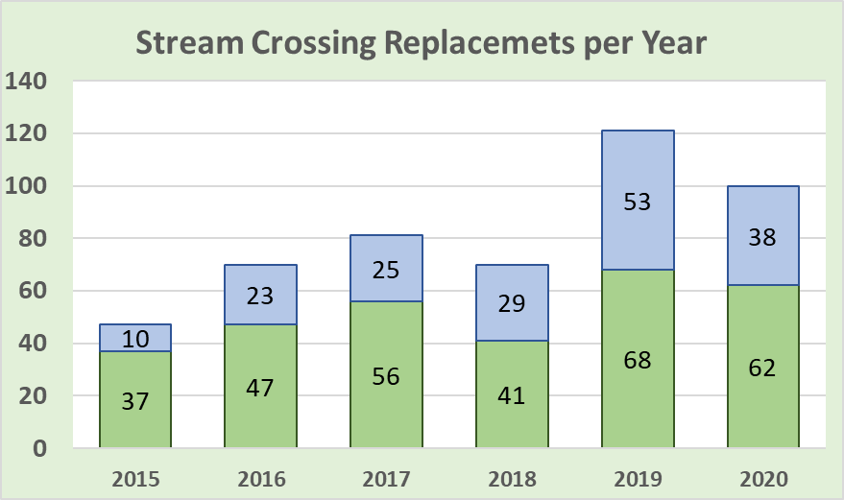
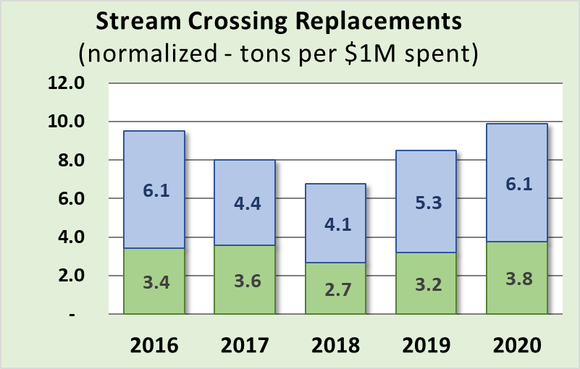
Annual Summary Report: Deliverables
Stream Crossing Replacements
Currently replacing ~100 per year
Fairly consistent 5-year trend
Improved data collected starting July 2019…
Dirt and Gravel
Paved Low-Volume
www.dirtandgravelroads.org

Slide 20
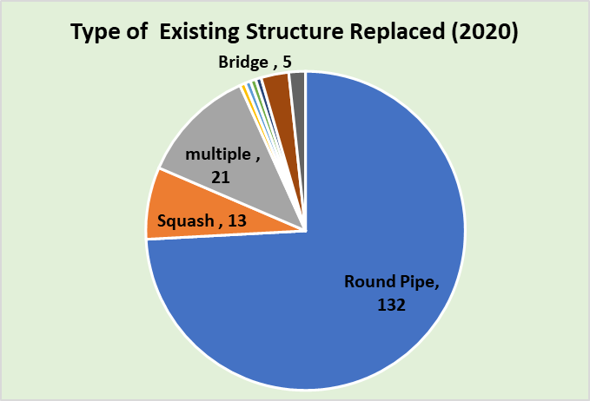
Annual Summary Report: Deliverables
Stream Crossing Replacements
178 replacements since July 2019
Old Structures: 75% were round pipes
www.dirtandgravelroads.org

Slide 21
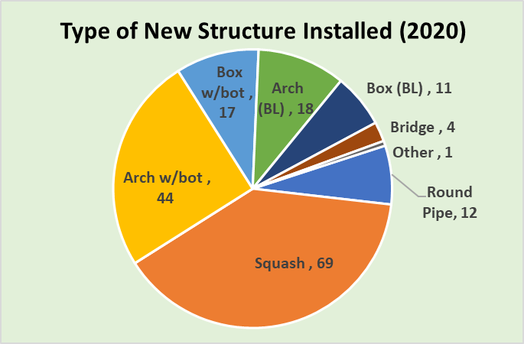
Annual Summary Report: Deliverables
Stream Crossing Replacements
178 replacements since July 2019
Old Structures: 75% were round pipes
New Structures:
Type
64% are squash or pipe arch (w/bottom)
18% are bottomless (arch/box/bridge)
www.dirtandgravelroads.org

Slide 22
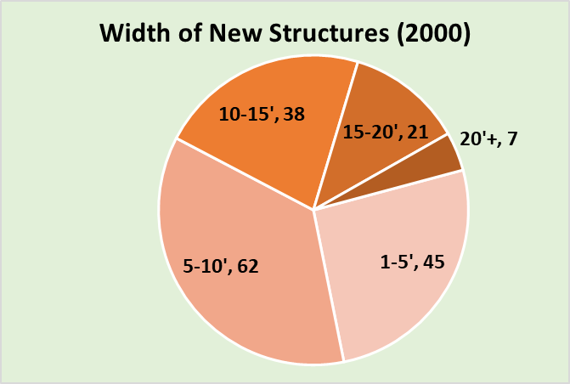
Annual Summary Report: Deliverables
Stream Crossing Replacements
178 replacements since July 2019
Old Structures: 75% were round pipes
New Structures:
Type
64% are squash or pipe arch (w/bottom)
18% are bottomless (arch/box/bridge)
Size:
62% are under <10’ width
Average new structure width is 9.5’
Average 112% of bankfull width
www.dirtandgravelroads.org

Slide 23
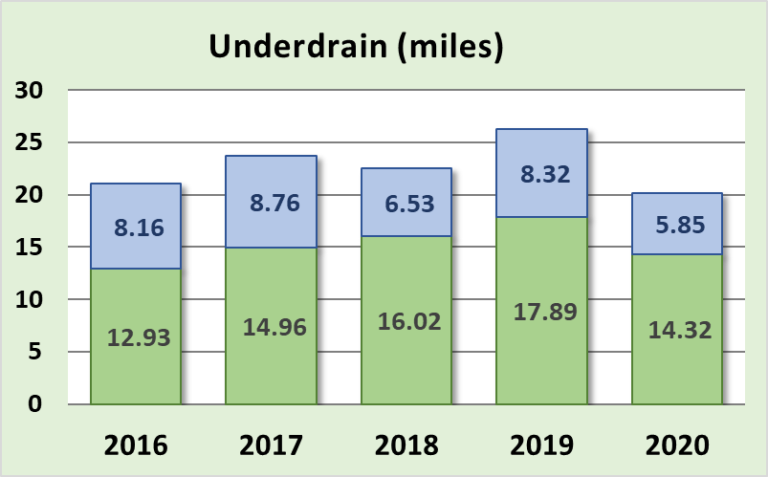
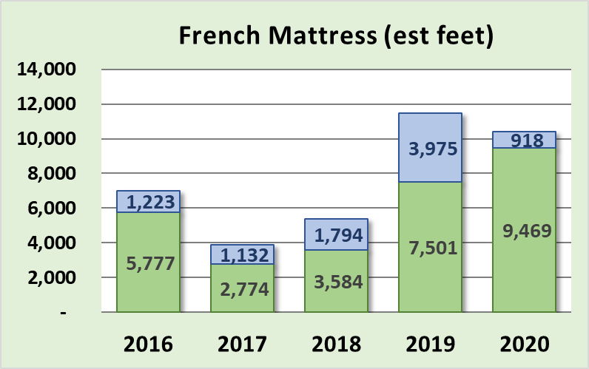
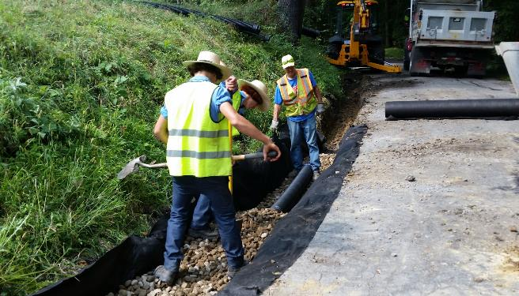
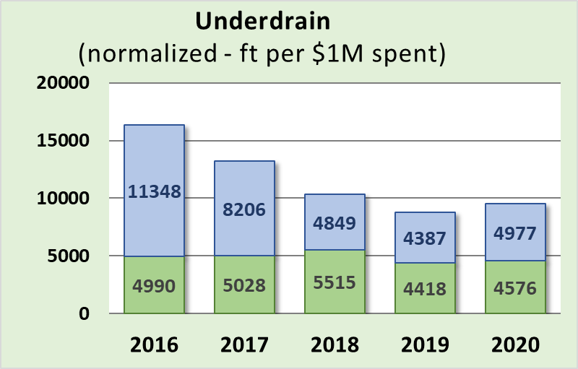
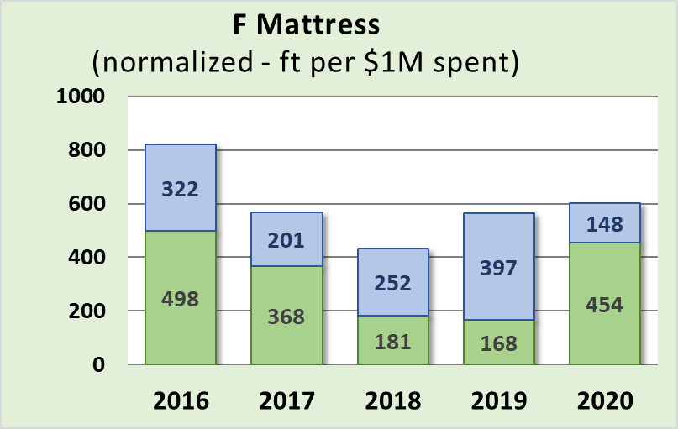
Annual Summary Report: Deliverables
Subsurface Drainage
Underdrains and French Mattresses used to address subsurface drainage
Underdrain use consistent on DnG roads, decreasing on LVR roads
French Mattress use steady or increasing
Dirt and Gravel
Paved Low-Volume
www.dirtandgravelroads.org

Slide 24
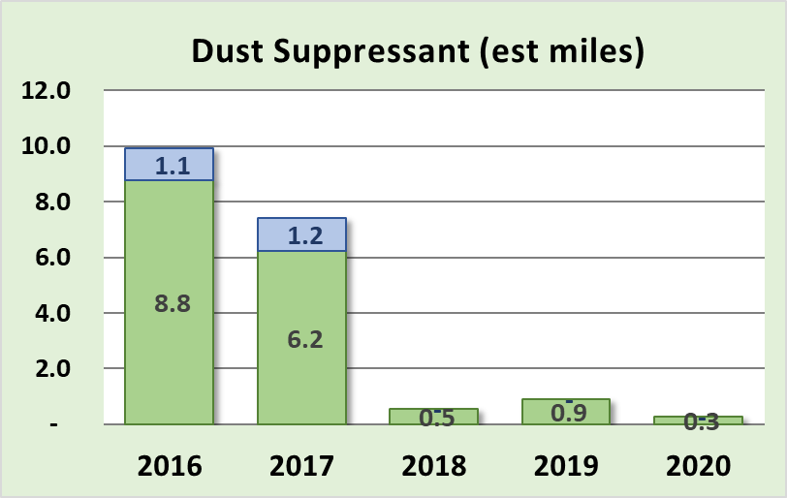
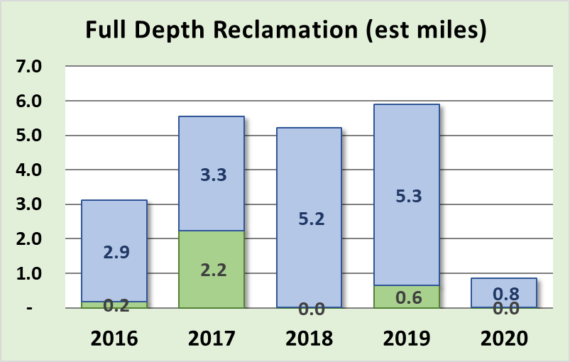
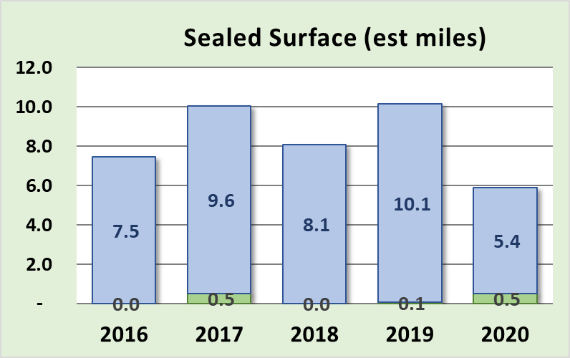
Annual Summary Report: Deliverables
Very Minor Players
Dust Suppressants: decreased to almost no use
Full Depth Reclamation: additional requirements in 2019 decreased use
Paving: most CDs only pay for what they disturb in fixing drainage. Note much of paving in graph below was in-kind.
Dirt and Gravel
Paved Low-Volume
www.dirtandgravelroads.org

Slide 25
Annual Summary Report: Deliverables
Overall Trends
Deliverables fairly consistent over last 5 years since funding increase
Continued focus on drainage improvements with fill & pipes the main tools
Decreasing in emphasis on Driving Surface Aggregate
Spending on Paving, Dust Suppressants, and F.D. Reclamation is very minor
More DGLVR funding going to stream crossings than in the past
www.dirtandgravelroads.org

Slide 26
Annual Summary Report: Deliverables
Where did these numbers come from, and can I do this for my county?
www.dirtandgravelroads.org

Slide 27
Annual Summary Report: Deliverables
Where did these numbers come from, and can I do this for my county?
Numbers came straight from GIS
YES, you can do the same thing and more for your county
Two 2019 Webinars recorded
March 7, 2019
March 21, 2019
CDGRS – education and training – webinars – past webinars
www.dirtandgravelroads.org

Slide 28
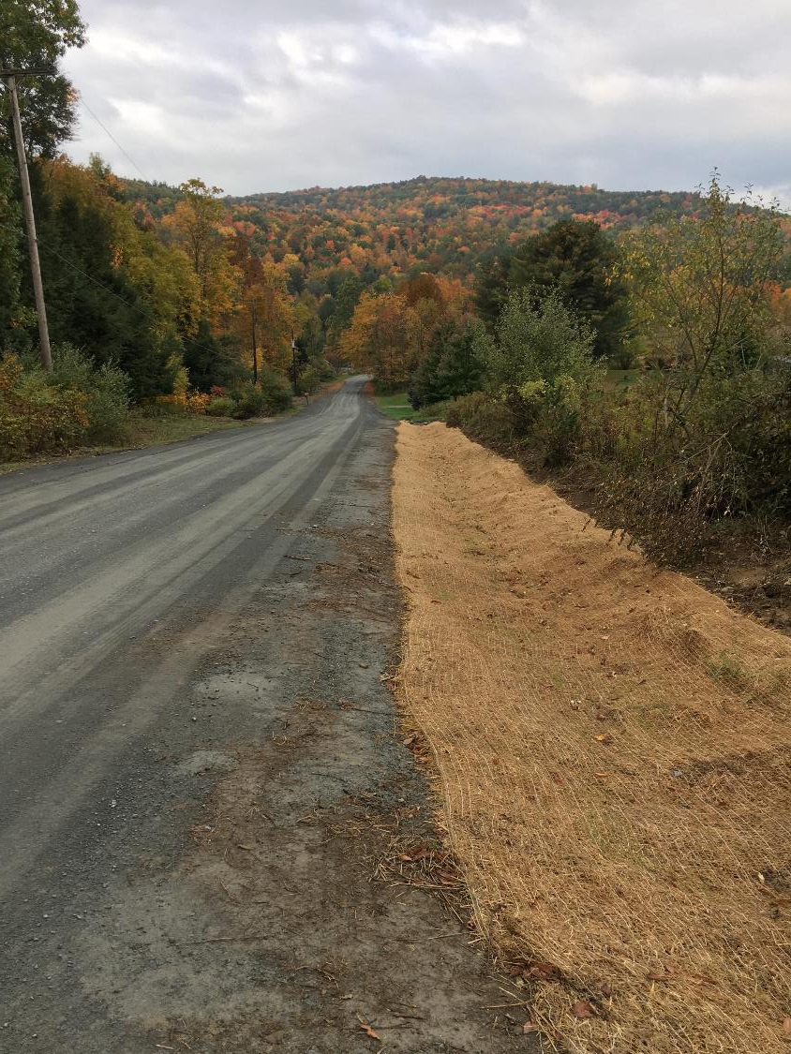
2020 Annual Summary Report
Annual Report: Financial
Annual Report: Deliverables
CD Financial Status
Allocation Eligibility

Slide 29
Annual Summary Report: CD Financial Status
Reminders / Overview
Currently in FY 2020-21, year 3 of 5-year agreement between SCC and CDs
CDs have two years to spend funding
Allocations to CDs
$ 26.1 Million Annually
$ 78.3 through first 3 years of this agreement
At least 80% required to go to projects, approx. ~90% does
CDs get ½ their allocation up front, other ½ remains in Hbg for replenishment
www.dirtandgravelroads.org

Slide 30
Annual Summary Report: CD Financial Status
Data as of 3/4/2021
Of the 78.3 million allocated under current 5-year agreement:
$2.8M remaining in Hbg (10% of one annual allocation)
+ $33.4M remaining in CD Local Accounts (128% of one annual allocation)
$36.2M remaining funds (CD&Hbg)(138% of one annual allocation)
- $21.0M committed but not paid to current contracts (80% of one annual allocation)
$15.2M uncommitted funds (58% of one annual allocation)
www.dirtandgravelroads.org

Slide 31
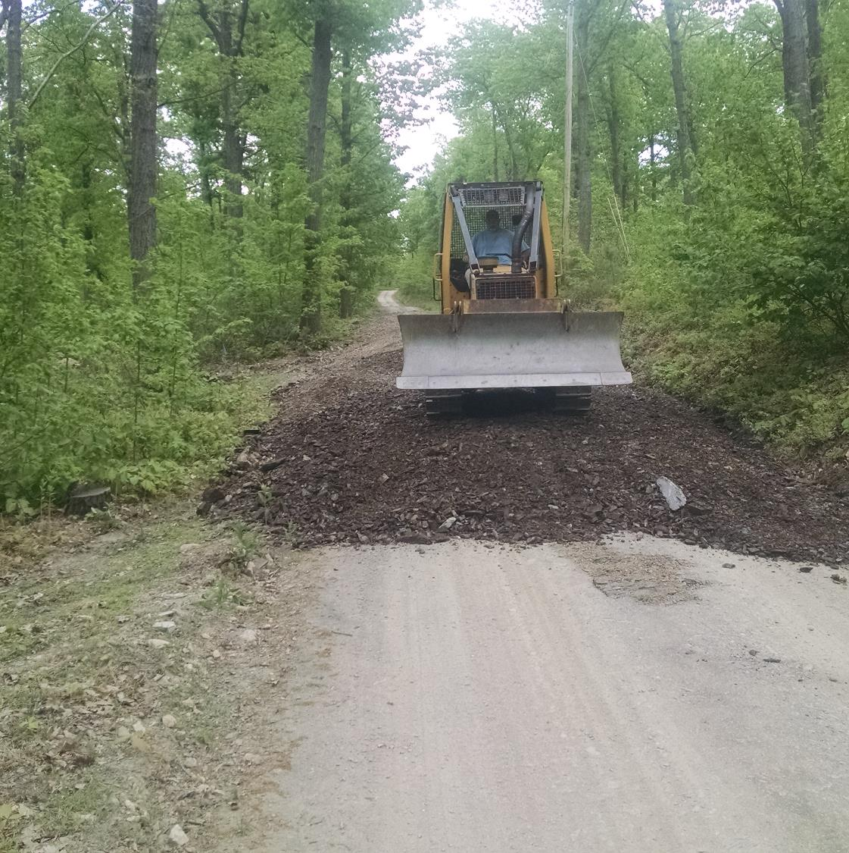
2020 Annual Summary Report
Annual Report: Financial
Annual Report: Deliverables
CD Financial Status
Allocation Eligibility

Slide 32
Annual Summary Report: Allocation Eligibility
Reminders / Overview
CDs have two years to spend funding
Otherwise not eligible for future allocations
Allocations from ineligible CDs distributed to other CDs
LVR and DGR calculated separately
Allocations can resume in future FYs once spending requirements are met
Data as of 3/4/2021
www.dirtandgravelroads.org

Slide 33
Annual Summary Report: Allocation Eligibility
Data as of 3/4/2021
Current Allocation Eligibility Status
DGR Green: requirements already met, OK for FY 2021-22 DGR Allocations
60 Counties
DGR Red: requirements not yet met
6 Counties
LVR Green: requirements already met, OK for FY 2021-22 LVR Allocations
59 Counties
LVR Red: requirements not yet met
7 Counties
CDs have until April 16th to meet spending deadlines
This allows allocations to be taken to SCC at May Meeting
www.dirtandgravelroads.org

Slide 34
Let’s zoom out some more and look at the BIG BIG BIG picture…

Slide 35
Annual Summary Report: Big Big Big Picture
Data as of 3/4/2021
Overall Program Lifetime Spending Summary (Since 1997)
$243M Total Allocated to CDs ($60M before 2014 funding increase, $182M since)
www.dirtandgravelroads.org

Slide 36
Annual Summary Report: Big Big Big Picture
Data as of 3/4/2021
Overall Program Lifetime Spending Summary (Since 1997)
$243M Total Allocated to CDs ($60M before 2014 funding increase, $182M since)
$177M Spent on 5,870 Completed Projects
$16M Spent on Administration at CDs
$6M Spent on Education at CDs
$30M contracted (423) with $9M of that $30M spent
$229M of funding spent ($208M) and Committed ($21M)
Plus $73M total in-kind!
This means Program has put 115%+ of funds allocated to CDs on the ground to date.
www.dirtandgravelroads.org

Slide 37
Annual Summary Report: Big Big Big Picture
Data as of 3/4/2021
Overall Program Lifetime Spending Summary (Since 1997)
$243M Total Allocated to CDs ($60M before 2014 funding increase, $182M since)
$177M Spent on 5,870 Completed Projects
$16M Spent on Administration at CDs
$6M Spent on Education at CDs
$30M contracted (423) with $9M of that $30M spent
$229M of funding spent ($208M) and Committed ($21M)
Only $15M, or about ½ a year’s allocation, currently uncommitted
With $208M spent, and a “cumulative statewide spending requirement” of $190M: Statewide, spending is currently $18M “in the green”
Plus $73M total in-kind!
This means Program has put 115%+ of funds allocated to CDs on the ground to date.
www.dirtandgravelroads.org

Slide 38
Annual Summary Report: Big Big Big Picture
Thank you
PA Conservation Districts
Adapting to funding increase and changing policies and reporting requirements
Administering efficient programs
Meeting spending deadlines
Submitting timely reports
Putting good projects on the ground
www.dirtandgravelroads.org

