Slide 1
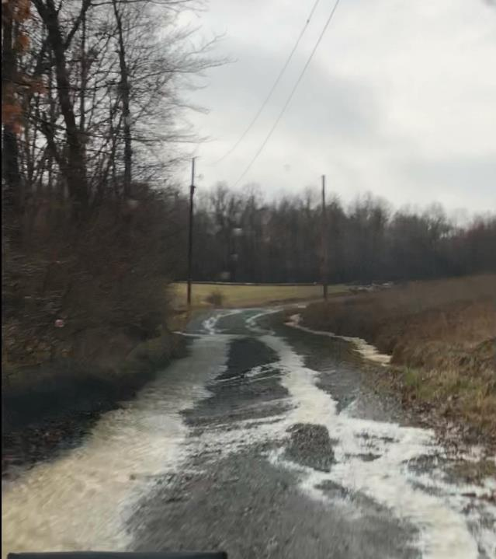
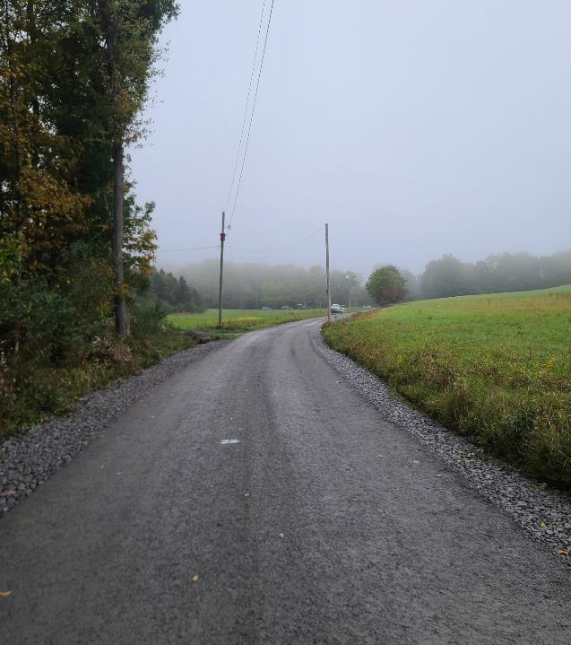
Dirt Gravel and Low Volume Road Program
WEBINAR
3/6/25, 9am
2024 Annual Summary Report
CDGRS
Steve Bloser
smb201@psu.edu
Photos: Clearfield CD
If you are reading this, then you are successfully seeing the webinar video. Webinar audio should be automatic through your computer (or click “join audio”), and options can be accessed in the “audio options” button on the bottom left. If your computer audio is not working, you can listen on your phone by dialing 646-876-9923.

Slide 2
Program Funding
Transit funding discussions occurring in Harrisburg
Includes discussion on “multi-modal” transportation funding.
CDGRS/SCC/PACD ensuring DGLVR is part of the discussion.
Status:
Various budget hearings held last few weeks.
“Keystone Transportation Funding Coalition” meeting late March.
Will keep you posted if things look like they might move.

Slide 3
Dirt Gravel and Low Volume Road Program
WEBINAR
3/6/25, 9am
2024 Annual Summary Report
CDGRS
Steve Bloser
smb201@psu.edu
Photos: Clearfield CD
If you are reading this, then you are successfully seeing the webinar video. Webinar audio should be automatic through your computer (or click “join audio”), and options can be accessed in the “audio options” button on the bottom left. If your computer audio is not working, you can listen on your phone by dialing 646-876-9923.

Slide 4
Purpose
Summarize 2024 Program Status
Overvieww of “Big Picture” Program spending and deliverables
All data based on CD reports in GIS as of 12/31/24

Slide 5
Purpose
Note this will be a short presentations this year.
2024 was “business as usual”, which isn’t a bad thing after COVID (it just makes for a boring update!)
All data based on CD reports in GIS as of 12/31/24

Slide 6
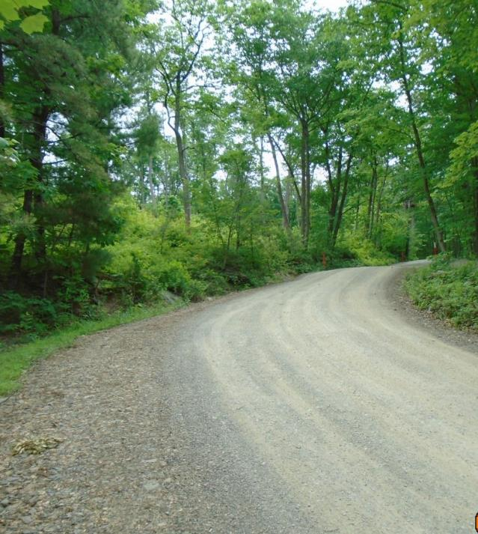
2024 Annual Summary Report
Annual Report: Financial
Annual Report: Deliverables
Getting data for your CD

Slide 7
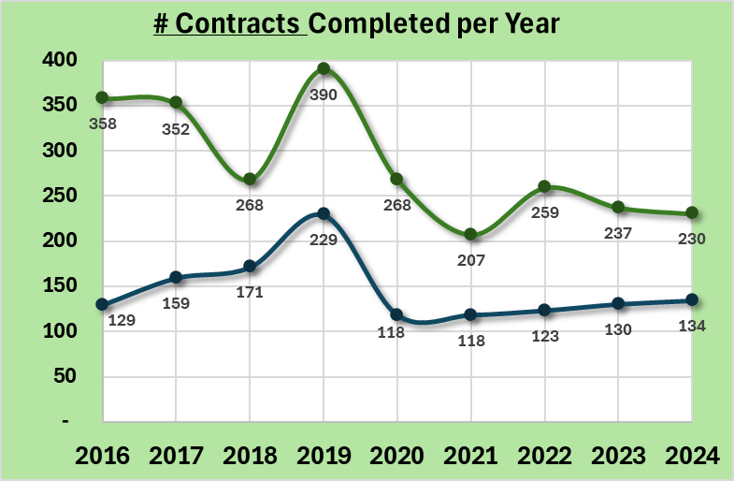
Annual Summary Report: Financial
2024 was “business as usual”
364 contracts complete (230 DG, 134 LV)
Dirt and Gravel
Paved Low-Volume
ASR data as of 12/31/2024

Slide 8
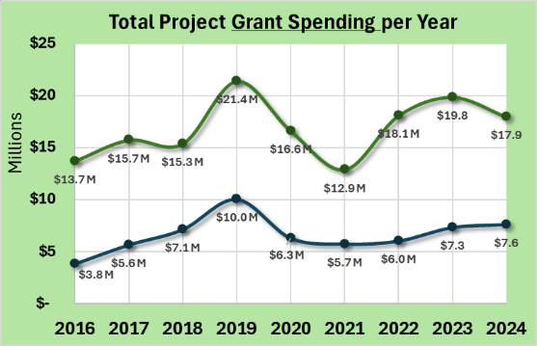
Annual Summary Report: Financial
2024 was “business as usual”
364 contracts complete (230 DG, 134 LV)
$25.5M spent ($17.9M DG, $7.6M LV)
Dirt and Gravel
Paved Low-Volume
Dirt and Gravel
Paved Low-Volume
ASR data as of 12/31/2024
www.dirtandgravelroads.org

Slide 9
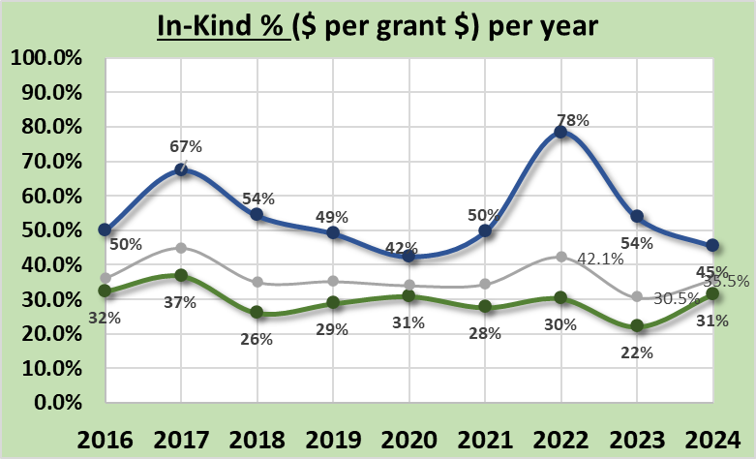
Annual Summary Report: Financial
2024 was “business as usual”
364 contracts complete (230 DG, 134 LV)
$25.5M spent ($17.9M DG, $7.6M LV)
36% In-kind ($9M in 2024)
Dirt and Gravel
Paved Low-Volume
Dirt and Gravel
Paved Low-Volume
DGLVR Total
Paved Low-Volume
Dirt and Gravel
ASR data as of 12/31/2024
www.dirtandgravelroads.org

Slide 10
Annual Summary Report: Financial
2024 was “business as usual”
364 contracts complete (230 DG, 134 LV)
$25.5M spent ($17.9M DG, $7.6M LV)
36% In-kind ($9M in 2024)
Program Lifetime
Surpassed $250M in completed grants ($271M)
Surpassed $100M of in-kind contributions ($108M)
(Majority of that in the last 10 years)
ASR data as of 12/31/2024

Slide 11
Annual Summary Report: Financial
Other financial Notes
Currently under contract: 320 contracts for $31.3M ($11.1M spent)

Slide 12
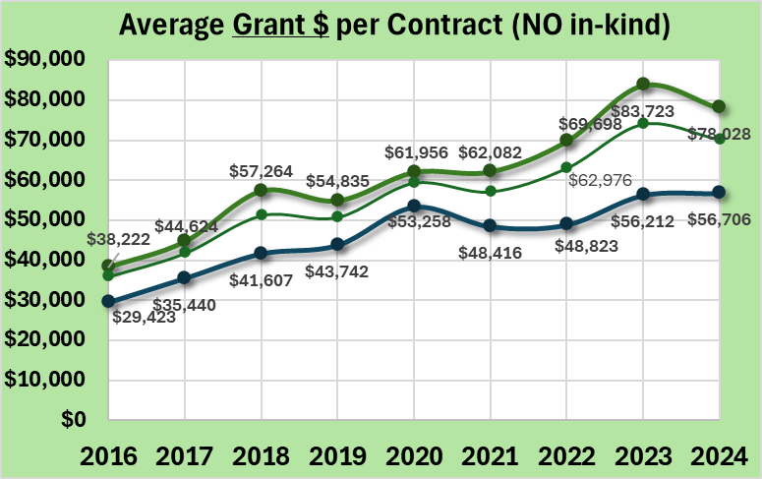
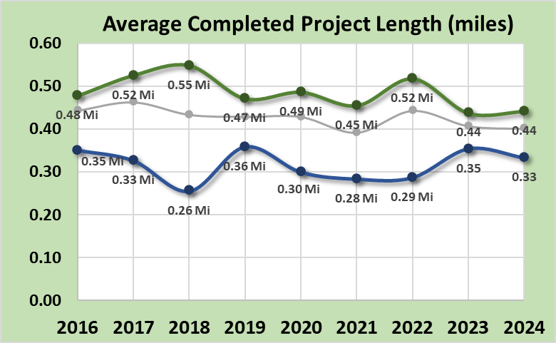
Annual Summary Report: Financial
Other financial Notes
Currently under contract: 320 contracts for $31.3M ($11.1M spent)
Average project in 2024: $70K grant + $25K in-kind, 2,100 feet in length
Dirt and Gravel
Dirt and Gravel
Paved Low-Volume
Paved Low-Volume
ASR data as of 12/31/2024
www.dirtandgravelroads.org

Slide 13
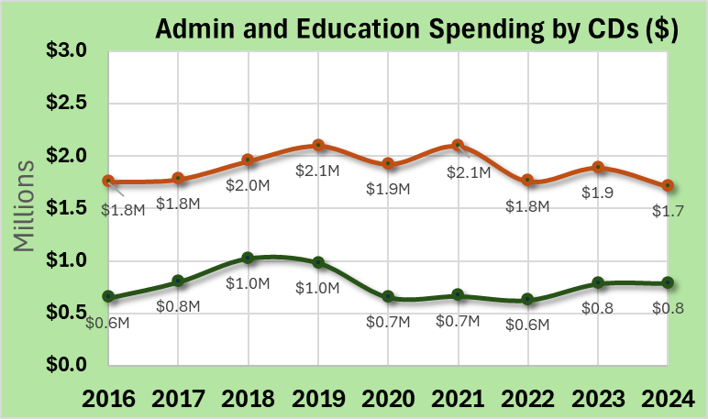
Annual Summary Report: Financial
Other financial Notes
Currently under contract: 320 contracts for $31.3M ($11.1M spent)
Average project in 2024: $70K grant + $25K in-kind, 2,100 feet in length
CD Admin/Edu Spending: steady at ~7% admin and ~3% edu ($2.5M in 2024)
CD Administration
CD Administration
CD Education
CD Education

Slide 14
2024 Annual Summary Report
Annual Report: Financial
Annual Report: Deliverables
Getting data for your CD

Slide 15
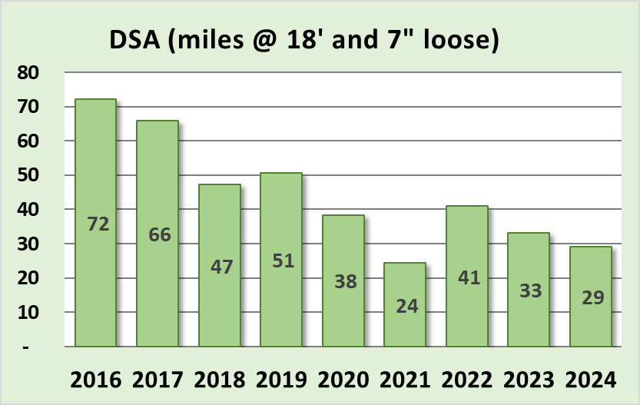
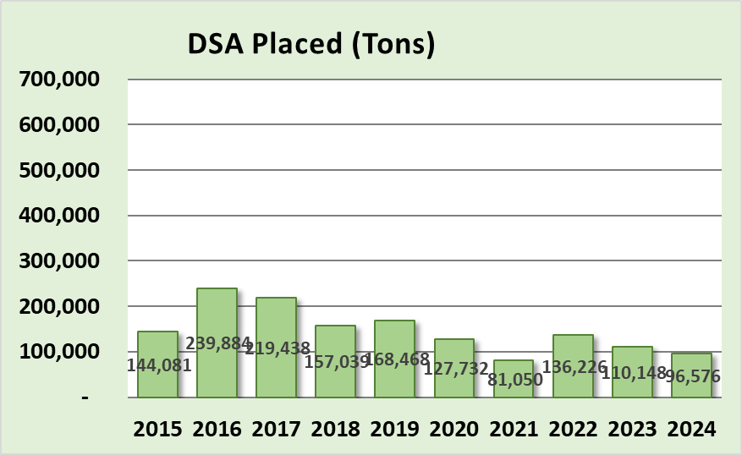
Annual Summary Report: Deliverables
Driving Surface Aggregate
29 miles in 2024, slowly declining (cost)
96,000 tons placed in 2024
ASR data as of 12/31/2024
www.dirtandgravelroads.org

Slide 16
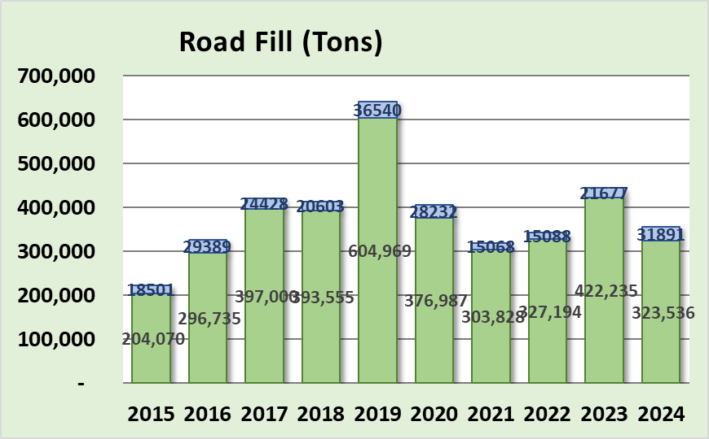
Annual Summary Report: Deliverables
Driving Surface Aggregate
29 miles in 2024, slowly declining (cost)
96,000 tons placed in 2024
Road Fill
Steady: 355,000 tons placed in 2024
ASR data as of 12/31/2024
Paved Low-Volume
Dirt and Gravel
www.dirtandgravelroads.org

Slide 17
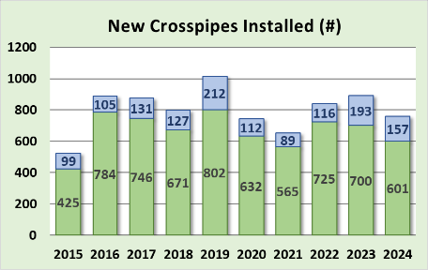
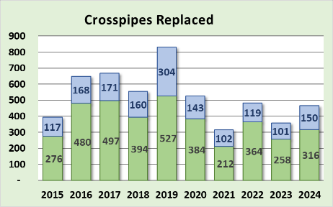
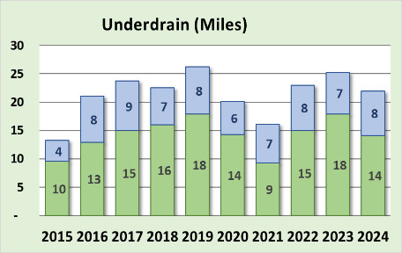
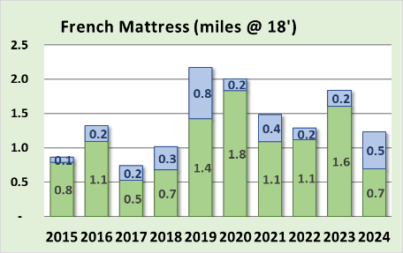
Annual Summary Report: Deliverables
Paved Low-Volume
Other Deliverable Notes”
Most major deliverables “holding steady”
2024
758 new pipes
466 pipes replaced
22 mi underdrain
6,300’ mattress
Dirt and Gravel
ASR data as of 12/31/2024
www.dirtandgravelroads.org

Slide 18
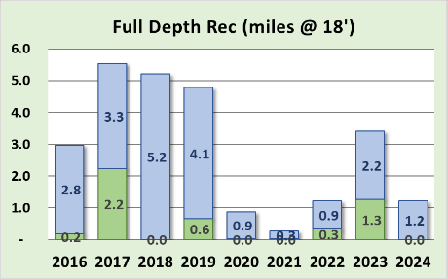
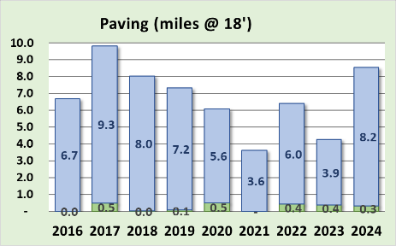
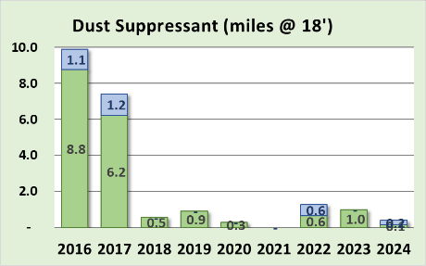
Annual Summary Report: Deliverables
Other Deliverable Notes”
What the Program doesn’t fund much of:
FDR (1 mile)
Paving (8 miles)
Dust suppressant (negligible)
Note these totals
include in-kind
Paved Low-Volume
Dirt and Gravel
ASR data as of 12/31/2024
www.dirtandgravelroads.org

Slide 19
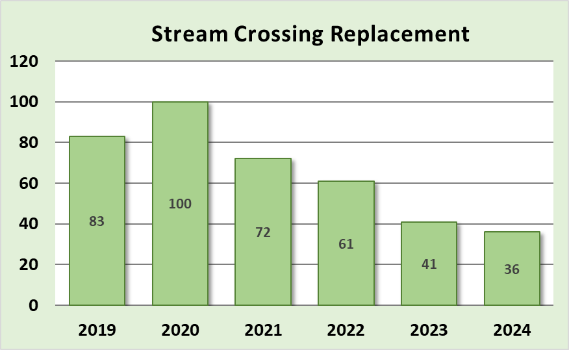
Annual Summary Report: Deliverables
Stream Crossing Replacements
Decreased since Standard in 2022
36 Completed in 2024
All but four were exemptions or pre-standard
ASR data as of 12/31/2024
www.dirtandgravelroads.org

Slide 20
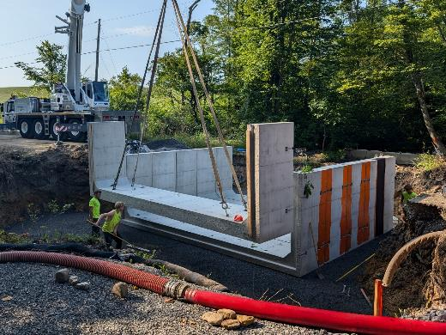
Annual Summary Report: Deliverables
Stream Crossing Replacements
Decreased since Standard in 2022
36 Completed in 2024
All but four were exemptions or pre-standard
Structures Removed in 2024
19 round, 11 multiple, 6 misc.
Average 5’ opening
Structures installed in 2024
12 bottomless, 11 squash, 9 box or arch, 4 bridge
Average 15’ opening
ASR data as of 12/31/2024
www.dirtandgravelroads.org

Slide 21
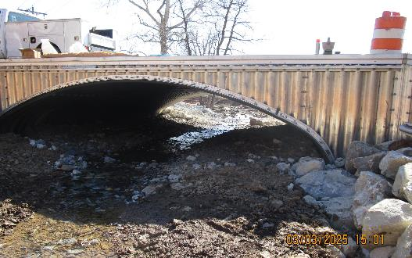
Annual Summary Report: Deliverables
Stream Crossing Standard
4 completed to Standard in 2024
25 under contract to the standard
10 expected to be complete to standard in 2025
Many exemptions and a few pre-standard contracts expected in 2025 as well
Just completed to standard in Adams
1/9/25 recorded webinar
ASR data as of 12/31/2024
www.dirtandgravelroads.org

Slide 22
2024 Annual Summary Report
Annual Report: Financial
Annual Report: Deliverables
Getting data for your CD

Slide 23
Annual Summary Report: Deliverables
Where did these numbers come from, and can I do this for my county?
Numbers came straight from GIS
YES, you can do the same thing and more for your county
Two 2019 Webinars recorded
March 7, 2019
March 21, 2019
CDGRS – education and training – webinars – past webinars
www.dirtandgravelroads.org

Slide 24
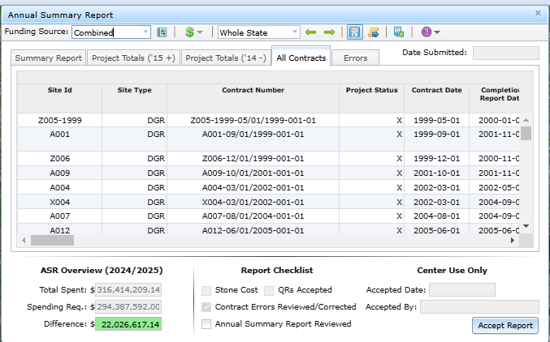
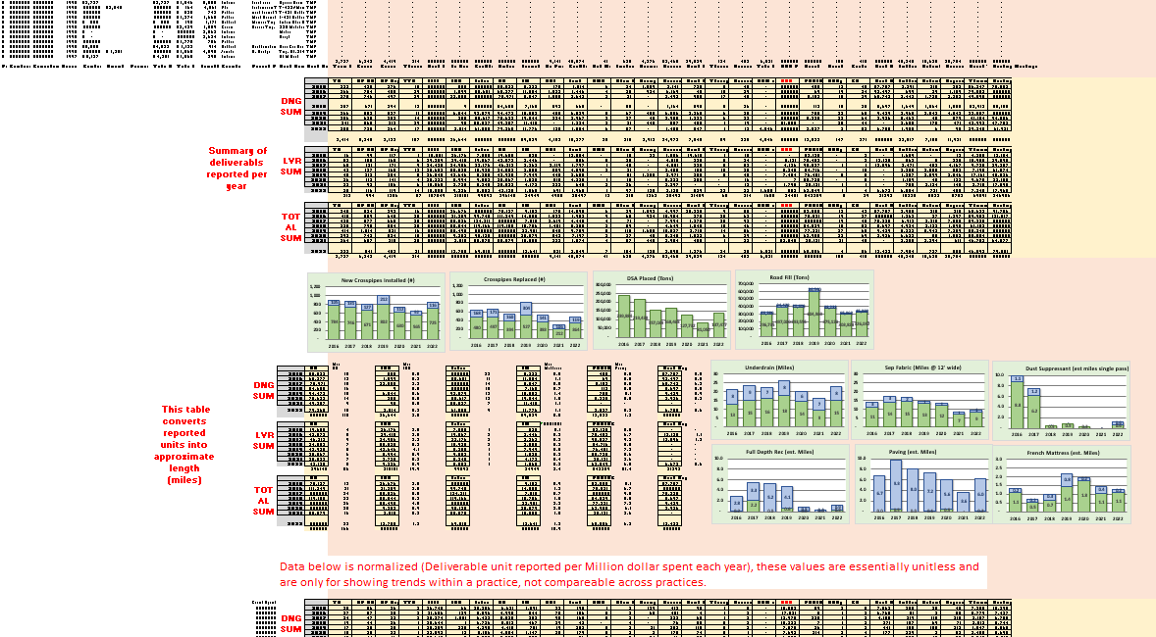
Annual Summary Report: Deliverables
Where did these numbers come from, and can I do this for my county?
Export Results
www.dirtandgravelroads.org

Slide 25
Annual Summary Report: Deliverables
Thanks for Joining
Stay tuned for a ~10-minute demo on collecting and analyzing data for your county if you would like.
www.dirtandgravelroads.org

