Slide 1
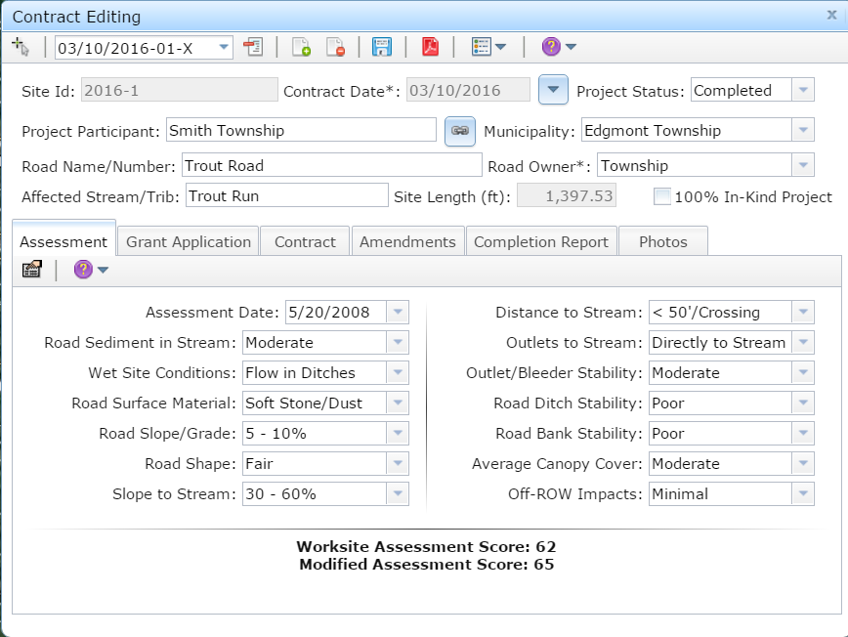
Worksite Assessment
Overview
Toggle Fullscreen
mode with this button above
1/31/2017
Starts at 9am
Use Chat box to ask Questions
If you are reading this, then you are successfully seeing the webinar video. In addition to audio on the webinar, we have opened a phone conference line to allow attendees to listen and ask questions directly: 866-823-7699. Please use either the webinar audio or conference line, but not both (will produce feedback).
Audio also available via phone: 866-823-7699
For assistance, call: 814-865-5355

Slide 2
Toggle Fullscreen
mode with this button
above
Participant phone lines will be muted until after initial presentation
Use Chat box to ask Questions
http://metrocount.com
Audio also available via phone: 866-823-7699
For assistance, call: 814-865-5355

Slide 3
DGLVR
Worksite Assessments
Purpose:
Provide background, overview, and additional reference material on worksite assessments.
Many new faces in the CD and DGLVR world never had any Assessment training.
Where did my potential sites come from?
What is this “dirty dozen” evaluation?
Is there any reference material for it?
Should I be using it?
Audio also available via phone: 866-823-7699
For assistance, call: 814-865-5355

Slide 4
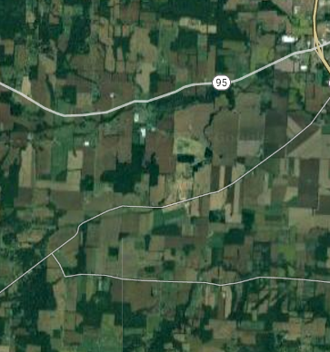
DGLVR
Worksite Assessments
Background
Process Overview
Current Use
Assessment and LVRs

Slide 5
Worksite Assessments
Background
What is a “Worksite Assessment”
Identification of segment of road contributing to stream pollution
Evaluation of that segment using established criteria
Audio also available via phone: 866-823-7699
For assistance, call: 814-865-5355

Slide 6
Worksite Assessments
Background
WORKSITE: An identified segment of unpaved road
where runoff is affecting a stream.
ROAD
BRIDGE
Ditches drain to stream
Culvert
1
4
2
FIELD
3
FOREST
STREAM
Audio also available via phone: 866-823-7699
For assistance, call: 814-865-5355

Slide 7
Worksite Assessments
Background
ASSESSMENT: Process of inspecting an unpaved road
to determine where runoff is affecting a stream.
Turning NON-POINT SOURCE
pollution into…
55
28
POINT SOURCES
And providing quantification of pollution potential!
WORKSITES!
72

Slide 8
Worksite Assessments
Background
HISTORY
1997 TU Assmt in HQ/EV (900 sites)
2000 CD Assmt Statewide (12,000 sites)
2008 CD Assmt Statewide (16,000 sites)

Slide 9
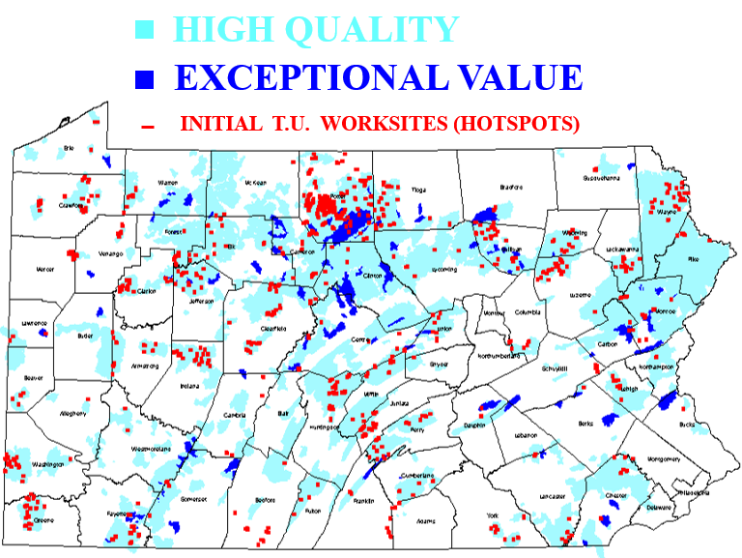
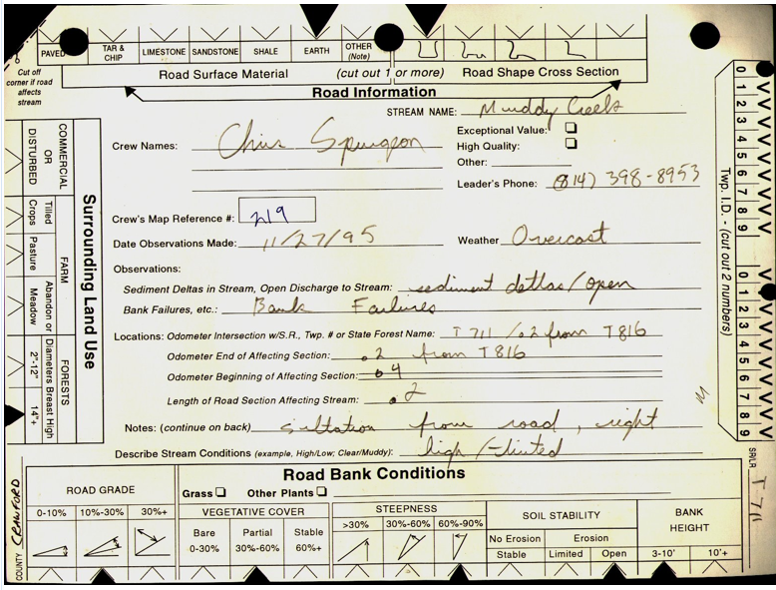
Worksite Assessments
Background
HISTORY
1997 TU Assmt in HQ/EV (900 sites)
2000 CD Assmt Statewide (12,000 sites)
2008 CD Assmt Statewide (16,000 sites)
1996-1998 TU Volunteer Assessment
Protected Watersheds only
900 worksites statewide
900 sites
Audio also available via phone: 866-823-7699
For assistance, call: 814-865-5355

Slide 10
Worksite Assessments
Background
HISTORY
1997 TU Assmt in HQ/EV (900 sites)
2000 CD Assmt Statewide (12,000 sites)
2008 CD Assmt Statewide (16,000 sites)
1996-1998 TU Volunteer Assessment
Established “verified need” for Program, and justified funding.
Were only sites funded in first few years.
More extensive assessment needed.
900 sites

Slide 11
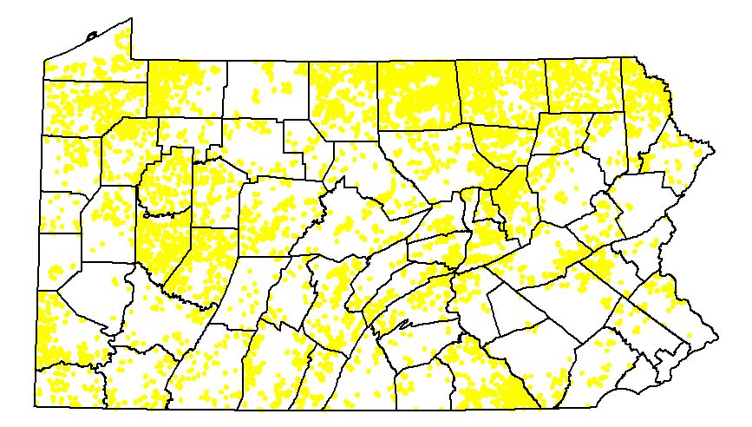
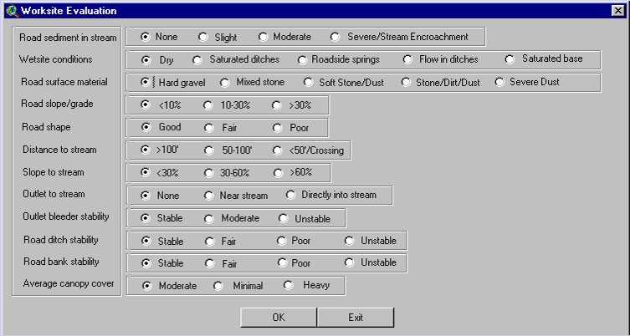
Worksite Assessments
Background
HISTORY
1997 TU Assmt in HQ/EV (900 sites)
2000 CD Assmt Statewide (12,000 sites)
2008 CD Assmt Statewide (16,000 sites)
2000 CD Statewide Assessment
Used first version of GIS, introduced “dirty dozen”.
Had to ask twps. where unpaved roads were!
ALL watersheds assessed.
~12,000 sites identified and assessed
12,000 sites

Slide 12
Worksite Assessments
Background
HISTORY
1997 TU Assmt in HQ/EV (900 sites)
2000 CD Assmt Statewide (12,000 sites)
2008 CD Assmt Statewide (16,000 sites)
2000 CD Statewide Assessment
12,000 sites formed basis of projects for Program.
Formed basis for CD allocations.
By 2006-2007, some CDs requesting opportunity to re-assess.
12,000 sites

Slide 13
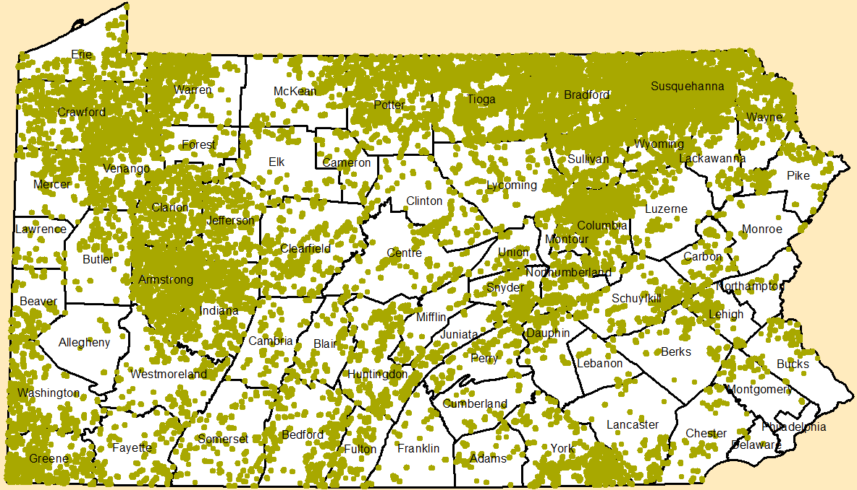
Worksite Assessments
Background
HISTORY
1997 TU Assmt in HQ/EV (900 sites)
2000 CD Assmt Statewide (12,000 sites)
2008 CD Assmt Statewide (16,000 sites)
2007-08 CD Statewide Assessment
Voluntary assessment period.
Increased to 16,000 worksites.
The basis for those yellow sites you see in GIS today!
16,000 sites

Slide 14
DGLVR
Worksite Assessments
Background
Process Overview
Current Use
Assessment and LVRs

Slide 15
Worksite Assessments
Process Overview
Once you have identified a “worksite”...
…You need criteria to evaluate it
Audio also available via phone: 866-823-7699
For assistance, call: 814-865-5355

Slide 16
Worksite Assessments
Process Overview
The “Dirty Dozen”
- 12 factors – evaluate “pollution potential”
- Assigns score from 0 (no impact) to 100 (worst impact)
Audio also available via phone: 866-823-7699
For assistance, call: 814-865-5355

Slide 17
Worksite Assessments
Process Overview
The “Dirty Dozen”
In field trainings held in 2008.
Assessment Scores are NO LONGER part of allocation formulas.
Purpose here is just to familiarize you and show you where to go for more info.
Audio also available via phone: 866-823-7699
For assistance, call: 814-865-5355

Slide 18
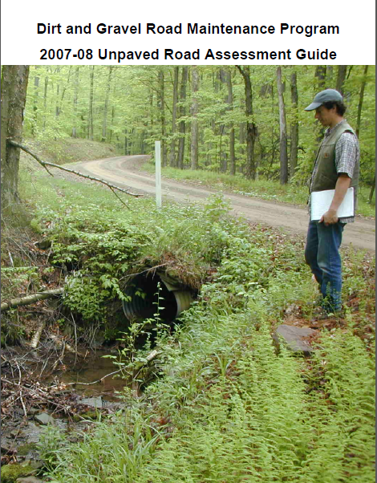
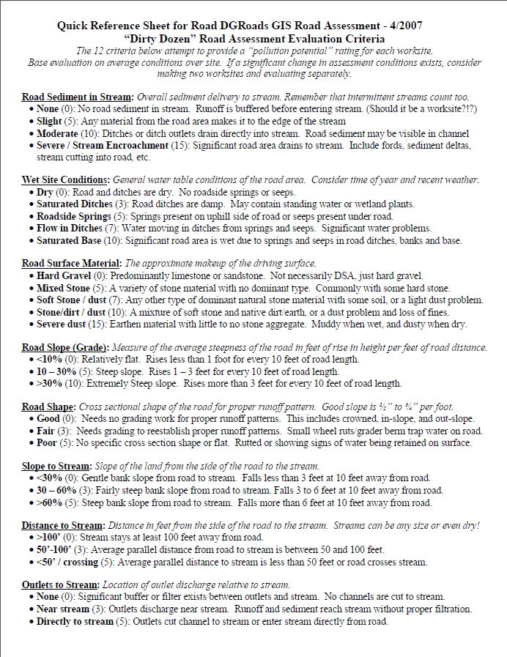
Worksite Assessments
Process Overview
The “Dirty Dozen” Resources:
FIELD GUIDE 2-page QUICK REFERENCE

Slide 19
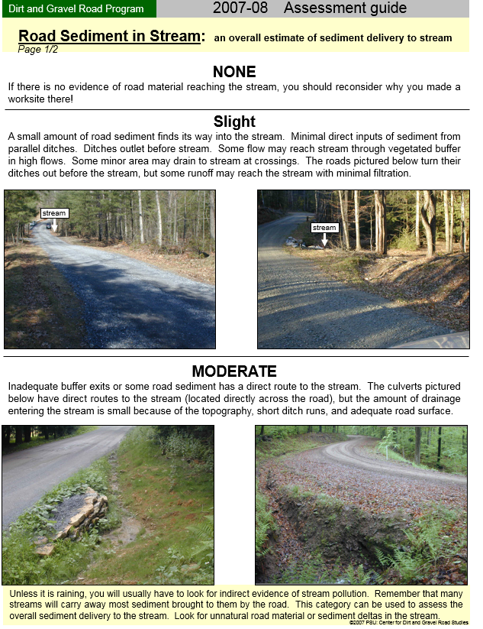
Worksite Assessments
Process Overview
Example Factor:
Road Sediment
in Stream
Assessment Manual
Quick Reference
Guide

Slide 20
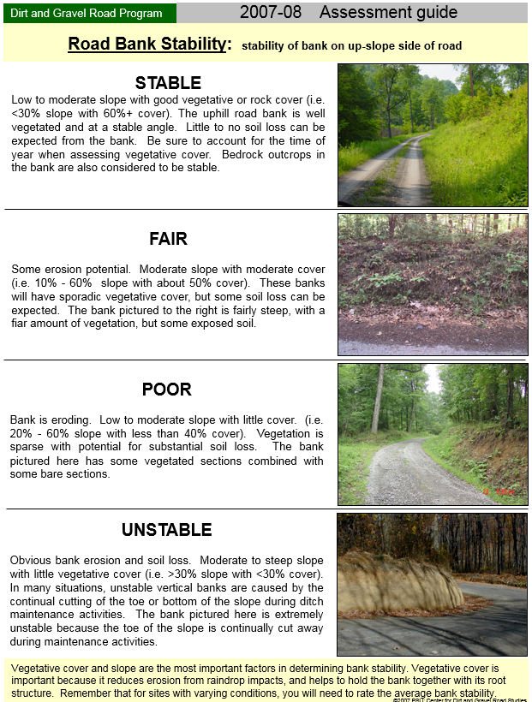
Worksite Assessments
Process Overview
Example Factor:
Road Bank
Stability
Assessment Manual
Quick Reference
Guide

Slide 21
Worksite Assessments
Process Overview
The “Dirty Dozen” Resources:
FIELD GUIDE 2-page QUICK REFERENCE
Documentation Online:
www.dirtandgravelroads.org
PA Program Resources
Program Resources
Blank Forms – scroll to bottom

Slide 22
DGLVR
Worksite Assessments
Background
Process Overview
Current Use
Assessment and LVRs

Slide 23
Worksite Assessments
Current Use
Assessments
No current plan for another statewide assessment.
Assessment scores NO LONGER a factor in CD Allocations.
Assessment are not required (but many CDs use it in their ranking criteria)
Audio also available via phone: 866-823-7699
For assistance, call: 814-865-5355

Slide 24
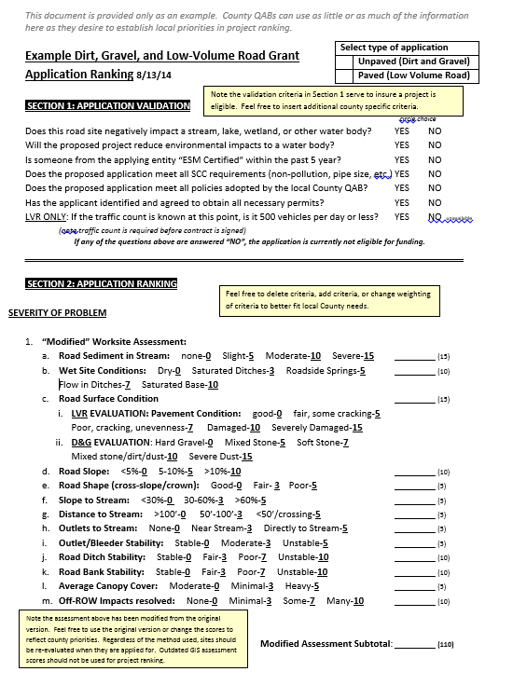
Worksite Assessments
Current Use
Assessments
~75% of sites have existing assessment, most are 8-16 years old.
Most CDs use “Dirty Dozen” in ranking criteria.
If you use assessment score in ranking, you should re-evaluate instead of relying on 8 to 16 year old data
Audio also available via phone: 866-823-7699
For assistance, call: 814-865-5355

Slide 25
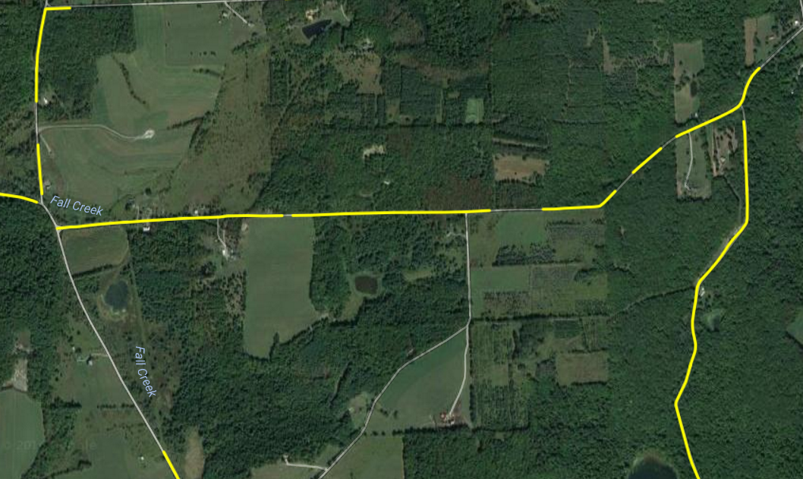
Worksite Assessments
Current Use
Assessments
CDs can add and assess potential sites to GIS at any time. Please notify CDGRS/SCC if you plan to do any kind of significant assessment effort.
Old potential sites can be combined, moved, lengthened, or deleted in GIS as necessary.
5 sites
1 site
Audio also available via phone: 866-823-7699
For assistance, call: 814-865-5355

Slide 26
DGLVR
Worksite Assessments
Background
Process Overview
Current Use
Assessment and LVRs

Slide 27
Worksite Assessments
Assessments and LVRs
With exception of “road surface condition” LVR and D&G Assessments are identical:

Slide 28
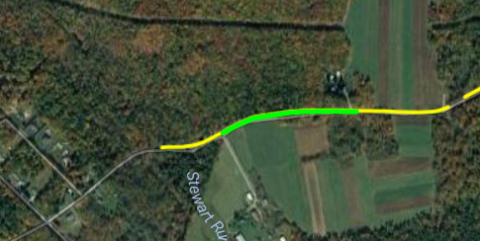
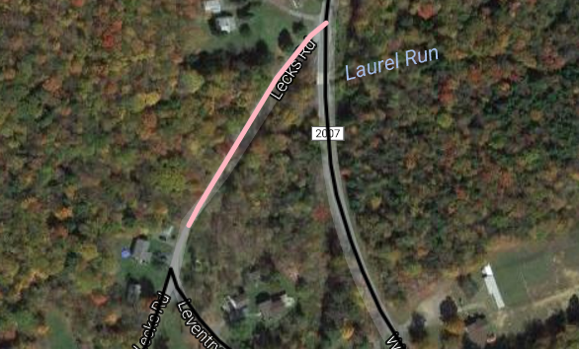
Worksite Assessments
Assessments and LVRs
Did you notice in GIS?
Unpaved worksites need a “potential” site first.
LVR worksites don’t have “potential” sites, they are made directly on LVRs.
Because there is no historical “assessment” of LVRs.

Slide 29
Worksite Assessments
Assessments and LVRs
There is no current or planned LVR Statewide Assessment
WHY NOT?
No comprehensive statewide traffic count exists to tell us which roads are Low Volume.
That leaves ~60,000+ miles of potential LVRs.
Estimated 4-5 person-years to complete assessment, not including doing traffic counts!
Create LVR worksites for new contracts. Assessment is needed if it is part of your ranking criteria.

Slide 30
Worksite Assessments
Process Overview
Questions?

