Slide 1
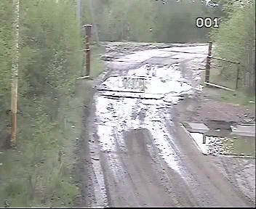
DGLVR Webinar
CD Spending and 5-year agreement update
3/28/2019
Starts at 9am
If you are reading this, then you are successfully seeing the webinar video. Webinar audio should be automatic through your computer, and options can be accessed in the “audio options” button on the bottom left. If you are having audio issues, or are in a location where listening via phone is preferable, audio is also available on the CDGRS conference line at: 866-823-7699
For technical assistance, call: 814-865-5355

Slide 2
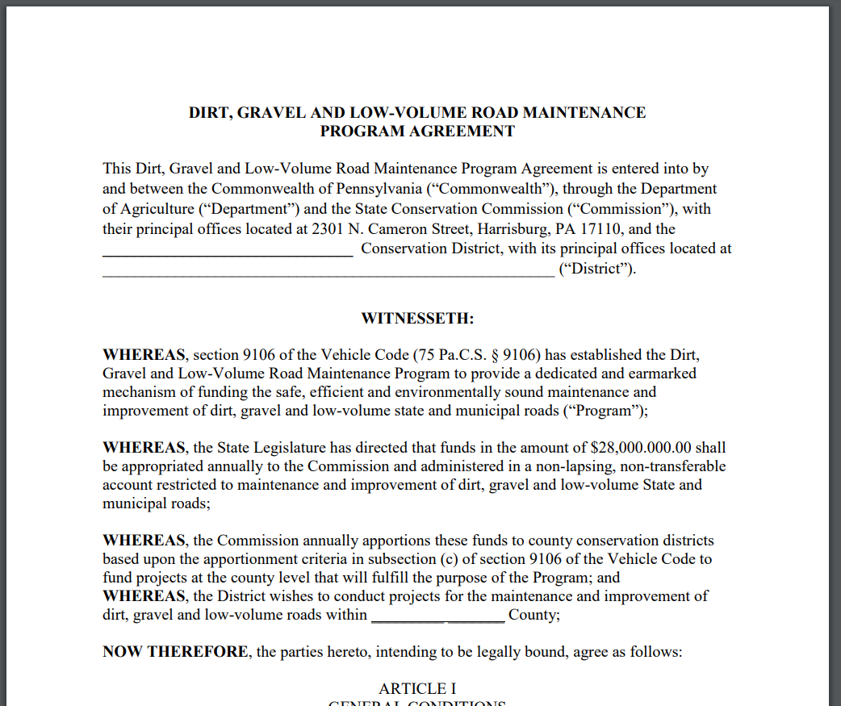
DGLVR Program
CD Spending and 5-Year Agreement
Background
DGLVR Program provides funding to conservation districts through 5-year agreements.
The current agreement (new agreement) covers the period from July 1, 2018 through June 30, 2023.
The previous agreement (old agreement) covers the period from July 1, 2013 through June 30, 2018 (extended to 2019)

Slide 3
DGLVR Program
CD Spending and 5-Year Agreement
Background: Old 5-year Agreement
CDs voiced concerns about ability to spend funds before end of 5-year agreement on 6/30/2018, primarily due to time needed to develop capacity after funding increase and addition of LVR component.
SCC staff worked with Comptroller to obtain a 1-year extension to old 5-year agreement to 6/30/2019.

Slide 4
DGLVR Program
CD Spending and 5-Year Agreement
Background: Old 5-year Agreement
Originally, funding from old agreement had to be spent by 6/30/2018.
Terms of extension from comptroller from 6/30/2018 to 6/30/2019:
CDs were given until 6/30/2018 to enter contracts into GIS system.
CDs were given until 6/30/2019 to complete the contracts.

Slide 5
DGLVR Program
CD Spending and 5-Year Agreement
Status:
All funding from old 5-year agreement out of SCC and in CD accounts ($116 million)
CDs holding $12 million (10.3%) that needs to be spent by 6/30/19 under the extension(as of 3/27/19).
$12 million unspent
$104 million spent

Slide 6
DGLVR Program
CD Spending and 5-Year Agreement
Looking Ahead:
Three potential categories CDs could fall into on 6/30/2019
Green: Old funds spent out
Good – no action required
YELLOW: Unspent old funds remaining, but everything committed to contract.
Did not meet spending requirement
RED: Unspent and Uncommitted old funds remaining
Did not meet spending requirement

Slide 7
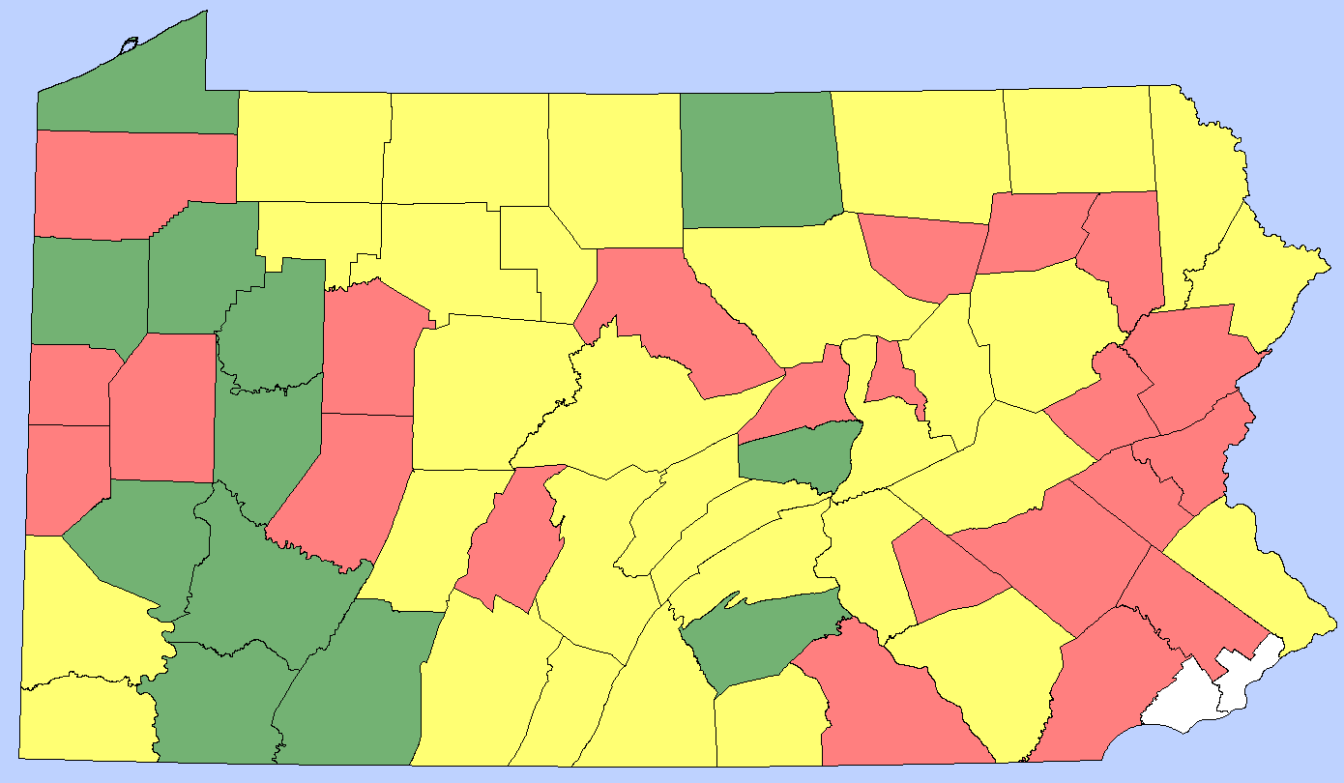
DGLVR Program
CD Spending and 5-Year Agreement
DnG Status:
DnG CD Spending Status
As of 3/27/19
All Old Funds Spent
Unspent Old Funds
Uncommitted Old Funds
31 Counties
Have committed but not spent funds

Slide 8
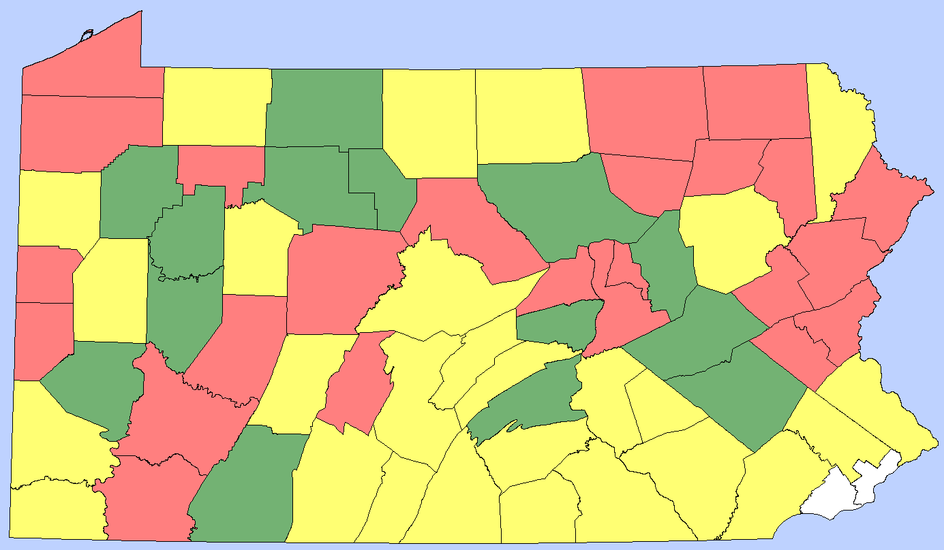
DGLVR Program
CD Spending and 5-Year Agreement
LVR Status:
LVR CD Spending Status
As of 3/27/19
All Old Funds Spent
Unspent Old Funds
Uncommitted Old Funds
LVR 3-20
12 Counties
Old 5-year funds spent out
27 Counties
Have uncommitted funds
26 Counties
Have committed but not spent funds

Slide 9
DGLVR Program
CD Spending and 5-Year Agreement
Looking Ahead:
As of 3/27/2019 in the DGLVR GIS system:
$37.2 million under contract
$12 million of that (32%) is from old 5-year agreement
Much of that $12 million likely to be spent by 6/30/2019.
But likely some will be unspent on 6/30/2019

Slide 10
DGLVR Program
CD Spending and 5-Year Agreement
Looking Ahead:
Several CDs have inquired about additional extensions beyond 6/30/2019
Given leniency of comptroller in granting current 1-year extension, and the amount of work SCC/CDGRS staff have put into educating and informing CDs over past 18 months, staff does not believe this would be an appropriate request.

Slide 11
DGLVR Program
CD Spending and 5-Year Agreement
Looking Ahead:
Several CDs have inquired about additional extensions beyond 6/30/2019
Given leniency of comptroller in granting current 1-year extension, and the amount of work SCC/CDGRS staff have put into educating and informing CDs over past 18 months, staff does not believe this would be an appropriate request.
ADDITIONAL TIME EXTENSIONS?

Slide 12
DGLVR Program
CD Spending and 5-Year Agreement
Looking Ahead:
Three potential categories CDs could fall into on 6/30/2019
Green: Old funds spent out
Good – no action required
YELLOW: Unspent old funds remaining, but everything committed to contract.
Did not meet spending requirement
RED: Unspent and Uncommitted old funds remaining
Did not meet spending requirement

Slide 13
DGLVR Program
CD Spending and 5-Year Agreement
Looking Ahead:
Two potential categories of not meeting 6/30/19 spending
YELLOW: Unspent old funds remaining, but everything committed to contract.
RED: Unspent and Uncommitted old funds remaining
SCC/CDGRS had several meetings with Policy and Planning Advisory Workgroup to develop recommended actions for CDs not meeting spending requirements

Slide 14
DGLVR Program
CD Spending and 5-Year Agreement
RED: Unspent and Uncommitted old funds remaining
SCC Action 1/3:
Give CDs until May 24th to enter all contracts into GIS.
After May 24th, CDs that have not committed all their funds under the old agreement (Red Category) should not be eligible for a FY 2019-2020 Allocation.
These CDs may be eligible for an allocation in FY 2020-21 if they meet the spending requirements at that time.
Note DnG and LVR funds handled separately, a CD could be eligible for both, one or the other, or neither.

Slide 15
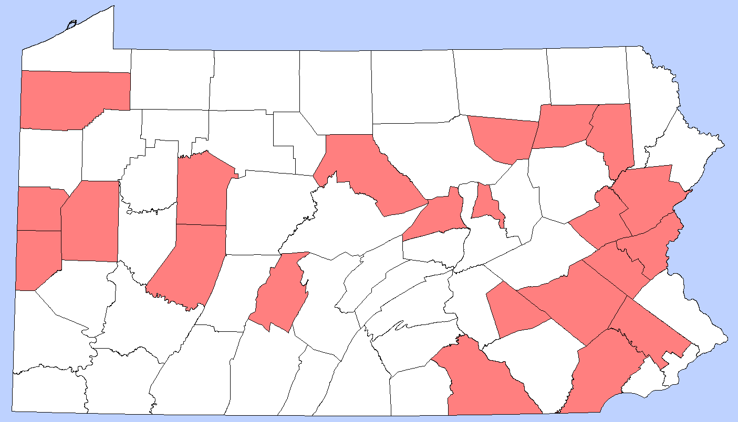
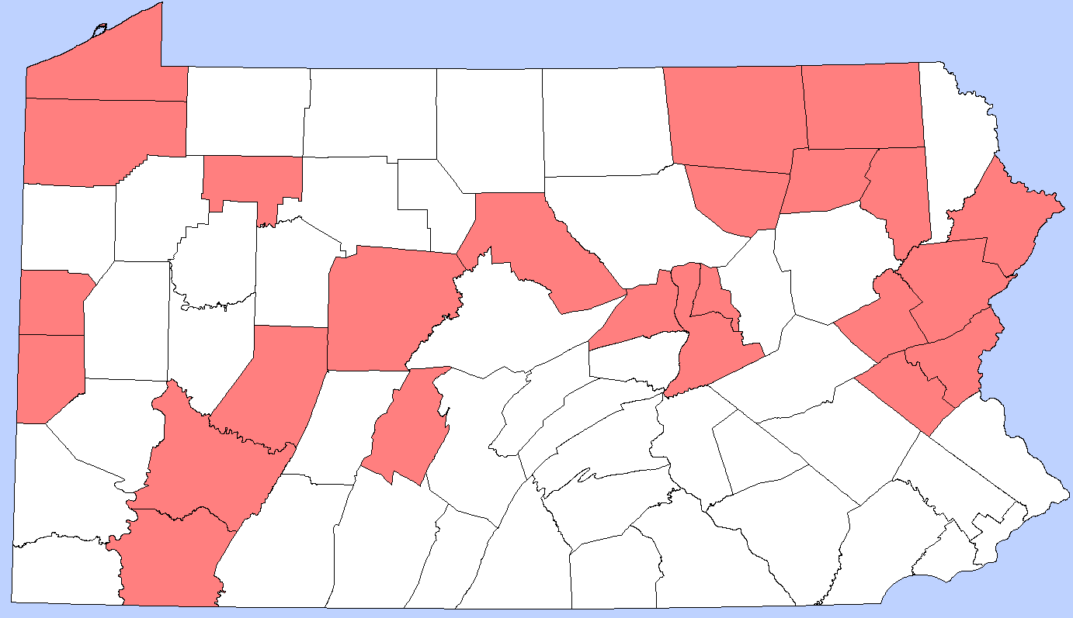
Current “Red” Counties (uncommitted old funds) (Status below as of 3/27, have until 5/24 to commit more funds)
DNG LVR

Slide 16
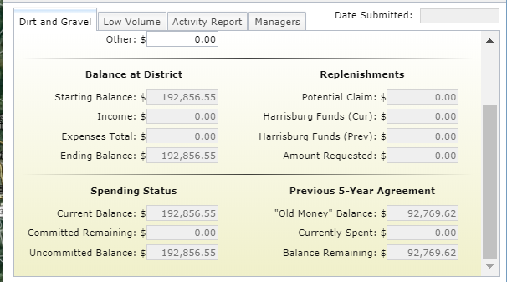
DGLVR Program
CD Spending and 5-Year Agreement
RED: Unspent and Uncommitted old funds remaining
No FY 2019-20 Allocation
Example Red County in GIS Report:
$92,769 remaining in old funds
$25,794 remaining committed to contracts
Leaves $66,975 uncommitted old funds
Need to commit $66,975 by 5/24 to become “yellow”
Need to spend $92,769 by 6/30 to become “green”

Slide 17
DGLVR Program
CD Spending and 5-Year Agreement
YELLOW: Unspent old funds remaining, but everything committed to contract.
SCC Action 2/3:
Counties have until 6/30/2019 to spend old funds.
Any CD who committed but did not spend old funds by 6/30/2019 (Yellow Category) should have their FY 2019-2020 allocation reduced by the amount of unspent funds.
Note DnG and LVR funds handled separately, a CD could be eligible for both, one or the other, or neither.

Slide 18
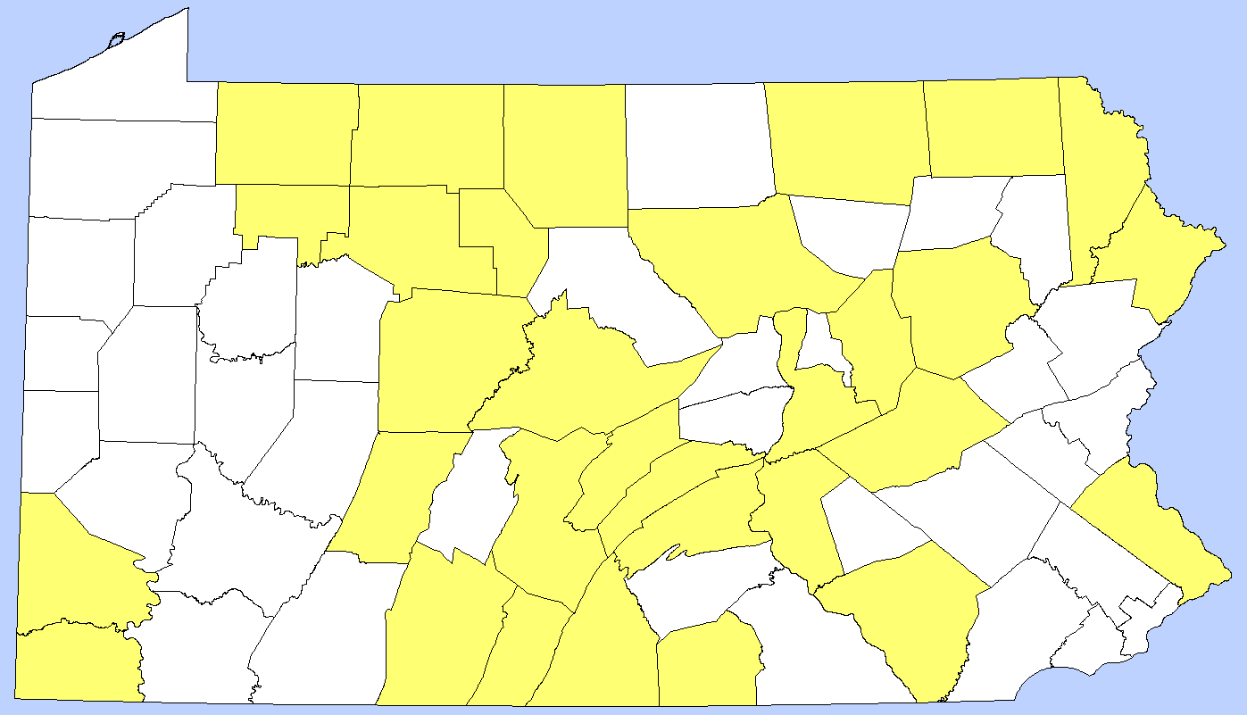
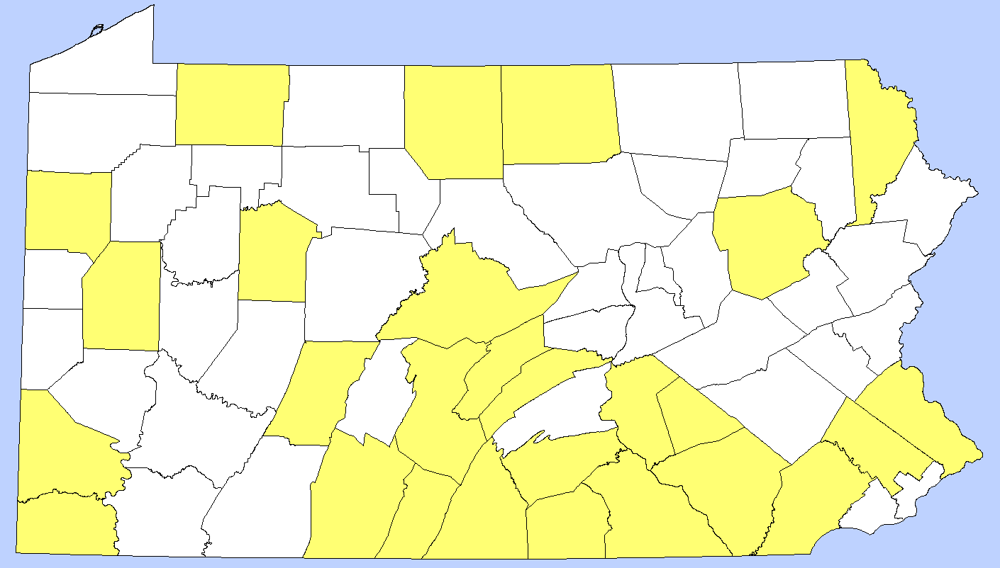
Current “Yellow” Counties
(committed but unspent old funds) (Status below as of 3/27, have until 6/30 to commit more funds)
DNG LVR

Slide 19
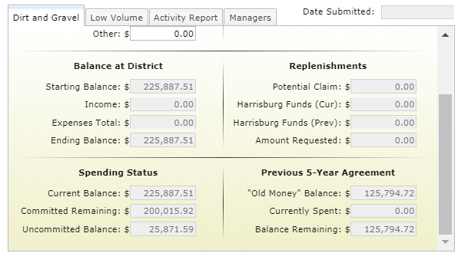
DGLVR Program
CD Spending and 5-Year Agreement
YELLOW: Unspent old funds remaining, but everything committed to contract.
FY 2019-20 Allocation reduced by $125,794
Example YELLOW County in GIS Report:
$125,794 remaining in old funds
$200,015 under contract
100% committed, but still need to spend the $125,794

Slide 20
DGLVR Program
CD Spending and 5-Year Agreement
YELLOW: Unspent old funds remaining, but everything committed to contract.
SCC Action 3/3:
Any funds that are not allocated to a (Red or Yellow) conservation district, as per recommendations 1 & 2 above, would be reallocated to other eligible (green) conservation districts for FY 2019-20.
RED: Unspent and Uncommitted old funds remaining

Slide 21
DGLVR Program
CD Spending and 5-Year Agreement
Note DnG and LVR funds handled separately, a CD could be eligible for both, one or the other, or neither.

Slide 22
DGLVR Program
CD Spending and 5-Year Agreement
Note:
Typical Allocation Timeline
SCC approved in May
Wait for State Budget Approval
CDs receive advances late August (w/ on-time State Budget approval)
Allocation Timeline This Year (to allow for eligibility determinations on 6/30/2019)
SCC approved in July
CDs receive advances late September (w/ on-time State Budget approval)

Slide 23
DGLVR Program
CD Spending and 5-Year Agreement
SCC Action Items
Uncommitted old funds = no FY 2019-20 allocation
Unspent (but committed) old funds = reduced FY 2019-20 allocation by amount of unspent funds.
Any funds withheld from CDs would be reallocated to eligible (green) CDs for FY 2019-20.
RED: Unspent and Uncommitted old funds remaining
YELLOW: Unspent old funds remaining, but everything committed to contract.
Note DnG and LVR funds handled separately, a CD could be eligible for both, one or the other, or neither.

Slide 24
DGLVR Program
CD Spending and 5-Year Agreement
Spending Tips
Complete existing projects
Make new contract and advance funds
Additional progress payments on contracts (must hold 30%)
Claim admin / education expenses
Keep GIS up to date

Slide 25
DGLVR Program
CD Spending and 5-Year Agreement
Question: What happens if a project comes in under budget?
CDs only get credit for what was actually spent
Fund another shovel-ready project or expand on this or another existing project.
Funding gap could be made up by funding for other projects
Last minute admin/edu expenses for small amounts

Slide 26
$192,000 in uncommitted funds
DGLVR Program
CD Spending and 5-Year Agreement
Question: Can I advance more than 50% to twps.?
Yes, but only if they have spent the 50%.
Could do another payment for 20%
In all cases, at least 30% must be held until project completion
SCC DGLVR Statement of Policy:
For the purpose of dispersing funds to a project participant under a project agreement, the district may process an advanced working capital payment as follows:
Upon the full execution of the project agreement, the district may process an advanced payment to a project participant of up to 50% of the approved project expenses.
Subsequent payments to the project participant will be made on an actual cash expended basis.
In all cases, the district shall withhold payment of at least 30% of the approved project expenses until the satisfactory completion of the project. Final payment for the project expenses shall be made only after a final inspection by the district determines that the work was performed consistent with the project application and the work plan, and to the satisfaction of the district.

Slide 27
DGLVR Program
CD Spending and 5-Year Agreement
Question: Do projects need to be finished by 6/30/19?
Depends on your situation:
Counties with enough other projects in the pipeline to advance money to meet requirements: No, projects do not have to be completed by 6/30/19
Counties relying on old projects to meet spending requirements (not a lot in the pipeline): Yes, only expenditures before 6/30/19 will count towards spending requirements
Priority is on spending old funds, not necessarily completing old projects.

Slide 28
DGLVR Program
CD Spending and 5-Year Agreement
Question: Can I just ask for an extension?
June 30, 2019 is already a
1-year extension from the
comptroller
ADDITIONAL TIME EXTENSIONS?

Slide 29
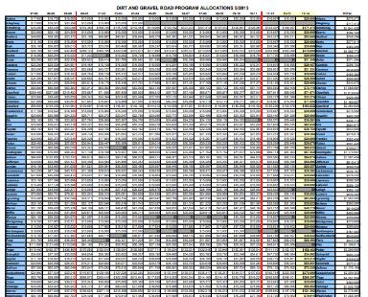
DGLVR Program
CD Spending and 5-Year Agreement
Question: Where does money not received by CDs who don’t meet spending requirements go?
Get automatically allocated to other CDs who have met spending requirement.
Shifts funding to where it can be used.
Same procedure used since 2001

Slide 30
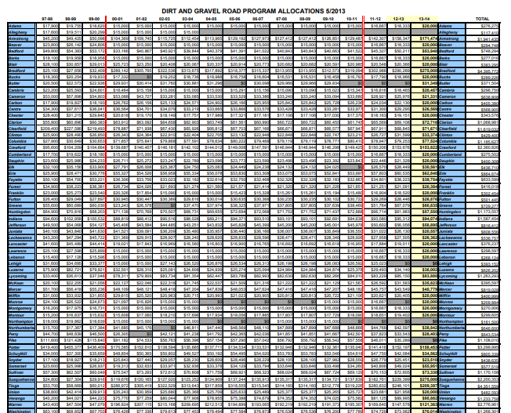
DGLVR Program
CD Spending and 5-Year Agreement

Slide 31
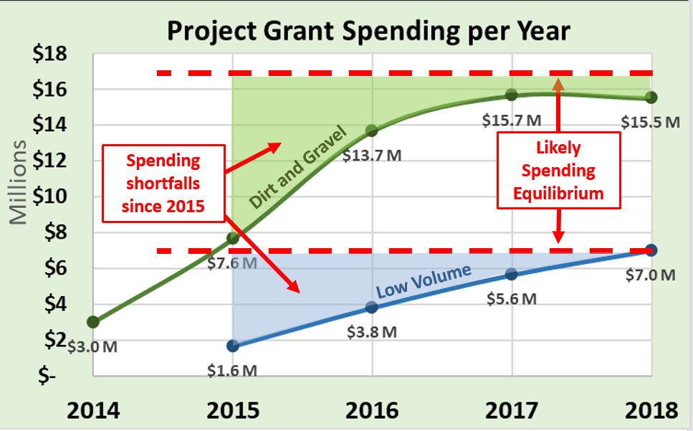
DGLVR Program
CD Spending and 5-Year Agreement
Question: What if weather prevents us from completing projects?
SCC Policy still applies
Advances on new projects count towards spending requirements

Slide 32
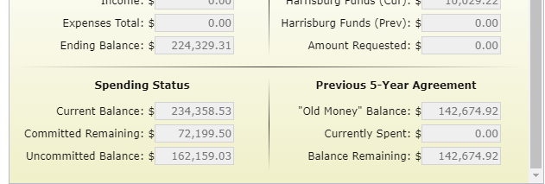
$192,000 in uncommitted funds
DGLVR Program
CD Spending and 5-Year Agreement
Question: How to I pay for staff with a reduced or no allocation?
CDs who don’t meet spending requirements have at least 1 years worth of allocation unspent.

Slide 33
$192,000 in uncommitted funds
DGLVR Program
CD Spending and 5-Year Agreement
Question: How will allocations change next year for eligible counties?
Unknown, many influencing factors:
DnG Only: Unpaved Road Assessments
DnG Only: FY 2019-20 is year two of a three year phase-in of DnG allocation formula change
DnG and LVR: How many counties will have reduced or no allocation for FY 2019-20?

Slide 34
$192,000 in uncommitted funds
DGLVR Program
CD Spending and 5-Year Agreement
Please keep your GIS up to date:
Quarterly Report Due 4/15
Keep up to date with contracts and payments
SCC / CDGRS monitoring regularly to help CDs
Contact Roy, Justin, or Ken with inquiries about your individual CD status

