Slide 1
DGLVR Webinar
COSTARS
6/9/20
Starts at 9am
If you are reading this, then you are successfully seeing the webinar video. Webinar audio should be automatic through your computer, and options can be accessed in the “audio options” button on the bottom left. If your computer audio is not working, you can listen on your phone by dialing 301-715-8592.
Audio via Phone: 301-715-8592

Slide 2
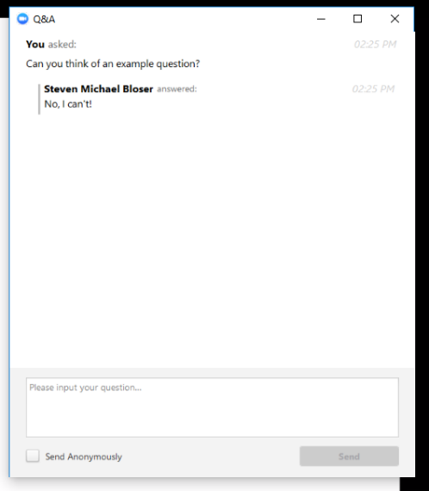
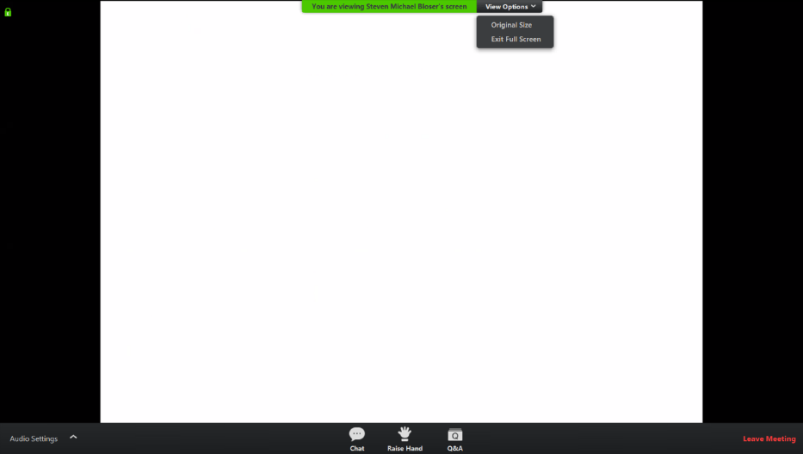
Q&A
Note you can ask a question anonymously
Q&A
Audio via Phone: 301-715-8592

Slide 3
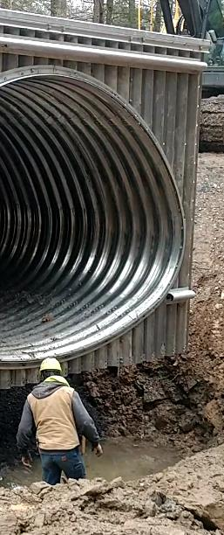
DGLVR Webinar: COSTARS
Purpose:
Follow-up to 4/14/20 “Municipal Bidding” webinar.
COSTARS Program, a cooperative purchasing program designed to make purchasing easier and price competitive for public entities.
Guest Speakers: Felicia Campbell & Kim Bullivant
Audio via Phone: 301-715-8592

Slide 4
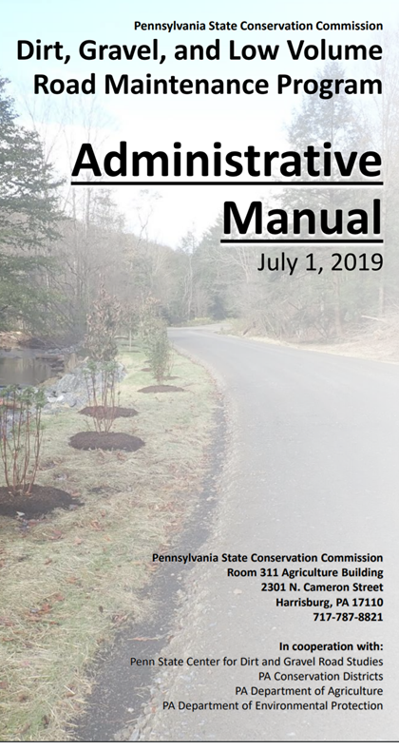
DGLVR Webinar: COSTARS
DGLVR Program Administrative Policy
Districts can utilize costars for expenses related to administration or training/education (see admin manual for more detail)
Must be in line with program guidelines and policy.
Must utilize an appropriate “cost allocation method”.
Program funds can not be utilized to purchase equipment for project participants.
Project Participants may utilize costars to procure materials for projects with construction grant funds.
Audio via Phone: 301-715-8592

Slide 5
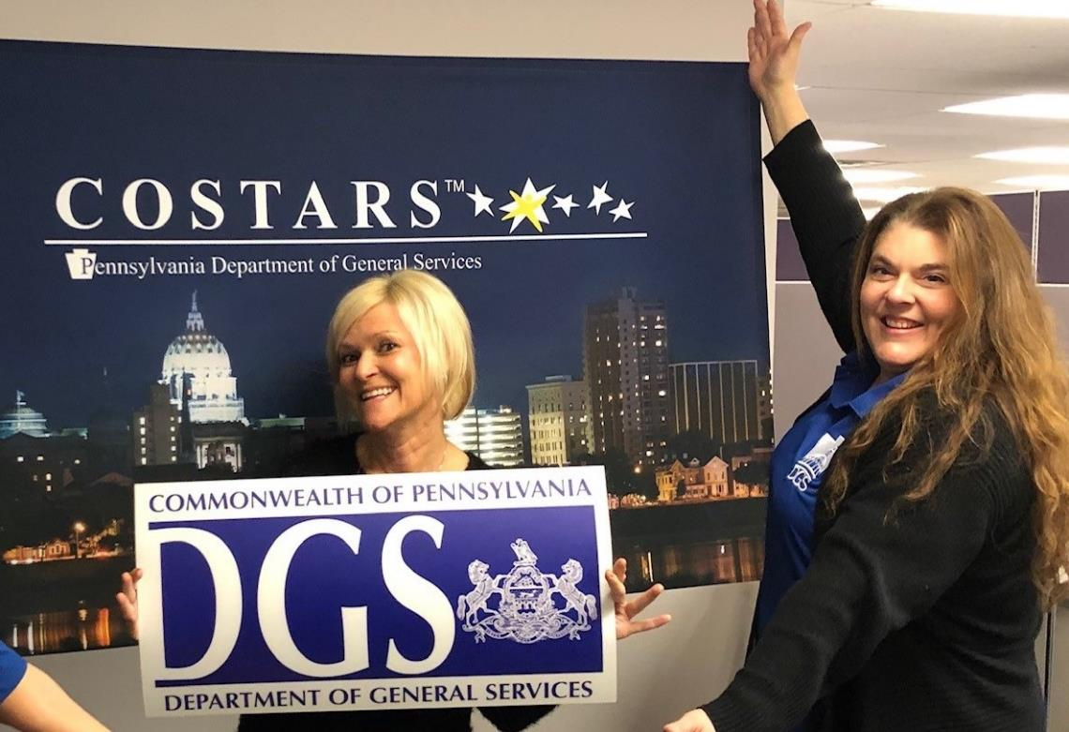
COSTARS VIRTUAL HELLO!
Notes:
FELICIA
We thank you so much for participating in today’s webinar! And we’d like to thank the Penn State Center for Dirt & Gravel Road Studies team for inviting us to join you all today!
Since we cannot be with everyone face-to-face, we wanted to send you our virtual, social distancing HELLO!
Introductions…
We want to begin by sharing our goals for today’s presentation. By the end of our presentation, we want you to:
Fully understand COSTARS and it’s benefits to you
Understand how to register for membership (if you aren’t currently), search contracts and find and utilize COSTARS member resources
Learn some tips, tricks, and best practices of using COSTARS

Slide 6
The COSTARS Program
Simplifying Local Procurement
Notes:
Some information we present today may be a refresh for some of you who use COSTARS regularly, but we often hear that as there is turnover in organizations, new employees may not receive in-depth training on using COSTARS.
So we want to make sure we provide the full COSTARS picture today.

Slide 7
COSTARS Background
1998
Legislature passed the Commonwealth Procurement Code - Act 57
2002
Legislature expanded the scope of eligible participants
2004
Legislature passed an amendment to the Procurement Code - Act 77 authorizing DGS to establish the COSTARS Program
Notes:
We will start with some background on how COSTARS came to be…
1998 – Legislature passed the Commonwealth Procurement Code- Act 57 – allowed local government to piggyback on state contracts for procurement.
2002 – Legislature expanded the scope of participants within Act 57 to allow School Districts, Non-profit fire, rescue or ambulance services, non-profit education and health services to benefit from state contracts. The government was currently preparing for a large purchase of computers. During this period, many agencies across the Commonwealth were handling their own procurement. For example, each agency was purchasing different computer brands for their offices from different suppliers. So, to make the process more efficient and to save taxpayer money, the administration opted for a single-source procurement of these computers.
2004 – The single-source decision for the government’s computer contract, made it difficult for local public procurement offices because it took away their variety of options, so an amendment was passed to establish the COSTARS program. Under COSTARS, we could then offer COSTARS-exclusive, multi-vendor contracts to LPPU’s, allowing for more variety and competitive bidding.

Slide 8
PA Procurement Law
Contracts
By purchasing through the COSTARS Program,
COSTARS members meet the procurement requirements of
Chapter 19 of the Procurement Code.
Below $11,300
Between $11,300
and $21,000
More than $21,000
No advertising, competitive bidding or price quotes required.
Three informal price quotes required with award to the lowest.
Advertise twice and formal competitive bidding required.
Unless using COSTARS or other
acceptable cooperative purchasing program.
Notes:
As many of you on today’s call are aware, PA state government entities must follow state law and mandates so must adhere to the Pennsylvania procurement law and purchasing threshold requirements.
Up to $11,300, you can purchase whatever you need from who ever you’d like – no bids, no quotes, no problem.
Between $11,300-$21,000, you must obtain 3 quotes and the purchase must be awarded to the lowest bidder.
For purchases over $21,000, you must follow the formal bidding process – including advertising and formal competitive bidding.
By using COSTARS, members meet the requirements of the Procurement Code at any threshold because our suppliers have already competitively bid with the Department of General Services and COSTARS.

Slide 9
COSTARS Member Savings
Advertising
Costs
Administrative
Costs
Attorney
Fees
$3,600
Notes:
It is estimated that for transactions over the $21,000 threshold, a member invests approximately $3,600 in the public bidding process – comprised of
Advertising costs
Administrative costs
Attorney fees
That $3,600 investment, once spent on the public bidding process, can be now applied to the hard costs of the goods and services you need to procure. In addition to saving money, your decision-making time is lessened because you can get right to negotiating and finalizing the purchase with the supplier.
In addition to these transactional savings, COSTARS members can increase their commodity savings by negotiating with suppliers for a lower price or the best value for their money.

Slide 10
Why COSTARS?
Reduces administrative costs of bidding and contract award.
Competitive pricing plus negotiation saves taxpayer funds.
Provides flexibility in choosing a supplier.
Local suppliers able to compete for millions of dollars in gov. business.
Allows for product customization.
Provides variety and ease-of-use.
Notes:
Why is COSTARS beneficial to members – therefore making it an effective business tool?
Because the suppliers already go through the competitive bidding process with DGS,
COSTARS reduces the costs of public bidding procedures
Provides our members with more flexibility and choice in their procurement process
Members may purchase from COSTARS-exclusive suppliers or piggyback on statewide, COSTARS-participating contracts
Allows for product customization
Unlike Statewide contracts that specify on the contract the specs of the item being purchased, COSTARS contracts allow for customization of the products. Using vehicles for example, you are able to negotiate additional add-ons to the vehicle that better fit your needs of that product
Because COSTARS members receive public funding for procurement of supplies and services, the combination of competitive pricing and negotiation saves taxpayer money!
And the added benefit for our Commonwealth is it has become a local economic development program allowing small, small-diverse, veteran-owned and local companies to compete for your business along with the larger suppliers
And that circles back to more supplier options for our members!
BUT WE FORGOT THE BEST THING!...

Slide 11
Why COSTARS?
MEMBERSHIP IS FREE!
Reduces administrative costs of bidding and contract award.
Competitive pricing plus negotiation saves taxpayer funds.
Provides flexibility in choosing a supplier.
Local suppliers able to compete for millions of dollars in gov. business.
Allows for product customization.
Provides variety and ease-of-use.
Notes:
There is no cost to become a member! And once you are a member, you are always a member.
The COSTARS-authorized suppliers pay an annual administrative fee which defrays the operating costs of the program.

Slide 12
Local Public Procurement Units
Political subdivision, e.g., local municipalities, school districts
Tax-exempt nonprofit education or public health institution
Public authority
Tax-exempt nonprofit fire, rescue, ambulance company
And to the extent provided by the law, any other entity at expends public funds for the procurement of supplies and services
Notes:
You may have heard me use the term “eligible” member during this presentation.
Eligibility for membership requires that an organization falls within the scope of a Local Public Procurement Unit (also know as LPPU’s).
LPPU’s are entities such as:
Local municipalities
School Districts
Public Authorities (parking, airport, sewer, and water)
Tax-exempt, Non-profit Education or Public Health institutions
Tax-exempt, Non-profit fire, rescue, and ambulance companies
Other entities who receive public funding for procurement of supplies & services

Slide 13
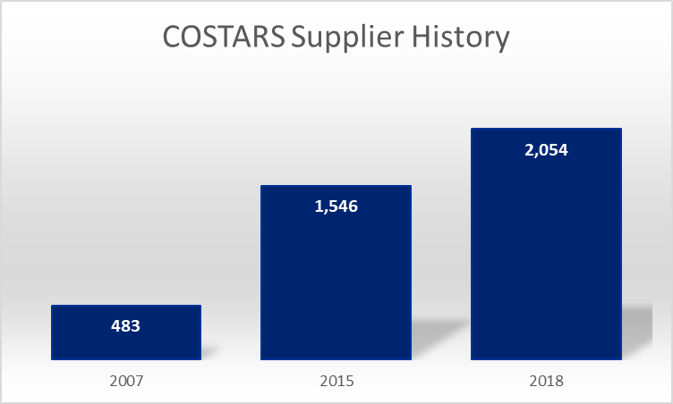
COSTARS Data
Notes:
As procurement professionals, numbers speak volumes, so we want to share some COSTARS statistics with you.
MEMBERSHIP GROWTH:
2005 membership – 2,998
2019 – Over 9,000
Finite number of Local government entities and School Districts…growth still comes from the vast number of
non-profit, publicly funded organizations.
Our growth averages about 1 new member each business day.
Remember we talked about the plethora of options COSTARS members have in suppliers?
SUPPLIER GROWTH:
2007 – 483
2015 – 1,546
Today – more than 2,000
Reflects supplies on COSTARS-exclusive and COSTARS-participating, statewide contracts.

Slide 14
COSTARS Contracts
Developed when a statewide contract supplier base is reduced by more than 50 percent.
Created exclusively for use by LPPUs, based upon perceived need.
Awarded to all “responsive and responsible” bidders.
Notes:
Before we talk about individual COSTARS-Exclusive contracts, let’s talk about how, why and when these contracts are created and how a supplier is awarded a COSTARS-exclusive contract.
REDUCED BY 50%:
If a statewide contract supplier base is reduced by more than 50 percent, we are mandated to create a parallel COSTARS contract. Because of this, you will notice that in some cases there are similar COSTARS-exclusive and statewide contracts: examples of these are the COSTARS-exclusive vehicles contract and a statewide vehicles contract; the COSTARS-exclusive IT hardware contract and a statewide IT hardware contract. Remember we discussed the single-source computer contract decision in 2002 that began the idea of COSTARS? When we see that there isn’t a variety of choice for LPPU’s we begin to look at the need for a COSTARS-exclusive contract for LPPU use. Based on agency need and member feedback, in April, we closed the statewide Electronic Monitoring contract #4400015767 and opened contract COSTARS-42 Electronic Monitoring Services and Electronic Monitoring Equipment, Repair Services and Equipment Rental to be sure our members still had access to this type of product and service.
PERCEIVED NEED:
Using COSTARS-39 Voting Systems and/or ePollbooks (EPBs) for example, the agencies don’t have a need for these products, but our LPPU’s do so COSTARS-39 was created for the exclusive use of our LPPU members. We often survey our members to get a feel for their current needs. Prior to 2015, we did not offer the rental of heavy equipment. Our members let us know via surveys that this was an important need for them so COSTARS 38 Heavy Equipment Rental was born.
RESPONSIVE AND RESPONSIBLE BIDDERS:
COSTARS awards contracts to all suppliers who submit properly completed bid paperwork with items competitively priced and within the scope of the contract. When a Commodity Specialist managing a contract requests updates to the submitted paperwork, the supplier must be timely in their reply to be considered responsive. We also ensure that bidding suppliers are in good standing with the Commonwealth.

Slide 15
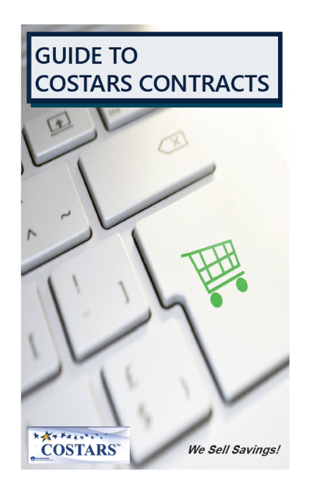
COSTARS Contracts
Exclusive Contracts
From Copiers to Municipal Work Vehicles
36
Notes:
Currently, there are 36 COSTARS-exclusive contracts covering nearly everything members would need.
For those of you who have not used the Guide to COSTARS Contracts, this is a very handy resource to have at your
fingertips. This helps to define which products fall under each contract.
COSTARS-EXCLUSIVE CONTRACTS:
1 Copiers, Document Imaging and Multifunction Devices
3 IT Hardware
4 Office, School and Library Supplies
5 Janitorial Supplies
6 Software
7 Foods
8 Maintenance, Repair & Operation (MRO) Equipment, Supplies and Services
9 Graphic & Printing Services, Equipment and Supplies
11 Toiletries
12 Emergency Responder Equipment and Supplies
13 Emergency Responder Vehicles
14 Recreational & Fitness Equipment
15 Water & Wastewater Treatment Consumables
16 Water & Wastewater Treatment Plants - Components/Equipment
17 Waste, Recycling & Materials Handling Containers
18 LED Traffic Signal Modules and/or Housings
19 Medical Supplies
20 Laboratory Supplies
21 Pest Control
24 Traffic Signs
25 Municipal Work Vehicles
26 Passenger Vehicles
28 Energy Conservation Management Supplies
Grounds Keeping Services and Supplies
Energy Consulting Services
32 Signage
33 Street Lighting, Parking Meters and Street Furniture (AKA Streetscape)
34 Theater (Auditorium) Furniture, Fixtures Audio/Visual Equipment and Musical Instruments
Furniture & Window Treatments
Appliances, Cafeteria Equipment & Supplies
Uniforms
Heavy Equipment Rental
Voting Systems and/or ePollbooks (EPBs)
Security and Surveillance Systems and Fire Alarm Systems, Equipment, Products and Services
Stormwater Management Products and Services
And new contract coming soon…
42 Electronic Monitoring Services and Electronic Monitoring Equipment, Repair Services and Equipment Rental
We are currently securing suppliers for this contract.

Slide 16
COSTARS Contracts
COSTARS-25
4x2 Utility Vehicles
Air Compressors and Generators (truck mounted)
Alternate Fuel Conversions
Alternate Fuel Vehicles
Body Uplifts
Bucket Trucks
Cab and Chassis
Cranes (truck mounted)
Lifts – Vehicle, Mobile
Liftgates
Liquid Winter Maintenance Systems (truck mounted)
Pickup Trucks and Cargo Vans
Recycling Trucks
Salt/Sand Spreaders (truck mounted)
Snowplows (truck mounted)
And more….
Municipal Work Vehicles
Notes:
Here are just a few examples of some COSTARS contracts found in the guide and the plethora of products & services that fall within them…
Under COSTARS-25 we offer products including:
Truck mounted Air Compressors, Generators, & Cranes
Bucket Trucks
Pickup Trucks and Cargo Vans
Lifts

Slide 17
COSTARS Contracts
COSTARS-38
Aerial Equipment
Air Equipment
Compaction Equipment
Concrete Equipment
Earthmoving Equipment
Forest/Landscaping Equipment
Highway/Road Maintenance Equipment
Power Generation (portable/trailer-supported)
Pump Equipment
Street Sweepers
Heaters
Light Towers
Utility Trailers
Dump Trucks
Heavy Equipment Rental
Short Term Rental Of
Equipment in the Following
Categories…
Notes:
The COSTARS-38 contract offers product rentals including:
Compaction Equipment
Earthmoving Equipment
Highway/Road Maintenance Equipment
Pump Equipment

Slide 18
New COSTARS Contracts
Stormwater Management Products
COSTARS-41
Stormwater Management Product and Services
• Baffle Boxes
• Biofiltration System
• Concrete Washout Berms
• Dewatering Bags & Sandbags
• Drain Debris Filters & Guards
• Drain Line, Valving & Components
• Filtering Components
• Grates & Inlets
• Leak Detection Equipment
• Manhole Covers
• Meters
• Pipes & Pipe Socks
• Pumps
• Tanks
• Tapping Sleeves
• Tarps & Blankets
• Ultraviolet Disinfection
• Valves
• Water Harvesting System
Stormwater Management Services
• Consulting Services
• Engineering Services
• Preventative Maintenance & Repair
• Line Inspection Services
• Monitoring Services
• Waste Pumping Services
Notes:
COSTARS-41 is one of our more recent contract offerings. Under this contract, our suppliers have products and services you will need to meet the requirements of the Stormwater Management Act (Act 167).
Products and services under this contract include:
Biofiltration Systems
Filters & Guards
Grates & Inlets
Pumps
Consulting & Engineering Services
Line Inspection Services

Slide 19
COSTARS Contracts vs. State Contracts
COSTARS Contracts | Statewide Contracts
36 multi-vendor contracts. Variety of suppliers. Contracts are awarded to all responsive & responsible bidders. | Over 100 COSTARS-participating suppliers. Contracted based on state agency need. Focused supplier selection.
Competitive pricing. Contract price is ceiling price. | Competitively priced through sealed bidding.
Products and services are customizable – within scope of the contract. | Products and services purchased as quoted on contract.
Notes:
COSTARS members are permitted to purchase under both the eligible statewide and COSTARS-exclusive contracts. The statewide contract suppliers who elect to become a COSTARS-authorized supplier, agree to offer COSTARS members the same pricing and terms & conditions they offer to state agencies under these contracts.
What are the differences between the two?
COSTARS contracts have many choices of suppliers with a lot of variety. We award COSTARS-exclusive contracts to all responsive & responsible bidders. With the wide variety of suppliers on COSTARS contracts, members have a lot of negotiation power!
Statewide contracts are focused on the procurement needs of state agencies which may or may not coincide with the needs of COSTARS members so in many cases, there is a much more focused supplier selection on statewide contracts.
COSTARS offers competitive pricing and a supplier’s pricing offered on a COSTARS contract is the ceiling price – they can offer lower pricing but cannot offer pricing higher than stated on the contract.
Statewide contracts are competitively priced through the formal bidding process
Customization
COSTARS members aren’t held to awarding the project to the lowest bidder.
You can use criteria that is important to you
Preferred brands
Location or past performance of a supplier
Negotiated value-adds to the purchase (ancillary services, package upgrades, etc)

Slide 20
State Agency Contracts
Construction/Heavy Duty Type Power Equipment
Credit Card Services
Fuel
Tires
Universal Fleet Card
Small Package Delivery
Bridge and Highway Maintenance Materials
Contract #4400022316
Box & Long Span Culverts
Aluminum & Steel Pipe
End Sections & Slope Pipe Fittings
Metal Deck Forms
Metal Plate Pipe Arches
Notes:
In addition to the 36 COSTARS contracts, our members can purchase through the over 100 statewide contracts currently in place – from Road Salt to Spring Water.
Other examples of Statewide Contracts…
Construction/Heavy Duty Type Power Equipment
Credit Card Services through US Bank
Tires
Universal Fleet Card through WEX which helps you track the spend on your fleet fuel expenses as well as take advantage of discount incentives offered through WEX.
Small Package Delivery through UPS
And our Bridge and Highway Maintenance Materials Contract
Now that you understand the COSTARS competitively bid contracts and COSTARS-participating contracts that can help you save money, Kim is going to walk you through use the COSTARS web-based program and search contracts.

Slide 21
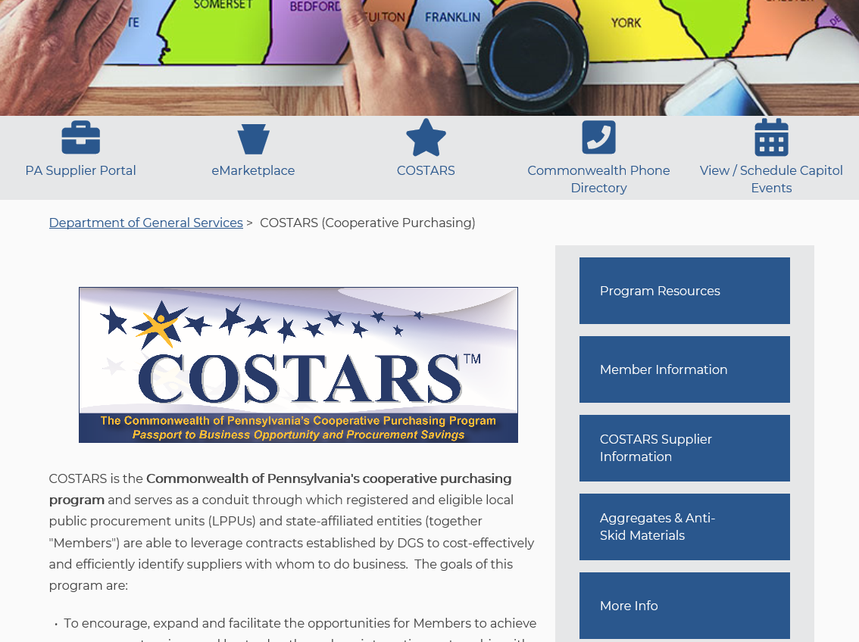
COSTARS Website
www.dgs.pa.gov/COSTARS
Update Profile
New Member Registration
New User Registration
Newsflashes & Newsletters
Road Salt Registration
Resources
Training Center
Contract Search
Notes:
KIM
We start with www.dgs.pa.gov/COSTARS.
The COSTARS page is the starting point for all COSTARS member information.
Once you click the “Member Information” tile within this web-based system, you can:
Update your member profile
Submit a new member & new user registration
Read newsflashes and quarterly newsletters
Register for road salt
Access resources
Members’ Quote Kit
Training Center
Search COSTARS exclusive and Statewide contracts
To login, you’ll select the Member Information button.

Slide 22
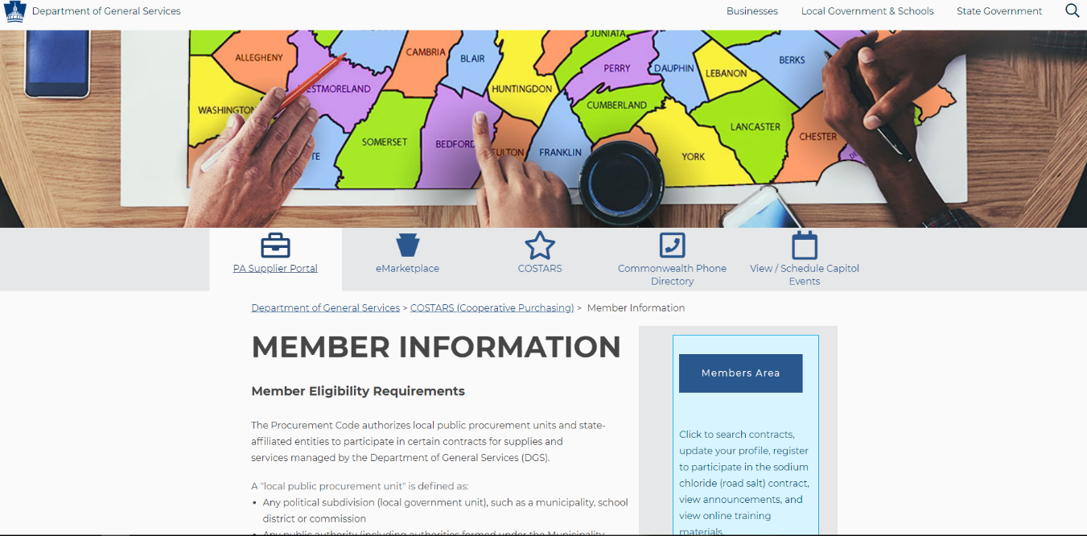
How to Become a COSTARS Member
Notes:
Then we’ll select the Members Area button.

Slide 23
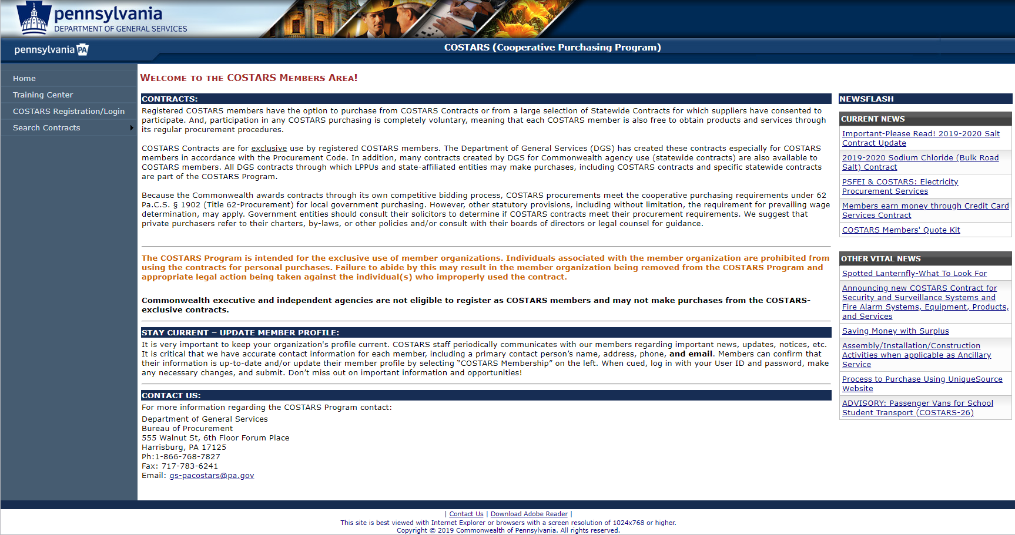
How to Become a COSTARS Member
Notes:
Select COSTARS Registration/Login

Slide 24
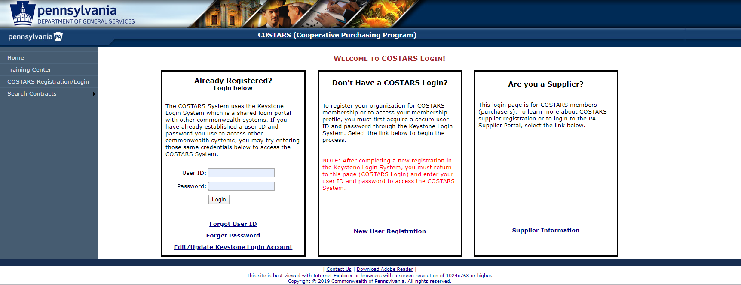
How to Become a COSTARS Member
Notes:
Add your Keystone credentials here to enter the COSTARS web-based system.

Slide 25
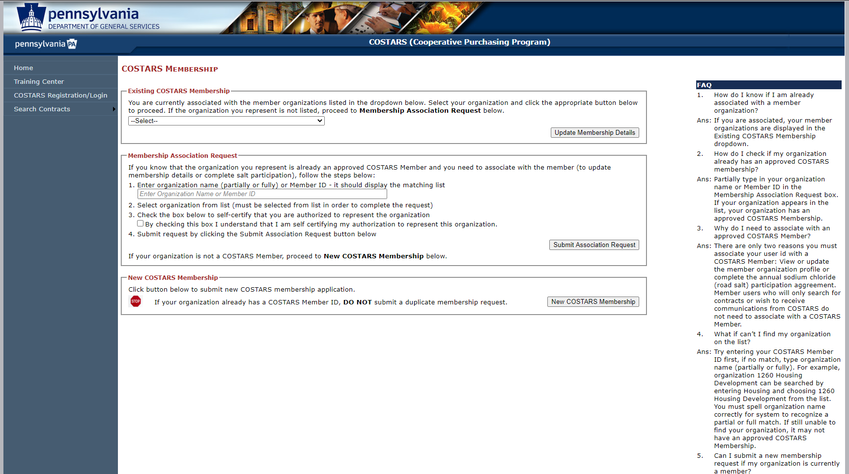
How to Become a COSTARS Member
Notes:
We will first click on New COSTARS Membership.

Slide 26
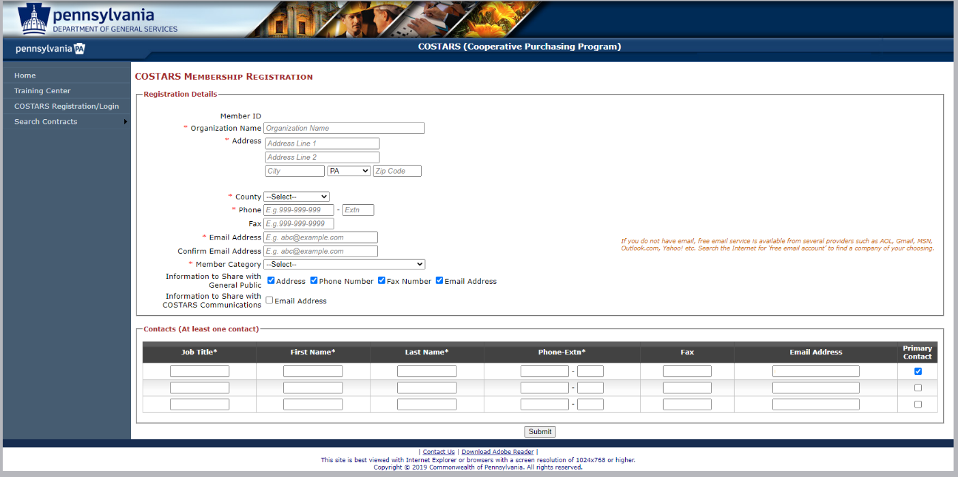
How to Become a COSTARS Member
Notes:
Here, you will fill out information about your organization as well as any contacts you want to add to your membership that should receive important announcements from the COSTARS team. You will want to chose one of these contacts as your primary contact.
Once you’ve submitted your registration application, the COSTARS team will evaluate the application and verify that the organization meets program eligibility requirements. This review process takes approx. 1-2 days.
Before you can purchase, however, you will need to know how to search and the process of purchasing through COSTARS.

Slide 27
Purchasing Through COSTARS
Search COSTARS contracts via the COSTARS website.
Call at least three or four COSTARS suppliers for quotes to ensure best value.
Negotiate! Suppliers are encouraged to offer competitive pricing and they are prepared to negotiate.
Search statewide contracts via PA eMarketplace to compare pricing.
Negotiate again! Remember, suppliers want your business!
Contact preferred supplier directly to place an order.
Notes:
When purchasing through COSTARS,
Start your search with the COSTARS contracts to get your quotes
Though our suppliers have already offered competitive pricing, you have the power to negotiate!
We recommend that you get quotes from 3-4 suppliers. This variety will help you in your negotiations!
Don’t forget to use the Members Quote Kit to record each quote for future reference and maintain this document with your purchasing records in the case you would be audited.
Once you’ve finalized your negotiated pricing, compare your pricing against statewide contracts
Use that information to negotiate more with the supplier you are most interested in working with – remember, both the COSTARS-exclusive and Statewide, COSTARS-participating suppliers want to win your business! Use your power to negotiate!

Slide 28
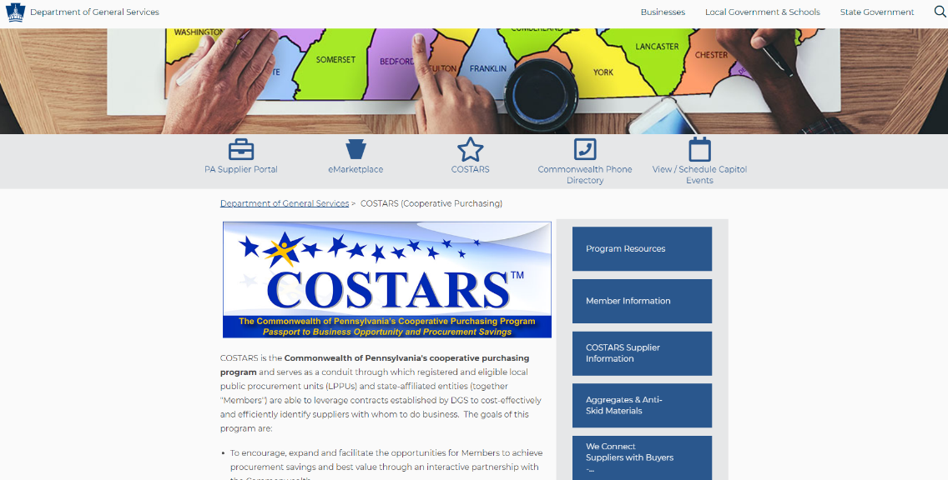
Aggregates and Anti-skid Materials
Purchasing from the Aggregates and Anti-skid Materials contract involves a different process. Using the COSTARS Program, there are two methods for determining your price.
Method 1 – Mini-bid Process

Slide 29
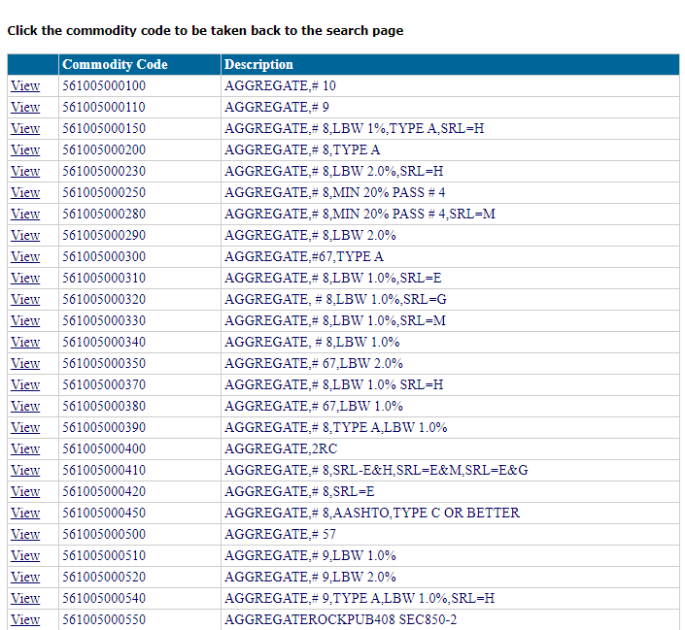
Aggregates and Anti-skid Materials

Slide 30
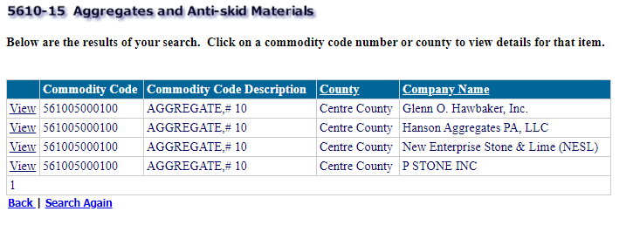
Aggregates and Anti-skid Materials
You will be provided with a list of qualified suppliers that you must contact. Select View to reveal each suppliers' contact information.
NOTE: Multiple listings for the same supplier indicate they have more than one source of supply. You are only required to send one RFQ per supplier.

Slide 31
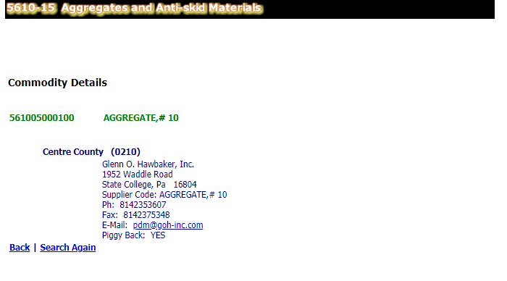
Aggregates and Anti-skid Materials
REQUIREMENTS FOR USING THE STATEWIDE CONTRACT
You MUST send a Request for Quote to ALL qualified suppliers.
Do not send a Request for Quote to or accept a quote from any supplier who has not indicated they will allow Piggyback Purchases.
Do not send a Request for Quote to
or accept a quote from any supplier not
listed in the Aggregates and Anti-skid
Materials contract #5610-15.
Doing so is a violation of the contract and can result in an audit finding against your municipality if your total aggregates purchase for the calendar year exceeds your bidding threshold.
Ultimately, you MUST choose the low-bid supplier or reject all bids.
NOTE:
If you are having the material delivered, you must accept the lowest quote.
If you are picking up the material yourself, you may account for your transportation cost to determine the lowest quote (e.g. if supplier A quotes $10 per ton and is 25 miles away, and supplier B quotes $10.25 per ton and is one mile away, you may choose supplier B based upon the better value).

Slide 32
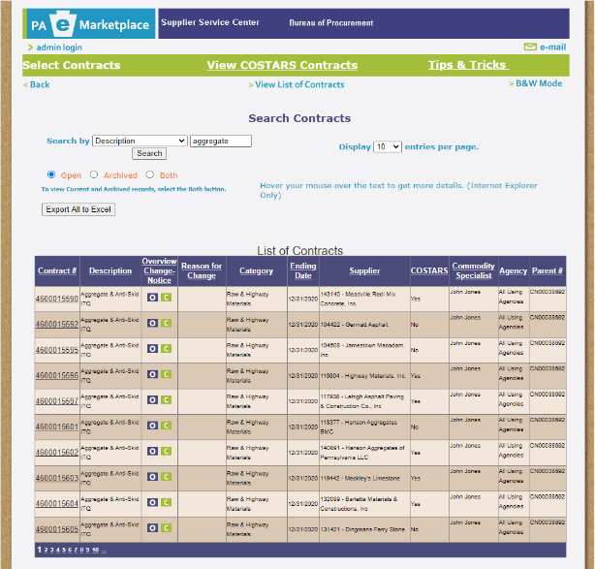
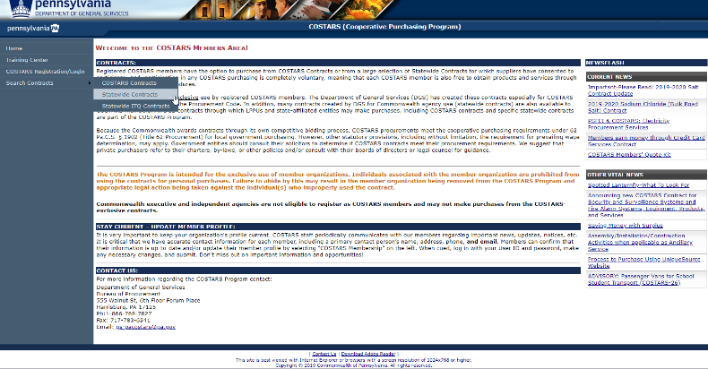
Aggregates and Anti-skid Materials
Method 2 – Source Pickup Pricing

Slide 33
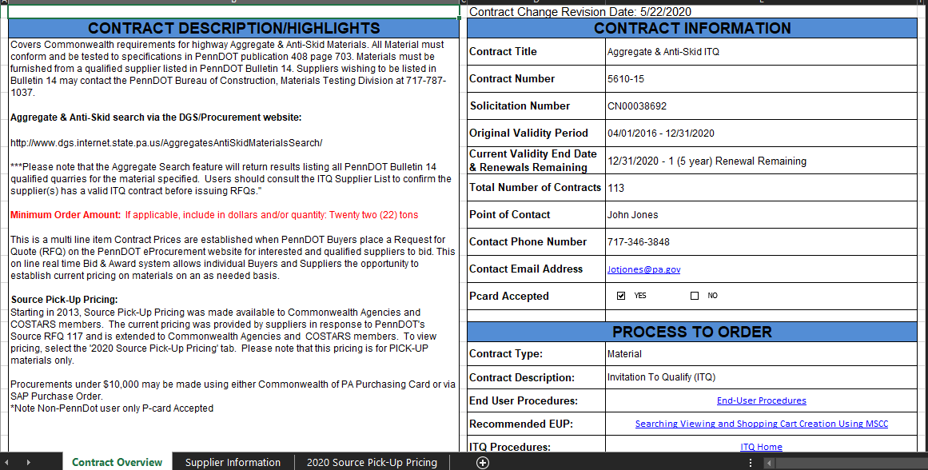
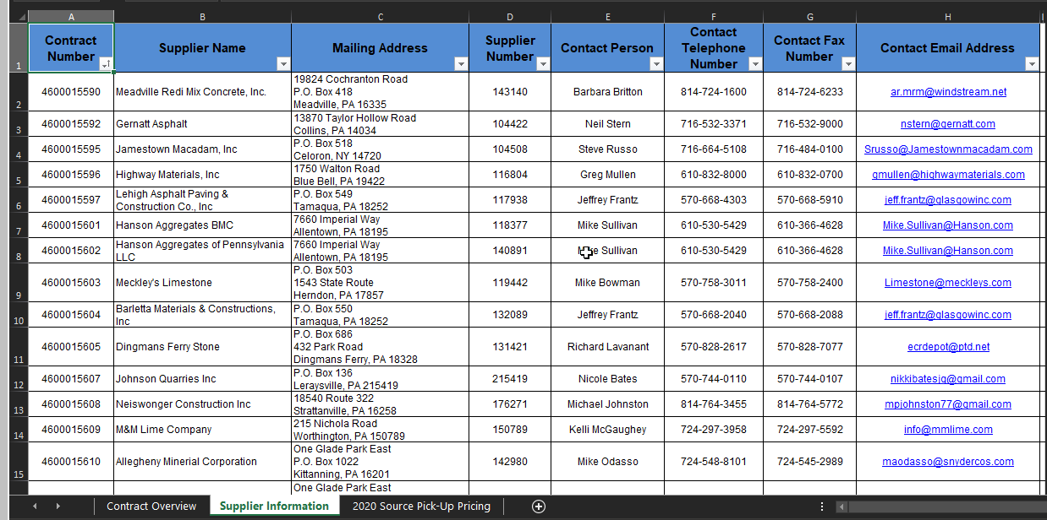
Aggregates and Anti-skid Materials

Slide 34
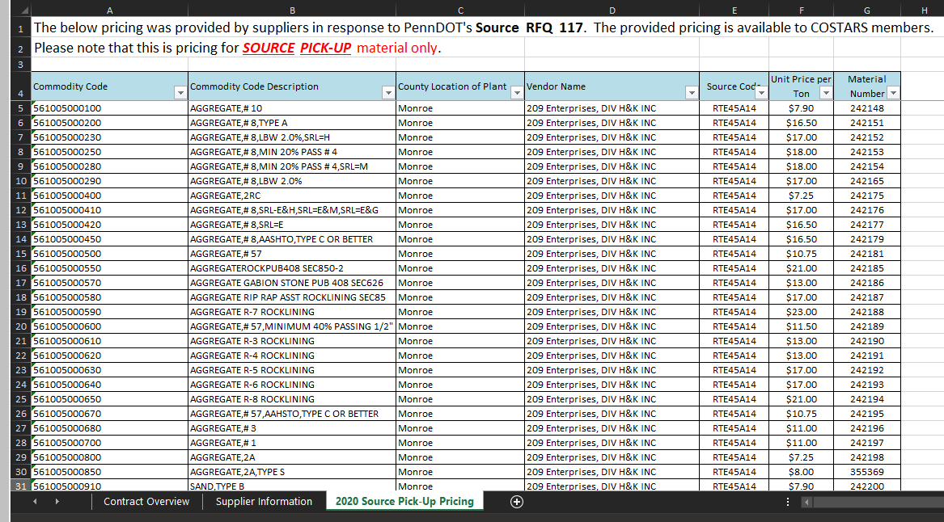
Aggregates and Anti-skid Materials
To purchase material, follow these steps:
Choose a vendor, aggregate and price for the material you require.
Contact the supplier using the information in the Vendor Information tab at the bottom of the spreadsheet.
Identify yourself as a COSTARS member and that you would like to use the Source Pick-up Pricing.
Place your order.
NOTE: Don't forget to check the Contract Search page to ensure the supplier is COSTARS-participating and always reference Contract #5610-15 on your purchase order.

Slide 35
Search COSTARS Contracts
Notes:
Before we start our search, I do want to point out a few things about this page.
In the middle of the page, you’ll see important information about contracts, your member profile and contact information for DGS’, Bureau of Procurement. To the right you will see, our Newsflash area. This give you both up-to-the moment updates you should see as well as other important, past information you may want to refer to ongoing.
Since we want to run through a search demo, we’ll look at the left navigation menu – under Search Contracts.
This allows you to search both COSTARS contracts and Statewide Contracts.
We’ll start with a COSTARS contract search today but you can start your search with either type.

Slide 36
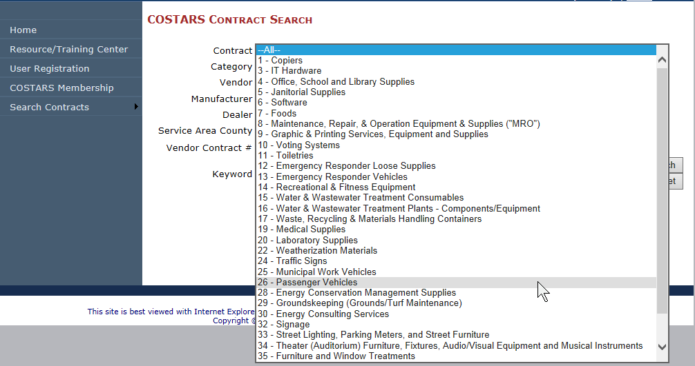
Search COSTARS Contracts
Notes:
We’ll use contract COSTARS-26 Passenger Vehicles for our search.

Slide 37
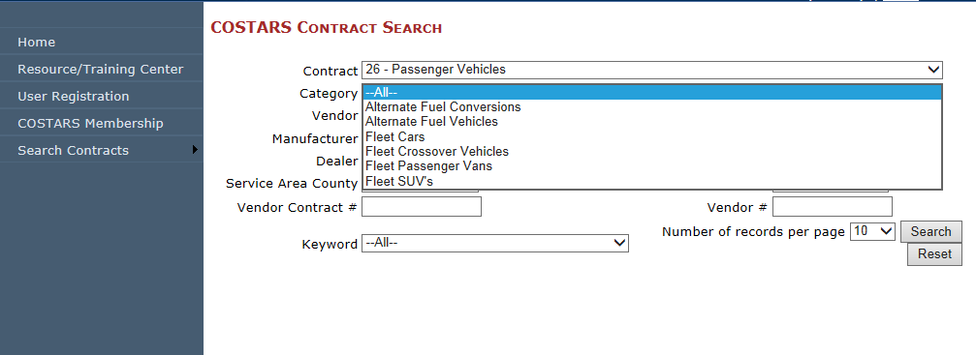
Search COSTARS Contracts
Notes:
You can get as detailed in your search as you’d like – even specifying a particular manufacturer or dealer but you can also search just contract 26 – Passenger Vehicles. Less, is often more in search criteria, so if your search nets no results, widen your criteria a little more.
For this simulation, we’ve chosen Fleet Passenger Vans as a category under Passenger Vehicles.
Once you’ve picked all the criteria you want to search by, you would click search and get list of suppliers to pick from.

Slide 38
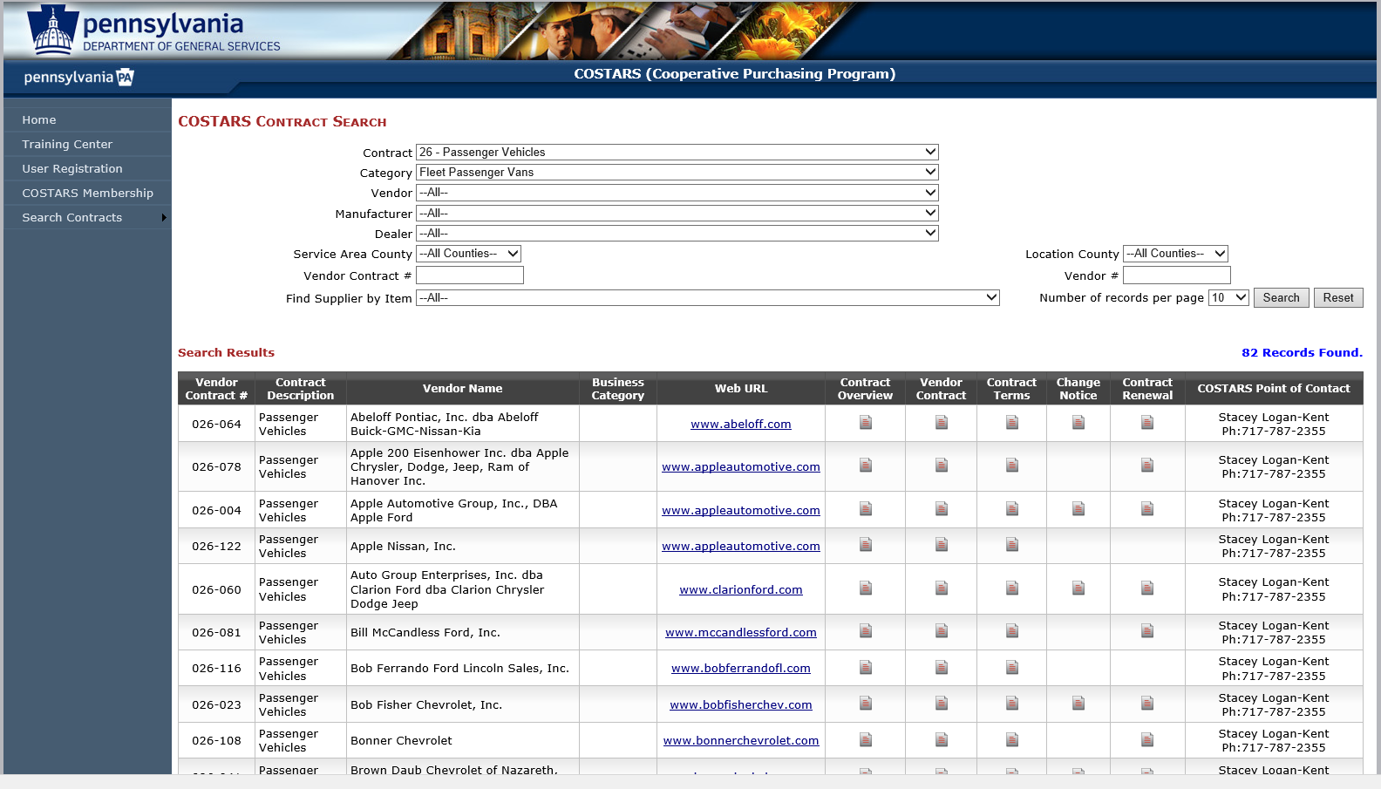
Search COSTARS Contracts
Notes:
From this list of suppliers, you can dial into several details.
Contract Overview
Vendor Contract
Contract Terms
Change Notice
Contract Renewal
Commodity Specialist contact information in charge of the contract you are interested in
Let’s look at a contract overview.

Slide 39
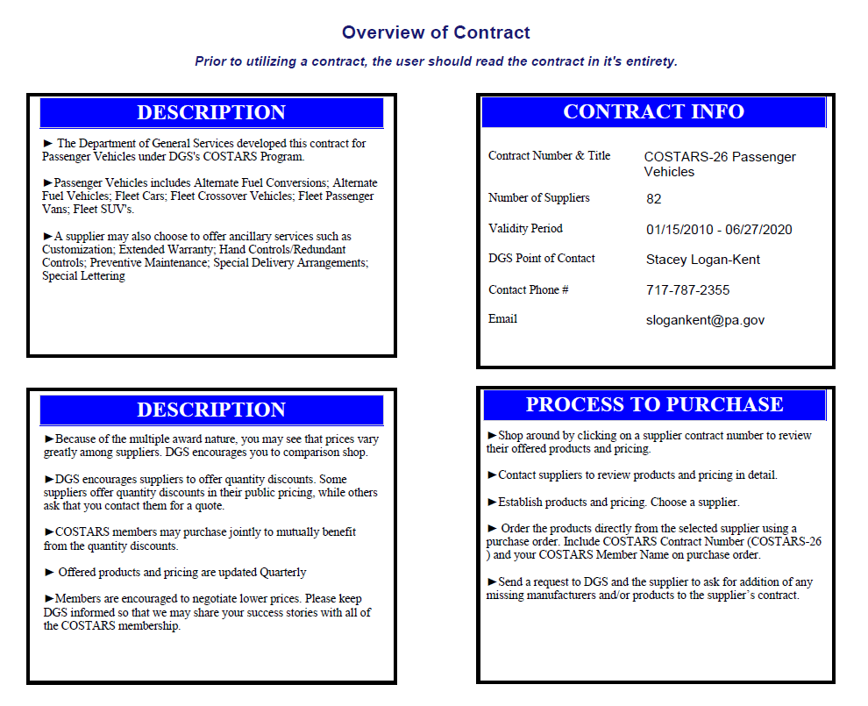
Search COSTARS Contracts
Notes:
This will give you an overview of the overall contract…
You can see in the description, this overview defines what “passenger vehicles” includes, including alternate fuel vehicles and fleet SUV’s for example.
Also notice in the lower description box of this contract that COSTARS members are allowed to purchase jointly to capitalize on quantity discounts if the supplier offers that option.
This also tells you the contact information of the COSTARS Commodity Specialist as well as the process of purchasing through COSTARS. As you can see in this section, it tells you that you are to order directly from the selected supplier using a purchase order and you must refer to the COSTARS contract number on the PO in order to receive the COSTARS discounted pricing. This is true of all purchases through COSTARS contracts.
We recommend that you print the contract overview and keep with your records in the event you are audited.

Slide 40
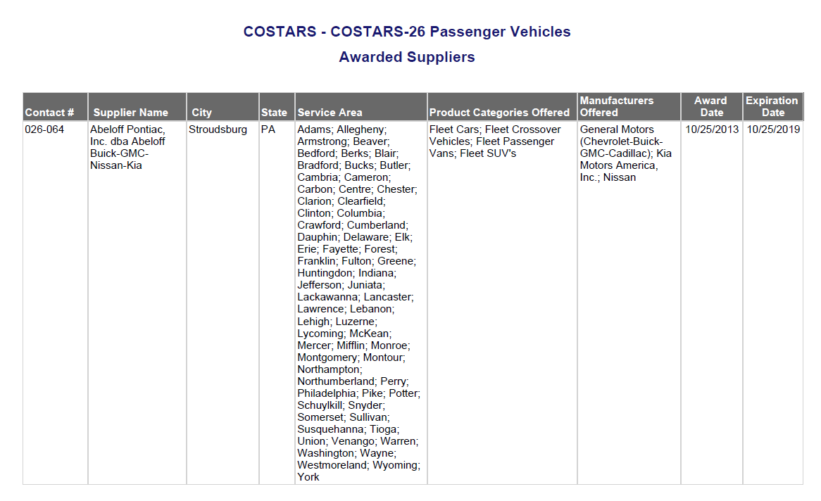
Search COSTARS Contracts
Notes:
You will also see in this document, an overview list by supplier including individual vendor contract numbers, their product categories & manufacturers offered by the suppliers as well as the contract award date and expiration date.
What you will not find in this view is any pricing per supplier or product.

Slide 41
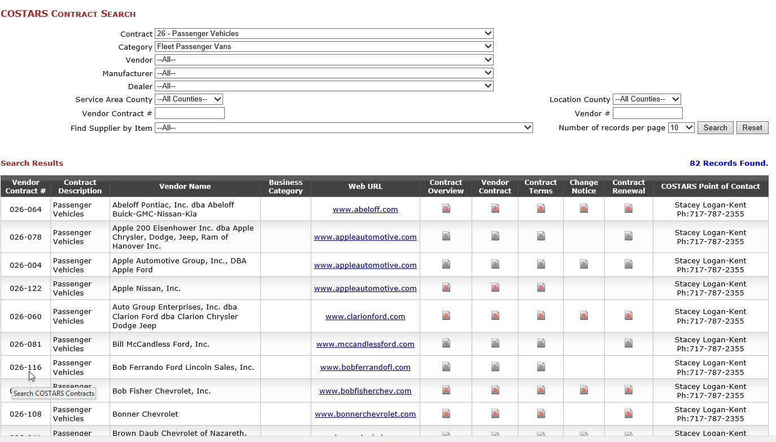
Search COSTARS Contracts
Notes:
For more info on a supplier’s pricing and ancillary services, we will look at the Vendor Contract

Slide 42
Search COSTARS Contracts
Notes:
For more info on a supplier’s pricing and ancillary services, we will look at the Vendor Contract

Slide 43
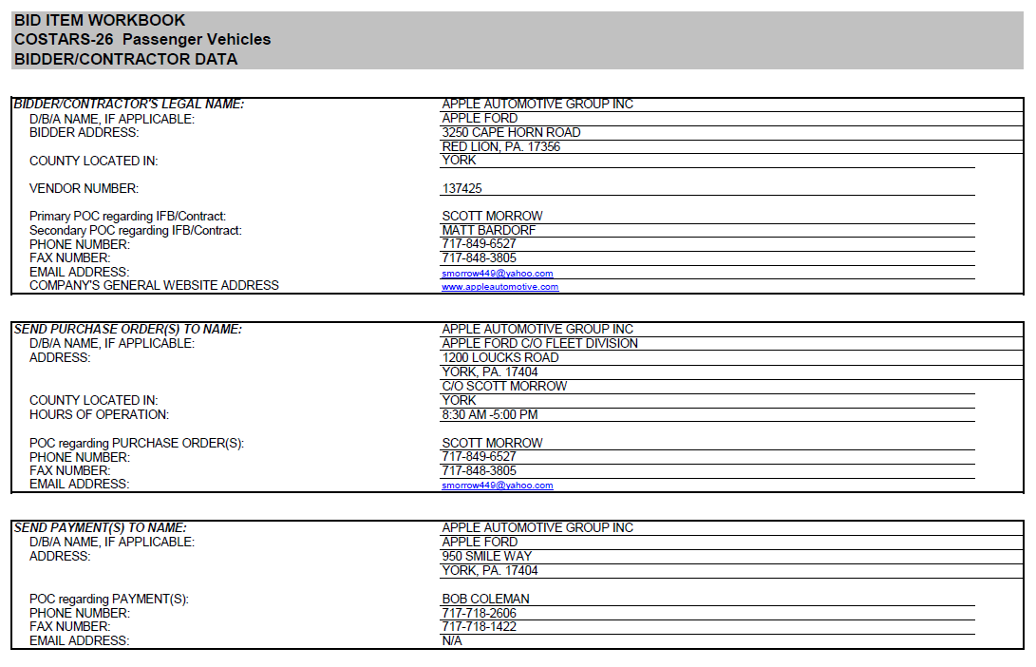
Search COSTARS Contracts
Notes:
This gives you detailed information on the vendor, their contact info.

Slide 44
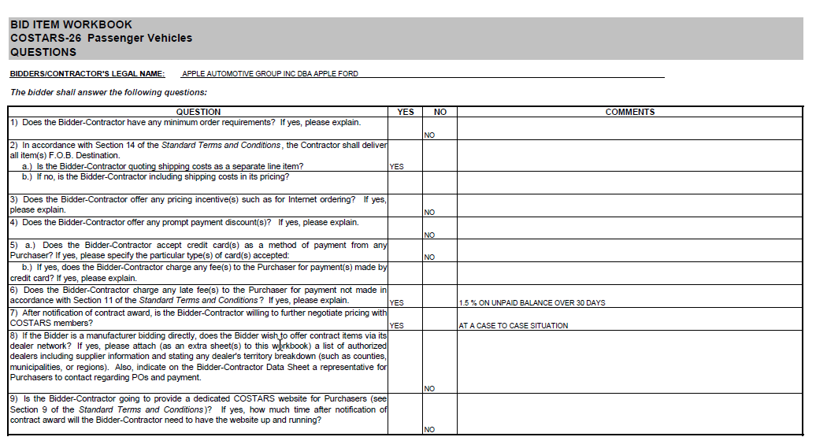
Search COSTARS Contracts
Sample Vendor
Notes:
We’ve also asked the supplier some important questions that may help you decide your top supplier options for quoting.
As you can see, this supplier does not have any minimum order requirements. Be sure to look at #4 to see if you can get extra savings through prompt-payment discounts. This supplier doesn’t offer one but as you can see by #6, there are late fee penalties. Lastly, be sure to notice if they answer YES to #7. Here’s where you can see your ability to negotiate with each supplier. Even if they indicate NO to this, it never hurts to try to negotiate further.

Slide 45
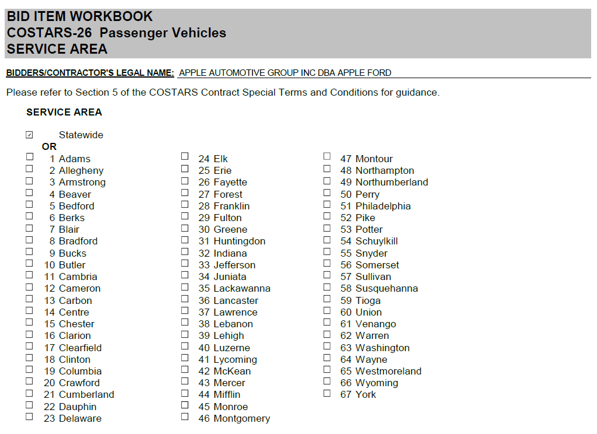
Search COSTARS Contracts
Sample Vendor
Notes:
They also indicate what counties they plan to serve.

Slide 46
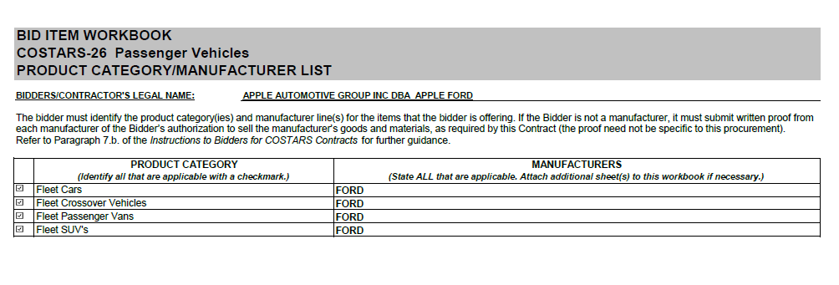
Search COSTARS Contracts
Sample Vendor
Notes:
Also found in the vendor contract are the product categories and manufacturers they offer in those categories. Here you can see that this supplier offers the Ford brand in the 4 product categories of this bid.

Slide 47
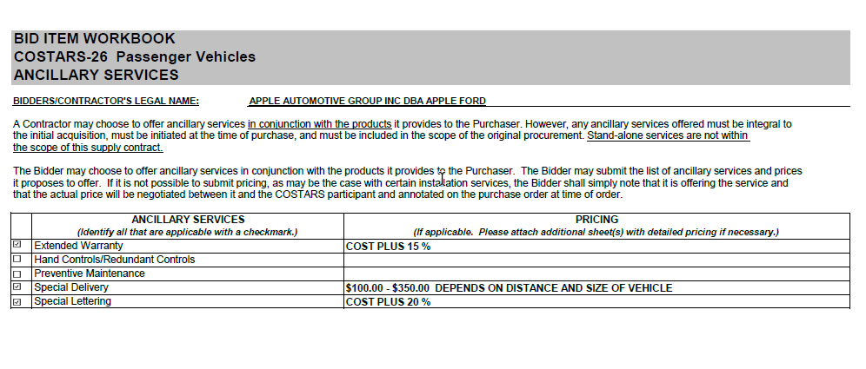
Search COSTARS Contracts
Sample Vendor
Notes:
The suppliers also indicate in this workbook any ancillary services and pricing they offer for those services.
This vendor is offering an extended warranty of 15% over cost and they are providing pricing information on things like special delivery and special lettering.
All ancillary services must be purchased at the same time as the product. These are not available as add-ons after the purchase date. Also, note that these services must be purchased in conjunction with the products purchased from the contract. These are not stand-alone services.

Slide 48
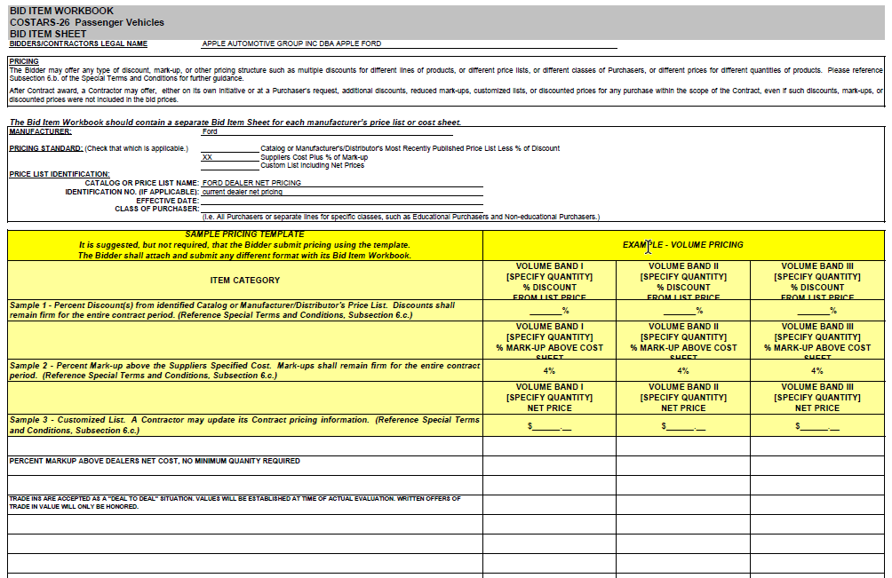
Search COSTARS Contracts
Sample Vendor
Notes:
And last, but not least, we find their pricing information.
Suppliers can offer 3 different types of pricing standards:
A percentage discount off the manufacturer’s/distributor’s most recently published price list – the price list and date must be indicated.
The supplier’s cost plus a percentage markup. The supplier must provide their cost to the member, if requested
Or they may attach a price list
The pricing on this supplier’s vehicles will be offered at 4% markup over the supplier’s cost. And notice…this pricing will remain firm through the entire contract period.
Pricing shown on this sheet is the ceiling price they will charge COSTARS members. A supplier can always choose to offer better pricing through the quote or even through negotiations.

Slide 49
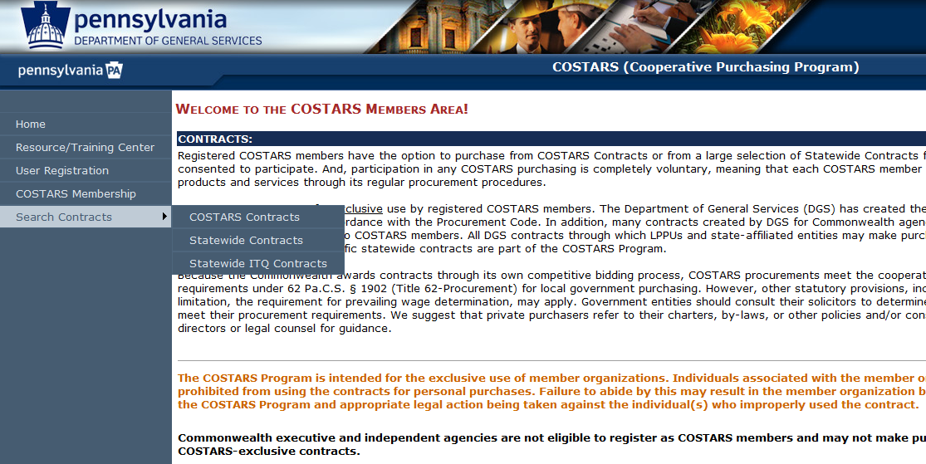
Compare with Statewide Contracts
Notes:
Once you’ve chosen several suppliers to negotiate with, you’ll want to compare your pricing with statewide contracts (or vice versa if you begin your search with Statewide contracts.)
Go back to the main COSTARS Members Area page to Search Contracts in the navigation pane. This time, we’ll choose “Statewide Contracts”.

Slide 50
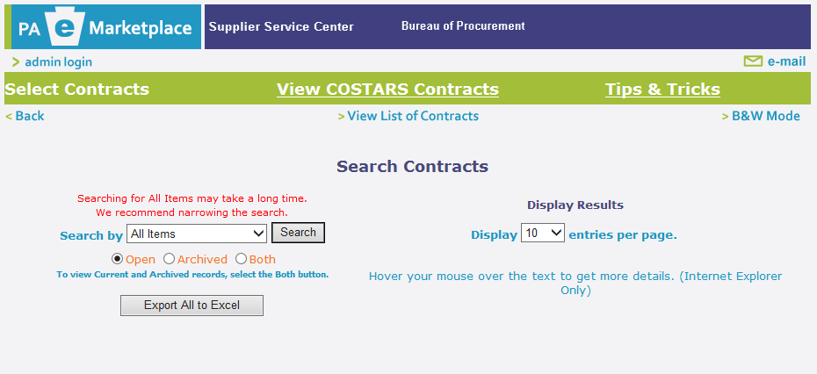
Search Statewide Contracts
Notes:
Here we can search Statewide Contracts, but also note, there is a quick link back to COSTARS Contracts in the green bar.
Also, notice, there is a Tips & Tricks link. This is a document you can refer to if you get stuck when searching state contracts in the future. It will walk you through the process.
Ok, back to our State Contract search…

Slide 51
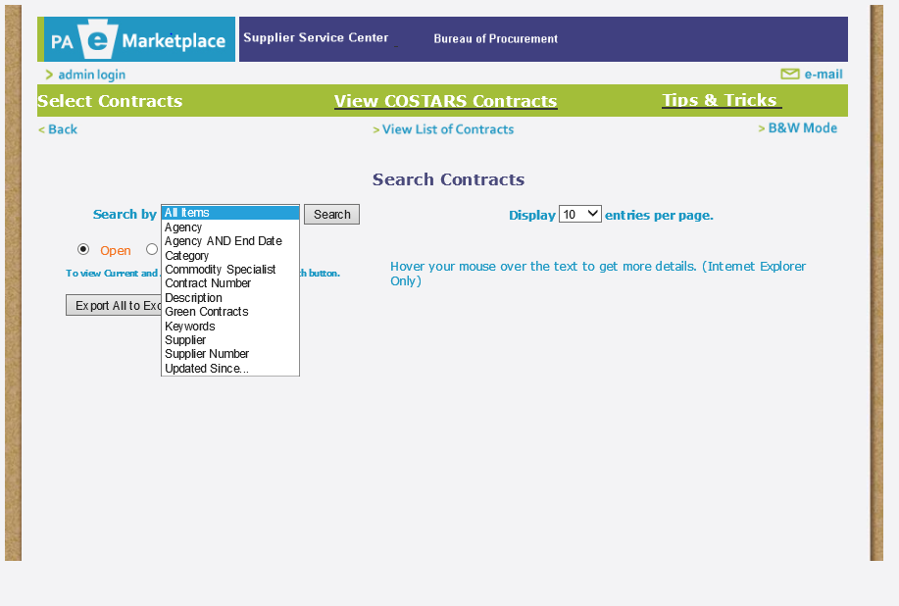
Search Statewide Contracts
Notes:
As you can see you can search by many different search criteria here too.

Slide 52
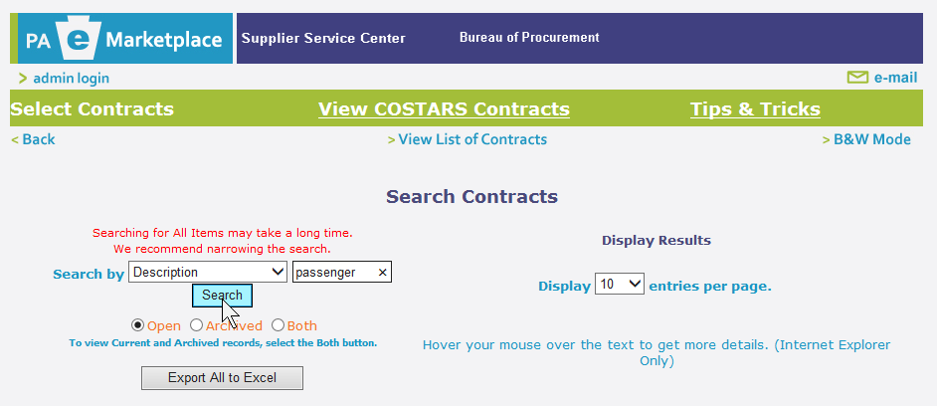
Search Statewide Contracts
Notes:
When using Description or Keyword, we can specify a search word we want to look for. Here’s a tip, when typing search words here, less is more. If we were searching for carpeting, you wouldn’t find anything with carpeting as a search word. You would want to use carpet. Sometimes one word will display a variety of different contracts.
We’ll search “passenger” to look for vehicles.

Slide 53
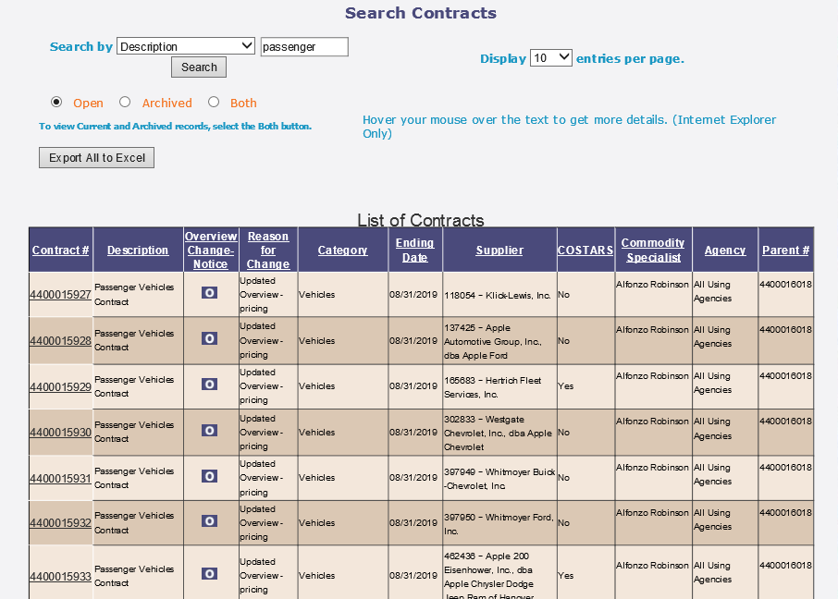
Search Statewide Contracts
Notes:
Here, you will want to pay attention to the COSTARS column to make sure you are comparing your pricing with the statewide suppliers who are offering their statewide pricing to COSTARS members. You are not able to purchase from suppliers who are not authorizing their contract for use by COSTARS members.
Again, you can look at the overview…

Slide 54
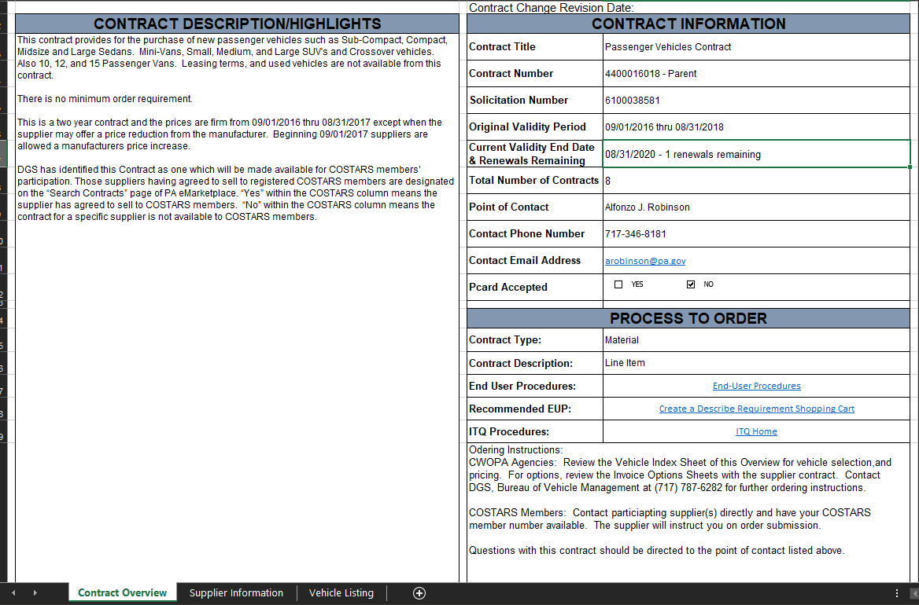
Search Statewide Contracts
Notes:
The overview in the statewide contracts looks different than the COSTARS version but you’ll find the same types of information in both.
Once you’ve reviewed the overview, you’ll want to click on the 2nd tab at the bottom to see the list of suppliers under the contract.

Slide 55
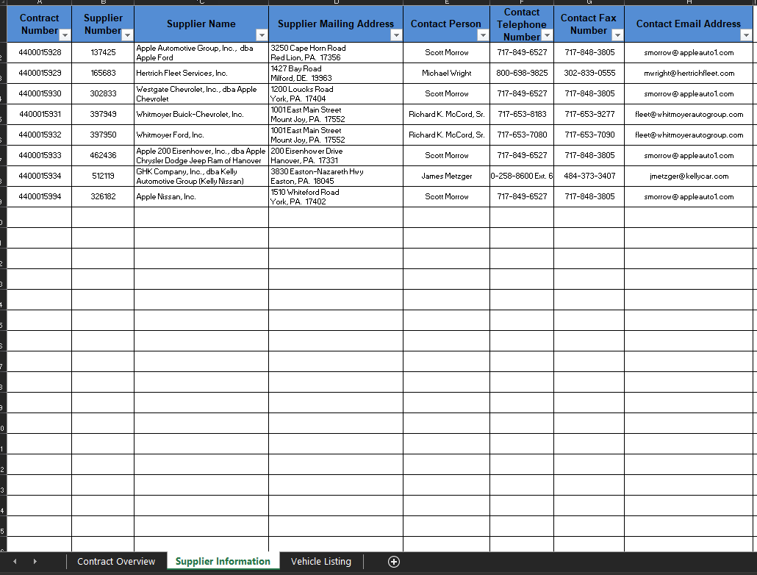
Search Statewide Contracts
Notes:
This list shows the contact info you will need for each individual supplier.
Remember, as a COSTARS member, you will work directly with both statewide and COSTARS-exclusive suppliers to make your purchases. Always remember to have your member number handy when working with these suppliers and reference the contract number you are purchasing under.
To see pricing, we’ll click the Vehicle Listing tab.

Slide 56
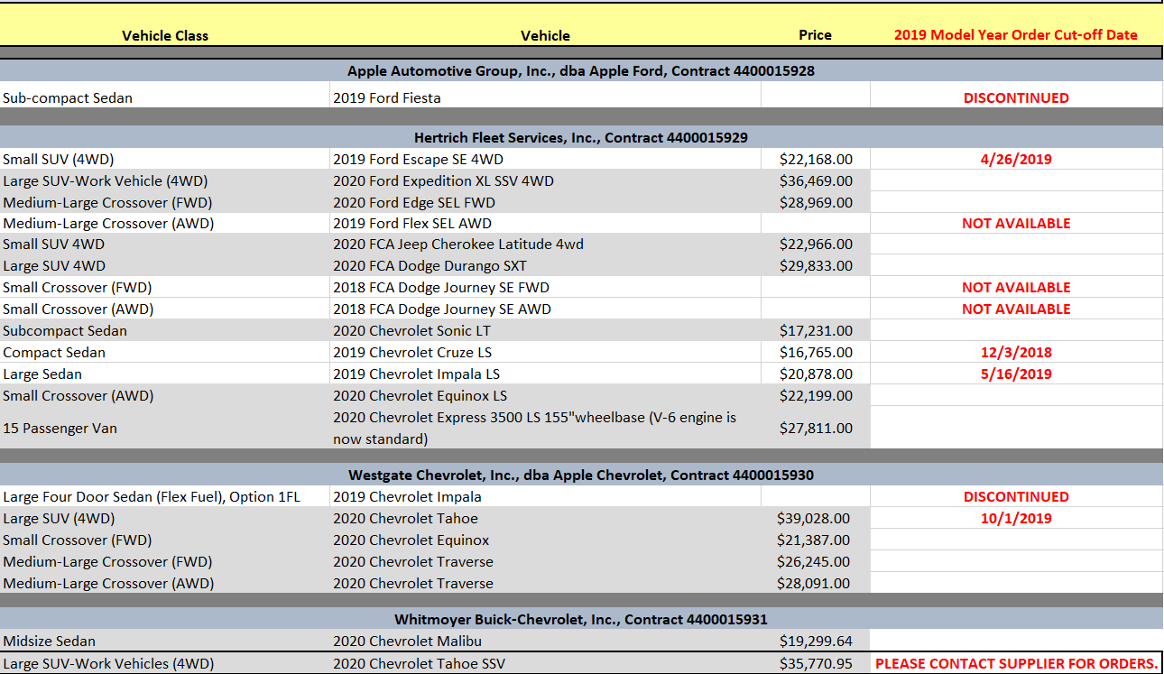
Search Statewide Contracts
Notes:
From here, you can see all vehicle classes, specific vehicles and prices listed per supplier.
You can also see special notes on when you need to place orders…
If your new search provided you with a better quote than you received from your initial search (COSTARS-exclusive or Statewide), be sure to go back to the supplier you are most interested in working with and negotiate again for a lower price/better value.
Now that we know how to search contracts, Felicia is going to go over some of the resources we have created to help you within the COSTARS process. (PITCH TO FELICIA)

Slide 57
COSTARS Member Resources
Helpful
Docs
Members’ Quote Kit
Guide to COSTARS Contracts
Education
Online Trainings & Guides
Webinars
Newsflash, Quarterly Newsletters
Email Alerts & Surveys
FAQ’s
Surplus Purchasing
Networking
Links to Associations & Gov. Agencies
EXPO
Social Media
News & Opportunities
Events
Notes:
FELICIA
In addition to providing you with competitively priced contracts, one of the main goals for the COSTARS team is the help make your jobs easier, so we offer our members many resources.
COSTARS-Exclusive Resources:
Guide to COSTARS Contracts
Members’ Quote Kit
F.A.Q.’s
Online trainings and guides
Webinars & Events
On-the-Road training, expos and educational sessions
The COSTARS team is active throughout PA, attending and exhibiting at trade events as well as presenting educational sessions
Newsflash area of COSTARS website
Quarterly Newsletters
COSTARS emails alerting you to important information
Surveys – we are always looking for your feedback!
Surplus Purchasing
Networking Opportunities at our EXPO every other year
Links to Associations and other governmental agencies
And lastly Social Media

Slide 58
Social Media
https://www.facebook.com/PAGenServices/
https://twitter.com/PAGenServices/
https://www.linkedin.com/company/pagenservices/
Notes:
We encourage our members to be active in COSTARS social media. This is a forum, outside of industry events, for members to exchange information with each other and the COSTARS team and announce your WINS!
Saving money for your community and the Commonwealth’s taxpayers is an accomplishment. Be proud of your savings and promote them!

Slide 59
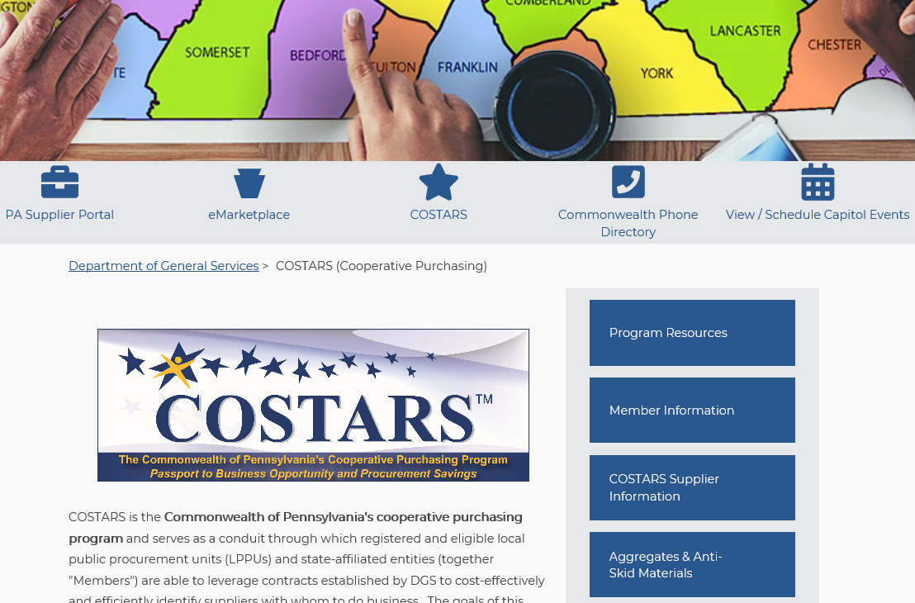
Resources
www.dgs.pa.gov/COSTARS
Notes:
We’ll walk through how to locate some of the resources we discussed.
We’ll go back to www.dgs.pa.gov/COSTARS, and we are going to look at the Program Resources tile and the Member Information tile.
We’ll go to the Member Information tile first.

Slide 60
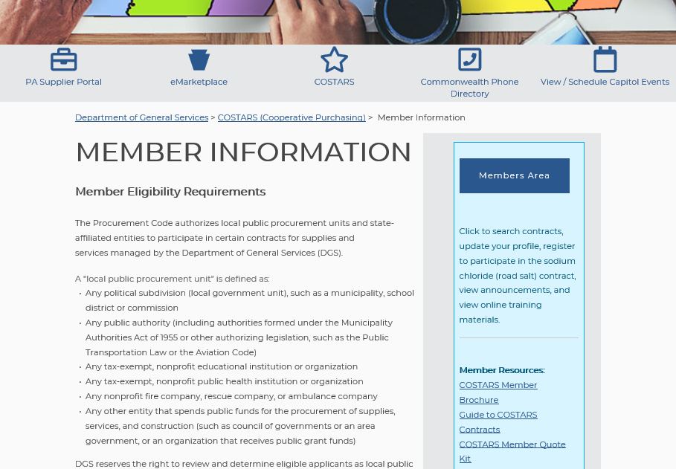
Resources
Notes:
The Member Quote Kit is located in the light blue are below the Member Area button.

Slide 61
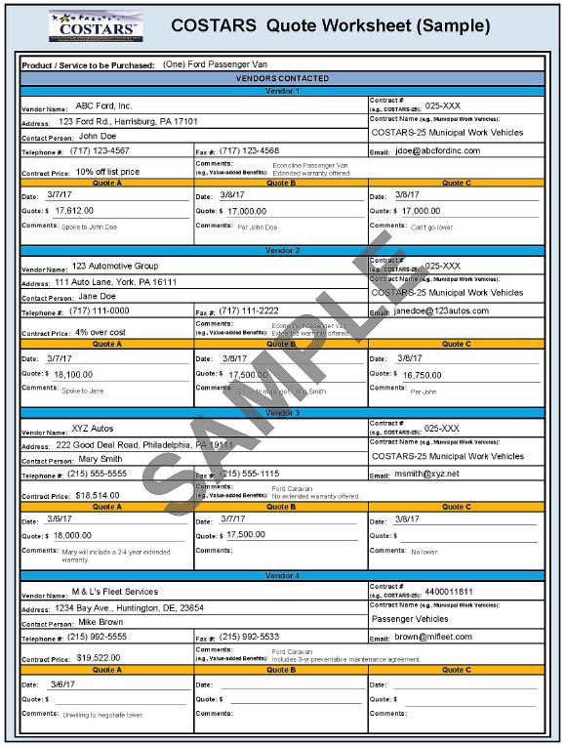
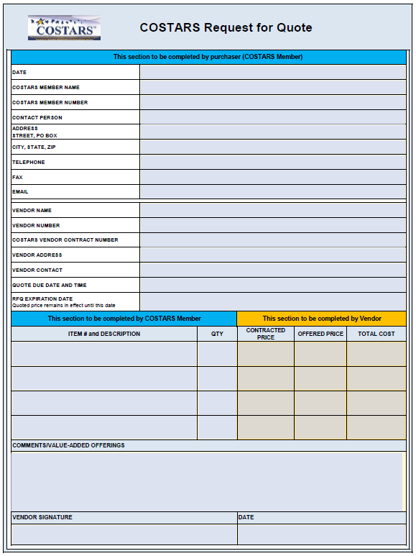
Resources
Notes:
In this kit, you will find a blank quote summary page as well as a sample page, seen here, so you can easily organize and compare your quotes.
We also include a sheet that you fill out and send to each supplier you wish to supply a quote for your project. They will fill out their offer based on the requirements of your project and return it to you. This allows you to have a signed, final document listing any negotiated pricing you and the supplier discussed.
We recommend that you keep a copy of this worksheet in your files in the event you are audited.
This quote kit and the recommended 3-4 quotes are not mandatory. The quotes and this kit paired together are a great way to ensure you are getting the best price for the supplier you most want to work with!

Slide 62
Resources
www.dgs.pa.gov/COSTARS
Notes:
To find the additional resources, we’ll go back to www.dgs.pa.gov/COSTARS, and click on the Program Resources tile to look at some other resources available to our members

Slide 63
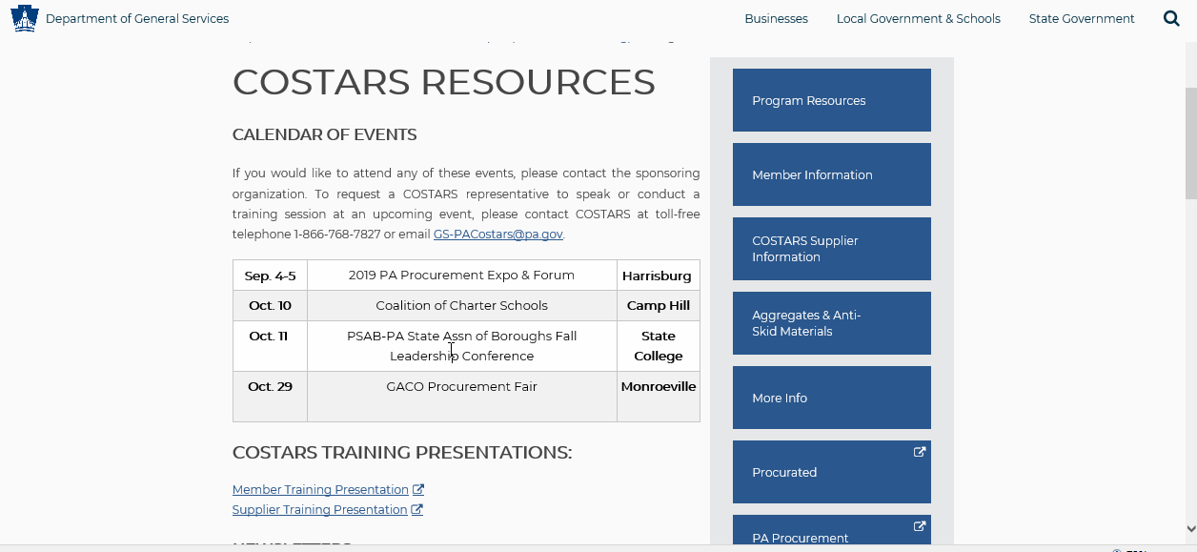
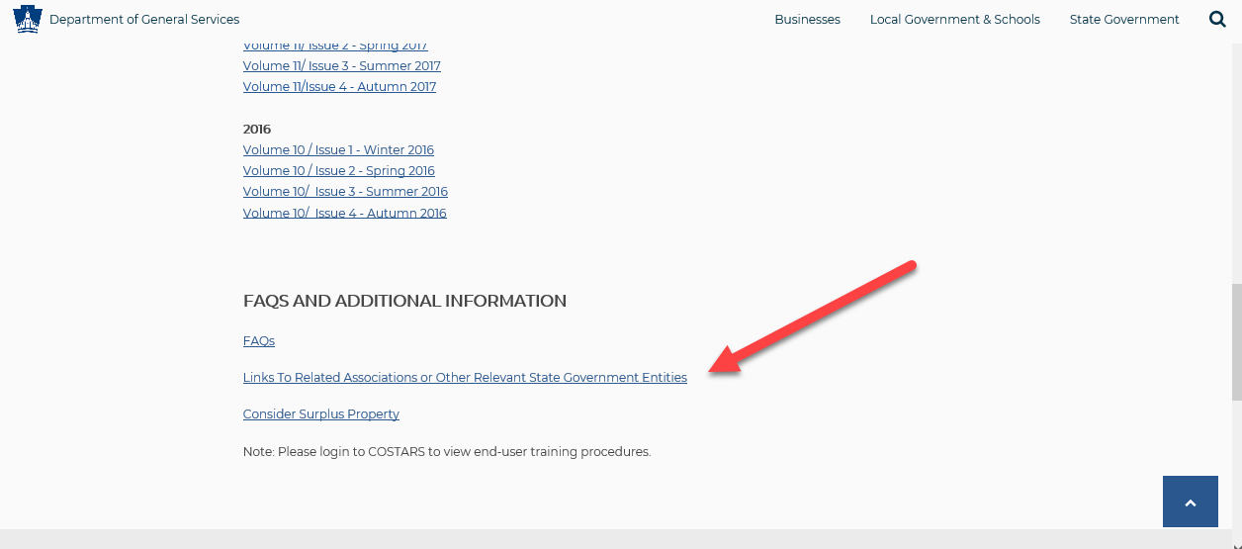
Resources
Notes:
Here you will find:
COSTARS Calendar of Events (back window)
On this calendar, you will see additional webinars we have planned for this year. When each is ready for registration, you will see hyperlinks in this calendar to register for each individual webinar.
Member Training Presentation (back window)
This is a video giving an overview of COSTARS and a detailed search demo much like you are experiencing today
This area also includes current and past issues of our newsletters (front window)
F.A.Q.’s
A link to related associations and other state governmental entities
A link to purchasing surplus property

Slide 64
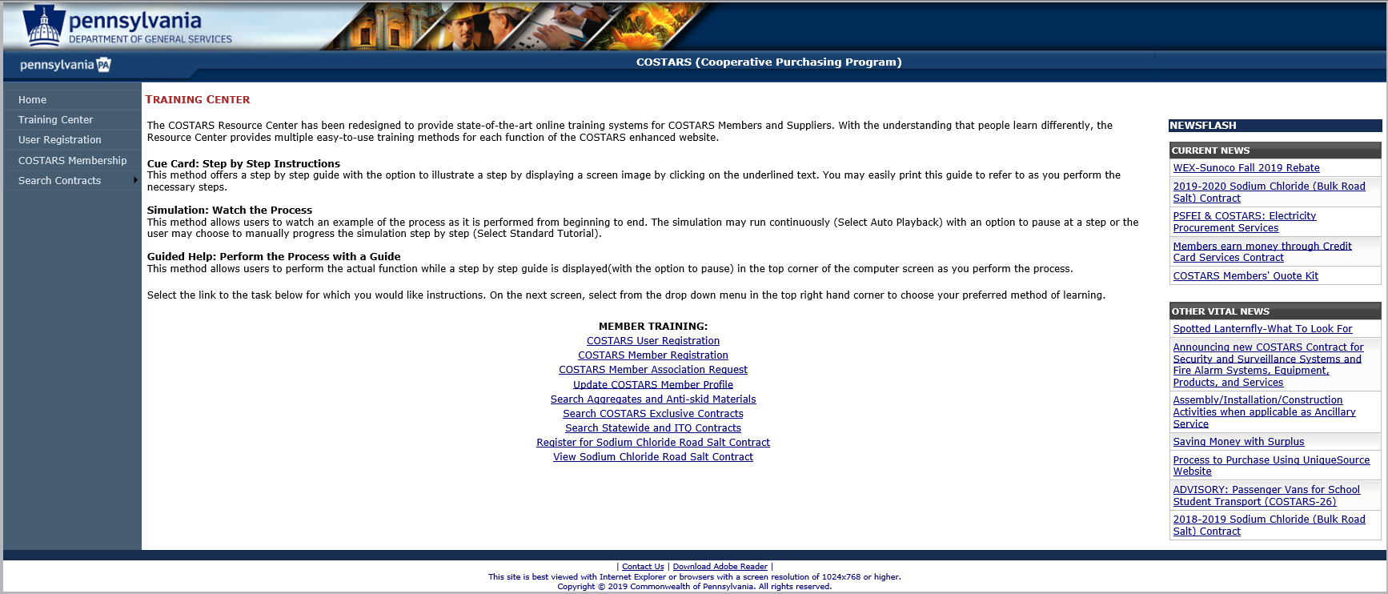
More on COSTARS Training
Notes:
We talked about the member and supplier training videos, but we also have the Training Center that has training modules to help you through individual processes within COSTARS. Here’s where you can find these trainings.
In the COSTARS Member Area, the Training Center’s trainings are broken into segments. If you only need to see how to update your member profile, you would choose the link to “update your member profile”.
There is also a training module for searching Aggregates and Anti-skid materials.

Slide 65
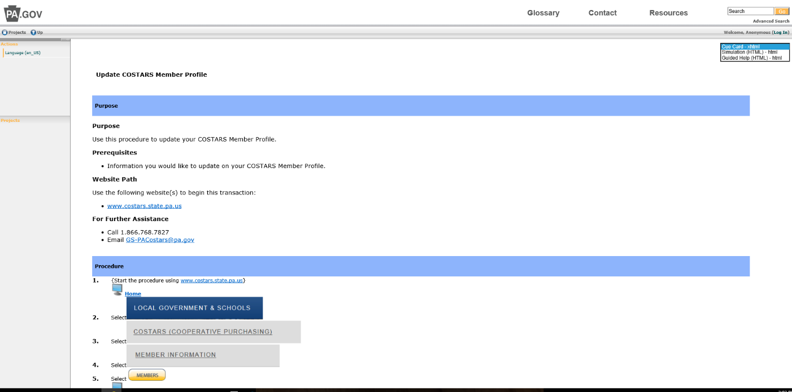
More on COSTARS Training
Notes:
The COSTARS team has thought about the different learning styles of our users, so we have created 3 different versions of the trainings:
Cue Card
Simulation
Guided Help

Slide 66
User Profile Recommendations
Verify your member profile information today
Primary Contact name, phone & email address
Are primary contact’s email and general email the same?
Confirm general email address
Update any P.O. Box to a street address of your office
Notes:
Since we just discussed updating the member profile, we have some recommendations for you…
We know that staff changes often as people transition into new positions or move on to other opportunities.
We recommend everyone verifies their member profile information today
Verify your primary contact is still current
Verify that the primary contact’s email and the general email address are the same – or that the general email address delivers to someone who understands the COSTARS system and its benefits to your organization
The general email address is very important because that is the email address that is used when we send member alerts and other important information like newsletters to our membership
If any changes are made to your record, you may not be able to save your updates without retyping your general email address under the email address cell in the organization contact section
If you have a P.O. Box as an address in your profile, please change this to the street address of your office.
Our system automatically links your organization with your legislative contacts and it doesn’t work with P.O. Boxes

Slide 67
Contact Us
COSTARS
Department of General Services
Bureau of Procurement
555 Walnut Street
6th Floor, Forum Place Harrisburg, PA 17101
1-866-768-STAR (7827)
www.dgs.pa.gov/COSTARS
Email: gs-pacostars@pa.gov
https://www.facebook.com/PAGenServices/
https://twitter.com/PAGenServices/
https://www.linkedin.com/company/pagenservices/
Notes:
And of course, if you cannot find the answer to a question, the COSTARS team is always here to help.
We recommend using the phone and email address listed in the blue area. This will connect you to the COSTARS team, so if an individual happens to be unavailable, others will be aware you’ve reached out and can help you.

Slide 68
2020 Webinar Schedule
Date | Webinar
Tuesday, July 21 | 911 – Get into Gear!
Tuesday, September 22 | Equipped to Serve
Tuesday, October 6 | Purchasing and Fleet Card Programs: Forge Ahead with Discounts
Wednesday, November 4 | COSTARS Your Procurement Partner
www.dgs.pa.gov/COSTARS
Email: gs-pacostars@pa.gov
https://www.facebook.com/PAGenServices/
https://www.linkedin.com/company/pagenservices/
Notes:
KIM
As we mentioned earlier, we have a full webinar schedule this year and we want to share these dates and topics with you.
These webinars will be listed on the Program Resources page on our events calendar. Once registration opens for each webinar, you will find a link to register right in the calendar for each event.

Slide 69
The COSTARS Program
Simplifying Local Procurement
Notes:
Do you have any questions for us?
I hope you have a lot of good takeaways from today’s presentation. We appreciate your time and partnership and we want to be your most valuable procurement resource! And please, remember to share your wins with us! We love to share our members’ savings stories!

