Slide 1
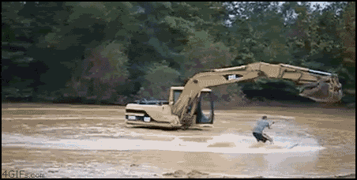
DGLVR Webinar
Coronavirus Impacts and 5/1 Allowance for restart of Construction
4/28/20
Starts at 9am
If you are reading this, then you are successfully seeing the webinar video. Webinar audio should be automatic through your computer, and options can be accessed in the “audio options” button on the bottom left. If your computer audio is not working, you can listen on your phone by dialing 312-626-6799.
Audio via Phone: 646-876-9923

Slide 2
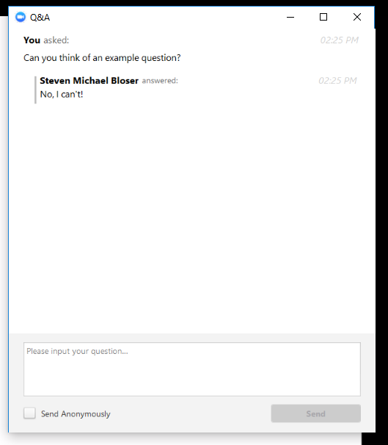
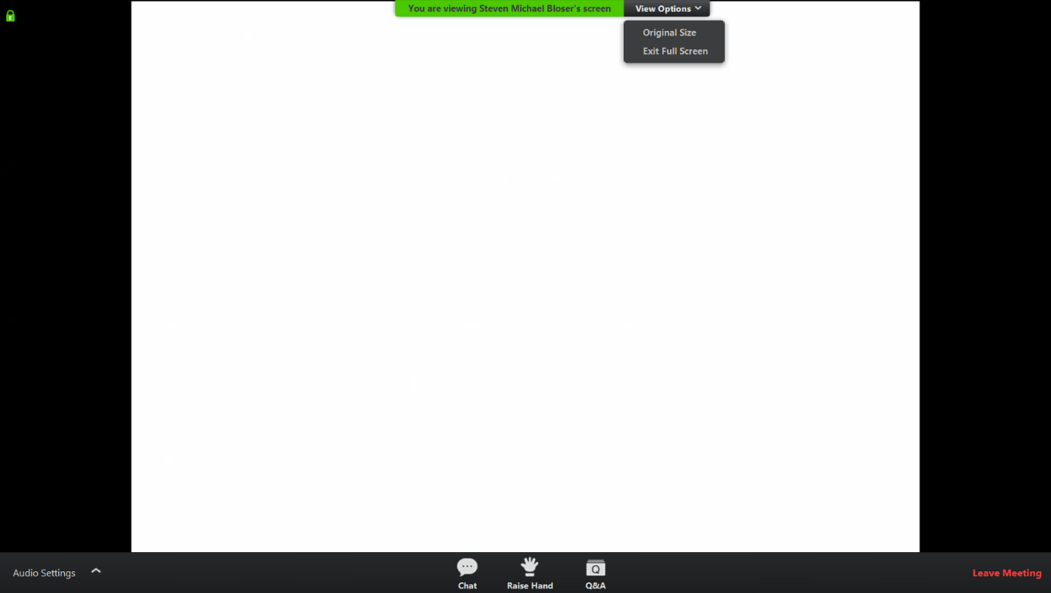
Q&A
Note you can ask a question anonymously
Q&A
Audio via Phone: 646-876-9923
Slide #

Slide 3
DGLVR Webinar
Impacts and Considerations from Coronavirus
Purpose:
Review DGLVR Program impacts from Coronavirus
Prepare for “restart of construction”
Allow CDs to ask questions
Audio via Phone: 646-876-9923

Slide 4
DGLVR Impacts and Considerations from Coronavirus
Current Restrictions Overview:
PSU/CDGRS
Remote work until through May 8th at least
Allowed to travel to support construction May 1
No trainings until July?????
State/SCC
Remote work until May 8th at least
Allowed to travel to support construction May 1
TU
Allowed to travel to support construction May 1
Allowed to travel for technical assistance to green/yellow counties May 8
Audio via Phone: 646-876-9923

Slide 5
DGLVR Impacts and Considerations from Coronavirus
ESM Trainings:
Current Status
3/25-26, Huntingdon - POSTPONED
3/14-15, McKean - POSTPONED
4/22-23, Berks - POSTPONED
5/12-13, Somerset- POSTPONED
6/2-3, York - POSTPONED
6/17-18, Erie - POSTPONED
Remaining: TBD
Audio via Phone: 646-876-9923

Slide 6
DGLVR Impacts and Considerations from Coronavirus
QAQCs:
~22 scheduled for 2020
Current Status
March: 2 postponed
April: 3 postponed
May: 1 postponed, 2 others TBD
Contact Justin Challenger with questions

Slide 7
DGLVR Impacts and Considerations from Coronavirus
Updates Covered in Past Webinars:
Budgets
Spending Requirements
CD Allocations
Assessments
CD Board and QAB Meetings
Traffic Counts
www.dirtandgravelroad.org – Education/Training – Webinars – Past Webinars

Slide 8
DGLVR Impacts and Considerations from Coronavirus
Pennsylvania Links
Red/Yellow/Green Reopening Plan: https://www.pa.gov/guides/responding-to-covid-19/#PhasedReopening
Guidance for construction industry: https://www.governor.pa.gov/wp-content/uploads/2020/04/20200423-Construction-Industry-Guidance.pdf
PA Worker Safety Order: https://www.governor.pa.gov/wp-content/uploads/2020/04/20200415-SOH-worker-safety-order.pdf
CDC Links
Preparing small business for Covid-19: https://www.cdc.gov/coronavirus/2019-ncov/community/guidance-small-business.html
Cleaning and disinfecting your building: https://www.cdc.gov/coronavirus/2019-ncov/community/disinfecting-building-facility.html
All links provided in webinar announcement e-mail

Slide 9
DGLVR Impacts and Considerations from Coronavirus
System: County Specific
DISCLAIMER
Roy, Justin, and Steve are NOT the pandemic safety experts, nor can they give you approval to start work.
We are just trying to share information provided by others.
Follow local guidance for restart of work.

Slide 10
DGLVR Impacts and Considerations from Coronavirus
Phased Reopening of PA
Red, Yellow, Green System: County Specific
Starts May 8th – likely Northcentral and Northwest PA will reopen first
Depends on:
Number of new cases per capita
Availability of tests
Other factors
https://www.governor.pa.gov/process-to-reopen-pennsylvania/

Slide 11
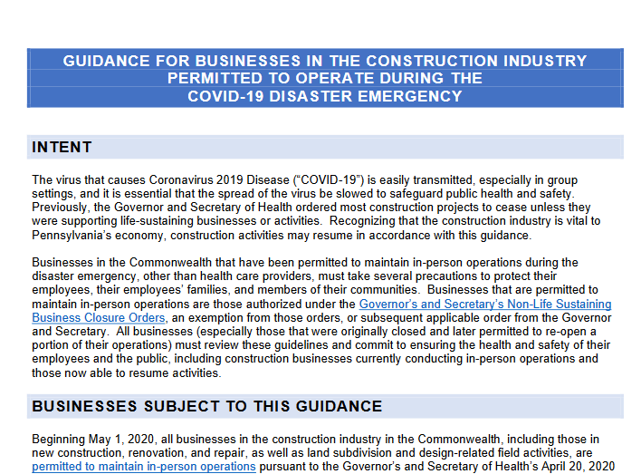
DGLVR Impacts and Considerations from Coronavirus
Restart of Construction: May 1
Regardless of red/yellow/green status
https://www.governor.pa.gov/wp-content/uploads/2020/04/20200423-Construction-Industry-Guidance.pdf

Slide 12
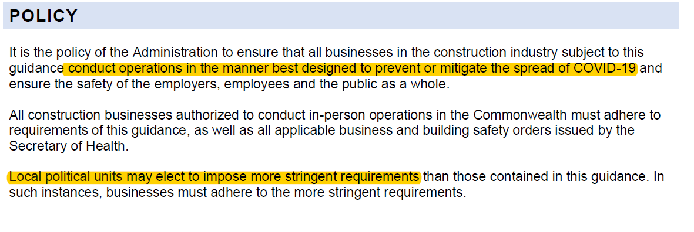
DGLVR Impacts and Considerations from Coronavirus
Restart of Construction: May 1

Slide 13
DGLVR Impacts and Considerations from Coronavirus
Restart of Construction: May 1

Slide 14
DGLVR Impacts and Considerations from Coronavirus
Restart of Construction: May 1
…continued

Slide 15
DGLVR Impacts and Considerations from Coronavirus
Restart of Construction: May 1
…continued

Slide 16
DGLVR Impacts and Considerations from Coronavirus
Restart of Construction: May 1
…continued
The primary responsibility of the Pandemic Safety Officer will be to convey, implement, and enforce the social distancing and other requirements of this guidance for the protection of employees, suppliers, and other personnel at the site.

Slide 17
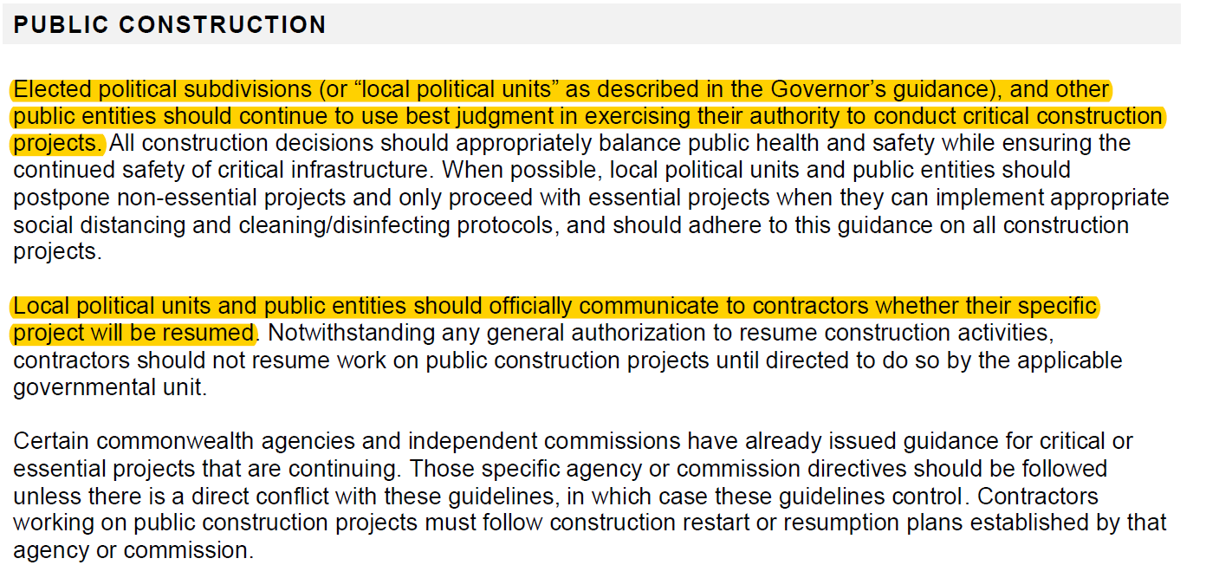
DGLVR Impacts and Considerations from Coronavirus
Restart of Construction: May 1
…continued

Slide 18
DGLVR Impacts and Considerations from Coronavirus
Restart of Construction: May 1
…continued

Slide 19
DGLVR Impacts and Considerations from Coronavirus
Common Sense Practices:
Wipe down frequently touched areas of vehicles (steering wheel, shifter, radio)
Drive to worksite separately
Wear a face mask on the jobsite
Wear gloves, if necessary
Travel separately in vehicles
Maintain social distancing
Carry hand sanitizer or sanitizer wipes – wash hands often
Wipe down frequently touched areas of vehicle upon retur
Postpone visit if anyone involved has a sick family member r co-worker

Slide 20
DGLVR Impacts and Considerations from Coronavirus
A Twp wants to start a project that is already under contract that they are doing on their own (no contractor).
This is a local decision up to the Conservation District.
If the CD is allowed and comfortable providing oversight, the project can move forward.
Otherwise the project should be delayed.
CD is responsible for quality assurance on all projects.
PSU/SCC/and TU are not allowed to travel to provide technical assistance until 5/1.
PSU/SCC/TU staff are available for assistance remotely.

Slide 21
DGLVR Impacts and Considerations from Coronavirus
A Contractor wants to start a project that is already under contract.
This is a local decision up to the Conservation District.
If the CD is allowed and comfortable providing oversight, the project can move forward.
Otherwise the project should be delayed.
CD is responsible for quality assurance on all projects.
PSU/SCC/and TU are not allowed to travel to provide technical assistance until 5/1.
PSU/SCC/TU staff are available for assistance remotely.

Slide 22
DGLVR Impacts and Considerations from Coronavirus
Note that some parts of the state will return to “normal” faster than others.
CDGRS and SCC staff can’t “run” your projects for you. If a CD representative is unavailable, you need to postpone.
CD is responsible for quality assurance on all projects.

Slide 23
DGLVR Impacts and Considerations from Coronavirus
Other Potential Quarantine Tasks for CDs:
Assessments
Virtual meetings with CDGRS/SCC staff using screen sharing (site discussion using pictures, application review, pre-design talks, plan reviews, etc.)
Familiarize yourself with optional documents (bid documents, checklists, etc)
Review Bid packets, permits, etc
Review QAB policies
Professional development, outside trainings, certifications, LTAP Road Scholars: Some classes are now webinars
Develop a newsletter?
Plan new education and outreach events (recorded webinar)
Keep up contact to your municipalities!!

Slide 24
DGLVR Impacts and Considerations from Coronavirus
Thursday 4/30 COSTARS Webinar Postponed
Check your e-mail for an update later today

Slide 25
DGLVR Impacts and Considerations from Coronavirus
Technical Assistance in the Field
Center May 1
Wade Brown: web127@psu.edu
Dave Creamer: dmc159@psu.edu
Maria Dreese: maa241@psu.edu
Dave Morrison: dcm35@psu.edu (DSA Notifications)
Eric Nevel: ern106@psu.edu
Tim Ziegler: tmz115@psu.edu
Steve Bloser: smb201@psu.edu
Trout Unlimited May 1 for Construction and May 8 for TAs in green/yellow
Jake Tomlinson: Jacob.Tomlinson@tu.org
Shaun McAdams: shaun.mcadams@tu.org
Phil Thomas: Philip.Thomas@tu.org
SCC May 1
Roy Richardson: rrichardso@pa.gov
Justin Challenger: jchallenge@pa.gov
Everyone is behind and will be in a hurry!
Contact us as early as possible
Please be patient
If you are uncomfortable or unavailable, delay project
https://www.dirtandgravel.psu.edu/center-info/center-staff-contact-information

