Slide 1
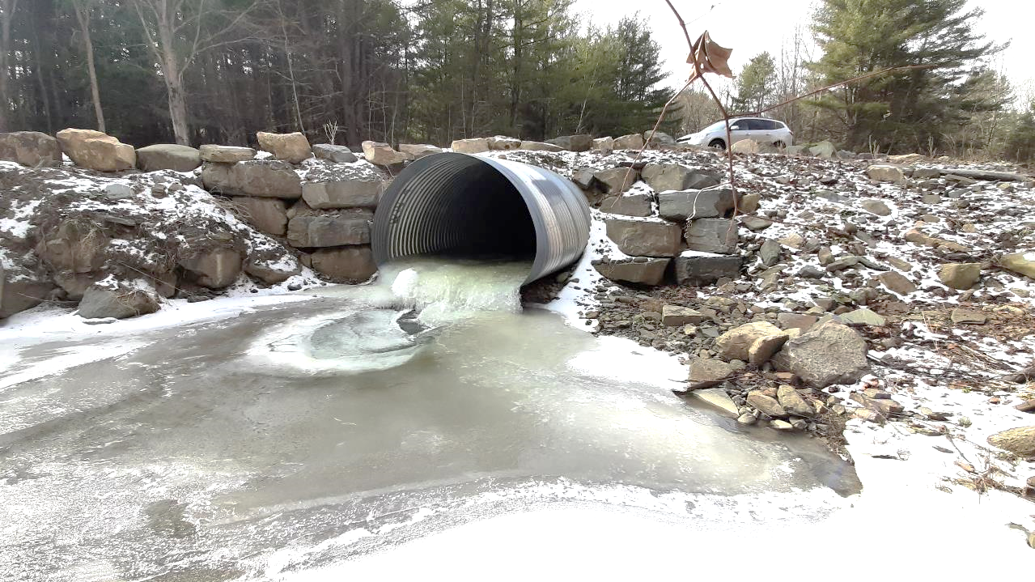


Dirt Gravel and Low Volume Road Program
WEBINAR
2/13/25, 9am
DGLVR
Program Updates
CDGRS
Steve Bloser
smb201@psu.edu
SCC
Sherri Law
shlaw@pa.gov
Andy Mickey
anmickey@pa.gov
If you are reading this, then you are successfully seeing the webinar video. Webinar audio should be automatic through your computer (or click “join audio”), and options can be accessed in the “audio options” button on the bottom left. If your computer audio is not working, you can listen on your phone by dialing 646-876-9923.

Slide 2
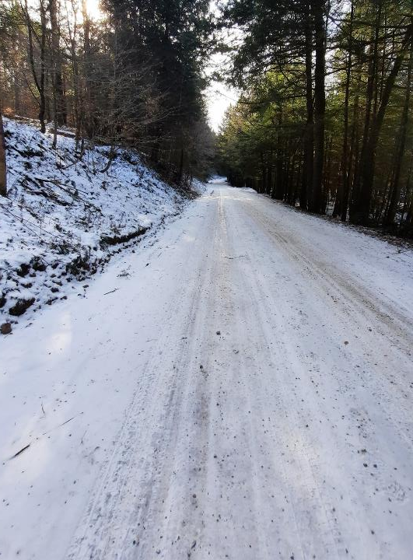



2025 Program Updates
2025 Training Opportunities
2025 QAQCs
Program Policy Update
Program Spending Update
Program Funding Update

Slide 3
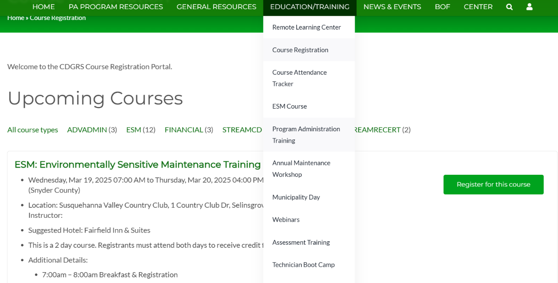
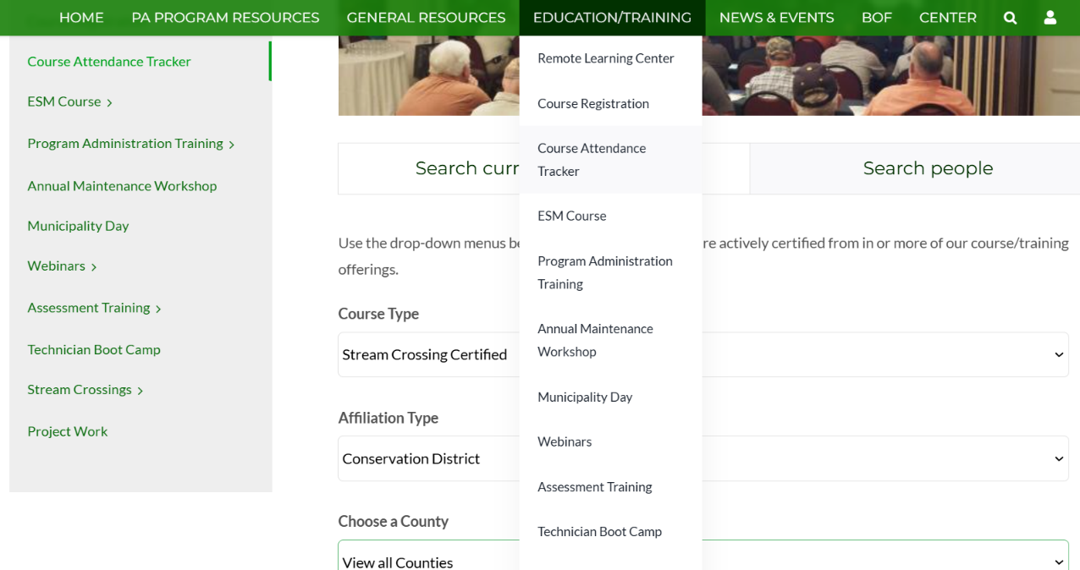
Course Attendance Tracker
Search certifications for all attendees of ESM, Stream Trainings, and Admin trainings

Slide 4

Course Registration
View and register for upcoming courses

Slide 5


ESM Training
2-day classroom training for Program Eligibility CD staff encouraged to go first morning for introductions
12 scheduled for 2025, based on requests and recent locations
CDGRS updated several modules this winter
  Orientation
  Infiltration
  Streams
  LVR
  Project Examples
March 19 & 20 (Snyder)
April 15 & 16 (Fayette)
May 14 & 15 (Mercer)
May 28 & 29 (Huntingdon)
June 4 & 5 (Adams)
July 9 & 10 (Luzerne)
July 30 & 31 (Butler)
August 13 & 14 (Tioga)
August 27 & 28 (Erie)
September 3 & 4 (Washington)
October 7 & 8 (Berks)
October 28 & 29 (Monroe)
Registration open

Slide 6
Stream Trainings - CDs
Standard CD Training
Intended for new CD staff
3-day in-person
Centre: 5/20-22
Centre: 8/19-21
NEW Re-certification CD Training
Intended for CD staff who have been to standard training
1.5-day in-person
Centre: 7/15-16
Centre: 10/21-22
Registration open

Slide 7
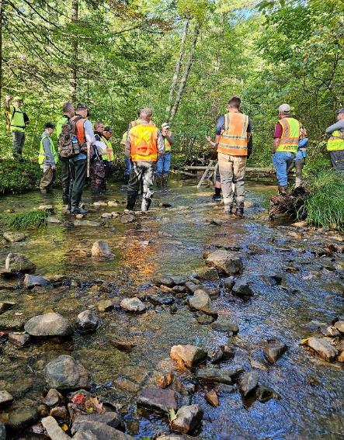
Stream Trainings - Engineers
Engineer Stream Trainings
For designers / engineers for stream crossings
1.5 days (1/2 remote, 1 in person)
Union: 8/5-6
Elk: 9/9-10
Registration open

Slide 8
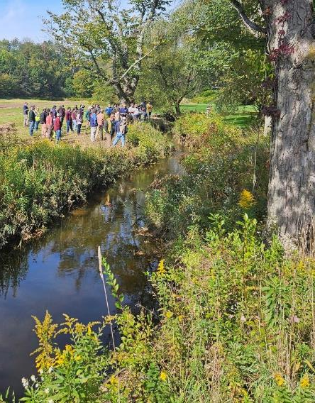
Stream Trainings - DEP
DEP Stream Trainings
For DEP permit review staff
1.5 day in-person
Two scheduled Spring 2025
DEP is handling registrations

Slide 9
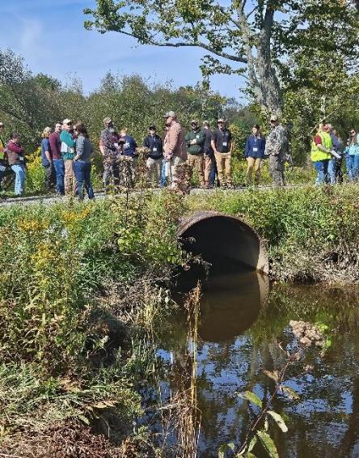
Stream Trainings - Other
Interest from other groups:
PA Game Commission
Western PA Conservancy
PA DCNR Forestry

Slide 10
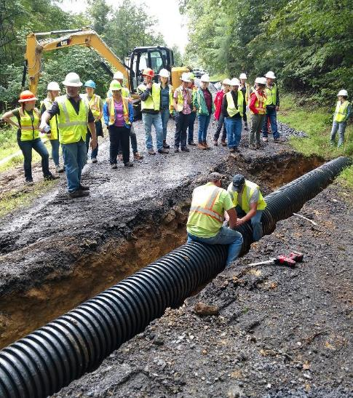
Boot Camps
DGLVR Boot Camps
3 day in-person trainings for CD DGLVR technicians.
Intended more for “NEW” technicians, but refreshers welcome.
Mixture of class sessions and field trips to proposed, active, and completed sites.
Working to schedule 1-2 for 2025

Slide 11
Boot Camps
DGLVR Boot Camps
CD Survey

Slide 12
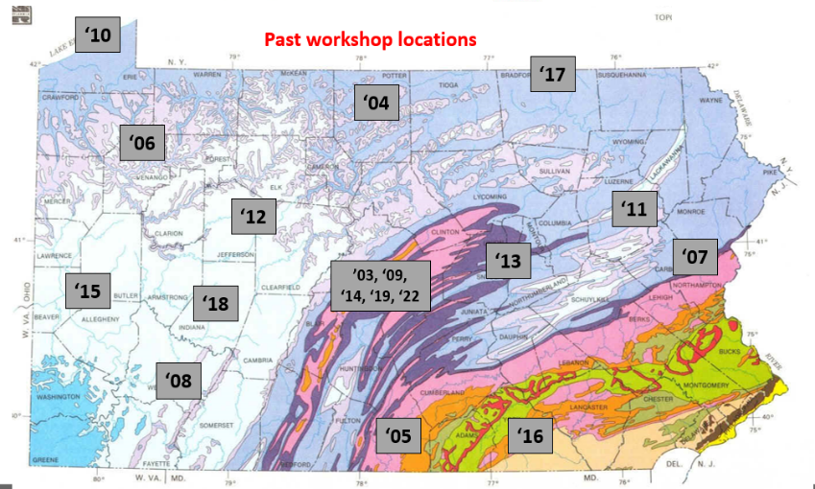
Workshop
DGLVR Workshop
Annual 3-day conference with concurrent class sessions and multiple field trips
2025 Workshop
Gettysburg
September 23-25
‘24

Slide 13
Technical Assistance
Winter Technical Assistance
  THIS IS A GREAT TIME FOR TECHNICAL ASSISTANCE!!
  Take advantage of the (relatively) slow time! Technical assistance wait times increase dramatically when spring hits.
  smb201@psu.edu

Slide 14
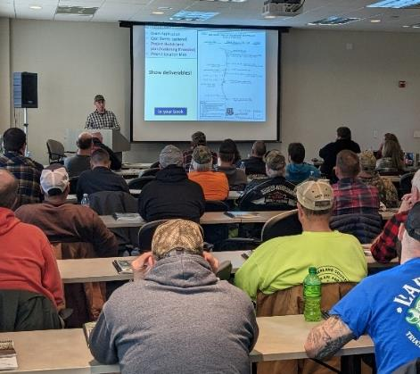
Admin Training
Wide variety of needs for administrative training:
  New technicians
  Experienced technicians
  Financial and administrative staff
Solution: More training options
  Basic Admin Training
  Advanced Admin Training
  Financial Training
  New Hire Training
Registration open

Slide 15

Advanced Admin Training
New in 2025
Geared towards district staff responsible for running DGLVR Program day-to-day.
Open to any conservation district staff who has completed the Basic DGLVR Admin Training.
Attendees are re-certified in DGLVR Program Administration for 3 years.
https://www.vhv.rs/download/TiwmRbR_graphic-picture-of-a-meeting-group-work-group/#google_vignette

Slide 16
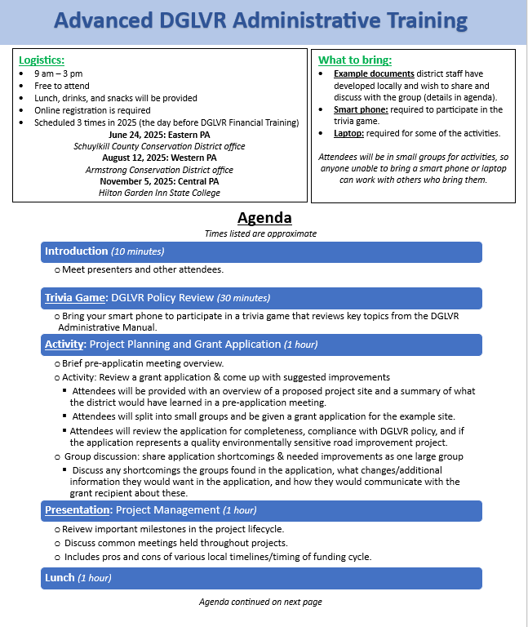
Advanced Admin Training
Agenda:
full agenda and logistics document on website
Focus on small group work and discussion
Includes:
  Policy trivia game
  Grant application review activity
  Project management presentation & discussion
  Practice reviewing invoices and filling out completion report

Slide 17
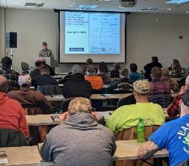
Admin Training
Is Advanced Admin Training replacing the current Admin Training?
  No – There are now 2 types of Admin Training!
  Basic Advanced

Slide 18
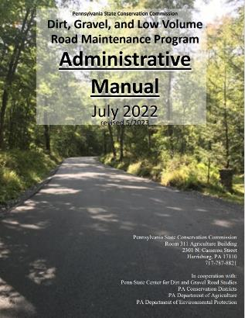
Admin Training Requirements
Unchanged: Conservation district staff person(s) most directly responsible for administering the Program must attend maintain DGLVR Program Administration Training at least every 3 years
To become certified in DGLVR Program Administration:
  district staff must attend Basic Admin Training
To renew certification in DGLVR Program Administration:
  District staff may attend Basic Admin Training
  District staff may attend Advanced Admin Training
Only new addition is option of Advanced Admin Training for recert

Slide 19


Financial Training
Geared towards district staff involved in DGLVR finances
  Highly recommended for at least one staff at each CD who is responsible for DGLVR finances
  Any district staff involved in the DGLVR Program are welcome to attend!
Covers:
  DGLVR financial policy, tracking funds, GIS financial tools
  Reconciling the GIS and conservation district DGLVR account balances
  Budgeting and spending requirements
  The financial portion of Quality Assurance / Quality Control visits (QAQCs)
https://en.wikipedia.org/wiki/File:Happy_Man_Throwing_Money_Cartoon.svg https://commons.wikimedia.org/wiki/File:Cartoon_Woman_Looking_Enjoying_The_Flying_Money_Around_Her.svg

Slide 20
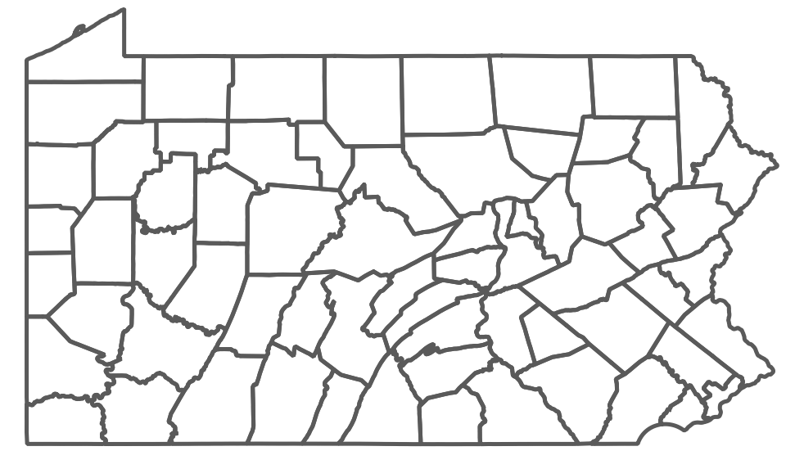
2025 Training Schedule
Advanced Admin and Financial Training scheduled back-to-back in 2025
Can attend one or both days
Hilton Garden Inn State College
Wed 11/5/25: Advanced Admin Training
Thurs 11/6/25: Financial Training
Armstrong CD office
Tues 8/12/25:
  Advanced Admin Training
Wed 8/13/25:
  Financial Training
Schuylkill CCD office
Tues 6/24/25:
  Advanced Admin Training
Wed 6/25/25:
  Financial Training

Slide 21
New Hires
Reach out to notify the DGLVR Program of new conservation district staff getting involved in the DGLVR Program and to schedule Basic Admin Training
Amy Lee Pifer: alp90@psu.edu or 814-863-9983
Administrative Coordinator, Center for Dirt and Gravel Road Studies
and
Sherri Law: shlaw@pa.gov or 223-666-2567
Conservation Program Specialist I, State Conservation Commission

Slide 22
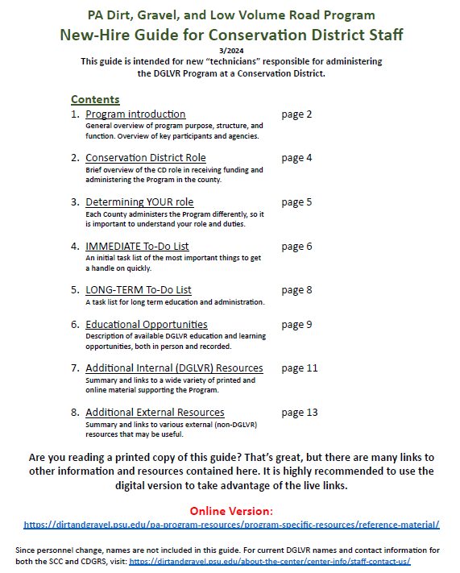
New Hires
Remember the New Hire Guide!
Geared towards technical conservation district staff new to running the DGLVR Program locally
Also a useful introduction for any other CD staff involved in the DGLVR Program
Reference Material - Center for Dirt and Gravel Road Studies

Slide 23
New Hires
One-on-One New Hire Training is available!
SCC and CDGRS visit to help new hires get a “jumpstart” to running the Program
Office visit and/or field visit
Tailored to whatever you need
If you don’t know what you need,
still schedule a day of new hire training!

Slide 24
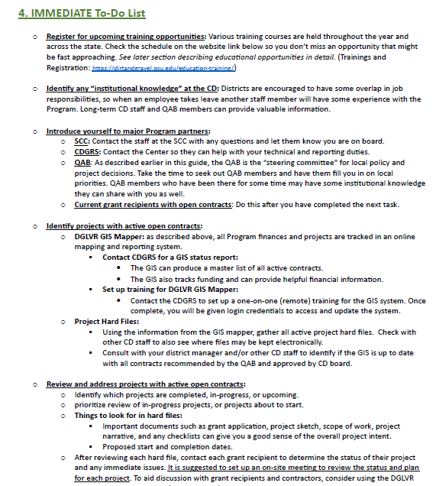
New Hires
One-on-One New Hire Training is available!
Potential topics:
  Open contracts for DGLVR Projects
  Timeline: application due date, QAB meeting, CD board meeting
  Education and outreach ideas and assistance
  Review applications in progress
  Visit DGLVR sites
    Potential, pre-application, funded, under construction, recently completed
  And more!

Slide 25
DGLVR Training Requirements Summary
 | Administration Certification | Environmentally Sensitive Maintenance (ESM) Certification | Stream Crossing Certification
Required for | CD staff person(s) most directly responsible for administering the Program | CD staff most involved in the Program Grant applicants One CD-appointed QAB member | CD staff most involved in the Program if the CD wants to fund stream crossing replacements
Initial Certification | Basic Admin Training | 2-day ESM Training | 4-day Stream Crossing Certification Training for CDs
Re-Certification | Basic Admin Training OR Advanced Admin Training | 2-day ESM Training OR Annual Maintenance Workshop | 4-day Stream Crossing Certification Training for CDs OR 1.5-day Stream Crossing Re-certification for CDs
Certification Length | 3 years | 5 years | 3 years
Certification expiration date | Dec 31st of the 3rd year | Dec 31st of the 5th year | Dec 31st of the 3rd year

Slide 26
Course Attendance Tracker
Search certifications for all attendees of ESM, Stream Trainings, and Admin trainings
Course Registration
View and register for upcoming courses

Slide 27
2025 Program Updates
2025 Training Opportunities
2025 QAQCs
Program Policy Update
Program Spending Update
Program Funding Update

Slide 28

2025 QAQCs
Round 5 QAQC – 2024 Summary
  21 QAQCs completed
  Overall Findings
    10 “Meets Expectations”
    11 “Exceeds Expectations”
The QAQC process is an opportunity for continued training and education.
It is not something to stress over.
QAQC Ratings | Financial | Admin/Functionality | Projects | Overall
Does Not Meet Expect. | 0 | 1 | 0 | 0
Needs Improvement | 0 | 1 | 0 | 0
Meets Expectations | 8 | 9 | 12 | 10
Exceeds Expectations | 9 | 8 | 9 | 11
Exceptional | 4 | 2 | 0 | 0

Slide 29
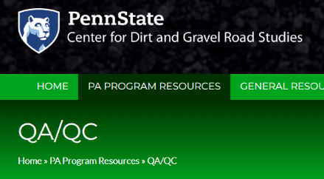

2025 QAQCs
Some changes will be implemented to the QAQC process in 2025
Pre-Visit
  Pre-Visit Letter & Attachments A-D updated.
    Will be available on Center’s website today
    Letter, Attachments, Round 4 QAQC report, and email with additional details in process of being sent to 2025 counties
  Virtual pre-visit discussion/interviews will continue.
    Some time will be spent discussing the district’s specific needs and how to address them.
  Financial reviews will continue remotely.
    Sherri can attend in-person for financial review or assistance where necessary.
Quality assurance should be an ongoing and active process.

Slide 30
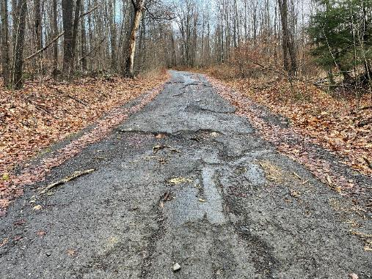
2025 QAQCs
In-Person Visit
  All QAQC visits are planned for either 1 day or 2 days.
  Increased Focus on review of open contracts.
  New: If necessary, some time will be spent providing administrative assistance.
  Project Site Visits:
    Completed sites
    Active contracts
    Potential sites
An SCC & Center staff member and your DEP Field Rep will typically attend the visit.

Slide 31
2025 QAQCs
QAQC Reports
  Shorter reports and quicker report turn-around times
  3–4-page summary for District Board & QAB
    Cover Letter, Ratings, Summary of Findings, All Commendations, Major Recommendations, Major Required Actions
  For District Staff:
    More in-depth recommendations, required actions, and narrative about the QAQC findings, summary of project themes, shorter & simplified project review write-ups, project assistance summaries
District staff are encouraged to provide any feedback on the QAQC preliminary report

Slide 32

2025 QAQCs
Preparing for the QAQC
  (Still officially every 3 years)
  Review the Pre-Visit Attachments
    What is working well and what isn’t?
  Don’t wait to review or send financial documentation.
  Review your District’s Round 4 QAQC report.
  Review your local QAB policy (send suggested changes)
  Think about your project sites
    Recommend a variety of completed sites. What help do you need with current contracts? Are there any difficult sites in the pipeline?
We’re here to help your program and improve project outcomes. Let us know what you need.

Slide 33
2025 Program Updates
2025 Training Opportunities
2025 QAQCs
Program Policy Update
Program Spending Update
Program Funding Update

Slide 34
DGLVR Policy Updates
Advisory Workgroup met in November 2024.
CDs on workgroup working on “suggested edits” to DGLVR Policy and admin manual.
CDs on workgroup meeting regularly to discuss.
Will bring suggestions back to full workgroup when finished.

Slide 35
DGLVR Policy Updates
Timeline: none set
  CDs provide suggestions.
  CDGRS and SCC provide suggestions.
  Workgroup works through all suggestions.
  Present proposed changes and send out to all CDs for review.
  Any final changes go through workgroup.
  SCC policy and legal review.
  SCC action for approval.

Slide 36
2025 Program Updates
2025 Training Opportunities
2025 QAQCs
Program Policy Update
Program Spending Update
Program Funding Update

Slide 37
Spending Requirement Update
We are over halfway through the current Fiscal Year (7/1/24-6/30/25)
Districts must spend DGLVR funds within 2 years to be eligible for the next DGLVR allocations
  Actually have 33 months to meet 2-year spending.
2023 2024 2025 2026
3/31/2025: check to see if districts met 6/30/2024 spending requirement
Actual 2-year spending requirement
When we check the 2-year spending requirement

Slide 38









Spending Requirement Update
6/30/2024 was the spending deadline for the previous 5-year agreement
Almost all conservation districts met the 6/30/2024 spending requirement and are eligible for 2025-26 DGLVR allocations
GREAT JOB!!

Slide 39

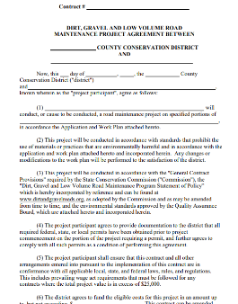
Spending Requirement Update
Goal now is to keep up with spending requirements by running an effective annual grant program
Have you allocated your 2024 funds to projects yet?
  If not, accept applications and fund projects ASAP
  Reach out to CDGRS and SCC for assistance in finding projects, understanding spending requirements, budgeting, etc.

Slide 40
Spending Requirement Update
Reminder: 2-year spending requirements are tracked in the Annual Summary Report in GIS
Green = eligible for an allocation
Red = spending requirement not yet met

Slide 41
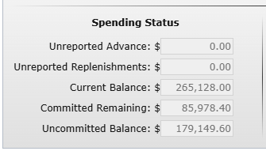
Spending Requirement Update
Quick Check for your spending status:
Look at your uncommitted balance in GIS Quarterly Report
If you have a year’s allocation or more uncommitted, it’s time to fund new projects

Slide 42




Spending Requirement Update
Recorded Webinars - Center for Dirt and Gravel Road Studies
April 25, 2024: Tips For Keeping Up With Spending Requirements
  Conservation districts are required to spend each annual allocation of DGR and LVR funds within 2 years to be eligible for future allocations. This webinar shared tips and tricks to help districts establish a local annual grant cycle to get ahead of these spending deadlines.
  Webinar Download (~1 hour, 2 minutes)
December 19, 2024: Annual Summary Report Refresher and Budgeting DGLVR Funds
  Topics include: planning how to spend your annual allocation, determining how much funding you have available for projects, factors to consider when budgeting, how to use the DGLVR GIS mapper to identify available funds, and using the budget tool in the GIS mapper.
  Webinar Download (~40 minutes)

Slide 43
2025 Program Updates
2025 Training Opportunities
2025 QAQCs
Program Policy Update
Program Spending Update
Program Funding Update

Slide 44
Program Funding Update
The last 2 times transportation funding was addressed in PA:
  1997: $5Million annually to establish DGR Program
  2013: LVR Added and DGLVR increased to $35M
Potential for transportation funding package for FY 2025-26…

Slide 45
Program Funding Update
From Shapiro’s Budget Address, Feb 2025
In Governor Shapiro’s first two years, we’ve delivered over $380 million in new funding for our roads and bridges — and with that investment, Pennsylvania repaired more poor condition bridges than any other state in the entire country. On top of that, we repaired 12,000 miles of roads in Pennsylvania — that’s more than any other time in the last decade.
But many Pennsylvanians also rely on mass transit — and whether you ride a bus, or hop on a trolley, a train, or the subway, every Pennsylvanian deserves a transportation network that gets them to work and home again in time for dinner safely. That’s why the Governor’s budget makes a significant investment in mass transit all across Pennsylvania and continues to deliver more funding for our roads and bridges.
Currently, 7.68 percent of all Sales and Use Tax receipts are deposited into the Public Transportation Trust Fund. This budget builds on that investment by proposing to increase that transfer by an additional 1.75 percent. This increase in available funding will inject an additional $292.5 million into mass transit across the Commonwealth in 2025-26, growing to more than $330 million in 2029-30.
The last two enacted budget reduced reliance on the Motor License Fund (MLF) to supplement the Pennsylvania State Police. This budget continues to step down the State Police’s reliance on the Motor License Fund by $50 million a year, until reliance is completely removed in 2029-30. As a result, over the next five years, PennDOT will have an additional $750 million for road and bridge projects.
This shift provides the Pennsylvania Department of Transportation (PennDOT) additional resources to match federal Infrastructure Investment and Job Act funds, allowing for more road and bridge construction and maintenance projects.

Slide 46
Program Funding Update
Why “Mass Transit”?
Mass transit is the “lead” headline.
The more “multimodal” (comprehensive) the funding is, the more attractive it will likely be to all lawmakers.
Keystone Transportation Funding Coalition is advocating for a comprehensive transporting package.

Slide 47
Program Funding Update
Status:
February budget address from Shapiro was the “starting gun”
Several transportation hearings in February/March.
Keystone Transportation Funding Coalition meeting in March.
Goal would be to have a comprehensive transportation funding update package in place for FY 25-26 budget.

Slide 48
Program Funding Update
Next Steps:
Talk to your legislators about value of DGLVR funds, need for increase funding, etc.
SCC/CDGRS/PACD working to advocate for DGLVR Program.
SCC/CDGRS working on some updated handouts and talking points.
More to come in the next few months…

