Slide 1
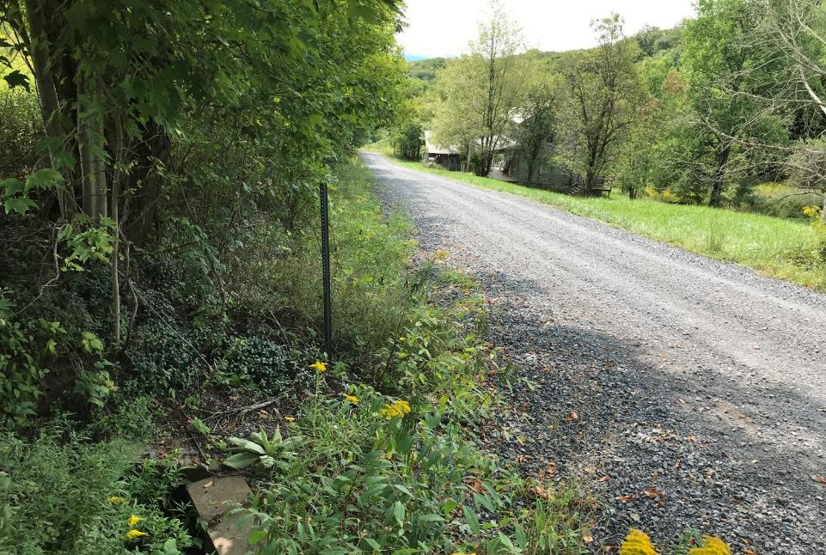
Dirt Gravel and Low Volume Road Program
WEBINAR
DSA Season
Wade Brown- CDGRS
Steve Bloser - CDGRS
www.dirtandgravelroads.org
3/13/25 Starts at 9am
If you are reading this, then you are successfully seeing the webinar video. Webinar audio should be automatic through your computer (or click “join audio”), and options can be accessed in the “audio options” button on the bottom left. If your computer audio is not working, you can listen on your phone by dialing 646-876-9923.
Audio via Phone if needed: 646-876-9923
Webinar ID: 987 5482 6192

Slide 2
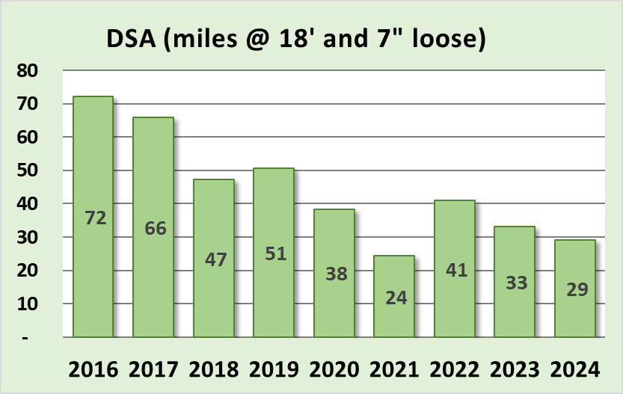
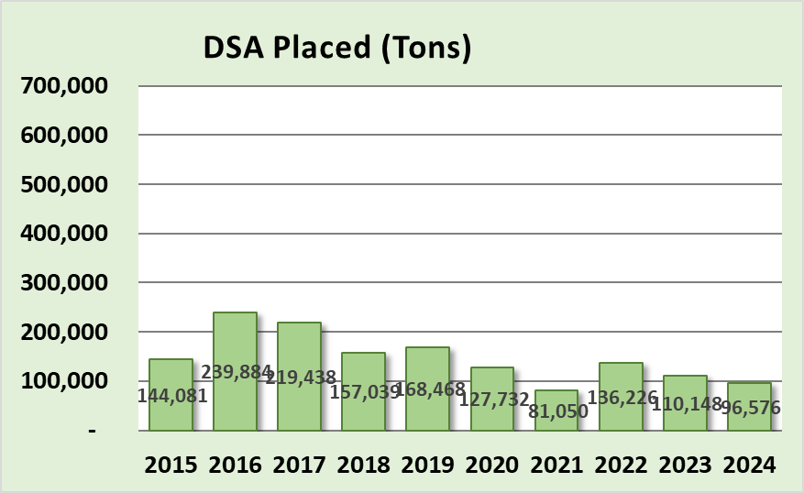
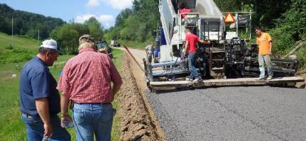
Driving Surface Aggregate
Placement Season April through September
96,576 tons placed in 2024 (SCC funds only), equivalent to 29 miles (18’ wide x 7” loose lift).
@ $45 a ton, that’s $4.3 Million or roughly 25% of overall DGR project spending

Slide 3
DSA Season Prep
Purpose
Primer and reminder for DSA placement season starting April 1
Discussion of new DSA Project Checklist

Slide 4
DSA Season Prep
RESOURCES:
DSA Certification: 2 page DSA certification form
DSA Specification: Material & Placement specs
DSA Handbook: More in depth DSA explanation
- Includes Request for Quote
- more details to come
All can be found on the CDGRS website including this webinar.
Notes:
In your course book are the resources noted here (on screen). There is also an Aggregate Handbook available which thoroughly covers DSA.

Slide 5
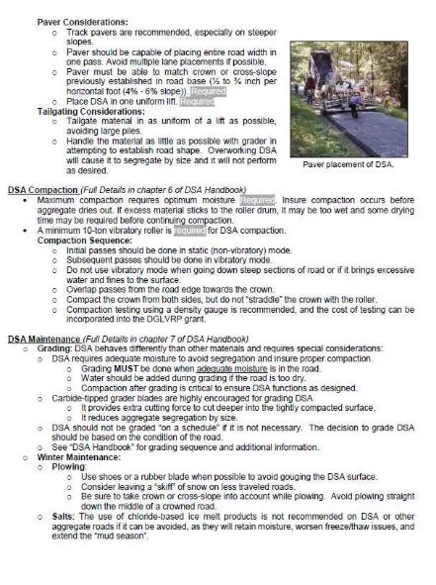
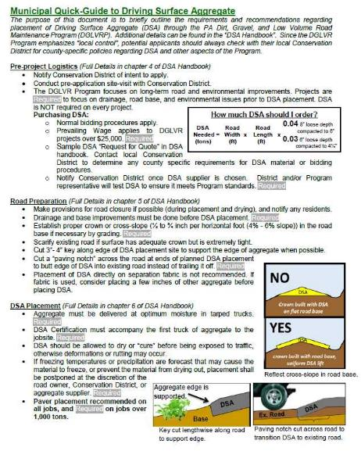
DSA Season Prep
Resources
DSA RESOURCES:
DSA Handbook: More in depth DSA information
includes Request for Quote
www.dirtandgravelroads.org
Municipal DSA Quick Guide:
Questions?
Notes:
In your course book are the resources noted here (on screen). There is also an Aggregate Handbook available which thoroughly covers DSA.

Slide 6
DSA Season Preparation
Spec Changes
Reminder: 2023 DSA Changes:
Material
Slight gradation change. #200 11%-15% (17% if PI <2)
Placement
Placement Season April 1 through September 30 unless approved by SCC – NO GUARANTEE!
Paver must place DSA in single pass (paver still not required for jobs less than 500 tons)

Slide 7
DSA Season Preparation
Spec Changes
Proposed Specification Change for 2025:
Requesting gradation change to #16 sieve.
Current: 15% -30%
Proposed: 15% -32%
Sieve Size | Percent Passing
1 ½ Inch | 100
¾ Inch | 65-97
#4 | 30-65
#16 | 15-30 32
#200 | 11-15

Slide 8
DSA Season Preparation
Spec Changes
Why the Proposed Specification Change for 2025:
Loosening to make DSA easier to make.
Response to increased #200 sieve from 10% to 11%, which caused a slight increase in the #16 sieve.
4 pile failures due to #16 sieve and they were just over the 30% maximum; in the 30%-31% range.
Minor change will not impact quality.
Change will be presented for approval at the March 18 SCC Meeting.
Requesting change to be effectively immediately.
Change will not impact current contracts or approved piles - “loosening” of the spec.
PA Concrete & Aggregate Association supports change.

Slide 9
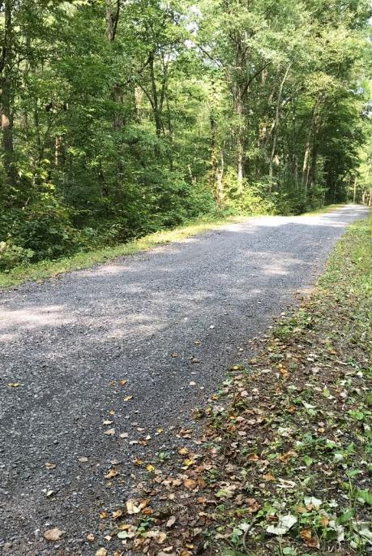
DSA Season Preparation
DSA Use
DSA Use and Overuse
DSA should be the very last phase of the project.
DSA alone does not constitute a comprehensive DGLVR Program project.

Slide 10
DSA Season Preparation
Sampling & Testing
Purchasing DSA with DGLVR Funds:
DSA must be independently sampled and tested
30-day notice time required for testing if CDGRS is doing the sampling.
Help from Center is also available for testing or placement on request.

Slide 11
DSA Season Preparation
Sampling & Testing
Purchasing DSA with DGLVR Funds:
DSA must be independently sampled and tested
30-day notice time required for testing if CDGRS is doing the sampling.
Help from Center is also available for testing or placement on request.
30 day notice is a minimum
Notify as soon as supplier is known
Supplier needs time to make entire pile
Time for sampling
Time for testing
Potential time for failures

Slide 12
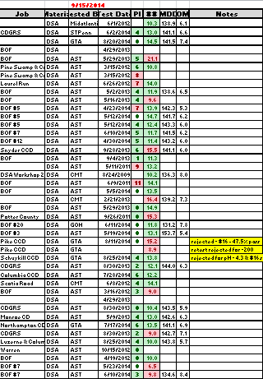
DSA
Sampling & Testing
Why require independent testing?
In the first year of sampling in 2014: 50% of the DSA we tested was out of spec!!!
2018 - 12% failed
2020 - 25% failed
2021 - 9% failed
2022 - 15% failed
Notes:
The one on one relationship you build when you visit the quarry will pay off with a better quality product.

Slide 13
DSA
Sampling & Testing
Why require independent testing?
2024 - 32% of the DSA we tested was out of spec!!!
Sampling Results:
70 DSA piles sampled.
23 piles failed
18 due to Gradation
14 due to fines (#200 sieve)
4 due #16 sieve being too high
4 due to Plasticity Index
1 due to Soundness.
Notes:
The one on one relationship you build when you visit the quarry will pay off with a better quality product.

Slide 14
DSA Season Preparation
Sampling & Testing
How to sample a DSA pile
Sampling must be done on the specific pile that’s supplying the project.
Sample the full pile required for the project.
If your project requires 5,000 tons, it must be a 5,000-ton pile (or more).
Quarries must produce DSA piles in advance of delivery allow time for sampling and testing.
Labs can get backlogged in construction season.

Slide 15
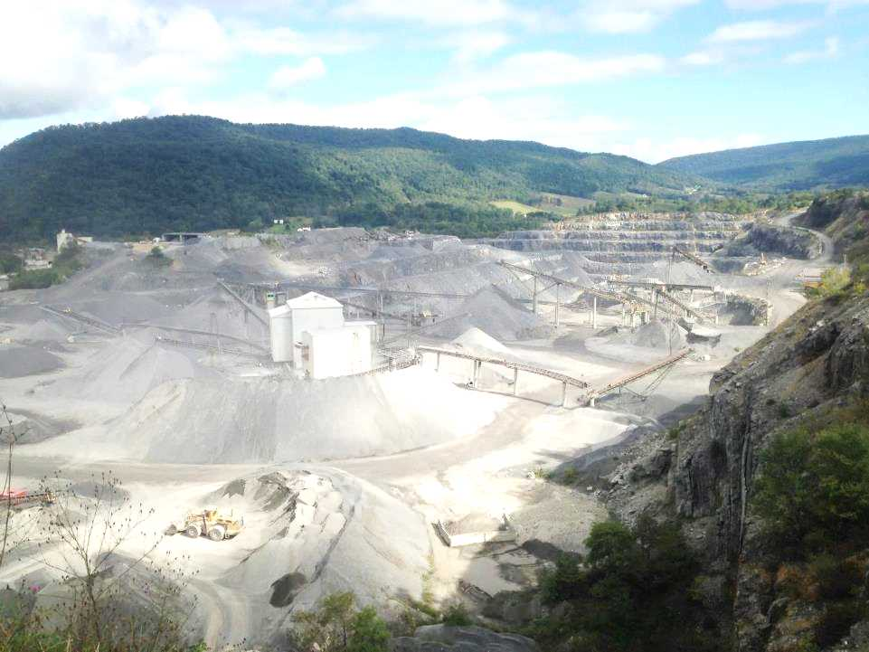
DSA Season Preparation
Sampling & Testing
Conservation district’s can pull their own sample
If a CD pulls their own sample, they must pay for the lab testing.
Costs of testing can be incorporated into the project cost or paid out of admin/education funds
Sampling and testing can also be done, free of charge, by the Center’s DSA Clearinghouse (more details on that later)

Slide 16
DSA Season Preparation
Sampling & Testing
How to collect a DSA sample…
Contact the Center and we will train at the quarry on how to properly pull a sample.
Not as simple as just putting material in a bucket!!!

Slide 17
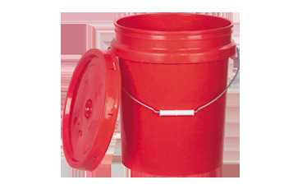
DSA Season Preparation
Sampling & Testing
How much do I need for a DSA sample?
Proctor, gradation, plasticity
(2) ¾ full 5-gallon buckets (Minimum)
More buckets necessary depending on pile size and required tests
Too much sample is always better than not enough

Slide 18
DSA Season Preparation
Sampling & Testing
Please contact the Center before testing for Soundness, LA Abrasion or pH Testing:
These tests need to be done BEFORE a quarry makes DSA.
Failure means the source rock is not useable.

Slide 19
DSA Season Preparation
Sampling & Testing
Lab Testing
Material must be tested by an independent lab (with no affiliation with the quarry or placement contractor) before delivery
The testing lab must be currently certified by AASHTO or PennDOT
Per the SCC specification, DSA shall not be placed without pre-delivery sampling and testing. This testing is key to catching any potential problems with the aggregate BEFORE it is placed.

Slide 20
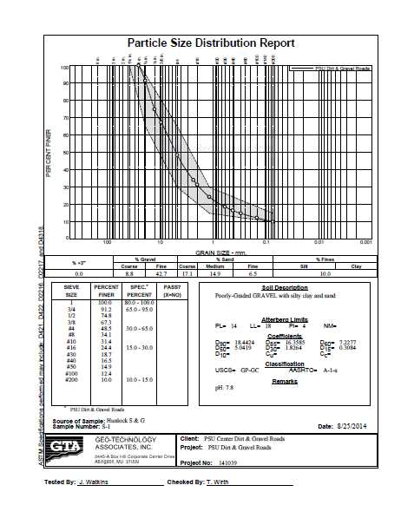
Plasticity
DSA Season Preparation
Sampling & Testing
Lab Testing
Example of lab results
The lab looks at more sieves than just those in the specification
This gives us a very clear snapshot of what is in the pile

Slide 21
DSA Season Preparation
Sampling & Testing
Lab Testing
Lot-dependent tests: run on every pile
Gradation (size distribution)
Plasticity (clay content)
Periodic test: Proctor (optimum moisture and max dry density)
Source-dependent tests: rarely needed
LA Abrasion
pH
Soundness (resistance to freeze/thaw)

Slide 22
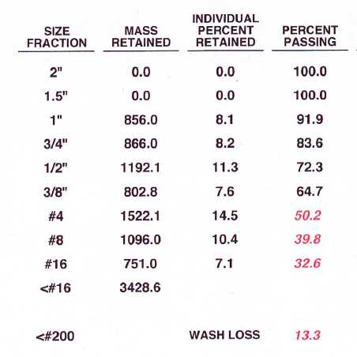
DSA Season Preparation
Sampling & Testing
What happens if a sample fails Gradation?
If it’s close to meeting the spec., re-sample and re-test. This is a common practice.
If it fails a second time, a new pile will have to be made
50.2
39.8
Spec: 15-30
13.3
Gradation tested on every pile

Slide 23
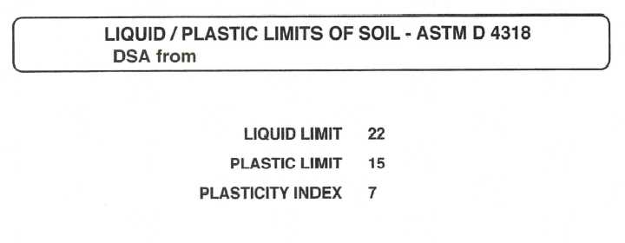
DSA Season Preparation
Sampling & Testing
What happens if a sample fails Plasticity?
A new pile needs to be made after discussion of production methods
Some quarries may never meet this spec.
Plasticity run on every pile
Maximum allowable PI is 4 (or 2 if fines are 15-17%)

Slide 24
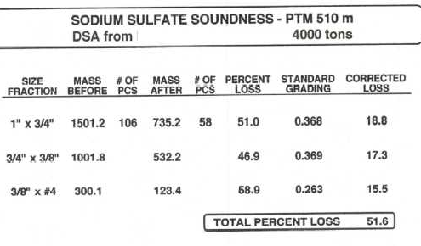
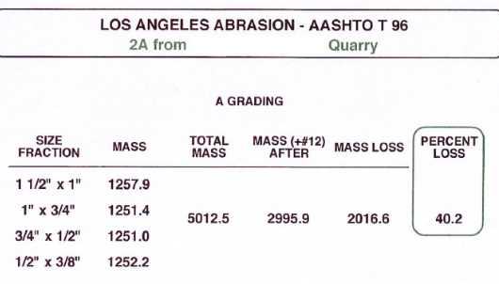
DSA Season Preparation
Sampling & Testing
What happens if a sample fails LA Abrasion and/or Soundness?
Find a new supplier. This property is a quality of the rock formation.
Its possible a new seam of rock at the quarry may perform better. Let quarry test it first.
Max. allowable soundness loss is 20%
Max. allowable abrasion loss is 45%

Slide 25
DSA Season Preparation
DSA Clearinghouse
DSA Clearinghouse
PURPOSE
Provide a central point of contact between conservation districts and DSA suppliers.
Provide DSA testing services when needed.
Provide DSA education to conservation districts.
Provide a central repository of DSA testing and placement data for the state to serve as a reference and avoid duplication of testing.

Slide 26
DSA Season Preparation
DSA Clearinghouse
DSA Clearinghouse
POTENTIAL SERVICES PROVIDED
Working with quarries and CD to ensure they understand the DSA requirements.
Collecting samples for testing to ensure DSA meets all material requirements before delivery and placement.
Providing contractor education on DSA.
Providing on-site assistance during DSA placement.
Education of District staff on DSA sampling, testing, and placement.
Troubleshooting.
Identifying potential DSA suppliers your area

Slide 27
DSA Season Preparation
DSA Clearinghouse
DSA Clearinghouse
DISTRICT RESPONSIBILITY
Contact the Center when a potential DSA supplier is chosen, at least 30 days before desired placement date.
Notification to be made with the DSA Purchase Notification Form.
If districts sample the DSA: share testing results with the Center in order to provide a comprehensive database and avoid duplicate testing.

Slide 28
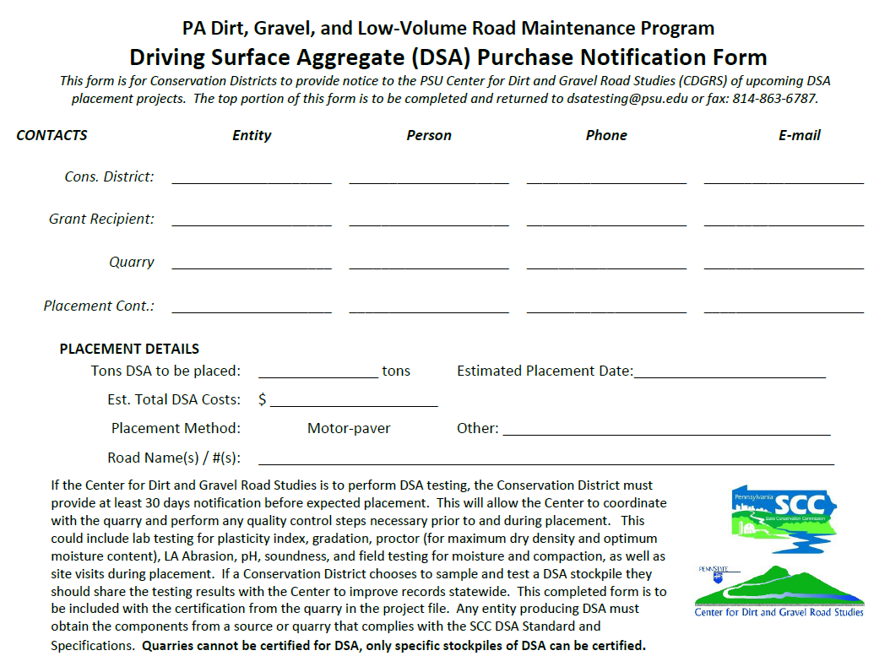
DSA Season Preparation
DSA Clearinghouse
DSA Notification: CD portion
Notes:
New email coming…DO NOT Fax until further notice
Email Dave Morrison dcm35@psu.edu

Slide 29
DSA Season Preparation
DSA Clearinghouse
DSA Notification: CD portion
Send to:
dsatesting@psu.edu
BUT PLEASE COPY
Dave Morrison
dcm35@psu.edu
Notes:
New email coming…DO NOT Fax until further notice
Email Dave Morrison dcm35@psu.edu

Slide 30
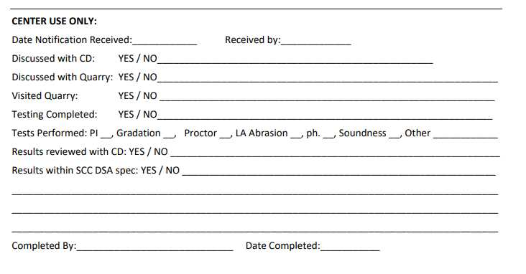
DSA Season Preparation
DSA Clearinghouse
DSA Notification: CDGRS portion
Notes:
You should share these results with the quarry or tell us to share them. As far as we are concerned these lab tests are property of the CD/SCC and are privileged info

Slide 31
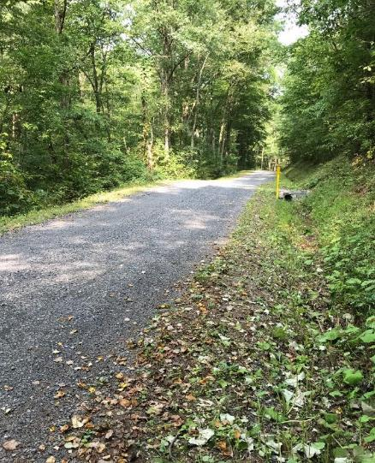
DSA Season Preparation
DSA Season Prep
Pre-application
Pre-Project logistics
~30 days prior to placement
Final Preparations
DSA Placement

Slide 32
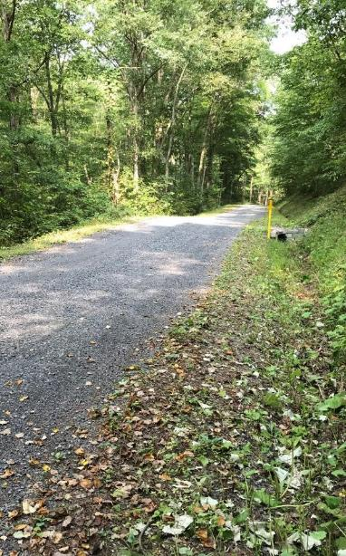
DSA Season Preparation
Pre-application
Drainage and base first!!
DSA is not required on every project
Program focus is on long-term road and environmental improvements
Projects are required to address any drainage, road base, and environmental issues prior to DSA placement

Slide 33
DSA Season Preparation
Pre-application
Meet with the municipality
Suggested An on-site pre-application meeting with the municipality helps to ensure a quality application
Discussing Topics:
Timing: Application, drainage work, placement date(s), placement season, time for production and testing, etc
Details: Project length, DSA depth, width, tonnage, available budget, paver, etc
Potential suppliers & placement contractors
Road preparation: Drainage, surface prep (fill/grading), etc
Compaction: Will compaction testing be utilized?

Slide 34
DSA Season Preparation
Pre-application
Material Calculation
The formula below is a general guide to the amount of DSA needed based on width, depth, and length of placement.
How much DSA should I order?
DSA Road Road
Needed = Width x Length x
(tons) (ft) (ft)
0.04 for 8” loose
compacted to 6”
0.03 for 6” loose
compacted to 4½”
Notes:
DSA is the icing on the cake.

Slide 35
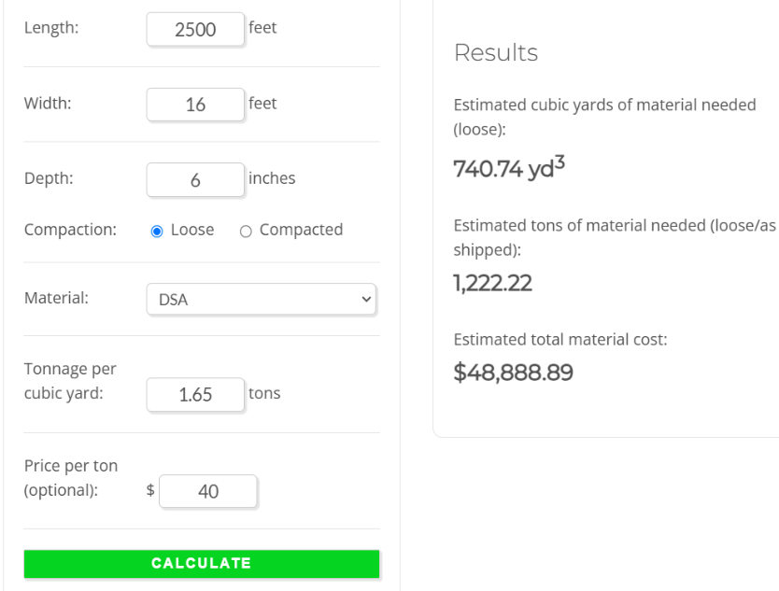
DSA Season Preparation
Pre-application
Materials Calculator: dirtandgravel.psu.edu/general-resources/dglvr-materials-calculator/
Density
(based on material selected)
Cost/ton
(optional)
RUN ESTIMATE
Notes:
DSA is the icing on the cake.

Slide 36
DSA Season Preparation
DSA Season Prep
Pre-application
Pre-Project logistics
~30 days prior to placement
Final Preparations
DSA Placement

Slide 37
DSA Season Preparation
Pre-project logistics
Bidding
Municipalities should follow their standard purchasing, bidding, and payment procedures.
Prevailing wage applies to contracted labor when the total value of the project exceeds $25,000
Placement dates are April 1 to September 30.
DO NOT MAKE CONTRACT END DATE SEPTEMBER 30!
Recommend August 30 – can extend contract date for weather or other reasonable delays.
An editable DSA Request for Quote form is available on the Center’s website if needed

Slide 38
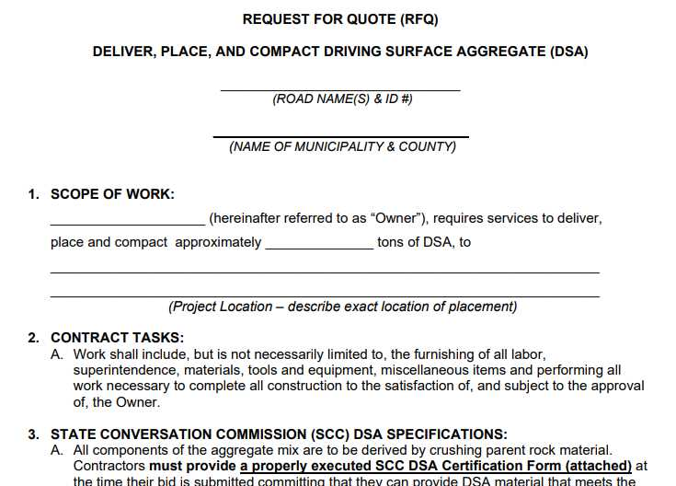
DSA Season Preparation
RFQ
RFQ: use is optional: editable version on CDGRS website

Slide 39
DSA Season Preparation
Pre-project logistics
Once placement contractor and supplier are determined…
Schedule target placement date, and a potential back-up date in case of delays. Allow as much time as possible for quarry to make material, sampling and testing. (Sampling delays, lab back-ups/failures)
DSA Sampling: Quarries do not have blanket approval to supply DSA. The full pile of DSA to be used on the job is required to be sampled and tested by a third-party lab prior to placement
The pile is approved once passing lab results are obtained

Slide 40
DSA Season Preparation
DSA Season Prep
Pre-application
Pre-Project logistics
~30 days prior to placement
Final Preparations
DSA Placement

Slide 41
DSA Season Preparation
30 Days Out
Pre-Construction Meeting
Highly Recommended!
An on-site pre-construction meeting with the placement contractor and the municipality helps to ensure a quality project by getting everyone on the same page!

Slide 42
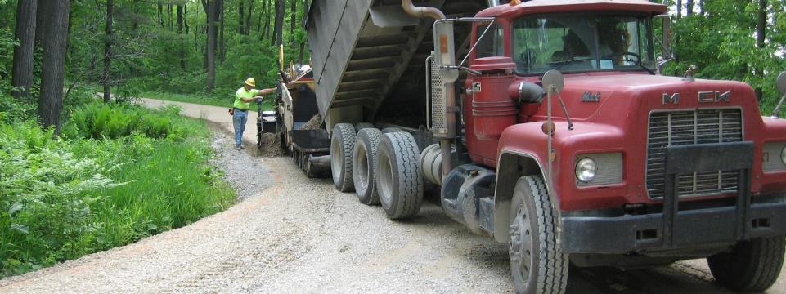
DSA Season Preparation
30 Days Out
Pre-Construction Meeting Discussion Points
Trucking Logistics
Final Road Preparation
Equipment
Material Slips
Road Closures
Compaction Testing

Slide 43
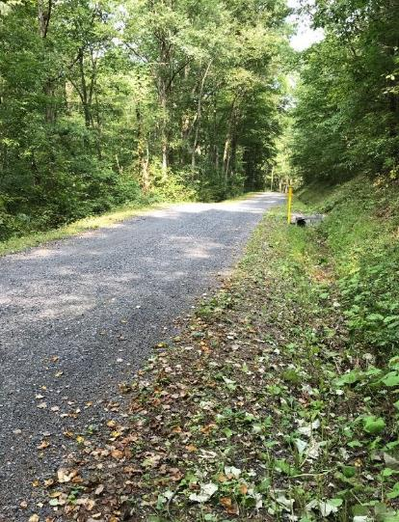
DSA Season Preparation
DSA Season Prep
Pre-application
Pre-Project logistics
~30 days prior to placement
Final Preparations
DSA Placement

Slide 44
DSA Season Preparation
Final Preparations
Week of Placement
Review final logistics with municipality, contractor, supplier, trucking provider to make sure all are on the same page
Road prep (crown, base, drainage)
Truck routes (power lines)
Staging areas
Availability of equipment and personnel

Slide 45
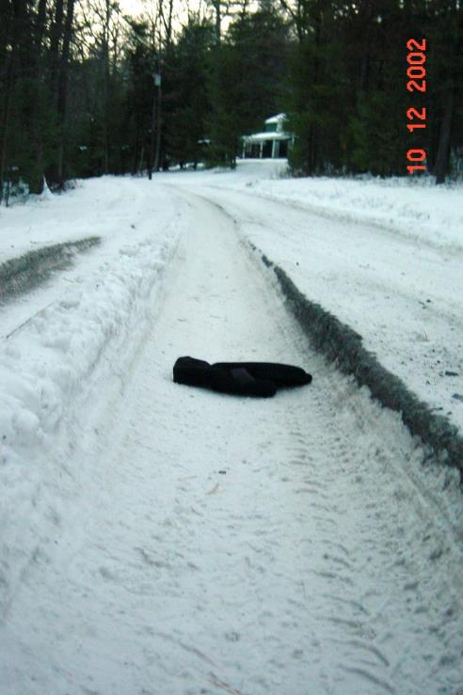
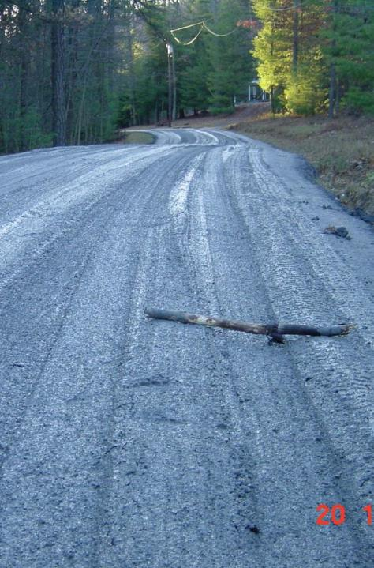
DSA Season Preparation
Final Preparations
Week of Placement: Check the Weather
Weather and Cancellations:
DSA specification: “If freezing temperatures or precipitation are forecast that may cause the material to freeze, or prevent the material from drying out, placement shall be postponed at the discretion of the road owner, Conservation District, or aggregate supplier.”.
It will often be up to the Conservation District to make calls to postpone due to weather.

Slide 46
DSA Season Preparation
Final Preparations
Day before and Day of Placement
Contact municipality, contractor, & quarry to verify placement plan.
Include engineering tech performing compaction testing (if applicable).

Slide 47
DSA Season Preparation
DSA Season Prep
Pre-application
Pre-Project logistics
~30 days prior to placement
Final Preparations
DSA Placement

Slide 48
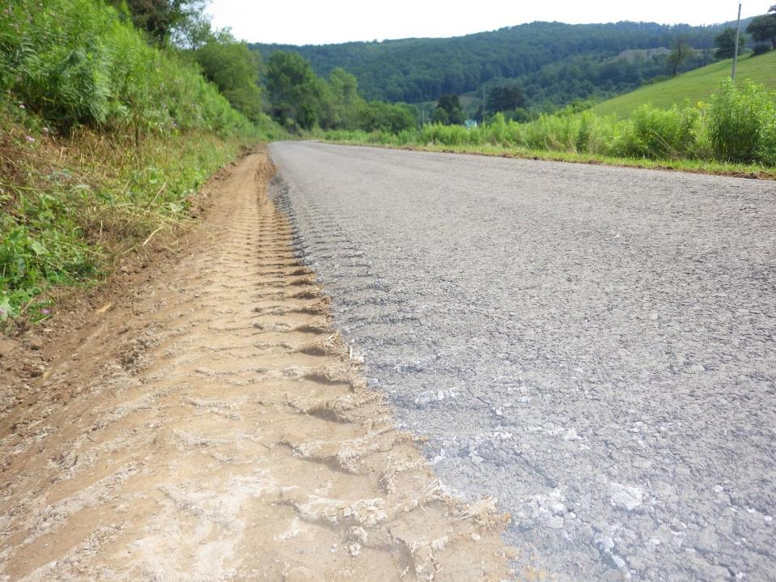
DSA Season Preparation
Placement
Placement Day
Are trucks tarped as required?
Did the first load come with a certification?
Required
Who is collecting load slips?

Slide 49
DSA
Placement
DSA Paving crew :
Paving machine:
Operator/driver
Screed control/depth check (both ends)
Recommend at least 3 people on the paver + 1 for the roller. Can require this by putting in Bid Documents
Roller
Operator should be dedicated to the roller. DSA moisture and compaction should be closely monitored. Should not be done in a rush.
Skid Steer/Other Equipment
Usually only used before and after placement
Notes:
DSA should be placed with a Paver, so the aggregate stays mixed, and it maintains the proper depth and crown. The following movie clips show a Paver in action, placing DSA.

Slide 50
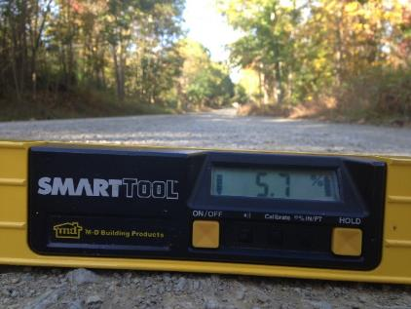
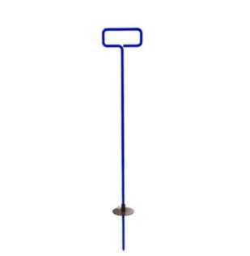
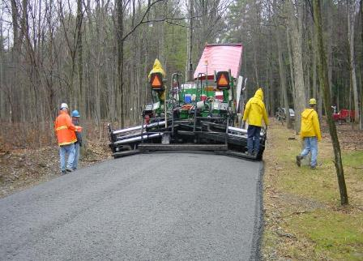
DSA Season Preparation
Placement
During placement
Continuously monitor the placement depth, width, & crown/cross-slope.
It may take several hundred feet to get the paver “dialed in”

Slide 51
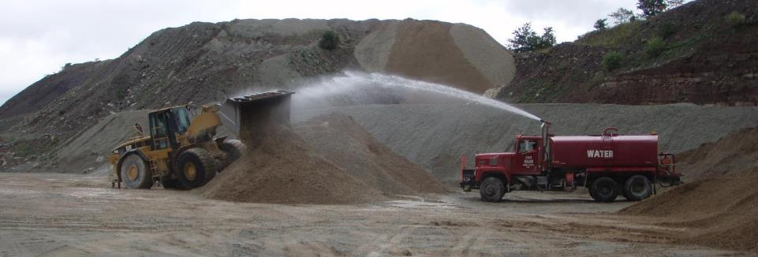
DSA Season Preparation
Placement
During placement
Continuously monitor…
Moisture, adequate mixing of material
Be alert for changes in consistency
Variations can happen throughout the day

Slide 52
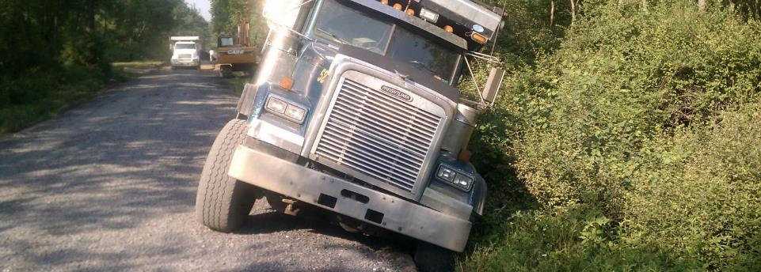
DSA Season Preparation
Placement
During placement
Continuously monitor…
Trucking logistics
# of trucks
Power lines
Turnarounds, routes, flaggers, etc.

Slide 53
DSA
Placement
DSA is designed for maximum compaction
Notes:
DSA is designed for maximum compaction.

Slide 54
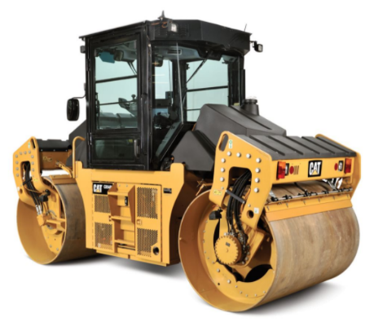
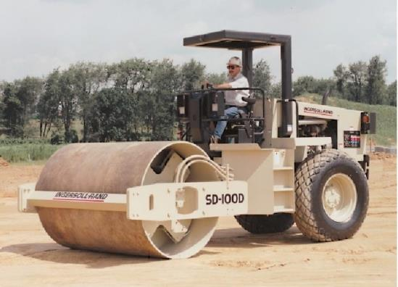
DSA
Placement
DSA Compaction :
If material sticks to roller drum, allow to dry first.
Roll up to, but not directly on crown.
Minimum 10-ton vibratory roller required.
https://www.cat.com/en_US/products/new/equipment/compactors/tandem-vibratory-rollers/1000027026.html
https://tuffmanequip.com/product/10-ton-roller
Asphalt roller
“Dirt” roller
Notes:
Here is a list of Compaction Considerations: Read List On Screen

Slide 55
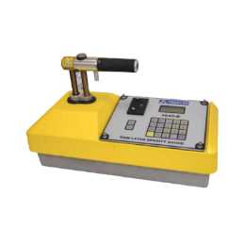
DSA Season Preparation
Placement
During placement
Compaction testing…
Utilizing a nuclear density gauge
Not required by Program
Quantitative way to quickly determine
Density (% compaction)
Moisture content – to compare to target moisture
Having this data can make it easier to send unacceptable loads back to the source
https://www.measur.ca/product/4640-b-surface-thin-layer-density-gauge/

Slide 56
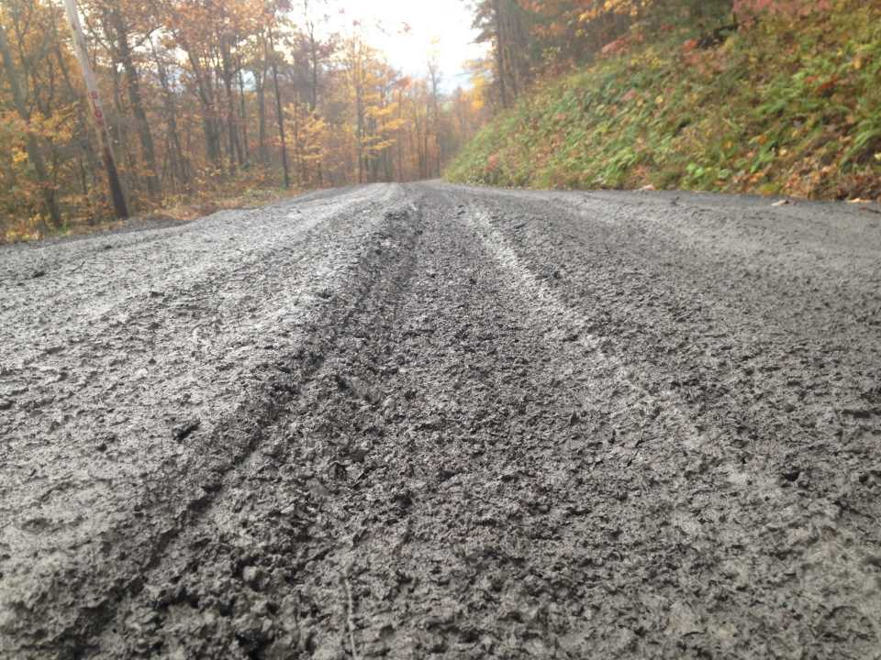
DSA Season Preparation
Placement
Water pouring from truck beds…
In its wettest state, DSA should look like very low-slump concrete, better if it’s a bit drier than that
Too wet

Slide 57
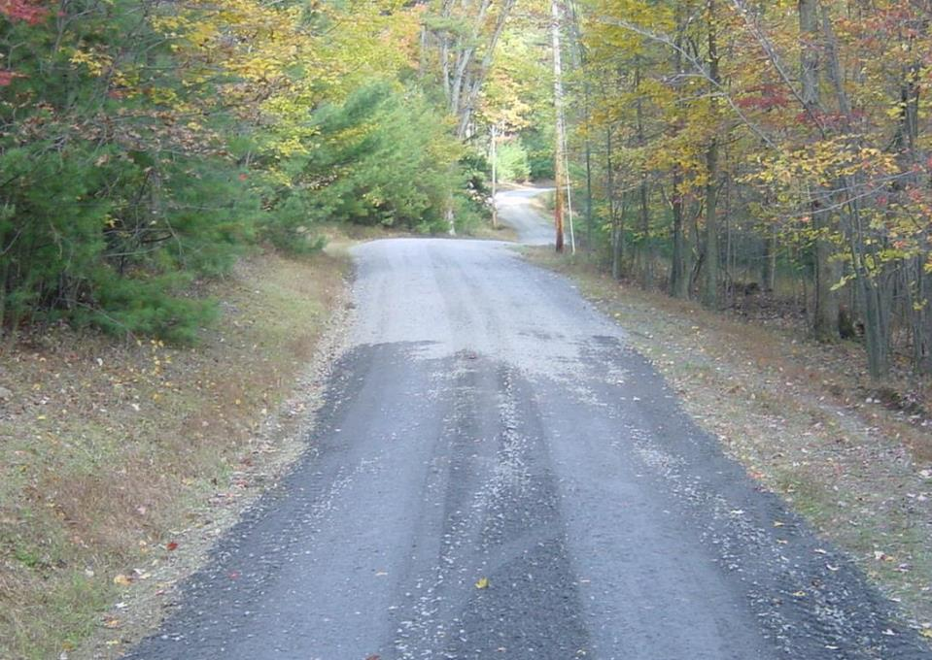
DSA Season Preparation
Placement
Too dry
Will not compact
Will come apart quickly

Slide 58
DSA Season Preparation
Placement
During placement
Making adjustments…
Contact quarry to make adjustments.
Use dump truck radios in remote areas
Note time of change request and compare to load time on tickets
Send trucks back if necessary!
Once DSA is placed on the road surface, its more difficult to fix
Visit quarry if necessary
Unforeseen problems like personnel/equipment/moisture issues

Slide 59
DSA Season Preparation
Key Points
DSA Key Points
DSA is not a stand alone project.
Base and drainage must be addressed first.
Contact the Center to schedule testing as soon as possible.
Submit DSA Notification Form
Pre-Construction Meeting to review DSA placement requirements.
Get everyone on the same page and answer any questions.
BE ON-SITE DURING PLACEMENTS!
You get what you INSPECT not what you EXPECT.
Send trucks back if necessary!
Once DSA is placed on the road surface, its more difficult to fix
Specification is clear on material delivery and moisture.
Close the road or limit traffic.

Slide 60
Environmentally Sensitive Maintenance for Dirt, Gravel, and Low-Volume Roads
PA Dept. of Conservation and Natural Resources
Forestry
Center for Dirt and Gravel Road Studies
PA State Conservation
Commission
QUESTIONS?
ADDITIONAL RESOURCES:
Center for Dirt & Gravel Road Studies
www.dirtandgravelroads.org
DGLVR Admin Manual
DSA Summary and Spec
Dave Morrison ☺

Slide 61
Tech Assists: Contact now for tech assists! Construction season is starting…
ESM Trainings: 12 scheduled statewide with the first one next week in Selinsgrove.
Stream Crossing Trainings: Conservation Districts
May 20-22
Aug 19-21
Stream Crossing Trainings: Design Engineers
Aug 5-6 Union
Sep 9-10 Elk
Advanced Administrative and Financial Trainings
June 24 (Admin), June 25 (financial), Schuylkill
November 5 (Admin), November 6 (financial), Centre
Other Training Notes:
Workshop: Mark your calendars for September 23-25 in Gettysburg.
ESM Boot Camps: Working on finalizing dates for “new hire boot camps”, details to come.
DEP Stream Trainings: Building off the three completed last year, the Center is holding a 1.5 day stream crossing trainings for DEP permit review staff this summer.
Course Tracker: Don’t forget the new course attendance tracker allows you to look up your, or anyone else’s, current certifications and expiration dates. https://dirtandgravel.psu.edu/education-training/course-attendance-tracker/

