Slide 1
DGLVR Webinar
DGLVR Educational Efforts Update
7/16/20
Starts at 9am
If you are reading this, then you are successfully seeing the webinar video. Webinar audio should be automatic through your computer, and options can be accessed in the “audio options” button on the bottom left. If your computer audio is not working, you can listen on your phone by dialing 312-626-6799.
Audio via Phone: 312-626-6799

Slide 2
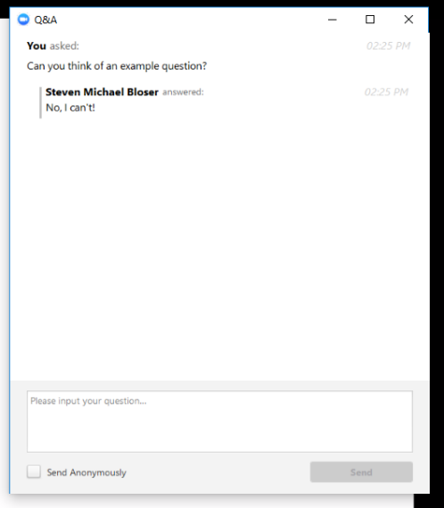
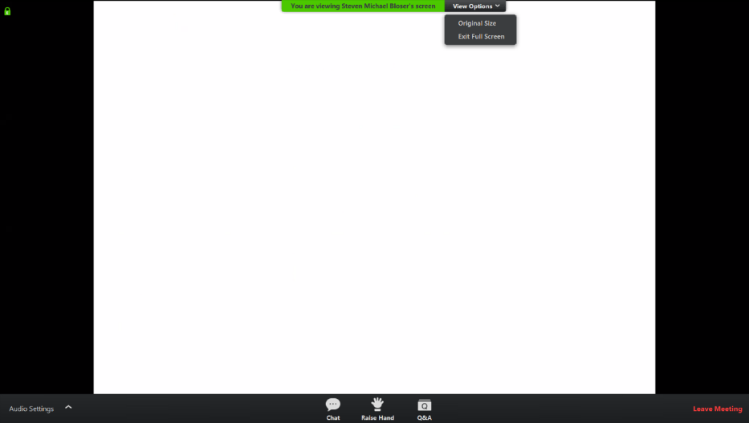
Q&A
Note you can ask a question anonymously
Q&A
Audio via Phone: 312-626-6799
Slide #

Slide 3
DGLVR Webinar
Educational Efforts Update
Purpose:
Provide Update on various educational efforts
Provide update on ESM trainings given Coronavirus limitations
Technical Assistance
QAQCs
Webinars
TU one-day field Session
Stream Crossing Boot Camp
DGLVR Annual Workshop
ESM Trainings
Certifications
In-person
Remote
Audio via Phone: 312-626-6799

Slide 4
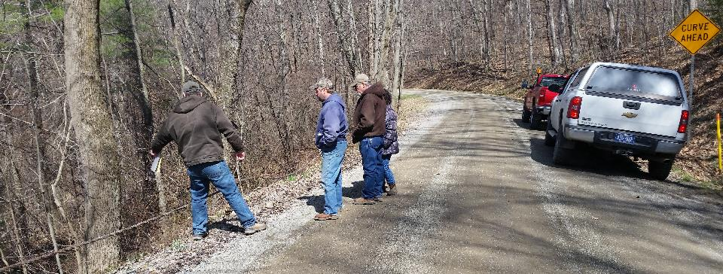
DGLVR Educational Efforts Update
Technical Assistance
Technical Assistance visits have been ongoing since May
Please contact Center or staff to schedule one.
Audio via Phone: 312-626-6799

Slide 5
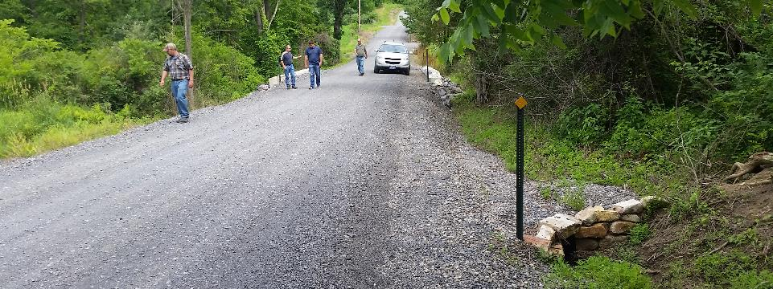
DGLVR Educational Efforts Update
QAQCs
Most interviews and discussions held remotely (zoom)
Field portions underway for current visits and postponed visits from Spring.
Hoping to complete full slate of 22-23 visits for 2020.

Slide 6
DGLVR Educational Efforts Update
Webinars
16 webinars held so far this year
General feed back has been appreciative
Will continue to hold blocks of them as topics arise to keep communication lines open
Reminder: all recordings and PPT available online
Please contact us with new webinar ideas

Slide 7
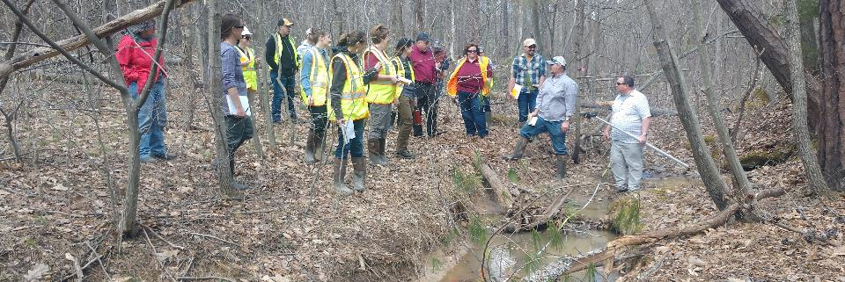
DGLVR Educational Efforts Update
TU One-Day Field Sessions
One day field events, some active project, some before and after visits.
TU sponsored activity – not a DGLVR event
Contact host conservation district for more information or to register
7/22 Clearfield
7/23 Venango
7/31 Elk
8/14 Elk
8/19 Clearfield
8/26 Cambria
9/2 Potter
9/16 McKean

Slide 8
DGLVR Educational Efforts Update
Stream Xing Boot Camp
Combined remote class and in-person field trip this year
Attend both classes remotely
Attend one of two field days (split due to distancing concerns)
Active placement of 11’ bottomless arch
Visit to several completed projects, surveying, longitudinal profile, etc.
7/21 Remote Class (12/30 spots left)
7/28 Field Day 1 (full at 10)
7/29 Field Day 2 (4/10 spots left)
8/11 Remote Class (12/30 spots left

Slide 9
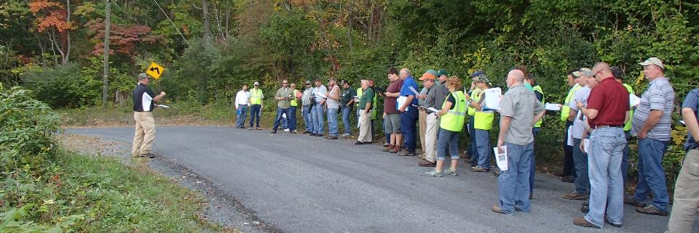
DGLVR Educational Efforts Update
Annual Maintenance Workshop
Workshop canceled for 2020 (was planned for Lackawanna in September)
Focus instead on Technical Assistance, Project Assistance, ESMs, Webinars, etc.

Slide 10
DGLVR Educational Efforts Update
ESM Trainings
Certifications
In-Person ESMs
Remote ESMs
Thanks for your continued patience as we work through the ever-changing rules and guidelines

Slide 11
DGLVR Educational Efforts Update
ESM Trainings – Certification Extensions
Reminder: Certifications expire at the END of the 5th calendar year, regardless of when the training was attended

Slide 12
DGLVR Educational Efforts Update
ESM Trainings – Certification Extensions
Reminder: Certifications expire at the END of the 5th calendar year, regardless of when the training was attended
NEW: Anyone whose training expired in 2019 (last ESM in 2014): certification extended through 12/31/2020
Certifications expiring in 2020 (last ESM in 2015): certifications have NOT been extended (may be in future if needed)

Slide 13
DGLVR Educational Efforts Update
ESM Trainings – Certification Extensions
Reminder: Certifications expire at the END of the 5th calendar year, regardless of when the training was attended
NEW: Anyone whose training expired in 2019 (last ESM in 2014): certification extended through 12/31/2020
Certifications expiring in 2020 (last ESM in 2015): certifications have NOT been extended (may be in future if needed)
CDs may consider making changes to application deadlines
ESM Certification Listing: https://www.dirtandgravel.psu.edu/education-and-training/esm-course
POLL

Slide 14
DGLVR Educational Efforts Update
ESM Trainings – In Person
3/25-26 Huntingdon
4/14-15 McKean
4/22-23 Berks
5/12-13 Fayette
6/2-3 York
6/17-18 Erie
Postponed: may try to reschedule if we can get approval and get in-person ESMs going safely again

Slide 15
DGLVR Educational Efforts Update
ESM Trainings – In Person
3/25-26 Huntingdon
4/14-15 McKean
4/22-23 Berks
5/12-13 Fayette
6/2-3 York
6/17-18 Erie
7/7-8 Bradford
7/15-16 Beaver
Postponed: may try to reschedule if we can get approval and get in-person ESMs going safely again
Postponed at last minute: Awaiting approval to reschedule and hold

Slide 16
DGLVR Educational Efforts Update
ESM Trainings – In Person
3/25-26 Huntingdon
4/14-15 McKean
4/22-23 Berks
5/12-13 Fayette
6/2-3 York
6/17-18 Erie
7/7-8 Bradford
7/15-16 Beaver
8/18-19 Snyder
10/20-21 Clarion
11/4-5 Luzerne
11/17-18 Centre
Postponed: may try to reschedule if we can get approval and get in-person ESMs going safely again
Postponed at last minute: Awaiting approval to reschedule and hold
Will hold if permitted.
Request to hold in-person training has been submitted to PSU

Slide 17
DGLVR Educational Efforts Update
ESM Trainings – In Person
COVID Considerations for in-person ESMs
Must follow PSU, State, and CDC guidance
Only held in “green” counties
Mask wearing will be enforced
Distancing guidelines will be followed
Attendance limited to allow 113 square feet per person (CDC)
May have to reschedule to larger facilities, or severely limit attendance
Likely changes to food setup (pre-packaged snacks and box lunches)
Additional sanitization, changes to registration, handouts, etc.
Request to hold in-person training has been submitted to PSU
* Yesterday’s change by Wolf limits indoor gatherings to 25 people

Slide 18
DGLVR Educational Efforts Update
ESM Trainings - Remote
Remote ESM trainings to be held via Zoom, starting in August
Will still be “live” trainings, not just recordings
Likely two 4-hour sessions over two days
New ESM certifications only (for now)
Limited attendees (to encourage questions / interaction)
Will have questions to verify attendance.

Slide 19
DGLVR Educational Efforts Update
ESM Trainings - Remote
Remote ESM trainings to be held via Zoom, starting in August
Will still be “live” trainings, not just recordings
Likely two 4-hour sessions over two days
New ESM certifications only (for now)
Limited attendees (to encourage questions / interaction)
Will have questions to verify attendance.
CDs are encouraged to host viewing sessions
If allowed, according to your County / employer guidelines
Use projector/TV for showing remote presentation
CD can provide local policies and answer specific questions over breaks
CD can verify attendance, submit questions to trainers
POLL

Slide 20
DGLVR Educational Efforts Update
ESM Trainings - Remote
August 12-13
August 26-27
September 2-3
Registration available soon: will notify via e-mail
Remote ESM trainings to be held via Zoom, starting in August
Will still be “live” trainings, not just recordings
Likely two 4-hour sessions over two days
New ESM certifications only (for now)
Limited attendees (to encourage questions / interaction)
Will have questions to verify attendance.
CDs are encouraged to host viewing sessions
If allowed, according to your County /District Guidelines
Use projector for showing remote presentation
CD can provide local policies and answer specific questions over breaks
CD can verify attendance, submit questions to trainers
Dates tentative
Dates tentative

Slide 21
DGLVR Educational Efforts Update
Webinars next week (note date change from 2/21 to 7/24)
DGLVR Webinar: 7/23, 9am: Policies, DSA, and more
Details: This webinar will review a variety of topics and policies that are pending approval at the 7/22 SCC meeting. If approved, this webinar will review policy changes as well as changes to the DSA specification. We will also go over a new optional “request for quote” form that is available for use in specifying material for road fill projects.
Joining the Webinar:
Click on this link to join: https://psu.zoom.us/j/94489572456
Audio (only if using phone instead of computer speakers): 301-715-8592
DGLVR Webinar: 7/24, 9am: Stream Crossing Notifications NEW DATE
Details: Pending approval of a new policy at the July SCC meeting, Conservation Districts will need to notify the SCC of upcoming stream crossing replacement projects. We have created an online notification system for districts on the CDGRS website. This webinar will walk through the notification system, and allow CDs to ask questions. The notification system will be active and available to CDs after the webinar. (webinar moved to 7/24 because it overlapped with remote session for stream crossing bootcamp)
Joining the Webinar:
Click on this link to join: https://psu.zoom.us/j/91203144529
Audio (only if using phone instead of computer speakers): 646-876-9923

