Slide 1
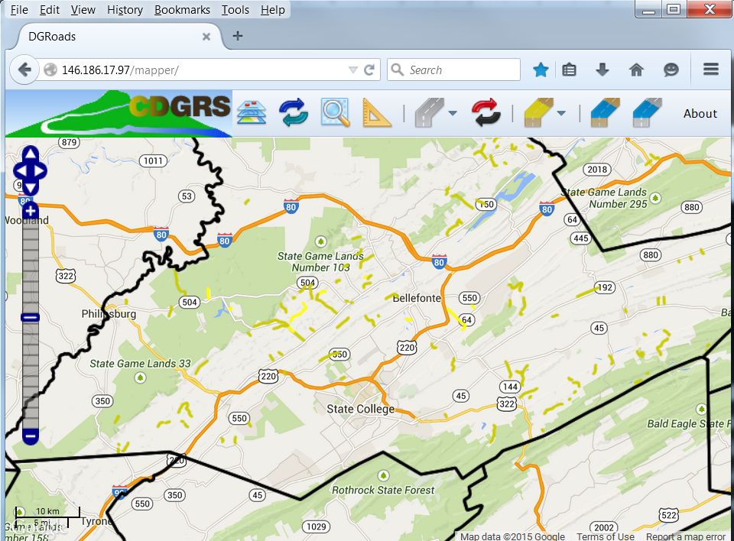
DGRoads GIS Update & Demo
Toggle Fullscreen
mode with this button
above
2/27/15
Starts at 10am
Use Chat box to ask Questions
http://metrocount.com
If you are reading this, then you are successfully seeing the webinar video. In addition to audio on the webinar, we have opened a phone conference line to allow attendees to listen and ask questions directly: 866-823-7699. Please use either the webinar audio or conference line, but not both (will produce feedback).
Audio also available via phone: 866-823-7699
For assistance, call: 814-865-5355

Slide 2
Toggle Fullscreen
mode with this button
above
Use Chat box to ask Questions
Participant phone lines will be muted until after initial presentation
http://metrocount.com
Audio also available via phone: 866-823-7699
For assistance, call: 814-865-5355

Slide 3
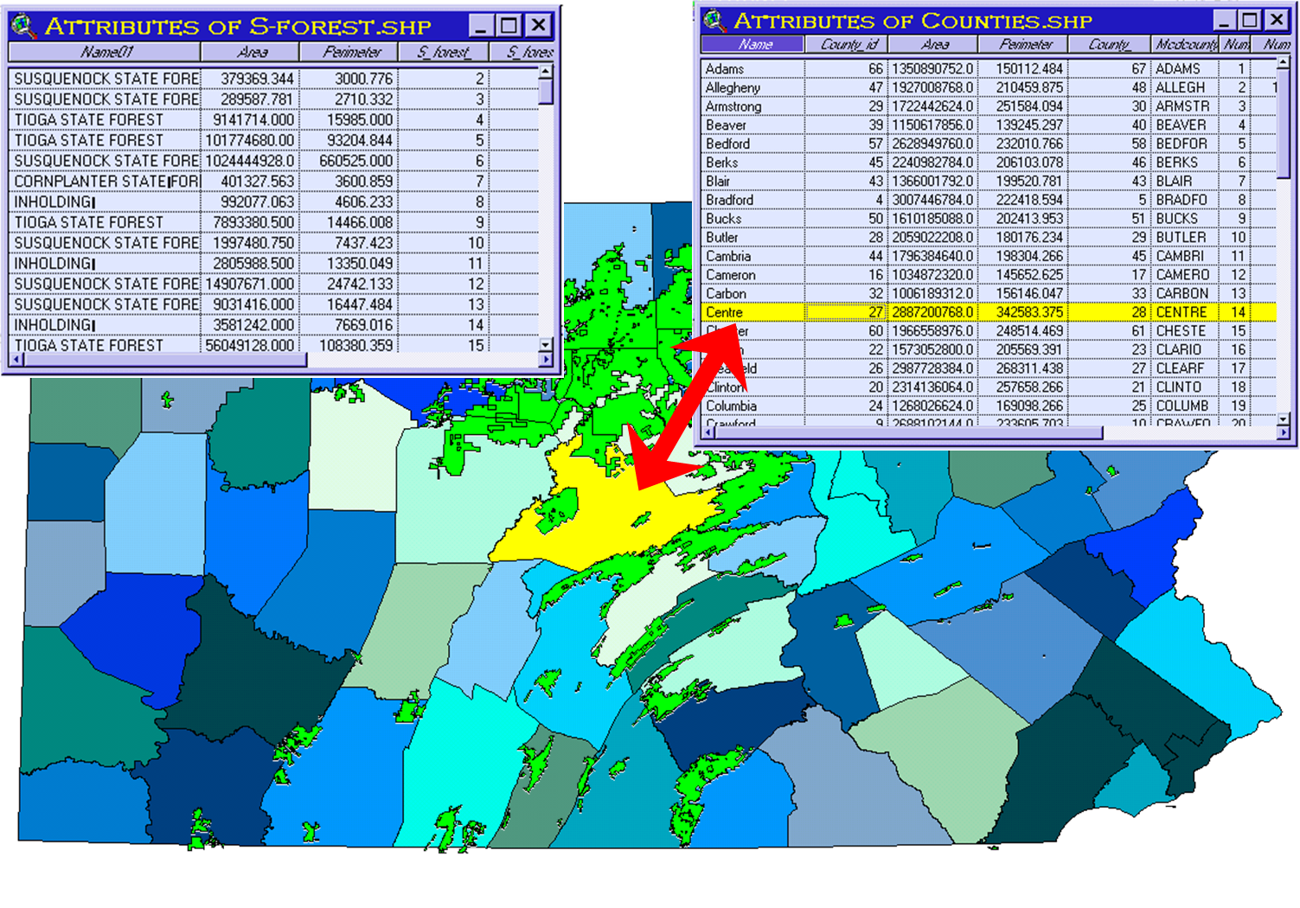
DGRoads GIS Update
What is a GIS?
Geographic Information System
“Map layers + data”

Slide 4
DGRoads GIS Update
How does DGLVRP use GIS?
Tracking for ~17,000 project sites statewide
Location data
Financial data
Reporting
Analysis
Since 1999, Districts use DGRoads to track projects and spending, and submit report annually.

Slide 5
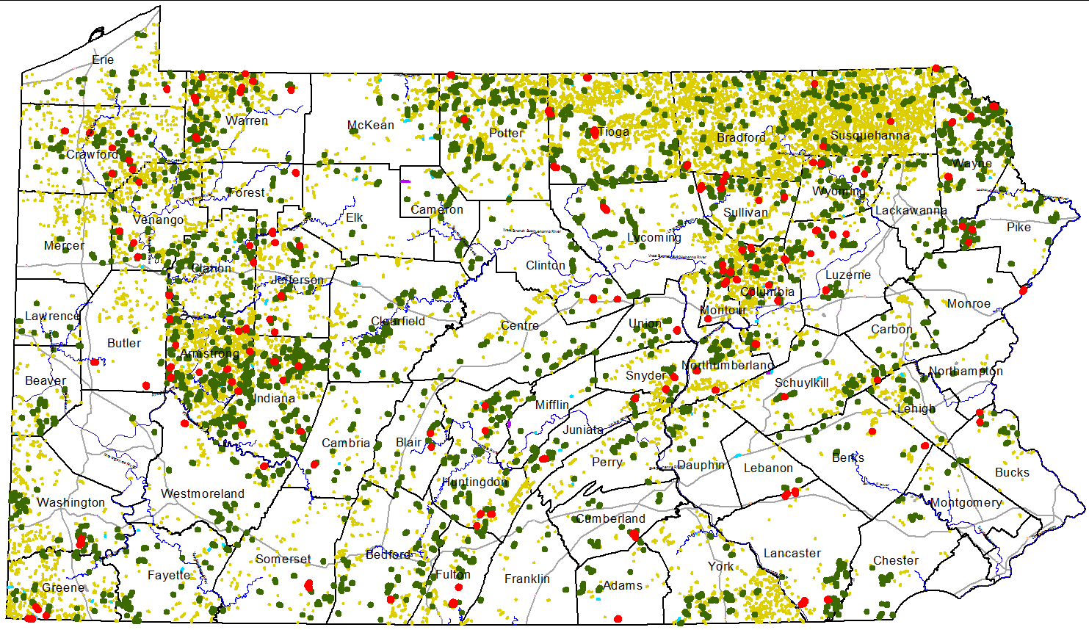
DGRoads GIS Update
How does DGLVRP use GIS?
Yellow: Unfunded identified worksites: 14,195
Green: 1997-2012 FUNDED worksites: 2,565
Red: 2013 FUNDED worksites: 167
2013 Status Map:

Slide 6
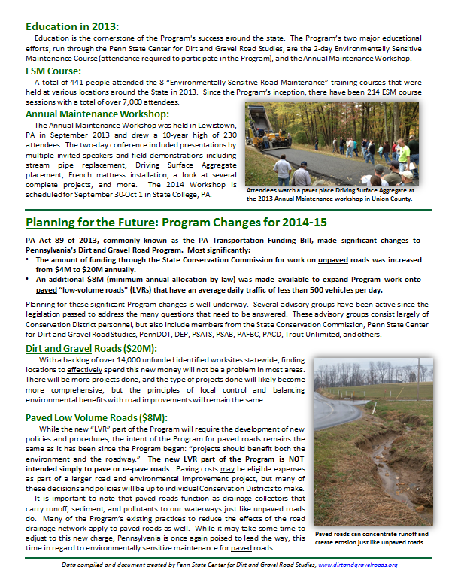
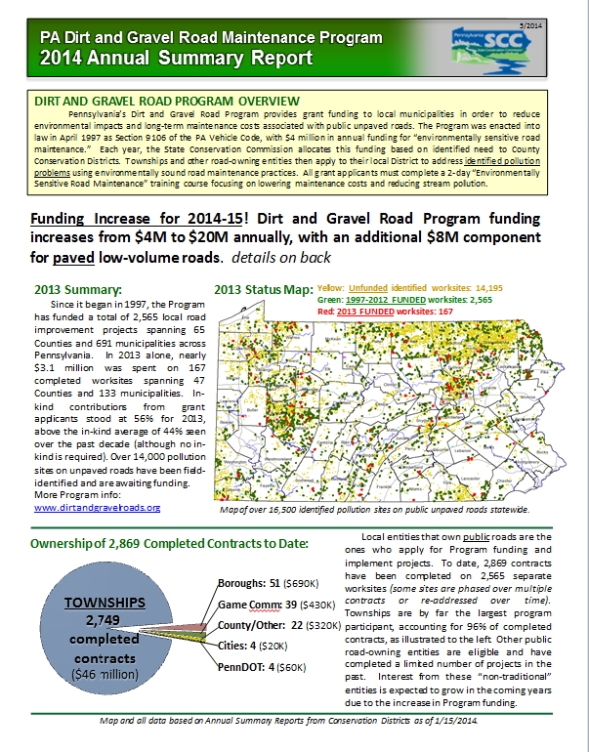
DGRoads GIS Update
How does DGLVRP use GIS?

Slide 7
DGRoads GIS Update
What is being updated?
Entirely new system!
Old system could not handle capacity of 7X funding.
Old system not designed for paved LVRs.
Center staff working with 2 subcontractors.

Slide 8
DGRoads GIS Update
Old System
Local Install
Permission issues
Outdated data
Data on CD harddrive
No remote access
Desktop only
No overlapping sites
No LVR support
New System
Web Based
Nothing to install
Live updates
Data on server
Access from anywhere
Offline and tablet mode
Can overlap sites
Includes LVRs

Slide 9
DGRoads GIS Update
DGRoads Online GIS System
Multi-user access via secure log-in
Public Viewer
CDs can edit data within their county
State administrators can edit data statewide
Will have ability to overlap sites and track LVR sites.
Should have “offline mode” and work on tablets.

Slide 10
Poll Question
What default internet browser do you use?
Internet Explorer
Mozilla Firefox
Google Chrome
Apple Safari
Other
http://metrocount.com
Audio also available via phone: 866-823-7699
For assistance, call: 814-865-5355

Slide 11
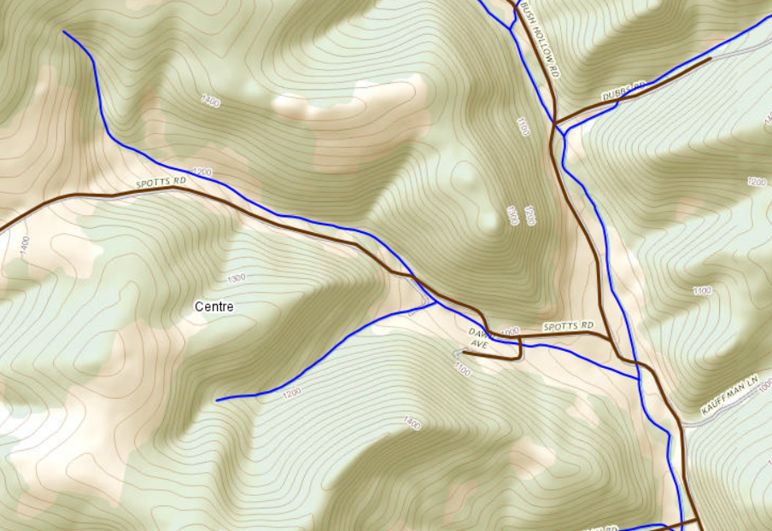
DGRoads GIS Update
NEW handling of worksites
OLD: One worksite shapefile
NEW: geodatabase of worksites
Potential Worksite Layer
Completed and contracted sites by year
Can turn individual years on and off.
Can edit projects in any year.
Will allow partial and complete overlaps of worksites.

Slide 12
DGRoads GIS Update
NEW handling of worksites
OLD: One worksite shapefile
NEW: geodatabase of worksites
Potential Worksite Layer
Completed and contracted sites by year
Can turn individual years on and off.
Can edit projects in any year.
Will allow partial and complete overlaps of worksites.
2004: stream crossing replacement

Slide 13
DGRoads GIS Update
NEW handling of worksites
OLD: One worksite shapefile
NEW: geodatabase of worksites
Potential Worksite Layer
Completed and contracted sites by year
Can turn individual years on and off.
Can edit projects in any year.
Will allow partial and complete overlaps of worksites.
2009: pipes and underdrain

Slide 14
DGRoads GIS Update
NEW handling of worksites
OLD: One worksite shapefile
NEW: geodatabase of worksites
Potential Worksite Layer
Completed and contracted sites by year
Can turn individual years on and off.
Can edit projects in any year.
Will allow partial and complete overlaps of worksites.
2015: Driving Surface Aggregate

Slide 15
DGRoads GIS Update
NEW handling of worksites
OLD: One worksite shapefile
NEW: geodatabase of worksites
Potential Worksite Layer
Completed and contracted sites by year
Can turn individual years on and off.
Can edit projects in any year.
Will allow partial and complete overlaps of worksites.

Slide 16
DGRoads GIS Update
DGRoads Online GIS System
Spring 2014: Planning began
Fall 2014: Preliminary work began
Fall/Winter 2014: several meetings and demos, continue development
Jan 2015: Last Summary Report done in old system

Slide 17
DGRoads GIS Update
DGRoads Online GIS System
Spring 2014: Planning began
Fall 2014: Preliminary work began
Fall/Winter 2014: several meetings and demos, continue development
Jan 2015: Last Summary Report done in old system
Feb 2015: “Beta” Version out to GIS test group
April 2015: Initial limited release for testing.
May-June 2015: Full release

Slide 18
DGRoads GIS Update
Please do not input new data into your old GIS.
Your 2014 ASR data will show up in new GIS system.
Don’t let inability to input data stop you from making contracts and doing business as usual.

Slide 19
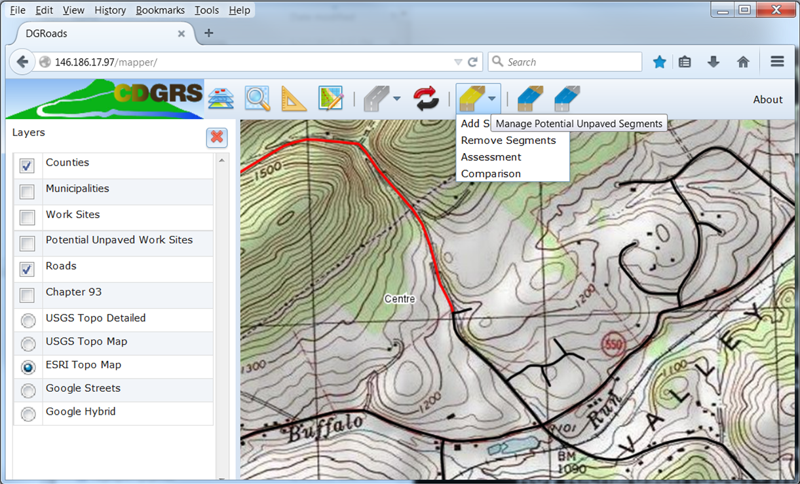
DGRoads Online GIS System Update
DEMO

