Slide 1
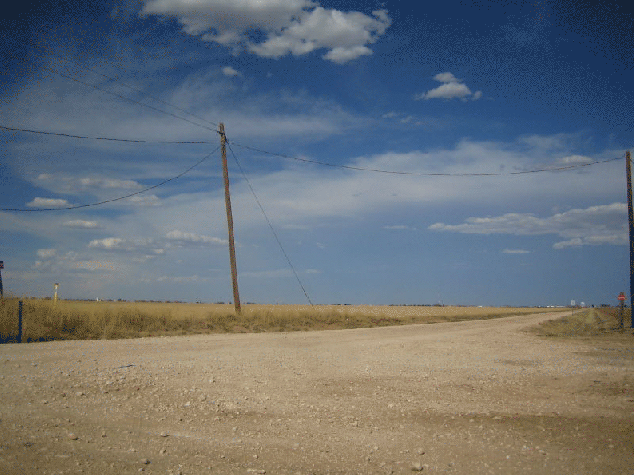
DGLVR Webinar
Manual,
Reporting, and Spending
Updates
5/23/19
Starts at 9am
If you are reading this, then you are successfully seeing the webinar video. Webinar audio should be automatic through your computer, and options can be accessed in the “audio options” button on the bottom left. If you are having audio issues, or are in a location where listening via phone is preferable, audio is also available on the CDGRS conference line at:
866-823-7699.
For technical assistance, call: 814-865-5355

Slide 2
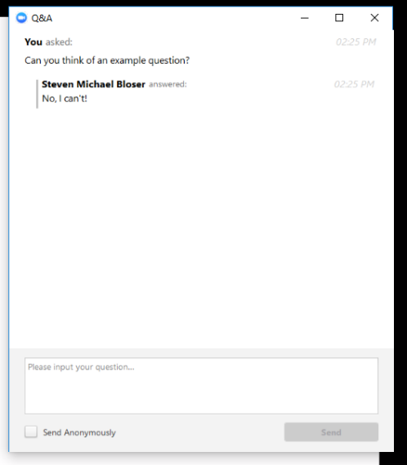
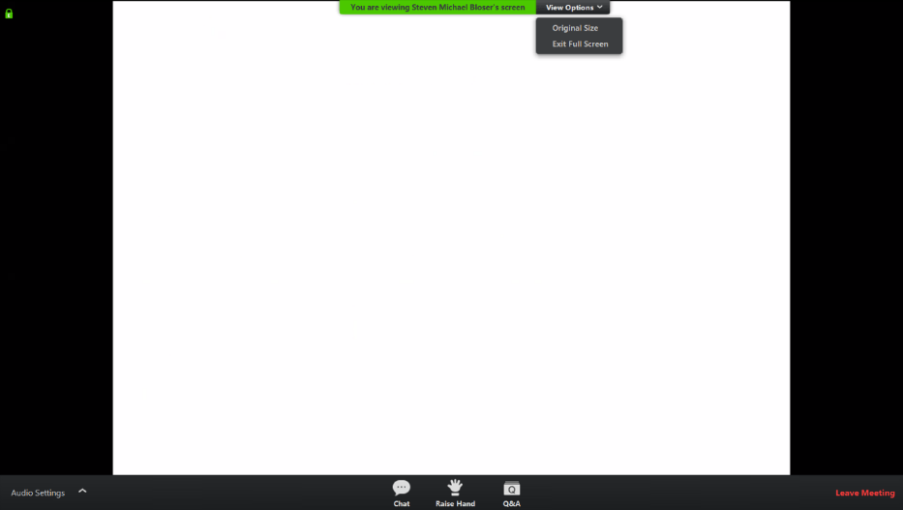
Q&A
Note you can ask a question anonymously
Q&A
For audio via phone: 866-823-7699
For technical assistance: 814-865-5355
Slide #

Slide 3
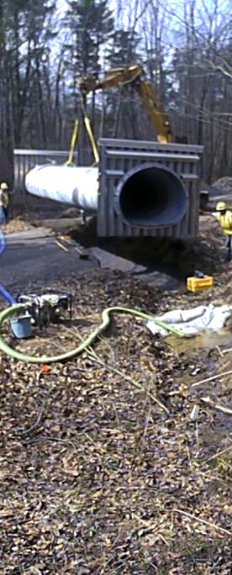
DGLVR Update
DGLVR Updates:
Admin Manual
Quarterly Reporting
Spending
Audio also available via phone: 866-823-7699
For assistance, call: 814-865-5355

Slide 4
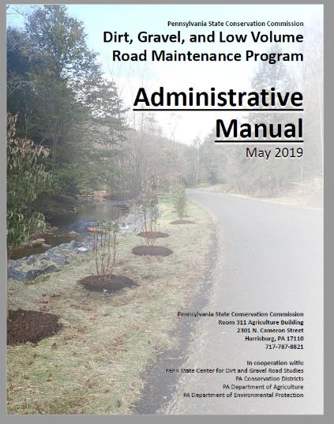
DGLVR Update
Administrative Manual
Admin Manual
Written in 2014, Updated in 2017
SCC approved updates 5/14/19 that take effect 7/1/19
Audio also available via phone: 866-823-7699
For assistance, call: 814-865-5355

Slide 5
DGLVR Update
Administrative Manual
Admin Manual
Manual Update Process
2018: Draft changes made to manual
Fall 2018: Advisory Workgroup had several meetings/calls to review and discuss
Jan 2019: To CDs for review (7 sets of comments received)
Jan 2019: Provided to PDA Legal for review
Mar 2019: Final advisory workgroup feedback
April 2019: Final approval by PDA legal
May 2019: “Track Changes” version of manual to SCC
5/14/19: SCC Approved manual effective 7/1/19
Audio also available via phone: 866-823-7699
For assistance, call: 814-865-5355

Slide 6
DGLVR Update
Administrative Manual
New Manual and Policies effective July 1, 2019:
Why: allows time to adjust, provide new forms (contract and completion report) and make GIS updates.
Contracts signed before 7/1/19: old policies apply (grandfathered)
Contracts signed on/after 7/1/19: new policies apply
GIS forms and website will be updated 7/1/19
Audio also available via phone: 866-823-7699
For assistance, call: 814-865-5355

Slide 7
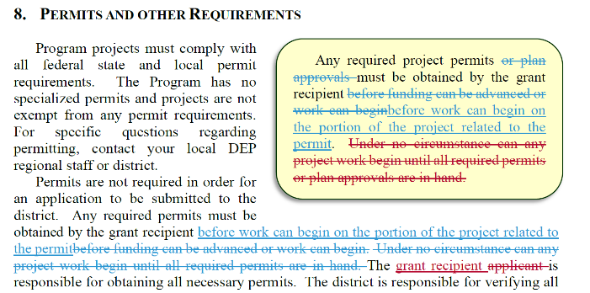
DGLVR Update
Administrative Manual
Review of Significant Changes
This is a Summary of major changes only
“Track Changes” version of admin manual available on CDGRS Website
Audio also available via phone: 866-823-7699
For assistance, call: 814-865-5355

Slide 8
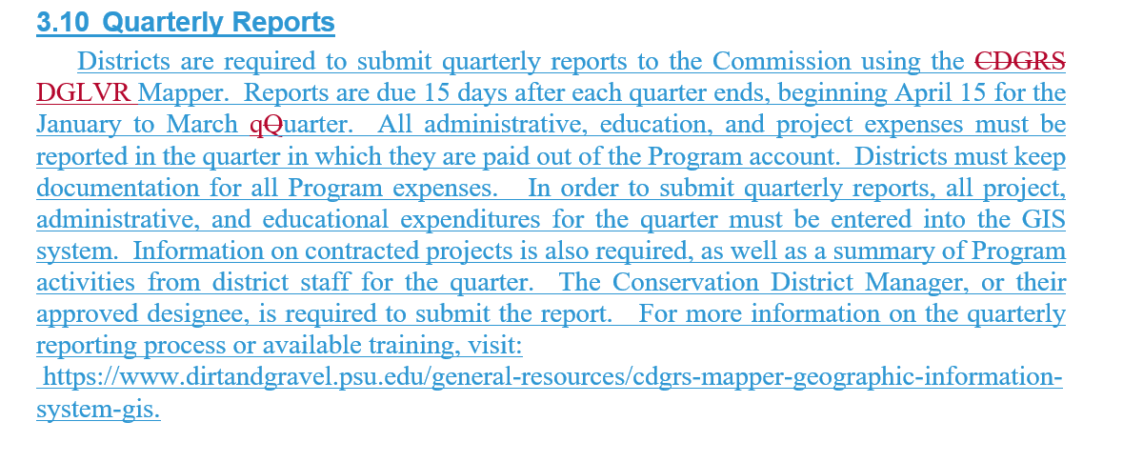
DGLVR Update
Administrative Manual
Significant Admin Manual Changes
Quarterly Reporting: Move to quarterly reporting required updates to several sections (3.3, 3.9, 3.10)
Audio also available via phone: 866-823-7699
For assistance, call: 814-865-5355

Slide 9
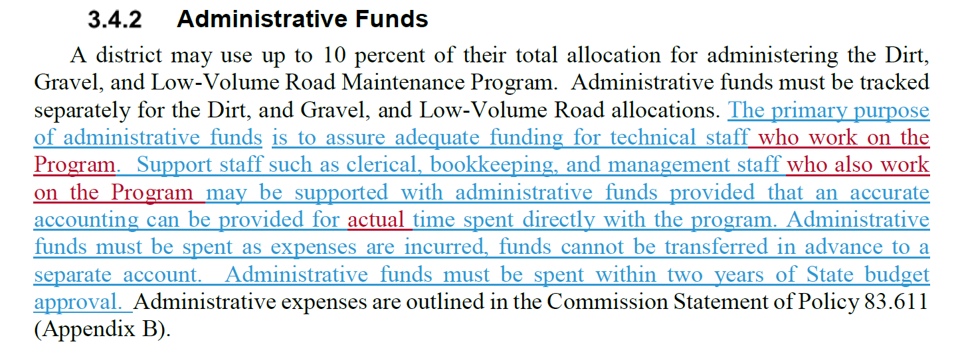
DGLVR Update
Administrative Manual
Significant Admin Manual Changes
3.4, Admin / Edu Wording: Clarification of allowable administrative and education expenses

Slide 10
DGLVR Update
Administrative Manual
Significant Admin Manual Changes
3.7.4.5, Prevailing Wage: Updated and clarified CD role in documenting PW. Included new notification letter and verification form as part of project contracts
Audio also available via phone: 866-823-7699
For assistance, call: 814-865-5355

Slide 11
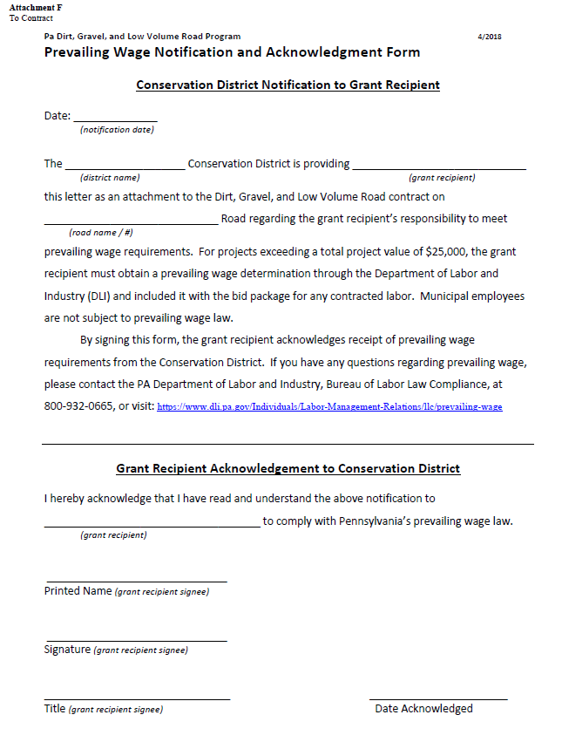
DGLVR Update
Administrative Manual
Significant Admin Manual Changes
3.7.4.5, Prevailing Wage:
Notification form for all contracts
New attachment to contract

Slide 12
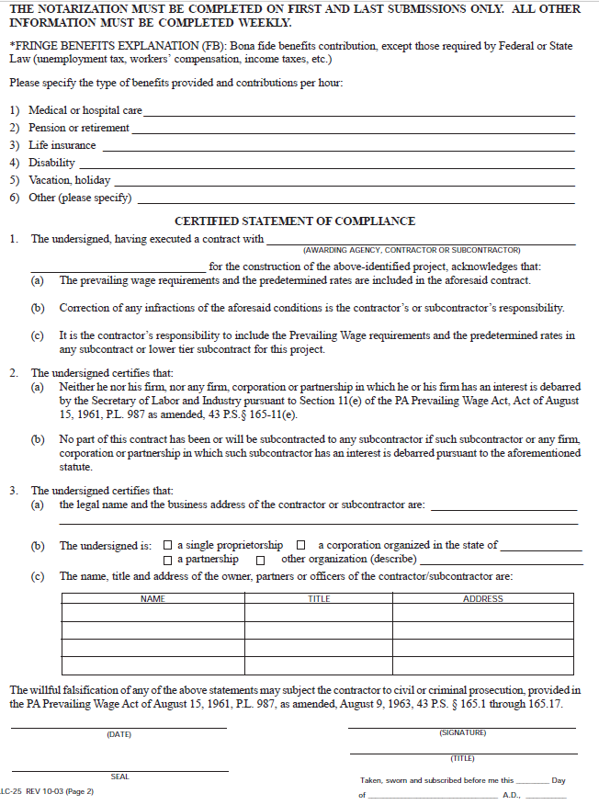
DGLVR Update
Administrative Manual
Significant Admin Manual Changes
3.7.4.5, Prevailing Wage:
Certification form for contracts where PW applies
New attachment to contract

Slide 13
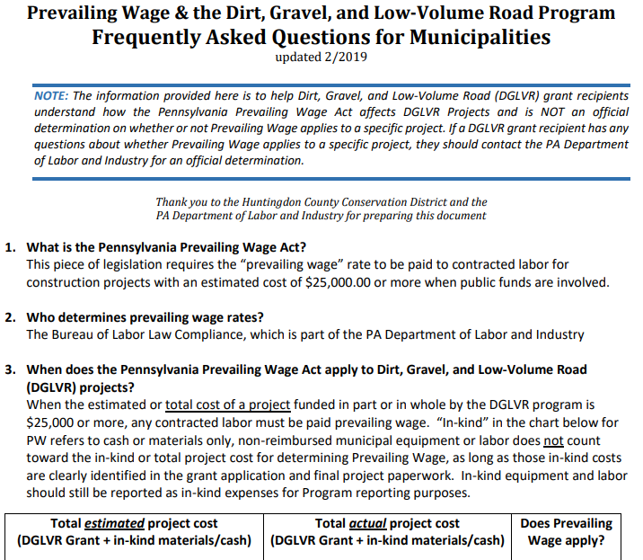
DGLVR Update
Administrative Manual
Note DGLVR Prevailing Wage Q&A Document
https://www.dirtandgravel.psu.edu/pa-program-resources/program-specific-resources/reference-material

Slide 14
DGLVR Update
Administrative Manual
Significant Admin Manual Changes
3.7.4.6, In-Kind Contributions: Added provision that in-kind spending must meet Program policies
Stream Crossing Replacements
Driving Surface Aggregate
Full Depth Reclamation
Audio also available via phone: 866-823-7699
For assistance, call: 814-865-5355

Slide 15
DGLVR Update
Administrative Manual
Significant Admin Manual Changes
Chapter 5:
Meant as a standalone chapter for Grant Applicants.
This chapter was updated to reflect changes elsewhere in manual.
Audio also available via phone: 866-823-7699
For assistance, call: 814-865-5355

Slide 16
DGLVR Update
Administrative Manual
Significant Admin Manual Changes
7.1, Stream Crossing Replacements:
No round pipes over 3’ allowed in streams
Audio also available via phone: 866-823-7699
For assistance, call: 814-865-5355

Slide 17
DGLVR Update
Administrative Manual
Significant Admin Manual Changes
7.1, Stream Crossing Replacements:
Policy application to small streams
Audio also available via phone: 866-823-7699
For assistance, call: 814-865-5355

Slide 18
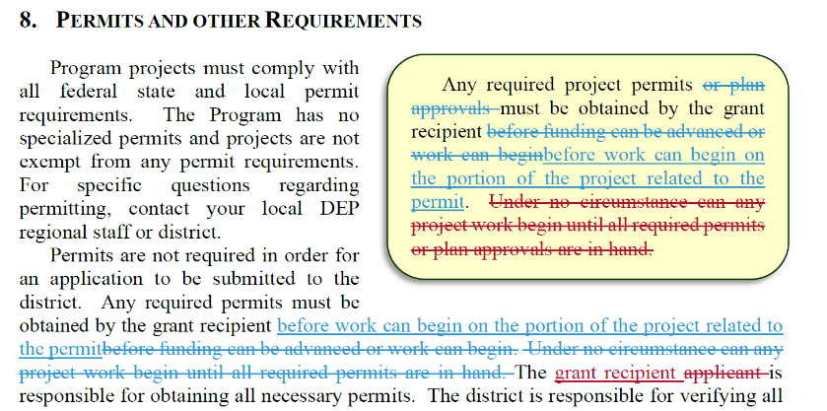
DGLVR Update
Administrative Manual
Significant Admin Manual Changes
8.1, Permits:
Old Wording: could not advance funds on project until permit was in hand
New Wording: “Any required project permits must be obtained by the grant recipient before work can begin on the portion of the project related to the permit.”

Slide 19
DGLVR Update
Administrative Manual
Significant Admin Manual Changes
Appendices:
Contract: minor wording changes, two new attachments dealing with Prevailing Wage
Will be updated in GIS 7/1/19

Slide 20
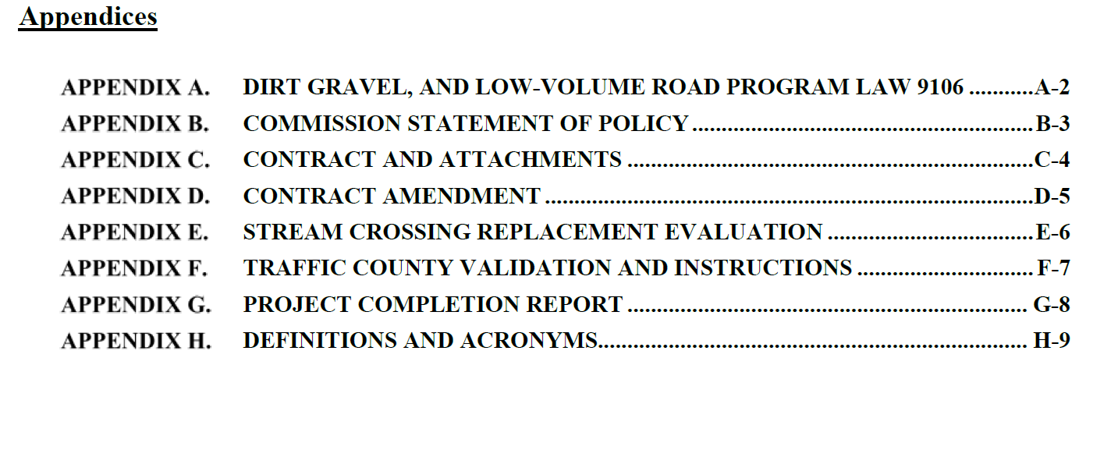
DGLVR Update
Administrative Manual
Significant Admin Manual Changes
Appendices:
Organization: Appendices reorganized and attachments to contract incorporated into single appendix

Slide 21
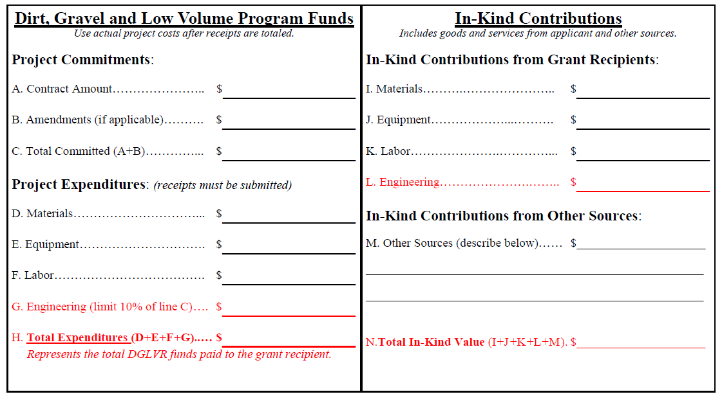
DGLVR Update
Administrative Manual
Significant Admin Manual Changes
Appendices:
Project Completion Report: minor changes to project closeout summary
Will be updated in GIS 7/1/19

Slide 22
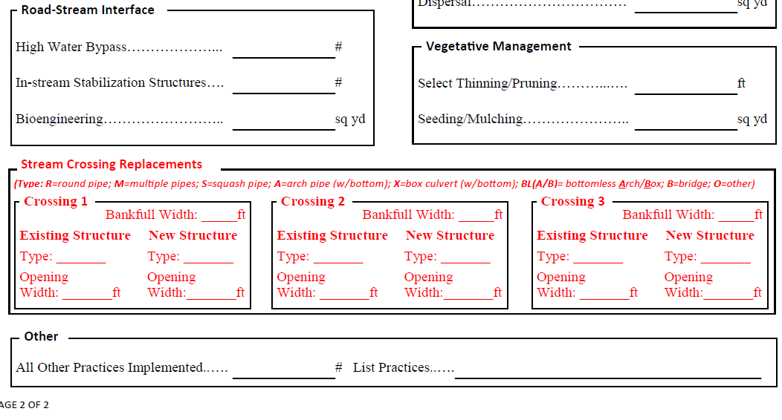
DGLVR Update
Administrative Manual
Significant Admin Manual Changes
Appendices:
Project Completion Report: minor changes to project closeout summary
Will be updated in GIS 7/1/19

Slide 23
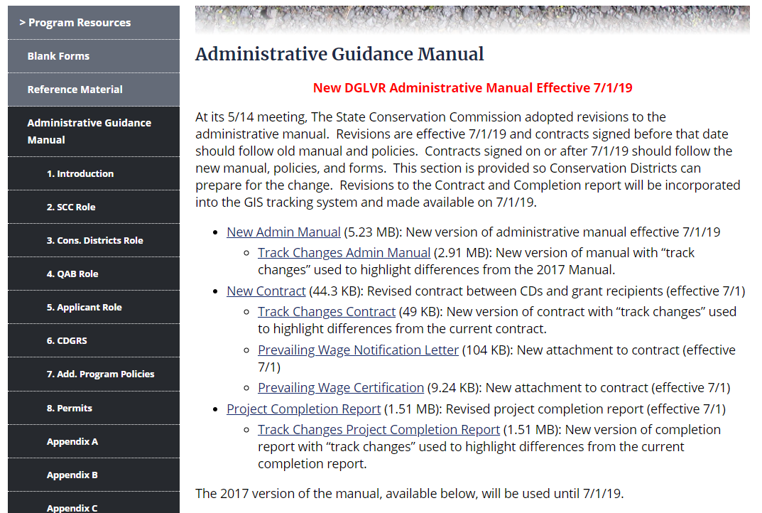
DGLVR Update
Administrative Manual
Manual on Website:

Slide 24
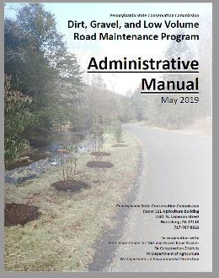
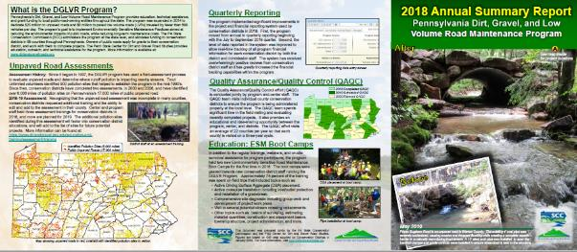
DGLVR Update
Administrative Manual
QUESTIONS?
Track Changes Manual available on CDGRS website
Contracts signed 6/30 or earlier – grandfathered into old policies
Contracts signed 7/1 or later: new manual and policies apply
New forms in GIS and on website 7/1/19
In the mail to CDS:
Two printed admin manuals
Three printed Annual Summary Reports

Slide 25
DGLVR Update
DGLVR Updates:
Admin Manual
Quarterly Reporting
Spending

Slide 26
DGLVR Update
Quarterly Reporting
Quarterly Reporting:
Three reports done since first one in Sep 2018
April-June report due July 15th ***
Automated replenishments working to get funds out of Harrisburg:
Only $220,000 of $26,000,000 for FY 2018-19 remain in Hbg

Slide 27
DGLVR Update
Quarterly Reporting
Quarterly Reporting:
Quarterly reports go with replenishments to justify spending
Some advice on quarterly reporting:

Slide 28
DGLVR Update
Quarterly Reporting
Example of Good Report:
Activity level justifies education spending.
Demo project, and workshops make a good outreach
Presentation to COG is a good way to get information out
ESM and Stream crossing training keeps staff up to date

Slide 29
DGLVR Update
Quarterly Reporting
Example of Good Report:
Admin/Edu Checks over $500

Slide 30
DGLVR Update
Quarterly Reporting
Example of Good Report:
Shows effort from active county
Keeping up to date with education and training

Slide 31
DGLVR Update
Quarterly Reporting
Example of Good Report:
Briefly describes a lot of one-on-one work with applicants

Slide 32
DGLVR Update
Quarterly Reporting
Example of Questionable Activity vs Spending:

Slide 33
DGLVR Update
Quarterly Reporting
Example of Questionable Activity vs Spending:
Minimal outreach
No project payments since quarterly reporting began
Still using admin/edu funds

Slide 34
DGLVR Update
DGLVR Updates:
Admin Manual
Quarterly Reporting
Spending

Slide 35
DGLVR Update
CD 5-year spending
CD 5-Year Contract and Spending
5-year SCC contract with CDs expired June 30, 2018
Agreements were extended through June 30, 2019 to allow CDs to expend money and complete projects.
Approved at 3/2019 SCC meeting:
Counties with uncommitted old funds as of 5/24/19 (Red): not eligible for FY 2019-20 Allocations
Counties with unspent old funds as of 6/30/19 (Yellow): FY 2019-20 allocations reduced by amount of unspent funds.
DNG and LVR tracked separately, and any money withheld is distributed to eligible CDs (Green).

Slide 36
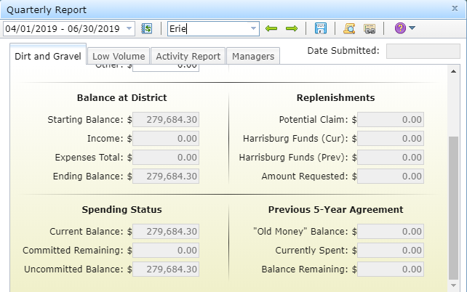
DGLVR Update
CD 5-year spending
CD 5- Year Contract and Spending
Reminder: how to determine your status
Example of a Green County
Zero Balance in “previous 5-Year Agreement”
Eligible for FY 2019-20 allocation

Slide 37
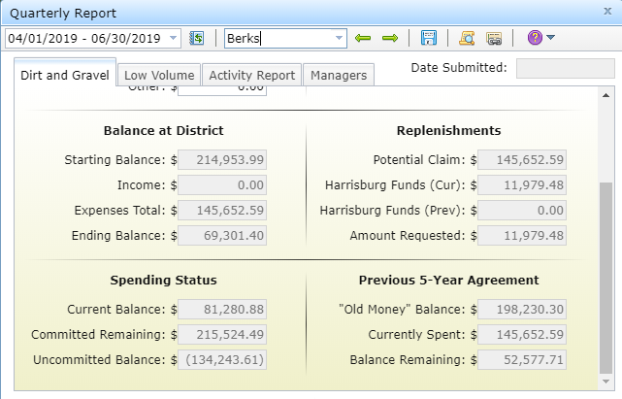
DGLVR Update
CD 5-year spending
CD 5- Year Contract and Spending
Reminder: how to determine your status
Example of a Yellow County
$53K remaining in Previous 5-year agreement, but $215K under contract:
Eligible for FY 2019-20 allocation
Would have allocation reduced by $53K

Slide 38
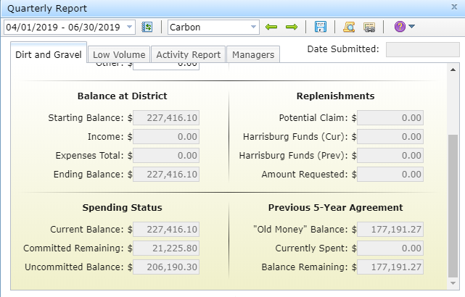
DGLVR Update
CD 5-year spending
CD 5- Year Contract and Spending
Reminder: how to determine your status
Example of a Red County
$177K remaining in Previous 5-year agreement, but only $21K under contract:
NOT Eligible for FY 2019-20 allocation

Slide 39
DGLVR Update
CD 5-year spending
Spending Status
$130M allocated to CDs through previous 5-year agreement
$5.4M in old funds left to be spent before June 30
$250,000 of that still needs to be committed (red)
$5.2M of that is committed, just needs to be spent (yellow)

Slide 40
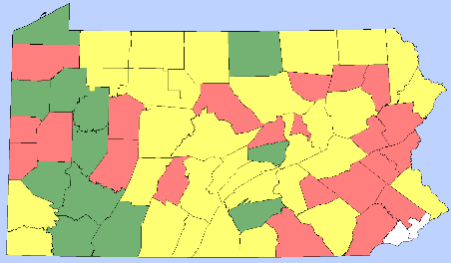
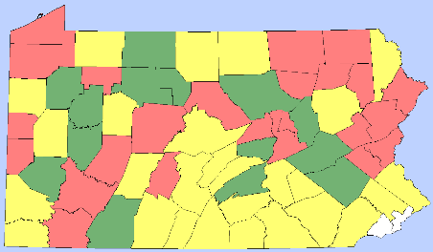
3/27/2019: $12 Million left
RED: 22 DnG, 24 LVR
YELLOW: 31 DnG, 27 LVR
GREEN: 12 DnG, 14 LVR
DnG
LVR

Slide 41
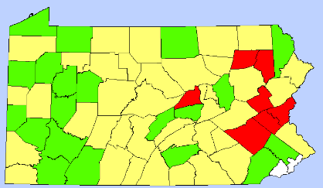
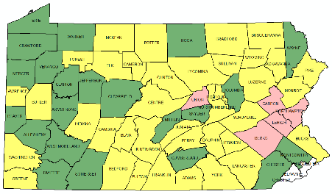
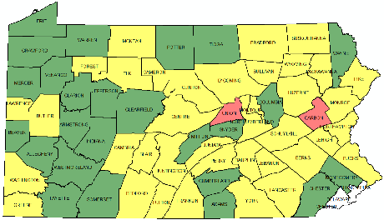
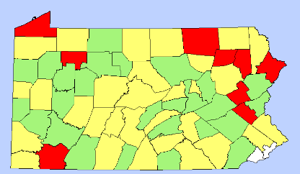
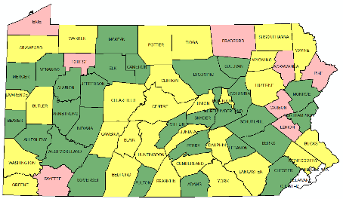
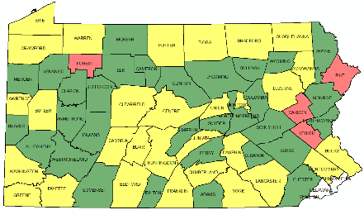
3/27/2019: $12 Million left
RED: 22 DnG, 24 LVR
YELLOW: 31 DnG, 27 LVR
GREEN: 12 DnG, 14 LVR
5/22/2019: $5 Million left
RED: 2 DnG, 4 LVR
YELLOW: 38 DnG, 31 LVR
GREEN: 25 DnG, 30 LVR
5/2/19 DnG
5/12/19 DnG
DnG
DnG
5/2/19 LVR
5/12/19 LVR
LVR
LVR

Slide 42
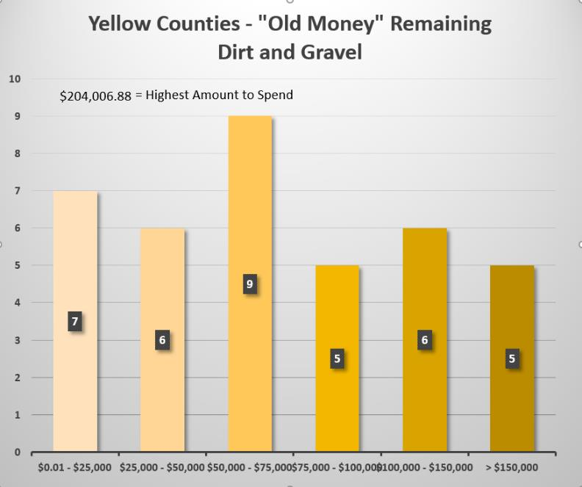
DGLVR Update
CD 5-year spending
CD 5- Year Contract and Spending

Slide 43
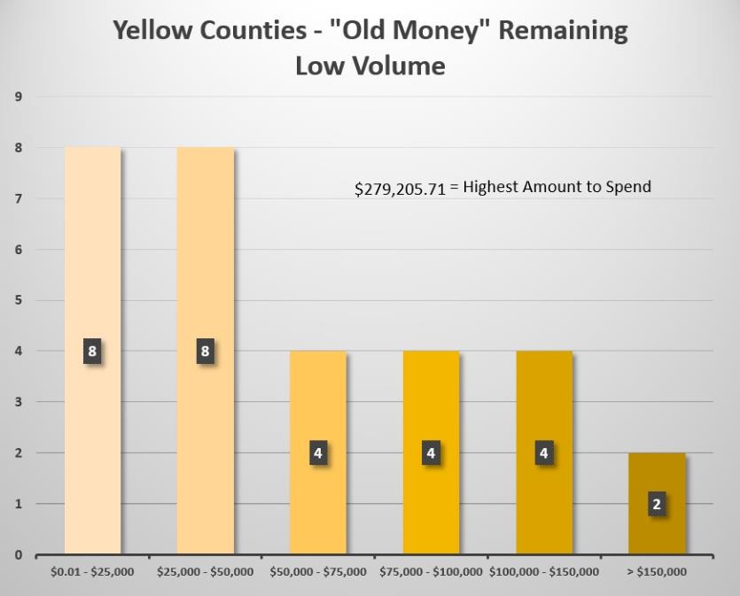
DGLVR Update
CD 5-year spending
CD 5- Year Contract and Spending

Slide 44
DGLVR Update
CD 5-year spending
CD 5- Year Contract and Spending
Advice for Yellow counties
Complete projects
Advance payments on new projects
Consider progress payments for projects
Must be for actual expenses
Must hold 30% until project completion
***Keep GIS up to date, don’t wait until July ASR Deadline

Slide 45
DGLVR Update
CD 5-year spending
CD 5- Year Contract and Spending
CDs have been busy getting contracts and completing projects
CDGRS and SCC have been busy helping with technical assistance.
Current Projection:
Less than 5 counties will be ineligible for an FY 2019-20 allocation (each DnG/LVR)
Less than 15 counties will get allocation reductions for FY 2019-20 allocations (each DnG/LVR)

