Slide 1
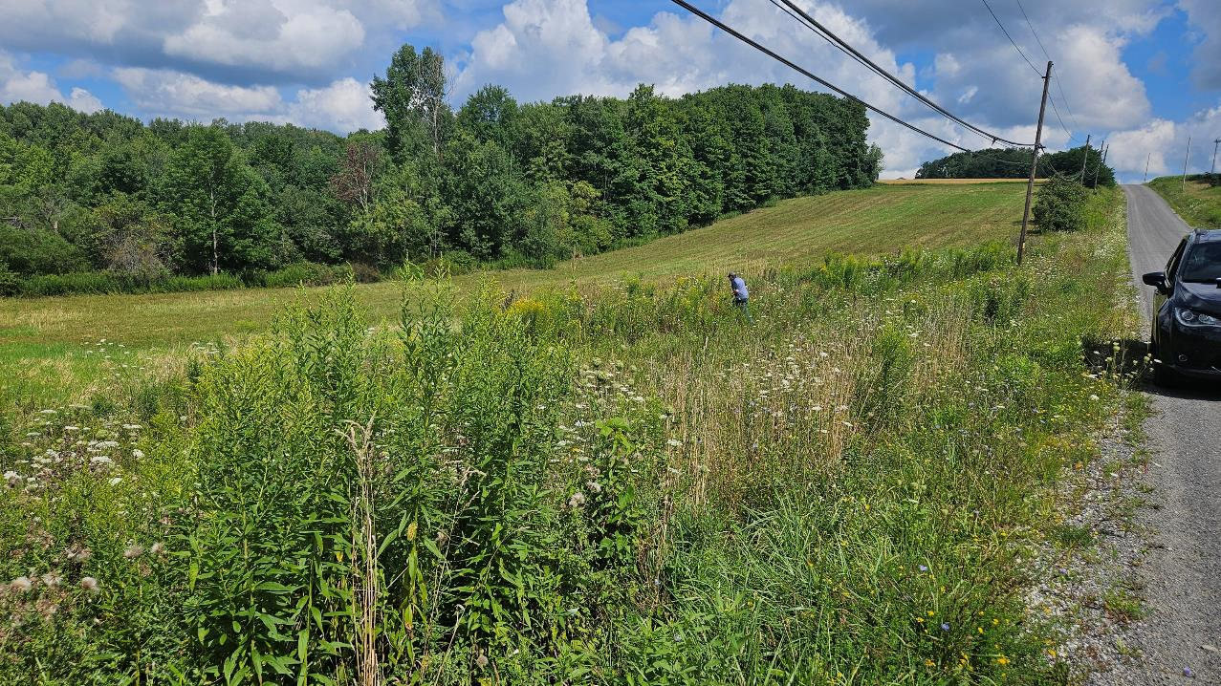
Dirt Gravel and Low Volume Road Program
WEBINAR
2/27/2025, 9am
Working Outside the Right-of-Way
SCC
Sherri Law
CDGRS
Dave Creamer
Blair County Conservation District
Chelsey Weyant
Sarah Oreskovitch

Slide 2
Working outside the Right-of-Way
Presentation Outline
What is the ROW & why work off ROW?
Eligible off ROW work
Permission from landowners
What to do if you can’t get off ROW permission
Example projects
Other funding sources

Slide 3
Working outside the Right-of-Way
Presentation Outline
What is the ROW & why work off ROW?
Eligible off ROW work
Permission from landowners
What to do if you can’t get off ROW permission
Example projects
Other funding sources

Slide 4
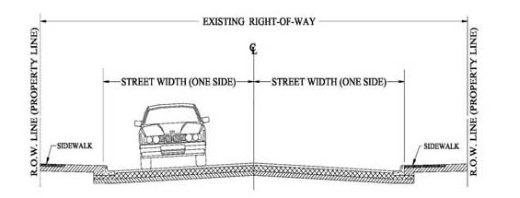
Working off the Right-of-Way
Right-of-way (ROW):
Publicly owned road corridor.
Typically 33’ width (16.5’ from road Centerline) for municipal roads.
Exceptions do apply, sometime up to 50’.
http://old.mcallen.net/landingpages/lp_engineering/roa_permits.aspx

Slide 5
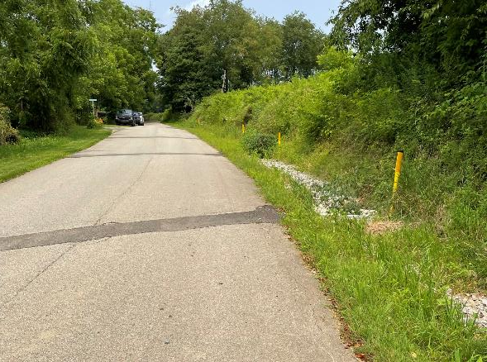
Where can DGLVR funds be spent?
DGLVR projects are on public roads
Eligible applicants are local, county, or state public entities
that maintain public roads open to public vehicle travel
The entity that owns the right of way is the determining factor
DGLVR contracts and payments can only be made with the entity that owns the road

Slide 6
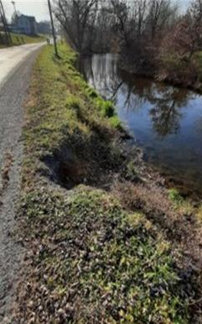
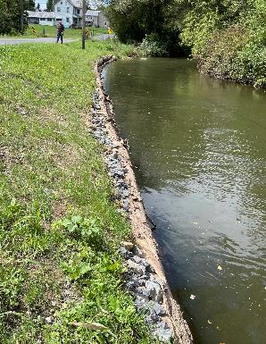
Where can DGLVR funds be spent?
Working outside the road right-of-way is an allowable Program expense
Only when:
the off right-of-way impact is having a direct negative effect on a public road
AND addressing the off right-of-way impact is directly necessary to the successful completion of the project on the public road.
Before
After
Union

Slide 7
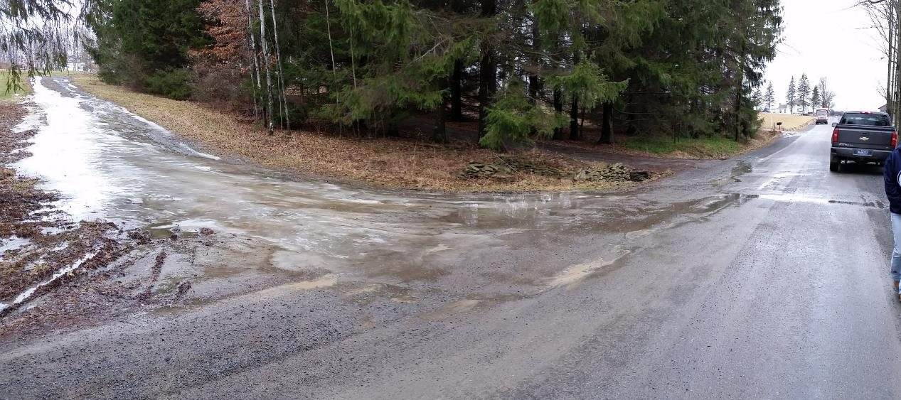
Why work off Right-of-Way?

Slide 8
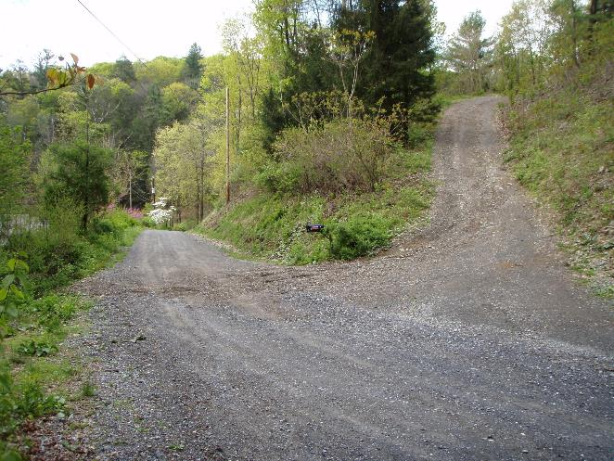
Why work off Right-of-Way?

Slide 9
Why Work off ROW?
Water from uphill can cause issues on the public road
Stabilization is needed where water leaves the road
Stream instability near roads needs to be fixed and often extends off ROW

Slide 10
Why work off ROW?
We can’t always solve road erosion issues in the right-of-way

Slide 11
Why work off ROW?
Ignoring off ROW water issues can leave erosion issues unresolved

Slide 12
Why work off ROW?
Many DGLVR Projects require work outside the right-of-way to fully correct erosion issues

Slide 13
Working outside the Right-of-Way
Presentation Outline
What is the ROW & why work off ROW?
Eligible off ROW work
Permission from landowners
What to do if you can’t get off ROW permission
Example projects
Other funding sources

Slide 14
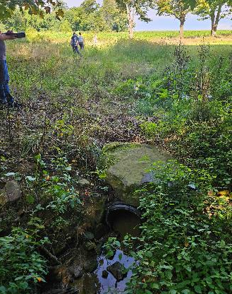
Working off the Right-of-Way
Administrative Manual Section 3.7.4.8
Funds can be spent on activities outside the right-of-way only when:
It is part of a larger project on a public road.
The issue on the public road cannot be effectively resolved within the right-of-way with traditional ESM practices.
The district determines it is directly necessary as part of the successful completion of the project on the public road.

Slide 15
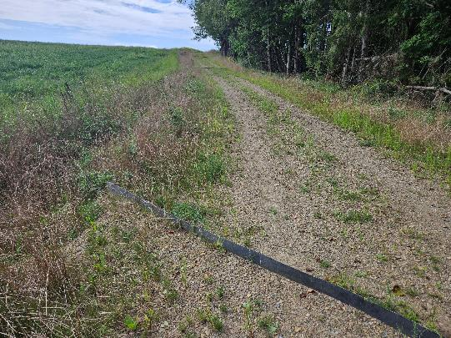
Working off the Right-of-Way
Administrative Manual Section 3.7.4.8
Funds can be spent on activities outside the right-of-way only when:
It is limited in scope to:
cost-effective ESM practices that directly reduce impacts to the public road.
only address the area necessary to reduce impacts to the public road.
Crawford

Slide 16
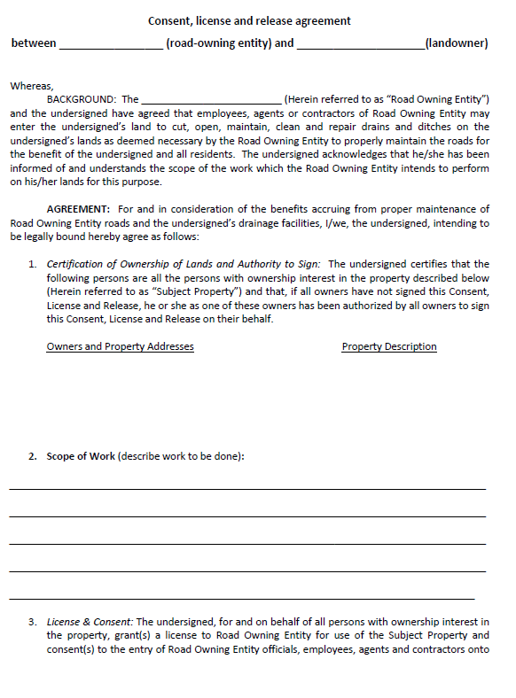
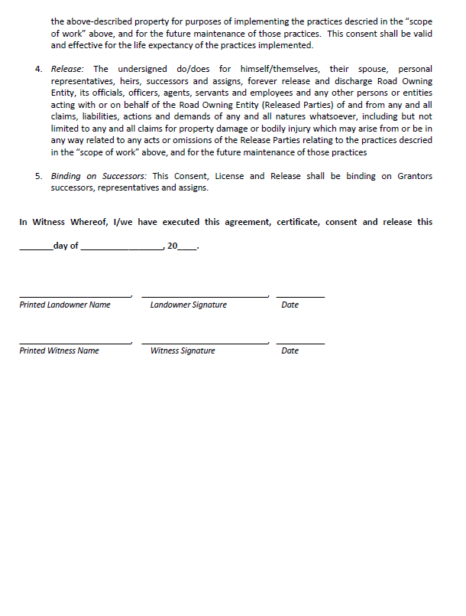
Working off the Right-of-Way
Administrative Manual Section 3.7.4.8
Funds can be spent on activities outside the right-of-way only when:
The grant recipient has obtained written permission from the landowner.
Districts must keep a copy of the signed landowner consent form with the project file for any work performed off the right of way.
Districts can use their own form, or the example provided in manual, but must use something!
Word Version Available Online
www.dirtandgravelroads.org

Slide 17
Working off the Right-of-Way
Administrative Manual Section 3.7.4.8
Funds can be spent on activities outside the right-of-way only when:
Prior written approval of the Commission is required before a contract can be signed:
Where off-right-of-way work is more than 35% of the total project costs (including program funds and in-kind contributions)
Where work extends more than 500 feet off of the right-of-way.
Call or email DGLVR SCC staff to request permission in these cases. A site visit is often required.

Slide 18
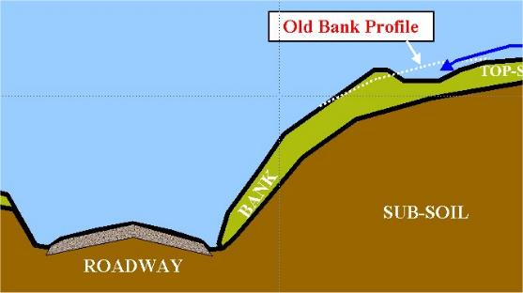
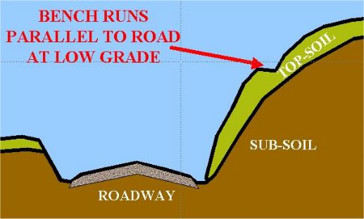
Example off ROW practices
DIVERSION SWALES vs BANK BENCHES
Channel shaped Flat
Sloped for water flow Very gentle slope
Designed to carry water Designed to slow water
Both need stable outlets!

Slide 19
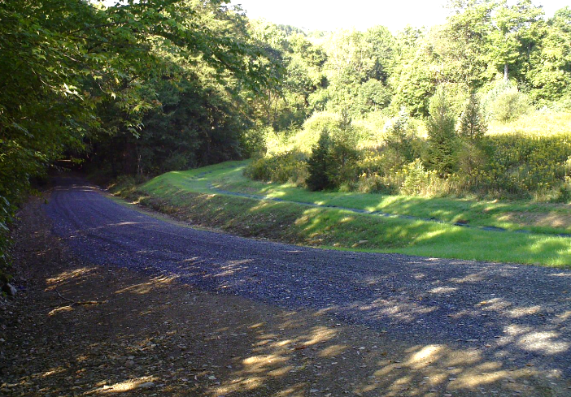
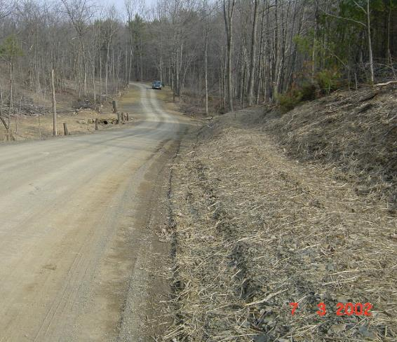
Example off ROW practices
Bank Bench
Swale with stable outlet
Jefferson
Huntingdon

Slide 20
Example off ROW practices
Drainage from access roads can be addressed with a wide variety of ESM practices:
Road fill
Crown or side slope
Cross pipes
Turn out
Grade break
Broad-based dip
Any ESM practice needed
Water flows down driveway onto road

Slide 21
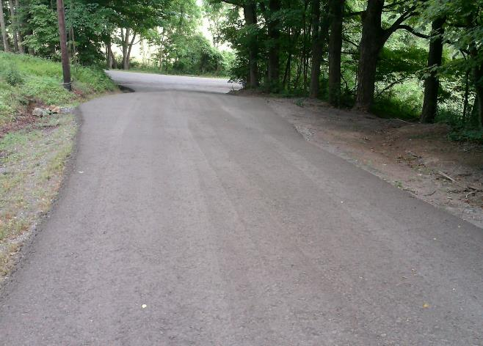
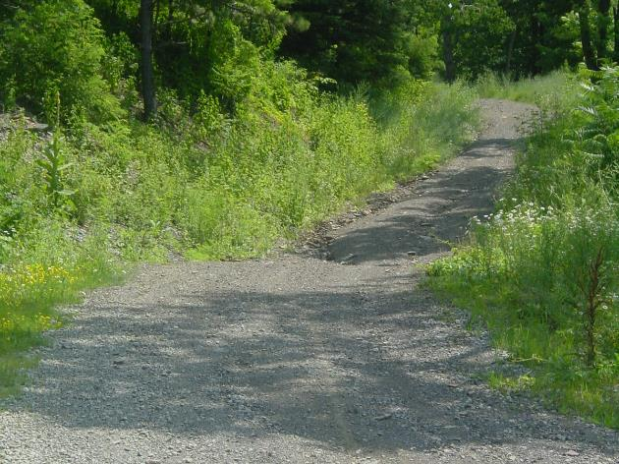
Example off ROW practices
Shallow pipe, grade break, and turnout
Broad-Based Dip
Twp Road
Driveway
Snyder
Clearfield

Slide 22
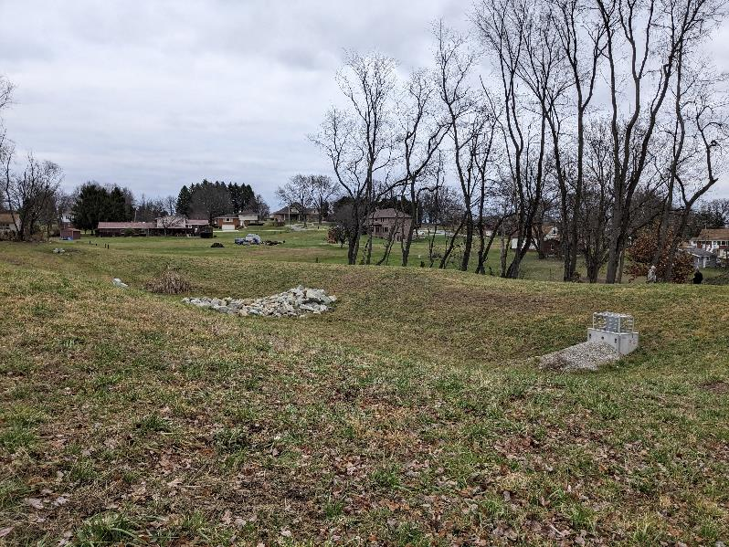
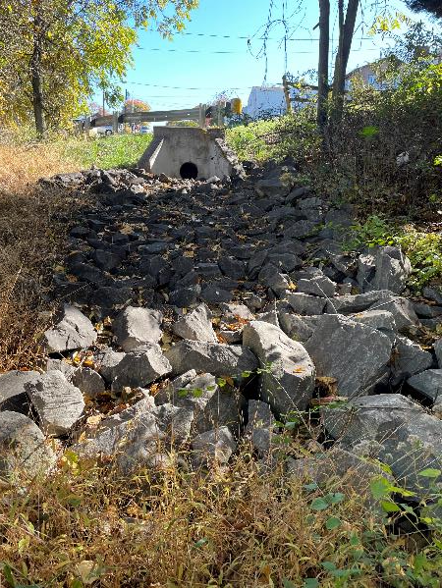
Example off ROW practices
Stormwater detention & infiltration
Outlet stabilization
Westmoreland
Allegheny

Slide 23
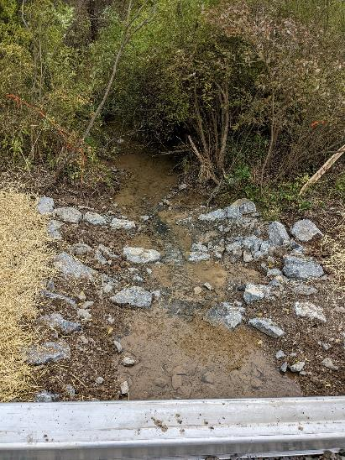
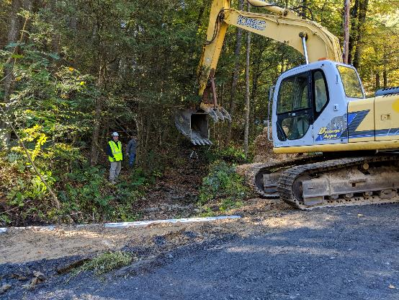
Example off ROW practices
Stream crossing replacements require stabilizing the stream channel upstream and downstream of the road

Slide 24
Working outside the Right-of-Way
Presentation Outline
What is the ROW & why work off ROW?
Eligible off ROW work
Permission from landowners
What to do if you can’t get off ROW permission
Example projects
Other funding sources

Slide 25
Working off the Right-of-Way
Written landowner permission:
Required before working outside the right-of-way.
Suggested when off-right-of-way impacts are expected, even if work is done within right-of-way.
New pipes and turnouts.
Subsurface drainage (French mattress & underdrain)
Driveway issues.
Road fill jobs.

Slide 26
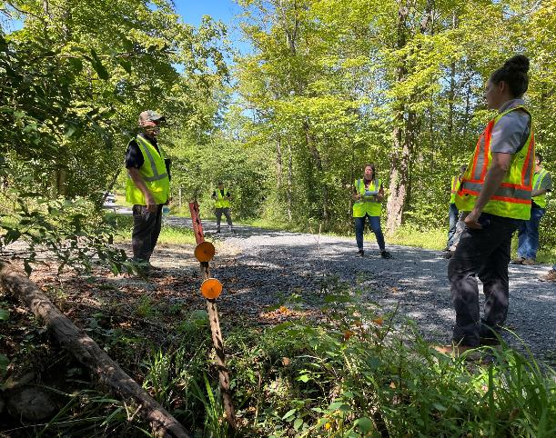
Working off the Right-of-Way
Landowner permission should be sought as early as possible in the funding process
Ideally before contracting
To ensure the project can be implemented as planned.
driveway
Public road

Slide 27
Project Life Cycle
Education and outreach
Pre-application meeting
Receive & review application
QAB meeting
CD Board meeting
Contracting
Preparing for Construction
If applicable: Design, permitting, bidding
Pre-construction meeting
Construction
Completion
Start talking about off-ROW permission during project planning
Local control: districts can require written off-ROW permission to be submitted:
with the grant application
before the QAB meeting
before signing a contract
etc.
Must have written off-ROW permission before working off ROW

Slide 28
Working off the Right-of-Way
How to get landowner permission
The grant recipient is responsible for obtaining written landowner permission.
The road owner is the one who has to maintain the project and work with the landowner long term.
However, the conservation district can help with these conversations.

Slide 29
Working off the Right-of-Way
Example ask for landowner permission:
Can we put in a new cross pipe that outlets water on your property?

Slide 30
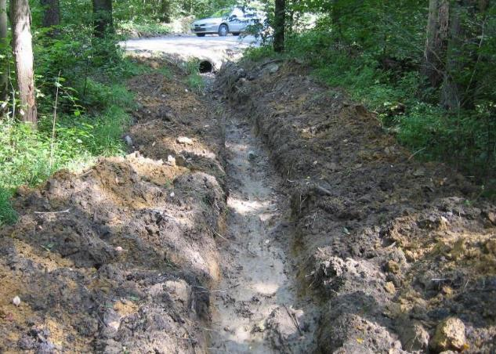
Working off the Right-of-Way
Example ask for landowner permission:
Can we put in a new cross pipe that outlets water on your property?
The only cross pipe outlet the landowner is familiar with:

Slide 31
Working off the Right-of-Way
Example ask for landowner permission:
Can we put in a new cross pipe that outlets water on your property?
The only cross pipe outlet the landowner is familiar with:
Probably not going to get permission
X

Slide 32
Working off the Right-of-Way
How to get landowners on board?
Offer your assistance to the road owner – go with them to ask landowners for permission to work on their property.
Use your expertise in conservation, the DGLVR Program, and talking to road owners when talking to the landowner.
Explain ESM principles:
Goal is to prevent erosion.
Break up stormwater between many outlets so only a small amount of water comes out at each outlet.
Or if stormwater is being collected, talk about benefits of detention/infiltration/stabilization at the outlet.
Districts can ask for CDGRS and/or SCC involvement as well.

Slide 33
Working off the Right-of-Way
How to get landowners on board?
Meet on site.
Introduce yourself and explain the conservation district role in the project, including ESM practices/DGLVR goals.
Share your overall work plan and how the off-ROW work fits into the overall road improvements.
Explain how this project solves a problem for the landowner.
Listen to their concerns.
Adjust the work plan as needed to address water issues in a way that works for the landowner & road owner.
Discuss who is responsible for long-term, routine maintenance.
Invite them to reach out if they have questions or concerns.

Slide 34
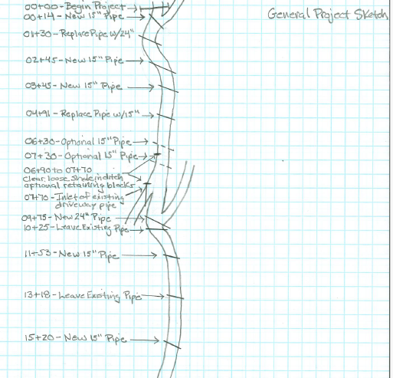
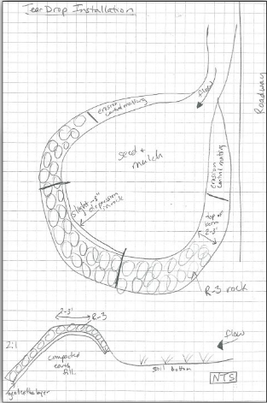
Working off the Right-of-Way
How to get landowners on board?
Use visual aids!
Work plan

Slide 35
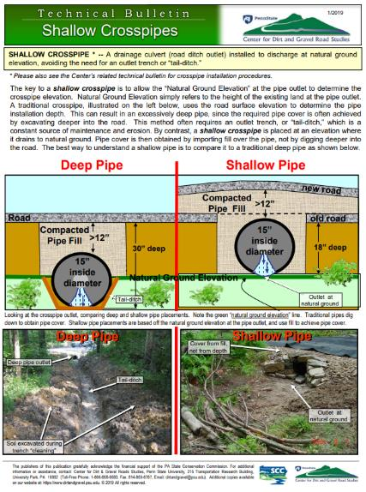
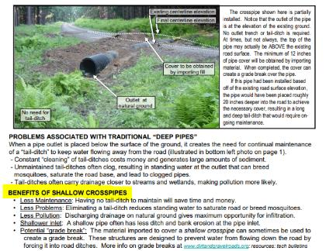
Working off the Right-of-Way
How to get landowners on board?
Use visual aids!
Work plan
Technical bulletins
Technical Bulletins - Center for Dirt and Gravel Road Studies

Slide 36
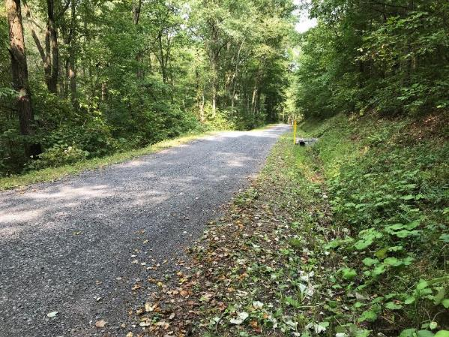
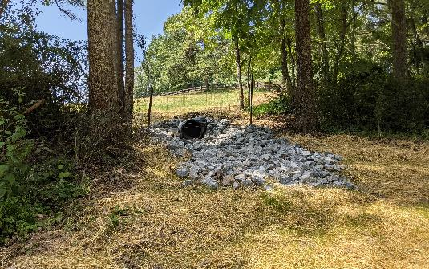
Working off the Right-of-Way
How to get landowners on board?
Use visual aids!
Work plan
Technical bulletins
Photos – completed work
Public road

Slide 37
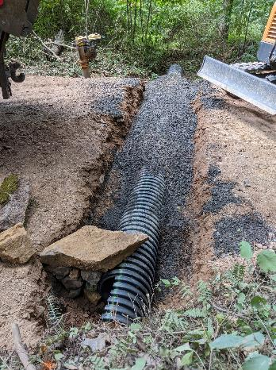
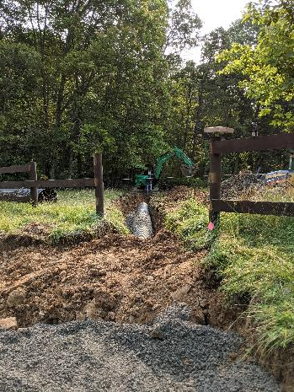
Working off the Right-of-Way
How to get landowners on board?
Use visual aids!
Work plan
Technical bulletins
Photos - construction

Slide 38
Working off the Right-of-Way
How to get landowners on board?
Use visual aids!
Work plan
Technical bulletins
Photos
Flyers from DGLVR Program
Blank Forms - Center for Dirt and Gravel Road Studies

Slide 39
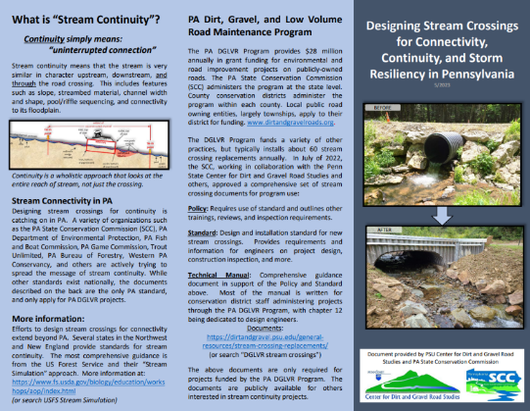
Working off the Right-of-Way
How to get landowners on board?
Use visual aids!
Work plan
Technical bulletins
Photos
Flyers from DGLVR Program
DGLVR Stream Continuity Flyer on Stream Crossings webpage: https://dirtandgravel.psu.edu/stream-crossing-replacements/

Slide 40
Working outside the Right-of-Way
Presentation Outline
What is the ROW & why work off ROW?
Eligible off ROW work
Permission from landowners
What to do if you can’t get off ROW permission
Example projects
Other funding sources

Slide 41
Working off the Right-of-Way
In some cases, landowner permission may be instrumental to implementing a successful DGLVR project (additional culvert outlets for example).

Slide 42
What if you can’t get off ROW permission?
If the road owner tells you that they cannot get landowner permission:
Make sure the road owner actually asked the landowner.
Ask for details about how the conversation went.
Did the landowner truly understand the goals of the project and the impacts to their property?
Offer your assistance in asking the landowner again.
Use tips from this webinar.

Slide 43
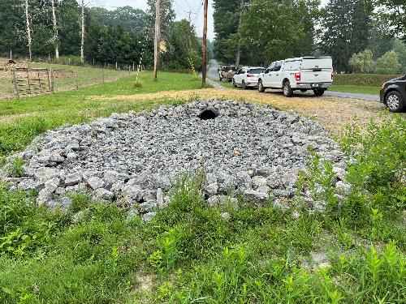
What if you can’t get off ROW permission?
Ask why the landowner is not agreeable to the proposed work.
See if there are alternatives that the landowner might be agreeable to:
Example: If an upslope driveway owner doesn’t want a grade break, see if they would be okay with a new cross pipe or sectional road fill.
Example: If a landowner doesn’t want water in their yard from a new outlet, see if you could plant a small rain garden to help manage extra water or see if there is a different area of the property that the water could be conveyed to with buried pipe or a swale.
Butler

Slide 44
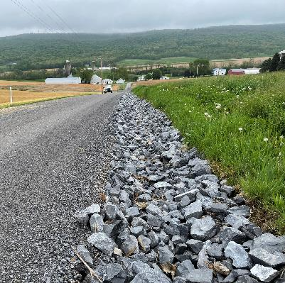
What if you can’t get off ROW permission?
In some cases, a viable alternative may exist to implement a successful plan without landowner permission.
Example: Can’t get permission for enough new cross pipe outlets? Can you install:
Enough road fill to obtain sheet flow?
Carry the water to a location where you have permission for a stable outlet?
Stabilized roadside ditch
Rip rap, channel lining, etc.
Storm sewer
Remember that outlets for concentrated stormwater will require a stabilized outlet (Rip Rap apron, infiltration or detention feature, etc.)
Blair

Slide 45
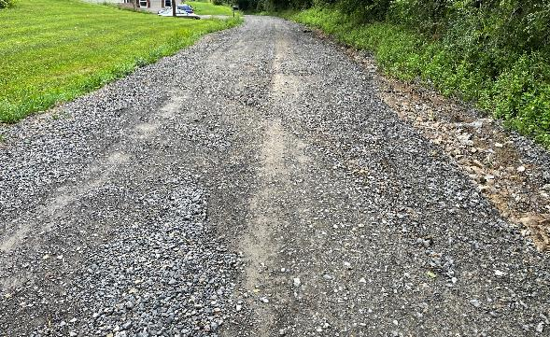
What if you can’t get off ROW permission?
In other cases, sufficient water quality improvements cannot be made due to landowner constraints. In such cases, DGLVR funding may be better spent on a different project location.
Contact the SCC in questionable circumstances where a lack of landowner permission may hinder successful project implementation.

Slide 46
Working outside the Right-of-Way
Presentation Outline
What is the ROW & why work off ROW?
Eligible off ROW work
Permission from landowners
What to do if you can’t get off ROW permission
Example projects
Other funding sources

Slide 47
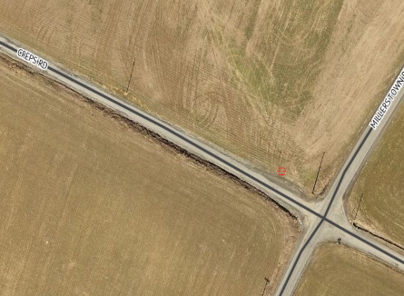
Project: Creps Road, Blair County
Creps Road, North Woodbury Township
The site was very entrenched and had no drainage outlets.
long-running ditch on steep road
led to erosive stormwater flows and created overly deepened ditches
The site was ultimately addressed with 2 DGLVR grants to fund work within the ROW
Contract 1: $138,689.75 DGR + $23,135.79 In-kind
Contract 2: $77,882.20 LVR + $20,843.94 In-kind

Slide 48
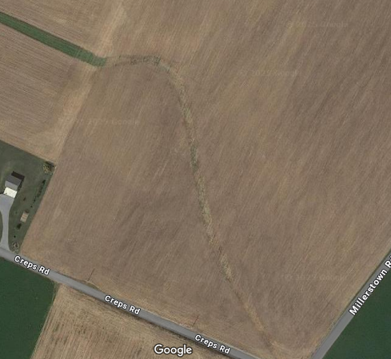
Project: Creps Road, Blair County
Traditional ESM Practices for entrenched roads:
Road fill
New cross pipes
New turnouts
First proposal: pipe ditch water off-ROW to outlet to existing waterway in farm field
Landowner & farmer would not allow this
However, a drainage outlet to remove water from the upslope ditch was essential to control erosion at this site.

Slide 49
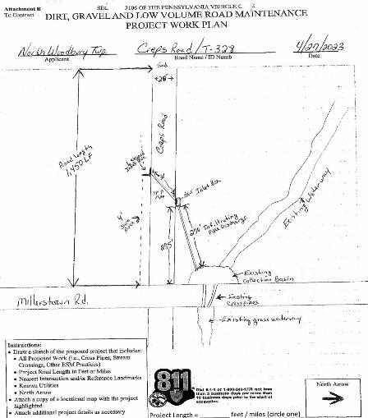
Project: Creps Road, Blair County
How to handle the water without new surface outlets:
Road fill created sheet flow off the downslope side of the road in many areas, eliminating a downslope ditch.
The upslope ditch was rock-lined with riprap.
A new cross pipe was installed to direct upslope flow to a catch basin downslope of the road.

Slide 50
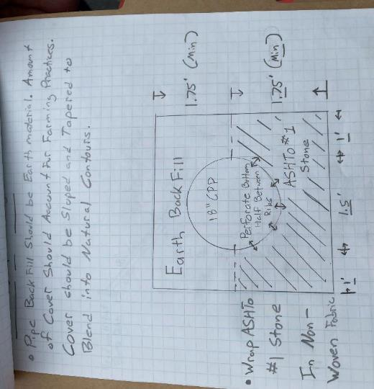
Project: Creps Road, Blair County
From the catch basin, flow is directed to a perforated 24” pipe with a constructed infiltration trench paralleling the downslope side of the road.
The 24” pipe discharges to an inlet box at the bottom of the road at the intersection in the event the infiltration trench is overwhelmed.

Slide 51
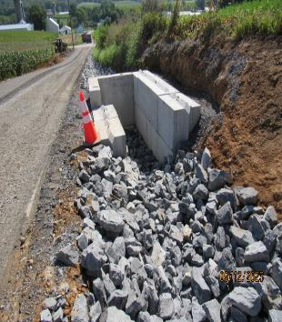
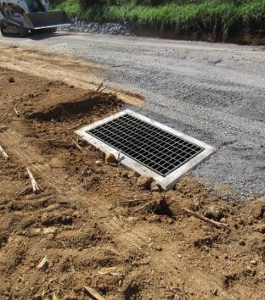
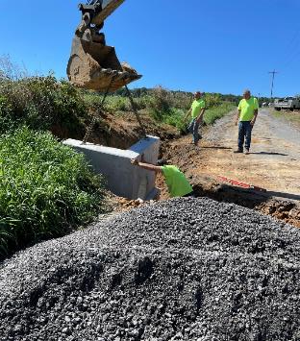
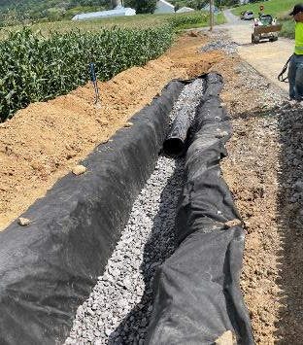
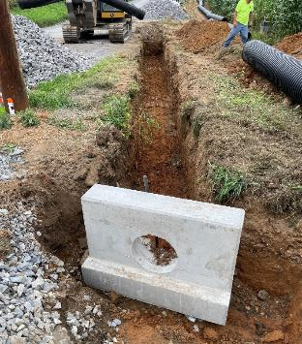
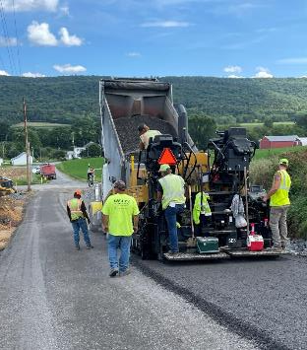
Construction Photos

Slide 52
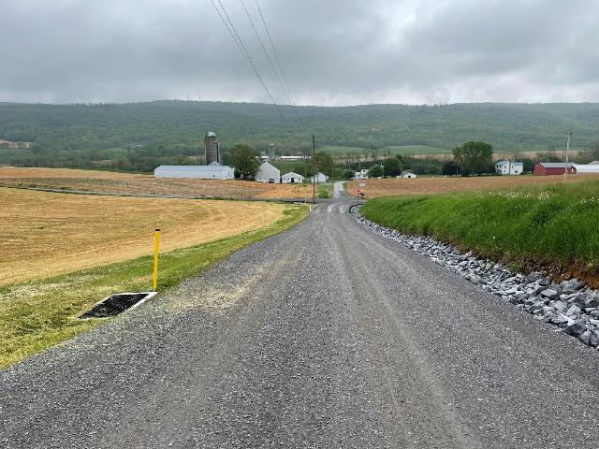
Project: Creps Road, Blair County
Completed 2023
Site Length: 2,529 feet
Practices:
1 new turn out installed
1 new cross pipe installed
286 feet of under drain added
1,074 tons of road fill added
1,199 tons of DSA placed
191 square yards of infiltration achieved
3,566 square yards of seeding and mulching
DGR funds: $138,689.75
In-kind funds: $ 23,135.79
Total cost: $161,825.54

Slide 53
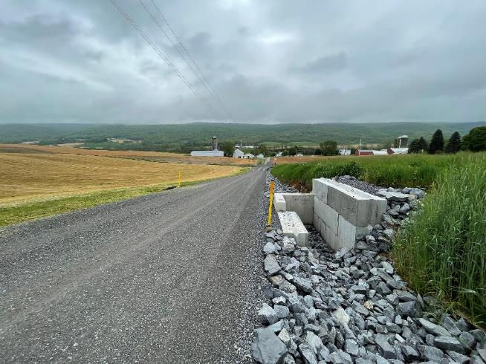
Project: Creps Road, Blair County
These combined practices:
Remove water from the road
Allows water to infiltrate downslope from the road
Prevents water from continuing down the road and across the intersection as it did previously

Slide 54
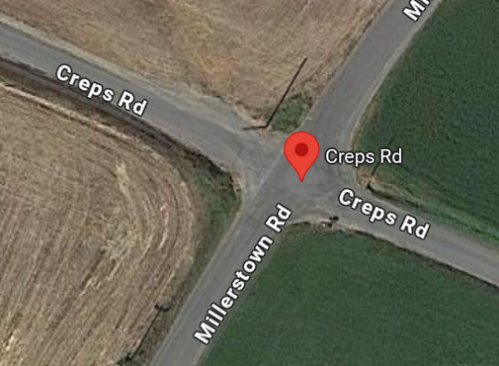
Project: Creps Road, Blair County
Phase II
This project is immediately adjacent downslope to the DGR project completed on Creps Road.
The large volume of stormwater and sediment that previously entered the project area was significantly reduced by the upslope DGR project.
An existing poorly designed piping system discharged water into the road base, deteriorating the road base and paved road surface.

Slide 55
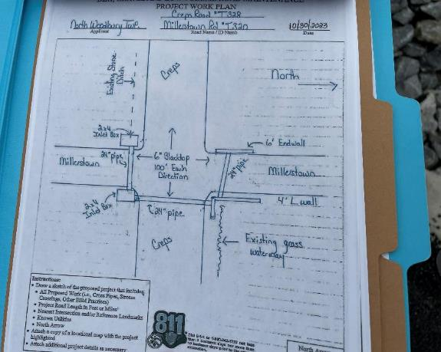
Project: Creps Road, Blair County
Inlet boxes and 24” pipe were installed across the intersection to properly convey any stormwater that has not been removed from the roadway on the DGR project site.
Completed 2024
Site Length: 390 feet
Practices:
3 replaced cross pipes
New inlet boxes
25 ft underdrain
Rip Rap outlet protection
10 sq yd seed/mulch

Slide 56
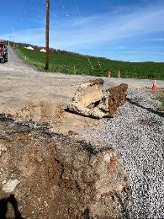
Failed Piping System Removed
New System Installed
Final Product

Slide 57
Project: Creps Road, Blair County
New inlet boxes and a combination of cross pipes and storm sewer were installed to better capture any stormwater reaching the site.
The outlet area was stabilized with riprap to prevent any erosion of the ditch below during high flow events.
LVR funds: $77,882.20
In-kind funds: $20,843.94
Total cost: $98,726.14

Slide 58
Working outside the Right-of-Way
Presentation Outline
What is the ROW & why work off ROW?
Eligible off ROW work
Permission from landowners
What to do if you can’t get off ROW permission
Example projects
Other funding sources

Slide 59
Combined Funds
Program funds may be combined with other funds to pay for a project.
Outside funding may be able to do more off ROW work than DGLVR funds when needed.
Detailed accounting of which funds were spent on which portions of the project must be maintained.
Other funding sources may be used as matching funds, provided the program funds are used on eligible projects.
Must still adhere to non-pollution standards and ESM practices.

Slide 60
Combined Funds
Recorded webinar on combining funds:
March 9, 2023: Leveraging Other Funding with DGLVR funds
With over $20 million going on the ground with DGLVR projects every year, there are numerous opportunities to use money spent on DGLVR projects as in-kind to obtain additional funding from a variety of sources. This webinar covered those opportunities.
Webinar Download (125 MB): MP4 format (~55 minutes)
Presentation Downloads:
Adobe PDF (2.54 MB)
MS Powerpoint (5.94 MB)

Slide 61
Combined Funds
ACAP funds can be used to address off ROW water issues.

Slide 62
Combined Funds
From 3/9/23 webinar:
Combining DGLVR and ACAP
ACAP:
Applicants are farms / ag operations.
Separate contract with farm owner
For BMPs that reduce sediment, nitrogen, or phosphorus on ag operations.
Has to be in a manure management plan, nutrient management plan, ag E&S plan, or conservation plan.
Most likely use of combining funds:
Improving farm lanes that impact roadways. Can fund DGLVR ESM practices to fix the farm lane / reduce pollution.
Reducing impacts to road from other “off row” water and sediment sources
Field and barnyard runoff
Diversions and swales
Streambank stabilization

Slide 63
Questions?

