Slide 1
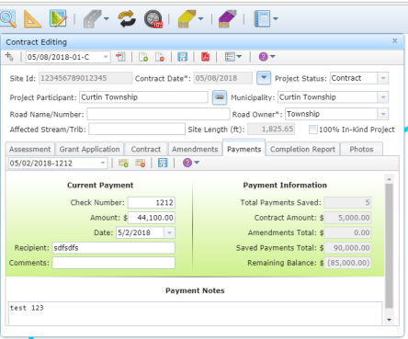
DGLVR Webinar
Payments Overview
6/18/2018
Starts at 9am
If you are reading this, then you are successfully seeing the webinar video. Webinar audio should be automatic through your computer, and options can be accessed in the “audio options” button on the bottom left. If you are having audio issues, or are in a location where listening via phone is preferable, audio is also available on the CDGRS conference line at:
866-823-7699.
For technical assistance, call: 814-865-5355

Slide 2
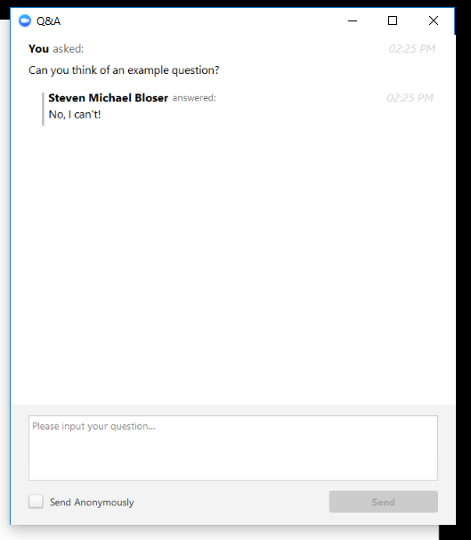
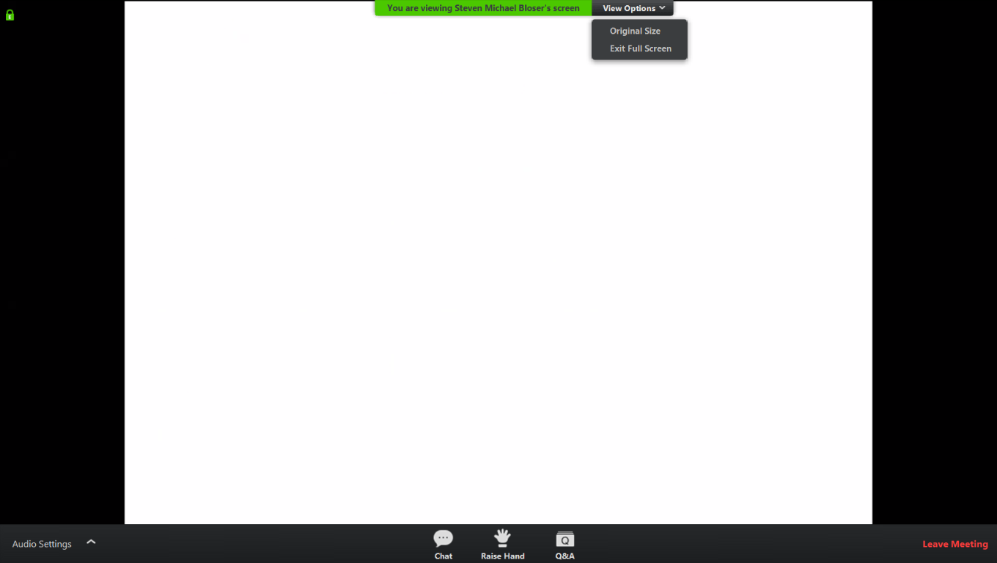
Q&A
Note you can ask a question anonymously
Q&A
For audio via phone: 866-823-7699
For technical assistance: 814-865-5355
Slide #

Slide 3
Payments Overview
GIS Update Implementation Timeline:
June 18, June 21, June 26: QR Update Webinars for all CDS:
July 1: Project payments tab made available to all CDs in GIS.
July 6, 9, 20: Webinars for all CDs: Training webinar to illustrate how individual project payments (checks) are now tracked.
July 20:
Last date for paper replenishments for “old” money.
Financial Statements needed for both DGR & LVR
GIS Fully Updated
Cost and Expenses report entered for the period of January 1 – June 30
August 6: Quarterly Reporting available to all CDs in GIS
Late July through August: Quarterly Report webinar trainings:
For Technicians: Project Payments and quarterly reports
For Managers and accountants: Financial reporting and replenishments
September 18: Full GIS Training for new hires in Indiana (workshop)
September 19: Four ~45 minute Quarterly Report Trainings in Indiana (workshop)
October 1: First quarterly report can be submitted
October 15: First quarterly report due in new system
Audio also available via phone: 866-823-7699
For assistance, call: 814-865-5355

Slide 4
Payments Overview
Project Payments
Implemented along with the new Quarterly Report
Used to by the GIS Mapper to track checks
Required for the new Quarterly Report
Used to generate the replenishment request
Payment system functionality based on a combination of the Contract Date and the Completion Date
Audio also available via phone: 866-823-7699
For assistance, call: 814-865-5355

Slide 5
Payments Overview
Project Payments
Required to Create Payment
Check Number
Amount
Date
Recipient
Optional
Comments for that individual check (i.e., DSA)
General Comments/Notes for all payments made
Audio also available via phone: 866-823-7699
For assistance, call: 814-865-5355

Slide 6
Payments Overview
Project Payments: General Rules
Payment cannot be saved:
If it exceeds the contract and amendments total
If the payment date is later than the current date (cannot make “future” payments)
If the payment date is older than the last unsubmitted quarter
Payments cannot be edited once a contract has been marked as completed
Contract cannot be completed (w/ exceptions):
If there are 0 payments entered
If the total payments does not equal the total expenditures
Audio also available via phone: 866-823-7699
For assistance, call: 814-865-5355

Slide 7
Payments Overview
Project Payments: Scenario 1
Contract Date: Prior to July 1, 2018
Completion Date: Prior to July 1, 2018
Payment Functionality:
Payments are completely disabled
Payment Difference ignored when saving a completed project
Audio also available via phone: 866-823-7699
For assistance, call: 814-865-5355

Slide 8
Payments Overview
Project Payments: Scenario 2
Contract Date: Prior to July 1, 2018
Completion Date: After June 30, 2018
Payment Functionality:
Payments are enabled
Can only enter payments for payments made after June 30.
At least one payment MUST be entered
Payment Difference ignored when saving a completed project but will alert you to remind you to enter all payments made after June 30
Audio also available via phone: 866-823-7699
For assistance, call: 814-865-5355

Slide 9
Payments Overview
Project Payments: Scenario 3
Contract Date: After June 30, 2018
Completion Date: After June 30, 2018
Payment Functionality:
Payments are enabled
All payments MUST be entered
Payment Difference check enforced
Cannot save as completed if the total payments do not equal the total expenditures
Audio also available via phone: 866-823-7699
For assistance, call: 814-865-5355

