Slide 1
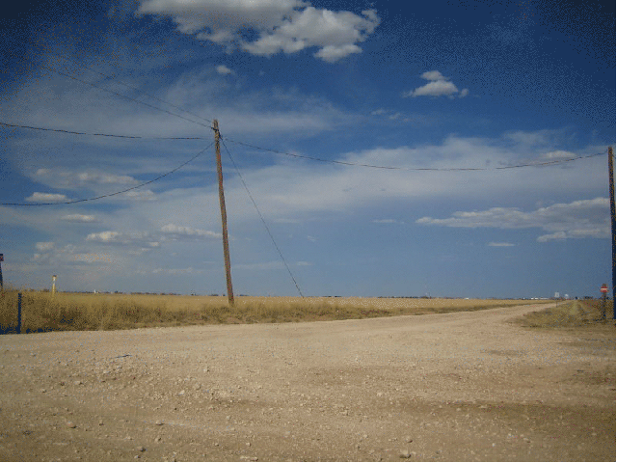

DGLVR Webinar
DGLVR
Standard Details
4/16/20
Starts at 9am
If you are reading this, then you are successfully seeing the webinar video. Webinar audio should be automatic through your computer, and options can be accessed in the “audio options” button on the bottom left. If your computer audio is not working, you can listen on your phone by dialing 646-876-9923.
For audio via phone: 646-876-9923

Slide 2
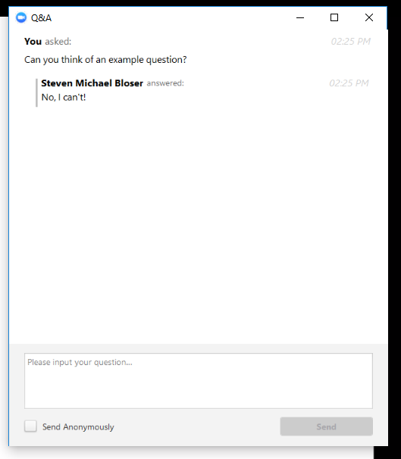
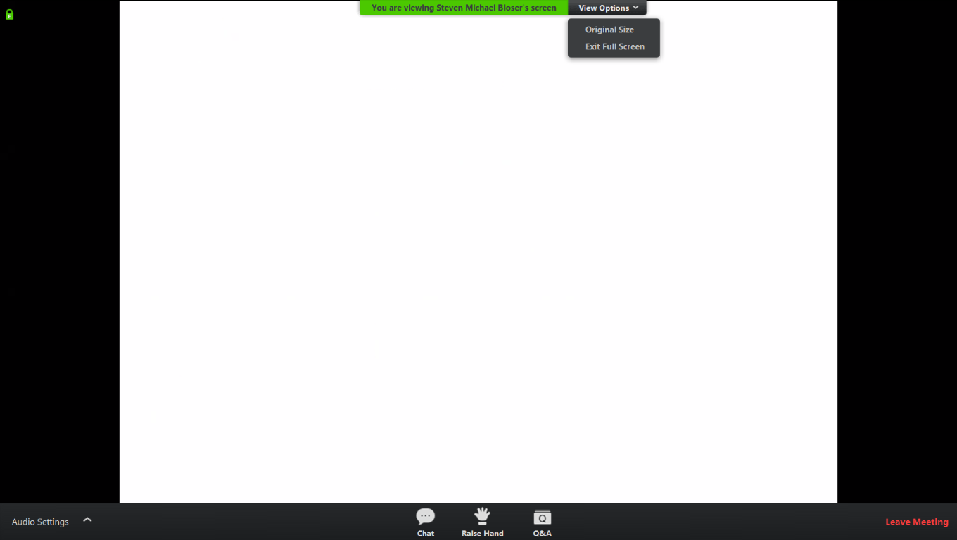
Q&A
Note you can ask a question anonymously
Q&A
For audio via phone: 646-876-9923
Slide #

Slide 3
DGLVR Standard Details
Background:
Standard Details
  Details for commonly used DGLVR Practices
    Road Crown
    Cross Pipe
    Through-the-Bank Pipe
    Cross Pipe and Through-the-Bank Pipes
    Raising the Road Profile
    French Mattress
    Underdrain
    Stone Sump
Details located on the CDGRS Website
  https://www.dirtandgravel.psu.edu/general-resources/standard-detail-sheets

Slide 4
DGLVR Standard Details
PDF Details
  Forms with text boxes
    Road Crown
    Cross Pipe
    Through-the-Bank Pipe
    Cross Pipe and Through-the-Bank Pipes
    Raising the Road Profile

Slide 10
DGLVR Standard Details
Excel Details:
  French Mattress
  Underdrain
  Stone Sump
Forms will calculate estimate stone amounts (tons).
  Use same formulas as the Materials Calculator

Slide 14

DGLVR Materials Calculator
To help DGLVR participants do material estimating
Details located on the CDGRS Website
    https://www.dirtandgravel.psu.edu/general-resources/dglvr-materials-calculator

Slide 15
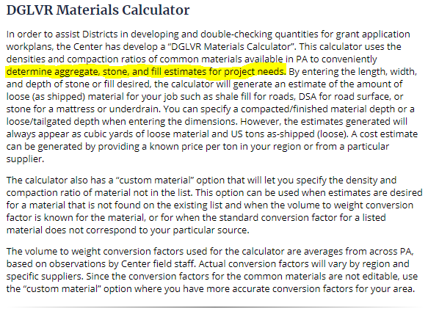
DGLVR Materials Calculator
“…to conveniently determine aggregate, stone, and fill estimates for project needs.”

Slide 16
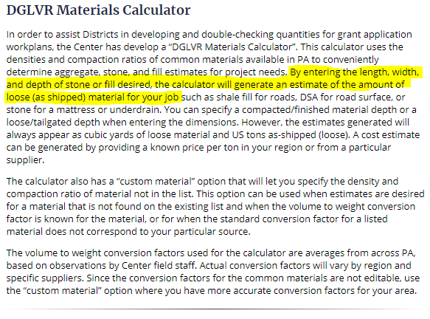
DGLVR Materials Calculator
“By entering the length, width, and depth of stone or fill desired, the calculator will generate an estimate of the amount of loose (as shipped) material for your job.”

Slide 17
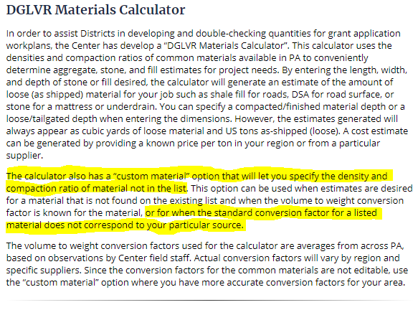
DGLVR Materials Calculator
The calculator also has a “custom material” option that will let you specify the density and compaction ratio of material not in the list… …or for when the standard conversion factor for a listed material does not correspond to your particular source.”

Slide 18
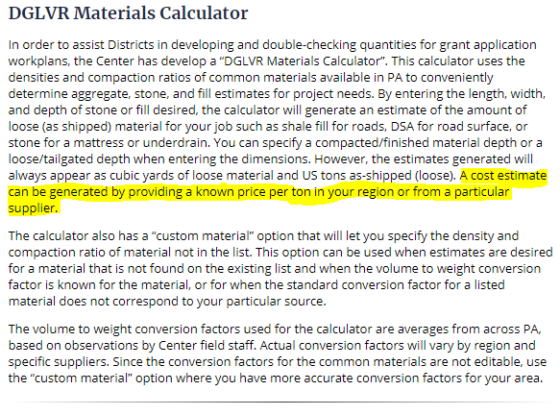
DGLVR Materials Calculator
A cost estimate can be generated by providing a known price per ton in your region or from a particular supplier.

Slide 19
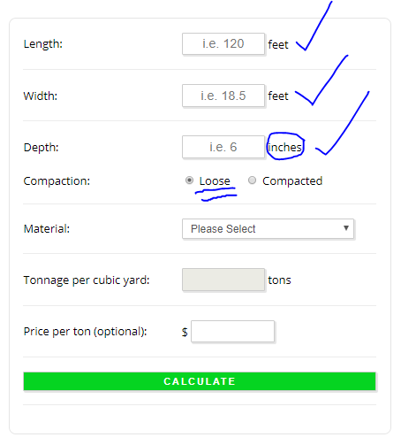
DGLVR Materials Calculator
Insert dimensions
In feet and inches
And select if these
Dimensions are loose
Or compacted

Slide 20
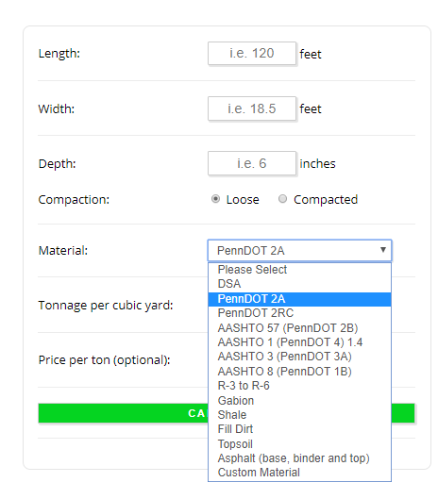
DGLVR Materials Calculator
Select from list of
Common PA Road
Materials
OR

Slide 21
DGLVR Materials Calculator
OR
Choose a Custom Material

Slide 22
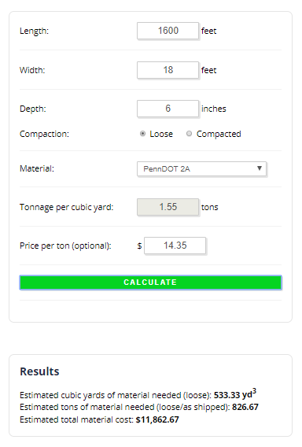
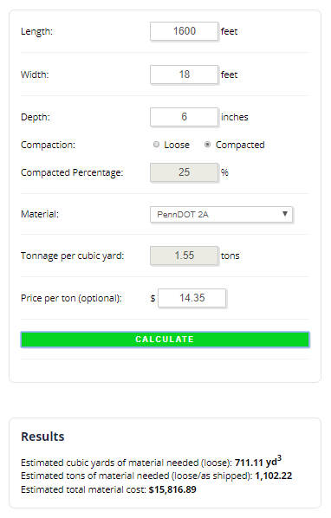
DGLVR Materials Calculator

Slide 23
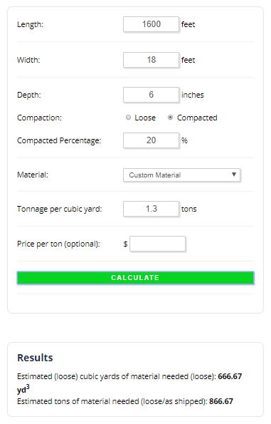
DGLVR Materials Calculator
Custom Material option
Can adjust the Compaction %
Can adjust the volume to
weight conversion factor
Use this option when you want to
calculate for a material not found
on the provided list
or
When your local source of a listed
material has different properties

Slide 24
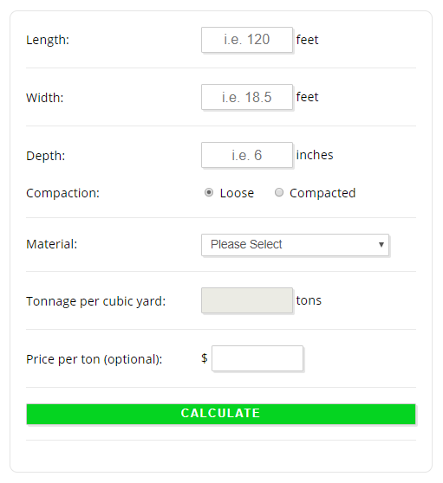
DGLVR Materials Calculator
Live Demonstration

Slide 25
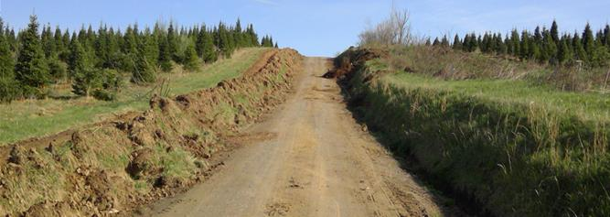
Material Estimating Know How
For Fill, Road Base, and Road Surface Material:
For fill, aggregate, and topsoil, know the required amount needed, including:
in-place volume (compacted)
the as-shipped volume (loose)
the tonnage (as invoiced)
Shale often hauled by the truckload (typical tri-axle truck will hold 12-14 yd³ or 20-23 tons of material).

Slide 26
Material Estimating Know How
Don’t overlook the effect of compaction
If you are not sure of the volume lost to compaction (the compaction %),
a good thumb rule is a material will lose 25% of its volume when compacted.

Slide 27
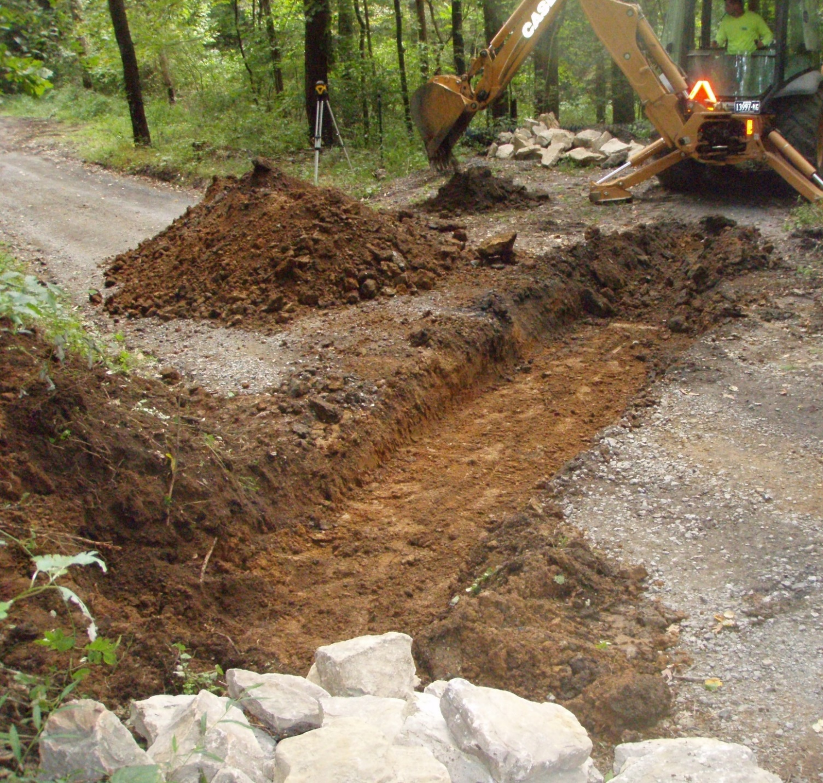
Material Estimating Know How
Pipe Backfill
Another rule of thumb is to add ½ triaxle load of aggregate (2A or 2RC) to your estimate for each crosspipe installed or replaced.
This is approximately
10-12 tons.

Slide 28
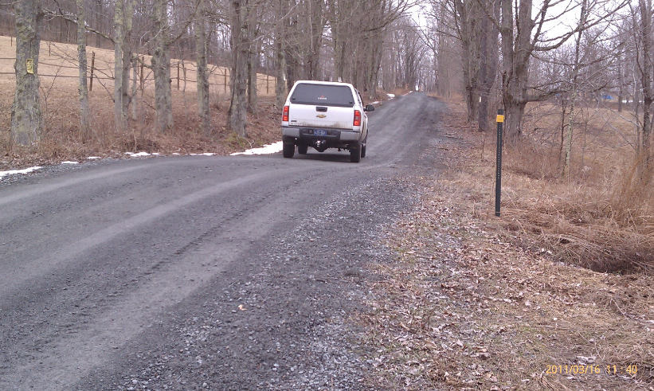
Material Estimating Know How
Surface Drainage Features
Add two triaxle loads of aggregate of preferred fill (approx. 45 tons) for each planned grade break or broad-based dip.

Slide 29
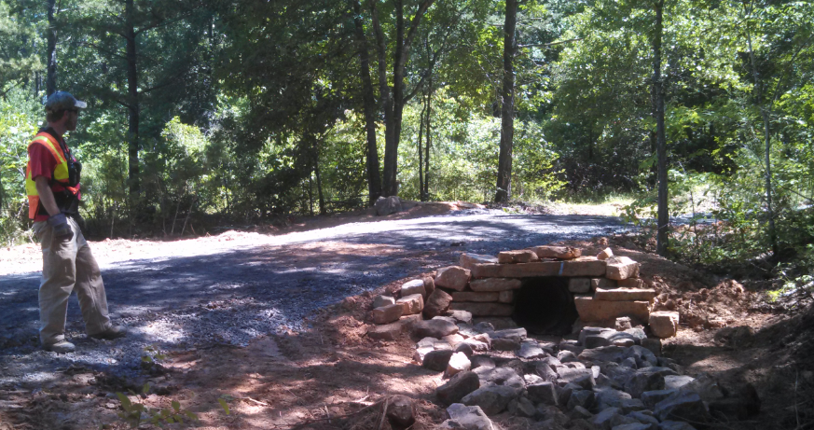
Material Estimating Know How
Drainage Pipe
On hillslopes, be sure to use effective angle on your crosspipe installations (~30⁰).
Figure the angle when estimating length needed and round to the nearest ½ stick.
(i.e. – 20’, 30’ 40’, 50’, etc.)

Slide 30
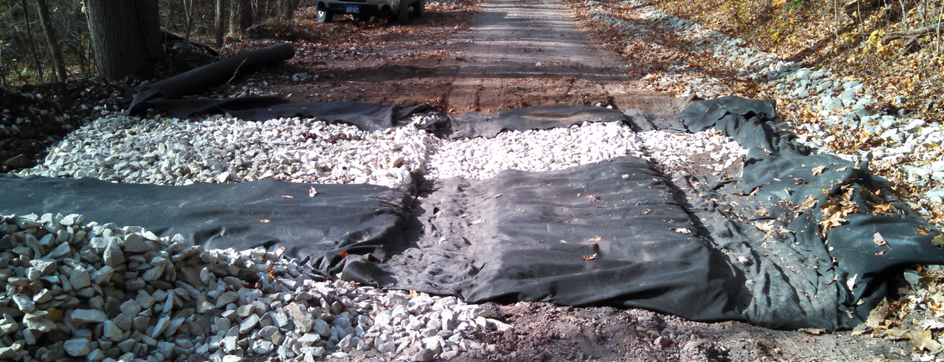
Material Estimating Know How
Geotextile
Figure ft² needed
Length x Width (don’t forget top, bottom and side for some practices)
Don’t forget a 2’ overlap at seams
Geotextile comes in standard 5,400 ft² rolls. The wider the material, the shorter the roll.
12 ½’ wide roll is 432’ long. 15’ wide roll is 360’ long. 17 ½’ wide roll is 309’ long.

Slide 31
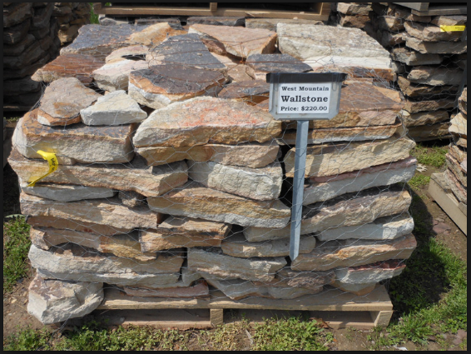
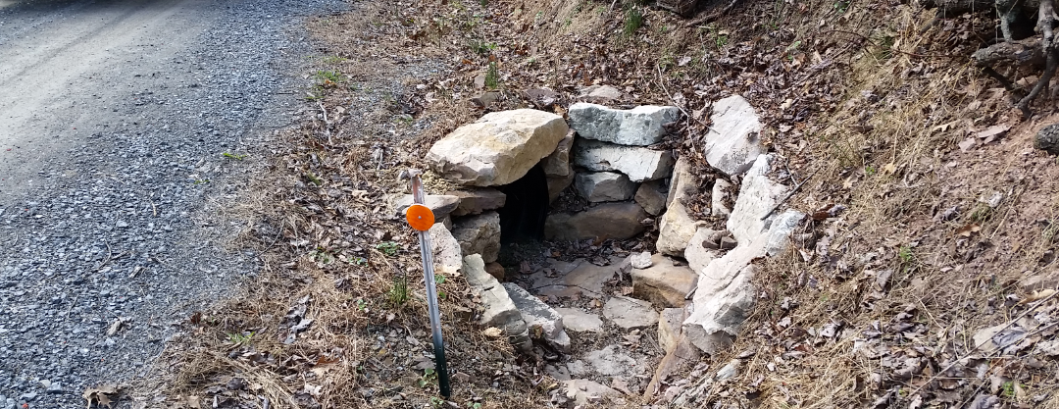
Material Estimating Know How
Wall Stone
One typical pallet of landscape/
Retaining wall stone will build
2 headwalls and 2 endwalls, or
is needed for every 2 crosspipes
in your plan.

Slide 32
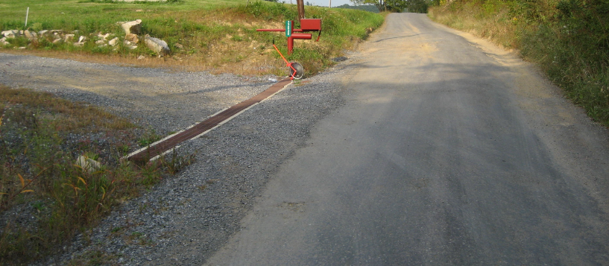
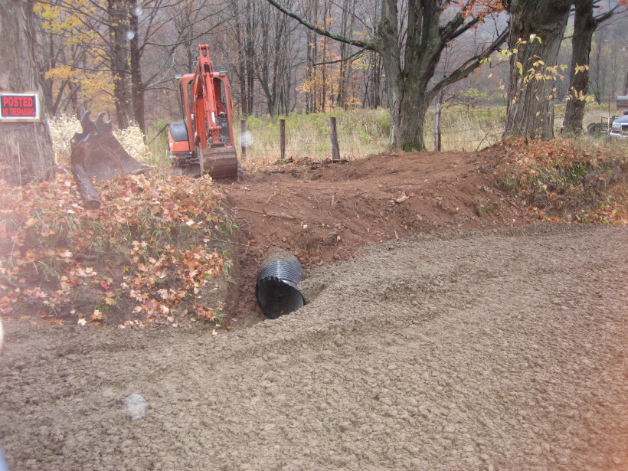
Material Estimating Know How
Don’t Forget
Transitions, Driveway Aprons,
seed, mulch, etc.
And it never hurts to add a 10%-15%
contingency factor to your estimates

Slide 33

DGLVR Standard Details & Materials Estimating
THANKS! SEE YOU NEXT TUESDAY
4/21, 9am: Coronavirus DGLVR Impacts Update
Questions for Tuesday?
Ideas or Request for Future Webinars?

