Slide 1
If you use any of these projects or pictures in your educational efforts, please give credit to the Conservation District that supplied them.
Our apologies, but since the webinar microphone was not working properly, a recording of this webinar is not available.

Slide 2
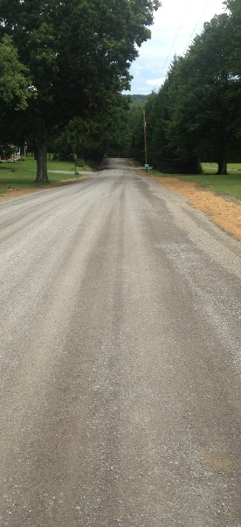
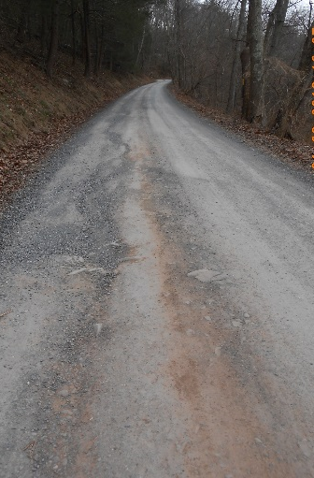
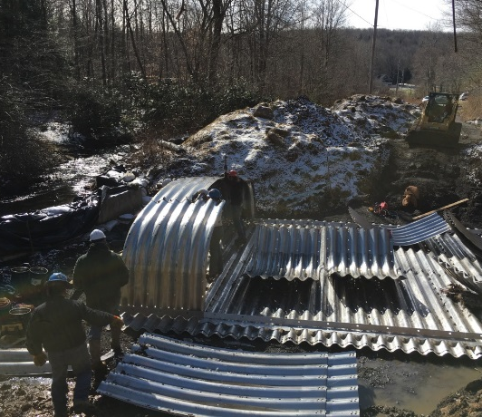
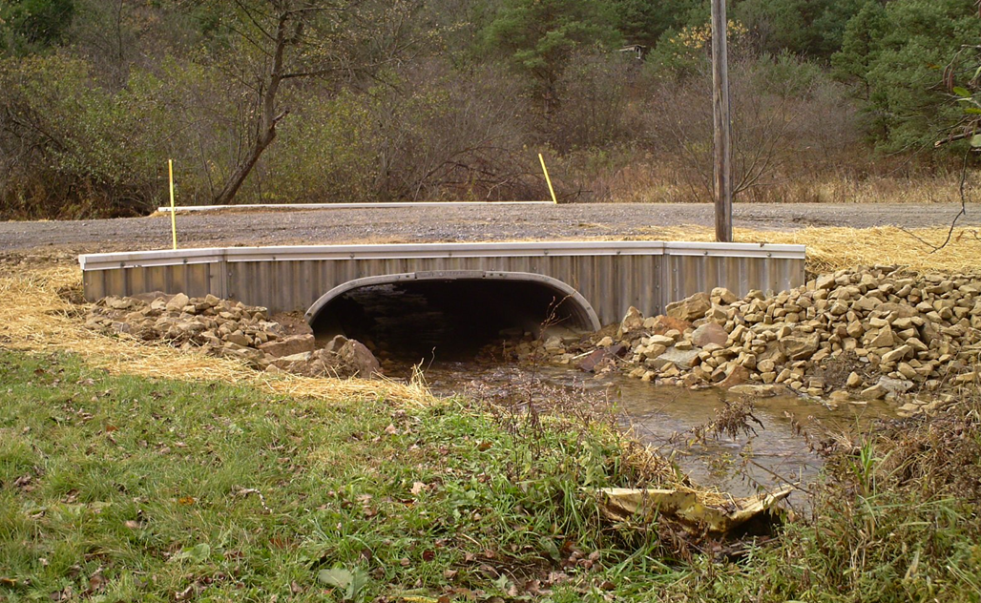
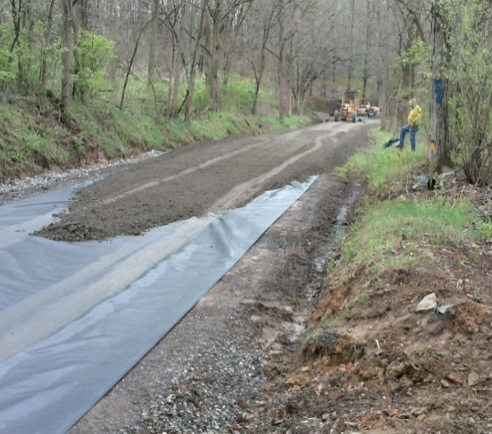
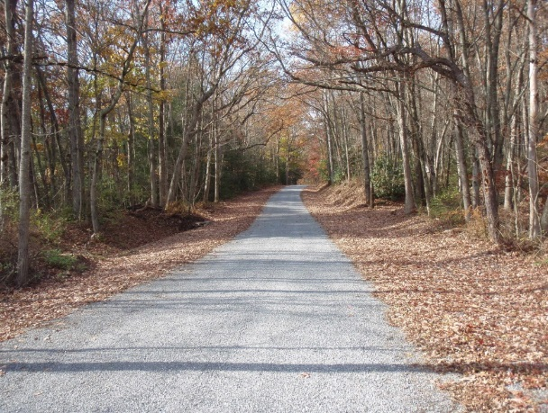
Project Sharing Session
Highlights 2017
Toggle Fullscreen
mode with this button above
3/17/17
Starts at 9am
Use Chat box to ask Questions
http://metrocount.com
If you are reading this, then you are successfully seeing the webinar video. In addition to audio on the webinar, we have opened a phone conference line to allow attendees to listen and ask questions directly: 866-823-7699. Please use either the webinar audio or conference line, but not both (will produce feedback).
Audio also available via phone: 866-823-7699
For assistance, call: 814-865-5355

Slide 3
Toggle Fullscreen
mode with this button
above
Use Chat box to ask Questions
Participant phone lines will be muted until after initial presentation
http://metrocount.com
Audio also available via phone: 866-823-7699
For assistance, call: 814-865-5355

Slide 4
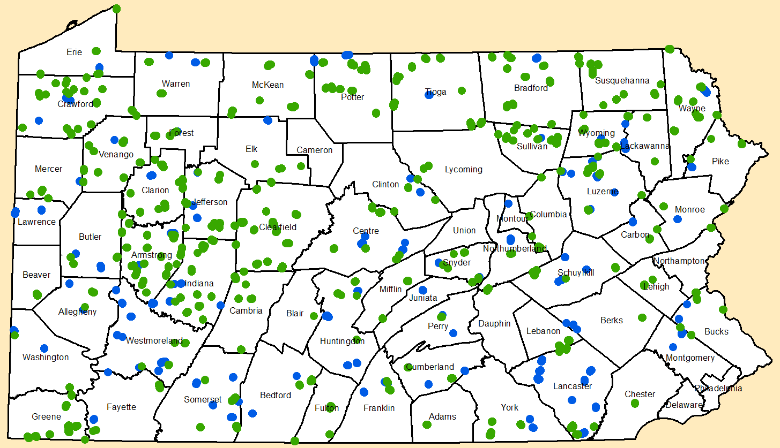
Project Sharing Sessions
Purpose:
Share some quick “project snippets” of 2016 DGLVR Projects
Thank You:
We often only see “snapshots” of projects on tech assists or QAQC visits. Your photos will help us to improve training materials such as ESM training.
Audio also available via phone: 866-823-7699
For assistance, call: 814-865-5355

Slide 5
Project Sharing Sessions
Disclaimer #1
31 Projects and 100+ images here
This will be a QUICK summary.
For more information:
Recording available online
Contact the project-owning District
Questions
Visit to completed projects
Visit sites in progress
Audio also available via phone: 866-823-7699
For assistance, call: 814-865-5355

Slide 6
Project Sharing Sessions
Disclaimer #2:
We saw a lot of projects in a short amount of time.
I apologize in advance for mis-speaking, forgetting things, or just plain making stuff up about your projects!
Audio also available via phone: 866-823-7699
For assistance, call: 814-865-5355

Slide 7
Project Sharing Sessions
Southeast
Audio also available via phone: 866-823-7699
For assistance, call: 814-865-5355

Slide 8
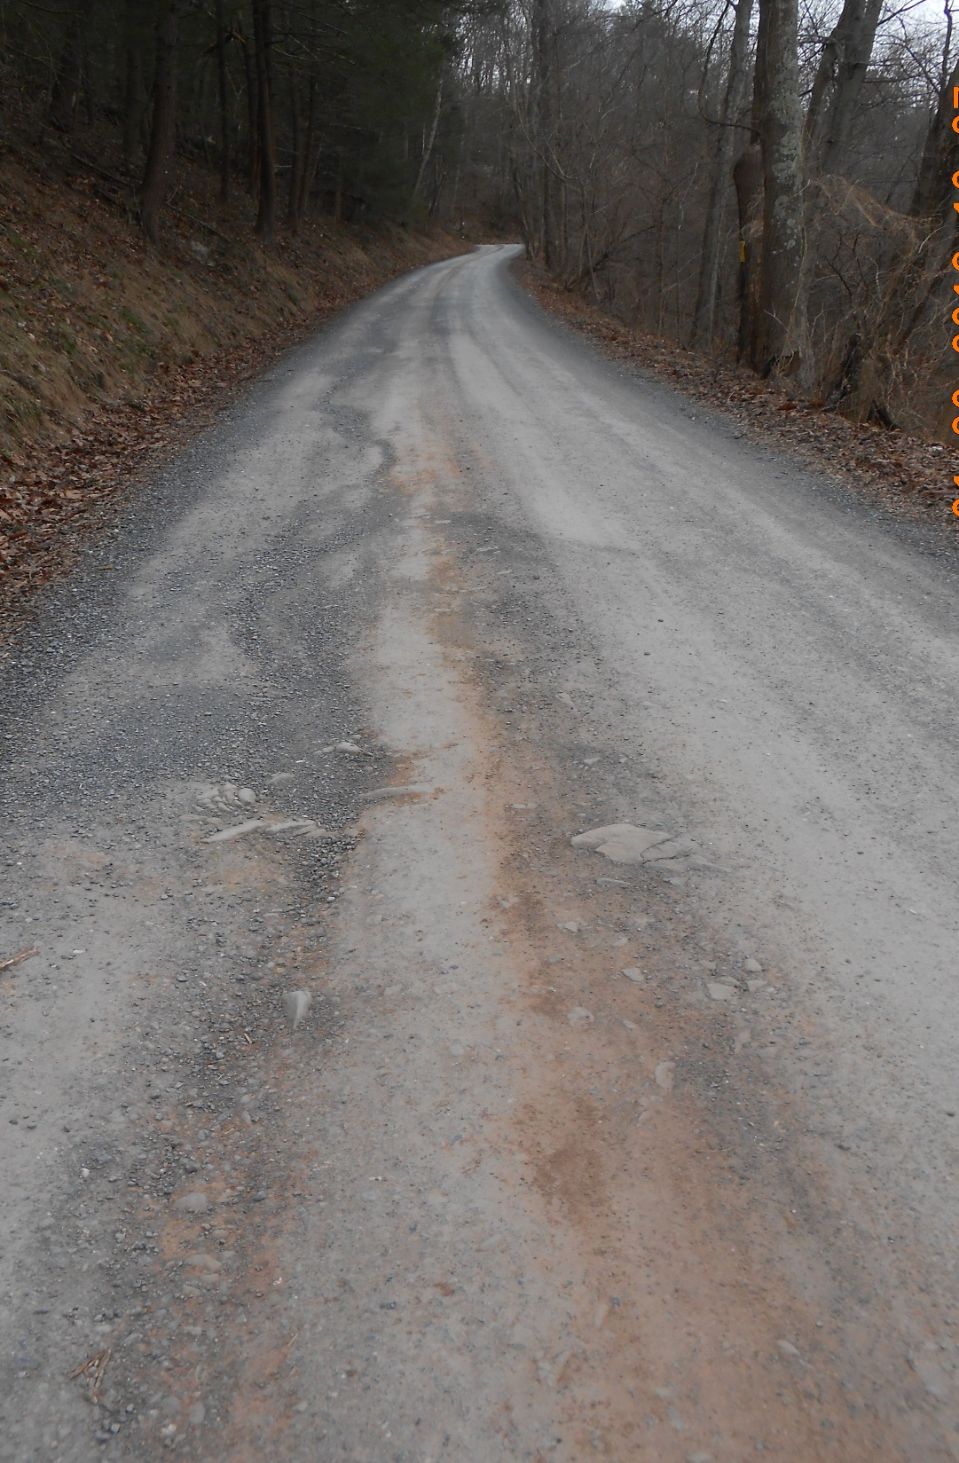
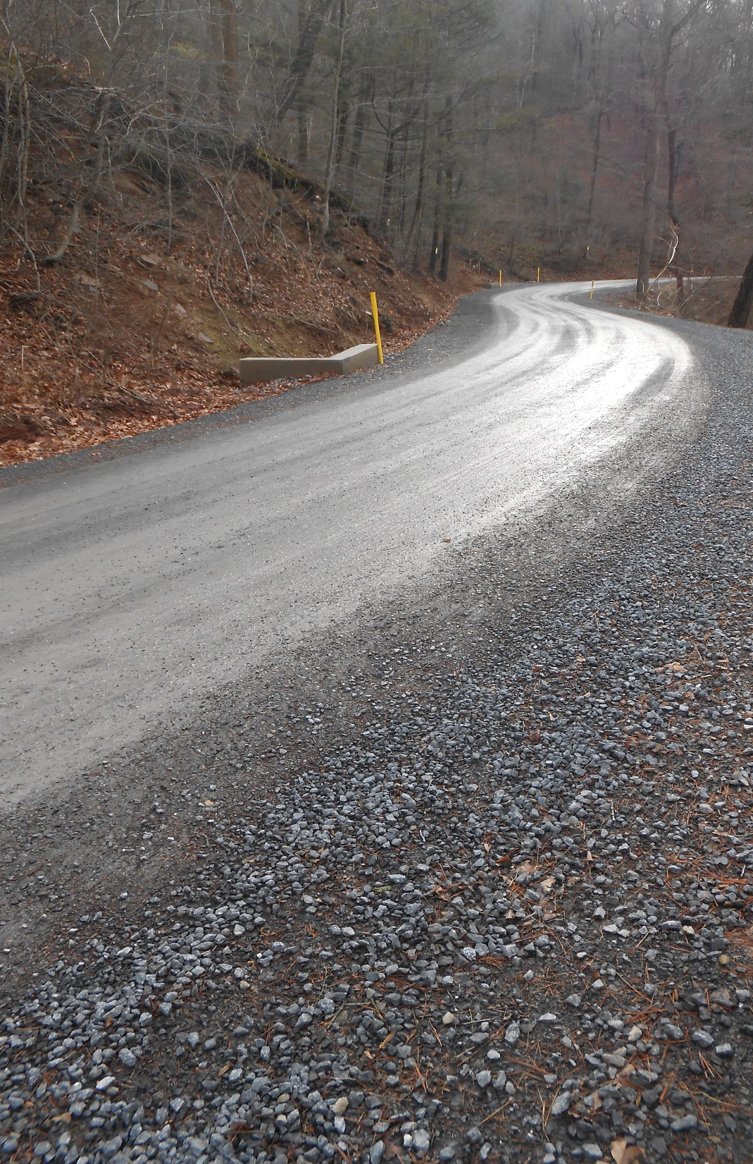
BEFORE
‘16 D&G Project - Complete
Dauphin County, Deibler’s Gap Rd
$119K Spent, $21K in kind
1- mile long
4,000 tons of fill
14 new crosspipes
DSA planned for 2017
AFTER

Slide 9
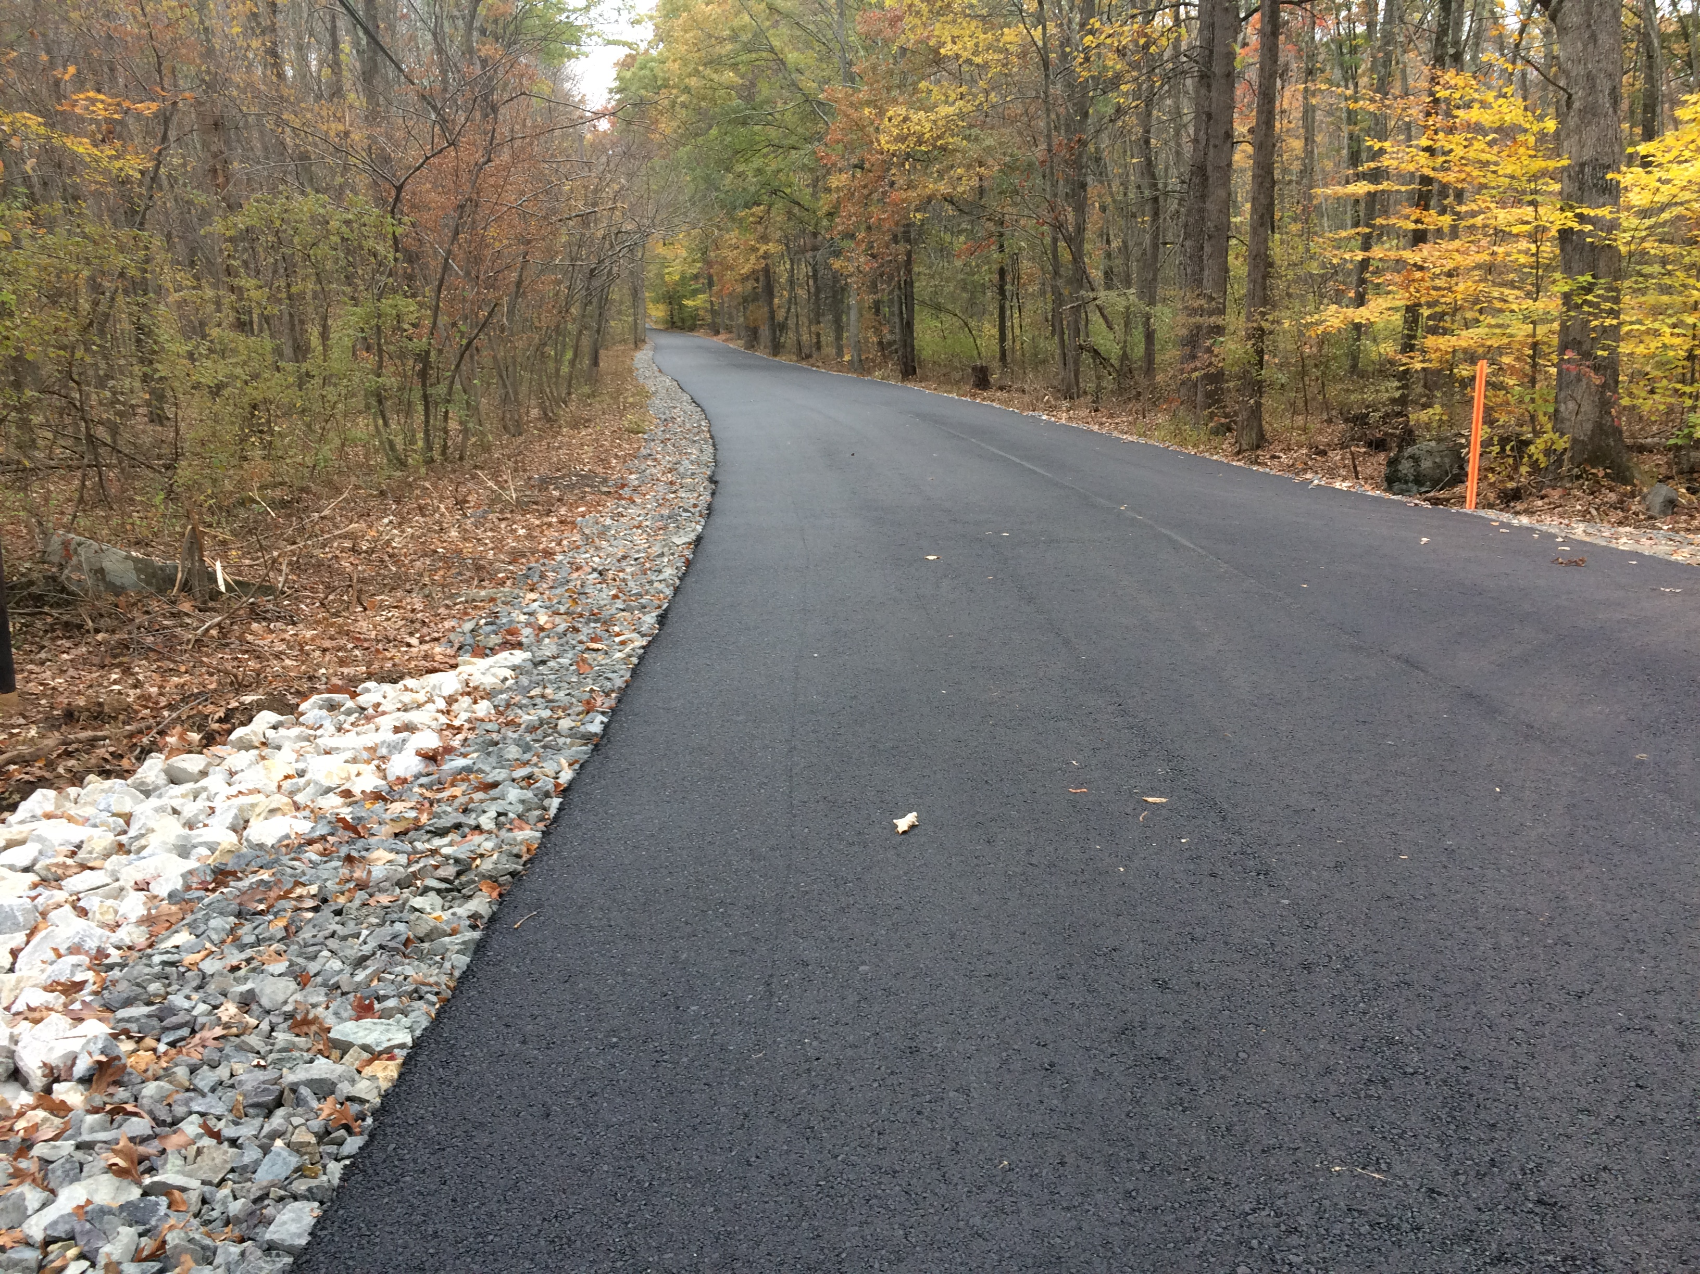
AFTER
‘16 LVR Project - Complete
Bucks County, Umbriet Rd
$60K Spent, $14 in kind
1,000’+ mattress
Several crosspipes

Slide 10
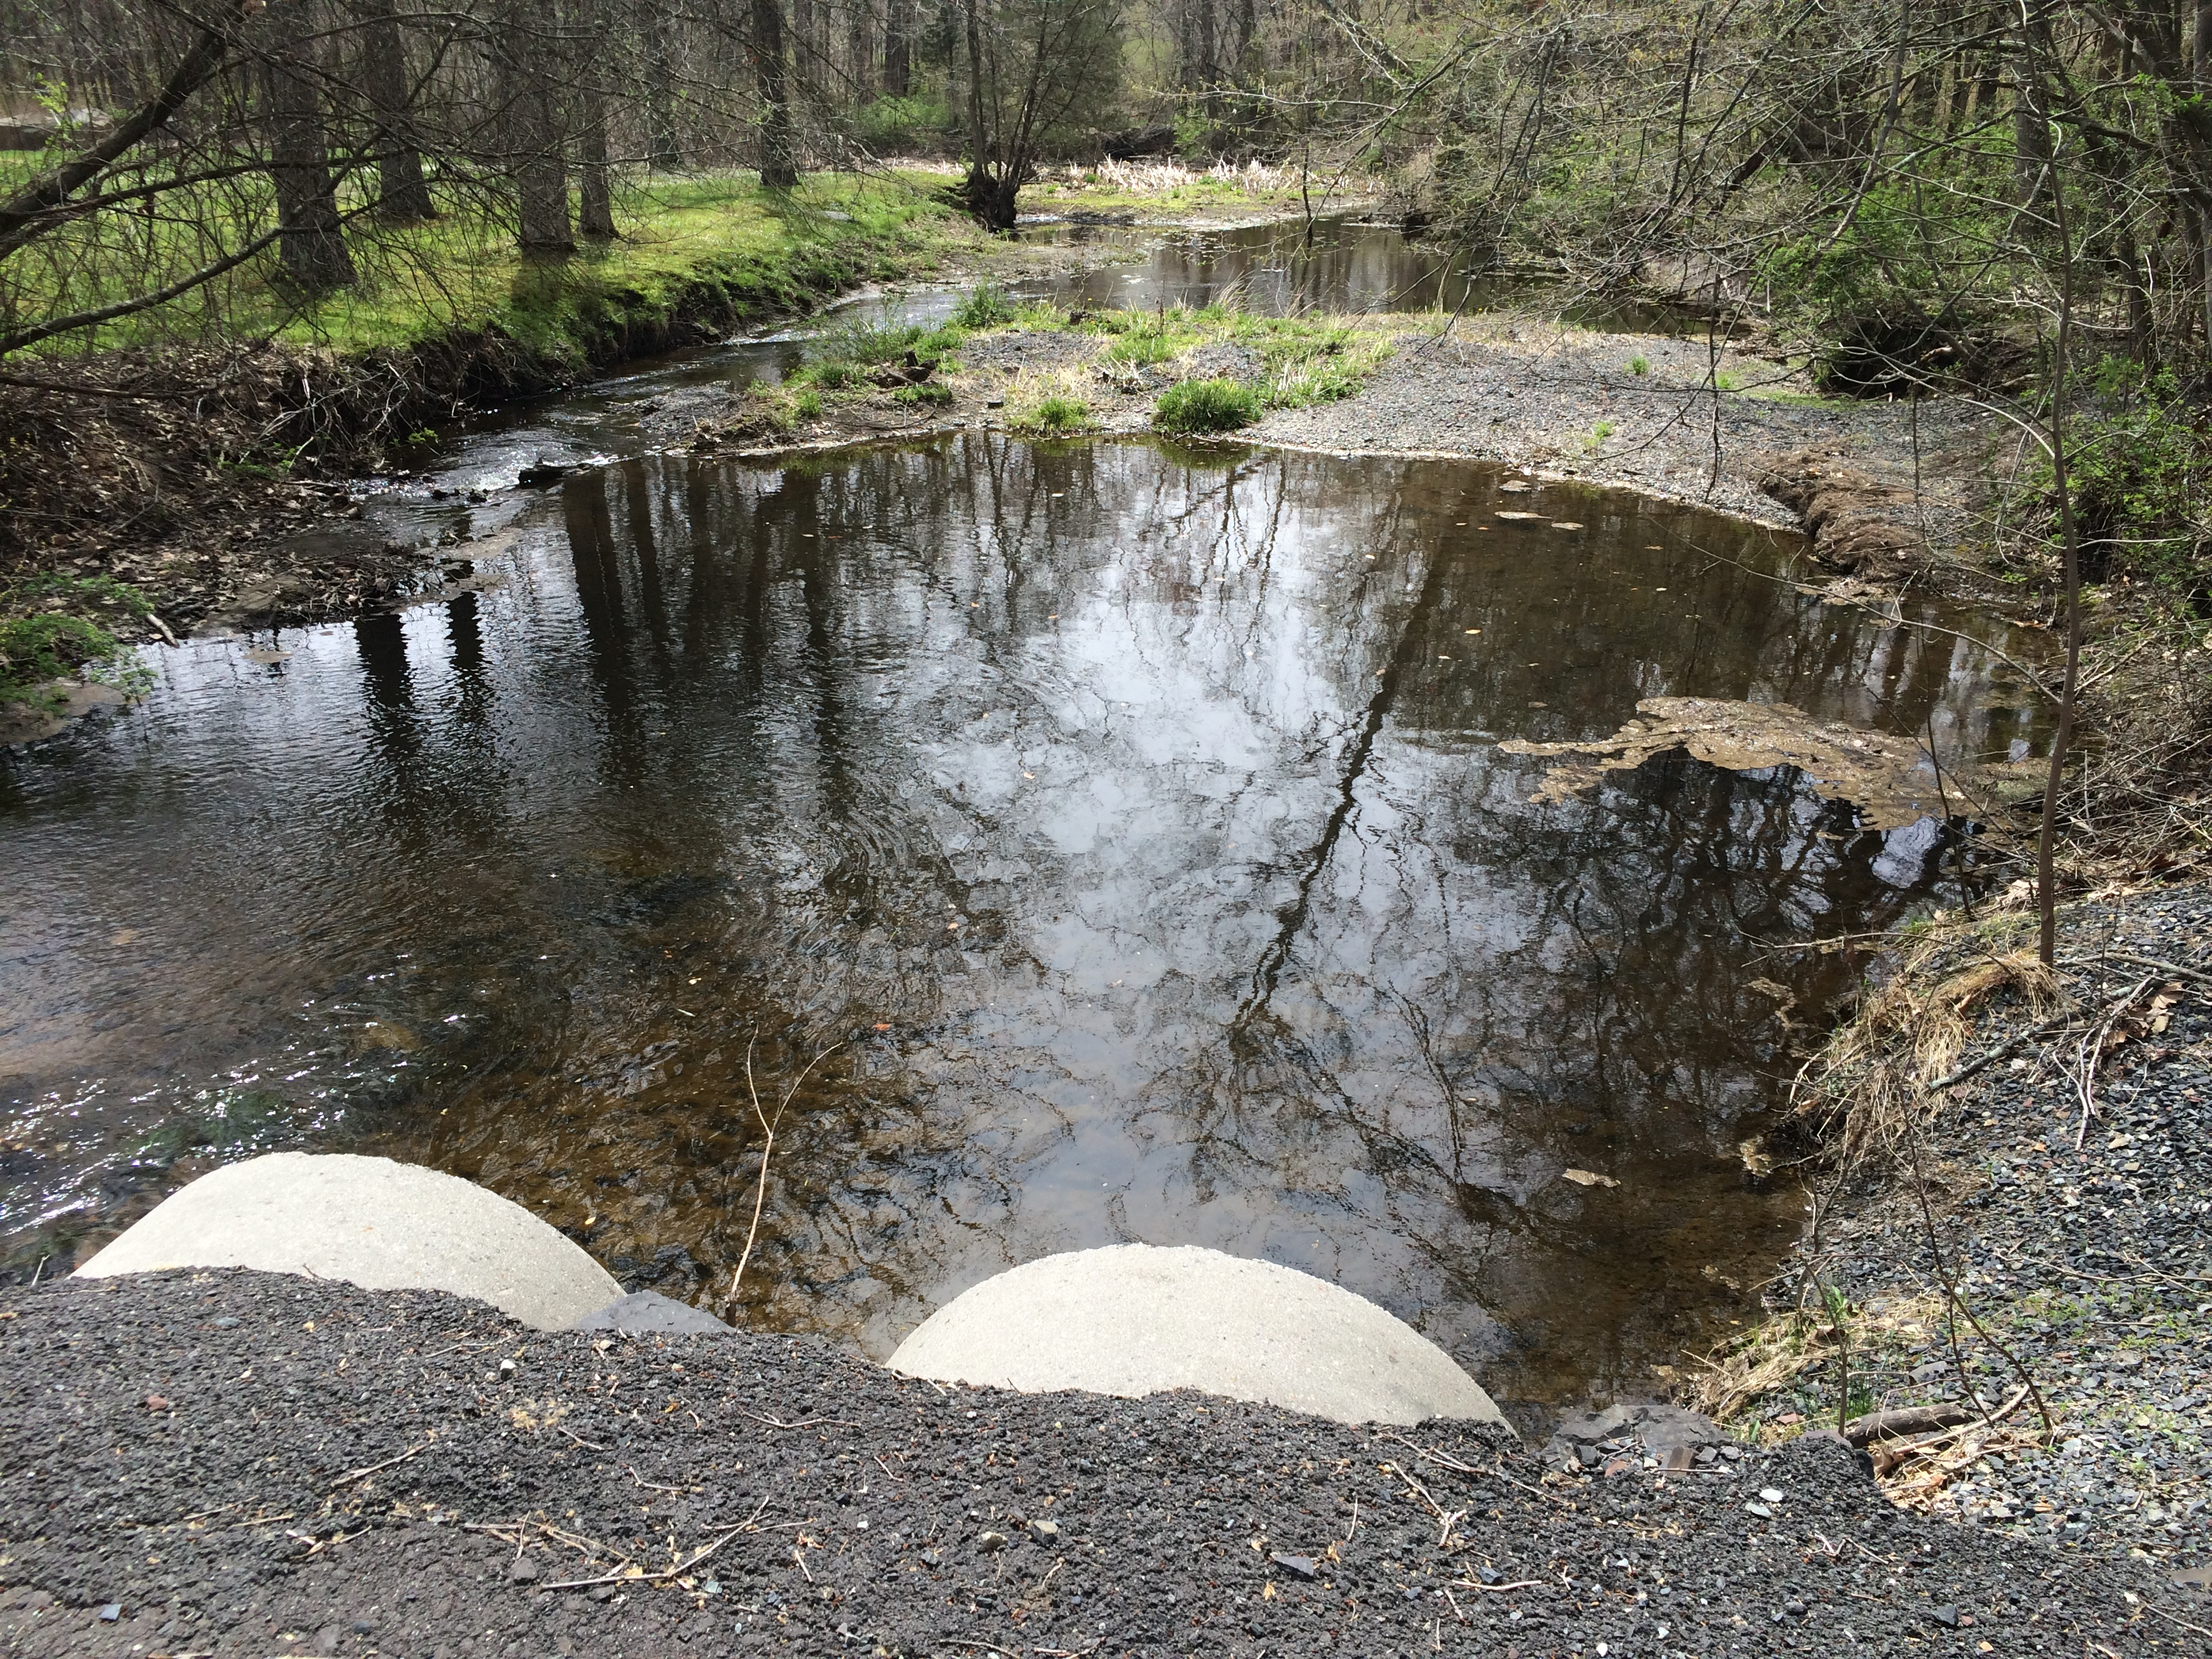
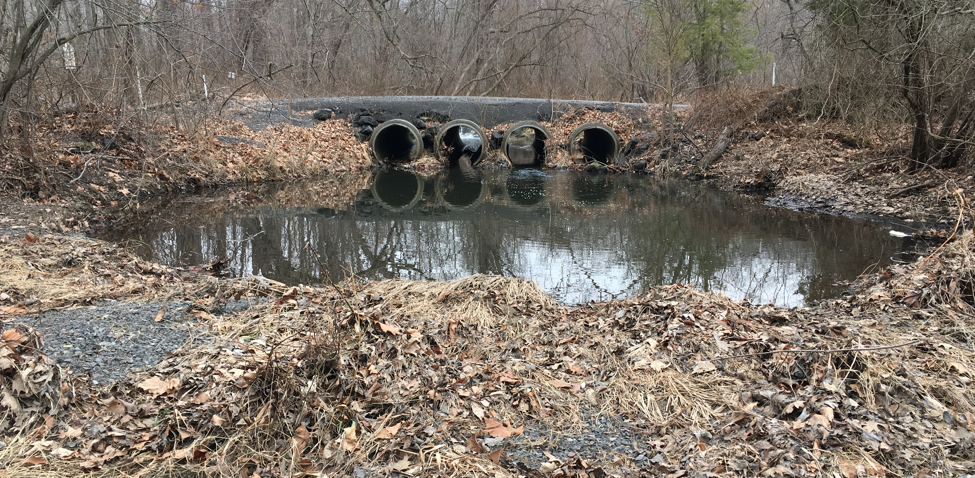
D&G Project - Application
Bucks County, Twin Lows Rd
Multi-pipe crossing that overtops road
Dam ~50’ upstream
Can’t close road
Same gravel bar

Slide 11
BEFORE
AFTER
‘16 D&G Project - Complete
York County, Blymire Hollow Rd
$102K Spent, $106K in kind
Undersized and failing bridge
28’ GRS bridge constructed
50% savings vs traditional bridge

Slide 12
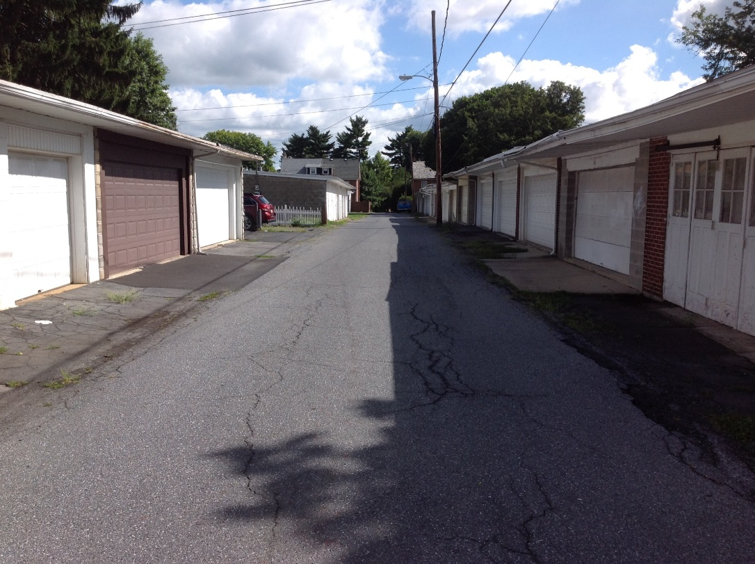
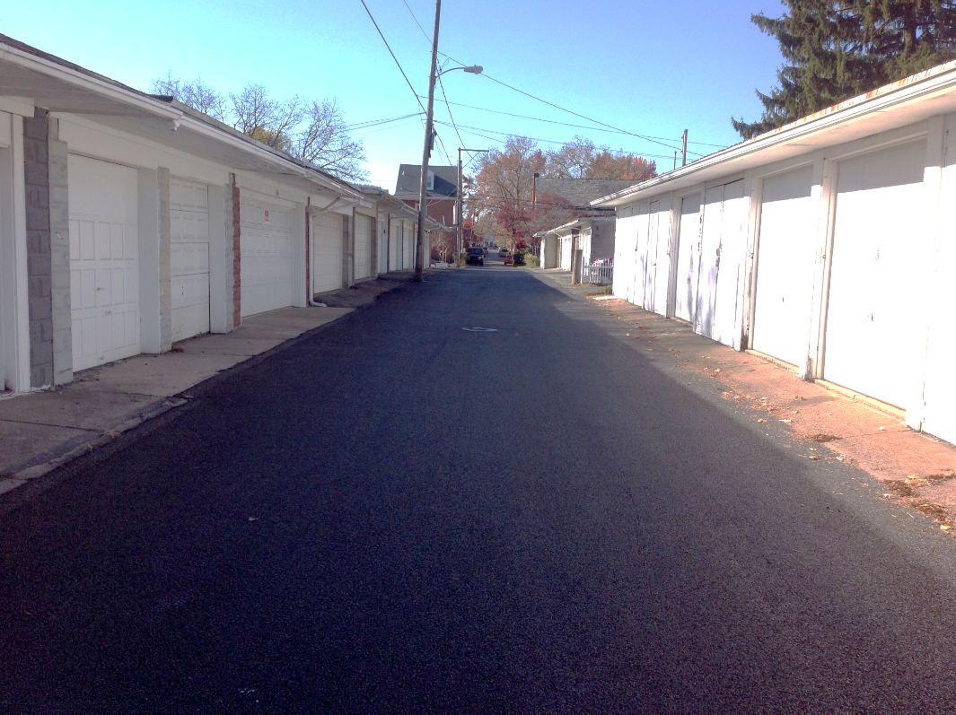
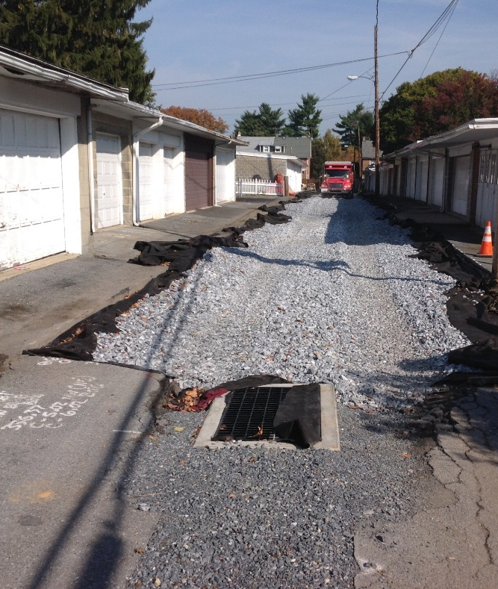
BEFORE
BEFORE
AFTER
‘16 LVR Project - Complete
Lancaster County, Reynolds Ave
$27K Spent, $171K in kind
Porous pavement
Infiltration bed
“selective funding”
AFTER
CD only funded infiltration and drainage practices

Slide 13
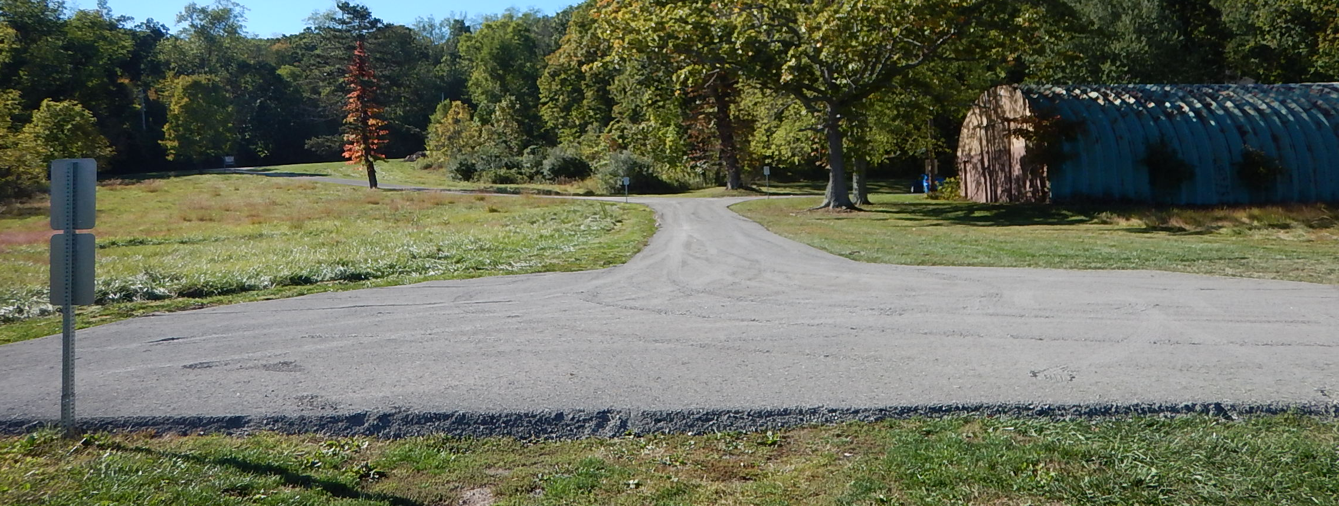
BEFORE
‘16 DnG Project - Complete
Montgomery County, Lake Skymount Dr.
$9K Spent, $6K in kind
Short lake access
Underdrain, gradebreak, DSA
Improved lake access area
AFTER

Slide 14
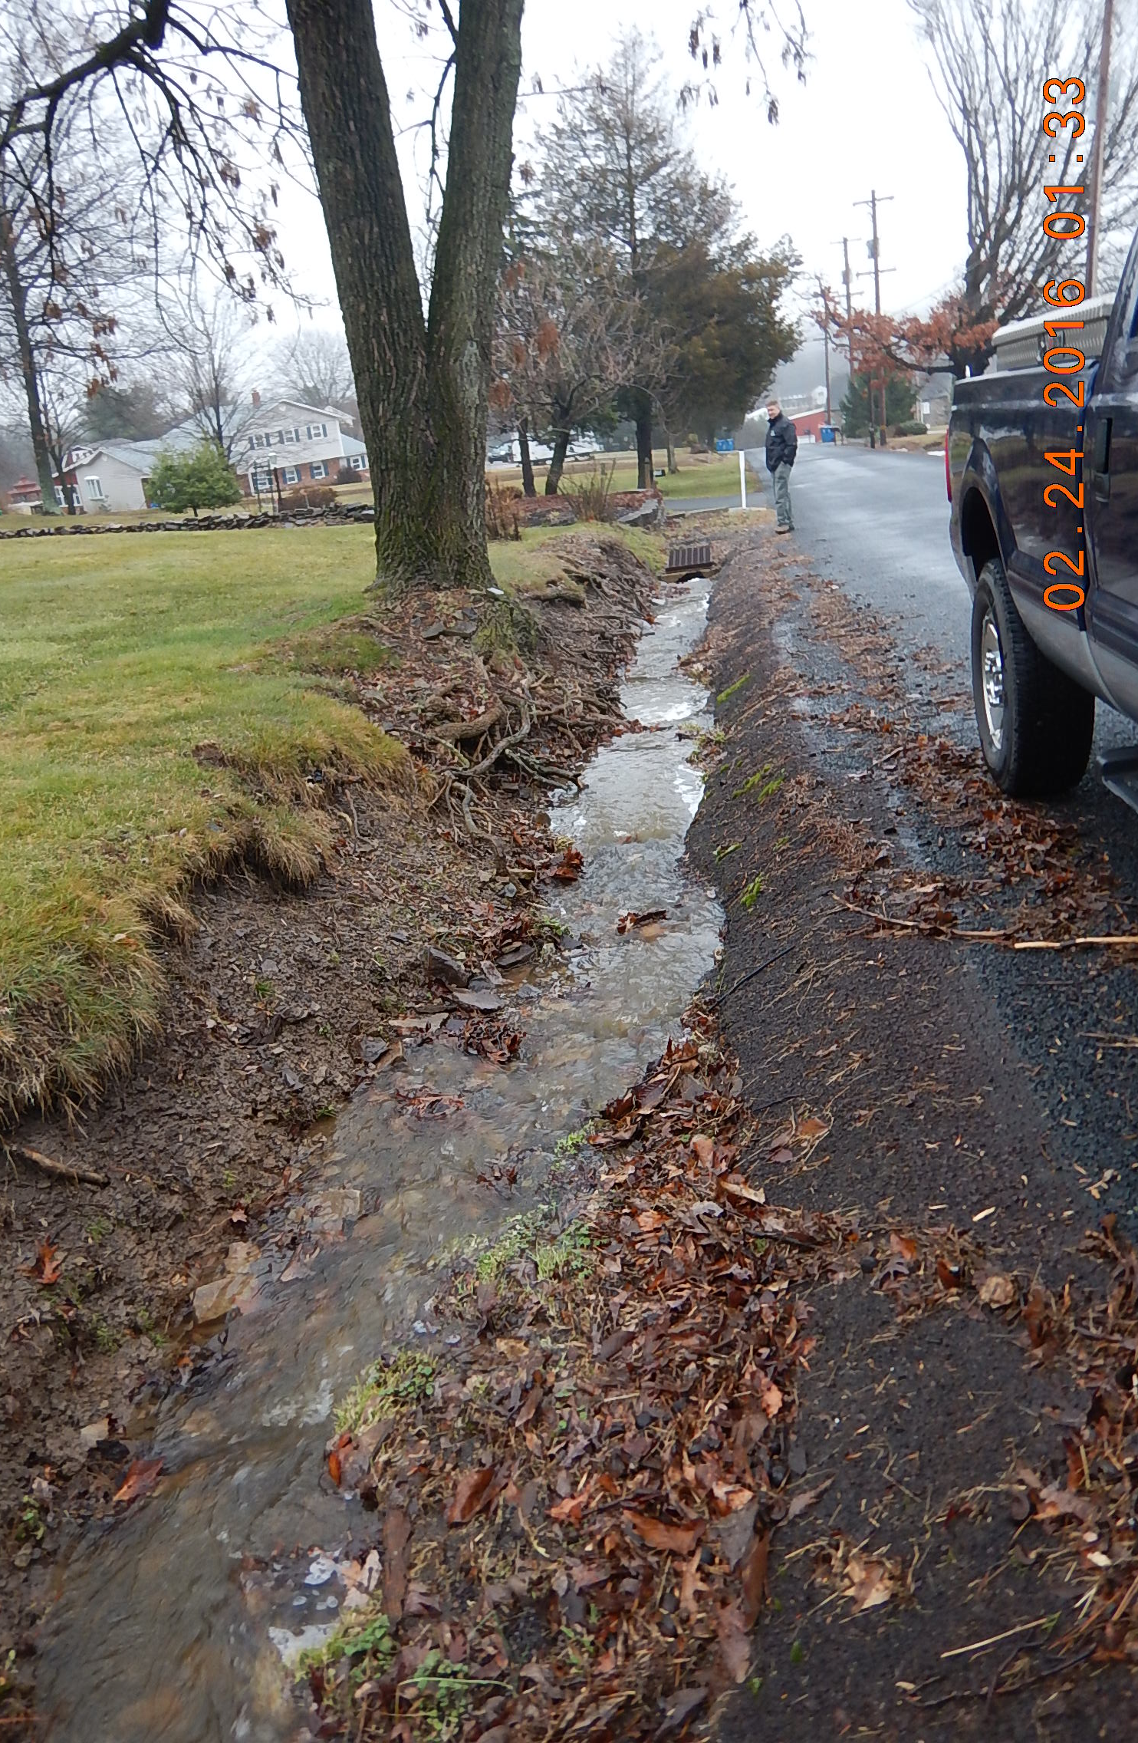
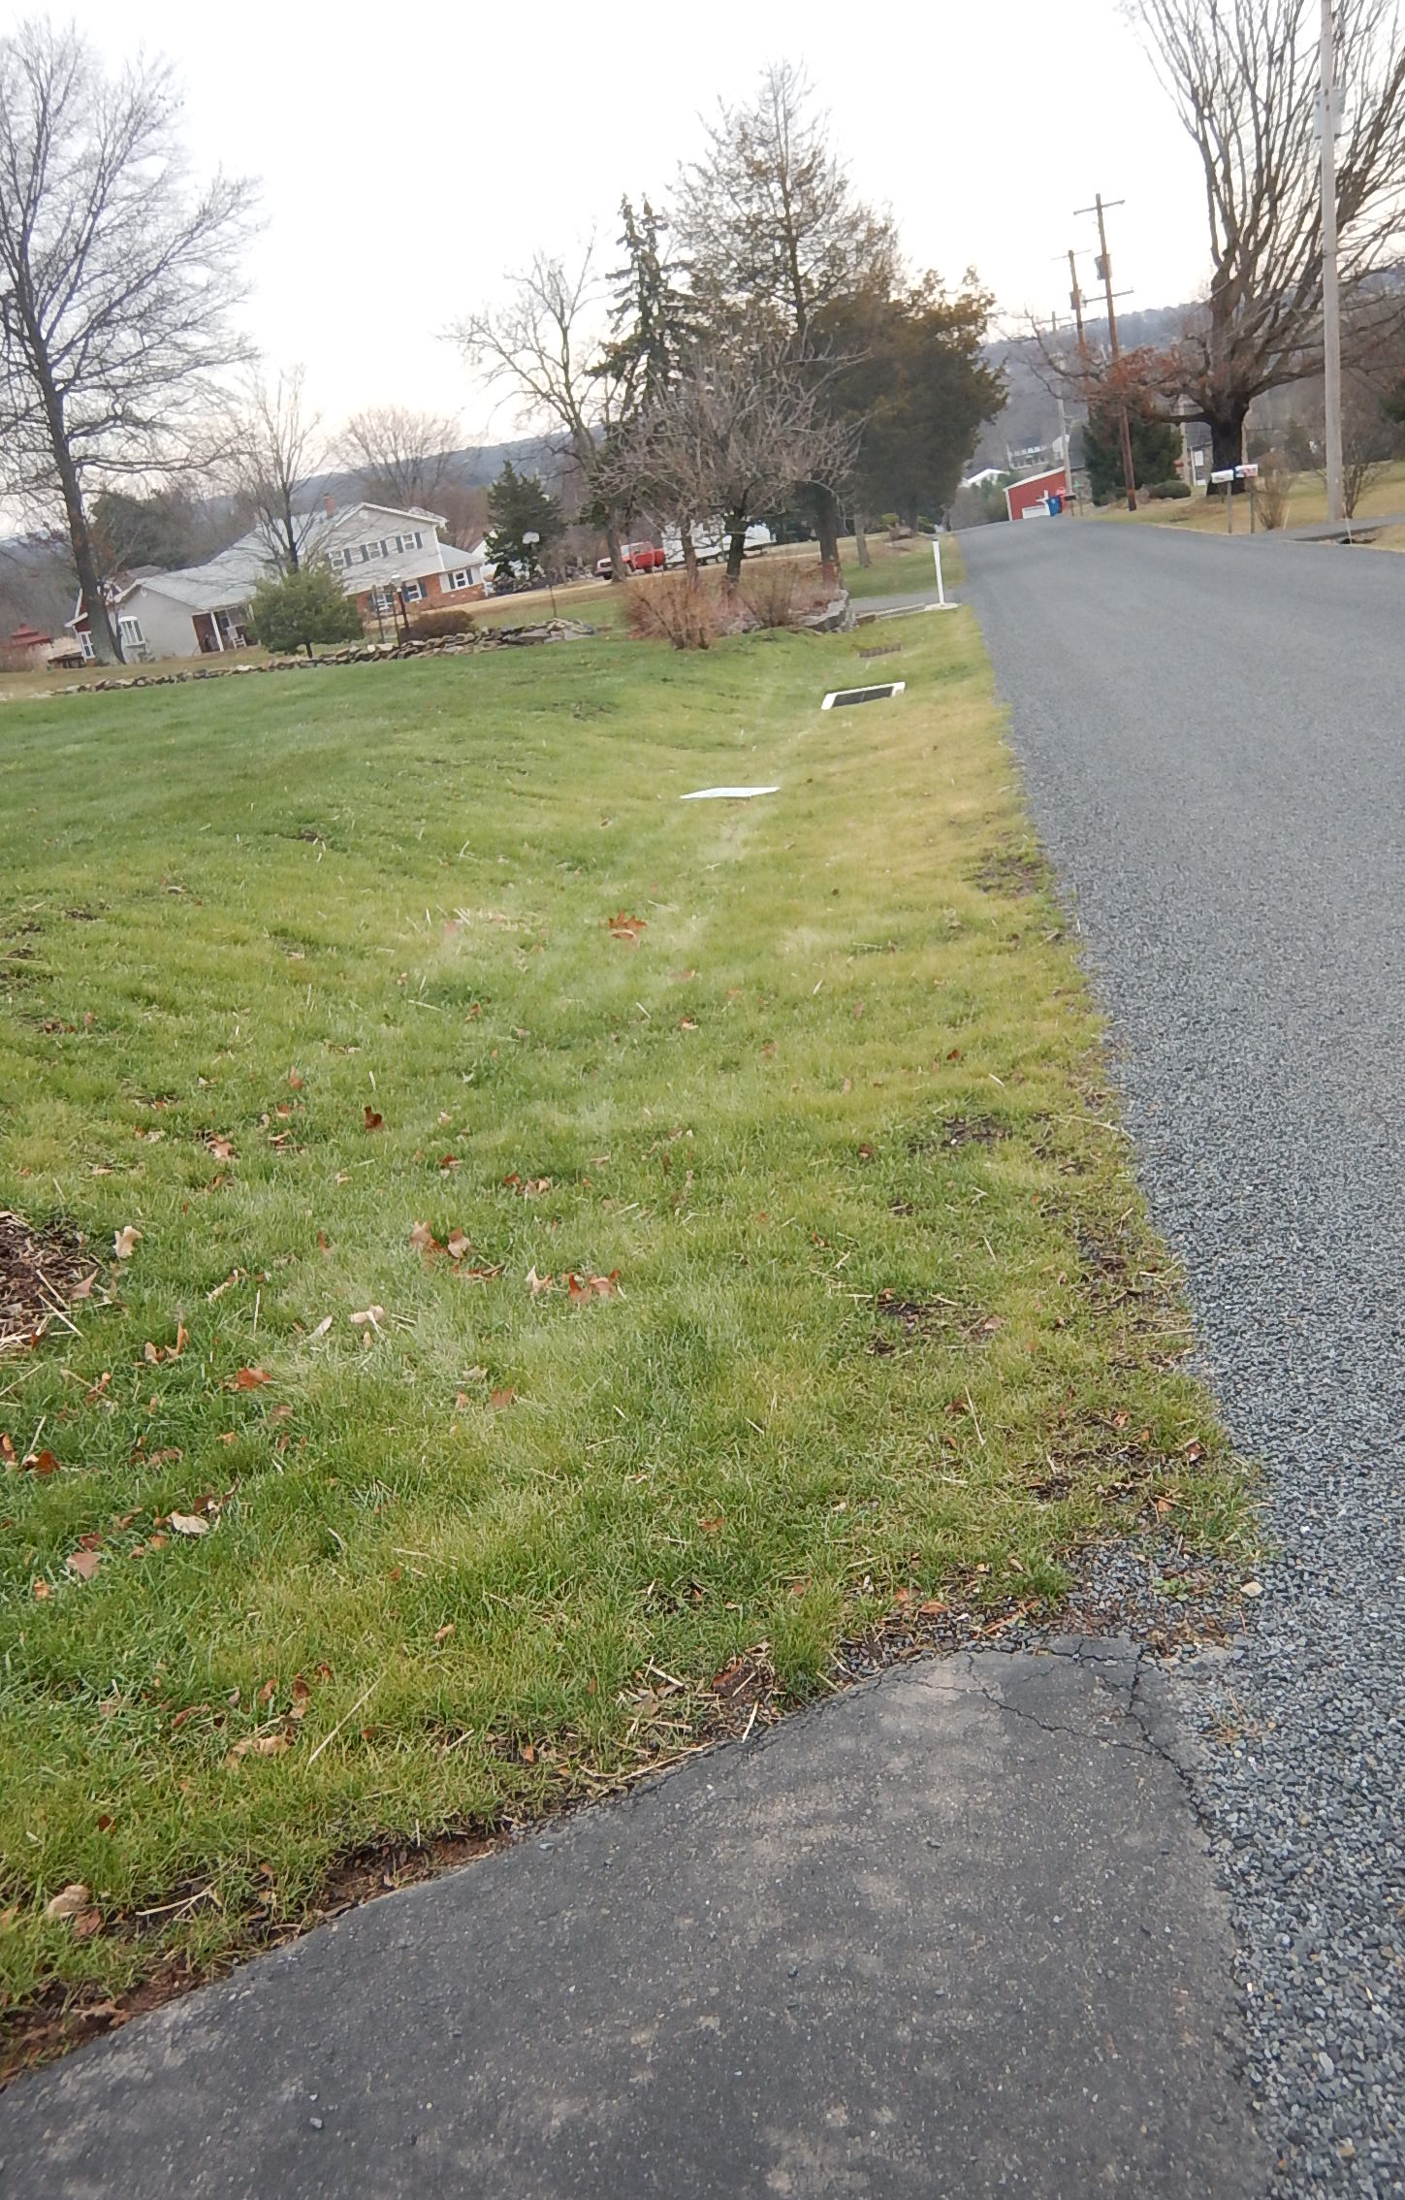
BEFORE
BEFORE
‘16 LVR Project - Complete
Montgomery County, Webber Rd
$33K Spent, $4K in kind
Excessive flow, yards drain to road, nowhere drain.
Stormwater system with grass swale on top.
AFTER
AFTER

Slide 15
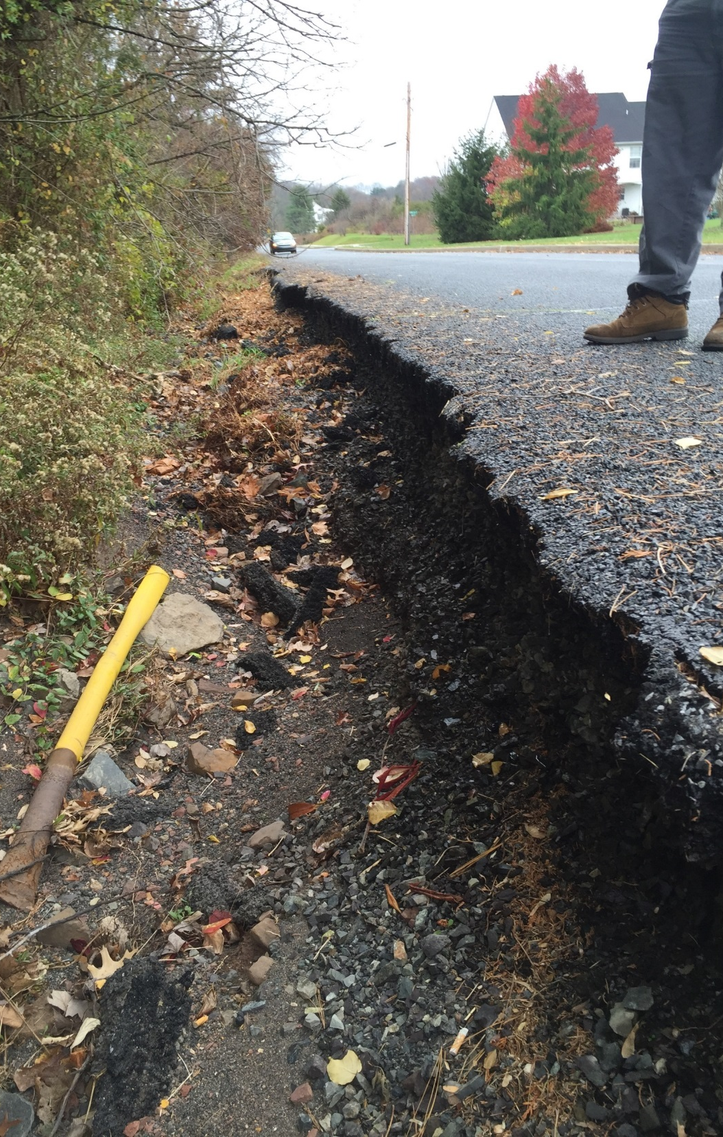
LVR – stormwater to outlet and asphalt repair
LVR Projects – Pre-Application
Montgomery County
DnG– 3.3’ baseflow pipe with 15’ bankfull
Looking at 15’ arch or box culvert
Same gravel bar

Slide 16
Project Sharing Sessions
Northeast
Audio also available via phone: 866-823-7699
For assistance, call: 814-865-5355

Slide 17
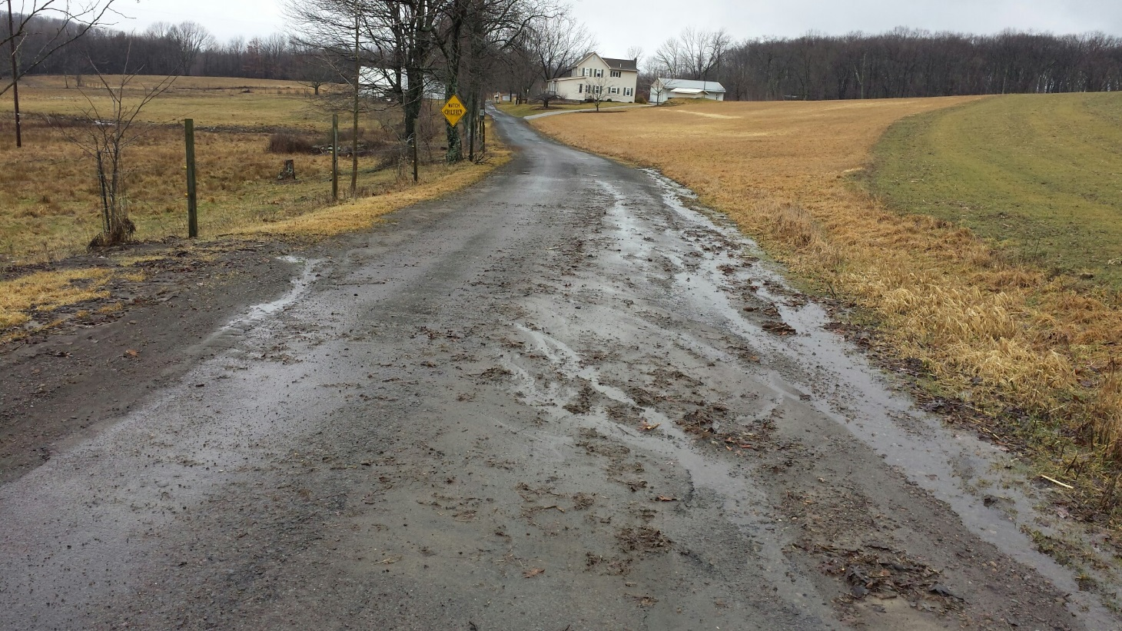
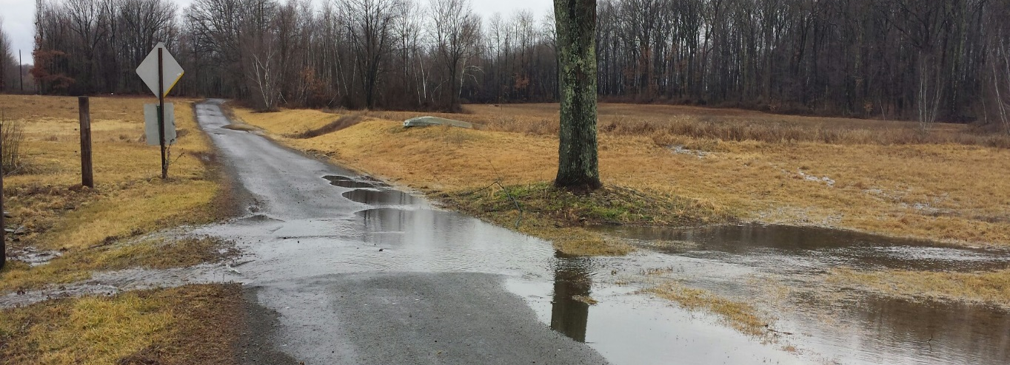
BEFORE
LVR Project - Application
Luzerne County, Barchik Rd
Off ROW – field diversion
Geotextile
French mattress
Several pipes
Convert to DSA

Slide 18
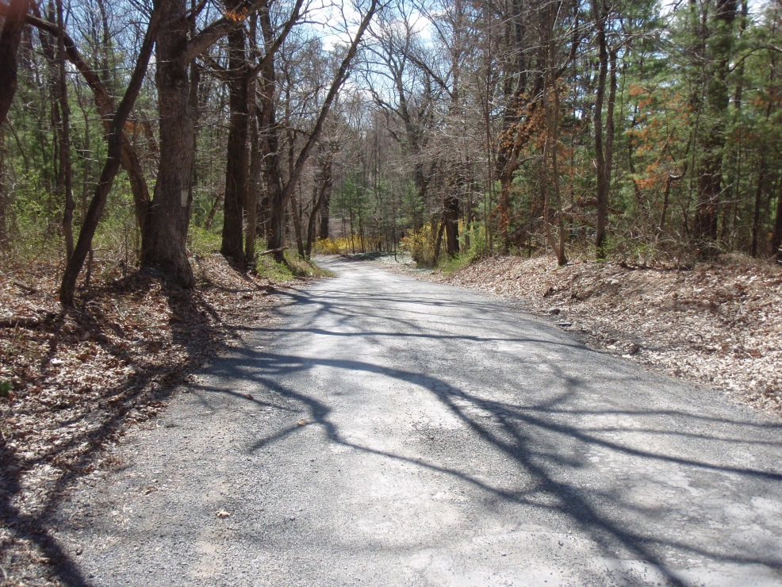
BEFORE
AFTER
‘16 D&G Project - Complete
Monroe County, Chill-Hypsie Gap Rd
$95K Spent, $8 in kind
Two French mattresses
Multiple pipes
DSA
Bank stabilization
2 mattresses in progress

Slide 19
BEFORE
AFTER
‘16 D&G Project - Complete
Monroe County, Hell Hollow Rd
$10K Spent, $16 in kind
Large overflow from braided channel
High-Water Bypass installed
2 mattresses in progress

Slide 20
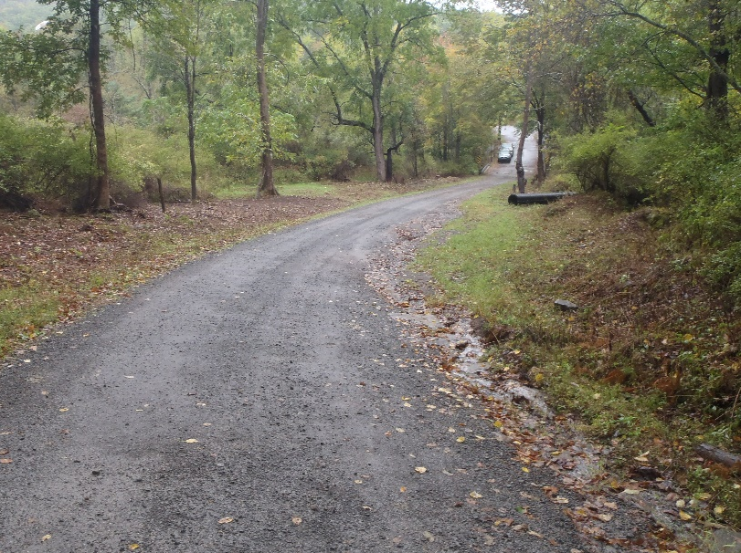
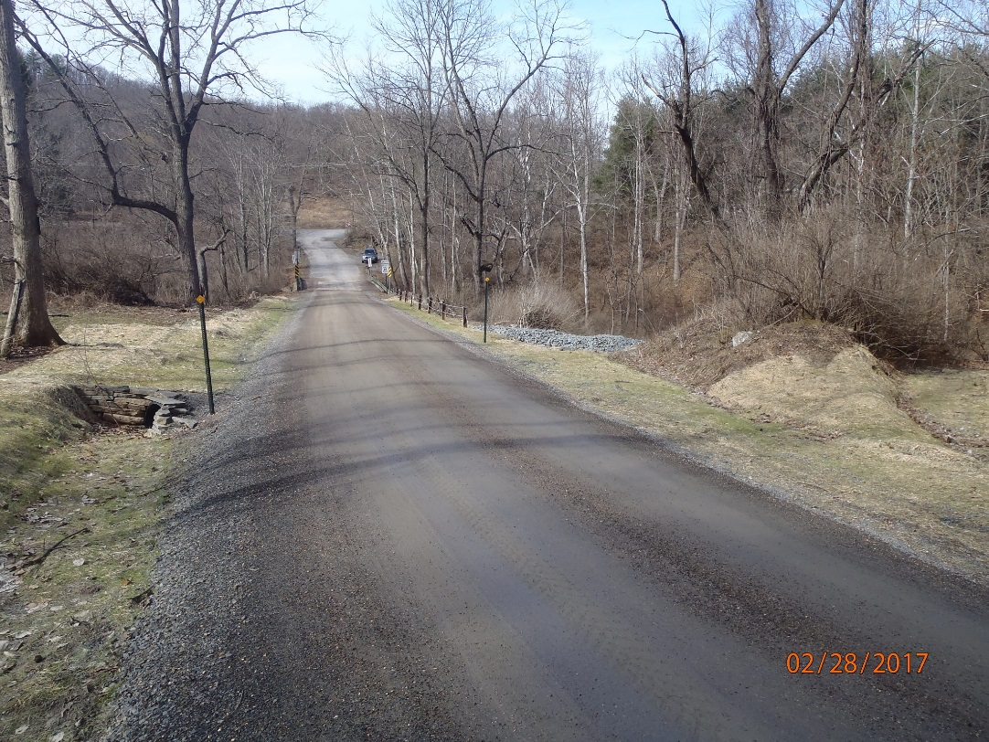
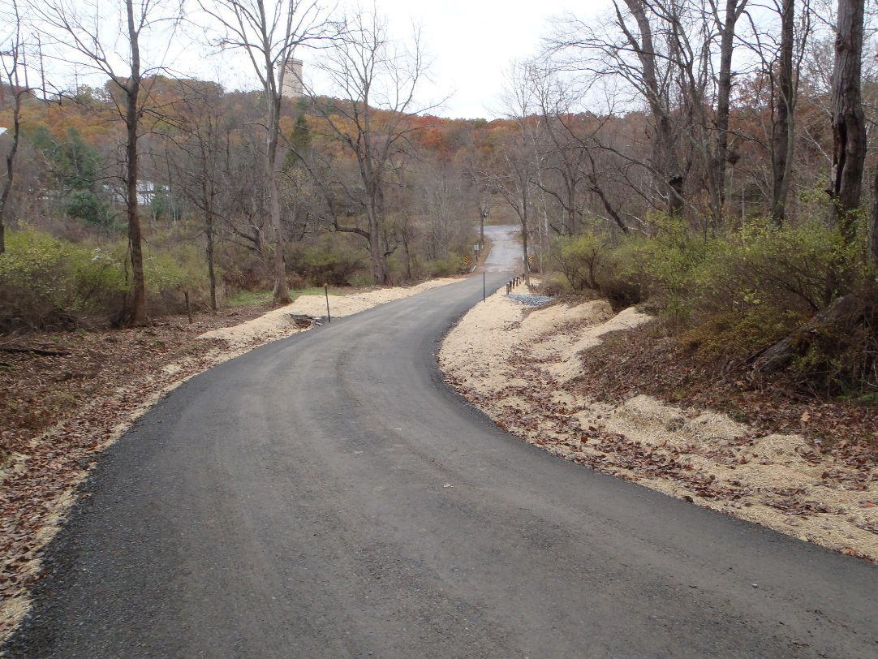
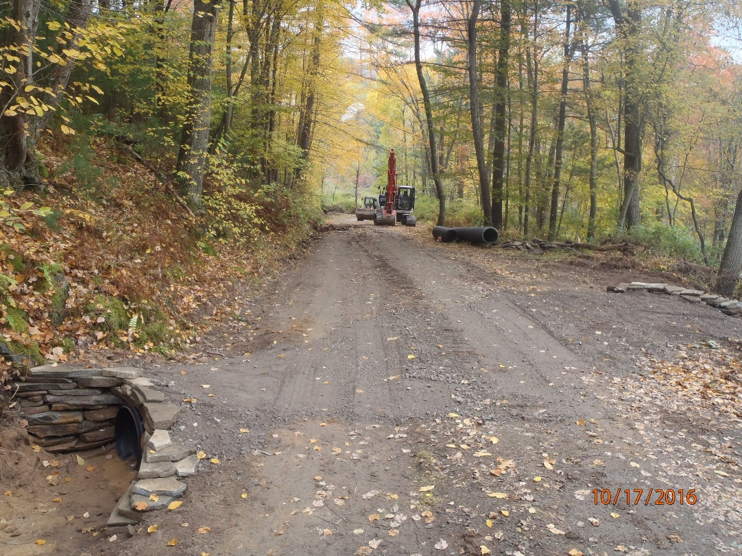
BEFORE
AFTER
No drainage outlets before stream
Separate crosspipe and turnout
‘16 D&G Project - Complete
Pike County, Henershot Rd
$25KSpent, $9K in kind
4 new pipes, several turnouts
Road fill and berm removal
DSA

Slide 21
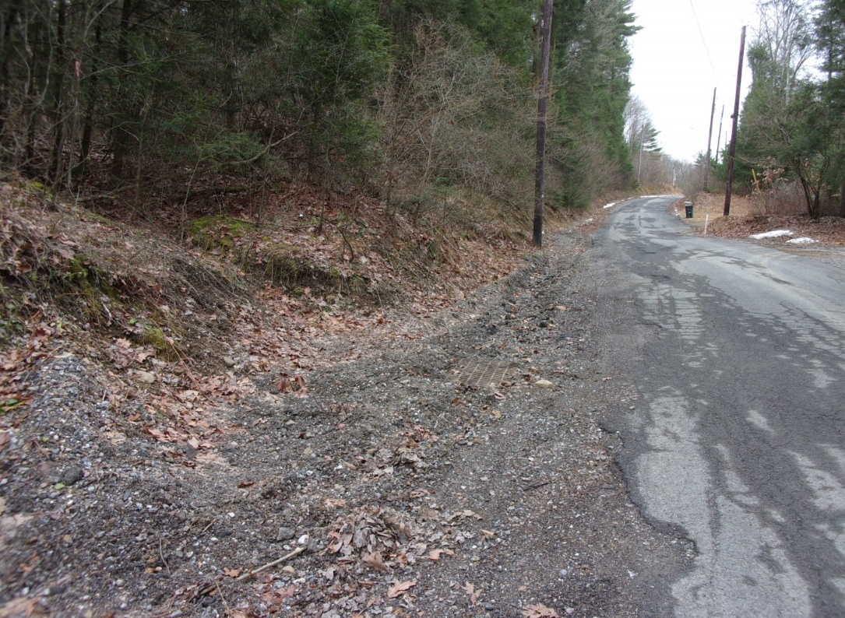
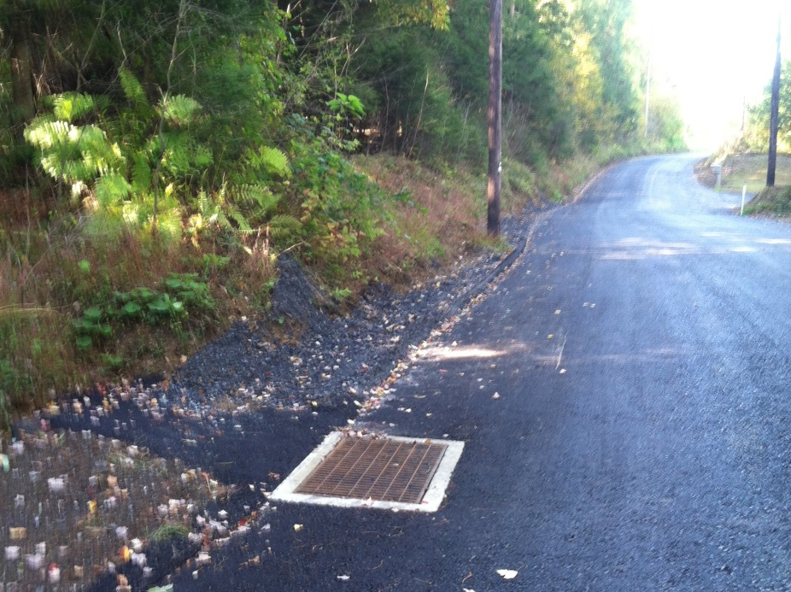
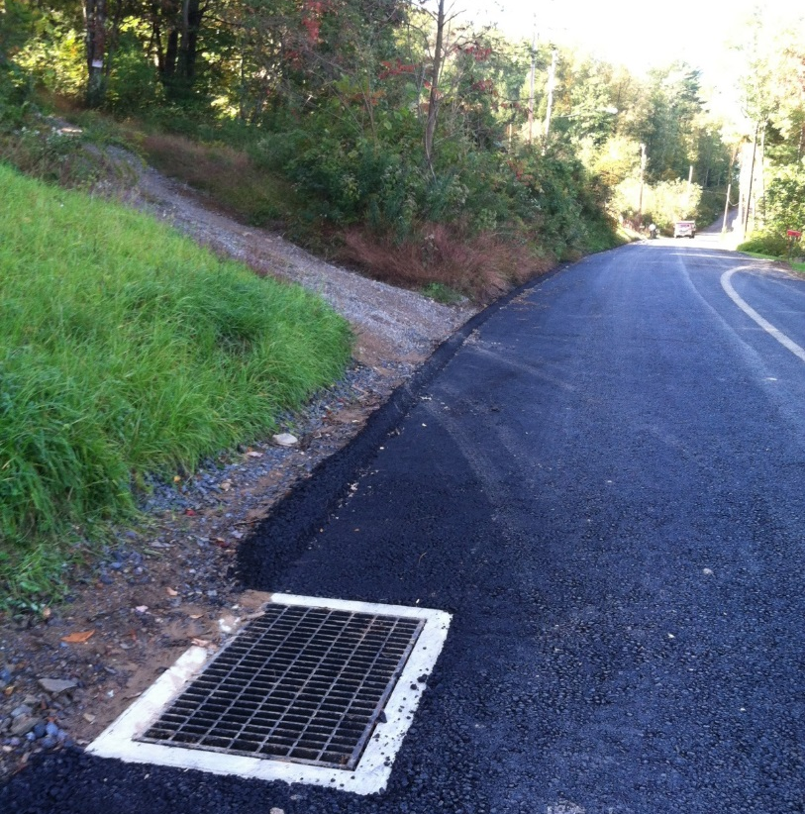
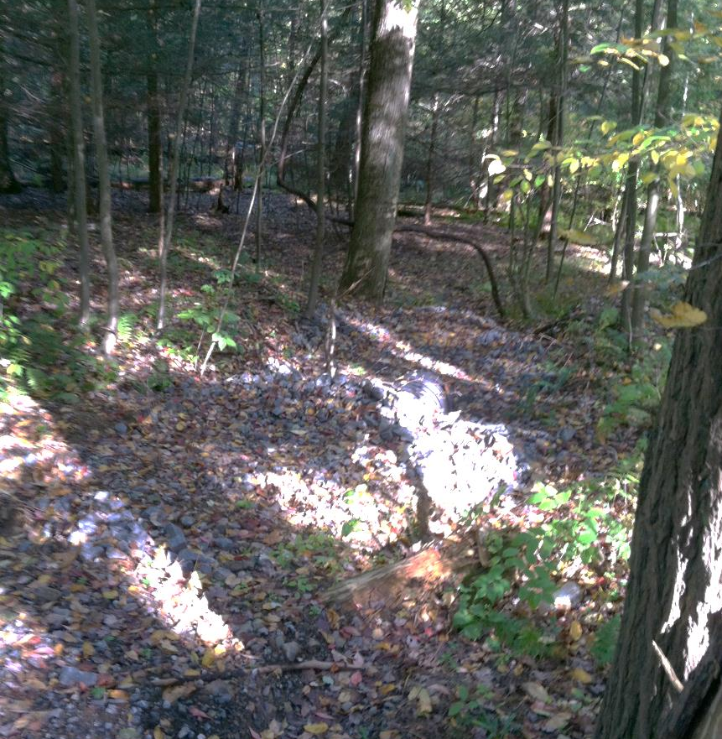
BEFORE
AFTER
Strom Drain outlet
Belt Diverter
‘16 LVR Project - Complete
Schuylkill County, Black Diamond Rd
$20K Spent, $54K in kind
Mill and repave
Storm sewer to forest outlet
Belt diverter on driveway

Slide 22
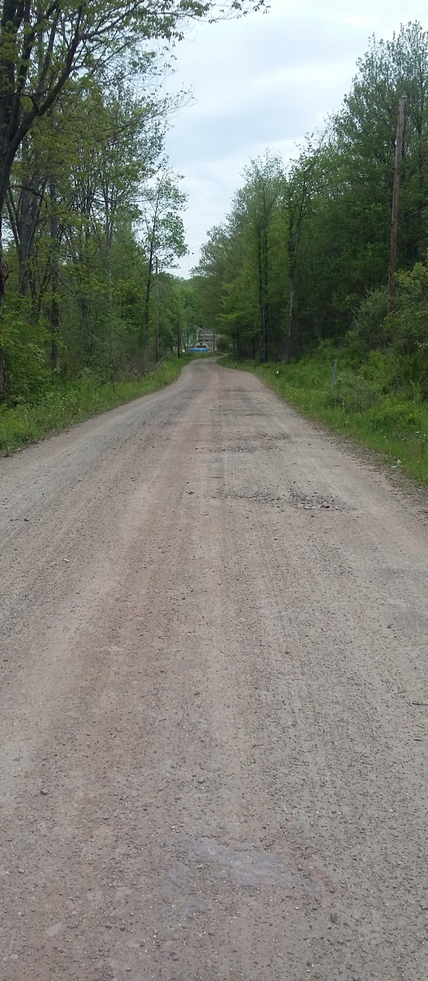
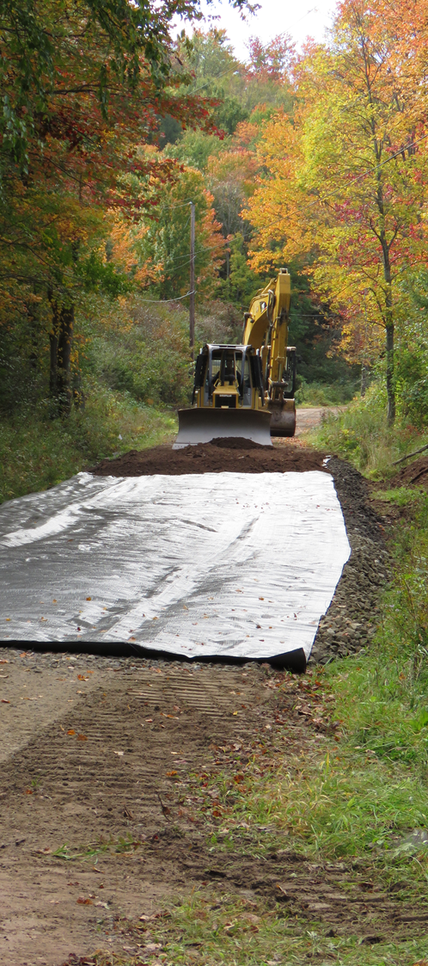
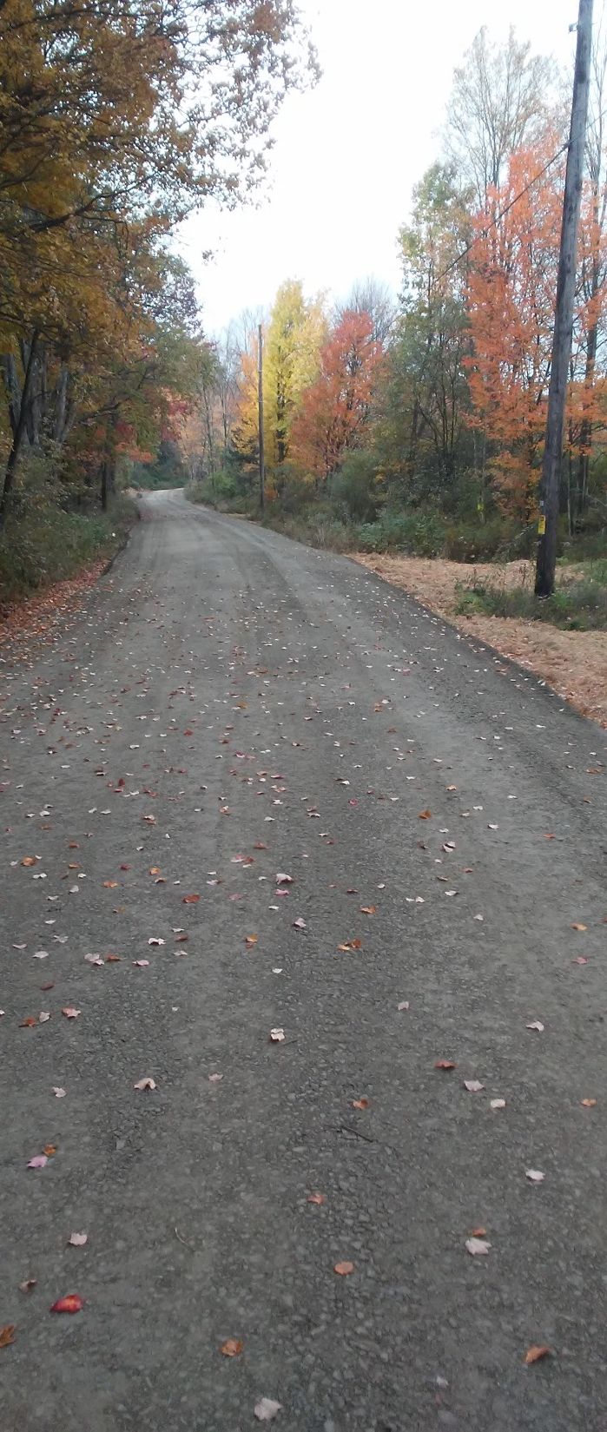
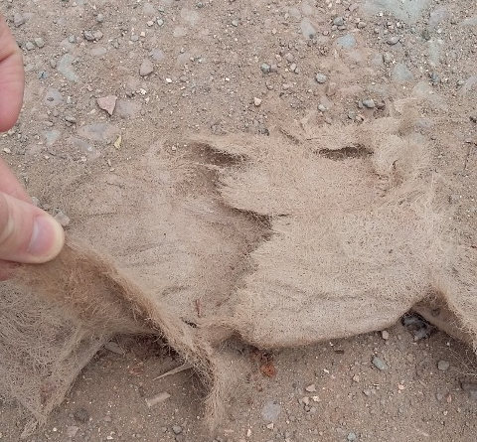
‘16 D&G Project - Complete
Wayne County, Johnson Creek Rd
$52K Spent, $3K in kind
Two 300’ French Mattresses
6 new pipes, underdrain, DSA
DURING
AFTER
BEFORE

Slide 23
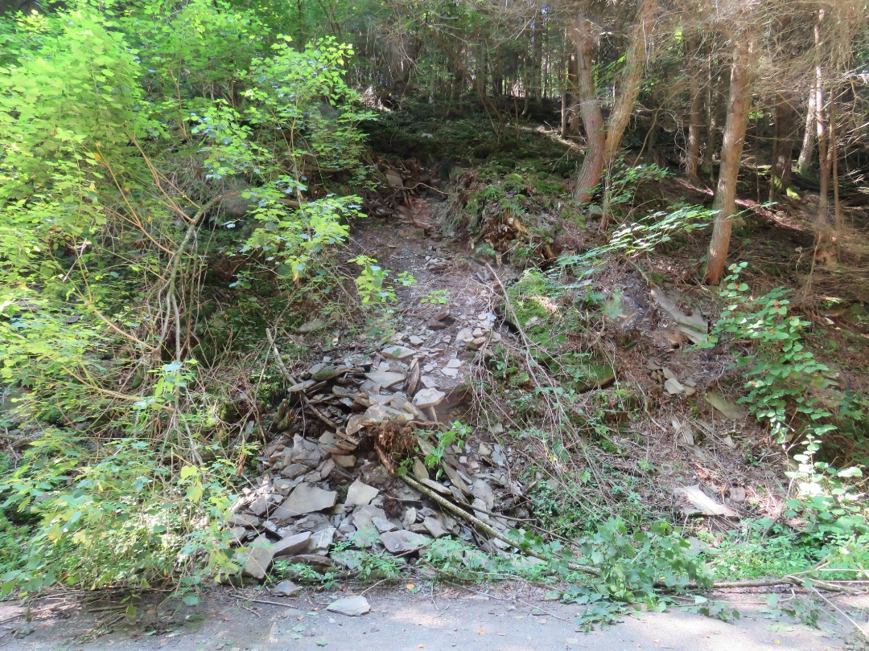
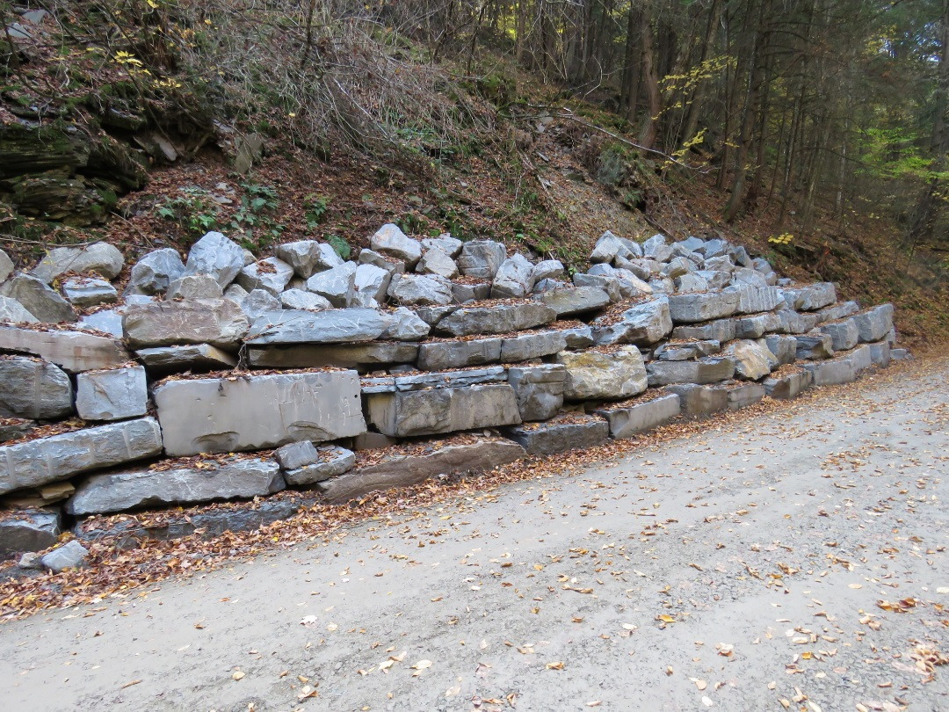
BEFORE 1
AFTER 1
‘16 D&G Project - Complete
Wayne County, Fall’s Rd
$86K Spent, $15K in kind
8 new crosspipes, DSA
Streambank Stabilization
Bankwall, off ROW pipe
BEFORE 2
AFTER 2

Slide 24
Project Sharing Sessions
Northwest
Audio also available via phone: 866-823-7699
For assistance, call: 814-865-5355

Slide 25
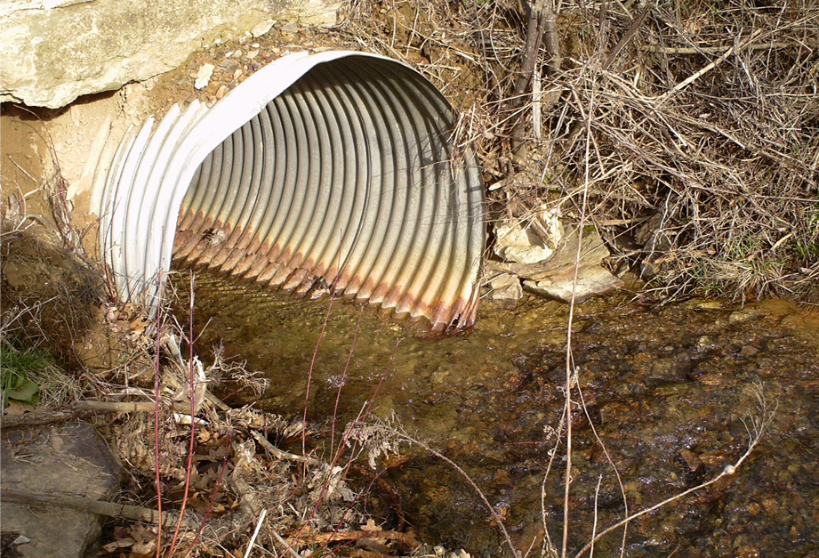
BEFORE
‘16 D&G Project - Complete
Jefferson County, Reed Rd
$31K Spent, $11K in kind
Bottomless arch Pipe
BEFORE 1
AFTER

Slide 26
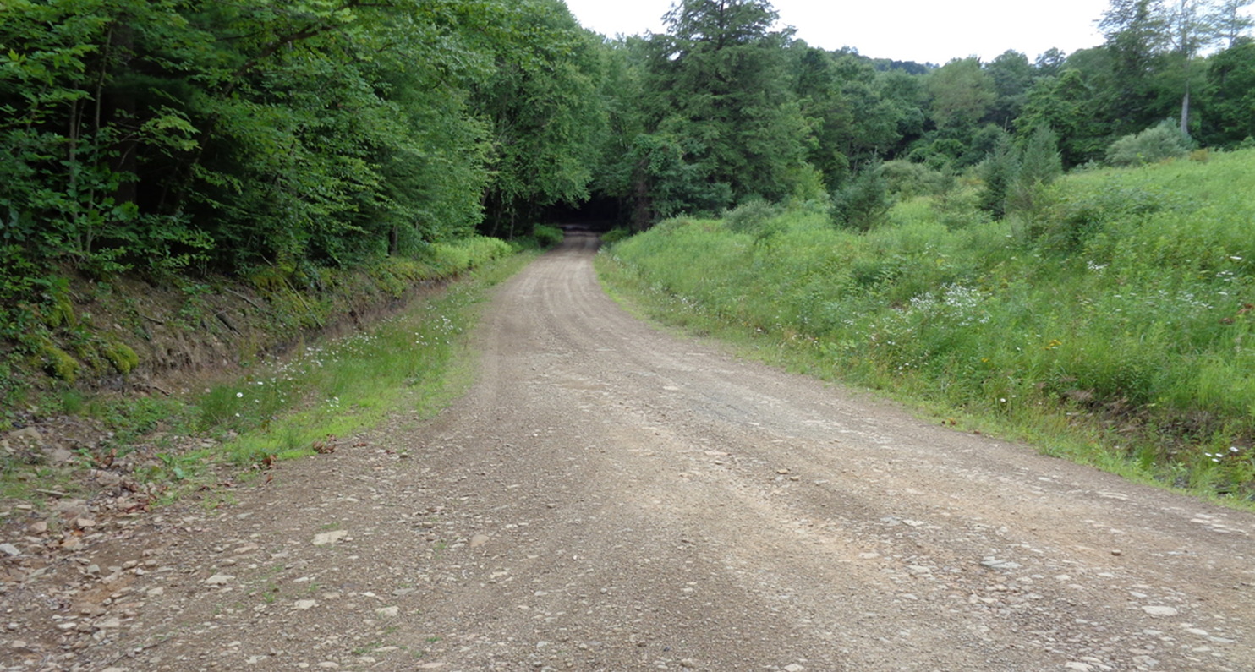
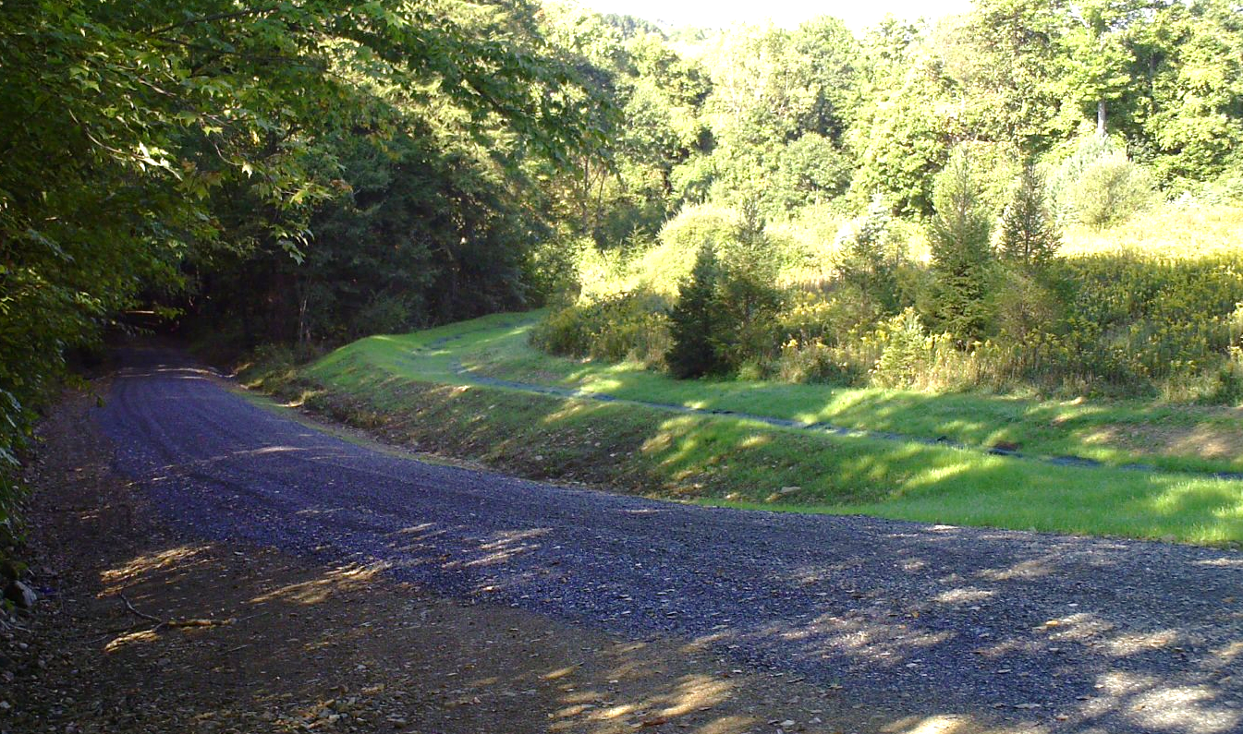
BEFORE
‘16 D&G Project - Complete
Jefferson County, Team Rd
$37K Spent, $4K in kind
Road Fill
Pipes and gradebreaks
Grassed outlet/diversion
BEFORE 1
AFTER

Slide 27
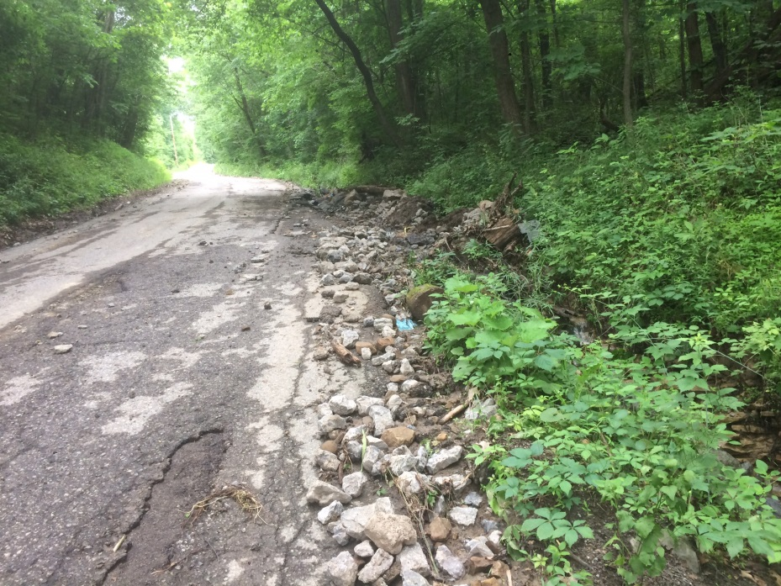
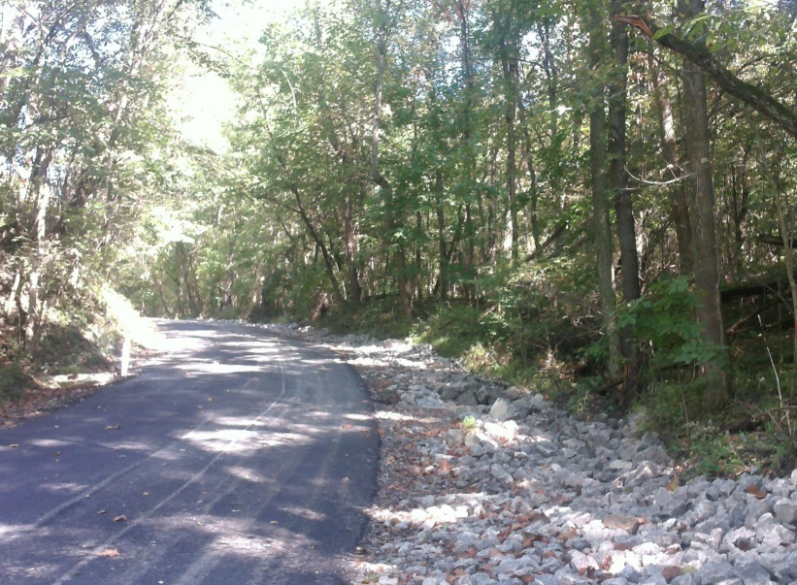
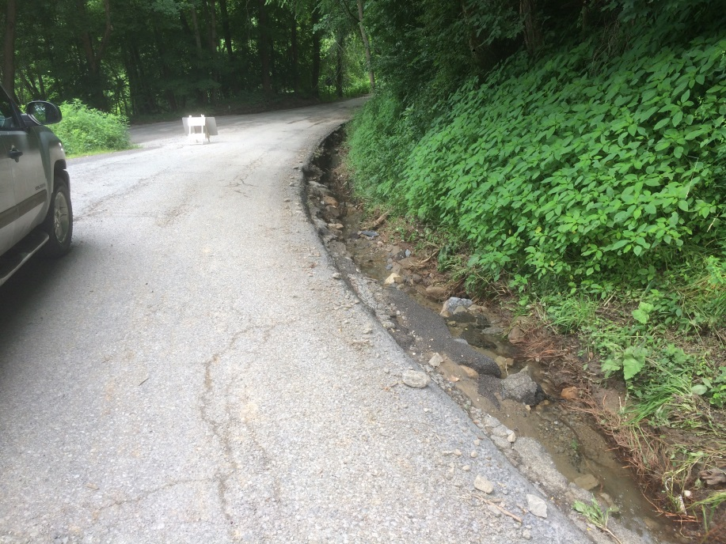
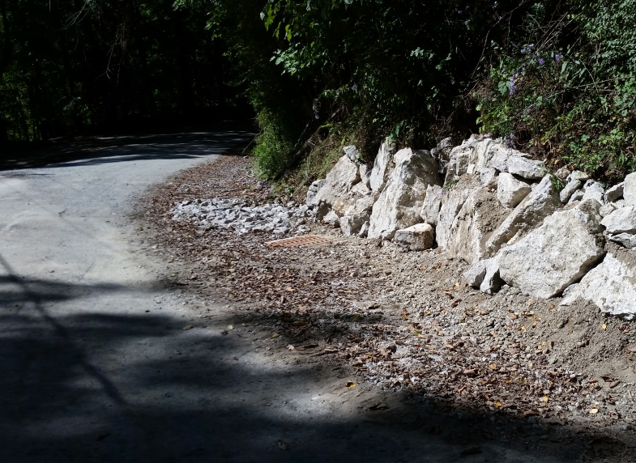
BEFORE 1
AFTER 1
‘16 LVR Project - Complete
Lawrence County, Erskine Quarry Rd
Through the bank pipe
Several new pipes
Bank stabilization
BEFORE 2
AFTER 2

Slide 28
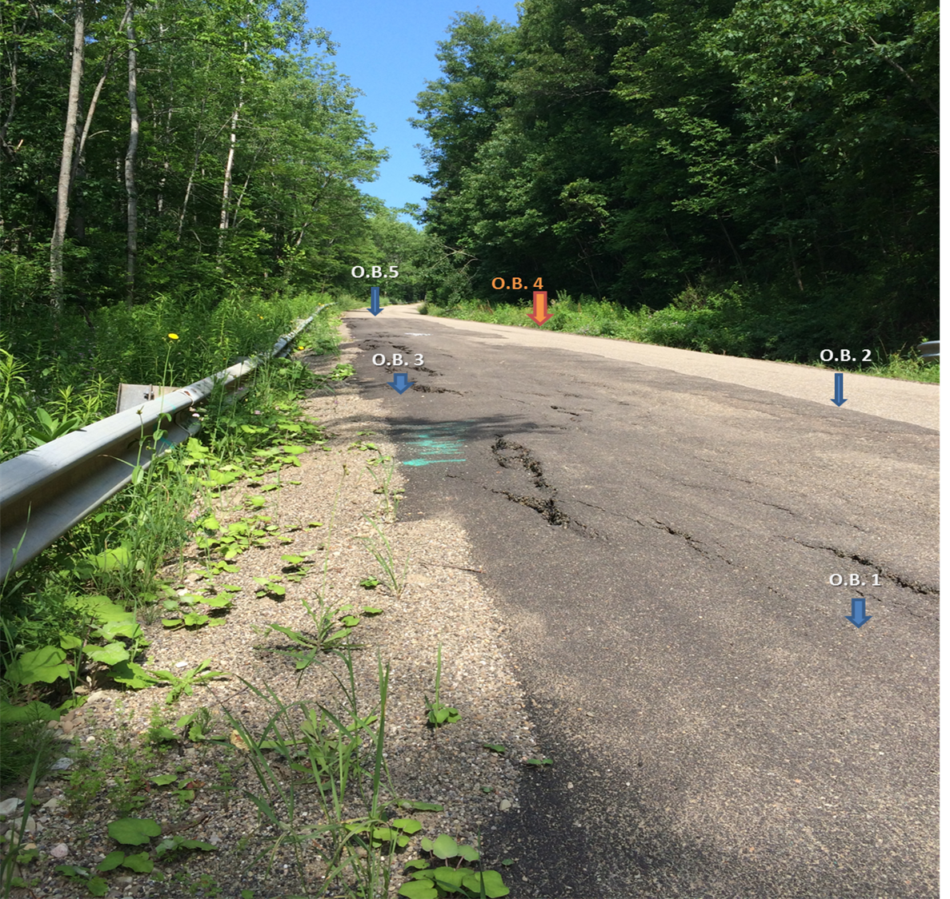
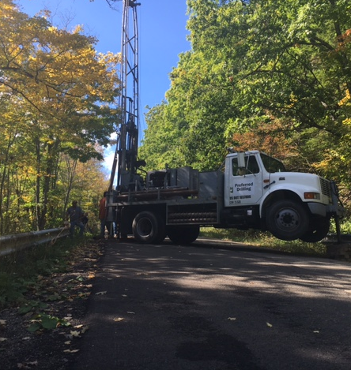
Before
‘17 D&G Project - Contract
McKean County, Hedgehog Ln
$84K Contract, $29K in kind
Abandon lane and shift road
1 new and 3 extended pipes
Underdrain
Resurfacing
O.B. 6
Depth of the slope failure is limited by the presence of weathered shale located at 11.3-13.6 ft below the road surface.
Cracking is a result of lateral movement of the slope as opposed to settlement of soils beneath the road.

Slide 29
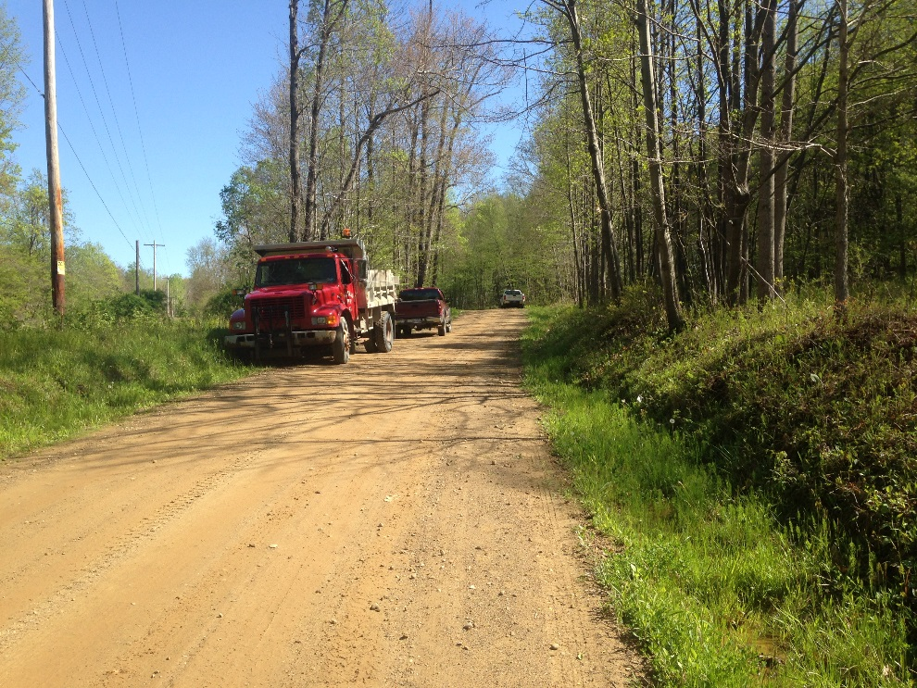
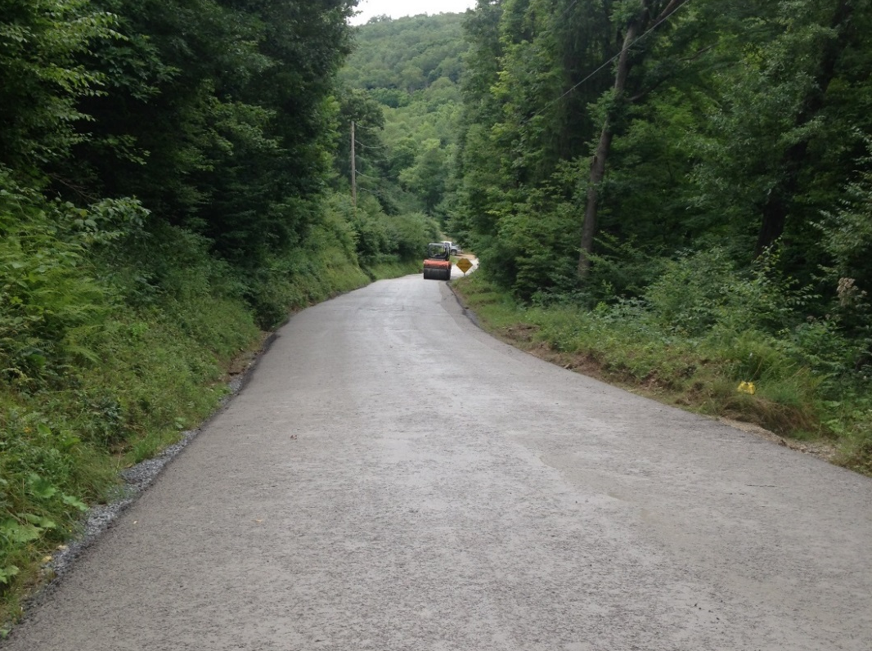
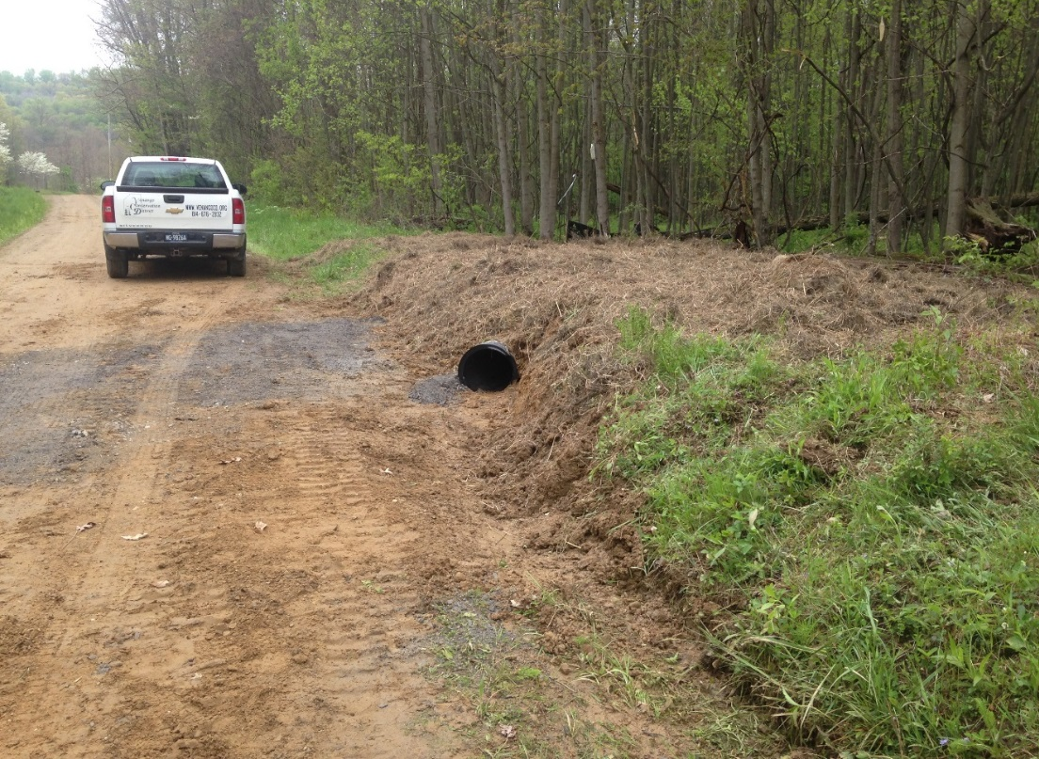
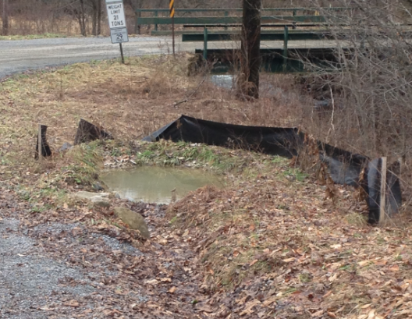
BEFORE
AFTER
BEFORE 1
‘16 LVR Project - Complete
Venango County, Henderson St. Rd
$110K Spent, $27K in kind
Several crosspies and through-the-bank pipes
Base improvements and DSA
Through the bank pipe
Small settling basin

Slide 30
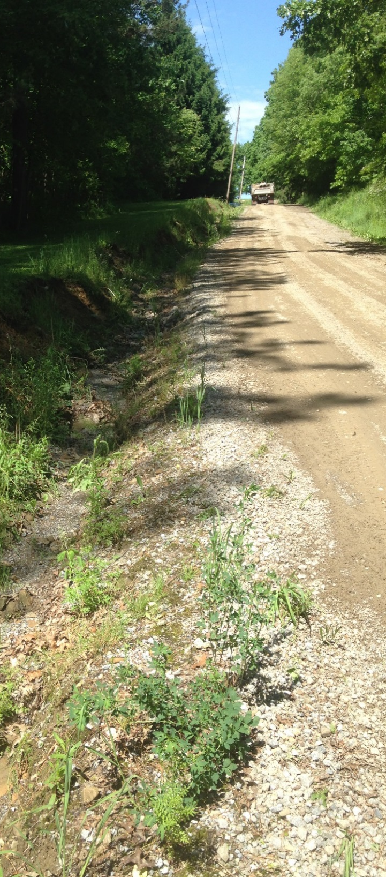
BEFORE
DURING
‘16 LVR Project - Complete
Venango County, Keister Rd
$144K Spent, $31K in kind
Massive fill job, underdrain and DSA
Crosspipes and through the bank pipes
BEFORE 1
AFTER
DURING

Slide 31
BEFORE
DURING
BEFORE 1
‘16 LVR Project - Contracted
Allegheny County, Sygan Rd
$213K Spent, $79K in kind
16’ aluminum arch pipe
600’ underdrain
New pipe and level spreader
New Surface in 2017
AFTER
DURING

Slide 32
BEFORE
AFTER
BEFORE 1
‘16 DnG Project - Completed
Clearfield County, Greenwood Rd
$9K Spent, $1K in kind
French Mattress / Underdrain to drain springs
DURING
AFTER
Flow out of end of mattress

Slide 33
BEFORES
BEFORE 1
‘17 LVR Project - Application
Crawford County, N First St
$108K Application, $14K in kind
Failing 7’ culvert (60’ long)
Proposed 12’x7’ Squash (100’ long)
outlet
inlet

Slide 34
BEFORE
BEFORE 1
‘16 LVR Project - Complete
Clarion County, N First St
$28K Application, $8K in kind
2,000 feet of underdrain w/ cleanouts
4 new crosspipes
DURING
Drone anyone?
DURING
DURING

Slide 35
Project Sharing Sessions
Central
Audio also available via phone: 866-823-7699
For assistance, call: 814-865-5355

Slide 36
BEFORE 1
BEFORE
AFTER 1
‘16 D&G Project - Active
Cambria County, Leck’s Rd
$104K Cont, $14K in kind
Two 24’ pipes at main crossing, secondary channel dug to two 3’ pipes
18’ aluminium plate culvert with fish structures, 4’ pipe in secondary chanel
AFTER

Slide 37
BEFORE 1
BEFORE 1
AFTER 1
‘16 D&G Project - Complete
Cumberland County, Bridgewater Rd
$54K Spent, $14K in kind
Mattress underdrain, shallow pipes, off-ROW issues, DSA
French Mattress Construction
BEFORE 2
AFTER 2

Slide 38
BEFORE 1
BEFORE 1
AFTER 1
‘16 D&G Projects - Complete
Cumberland County
$14K Spent, $4K in kind
$18K Spent, $8K inkind
DSA Placements
Drainage previously completed
BEFORE 2
AFTER 2
Good discussion on DSA only contracts as a follow-up to drainage contracts

Slide 39
BEFORE
BEFORE 1
AFTER
Driveway pipe, grade break and 150’ of DSA
‘16 D&G Project - Complete
Snyder County, Mattern Rd
$40K Spent, $7K in kind
Driveway pipe and gradebreak
Base improvements
Fill, pipes, and DSA
Geotextile and fill

Slide 40
BEFORE 1
BEFORE 1
AFTER 1
‘16 D&G Project - Complete
Snyder County, Brick Plant Rd
$28K Spent, $3K in kind
Road fill and DSA
Underdrain and bank work
AFTER 2
AFTER 2

Slide 41
BEFORE
AFTER
‘16 D&G Project - Complete
Snyder County, Possum Rd
$36K Spent, $25K in kind
15.5’ X 6.5’ bottomless aluminum culvert

Slide 42
For more information:
Recording available online
Contact the project-owning District
Questions
Visit to completed projects
Visit sites in progress

Slide 43
Webinars:
March 17th Project Sharing Session Highlights
April 13th Overview of Admin Manual Changes
April 18th CD Replenishments and Direct Deposit
Admin/GIS/Field Day New-Hire Training:
Register: http://www.dirtandgravel.psu.edu/education-and-training/conservation-district-new-hire-training
Schedule: March 28, 29, 30 in State College
Bankfull / Stream Crossing Trainings:
Registration available soon
Schedule:
April 26th Cumberland County
May 10th Elk County
May 11th Indiana County
June 6th Pike County
June 8th Centre County
June 27-28th NAACC Culvert Assessment Training (St College Area): This is a methodology for assessing and ranking road/stream crossings for aquatic connectivity, used throughout the Northeastern US. More details to come. Web Link: https://streamcontinuity.org/
NEW DATE (was 3/21)

