Slide 1
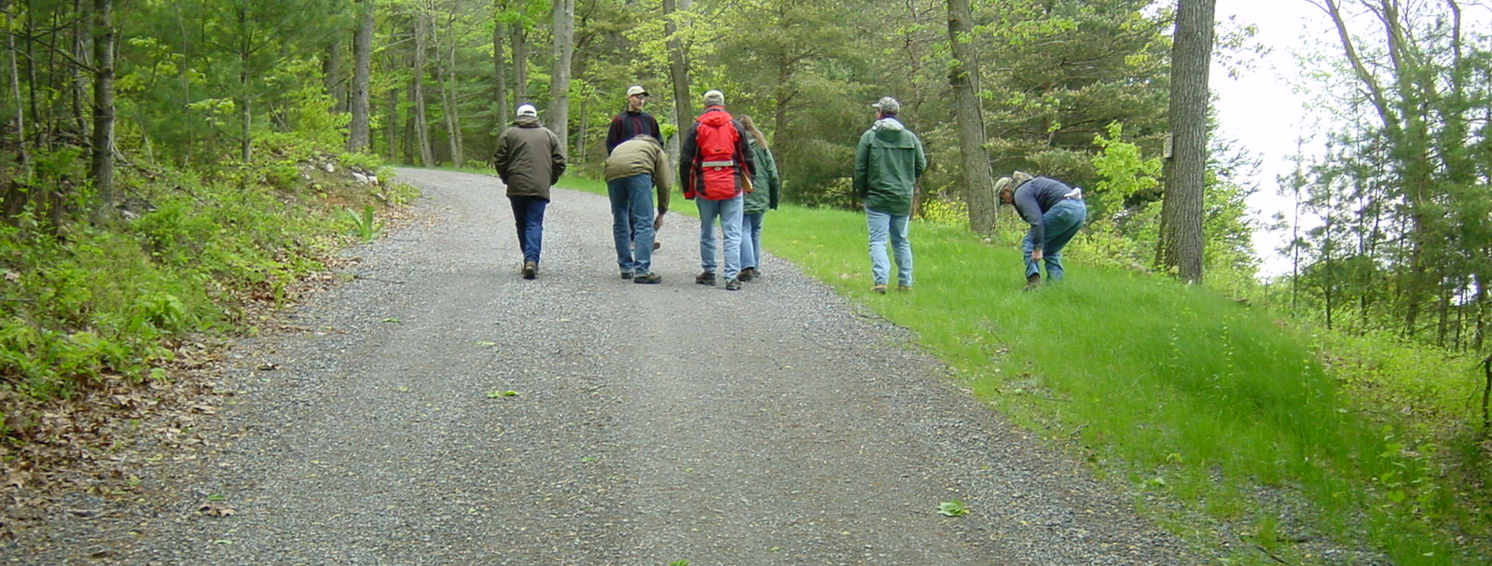
Quality Assurance Boards
11/20/20104
Toggle Fullscreen
mode with this button
above
Use Chat box to ask Questions
http://metrocount.com
If you are reading this, then you are successfully seeing the webinar video. In addition to audio on the webinar, we have opened a phone conference line to allow attendees to listen and ask questions directly: 866-823-7699. Please use either the webinar audio or conference line, but not both (will produce feedback)
Audio also available via phone: 866-823-7699
For assistance, call: 814-865-5355

Slide 2
Toggle Fullscreen
mode with this button
above
Use Chat box to ask Questions
Participant phone lines will be muted until after initial presentation
http://metrocount.com
Audio also available via phone: 866-823-7699
For assistance, call: 814-865-5355

Slide 3
QAB Issues
Webinar, including Q&A, will be recorded and available later. www.dirtandgravelroads.org
Audio also available via phone: 866-823-7699
For assistance, call: 814-865-5355

Slide 4
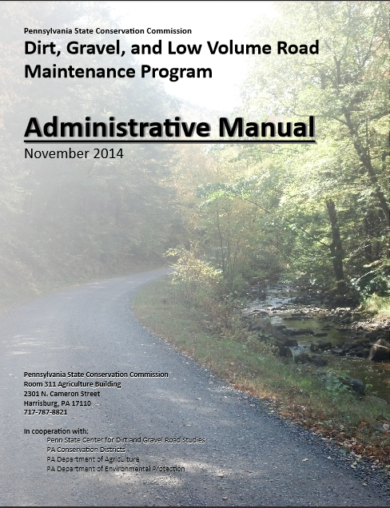
Structure and Purpose
QAB Issues
DG&LVR Administrative Manual
Approved by SCC 11/12/14
Introduction
SCC Role
Conservation District Role
Quality Assurance Board Role
Applicant Role
Center for Dirt and Gravel Roads
Additional Policies
Permits and Other Requirements
Appendices

Slide 5
Driving Surface Aggregate
Introduction
Quality Assurance Board (QAB) Issues
QAB Structure and Purpose
QAB Meeting Guidelines
QAB Role in Local Projects
QAB Role in Local Policy
QAB “to-do list”
Audio also available via phone: 866-823-7699
For assistance, call: 814-865-5355

Slide 6
Structure and Purpose
QAB Issues
Quality Assurance Board -§ 9106, (E)
Within the conservation district a Quality Assurance Board shall be impaneled to establish and administer the grant program. The four-member QAB is to be comprised of a nonvoting chairman appointed by the conservation district directors and one local representative appointed by each of the following entities:
(1) The Federal Natural Resource Conservation Service
(2) The Pennsylvania Fish and Boat Commission
(3) The county conservation district
If circumstances require, the chairman may vote to decide a tie vote.
Audio also available via phone: 866-823-7699
For assistance, call: 814-865-5355

Slide 7
Structure and Purpose
QAB Issues
Quality Assurance Board Why?
Audio also available via phone: 866-823-7699
For assistance, call: 814-865-5355

Slide 8
Structure and Purpose
QAB Issues
Quality Assurance Board Why?
Local Involvement and Control
NRCS – Federal: conservation and erosion
PAFBC – State: aquatics and hydrology
District – County: conservation multi-discipline
Who knows best for the County?
People in the County!

Slide 9
Structure and Purpose
QAB Issues
Quality Assurance Board
Local control within guidelines established by the commission.
QAB’s purpose is to advise and assist the conservation district board.
QAB is advisory only
District Board has the final say
Audio also available via phone: 866-823-7699
For assistance, call: 814-865-5355

Slide 10
Poll Question
How many QAB members are listening to this Webinar?
http://metrocount.com
Audio also available via phone: 866-823-7699
For assistance, call: 814-865-5355

Slide 11
Structure and Purpose
QAB Issues
QAB Structure
Only 4 members
Non-voting chair appointed by district board
One voting member appointed by the district board
One voting member appointed by Fish and Boat commission
One voting member appointed by NRCS
Chairman may only vote to decide a tie
Audio also available via phone: 866-823-7699
For assistance, call: 814-865-5355

Slide 12
Structure and Purpose
QAB Issues
QAB Structure
Only 4 members
Non-voting chair appointed by district board
One voting member appointed by the district board
One voting member appointed by Fish and Boat commission
One voting member appointed by NRCS
Chairman may only vote to decide a tie
Voting members appointed by the agencies do not have to be employees
All QAB members are strongly encouraged to take ESM training
At least one district member must take ESM training
QAB can have as many advisors as the deem necessary, but advisors are non voting
Audio also available via phone: 866-823-7699
For assistance, call: 814-865-5355

Slide 13
Structure and Purpose
QAB Issues
QAB Structure
Only 4 members
Non-voting chair appointed by district board
One voting member appointed by the district board
One voting member appointed by Fish and Boat commission
One voting member appointed by NRCS
Chairman may only vote to decide a tie
Voting members appointed by the agencies do not have to be employees
All QAB members are strongly encouraged to take ESM training
At least one district member must take ESM training
QAB can have as many advisors as the deem necessary, but advisors are non voting
Audio also available via phone: 866-823-7699
For assistance, call: 814-865-5355

Slide 14
Structure and Purpose
QAB Issues
QAB Structure
Only 4 members
Non-voting chair appointed by district board
One voting member appointed by the district board
One voting member appointed by Fish and Boat commission
One voting member appointed by NRCS
Chairman may only vote to decide a tie
Voting members appointed by the agencies do not have to be employees
All QAB members are strongly encouraged to take ESM training
At least one district member must take ESM training
QAB can have as many advisors as they deem necessary, but advisors are non voting

Slide 15
Structure and Purpose
QAB Issues
NRCS and PAFBC (not CD) designate their QAB appointees
Does not have to be NRCS/PAFBC employee.
Can also designate an alternate.
Should have appointment in writing
Sample appointment letter:
Audio also available via phone: 866-823-7699
For assistance, call: 814-865-5355

Slide 16
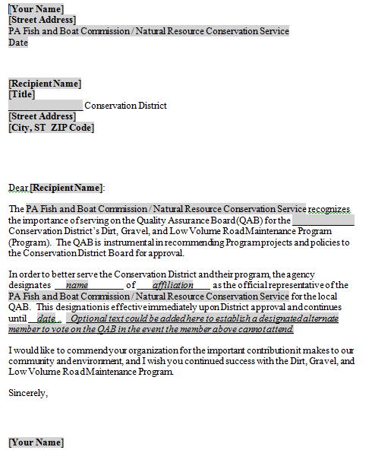
Structure and Purpose
QAB Issues
Sample appointment letter:
Voting members appointed by the agencies do not have to be employees

Slide 17
Driving Surface Aggregate
Introduction
Quality Assurance Board (QAB) Issues
QAB Structure and Purpose
QAB Meeting Guidelines
QAB Role in Local Projects
QAB Role in Local Policy
QAB “to-do list”
Audio also available via phone: 866-823-7699
For assistance, call: 814-865-5355

Slide 18
Meeting Guidelines
QAB Issues
QAB Meetings
On a regular schedule or as needed basis
Common action items at a QAB meeting:
Review grant applications
Recommend projects for funding to the district board
Review completed projects
Recommend local policies to district board
Audio also available via phone: 866-823-7699
For assistance, call: 814-865-5355

Slide 19
Meeting Guidelines
QAB Issues
QAB Meetings must be Sunshined
The Pennsylvania Sunshine Act requires all public agencies to take all official actions and conduct all deliberations leading up to official actions at public meetings. The Act covers all such actions by municipal governing bodies, committees of these governing bodies and municipal boards and commissions.
-Open Meetings, the Sunshine Act (Pennsylvania)
Audio also available via phone: 866-823-7699
For assistance, call: 814-865-5355

Slide 20
Meeting Guidelines
QAB Issues
QAB Meetings must be Sunshined
Regular meetings may be noticed in local paper.
As needed meeting must be noticed in local paper at least 24 hours in advance.
Conference call meetings are ok, but must still be sunshined.
Must have quorum of voting members (2 of three voting members).
Must keep minutes.
http://webpages.charter.net/gdsbmmllp/sunshine.htm
Audio also available via phone: 866-823-7699
For assistance, call: 814-865-5355

Slide 21
Driving Surface Aggregate
Introduction
Quality Assurance Board (QAB) Issues
QAB Structure and Purpose
QAB Meeting Guidelines
QAB Role in Local Projects
QAB Role in Local Policy
QAB “to-do list”
Audio also available via phone: 866-823-7699
For assistance, call: 814-865-5355

Slide 22
QAB role in projects
QAB Issues
QAB Role in Projects
Make funding recommendations to District Board.
Establish local priorities & ranking criteria
Application deadlines and retention policies
Rank applications
Recommend applications to CD board
Audio also available via phone: 866-823-7699
For assistance, call: 814-865-5355

Slide 23
Poll Question
How do you evaluate applications?
QAB visits sites as a group
QAB visits sites individually
District technician visit sites and reports back
No site visits, rank paper applications only
Please be honest, we can’t track answers anyway!
http://metrocount.com
Audio also available via phone: 866-823-7699
For assistance, call: 814-865-5355

Slide 24
QAB role in projects
QAB Issues
QAB Role: Project Ranking
QAB members should become familiar with applicant’s worksites:
Site visits as a group
Site visits individually
Photo tour from District staff
Paper application review only
Throw darts at “application dartboard”
Best option
Not recommended
Audio also available via phone: 866-823-7699
For assistance, call: 814-865-5355

Slide 25
QAB role in projects
QAB Issues
QAB Role: Project Ranking
Project Ranking Criteria
Individual to your county
Should have environmental focus
REQUIRED – the only way to answer: “why did you fund that project and not my project?”
Example provided by Center:
Audio also available via phone: 866-823-7699
For assistance, call: 814-865-5355

Slide 26
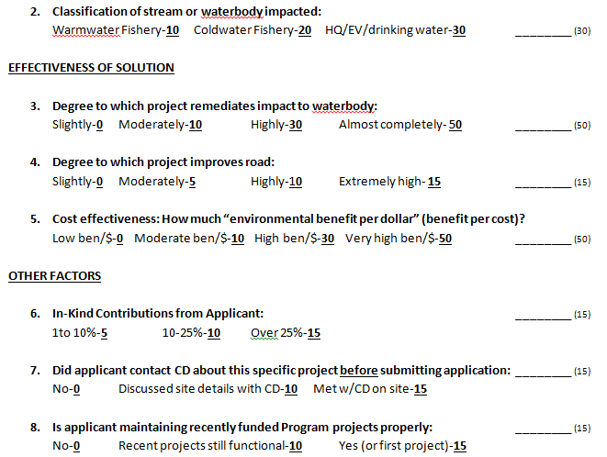
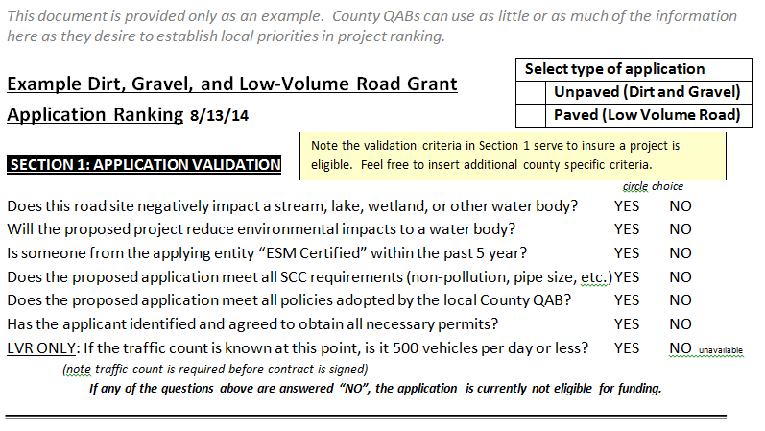
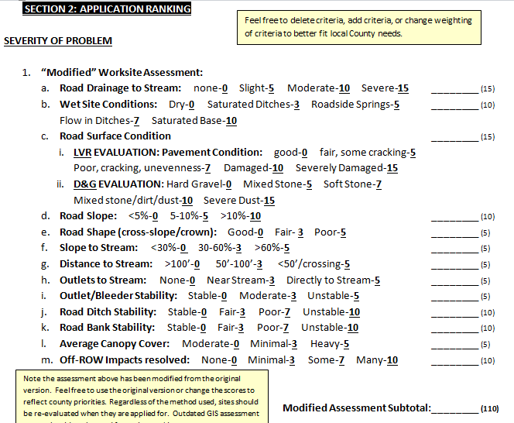
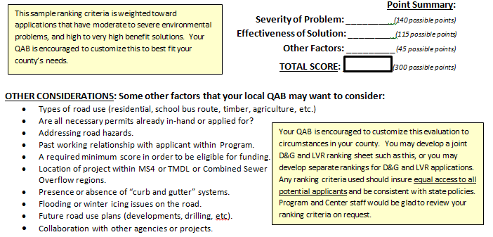
Sample Ranking Criteria
QAB Issues
Application Ranking Criteria SAMPLE ONLY
Audio also available via phone: 866-823-7699
For assistance, call: 814-865-5355

Slide 27
Sample Ranking Criteria
QAB Issues
Application Ranking Criteria SAMPLE ONLY
NEXT WEBINAR: December 11th 10AM
Application Ranking Criteria
Review of Center’s sample template
Explanation of items in sample template
Discussion of other potential factors
Input from other Conservation Districts

Slide 28
QAB role in projects
QAB Issues
QAB Role: Project Ranking
QAB members should become familiar with applicant’s worksites
Site visit is recommended. Must be sunshined if a quorum of voting members is present.
The Pennsylvania Sunshine Act requires all public agencies to take all official actions and conduct all deliberations leading up to official actions at public meetings. The Act covers all such actions by municipal governing bodies, committees of these governing bodies and municipal boards and commissions.
-Open Meetings, the Sunshine Act (Pennsylvania)
Audio also available via phone: 866-823-7699
For assistance, call: 814-865-5355

Slide 29
QAB role in projects
QAB Issues
QAB Role: Funding Recommendations
QAB makes funding recommendations to District Board.
District Board then considers QAB recommendations.
When the District Board approves an application, district staff may then develop and secure a contract.
Audio also available via phone: 866-823-7699
For assistance, call: 814-865-5355

Slide 30
QAB role in projects
QAB Issues
QAB Role: Project Implementation
After contract is secured, district staff is responsible for project administration, oversight, and inspection.
Future funding decisions for the project may be made by the board with minimal QAB involvement.
i.e. District board could approve a contract amendment without QAB involvement
Audio also available via phone: 866-823-7699
For assistance, call: 814-865-5355

Slide 31
Poll Question
Do QAB members ever visit in-progress projects?
Always
Usually
Occasionally
Rarely
Never
http://metrocount.com
Audio also available via phone: 866-823-7699
For assistance, call: 814-865-5355

Slide 32
Poll Question
Does your QAB visit completed projects?
QAB visits as a group as part of site inspection
QAB visit as a group after completion
QAB members visit individually
QAB gets report from CD only
QAB never discusses completed projects
http://metrocount.com
Audio also available via phone: 866-823-7699
For assistance, call: 814-865-5355

Slide 33
Driving Surface Aggregate
Introduction
Quality Assurance Board (QAB) Issues
QAB Structure and Purpose
QAB Meeting Guidelines
QAB Role in Local Projects
QAB Role in Local Policy
QAB “to-do list”
Audio also available via phone: 866-823-7699
For assistance, call: 814-865-5355

Slide 34
QAB Role in Policy
QAB Issues
QAB Role in Policy
Developing local policy is a major function of the QAB:
QABs develops and recommends policy
District Board adopts policy
Audio also available via phone: 866-823-7699
For assistance, call: 814-865-5355

Slide 35
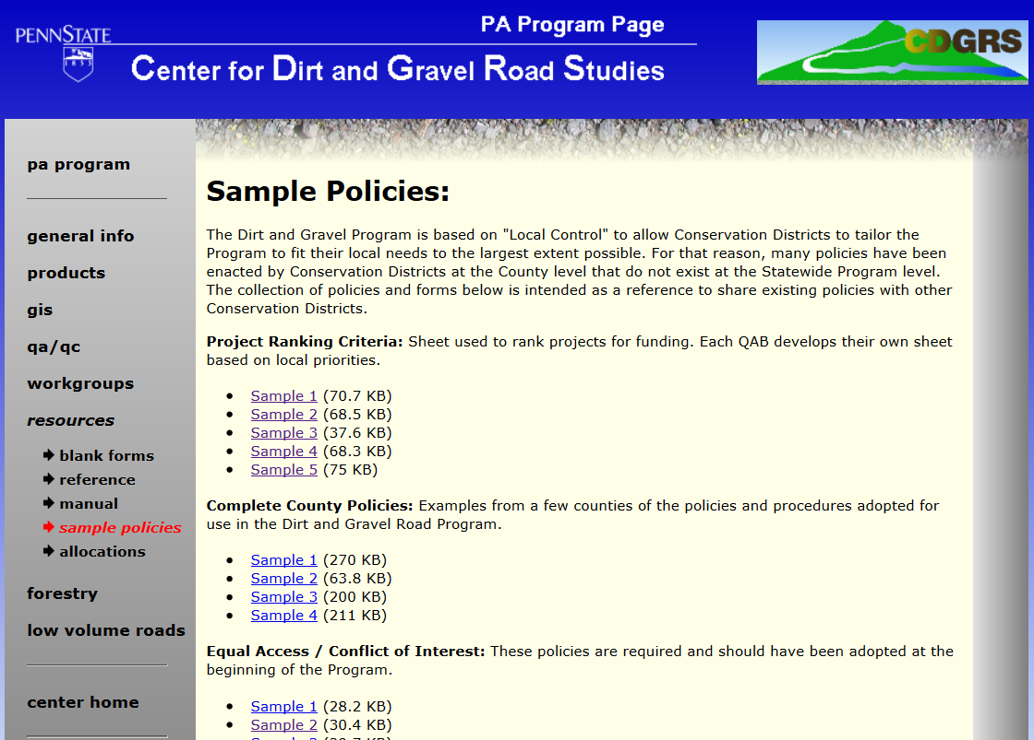
QAB Role in Policy
QAB Issues
Required Policies
Equal Access
Conflict of Interest
Project Ranking
Non-pollution Standards
Samples online→
Audio also available via phone: 866-823-7699
For assistance, call: 814-865-5355

Slide 36
QAB Role in Policy
QAB Issues
Optional Local Policies
QAB can recommend policies for use within County Program.
Can be “more stringent” than Statewide policy.
Cannot conflict with Statewide policy.
LOCAL CONTROL!
Audio also available via phone: 866-823-7699
For assistance, call: 814-865-5355

Slide 37
QAB Role in Policy
QAB Issues
Optional Local Policies
Examples of acceptable local policy:
Establishing grant submittal deadlines
Maximum grant award of $XX,XXX.
Will not pay for asphalt or DSA.
Limit DSA to within XXX’ of stream.
Maintenance policy for old projects.
Only advance XX% of funds to grant recipient.
Requiring XX% in-kind match.
Audio also available via phone: 866-823-7699
For assistance, call: 814-865-5355

Slide 38
QAB Role in Policy
QAB Issues
Optional Local Policies
Examples of UNacceptable local policy:
Allow use of 2A instead of DSA for surface
Advance 75% of funds to grant recipient.
All townships are eligible regardless of training.
OK to do projects on private roads or trails.
PennDOT Can’t apply. (or any other eligible entity)
Audio also available via phone: 866-823-7699
For assistance, call: 814-865-5355

Slide 39
QAB Role in Policy
QAB Issues
Optional Local Policies
Examples of UNacceptable local policy:
Allow use of 2A instead of DSA for surface
Advance 75% of funds to grant recipient.
All townships are eligible regardless of training.
OK to do projects on private roads or trails.
PennDOT Can’t apply. (or any other eligible entity)
Audio also available via phone: 866-823-7699
For assistance, call: 814-865-5355

Slide 40
Driving Surface Aggregate
Introduction
Quality Assurance Board (QAB) Issues
QAB Structure and Purpose
QAB Meeting Guidelines
QAB Role in Local Projects
QAB Role in Local Policy
QAB “to-do list”
Audio also available via phone: 866-823-7699
For assistance, call: 814-865-5355

Slide 41
QAB “To Do List”
QAB Issues
Insure QAB is complete and reaffirm member involvement and commitment.
More QAB activity required in 2015.
This winter is the time to insure QAB is functioning.

Slide 42
QAB “To Do List”
QAB Issues
Insure QAB is complete and reaffirm member involvement and commitment.
Get new/replacement/alternate members if needed.

Slide 43
QAB “To Do List”
QAB Issues
Insure QAB is complete and reaffirm member involvement and commitment.
Get new/replacement/alternate members if needed.
Meet with CD to get up to speed on new policies, LVR issues, stream crossings, ranking criteria, etc.

Slide 44
QAB “To Do List”
QAB Issues
Insure QAB is complete and reaffirm member involvement and commitment.
Get new/replacement/alternate members if needed.
Meet with CD to get up to speed on new policies, LVR issues, stream crossings, ranking criteria, etc.
Make sure you are following meeting rules (sunshine, conflict of interest, etc.).

Slide 45
QAB “To Do List”
QAB Issues
Insure QAB is complete and reaffirm member involvement and commitment.
Get new/replacement/alternate members if needed.
Meet with CD to get up to speed on new policies, LVR issues, stream crossings, ranking criteria, etc.
Make sure you are following meeting rules (sunshine, conflict of interest, etc.).
Evaluate existing county required policies.
Conflict of interest, equal access, etc.

Slide 46
QAB “To Do List”
QAB Issues
Insure QAB is complete and reaffirm member involvement and commitment.
Get new/replacement/alternate members if needed.
Meet with CD to get up to speed on new policies, LVR issues, stream crossings, ranking criteria, etc.
Make sure you are following meeting rules (sunshine, conflict of interest, etc.).
Evaluate existing county required policies.
Evaluate existing county optional policies.
Maintenance clauses, paying for DSA, etc.

Slide 47
QAB “To Do List”
QAB Issues
Insure QAB is complete and reaffirm member involvement and commitment.
Get new/replacement/alternate members if needed.
Meet with CD to get up to speed on new policies, LVR issues, stream crossings, ranking criteria, etc.
Make sure you are following meeting rules (sunshine, conflict of interest, etc.).
Evaluate existing county required policies.
Evaluate existing county optional policies.
Establish new county policies if needed.
Paying for asphalt, traffic counts, etc.

Slide 48
QAB “To Do List”
QAB Issues
Insure QAB is complete and reaffirm member involvement and commitment.
Get new/replacement/alternate members if needed.
Meet with CD to get up to speed on new policies, LVR issues, stream crossings, ranking criteria, etc.
Make sure you are following meeting rules (sunshine, conflict of interest, etc.).
Evaluate existing county required policies.
Evaluate existing county optional policies.
Establish new county policies if needed.
Evaluative existing project ranking criteria.
Update old criteria, tweak for LVRs

Slide 49
QAB “To Do List”
QAB Issues
Insure QAB is complete and reaffirm member involvement and commitment.
Get new/replacement/alternate members if needed.
Meet with CD to get up to speed on new policies, LVR issues, stream crossings, ranking criteria, etc.
Make sure you are following meeting rules (sunshine, conflict of interest, etc.).
Evaluate existing county required policies.
Evaluate existing county optional policies.
Establish new county policies if needed.
Evaluative existing project ranking criteria.
Come to admin training and/or ask for help!

