Slide 1
DGLVR Webinar
Quarterly Reporting and Replenishment Updates
(While waiting for the webinar to begin, log in to the GIS Mapper. I’ll have each of you open the new tool once I introduce it.)
6/4/20
Starts at 9am
If you are reading this, then you are successfully seeing the webinar video. Webinar audio should be automatic through your computer, and options can be accessed in the “audio options” button on the bottom left. If your computer audio is not working, you can listen on your phone by dialing 312-626-6799.
For technical assistance, call: 814-865-5355

Slide 2
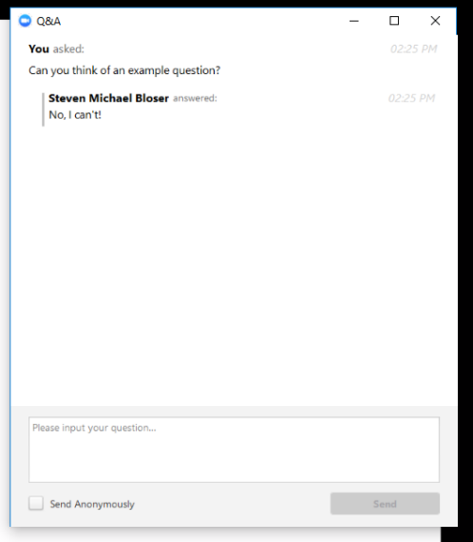
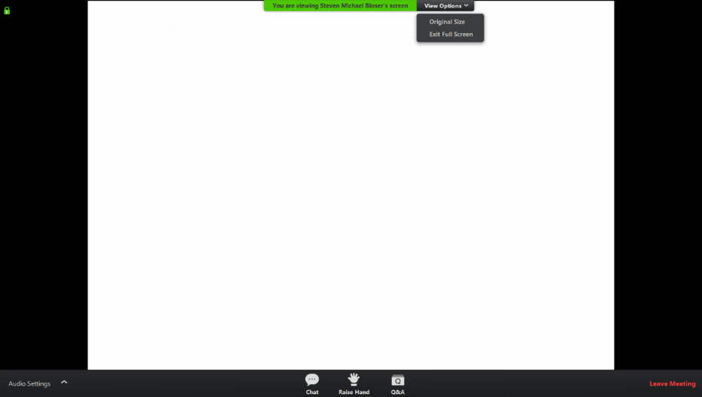
Q&A
Note you can ask a question anonymously
Q&A
For audio via phone: 312-626-6799
For technical assistance: 814-865-5355
Slide #

Slide 3
DGLVR Webinar
Quarterly Reporting and Replenishment Updates
Visual Updates
Unreported Replenishments
ACH Changes
Receipt Invoice Uploader
For audio via phone: 312-626-6799
For technical assistance: 814-865-5355

Slide 4
DGLVR Webinar
Quarterly Reporting and Replenishment Updates: Visual Updates
Purpose:
Rearranged some buttons accessible to District Manager’s
Smaller monitors did not allow for all buttons to show
For audio via phone: 312-626-6799
For technical assistance: 814-865-5355

Slide 5
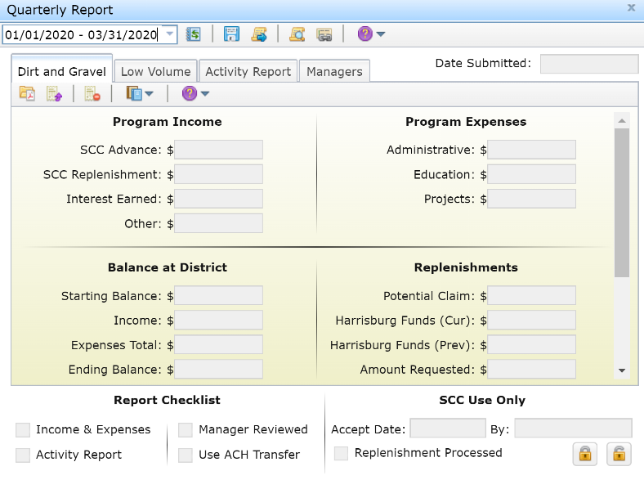
QR & Replenishment Updates: Visual Updates
For audio via phone: 312-626-6799
For technical assistance: 814-865-5355

Slide 6
DGLVR Webinar
Quarterly Reporting and Replenishment Updates: Unreported Replenishments
Purpose:
Enables the Districts to determine if they have missed reporting any SCC Replenishment income.
Misreporting of income has led to confusion pertaining to:
Accurate Program balances
Misleading Uncommitted balances
For audio via phone: 312-626-6799
For technical assistance: 814-865-5355

Slide 7
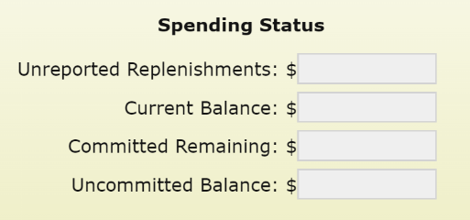
QR & Replenishment Updates: Unreported Replenishments
Unreported Replenishments = Sum of ALL SCC Replenishments scheduled to be received from previous quarters for a given Program. Does not include the currently active quarter.
Automatically reduced when entering SCC Replenishment Income.
Will prevent accidental over stating of SCC Replenishment Income.
Will allow for more accurate representation of Uncommitted Balance.
Uncommitted Balance = Current Balance – Committed Remaining
Current Balance = Ending Balance + Remaining Harrisburg Money + Unreported Replenishments
For audio via phone: 312-626-6799
For technical assistance: 814-865-5355

Slide 8
QR & Replenishment Updates: Unreported Replenishments
What should I do if I have unreported replenishments?
Compare to last quarter. Likely they will be same.
If different, look at previous quarters to determined the missed replenishment(s).
Verify that the missed replenishments have been deposited and transferred into the correct Program account.
If having trouble with 1-3, call Ken for help.
For audio via phone: 312-626-6799
For technical assistance: 814-865-5355

Slide 9
DGLVR Webinar
Quarterly Reporting and Replenishment Updates: ACH Changes
Purpose:
To eliminate issues with invalid ACH Bank Account information.
To reflect what Treasury now recommends with submitted replenishment requests
Actual Bank Account Information - NO
Assigned Bank Partner Number - YES
For audio via phone: 312-626-6799
For technical assistance: 814-865-5355

Slide 10
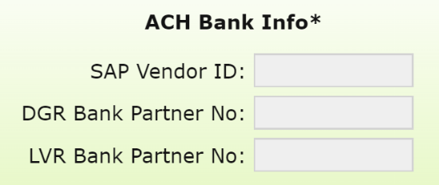
QR & Replenishment Updates: ACH Changes
Bank Partner Numbers
Replaces Bank Account/Key
Tied to District’s SAP Vendor ID
Will appear on Replenishment Form when “Use ACH Transfer” is selected
Are not editable locally.
Contact Vendor Services to obtain a new one.
Must contact Roy to request change of one shown.
For audio via phone: 312-626-6799
For technical assistance: 814-865-5355

Slide 11
QR & Replenishment Updates: Unreported Replenishments
What should I do to prepare for the July-September quarter?
If you have ACH implemented :
Verify that the Bank Partner Numbers are correct.
If not, contact Roy and provide him with the correct information.
We will update the GIS once verified.
If you do not have ACH implemented:
Contact Vendor Services to set up your account.
Contact Roy once Vendor Services has activated your account.
We will update the GIS once verified.
For audio via phone: 312-626-6799
For technical assistance: 814-865-5355

Slide 12
DGLVR Webinar
Quarterly Reporting and Replenishment Updates: Receipt Invoice Uploader
Purpose:
To help eliminate possible delays with District’s replenishment requests.
Allows Districts to attach expense documentation to the replenishment request
These tools only available to users with the District Manager or Financial roles
For audio via phone: 312-626-6799
For technical assistance: 814-865-5355

Slide 13
DGLVR Webinar
Quarterly Reporting and Replenishment Updates: Receipt Invoice Uploader
THIS IS COMPLETELY OPTIONAL!!
For audio via phone: 312-626-6799
For technical assistance: 814-865-5355

Slide 14
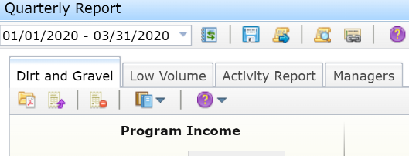
QR & Replenishment Updates: Receipt Invoice Uploader
To Use the Uploader
Click the Browse Receipt Invoice button and browse for the appropriate pdf.
Once uploaded, you can verify the file name by hovering the mouse over the Browse Receipt Invoice button.
Click the Upload Receipt Invoice button. You’ll receive confirmation upon successful upload.
To remove an uploaded receipt invoice, click the Delete Receipt Invoice button.
Click the View Replenishment button to view the receipt invoices with the replenishment request.
For audio via phone: 312-626-6799
For technical assistance: 814-865-5355

Slide 15
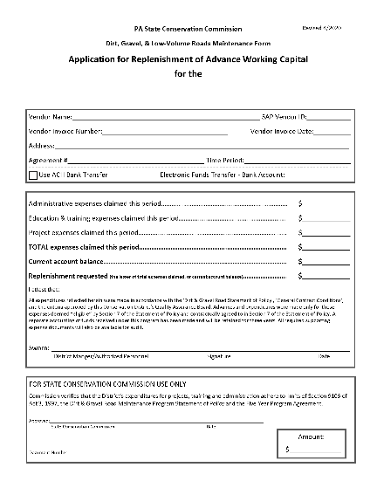
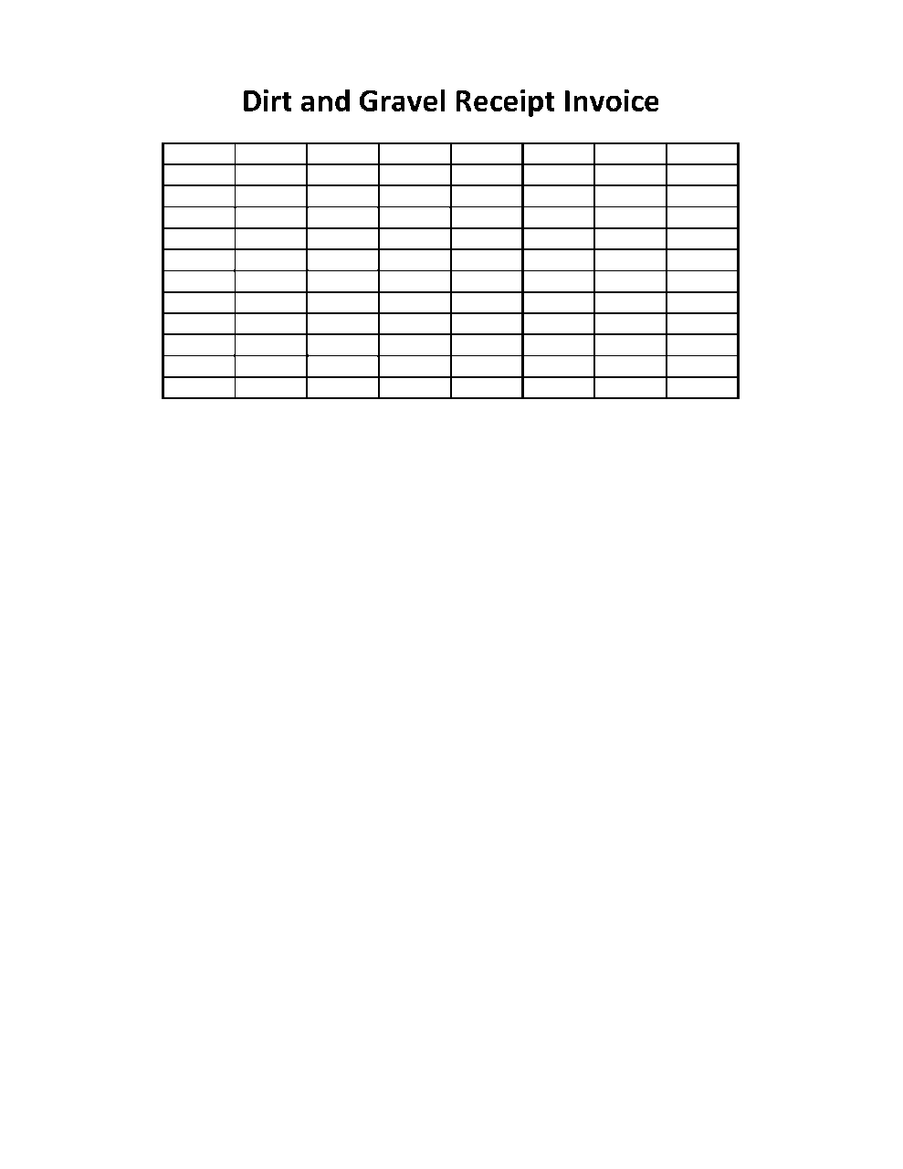
QR & Replenishment Updates: Receipt Invoice Uploader
For audio via phone: 312-626-6799
For technical assistance: 814-865-5355

