Slide 1
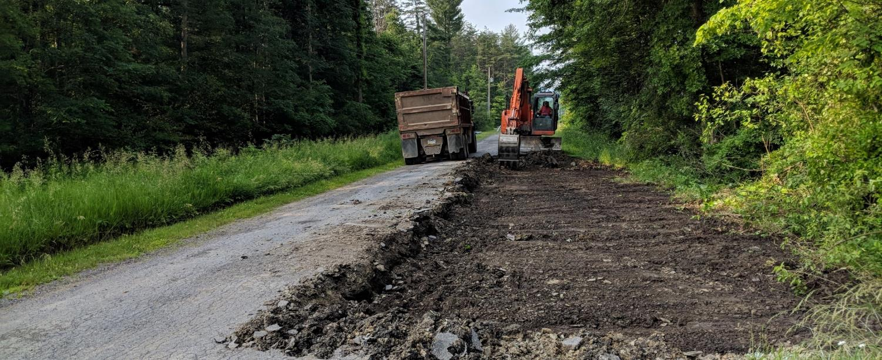
Dirt, Gravel, and Low-Volume Roads
“Old” Money Spending Overview
Tips and Tricks for meeting the June 30, 2019 Spending Deadline
2/12/2019
Roy Richardson - State Conservation Commission
Ken Corradini - PSU Center for Dirt and
Gravel Road Studies
Huntingdon County
2018 project

Slide 2
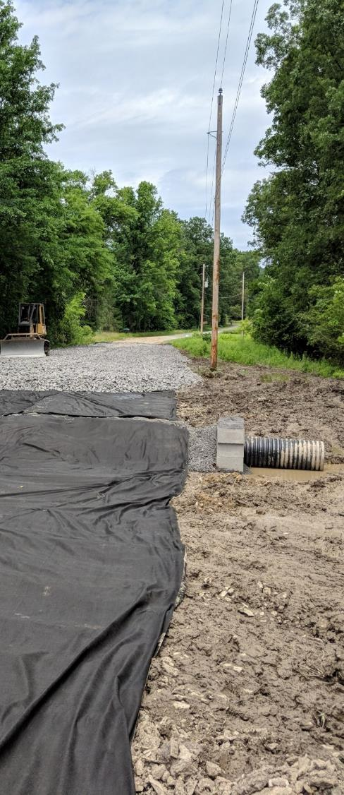
“Old” Money Spending Overview
2/12/2019
Financial Reporting Update
ASR vs “Old” Money Spending
5-year Contracts and Funds
Spending Your “Old” Money
Upcoming Calls – How to Prepare
Huntingdon County
2018 project

Slide 3
“Old” Money Spending Overview
Financial Reporting Update
2018 Annual Reporting
  Was due Jan 22nd, complete as of Jan 25th
  Full details later (presented and in print)
In Addition: as of 2/11/19
  $35.5M currently under contract
    $10.5M spent on active contracts
    $25M contracted but not spent

Slide 4
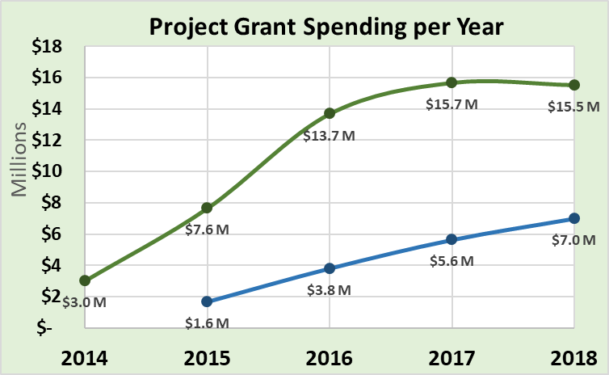
“Old” Money Spending Overview
Financial Reporting Update
2018 Annual Reporting
  Was due Jan 22nd, complete as of Jan 25th
  Full details later (presented and in print)
Likely Spending Equilibrium
DnG
LVR

Slide 5
“Old” Money Spending Overview
Financial Reporting Update
2018 Annual Reporting
  Was due Jan 22nd, complete as of Jan 25th
  Full details later (presented and in print)
Remaining “old money” to be spent
Likely Spending Equilibrium
DnG
LVR

Slide 6
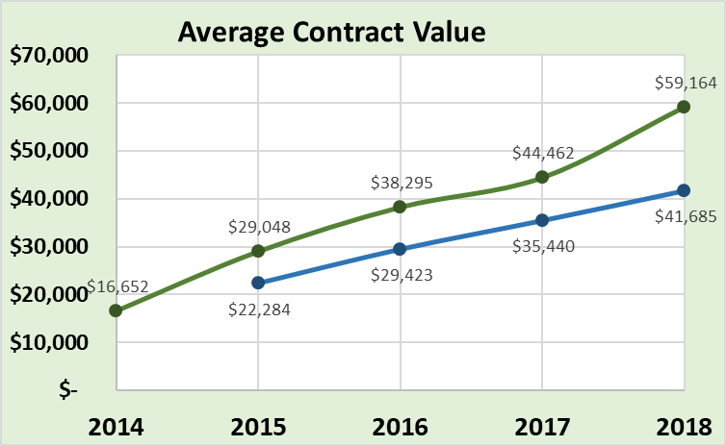
“Old” Money Spending Overview
Financial Reporting Update
2018 Annual Reporting
  Was due Jan 22nd, complete as of Jan 25th
  Full details later (presented and in print)
DnG
LVR

Slide 7
“Old” Money Spending Overview
Financial Reporting Update
Quarterly Reporting
  Second Quarterly report for Oct-Dec due 1/15/19.
  All reports in by 1/25/19

Slide 8
“Old” Money Spending Overview
Financial Reporting Update
Quarterly Reporting
  Replenishments:
    Now automatically generated based on spending
    All 65 already being processed
    FY 2018-19 allocations:
      $26M allocated to CDs
      $13M advanced to CDs
      $11.1M of $13M already claimed in replenishment
      $1.9M remaining in Harrisburg

Slide 9
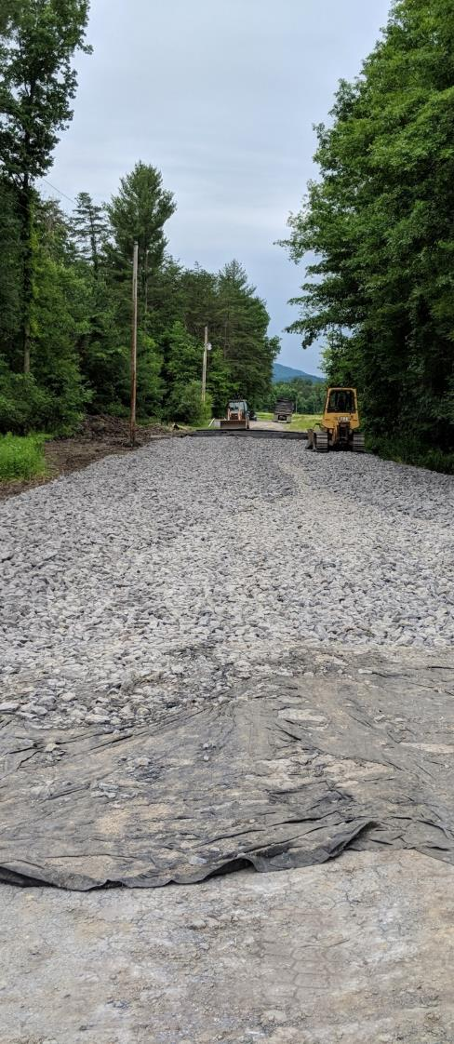
“Old” Money Spending Overview
2/12/2019
Financial Reporting Update
ASR vs “Old” Money Spending
5-year Contracts and Funds
Spending Your “Old” Money
Upcoming Calls – How to Prepare
Huntingdon County
2018 project

Slide 10
“Old” Money Spending Overview
ASR vs “Old” Money Spending
Annual Summary Report Spending Difference VS Previous 5-Year Balance Remaining?
In a Normal Year:
CDs have 2 years to spend funds to be eligible for next FY allocations
Spending Requirement does not include two most recent allocation Fiscal Year’s
  FY 17/18 not included
CD Status reflected in GIS “ASR Overview”:
  Green = OK
  Red = Short of spending
From Annual Report

Slide 11
“Old” Money Spending Overview
ASR vs “Old” Money Spending
Annual Summary Report Spending Difference VS Previous 5-Year Balance Remaining?
This Year Only: Green/Red Status does not matter!
Why?
Since old 5-year contract funds must be spent by June 30, 2019, that requirement is actually more strict than the traditional green/red for 2-year spending.
So what does matter?
In a Normal Year:
CDs have 2 years to spend funds to be eligible for next FY allocations
CD Status reflected in GIS “ASR Overview”:
  Green = OK
  Red = Short of spending

Slide 12
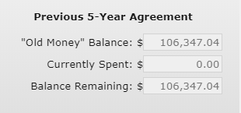
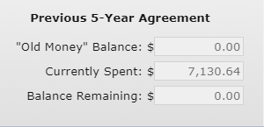
“Old” Money Spending Overview
ASR vs “Old” Money Spending
Annual Summary Report Spending Difference VS Previous 5-Year Balance Remaining?
This Year:
Must “zero out” balance remaining in old 5-year contract funds
Balance Remaining includes FY 17/18
Don’t forget to check BOTH DnG and LVR – tracked separately!
From Quarterly Report
County A: still $106 left to spend
County B: old money spent!

Slide 13
“Old” Money Spending Overview
ASR vs “Old” Money Spending
Take Home
Be concerned with ONLY the Previous 5-Year Balance Remaining!!!!!
This is the only balance that includes FY 17/18!
Through June 30, 2019, IGNORE the ASR Spending Difference!!

Slide 14
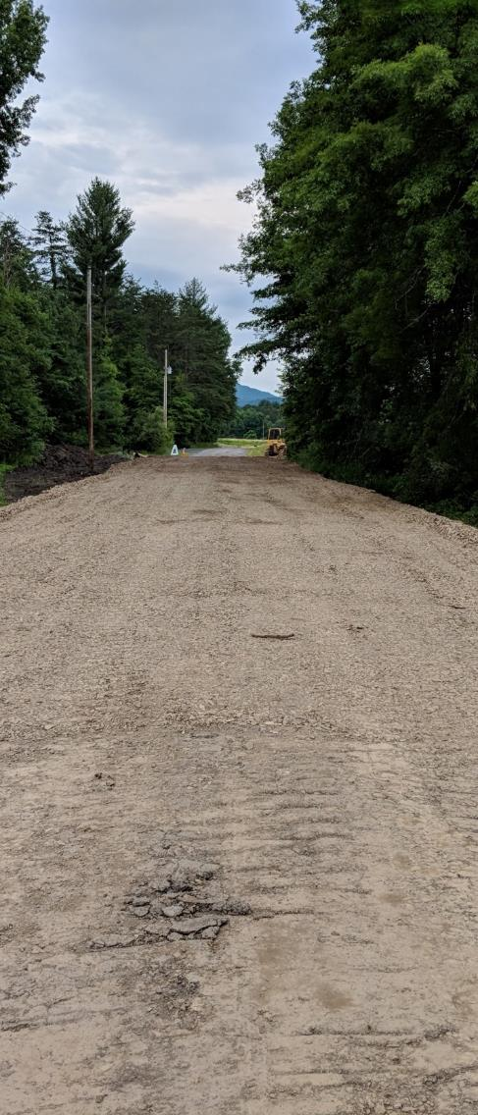
“Old” Money Spending Overview
2/12/2019
Financial Reporting Update
ASR vs “Old” Money Spending
5-year Contracts and Funds
Spending Your “Old” Money
Upcoming Calls – How to Prepare
Huntingdon County
2018 project

Slide 15
“Old” Money Spending Overview
5-year Contracts and Funds
Summary
  Funding moves from SCC to CDs via 5-year contract
  Currently year one of new contract (FY 19/20 – 23/24)
  Old 5-year contract ended 6/30/18
  Comptroller allowed 1-year extension to spend funds through 6/30/19
  CDs must spend funds from old contract, (FY 17-18 allocations and earlier), by 6/30/19.

Slide 16
“Old” Money Spending Overview
5-year Contracts and Funds
In Addition: as of 2/11/19
  $35.5M currently under contract
    $10.5M spent on active contracts
    $25M contracted but not spent
    Of the $25M contracted, $15.9M is old money to be spent by 6/30/19
    Going to be a very busy spring!

Slide 17
“Old” Money Spending Overview
5-year Contracts and Funds
County Spending Status 2/11/19
  Counties currently spent out of old contract
  Counties with all old money committed, left to spend
  Counties with old money left to commit and spend
  Counties with old money left in Harrisburg

Slide 18
“Old” Money Spending Overview
5-year Contracts and Funds
County Spending Status 2/11/19
  Counties currently spent out of old contract
    8 DnG
    8 LVR
DnG
Allegheny
Armstrong
Cumberland
Erie
Fayette
Snyder
Venango
Westmoreland
LVR
Armstrong
Berks
Clarion
Elk
Perry
Snyder
Somerset
Venango

Slide 19
“Old” Money Spending Overview
5-year Contracts and Funds
Examples:
  Counties currently spent out of old contract

Slide 20
“Old” Money Spending Overview
5-year Contracts and Funds
Examples:
  Counties currently spent out of old contract

Slide 21
“Old” Money Spending Overview
5-year Contracts and Funds
County Spending Status 2/11/19
  Counties currently spent out of old contract
    8 DnG
    8 LVR
  Counties with all old money committed, left to spend
    30 DnG
    27 LVR

Slide 22
“Old” Money Spending Overview
5-year Contracts and Funds
Examples:
  Counties with all old money committed, left to spend

Slide 23
“Old” Money Spending Overview
5-year Contracts and Funds
Examples:
  Counties with all old money committed, left to spend

Slide 24
“Old” Money Spending Overview
5-year Contracts and Funds
County Spending Status 2/11/19
  Counties currently spent out of old contract
    8 DnG
    8 LVR
  Counties with all old money committed, left to spend
    30 DnG
    27 LVR
  Counties with old money left to commit and spend
    27 DnG
    30 LVR

Slide 25
“Old” Money Spending Overview
5-year Contracts and Funds
Examples:
  Counties with old money left to commit and spend

Slide 26
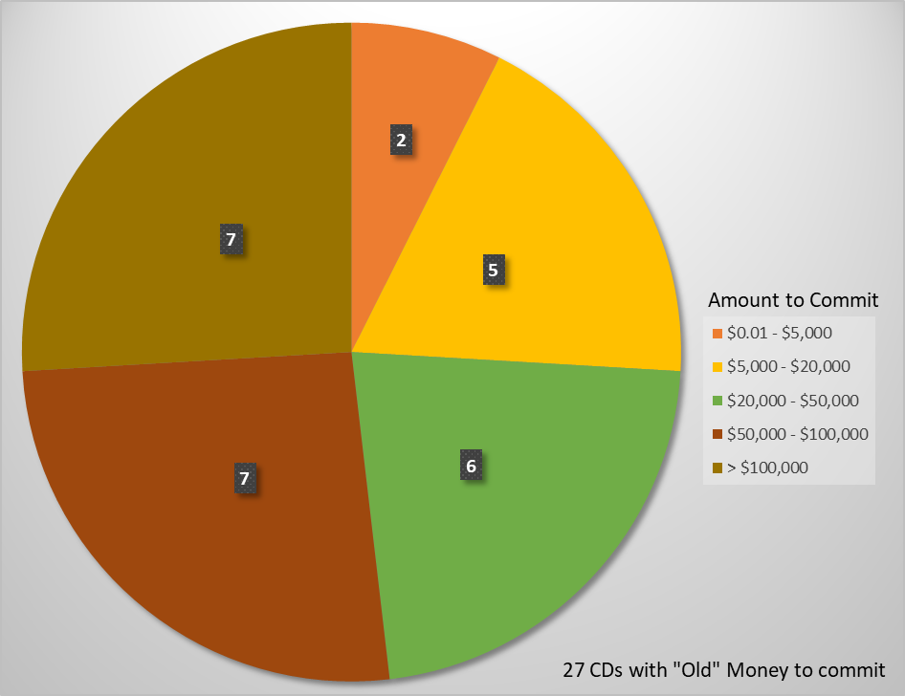
“Old” Money Spending Overview
5-year Contracts and Funds
Examples:
  Counties with old money left to commit and spend
  Dirt and Gravel

Slide 27
“Old” Money Spending Overview
5-year Contracts and Funds
Examples:
  Counties with old money left to commit and spend

Slide 28
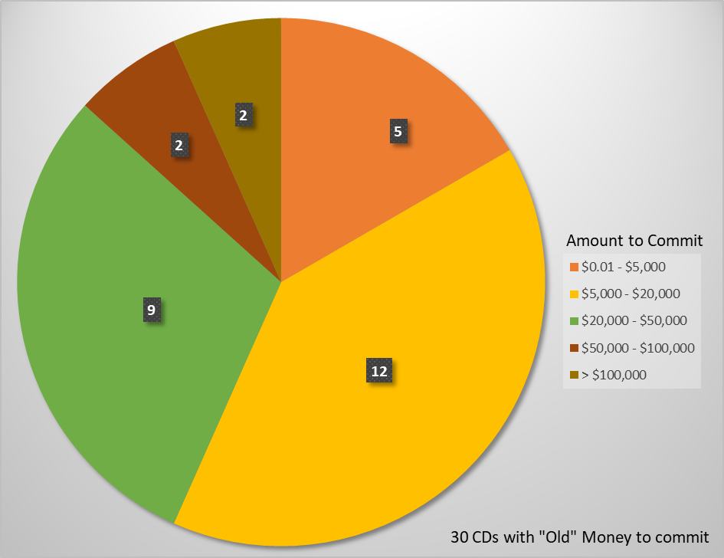
“Old” Money Spending Overview
5-year Contracts and Funds
Examples:
  Counties with old money left to commit and spend
  Low Volume

Slide 29
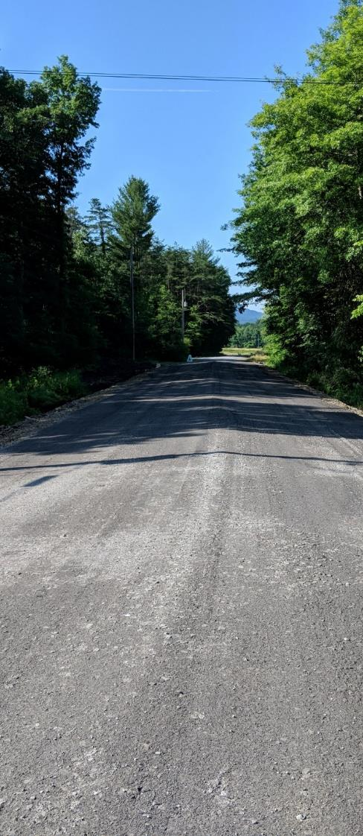
“Old” Money Spending Overview
2/12/2019
Financial Reporting Update
ASR vs “Old” Money Spending
5-year Contracts and Funds
Spending Your “Old” Money
Upcoming Calls – How to Prepare
Huntingdon County
2018 project

Slide 30
“Old” Money Spending Overview
Spending Your “Old” Money
Counties have 5 months
remaining to spend funding!!
    Some districts are asking about the possibility of an extension. Remember -- we are already working in a one year extension.

Slide 31
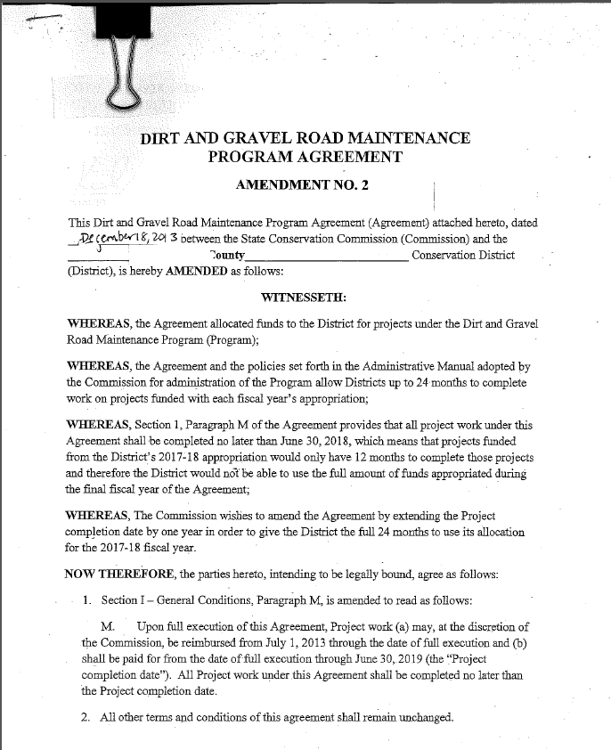
“Old” Money Spending Overview
Spending Your “Old” Money

Slide 32
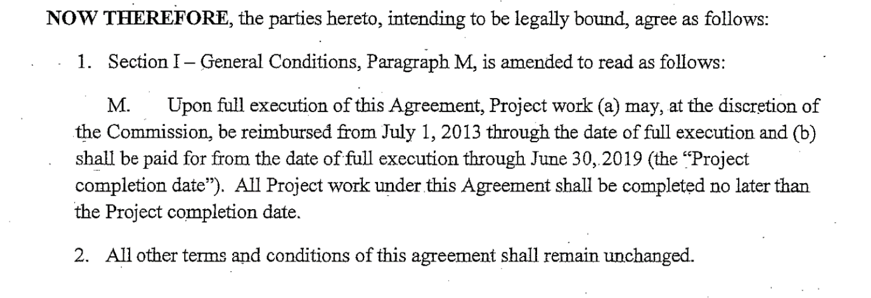
“Old” Money Spending Overview
Spending Your “Old” Money

Slide 33
“Old” Money Spending Overview
Spending Your “Old” Money
  Current Workgroup Thoughts:
  Counties with unspent old funds
    Reduce 2019-20 allocation by amount of unspent funds
  Counties with uncommitted old funds
    Not Eligible for FY 2019-20 allocations
    Exceptions may be granted
    Recommendation to be provided at future meeting

Slide 34
“Old” Money Spending Overview
Spending Your “Old” Money
Scenario 1
I have all my “Old” Money committed to active contracts. Am I ok?

Slide 35
“Old” Money Spending Overview
Spending Your “Old” Money
Scenario 1
I have all my “Old” Money committed to active contracts. Am I ok?
MAYBE

Slide 36
“Old” Money Spending Overview
Spending Your “Old” Money
Scenario 1: Potential Problem #1
Do you have all your eggs in one basket?
Example
1 large contract. If contract fails to be completed by June 30 or comes in under budget, no other options to spend the “Old Money”.

Slide 37
“Old” Money Spending Overview
Spending Your “Old” Money
Scenario 1: Potential Problem #1
Do you have all your eggs in one basket?
  Potential Solutions
  Enter into a new agreement with available funds and advance funds.
  Refine cost estimate for the large project and if it is much less than the original estimate, redo the contract to free up the overage. This overage can then be used to find new contracts.

Slide 38
“Old” Money Spending Overview
Spending Your “Old” Money
Scenario 1: Potential Problem #2
Of the projects currently under contract, will they be completed by June 30?
Examples
A single municipality with multiple contracts. Will they be able to complete all the projects by June 30?
Several contracts waiting on permits? Will they arrive in time for construction to begin and projects to complete by June 30?

Slide 39
“Old” Money Spending Overview
Spending Your “Old” Money
Scenario 1: Potential Problem #2
Of the projects currently under contract, will they be completed by June 30?
  Potential Solutions
  Work with engineers and DEP to determine the status of the permits.
  If possible, phase contract into multiple contracts.
Example
Your existing contract calls for a permit-required stream crossing and drainage work on a mile long road. Phase project into two contracts. Phase 1: drainage work requiring no permit, which can begin immediately. Phase 2: permit-required stream crossing.

Slide 40
“Old” Money Spending Overview
Spending Your “Old” Money
Scenario 1: Potential Problem #2
Of the projects currently under contract, will they be completed by June 30?
  Potential Solutions
  For projects that definitely will not be completed by June 30, consider delaying contracts until the next advance is received. This will free up money to find additional contracts that will be able to be completed by the June 30 deadline.

Slide 41
“Old” Money Spending Overview
Spending Your “Old” Money
Scenario 2
I still have “Old” Money to commit to projects. What can I do?
  Potential Solutions
  Work with the Center staff to assist in finding potential projects.
  Get together with municipalities (i.e., a breakfast, “municipality day”, etc.) to discuss the urgency to find and apply for projects.

Slide 42
“Old” Money Spending Overview
Spending Your “Old” Money
Scenario 2
I still have “Old” Money to commit to projects. What can I do?
  Potential Solutions cont…
  Consider immediately opening up the application period.
  Consider expediting the application approval process via discussions with your CD Board and QAB.

Slide 43
“Old” Money Spending Overview
Spending Your “Old” Money
Ways to Move Money through the system
Consider giving advances for existing contracts
  Many CDs typically give %50
Consider spending administrative and education funds
  Must stay within your 10% max for both administrative and education expenses
  Must be an approved expense as noted in the DGLVR Administrative Manual
  Must be actual expenses with receipts

Slide 44
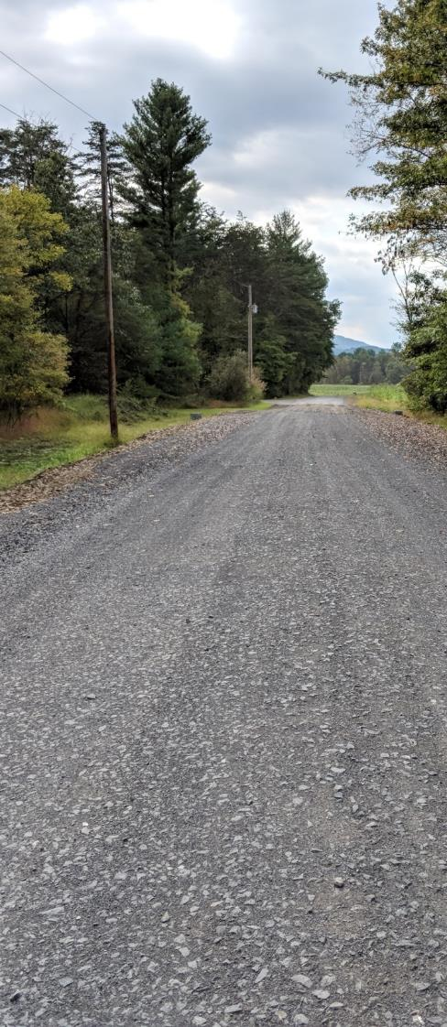
“Old” Money Spending Overview
2/12/2019
Financial Reporting Update
ASR vs “Old” Money Spending
5-year Contracts and Funds
Spending Your “Old” Money
Upcoming Calls – How to Prepare
Huntingdon County
2018 project

Slide 45
“Old” Money Spending Overview
Upcoming Calls - How to Prepare
Calls will review current status for your county
Will Focus on (for both DGR and LVR):
  Previous 5-Year Agreement Balance Remaining
  Committed Remaining Balance
    Amount of money remaining committed to active contracts
    i.e., An $100,000 project with a $40,000 advance has a committed remaining balance of $60,000
  Uncommitted Balance
    Amount of money available to spend on new contracts, admin, and education.
  Review projects and logistics
    Will the projects currently under contract be completed by June 30?
    How can we help you suggest ways to spend your “Old” money?

Slide 46
“Old” Money Spending Overview
Upcoming Calls - How to Prepare
What do you need to do prior to our call?
Keep the GIS Current (for both DGR and LVR):
  Enter all contracts
  Enter all payments
  Enter actual administrative and education expenses, if known (i.e., update the current QR with as much info as possible)
Will allow for an accurate snapshot of your Previous 5-Year Agreement remaining balance.

Slide 47
“Old” Money Spending Overview
Upcoming Calls - How to Prepare
What do you need to do prior to our call?
Have a good understanding of the current status of your active contracts.
  Are they “shovel ready”?
  Are they waiting on permits? If so, can they be phased?
  Will they be completed by June 30?
The current status of future potential contracts.

Slide 48
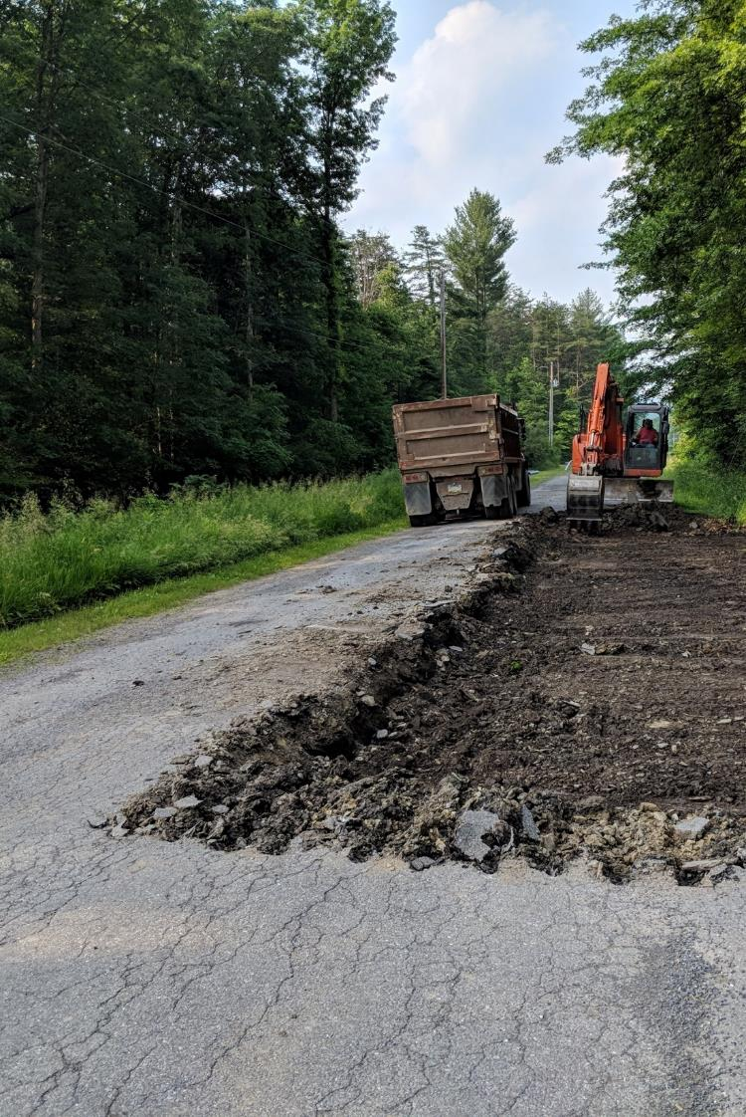
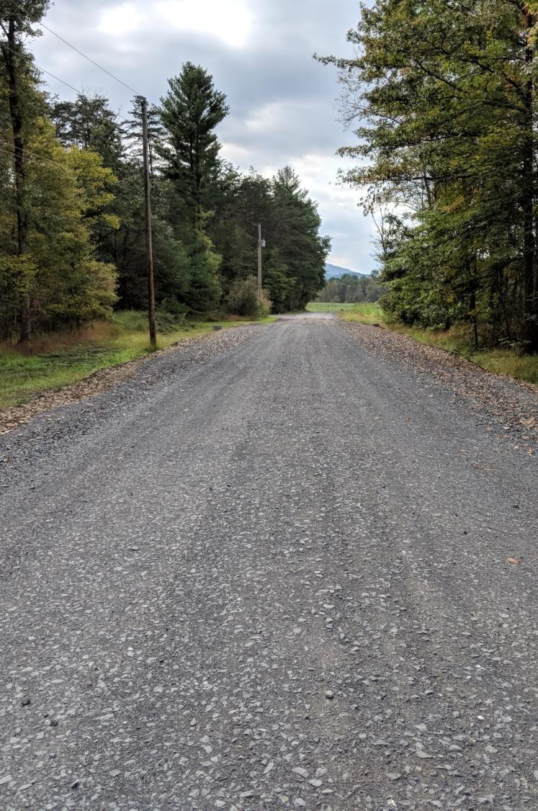
QUESTIONS?
BEFORE
Huntingdon County, 2018 project
AFTER

