Slide 1
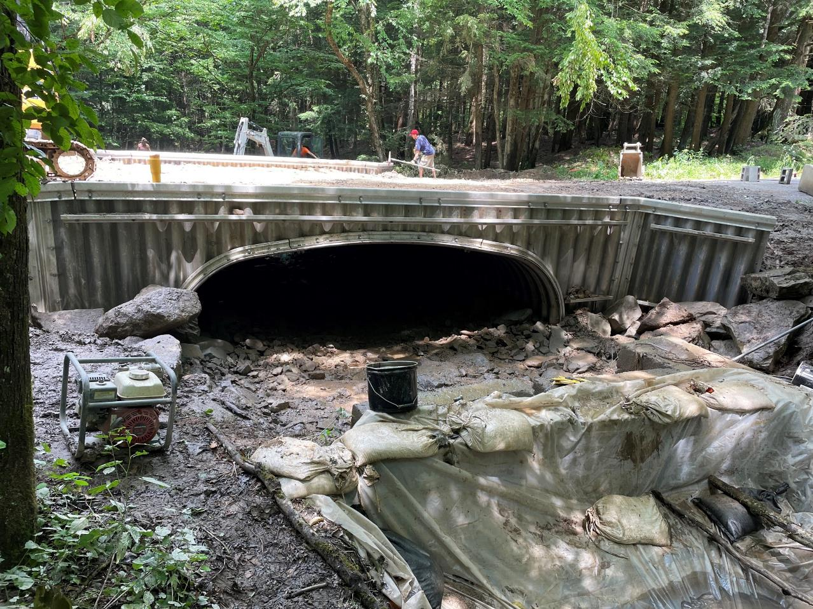
Dirt Gravel and Low Volume Road Program
WEBINAR
02/06/25, 9am
Stream Crossing Replacement
Site Prioritization
SCC
Andy Mickey
CDGRS
Shaun McAdams
PFBC
Clayton Good
If you are reading this, then you are successfully seeing the webinar video. Webinar audio should be automatic through your computer (or click “join audio”), and options can be accessed in the “audio options” button on the bottom left. If your computer audio is not working, you can listen on your phone by dialing 646-876-9923.

Slide 2
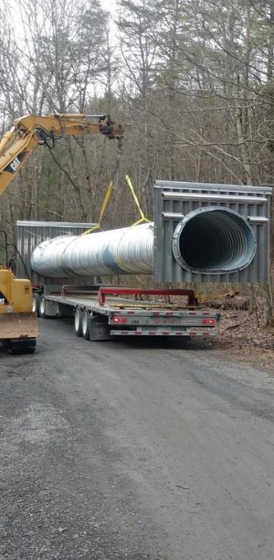
Stream Crossing Replacement
Site Prioritization
Background
Considerations for Prioritizing Stream Crossings
Criteria for Prioritizing Stream Crossings
Finding Priority Stream Crossings
Tools
Leveraging Additional Funding Sources

Slide 3
Background
Stream crossing replacements are costly, limiting the number of replacements each county can complete.
Conservation districts have shown interest in maximizing the benefits of crossing replacements (some crossings have greater environmental value than others).
There are various criteria that can be used to prioritize sites that provide the most benefit for the intended cause.
Can be beneficial for finding project sites and selecting between sites.
The information provided in this webinar is for your consideration when identifying and funding stream crossing replacements. They are not requirements.

Slide 4
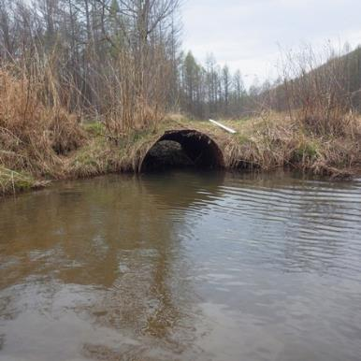
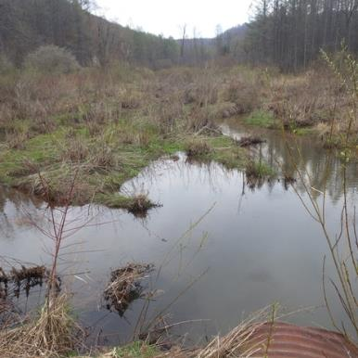
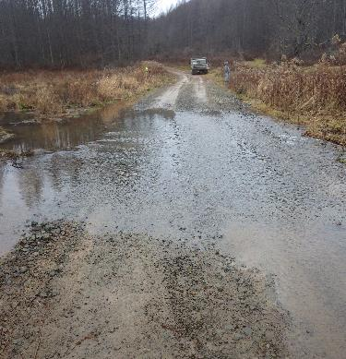
Background
There should be a focus on environmental issues, not so much general infrastructure replacement.
Structural and environmental issues.

Slide 5
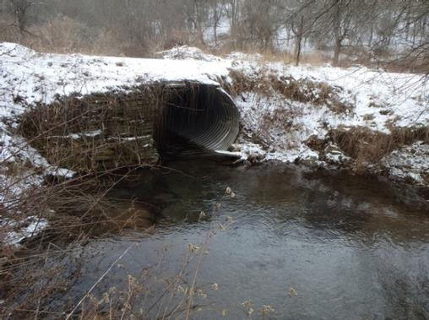
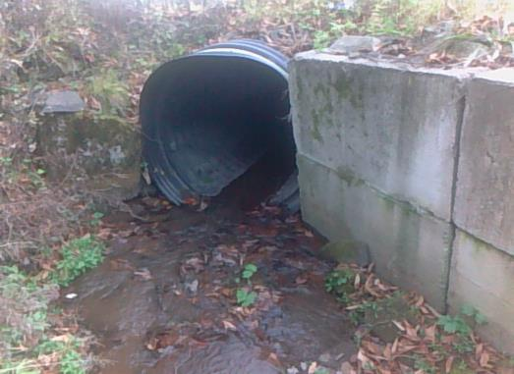
Background
Structurally sound with environmental issues.

Slide 6
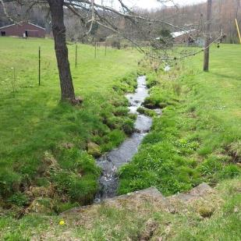
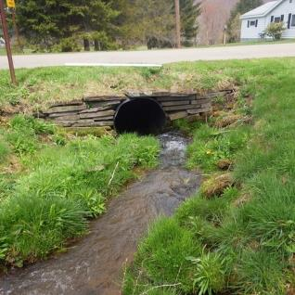
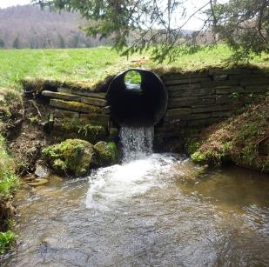
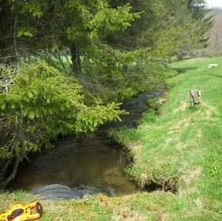
Background
Structurally sound with environmental issues.

Slide 7
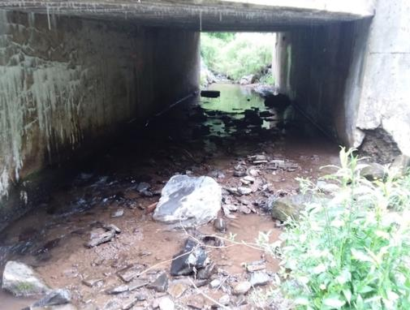
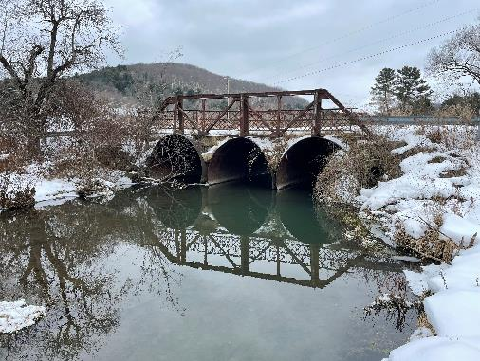
Background
Structural issues. Minimal environmental issues.

Slide 8
Stream Crossing Replacement
Site Prioritization
Background
Considerations for Prioritizing Stream Crossings
Criteria for Prioritizing Stream Crossings
Finding Priority Stream Crossings
Tools
Leveraging Additional Funding Sources

Slide 9
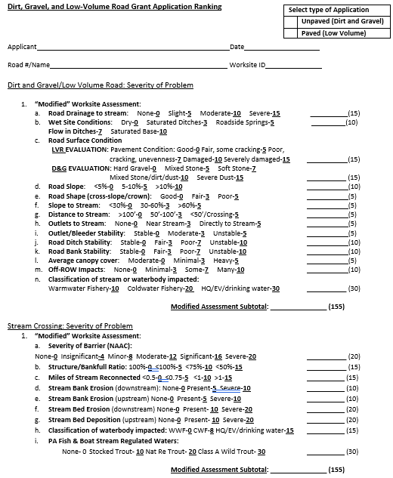
Considerations for Prioritizing Stream Crossings
An application deadline is imperative for being selective when funding projects. The prioritization approach is minimally effective if taking applications on a rolling basis.
There needs to be multiple stream crossing applications to prioritize against each other.
The local ranking criteria should be set up to inform the prioritization.
Districts can help steer potential applicants to the best sites.

Slide 10
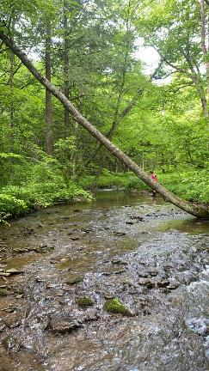
Considerations for Prioritizing Stream Crossings
Consider the environmental impact then consider the resources affected.
Are there negative effects resulting from the crossing?
What is the value of the resource affected? (Habitat Value)

Slide 11
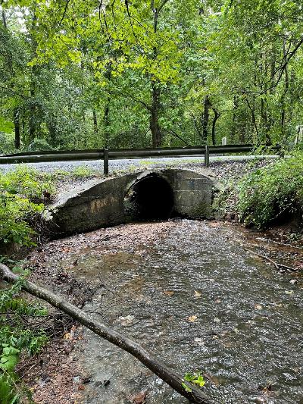
Considerations for Prioritizing Stream Crossings
Example
Lancaster County – Pumping Station Road
Walnut Run
1.6-mile-long wild trout stream and tributary to larger wild trout stream, Hammer Creek
AOP Barrier
Upstream Deposition
Downstream Scour
Failing Pipe
Stormwater Drainage Impacts
Reconnects >1.5 miles of stream (headwaters to mouth)

Slide 12
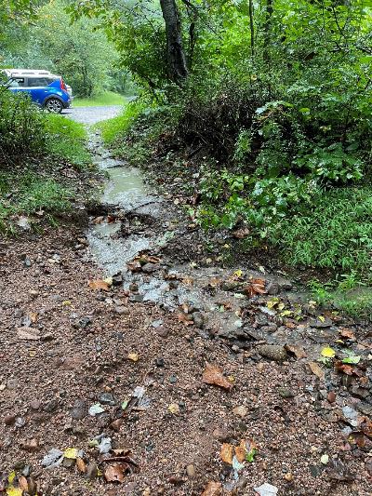
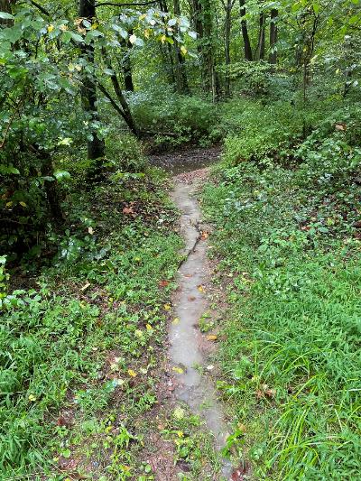
Considerations for Prioritizing Stream Crossings

Slide 13
Considerations for Prioritizing Stream Crossings
Does the site have issues outside the crossing?
Examples
Are there drainage impacts affecting the stream/stream crossing?
Does the project build upon other completed projects in the watershed?
Is the project necessary to the greater success of other locally completed projects?
Is the stream crossing replacement part of a phased project?

Slide 14
Stream Crossing Replacement
Site Prioritization
Background
Considerations for Prioritizing Stream Crossings
Criteria for Prioritizing Stream Crossings
Finding Priority Stream Crossings
Tools
Leveraging Additional Funding Sources

Slide 15
Criteria for Prioritizing Stream Crossings
Examples
Wild trout
Brook trout, Priority Brook trout watersheds
Other species of concern
Stream Designation (WWF->EV)
Culvert Barrier Severity (AOP-related)
Miles of Stream Reconnected
Constriction Severity (hydraulic conveyance, existing structure vs. bankfull)
Stream Channel Impact (bed/bank erosion, bed deposition, overtopping, etc.)
Landscape position (multiple roads cross the stream from headwaters to mouth)

Slide 16
Local Ranking Criteria Example
Severity of Barrier (NAAC): None: 0 Insignificant: 4 Minor: 8 Moderate: 12 Significant: 16 Severe: 20 _____(20)
Structure/Bankfull Ratio: 100%: 0 <100%: 5 <75%: 10 <50%: 15 _____ (15)
Miles of Stream Reconnected <0.5: 0 <0.75: 5 <1: 10 >1: 15 _____ (15)
Stream Bank Erosion (downstream): None: 0 Present: 5 Severe: 10 _____ (10)
Stream Bank Erosion (upstream) None: 0 Present: 5 Severe: 10 _____ (10)
Stream Bed Erosion (downstream) None: 0 Present: 10 Severe: 20 _____ (20)
Stream Bed Deposition (upstream) None: 0 Present: 10 Severe: 20 _____ (20)
PA DEP Stream Designation: WWF: 0 CWF: 8 HQ/EV/drinking water: 15 _____ (15)
PA Fish & Boat Stream Designation: None: 0 Stocked Trout: 10 Nat Re. Trout: 20 Class A Wild Trout: 30 _____ (30)
This criteria can be adjusted to suit each individual county’s needs. An updated example ranking criteria sheet will be available on the Center’s website shortly.

Slide 17
Stream Crossing Replacement
Site Prioritization
Background
Considerations for Prioritizing Stream Crossings
Criteria for Prioritizing Stream Crossings
Finding Priority Stream Crossings
Tools
Leveraging Additional Funding Sources

Slide 18
Finding Priority Stream Crossings
You can be proactive in finding high-priority crossings for your municipal partners.
A stream crossing in poor condition with significant environmental impact may not even be on the municipality’s radar.
Strengthens the municipality’s application and likelihood of funding
Many projects have been done where the district brought the project idea to the road owner.

Slide 19
Finding Priority Stream Crossings
Prioritizing only small crossings on small streams may not optimize environmental uplift and expense
Limited habitat value or environmental impact
May often be necessary as part of a larger project
It is a misconception that small streams make for easier crossing replacements
Steeper slopes
Vertical offset of the channel
Constructability issues

Slide 20
Finding Priority Stream Crossings
Be Upfront (Pre-Screening)
If a site has low environmental impact and is unlikely to be funded, let the municipality know and why.
Avoid the time for site assessment for projects that are unlikely to be funded.
Focus time for survey and material / cost estimating for projects that have a realistic chance of receiving funding.
Work with your municipalities to identify high-priority sites (be proactive)

Slide 21
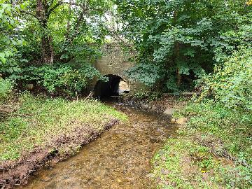
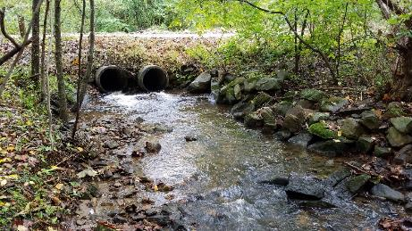
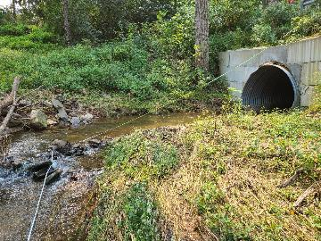
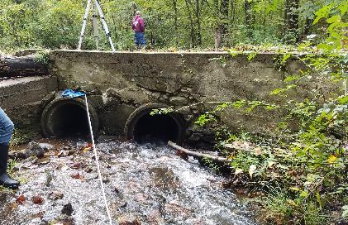
Finding Priority Stream Crossings

Slide 22
Stream Crossing Replacement
Site Prioritization
Background
Considerations for Prioritizing Stream Crossings
Criteria for Prioritizing Stream Crossings
Finding Priority Stream Crossings
Tools
Leveraging Additional Funding Sources

Slide 23
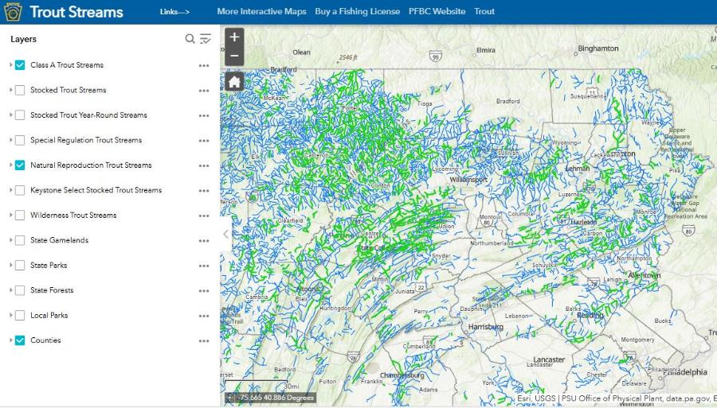
Tools (PFBC Interactive Trout Streams Map)
Trout Streams

Slide 24
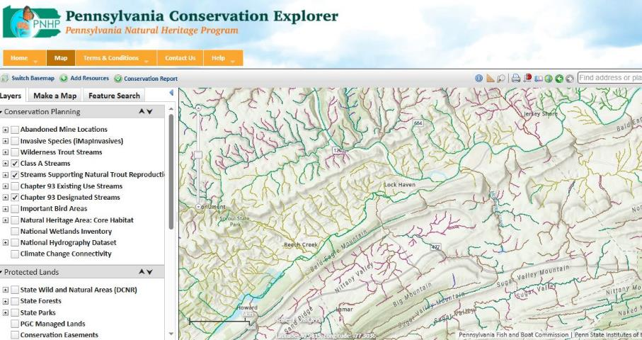
Tools (Conservation Explorer Map)
Map | PA Conservation Explorer

Slide 25
Tools (North Atlantic Connectivity Collaborative)
Also known as NAACC
Method for assessing culvert conditions and aquatic organism passage
Coarse index of barrier severity
Become familiar with the parameters NAACC uses to visually determine the severity of barrier, etc.
PFBC has staff and partners that can come survey an unassessed site.

Slide 26
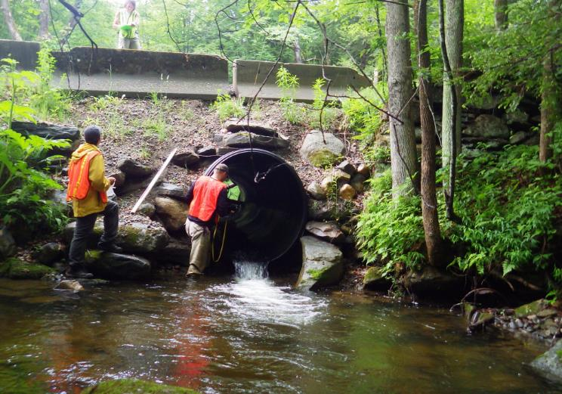
Tools (North Atlantic Connectivity Collaborative)
Bankfull width
Structure width
Substrate coverage
Vertical offsets
Water depth and velocity
Condition of structure

Slide 27
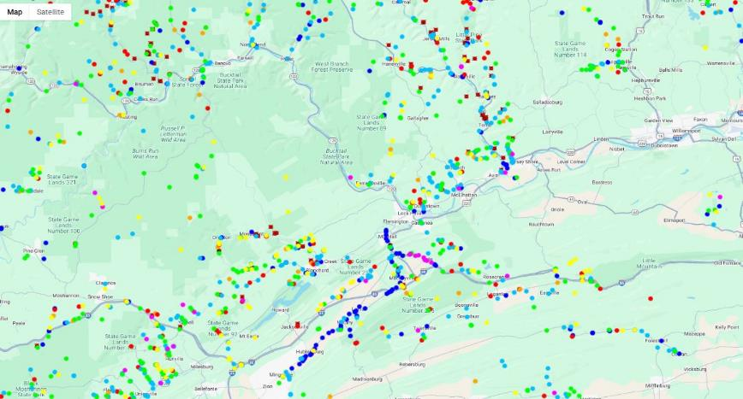
Tools (North Atlantic Connectivity Collaborative)
https://naacc.org/naacc_data_center_home.cfm

Slide 28
Tools (North Atlantic Connectivity Collaborative)
PFBC is working with several colleges to do NAACC surveys at unassessed crossings
Non-profits: TU and WPC
Dave Dippold: PFBC Fish Passage Biologist
ddippold@pa.gov
Clayton Good: PFBC Division of Environmental Services
Clgood@pa.gov

Slide 29
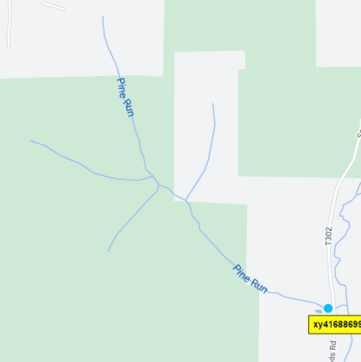
Tools (North Atlantic Connectivity Collaborative)
Perennial Stream
High-Quality Cold-Water Fishery
Wild Trout Stream (Class A candidate)
Only culvert on entire stream
Complete AOP barrier
Restores connectivity to 1.1 upstream miles
Reconnects stream from headwaters to mouth
Existing 3’ failing round pipe
9-foot average bankfull width

Slide 30
Tools (National Aquatic Barrier Inventory and Prioritization Tool)
https://aquaticbarriers.org/priority/small_barriers/

Slide 31
Stream Crossing Replacement
Site Prioritization
Background
Considerations for Prioritizing Stream Crossings
Criteria for Prioritizing Stream Crossings
Finding Priority Stream Crossings
Tools
Leveraging Additional Funding Sources

Slide 32
Leveraging Additional Funding Sources
The road owner may only be interested in the replacement if the district can provide total funding.
Some districts do not have the budget to complete stream crossing replacement projects with DGLVR Program funding alone.
There are opportunities to seek and utilize other grant funding sources to offset these costs.
To achieve more benefits, it may be important to replace additional stream crossings that the DGLVR Program cannot fund.

Slide 33
Potential Funding Sources
National Fish and Wildlife Foundation
DEP Growing Greener
DCNR C2P2
Coldwater Heritage Partnership
Eastern Brook Trout Joint Venture
Energy Companies
US Fish and Wildlife
Chesapeake WILD Program
Delaware Watershed Conservation Fund
Great Lakes Fish and Wildlife Restoration Act Grant Program
National Fish Passage Program

Slide 34
Stream Crossing Replacement
Site Prioritization
Questions?
SCC
Andy Mickey
anmickey@pa.gov
CDGRS
Shaun McAdams
spm140@psu.edu
PFBC
Clayton Good
clgood@pa.gov

