Slide 1
Dirt Gravel and Low Volume Road Program
WEBINAR
Stream Crossing Project Examples
Survey Results
ESM Trainings
Webinars
Longer Remote Trainings
Online training Center
Winter Tech Assists
2/11/21 Starts at 9am
If you are reading this, then you are successfully seeing the webinar video. Webinar audio should be automatic through your computer (or click “join audio”), and options can be accessed in the “audio options” button on the bottom left. If your computer audio is not working, you can listen on your phone by dialing 646-876-9923.

Slide 2
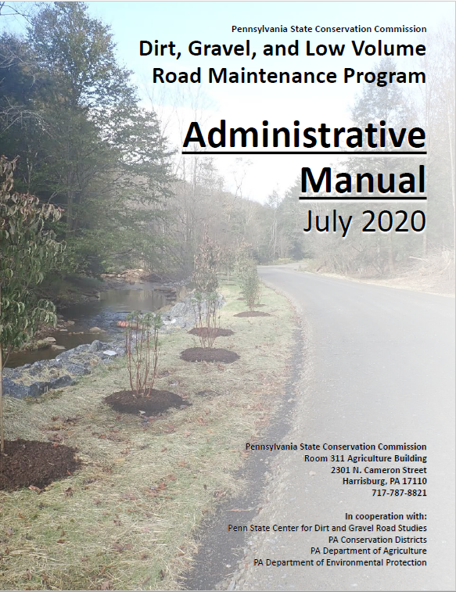
7 Additional Program Policies
Chap 7. Add. Policies
7.1 Stream Crossing Replacement Policy

Slide 3
7.1 Stream Crossings
Chap 7. Add. Policies
Stream crossings with existing structures OVER 12.5 ft² opening (4’diameter)
In order to be eligible for replacement, EXISTING structures must:
1. Have a structure to bankfull width ratio of 75 % or less.
2. Show signs of streambank erosion.
3. Show signs of streambed erosion/aggradation.
The NEW REPLACEMENT structure must (all four):
1. Have a structure width at least equal to bankfull width (100% ratio).
2. Be properly aligned with the channel.
3. Consider additional floodplain connectivity when possible.
4. Be designed and constructed to accommodate the passage of aquatic organisms through the structure.

Slide 4
7.1 Stream Crossings
Chap 7. Add. Policies
Stream crossings with existing structures UNDER 12.5 ft² opening (4’ diameter)
In order to be eligible for replacement, EXISTING structures must:
1. Have a structure to bankfull width ratio of 75% or less.
2. Show signs of streambank erosion.
3. Show signs of streambed erosion/aggradation.
The NEW REPLACEMENT structure must (all four):
1. Have a structure width at least equal to bankfull width (100% ratio).
2. Be properly aligned with the channel.
3. Consider additional floodplain connectivity when possible.
4. Be designed and constructed to accommodate the passage of aquatic organisms through the structure.

Slide 5
7.1 Stream Crossings
Chap 7. Add. Policies
Other policies that pertain to stream crossings
Round pipes over 36” are not permitted for use in DGLVR funded stream crossings.
Oval or squash pipes are acceptable
Structures that do not meet replacement criteria (as listed above) are not eligible for replacement with program funds. (materials, equipment, and labor)
Replacement structures must be single span openings. Multiple opening structures are not permitted
Existing crossings consisting of multiple “side by side” pipes are eligible for replacement regardless of bankfull width ratio

Slide 6
7.1 Stream Crossings
Chap 7. Add. Policies
Policy Application to small streams and Routine Maintenance
Stream crossing policy applied to situation where streams, including intermittent channels, with identified bed and banks are flowing into the road or uphill ditch. Contact the SCC in questionable circumstances. In order for policy exemptions of “questionable streams” channels, Districts must obtain written approval from the SCC prior to contracting the project.
The Program has never paid for “routine or regular maintenance” such as grading roads. Similarly, regular maintenance of stream crossing structures is not eligible for funding. This includes items such as culvert lining, extending undersized stream crossings, bridge deck repair, etc. that provide minimal environmental improvements.

Slide 7
Stream Crossing Project Examples
“The Good, The Bad, and The In-Between”
Project Site Visits from 2018-2020 QAQC’s

Slide 8
Projects that exceed expectations
“The Good”

Slide 9
What makes a good stream crossing?
Wider than bankfull width structure at the bankfull elevation
Low Flow Channel
Stable Bank Margins
Properly spaced grade controls & proper stream slope
Structure properly aligned with the channel
Considers floodplain connectivity
Hydraulic opening sufficient for at least the 100 year storm event
Sufficient structure height to accommodate waves of debris or bedload movement and constructability of streambed
Full Aquatic Organism passage (AOP)
Stream Continuity = items 1 through 9

Slide 10
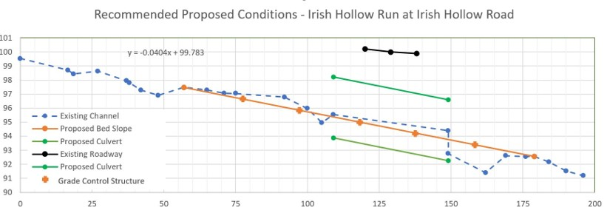
Example of a longitudinal profile showing new culvert and proposed streambed

Slide 12
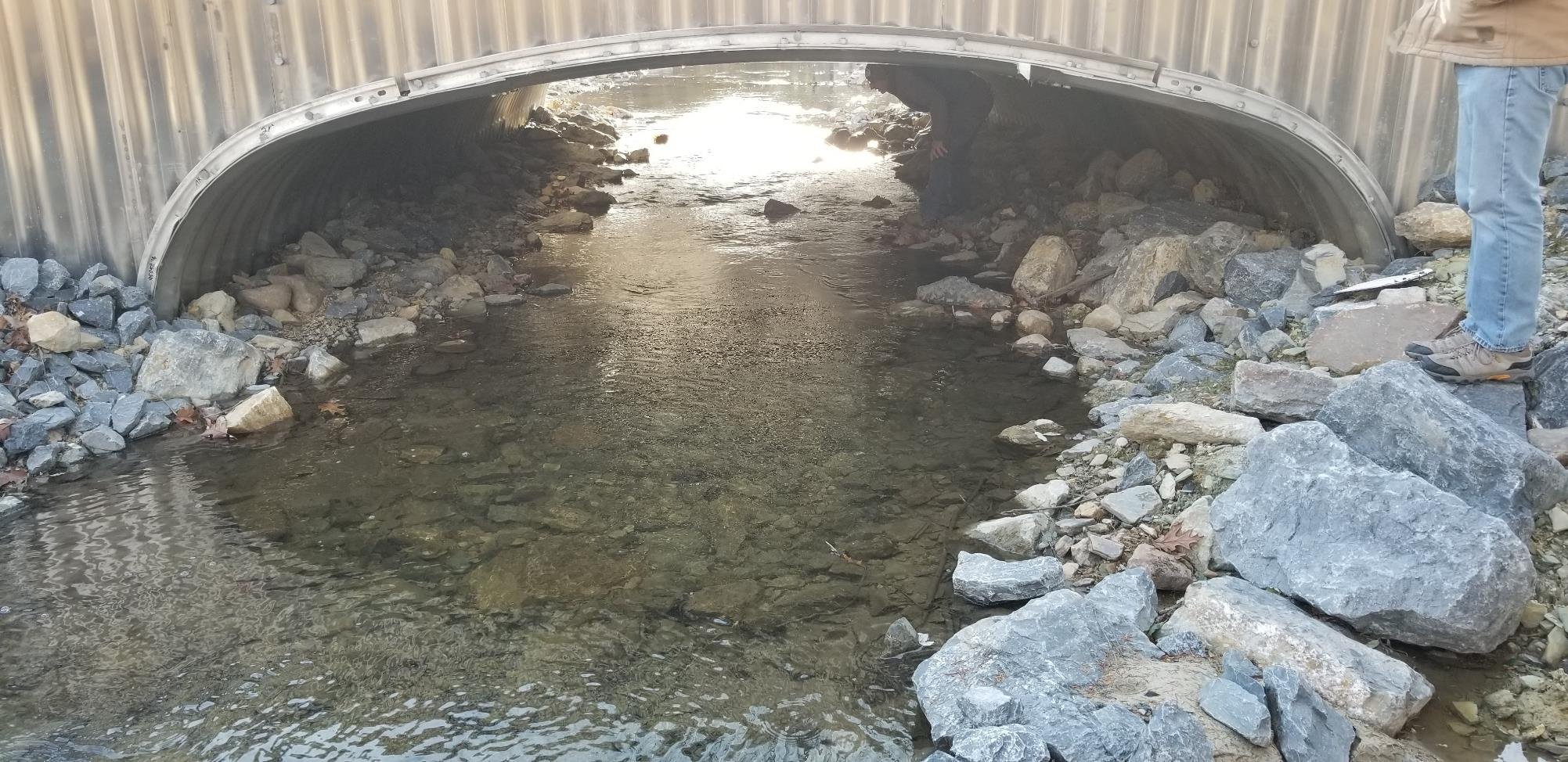
Greater than bankfull width structure with Full AOP
Over bankfull width Structure
@ the bankfull elevation
Structure properly aligned with channel
Stable Bank Margins
Low Flow Channel
Stable Streambed through structure, no bare metal showing,

Slide 13
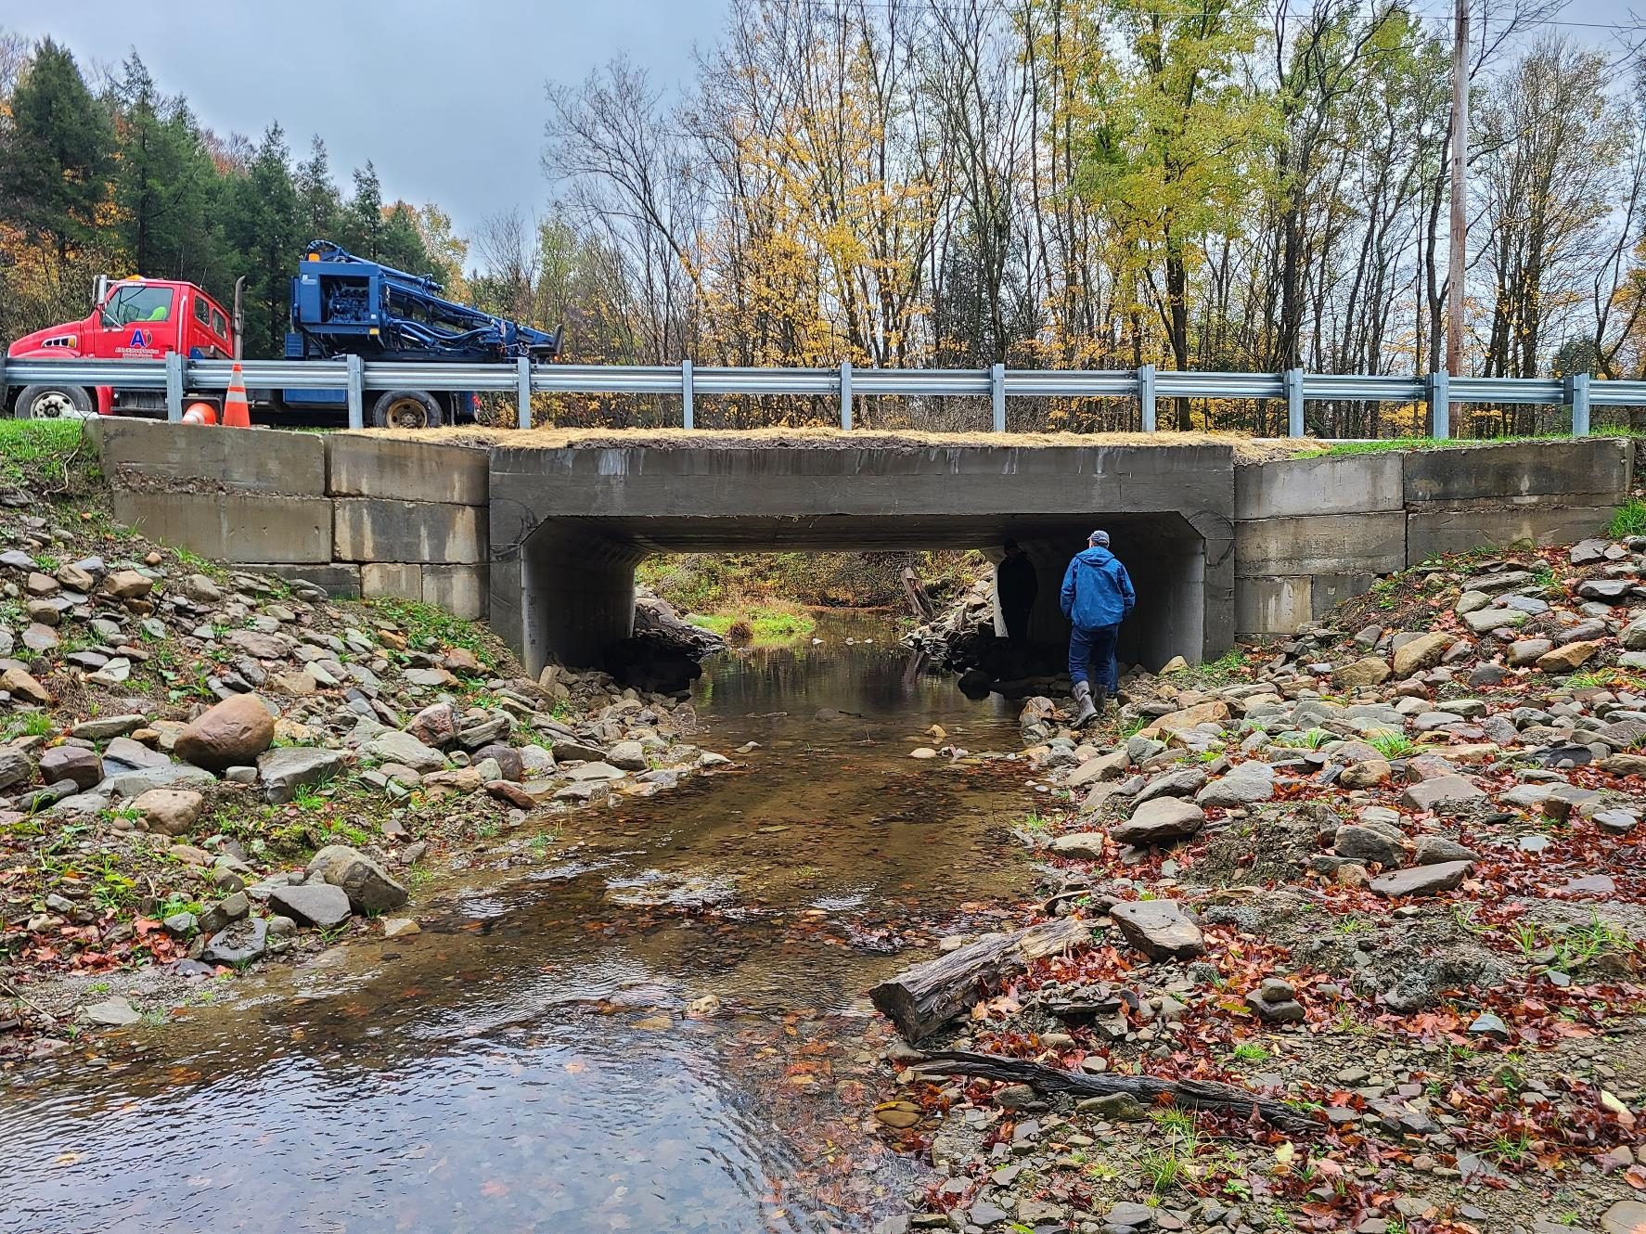
Greater than bankfull width structure with Full AOP
Stable Bank Margins
Low Flow Channel
Stable Streambed through structure

Slide 14
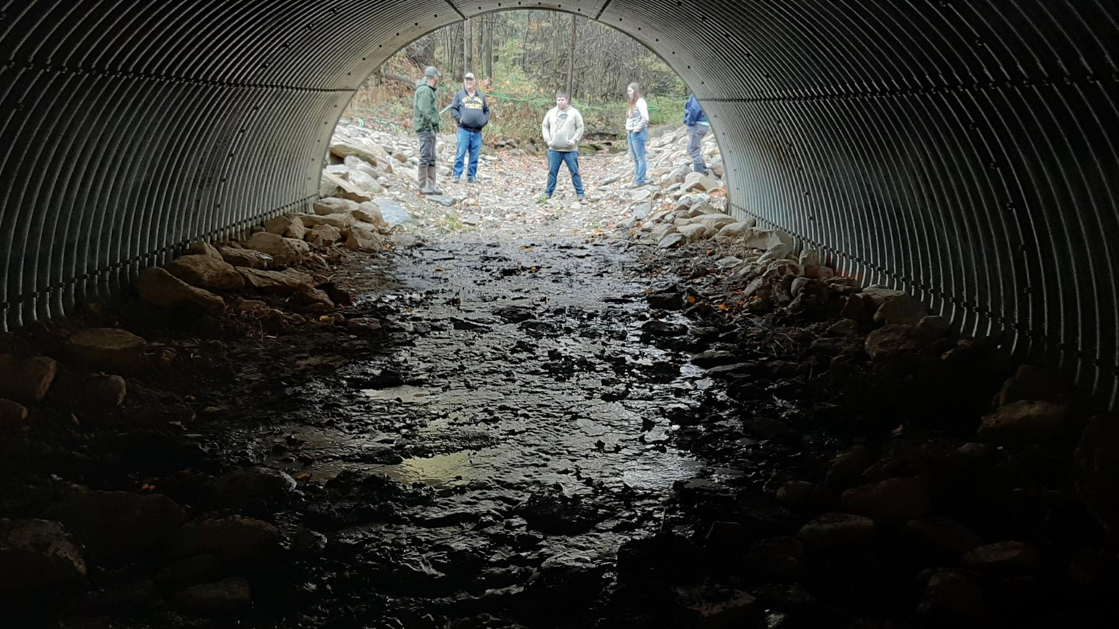
Greater than bankfull width structure with Full AOP

Slide 15
Examples of Projects that do not meet expectations / unacceptable
“The Bad”

Slide 16
What makes a stream crossing not meet expectations?
Structure that is less than the bankfull width of the channel
Lack of streambed through the structure
Structure not properly aligned with the channel
No grade controls
No aquatic organism passage

Slide 17
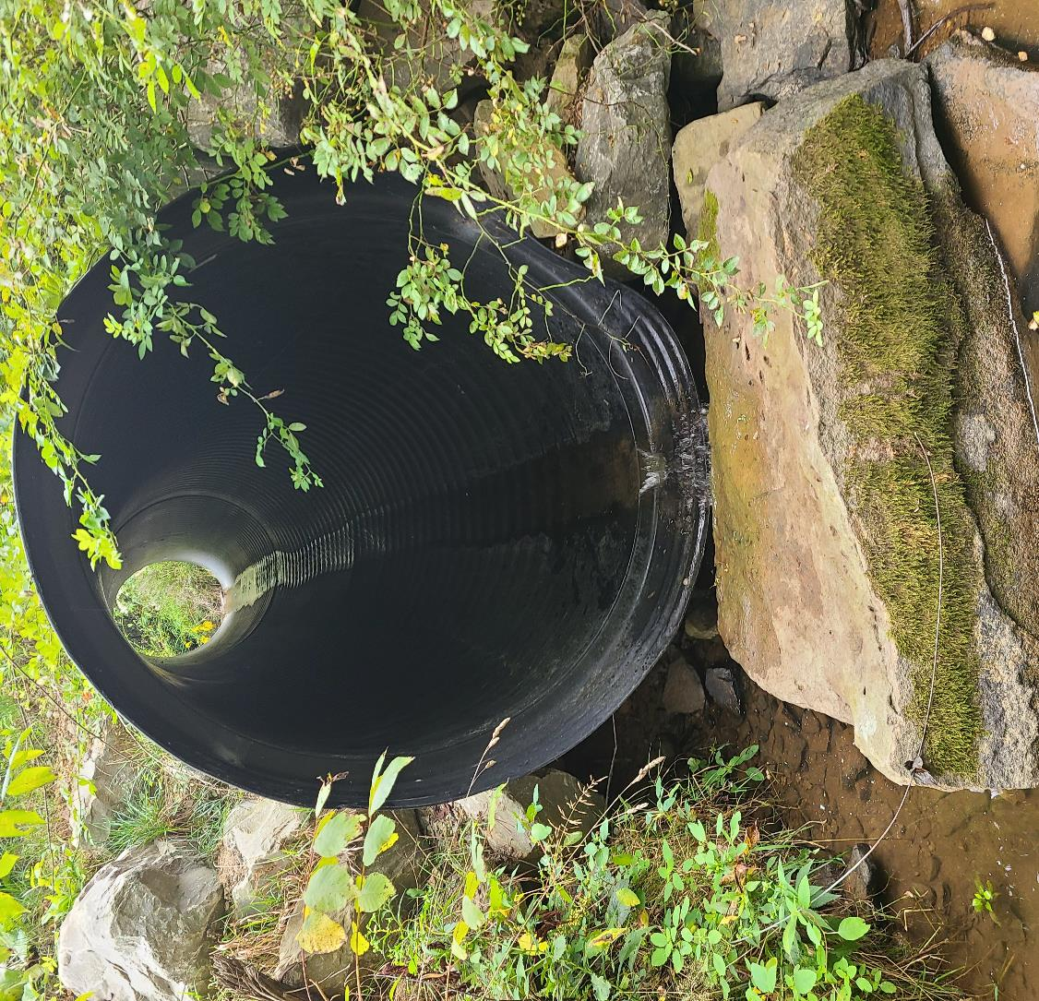
4’ Round Pipe in 8’ Bankfull
<100% bankfull width
Not Designed and Constructed to accommodate AOP
No streambed material in structure
No bank margins, low flow channel, or grade controls
Structure set too high
Significant drop at outfall of structure
Round pipes over 3’

Slide 18
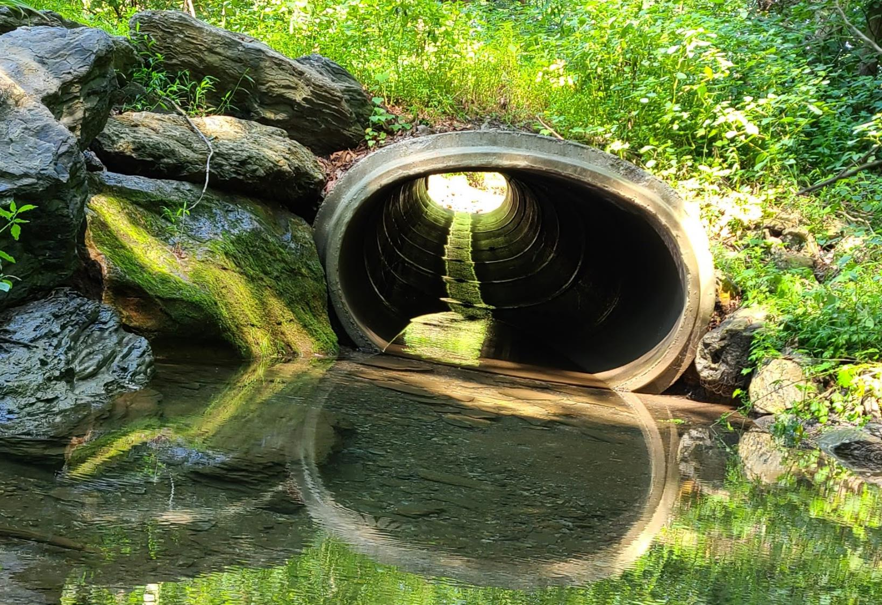
6’ Pipe in 15’ bankfull
Not designed and constructed to accommodate AOP
No bank margins, low flow channel, or streambed material

Slide 19
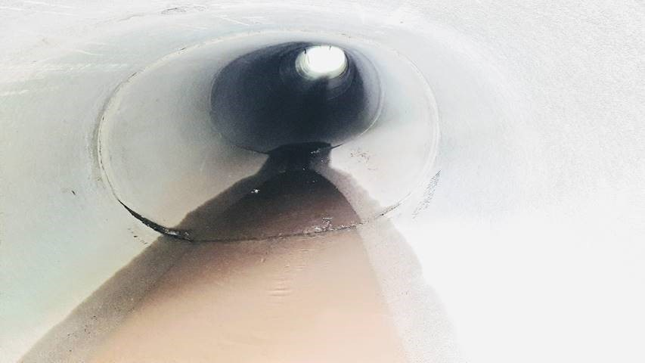
Inside of structure in previous picture

Slide 20
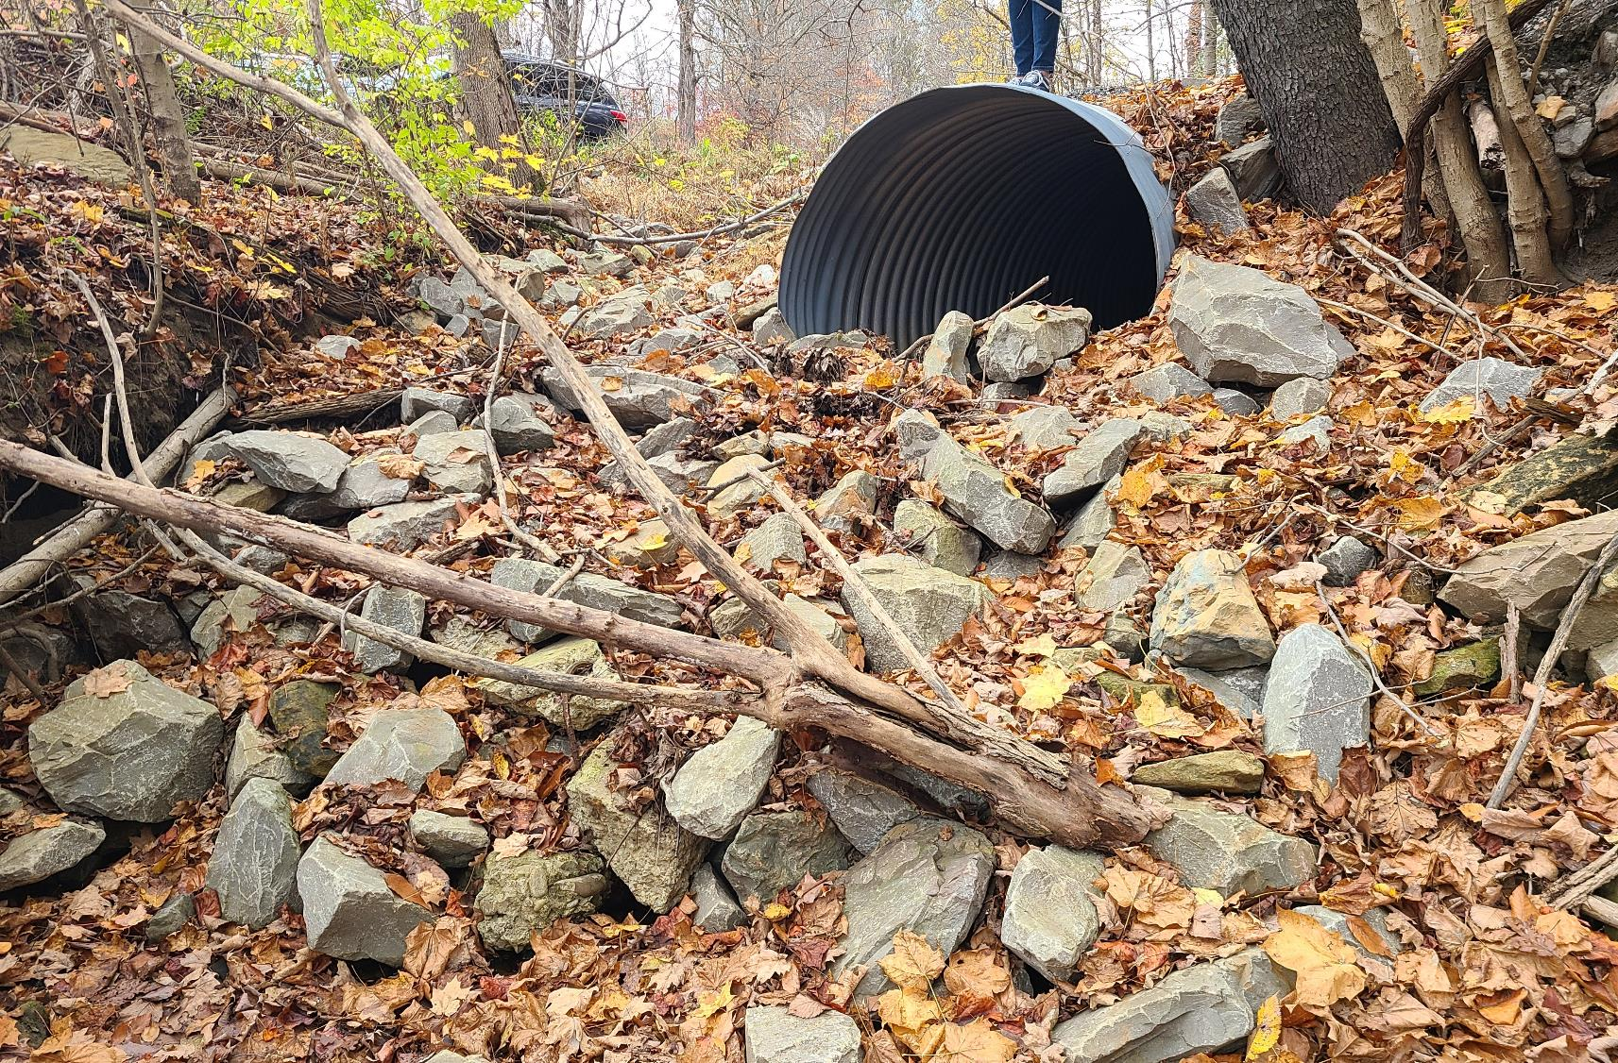
6’ Pipe in 11’ Bankfull. No AOP

Slide 21
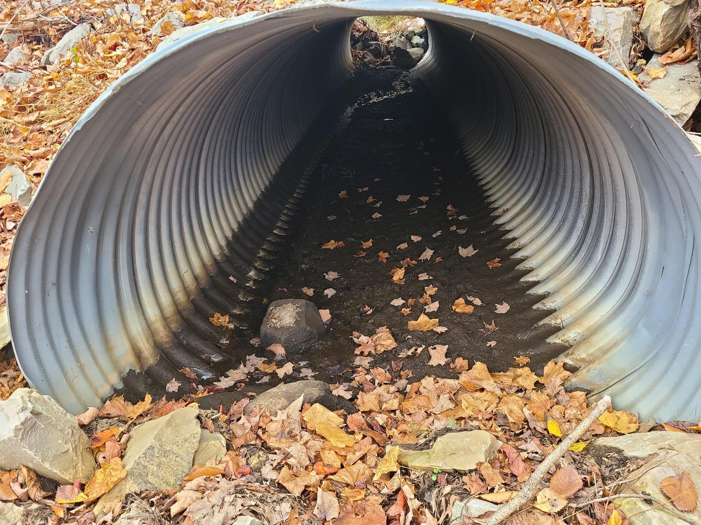
Inside of structure in previous picture

Slide 22
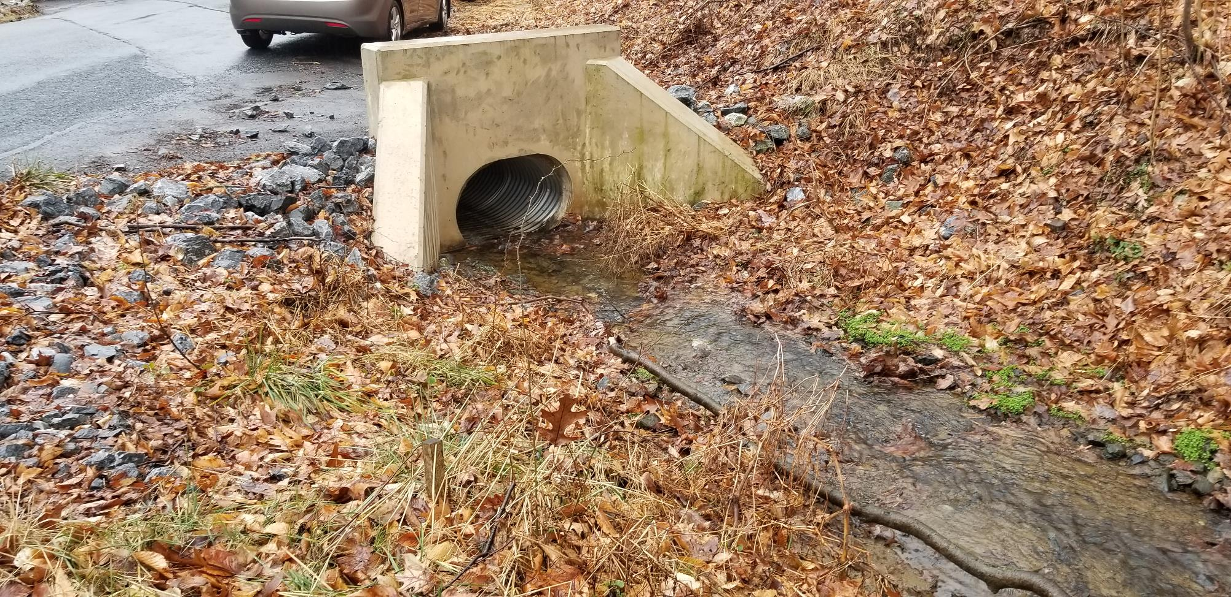
4’ pipe in a 7’ bankfull, No AOP

Slide 23
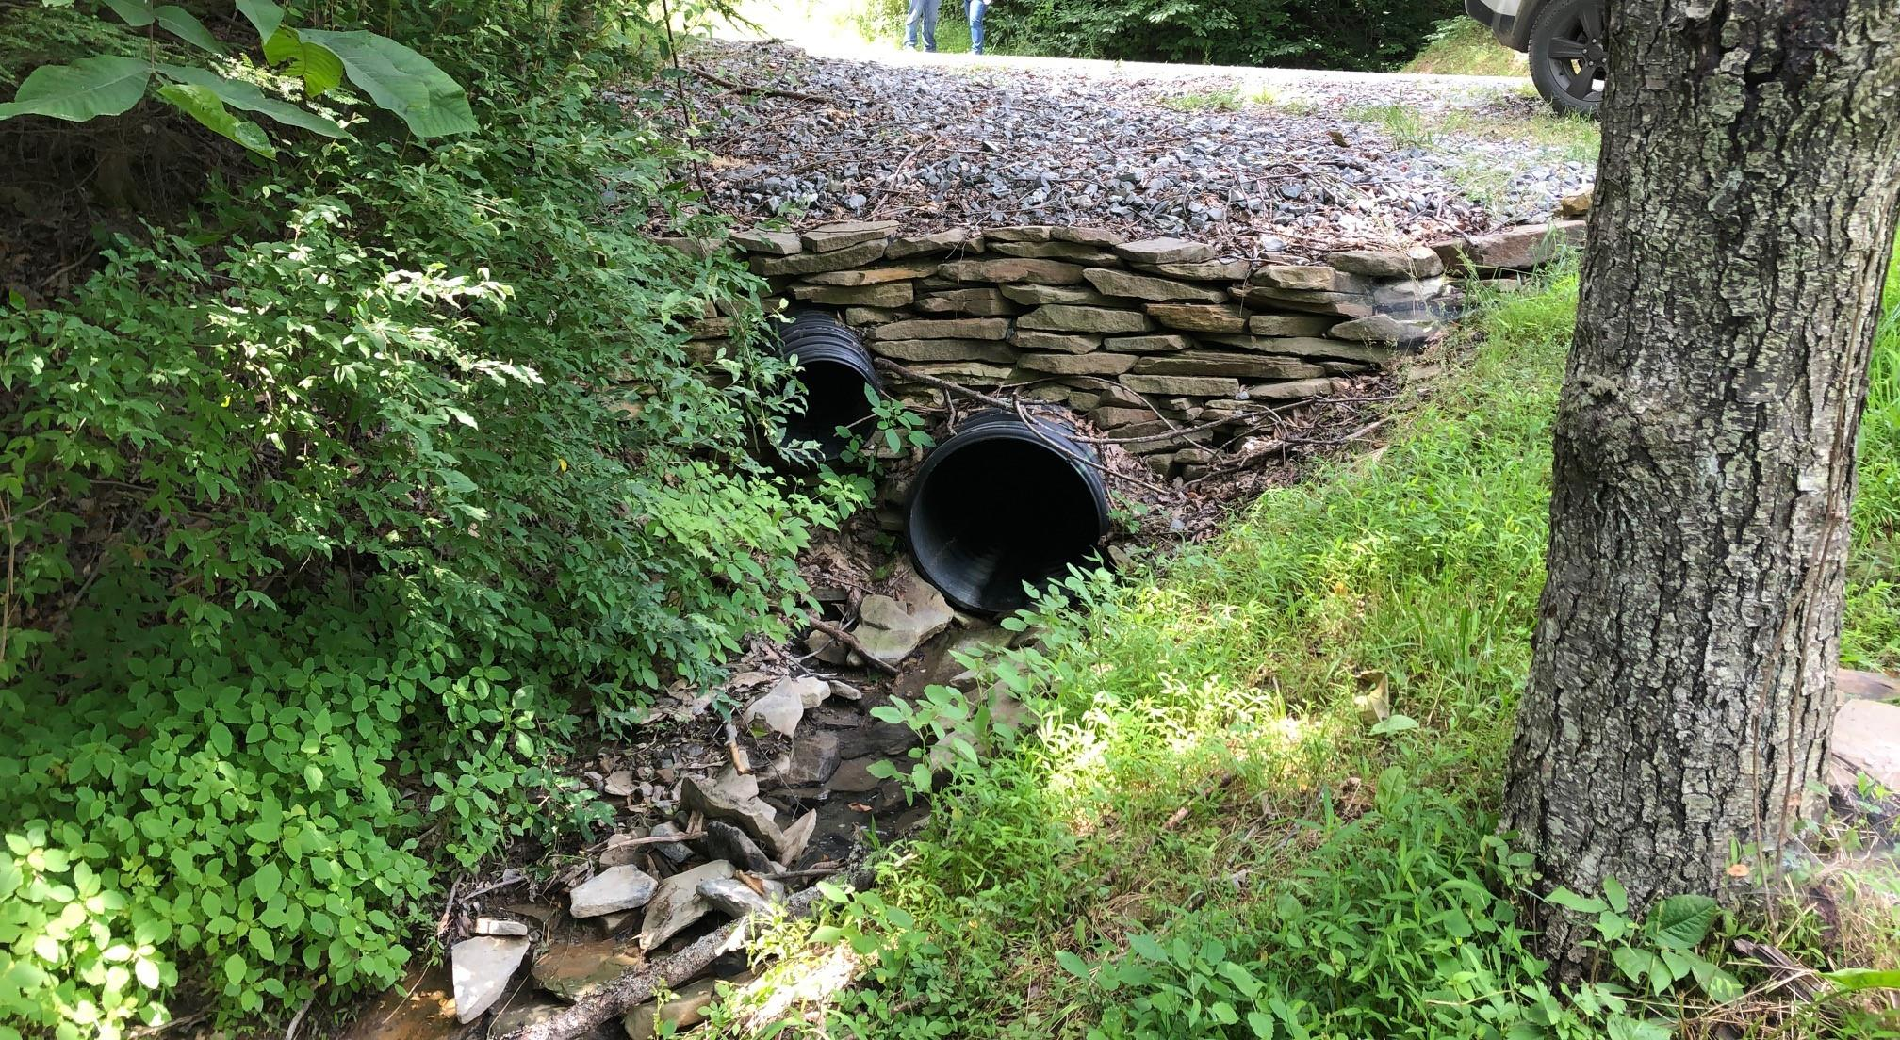
Structure is under bankfull and lacks AOP

Slide 24
This structure is bankfull width, but lacks AOP

Slide 25
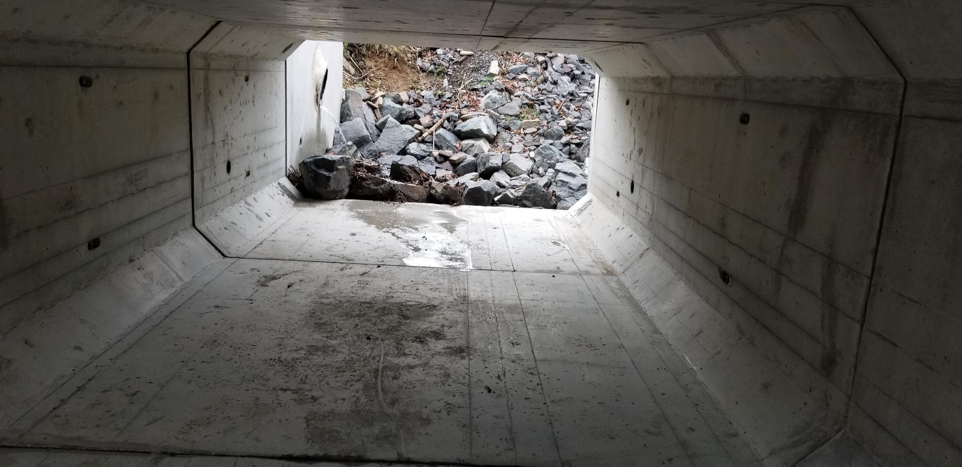
Inside of structure in previous picture

Slide 26
Downstream of structure in previous picture

Slide 27
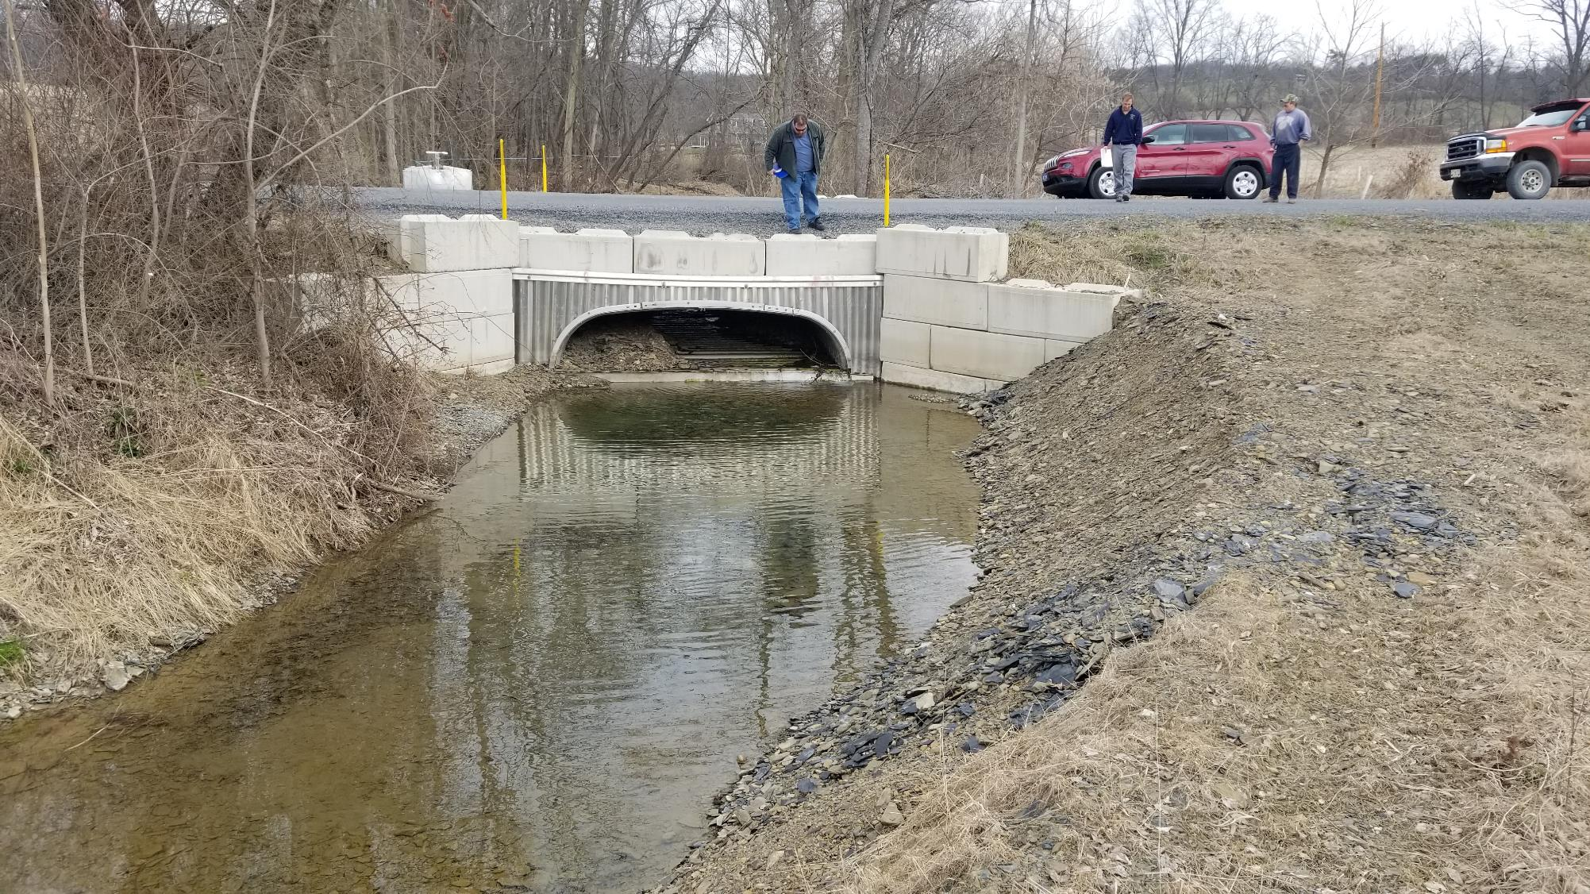
This structure is bankfull width, but lacks AOP
Shows typical issues with low profile arch

Slide 28
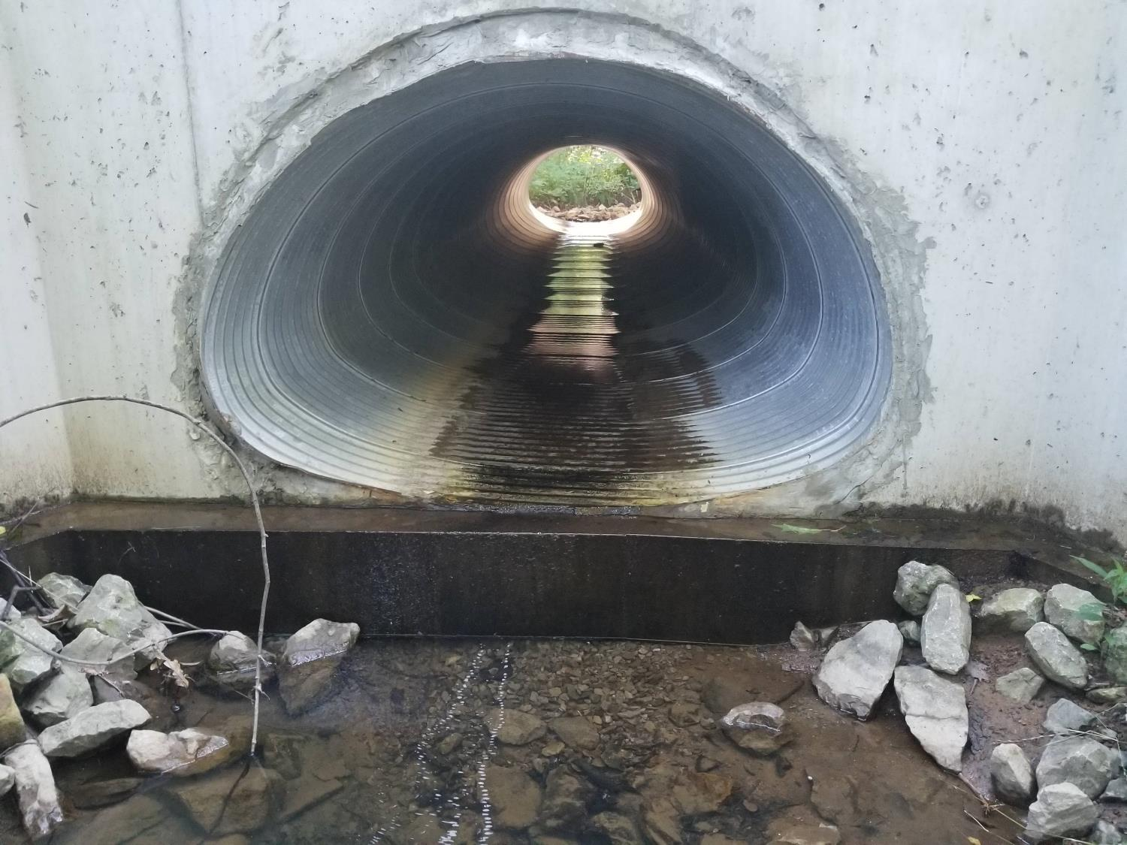
Bankfull width structure, No AOP
Structure will rust much faster without streambed material

Slide 29
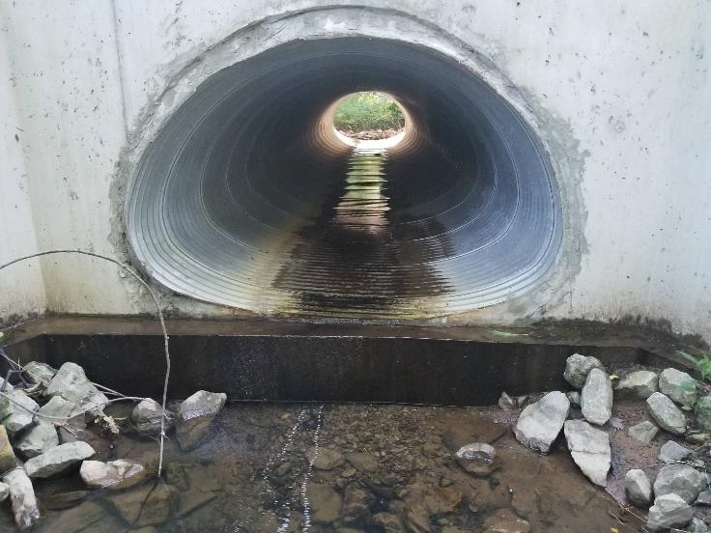
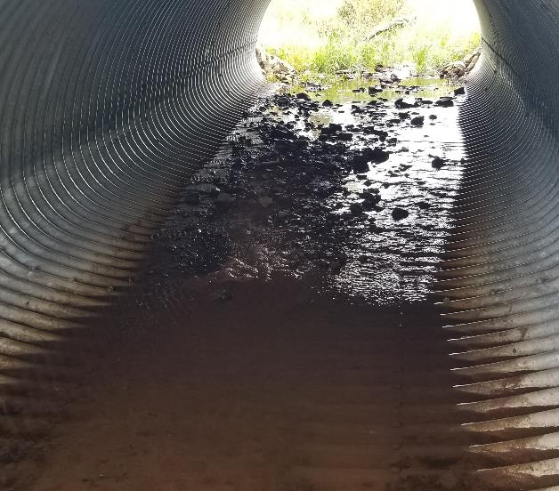
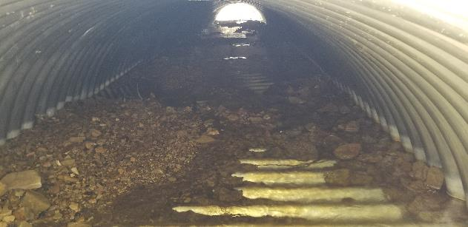
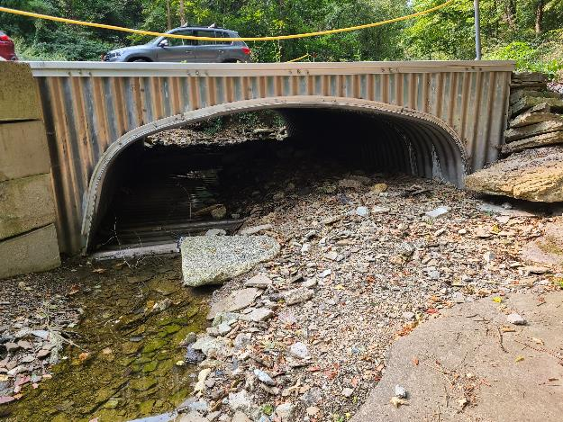
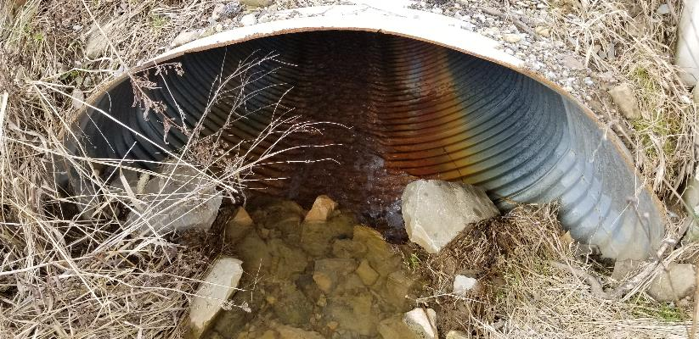
Streambed material is NOT just for AOP

Slide 30
Examples of Projects That Meet Expectations, but could use improvement
“The In-Between”

Slide 31
Common issues with stream crossings
Lack of bank margins and low flow channels
Structure installed too high or too low
Slope of structure and streambed issues
Depth of streambed material

Slide 32
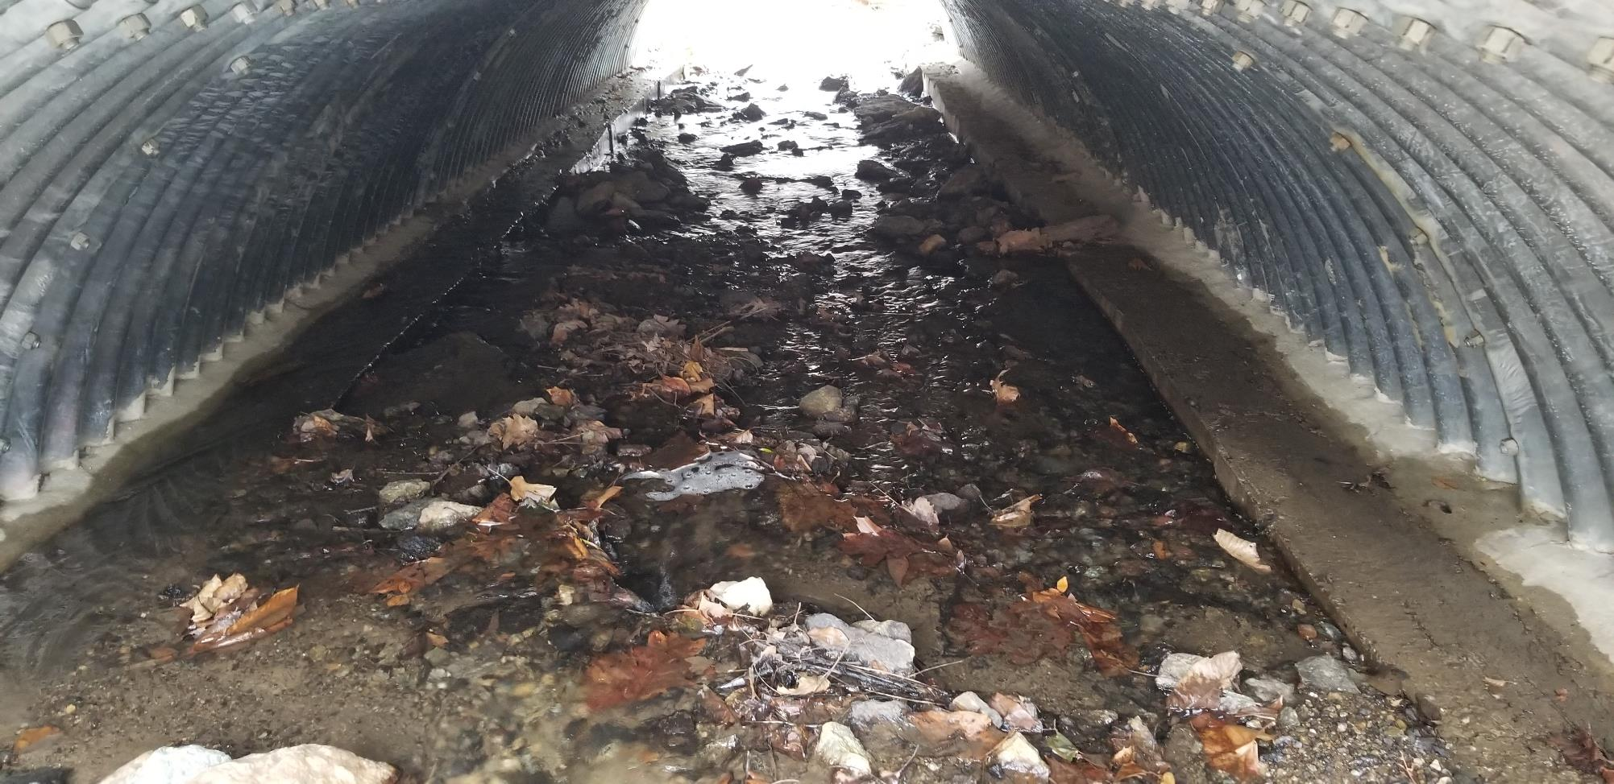
-100% Bankfull width
-Designed and Constructed to accommodate AOP
-No Bank Margins
-No Low Flow Channel
-Potential for scour along footers

Slide 33
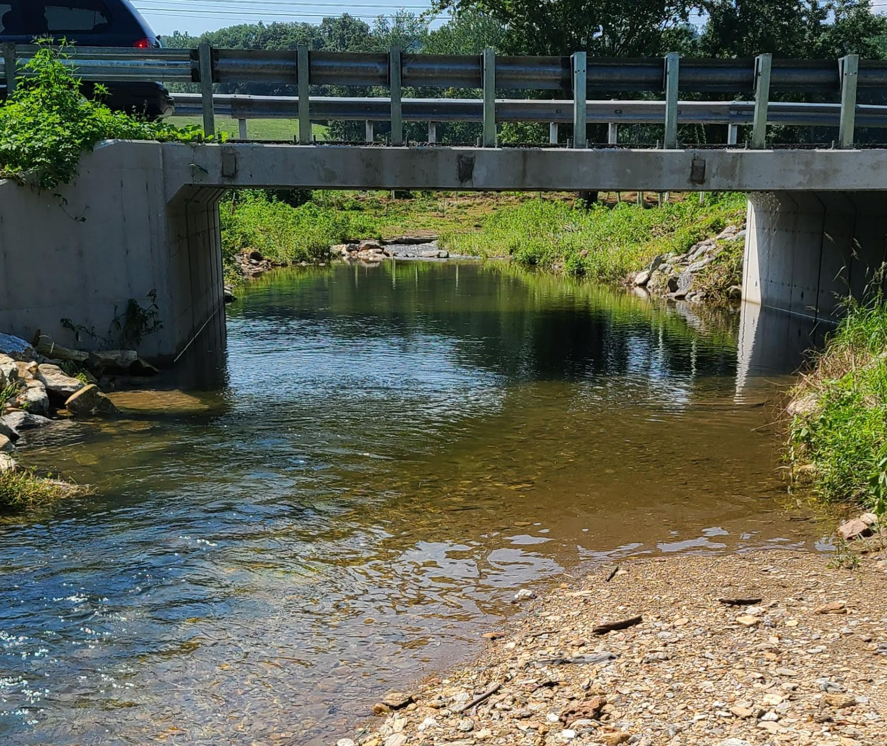
-100% Bankfull width
-Designed and Constructed to accommodate AOP
-No Bank Margins or Low Flow Channel can cause deposition inside structure
-Streamflow directed at footer
Stream flow directed at edge of structure.

Slide 34
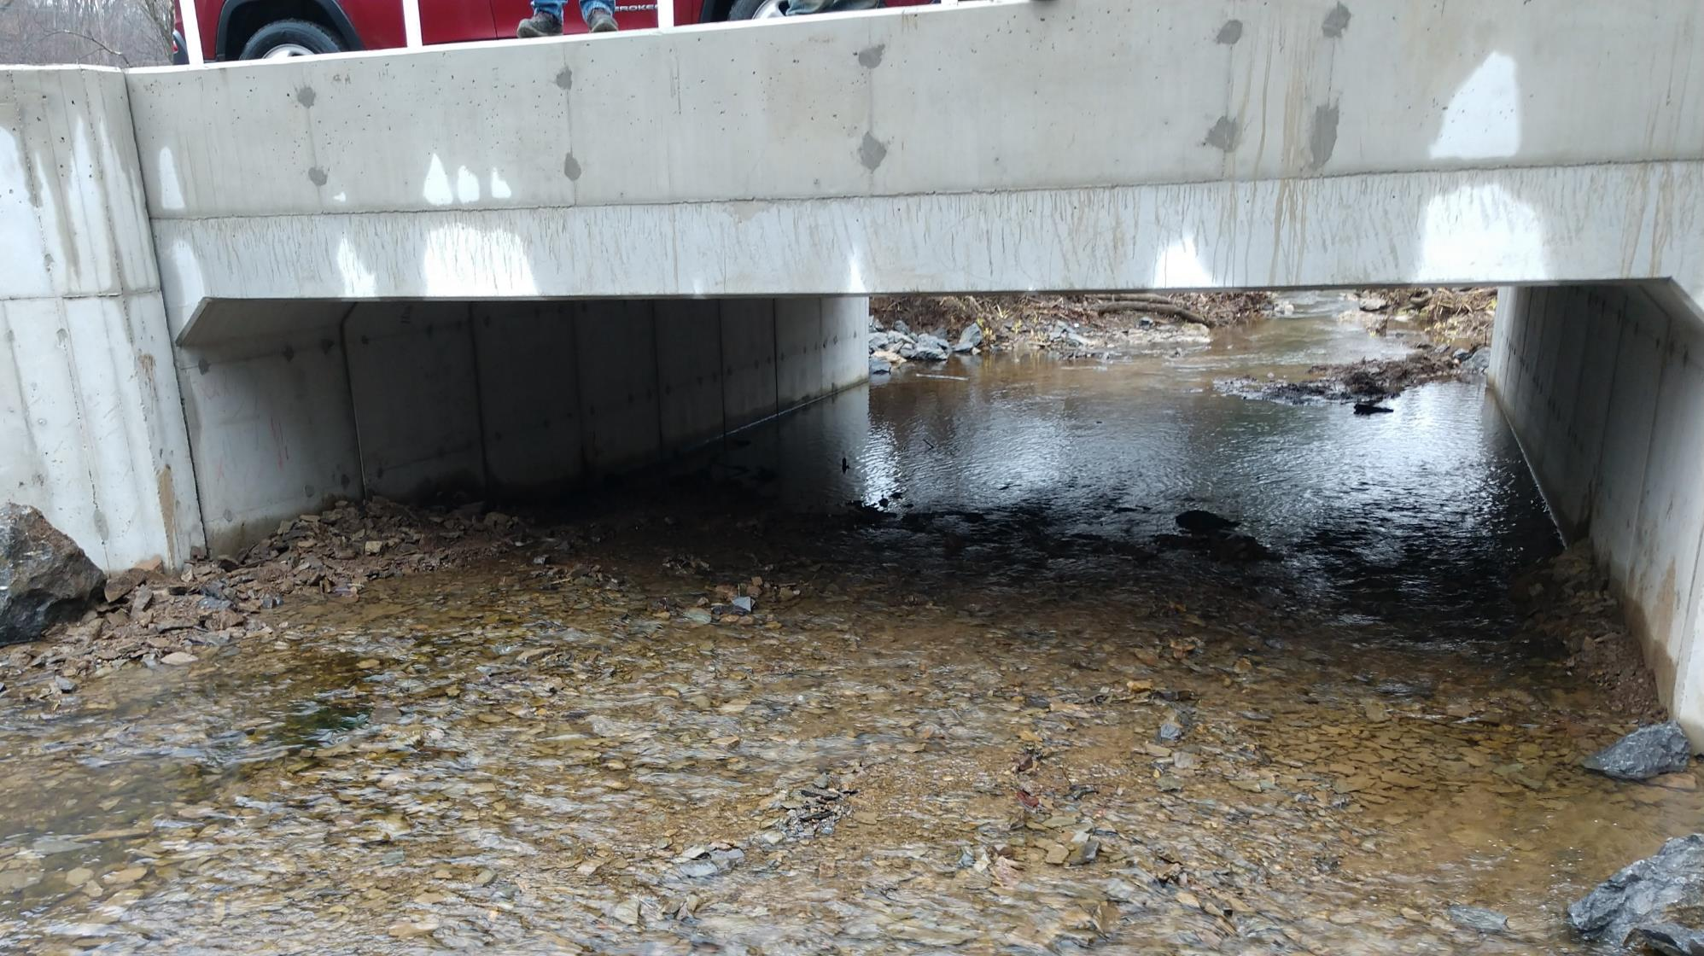
3/2018
~ 14’ structure in ~10’ bankfull channel – GREAT!
But lack of channel structure causing deposition
Note concrete seam
~2.5’ above streambed
Deposition wedge starting to form

Slide 35
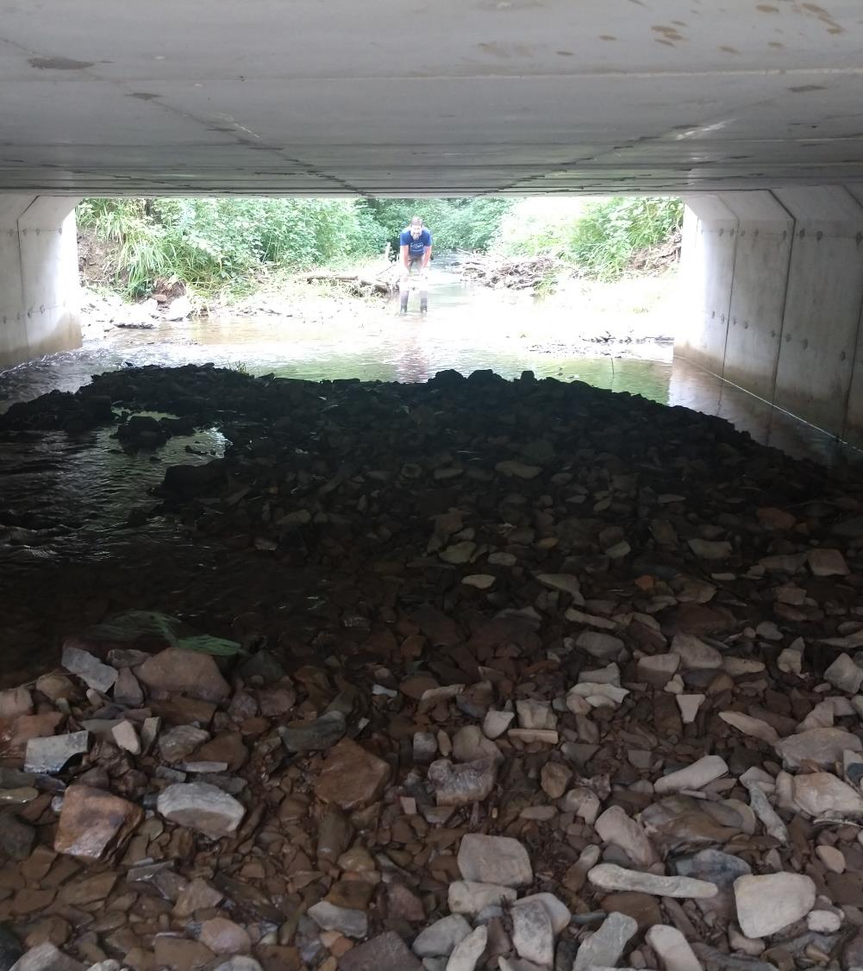
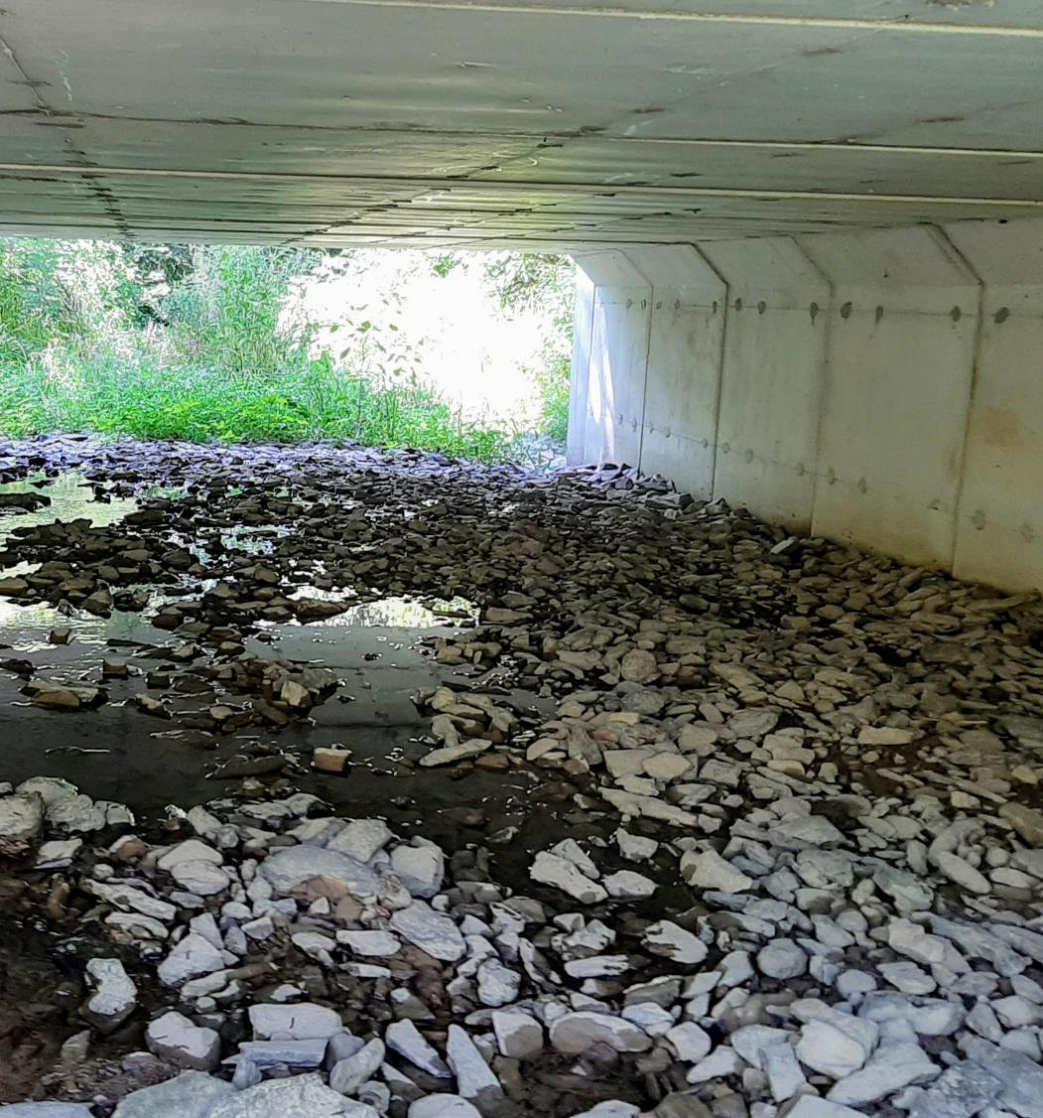
7/2018
8/2020
Deposition wedge growing and has created island below structure
Note concrete seam
~2.5’ above streambed
Note concrete seam
~1’ above streambed
Deposition wedge splitting flow through structure

Slide 36
Common issues with stream crossings
Lack of bank margins and low flow channels
Structure installed too high or too low
Slope of structure and streambed issues
Depth of streambed material

Slide 37
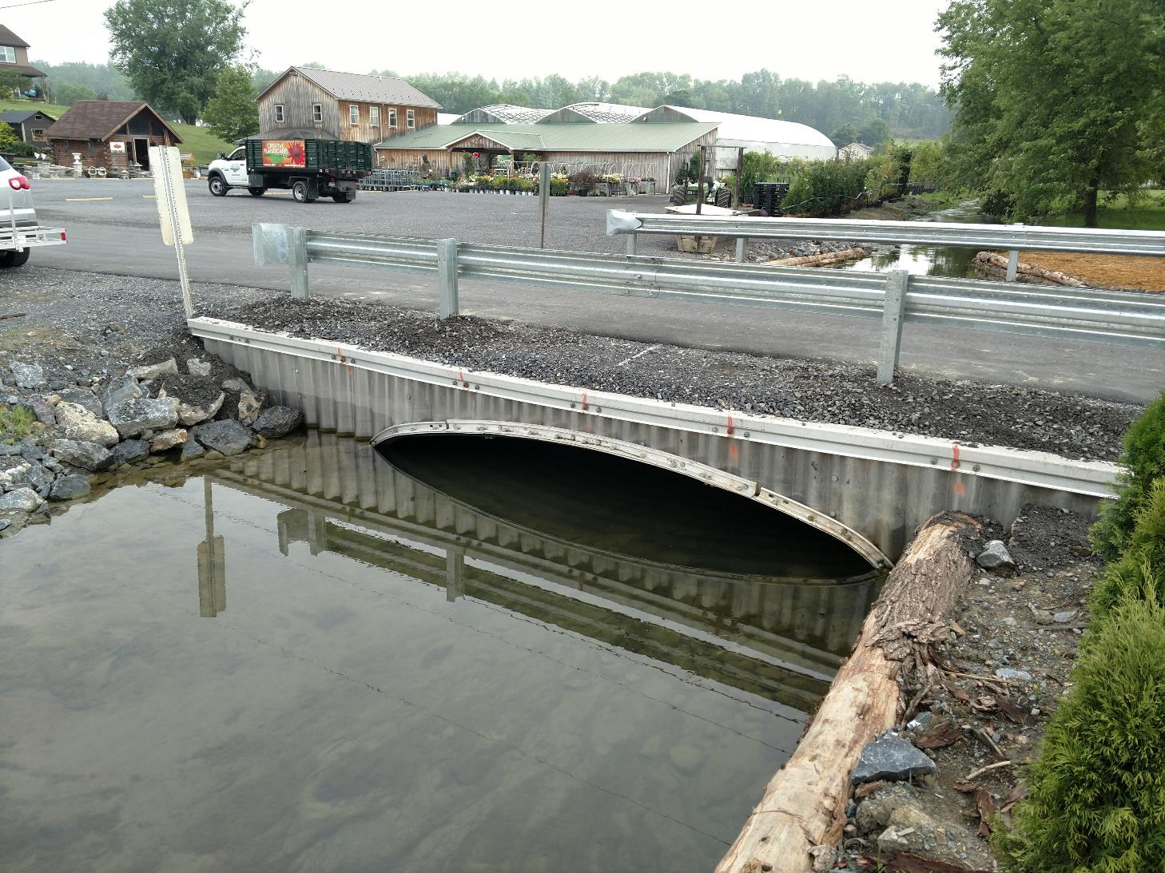
-100% Bankfull width
-Designed and Constructed to accommodate AOP
-Structure set too deep causing stream to neck down
-Lacks sufficient height to pass bedload and stormflow

Slide 38
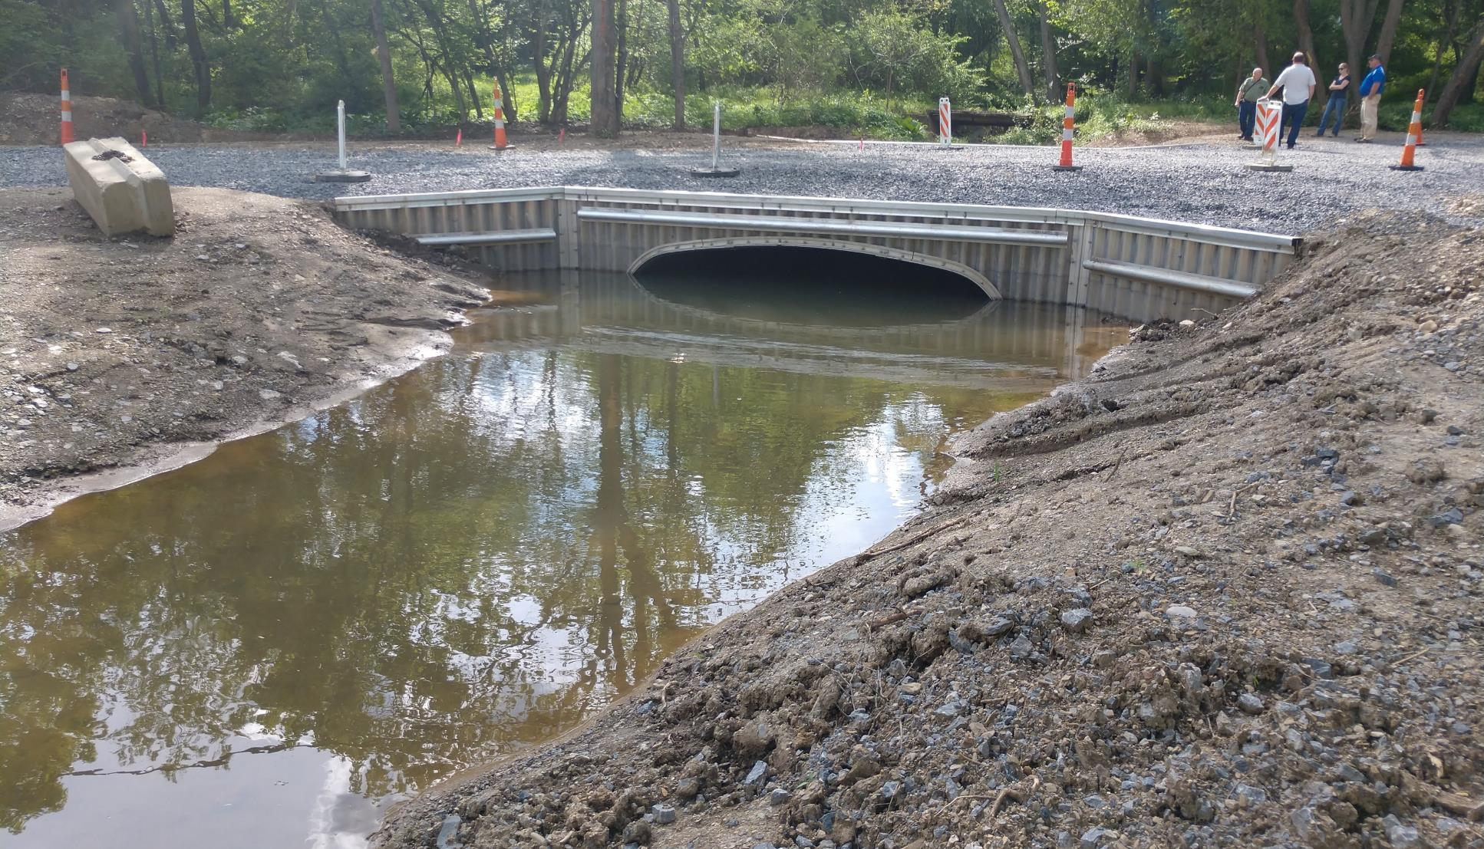
bankfull width structure
-100% Bankfull width
-Designed and Constructed to accommodate AOP
-Structure set too deep causing stream to neck down
-Lacks sufficient height to pass bedload and stormflow

Slide 39
-100% Bankfull width
-Designed and Constructed to accommodate AOP??

Slide 40
Inside previous structure
Deposition occurs when structure lacks appropriate streambed
Designed and Constructed to accommodate AOP?
Lacks bank margins and low flow channel

Slide 41
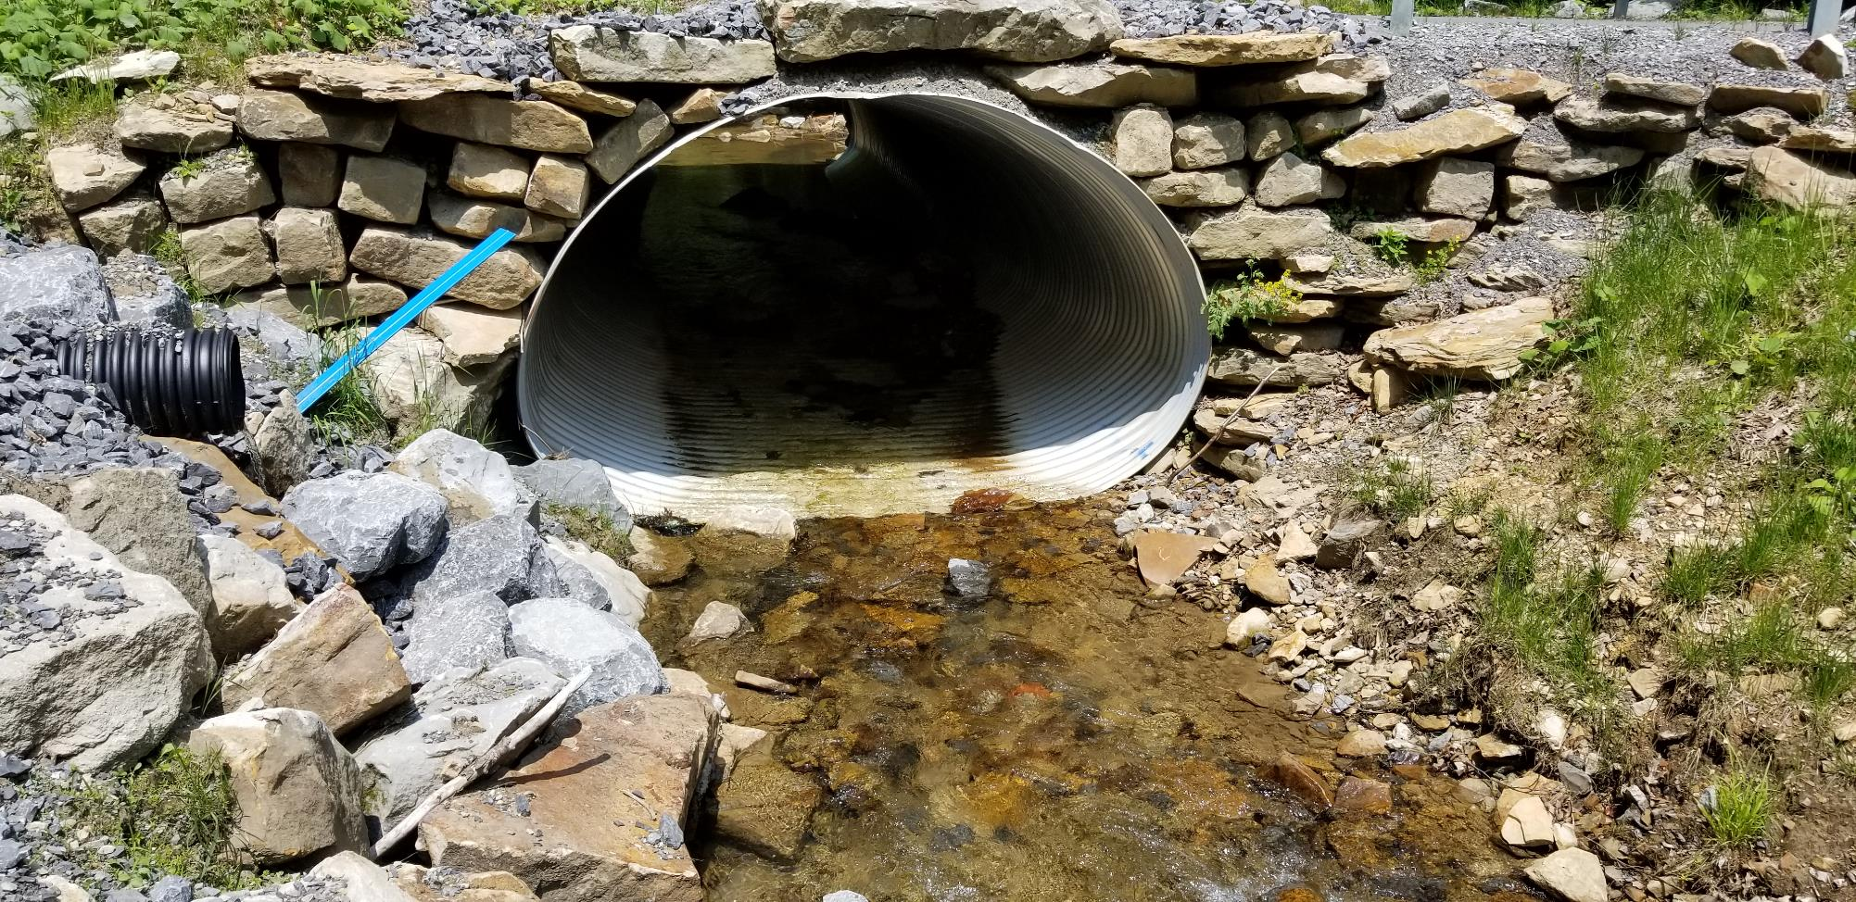
Designed and Constructed to accommodate AOP?
-Structure not depressed properly into stream bed.
-Structure width is too high, causing stream to narrow
-Lack of streambed material causes “velocity barrier”
Lacks bank margins and low flow channel

Slide 42
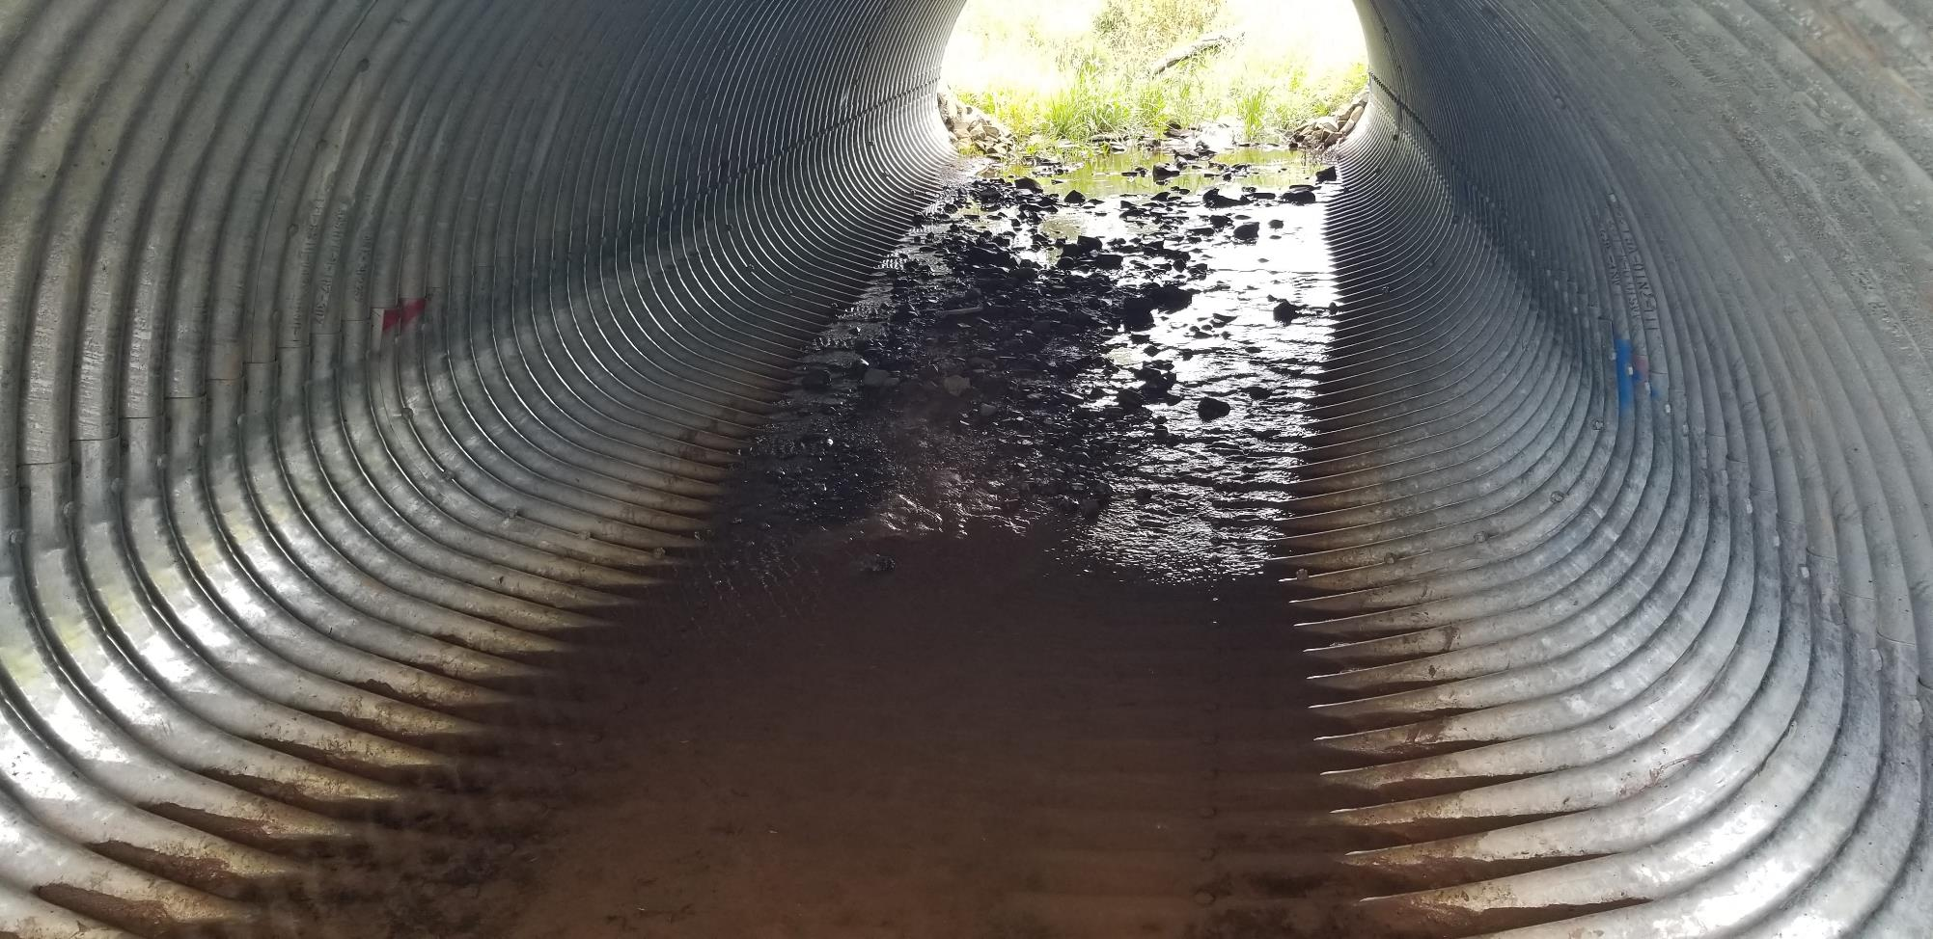
-Structure not depressed properly into stream bed.
-Structure installed too high, causing stream to narrow
-Lack of streambed material causes “velocity barrier”
-Lifespan of crossing that lacks material?

Slide 43
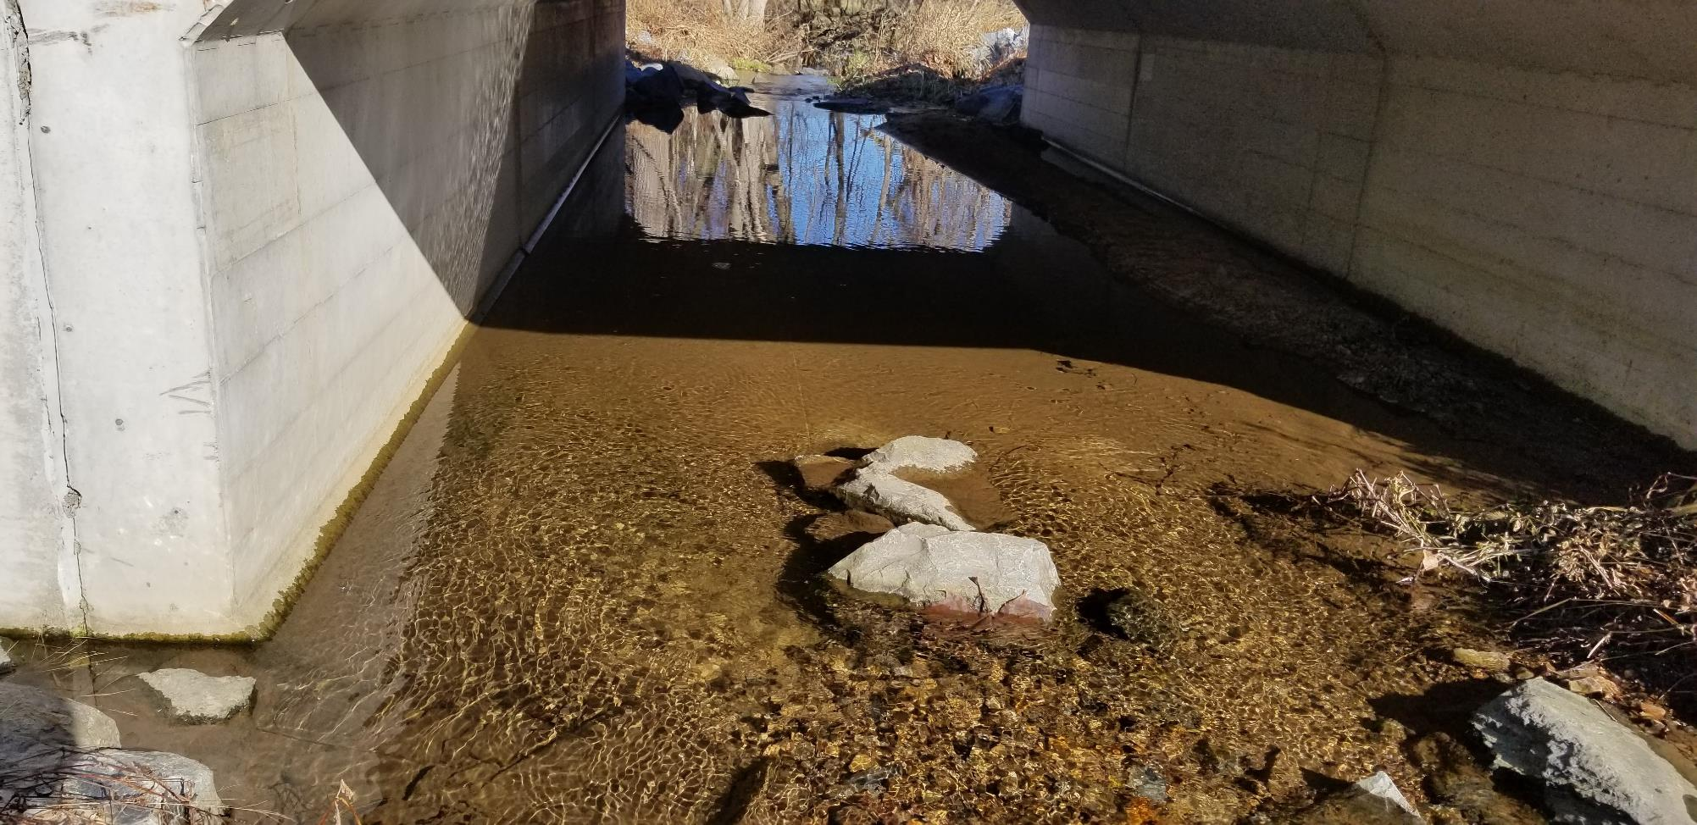

Slide 44
Common issues with stream crossings
Lack of bank margins and low flow channels
Structure installed too high or too low
Slope of structure and streambed issues
Depth of streambed material

Slide 46
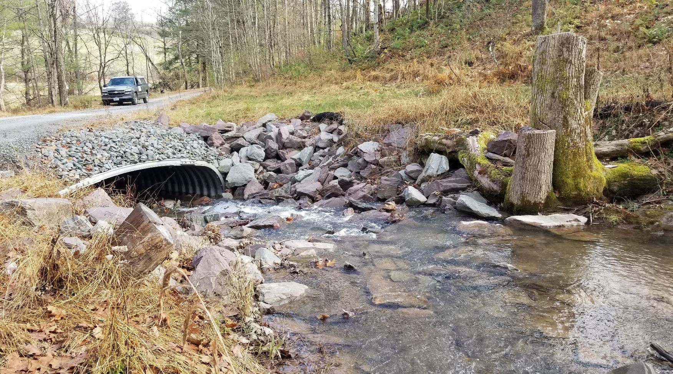
-100% Bankfull width
-Designed and Constructed to accommodate AOP??

Slide 47
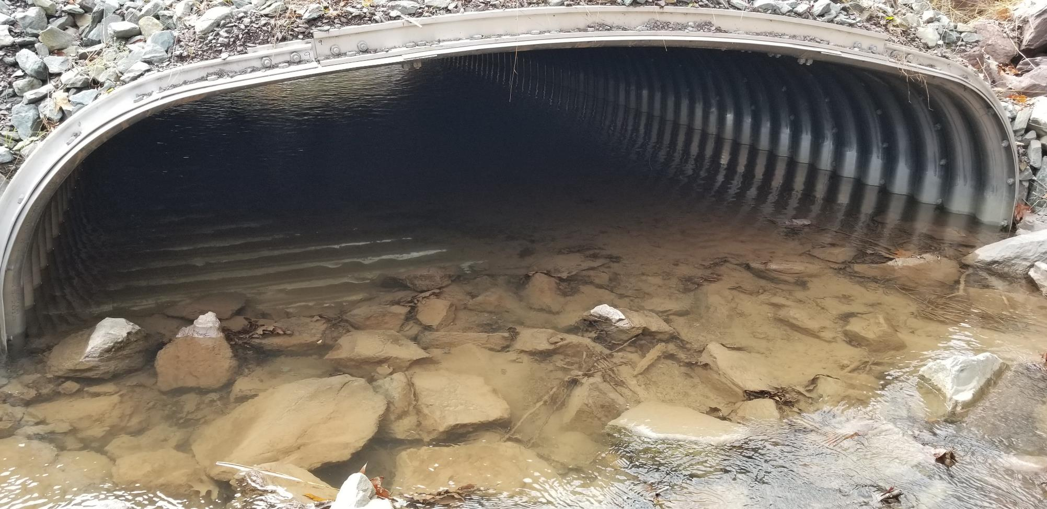
-Stream drops steeply into new structure
-Structure is set flat, causing a “concave/convex” profile
-No streambed built through the structure
-Lacks bank margins and low flow channel

Slide 48
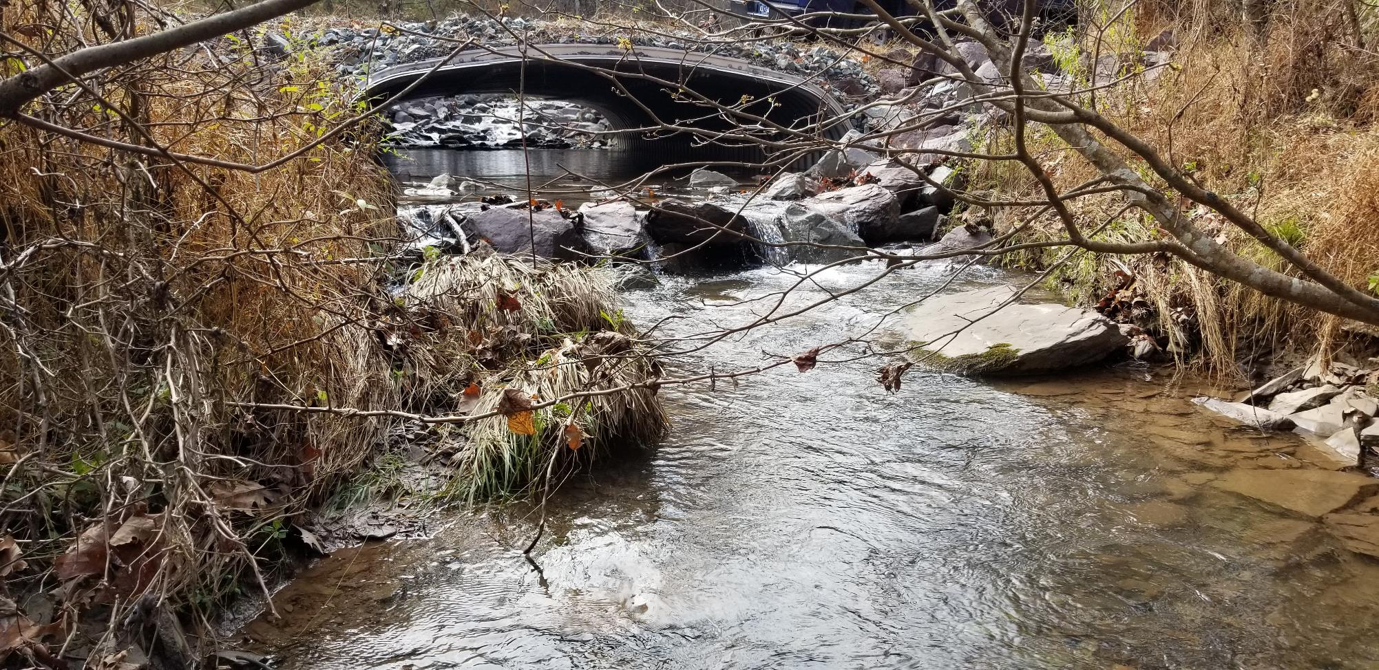
-No streambed built through the structure
-Lacks bank margins and low flow channel
-AOP barrier downstream
-Potential for head cut
-Stream drops steeply into new structure
-Stream is flat through structure
-Stream drops again leaving the structure
-Structure is set flat, causing a “concave/convex” profile

Slide 50
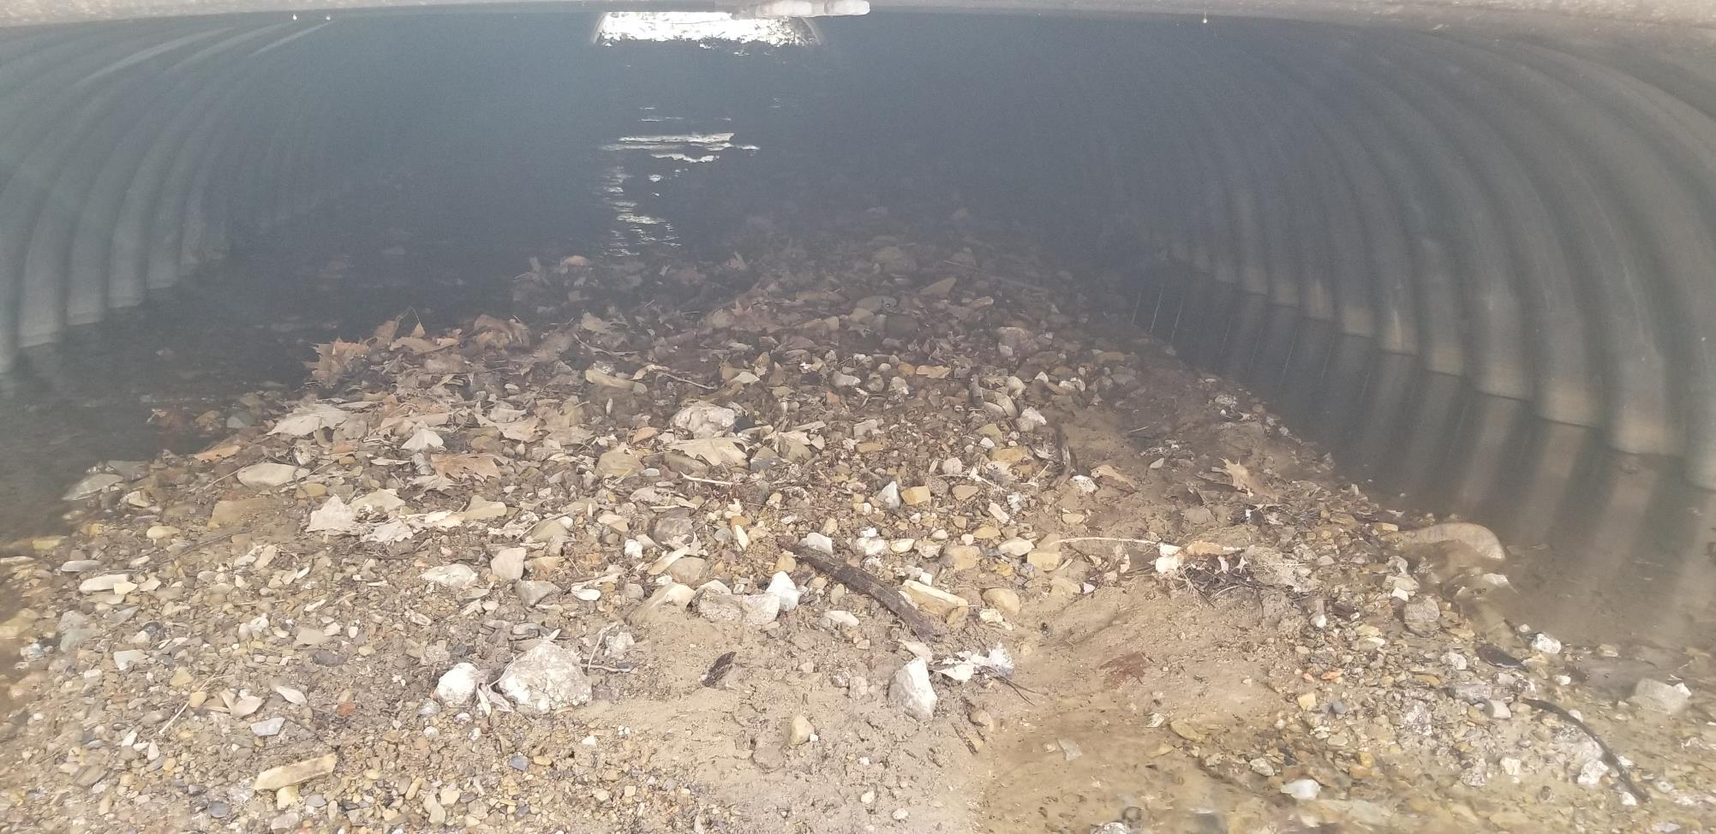
- example of a “concave” installation
-Shows typical deposition and split of stream

Slide 51
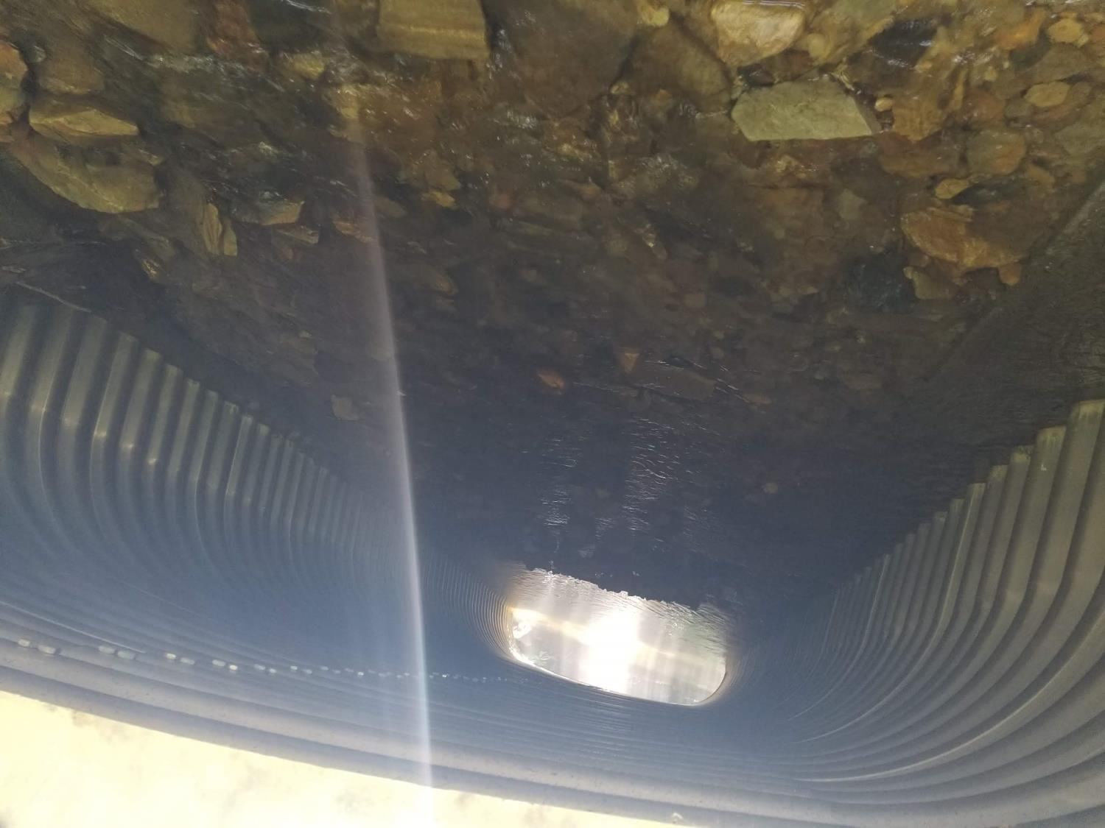
- example of a “concave” installation
-Shows typical deposition and split of stream

Slide 52
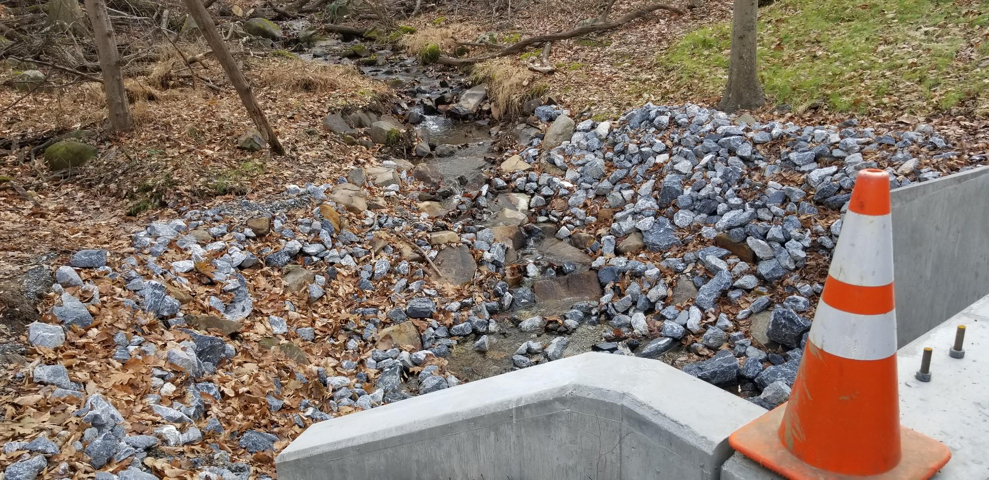
-Stream drops steeply into new structure
-Structure is set flat

Slide 53
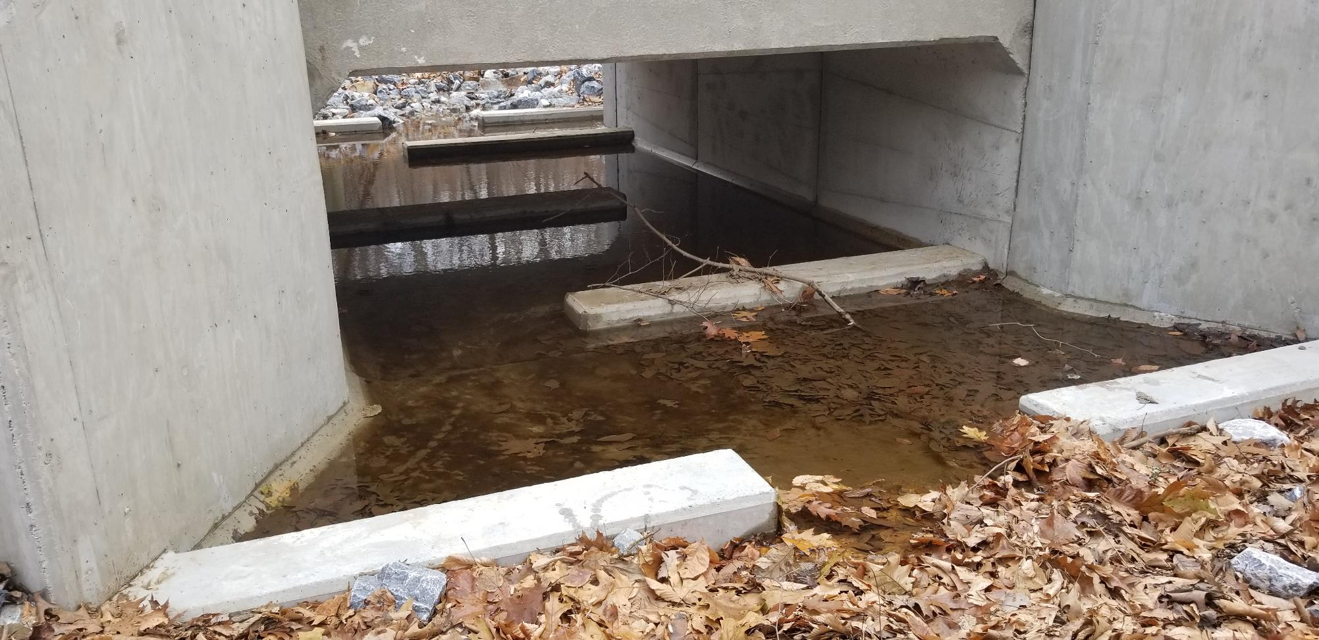
-100% Bankfull width
-Designed and Constructed to accommodate AOP??

Slide 54
Common issues with stream crossings
Lack of bank margins and low flow channels
Structure installed too high to too low
Slope of structure and streambed issues
Depth of streambed material

Slide 55
-Lacks sufficient streambed material
-No bank margins and low flow channels
-Scour is greater than depth of streambed material

Slide 56
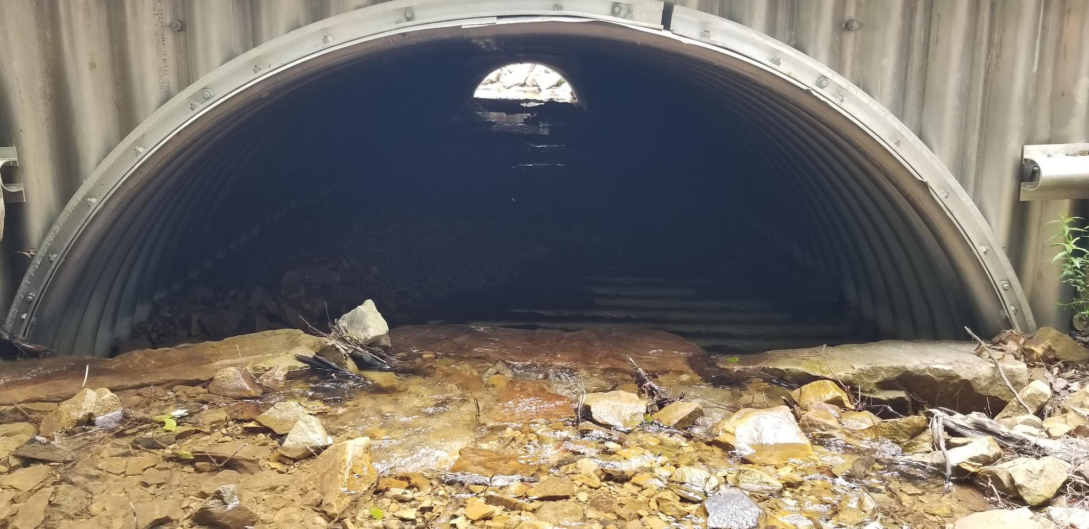
-Lacks sufficient streambed material
-No bank margins and low flow channels
-Lacks sufficient streambed material
-No bank margins and low flow channels
-Scour is greater than depth of streambed material

Slide 57
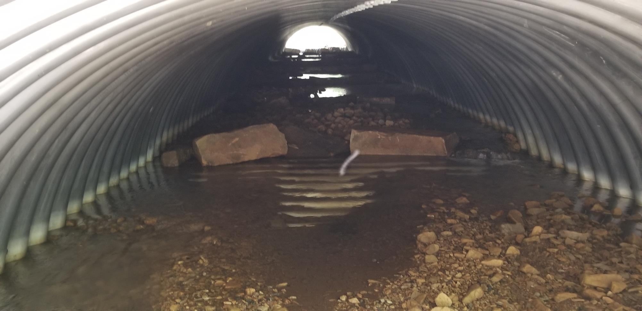
-Lacks sufficient streambed material
-No bank margins and low flow channels
-Lacks sufficient streambed material
-No bank margins and low flow channels
-Scour is greater than depth of streambed material
-Large grade controls like these will cause more scour on the downstream

Slide 58
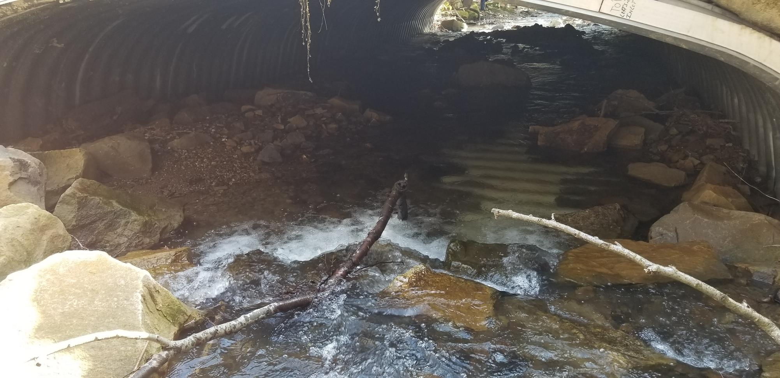
-Lacks sufficient streambed material
-No bank margins and low flow channels
-Scour is greater than depth of streambed material

Slide 59
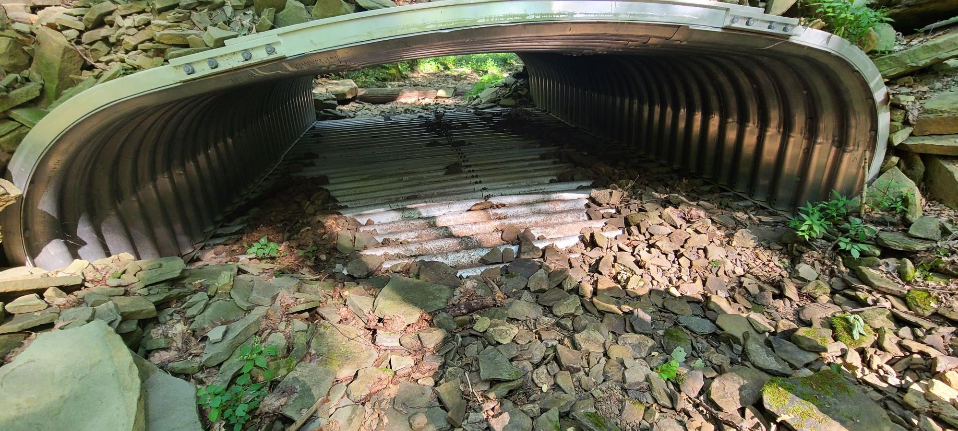
-Lacks sufficient streambed material
-No bank margins and low flow channels
-Scour is greater than depth of streambed material

Slide 60
Example of a longitudinal profile showing new culvert and proposed streambed

Slide 61
Lessons we have learned
The Program needs to provide more guidance and better define policy expectations
Stream continuity is the key to ensuring a successful project
100% Bankfull structure is typically not wide enough to construct the crossing properly
100% Bankfull width structure with no material or “AOP” will greatly decrease life span of structure
Long pro’s are very important for stream bed slope continuity

Slide 62
Lessons we have learned
Bury depth is very important and should be determined using a long pro and potential scour
Low profile structures need careful consideration for constructability of streambed within the structure
There is often a cost increase with installing appropriate streambed material that is not planned during the application phase
Projects should give extra consideration to using bottomless structures (where appropriate)

Slide 63
Where do we go from here?
Developing stream crossing technical manual
Reference guides for engineering services
Additional training and education opportunities
Updating policy where appropriate
The Center’s website has about 6 hours of recorded stream crossing boot camp classroom session!

