Slide 1
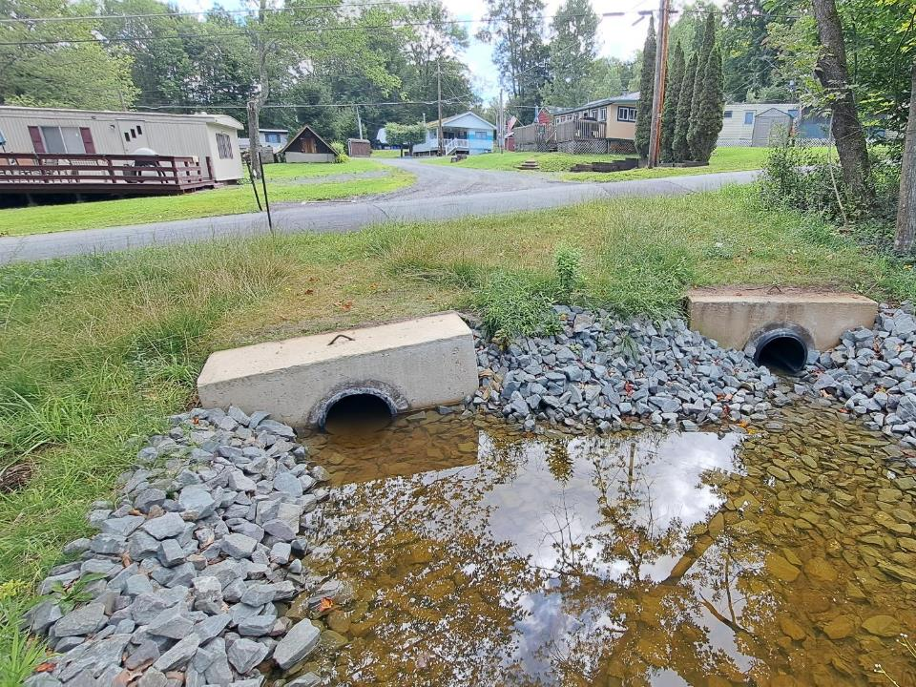
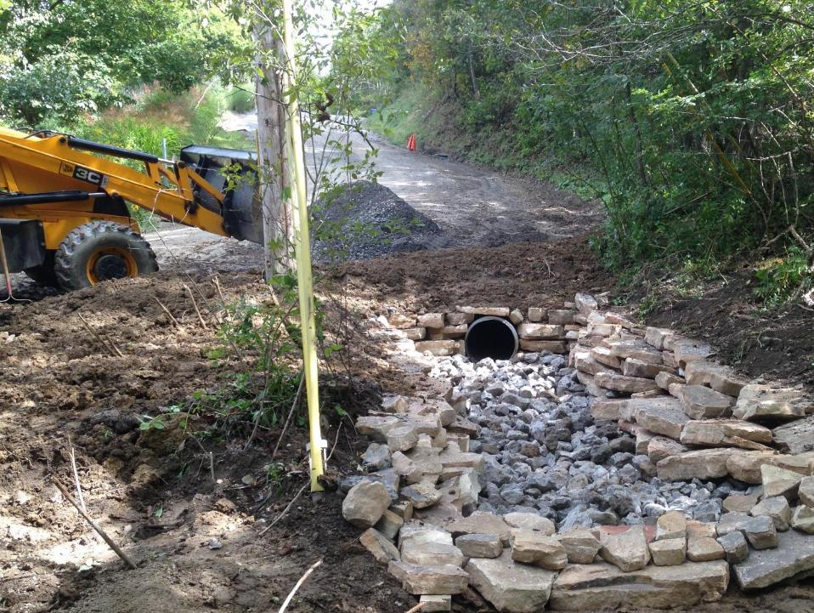
Structural
Infiltration Practices

Slide 2
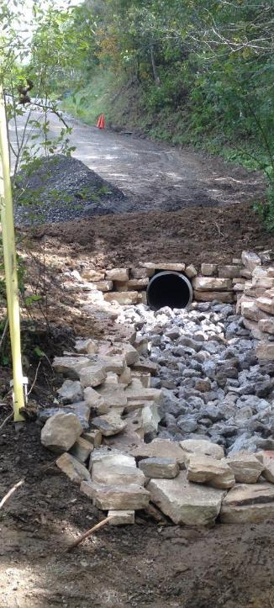
Structural Infiltration Practices
Introduction
Practices
DGLVR Project
Examples

Slide 3
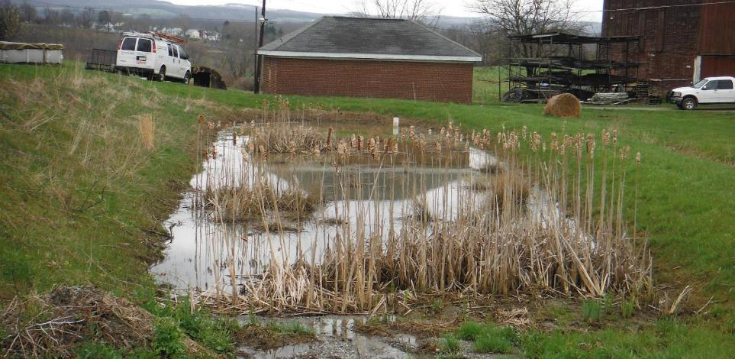
Infiltration Practices
Introduction
What is “infiltration”:
Any practices that encourage water to soak into the ground instead of running off.

Slide 4
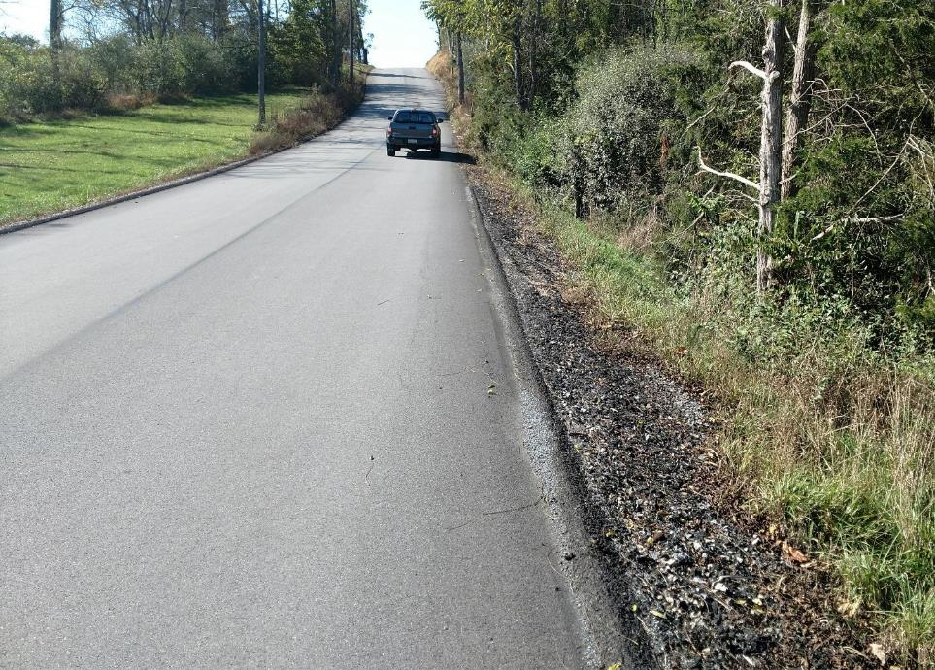
Infiltration Practices
Introduction
“Traditional Practices”: Collection over infiltration
X
Roller curb berms
X

Slide 5
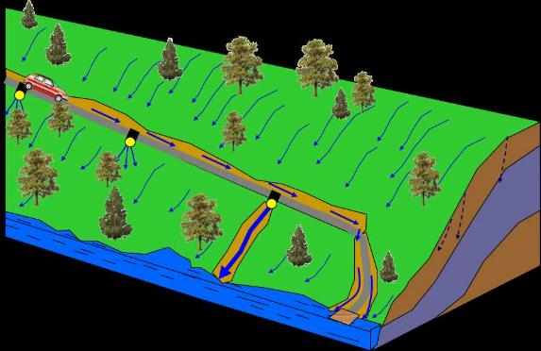
Infiltration Practices
Introduction
Remember
our hillside?
Infiltration over runoff is a Program Focus (road fill, pipes, underdrain, etc.).
What happens in the real world….

Slide 6





Infiltration Practices
Introduction
Remember
our hillside?
Infiltration over runoff is a Program Focus (road fill, pipes, underdrain, etc.).
What happens in the real world….
Sometimes the situation requires more “structural” infiltration practices

Slide 7
Infiltration Practices
Introduction
Structural Infiltration practices:
Structures that capture stormwater runoff and allow it to slowly seep into the soil.
Applicable for urban, suburban, and rural roads.
Often most beneficial in densely developed areas and agricultural landscapes.
Alleviate flooding and erosion, reduce surface water pollution, and promote groundwater recharge.

Slide 8
Infiltration Practices
Introduction
Structural Infiltration practices:
Any structure designed to capture stormwater runoff and allow it to slowly seep into the soil.
Infiltration Basin
Rain Garden
Detention Basin
Infiltration Trench
Infiltration Swale
Stilling Basin
Bio-Swale
Grassed Waterway
Permeable Pavement
Constructed Wetland
Examples: too many types and sizes to cover them all

Slide 9
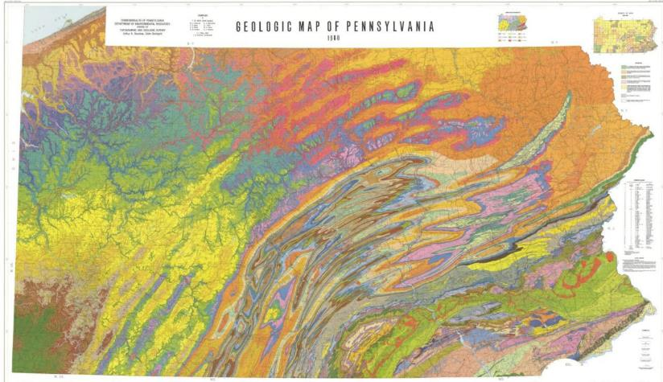
Infiltration Practices
Introduction
Geology, Soils, and Infiltration rates vary widely across PA.
Analysis may be needed to determine infiltration rates.

Slide 10
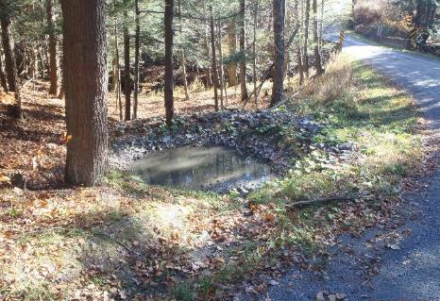
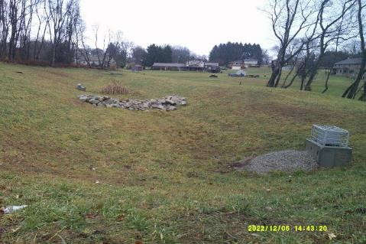
Infiltration Practices
Introduction
Disclaimer #1
ENGINEERING / DESIGN (and permits) may be needed, depending on structure, location, and size.
Conservation District can help determine if an engineer or design is needed.

Slide 11
Infiltration Practices
Introduction
Disclaimer #2
Practices are customizable and vary based on site conditions.
This entire training could be on infiltration. These are examples only.
Purpose is to show ideas of what might be possible through DGLVR!

Slide 12
Structural Infiltration Practices
Introduction
Practices
DGLVR Project
Examples

Slide 13
Infiltration Practices
Structural Infiltration Practices
Infiltration Beds / Trenches
Infiltration Basins
Vegetated Swales
Rain Gardens
Subsurface Structures
This is not all-inclusive

Slide 14
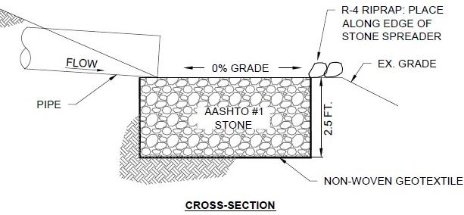

Infiltration Practices
Infiltration Beds / Trenches
Infiltration Bed Detail
Typical from PA Stormwater BMP Manual
Pipe Outlet
When sized appropriately, stone beds can be used at outlet of individual pipes and turnouts or at the terminal outlet of a storm sewer system.

Slide 15
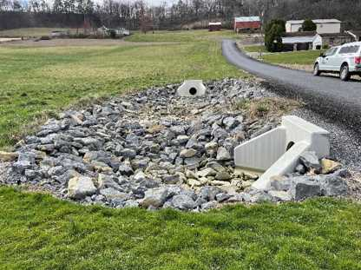
Infiltration Practices
Infiltration Beds / Trenches
Pipe Inlet
Infiltration Bed used on rural storm sewer in agricultural area.
Bed located prior to discharge to headwater channel of valley stream.

Slide 16
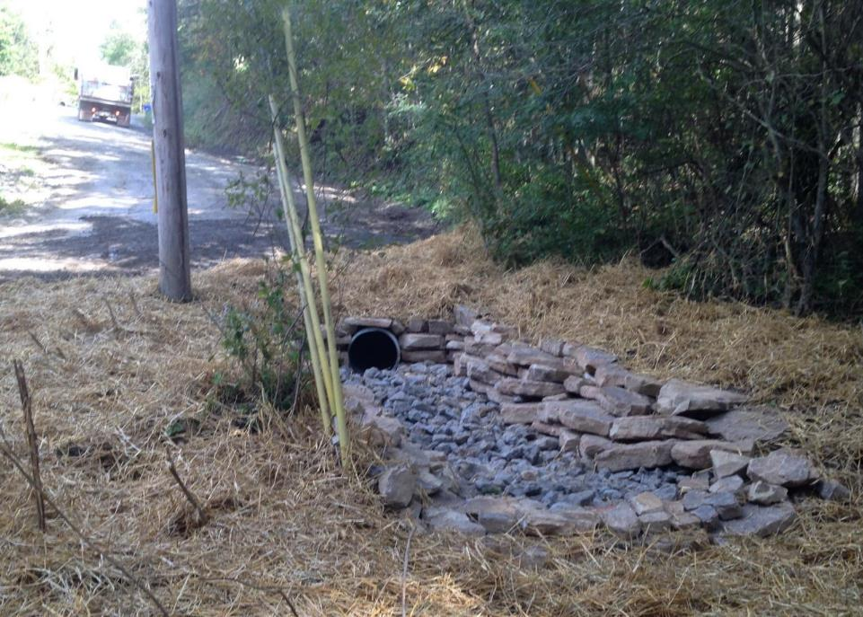
Infiltration Practices
Infiltration Beds / Trenches
Infiltration Bed
(3’D x 20’L x 7’W)
15” Pipe Outlet
3’ Deep, filled w/ R4 and edged with pallet stone.

Slide 17
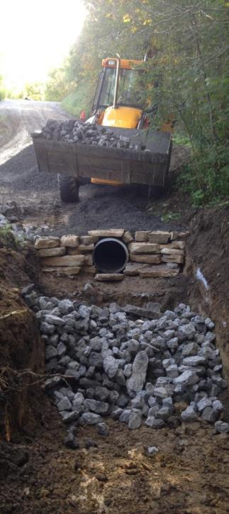
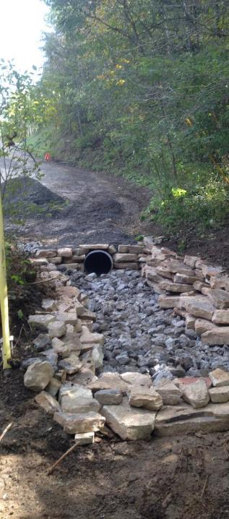
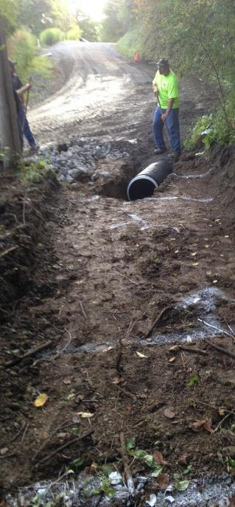
Infiltration Practices
Infiltration Beds / Trenches
1
2
3
3’ Deep, filled w/ R4 and edged with pallet stone.

Slide 18
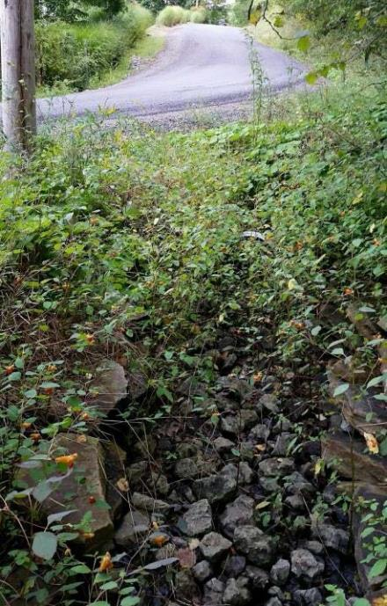
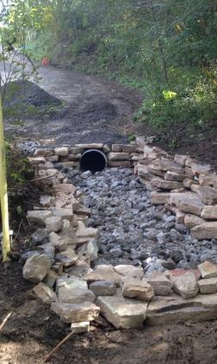
Infiltration Practices
Infiltration Beds / Trenches
7 years later
15” Pipe Outlet
Over time Infiltration Bed blends in but continues to function as intended to reduce water and sediment leaving the road.
Infiltration Bed
(3’D x 20’L x 7’W)

Slide 19
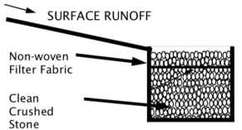
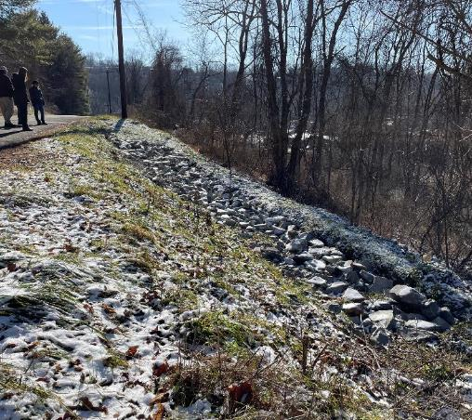
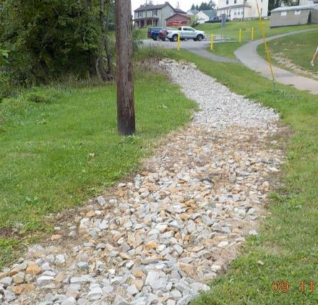
Infiltration Practices
Infiltration Beds / Trenches
Infiltration Trench
Similar to infiltration bed, but longer and on contour (virtually flat)

Slide 20
Infiltration Practices
Structural Infiltration Practices
Infiltration Beds / Trenches
Infiltration Basins
Vegetated Swales
Rain Gardens
Subsurface Structures
This is not all-inclusive

Slide 21
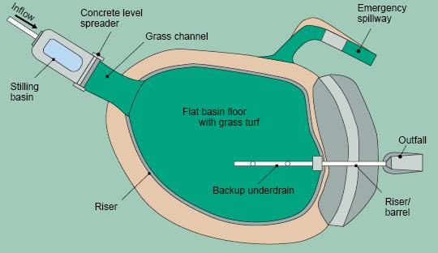
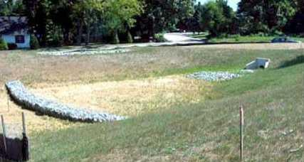
Infiltration Practices
Infiltration Basin
Infiltration basin: A depression that temporarily stores stormwater and allows it to seep into the soil.
Typical features:
Forebay or Stilling Basin
Storage Pool
Pool Level Riser
High-water Spillway
Incorporated Underdrain
Easily Maintained
Not all infiltration basins have all the above features
https://stormwaterbook.safl.umn.edu/infiltration-practices

Slide 22
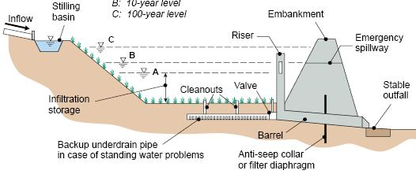
Infiltration Practices
Infiltration Basin
Infiltration basin: A depression that temporarily stores stormwater and allows it to seep into the soil.
Practical Uses:
Upslope of road to intercept water
At ditch outlets
At storm sewer discharge
Before storm sewers to reduce flows
*situations often call for site specific innovation
https://stormwaterbook.safl.umn.edu/infiltration-practices

Slide 23
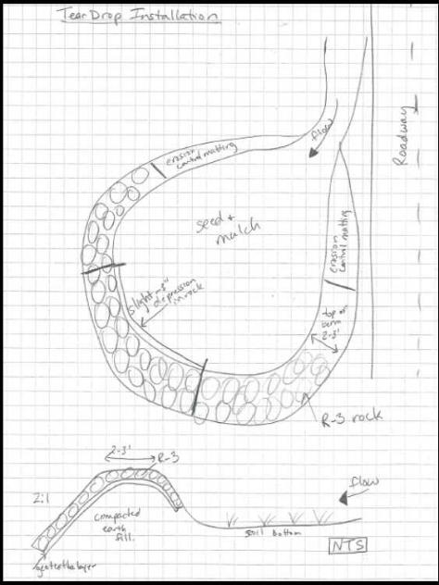
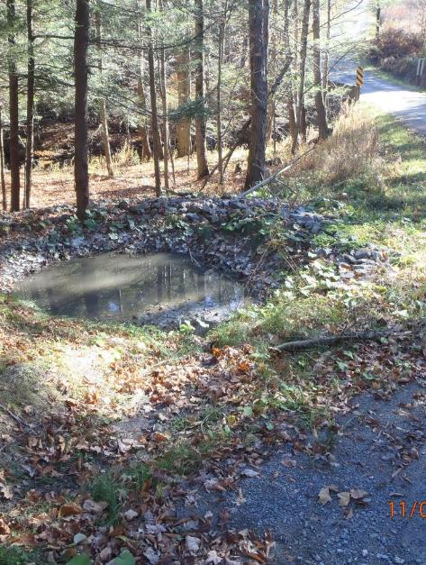
Infiltration Practices
Infiltration Basin - Teardrop
Infiltration Basins: “Teardrops” for individual pipe outlets

Slide 24
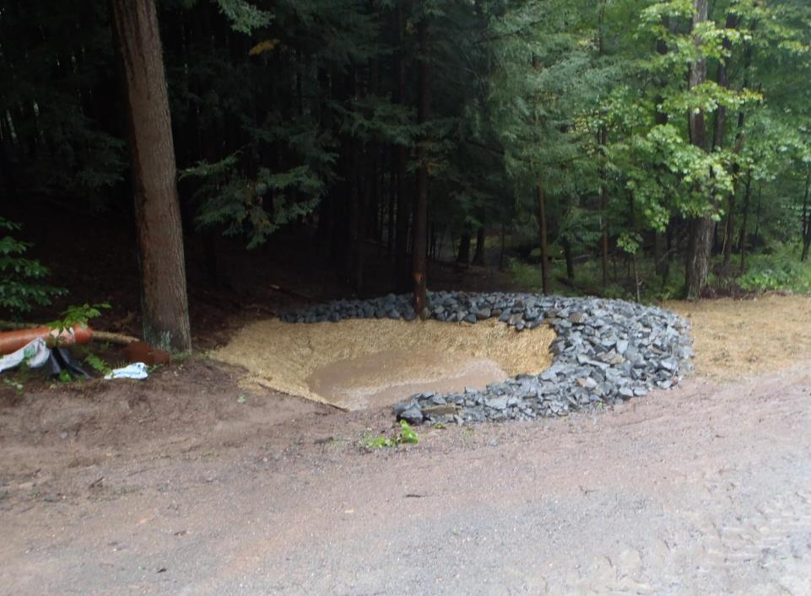

Infiltration Practices
Infiltration Basin - Teardrop
Infiltration Basins: “Teardrops” for individual pipe outlets
Designed Overflow
R3 riprap
Ditch/Pipe Flow
Earthen Bottom

Slide 25
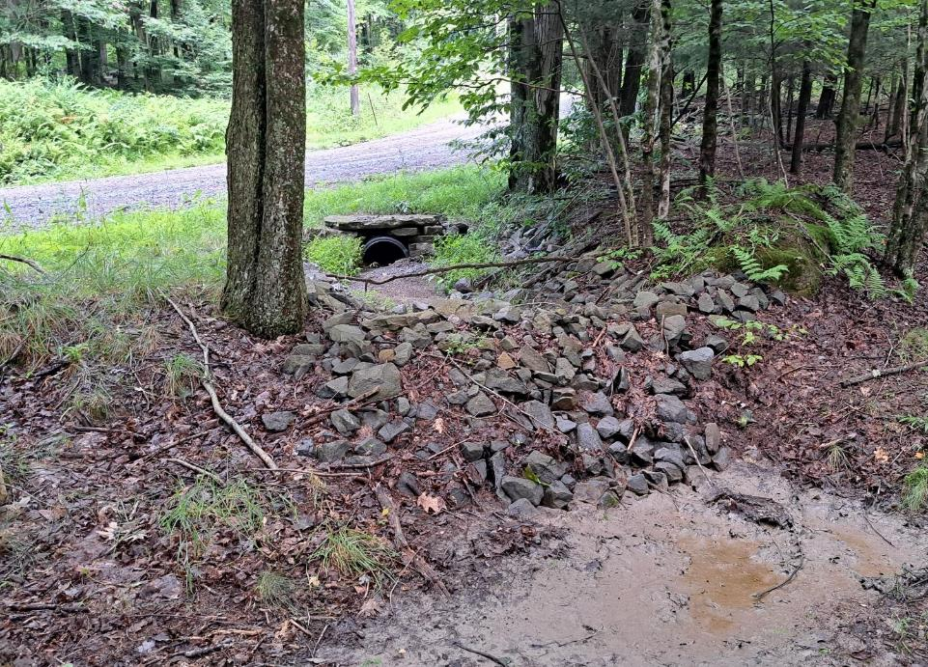
Infiltration Practices
Infiltration Basin - Teardrop
Infiltration Basins: “Teardrops” for individual pipe outlets
Ditch/Pipe Flow
R3 riprap
Teardrop
Designed Overflow

Slide 26
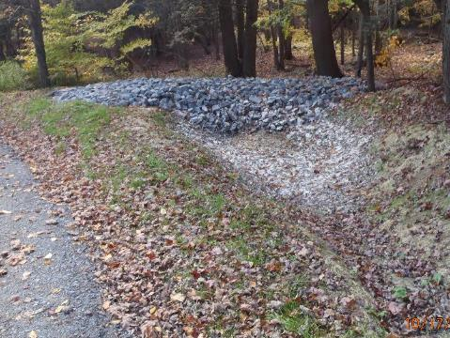
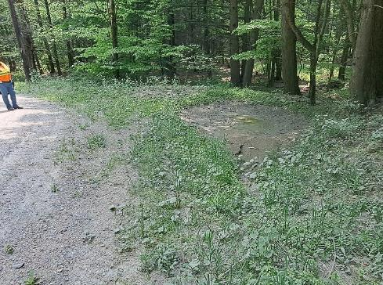
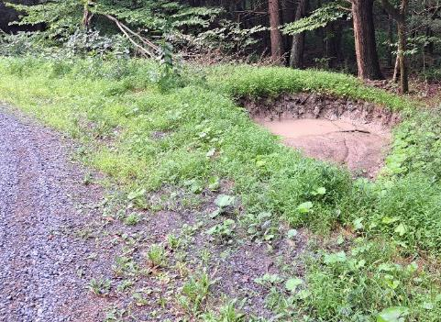
Infiltration Practices
Infiltration Basin - Teardrop
Year 1
Year 5
Full of sediment
After Cleanout
Must be maintained, especially on gravel roads.

Slide 27
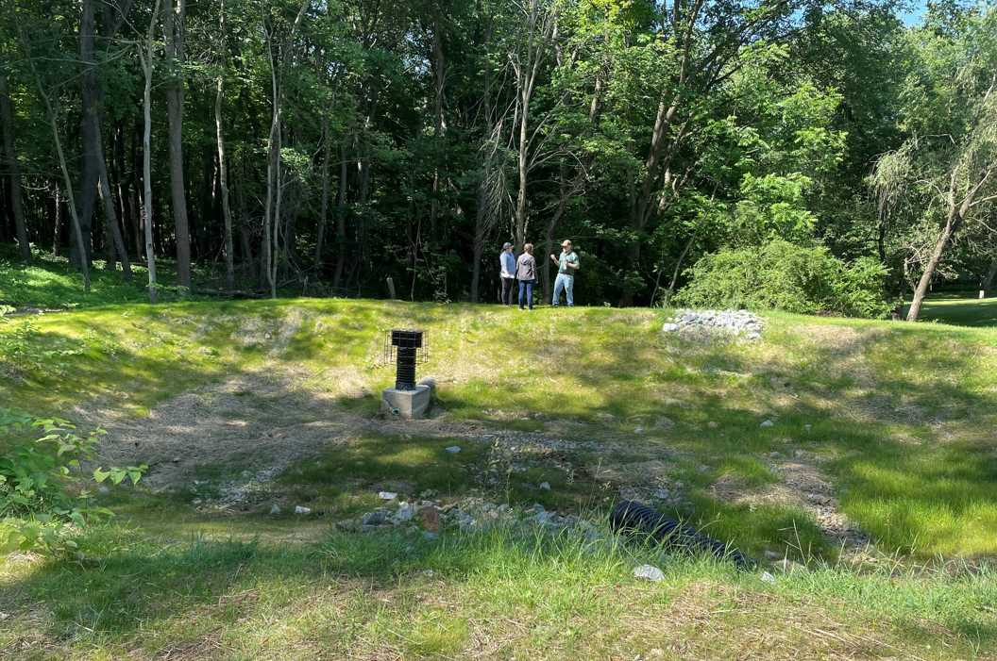
Infiltration Practices
Infiltration Basin - Off-ROW
Infiltration Basins: for Off-right-of-way flow coming to road
Stormwater basin collects and infiltrates runoff from an upslope park and slowly discharges storm flow.
Road
Overflow to road ditch

Slide 28
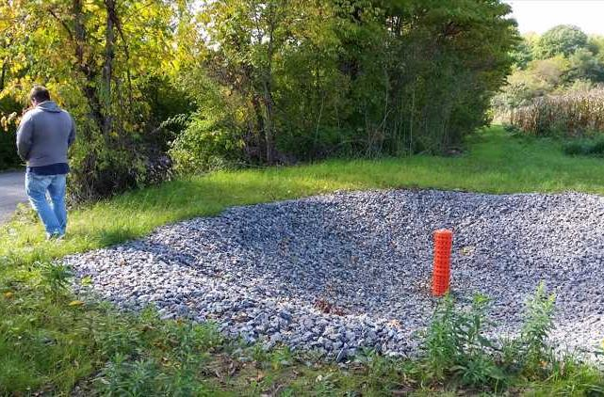
Infiltration Practices
Infiltration Basin - Off-ROW
Infiltration Basins: Can go above road for off-ROW water
Basin infiltrates runoff from farm fields and overflows to grass swale
Road

Slide 29
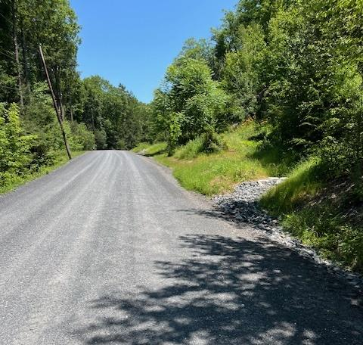
Infiltration Practices
Infiltration Basin - Off-ROW
Infiltration Basins: Can go in ditch for road runoff
Use when ditch outlets are not feasible, and space is available.
Basins can be in a series to:
Slow ditch drainage
Limit runoff
Capture sediment
Design to be easily maintained from the road.
Infiltration Basin
overflow

Slide 30
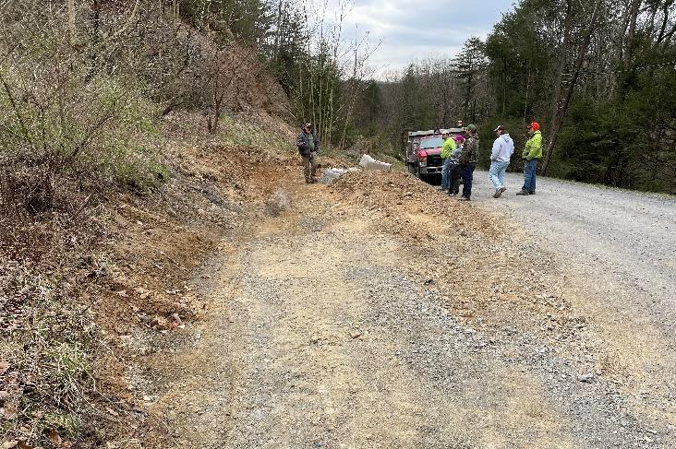
Infiltration Practices
Infiltration Basin - Off-ROW
Infiltration Basins: Can go in ditch for road runoff
Infiltration Basin

Slide 31
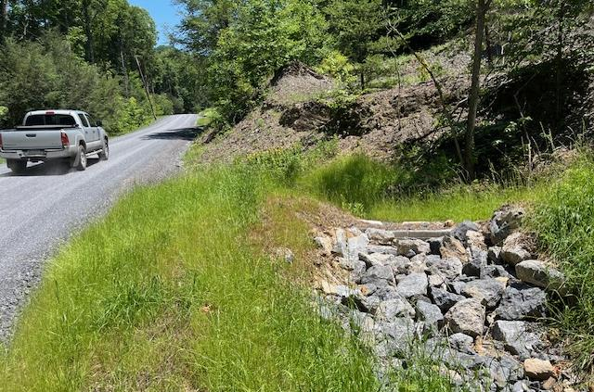
Infiltration Practices
Infiltration Basin - Off-ROW
Infiltration Basins: Can go in ditch for road runoff
Infiltration Basin
overflow

Slide 32
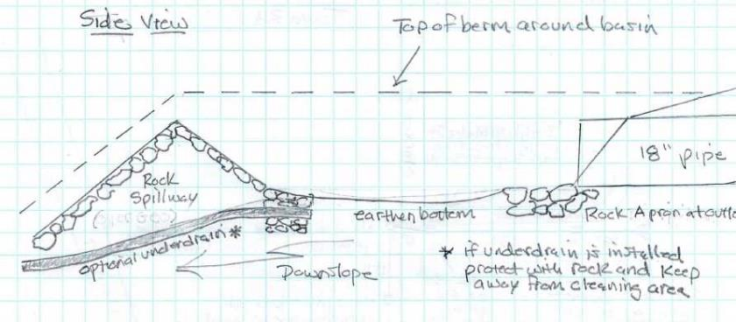
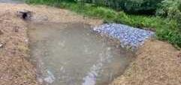
Infiltration Practices
Infiltration Basin - Off-ROW
Infiltration Basins: Can go at pipe or storm sewer outlet
overflow

Slide 33
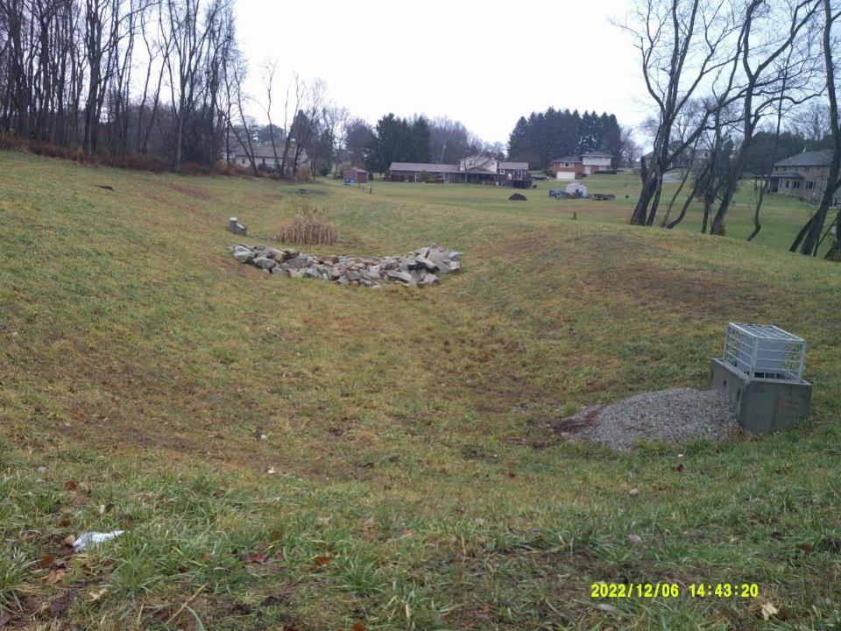
Infiltration Practices
Infiltration Practices
Infiltration Basin – Storm Sewer
Infiltration Basin - Off-ROW
Infiltration Basins: Can go at pipe or storm sewer outlet
Storm Sewer Outlets from two streets
Infiltration Basin
Outlet
Infiltration Basin

Slide 34
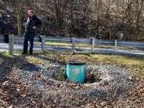
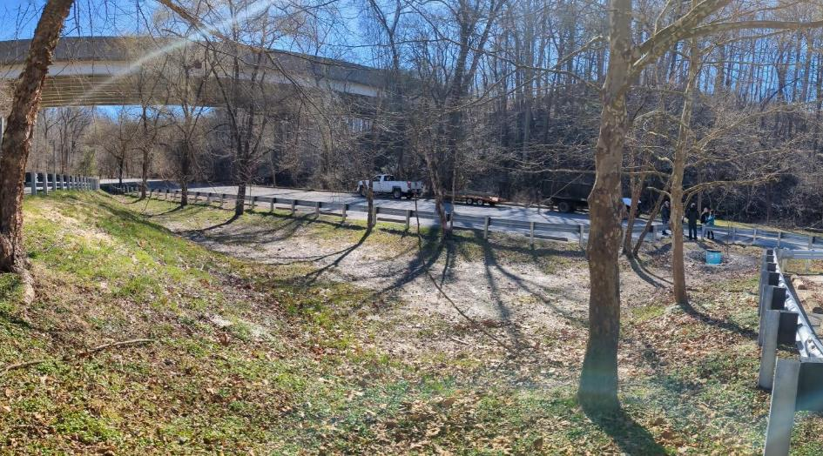
Infiltration Practices
Infiltration Basin – Storm Sewer
Large basin collects water from two roads and parking lot
Outlet riser

Slide 35
Infiltration Practices
Structural Infiltration Practices
Infiltration Beds / Trenches
Infiltration Basins
Vegetated Swales
Rain Gardens
Subsurface Structures
This is not all-inclusive

Slide 36
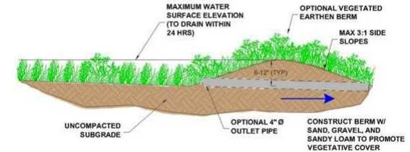
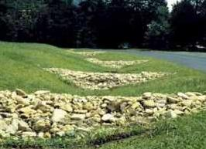
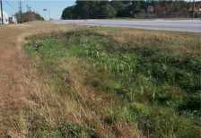
Infiltration Practices
Vegetated Swale
Vegetated Swales: Filter and slow runoff, promote infiltration

Slide 37
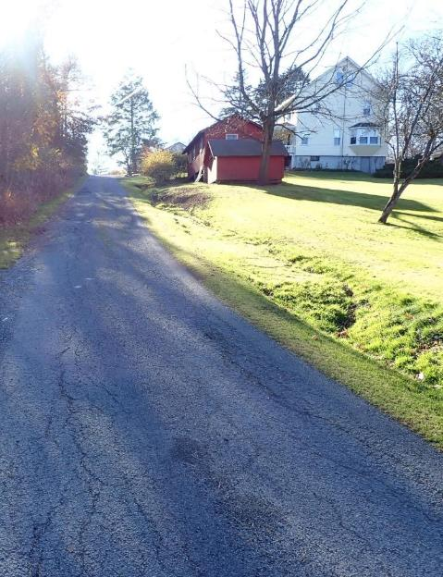
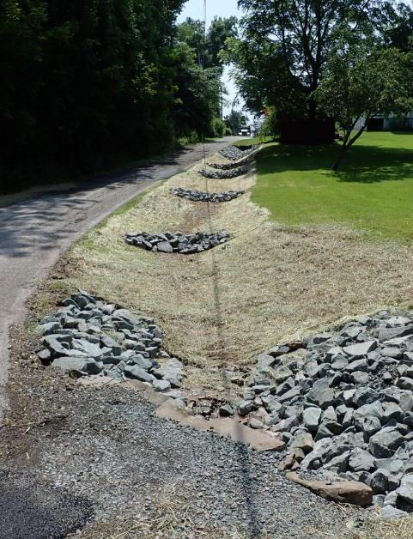
Infiltration Practices
Vegetated Swale
Vegetated Swales: Filter and slow runoff, promote infiltration
BEFORE
AFTER
Could not get drainage outlets
Ditch continually eroding
Check dams installed to slow flow
Ditch seeded and mulched

Slide 38
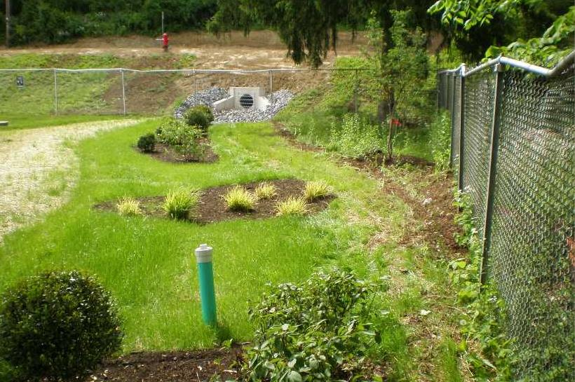
Infiltration Practices
Vegetated Swale
Vegetated Swales: Filter and slow runoff, promote infiltration
Road
Storm Sewer Outlet

Slide 39
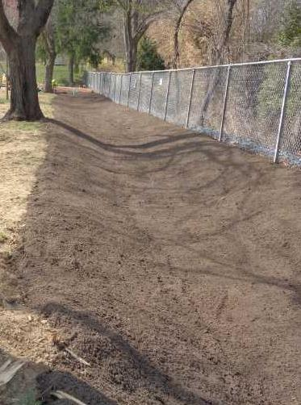
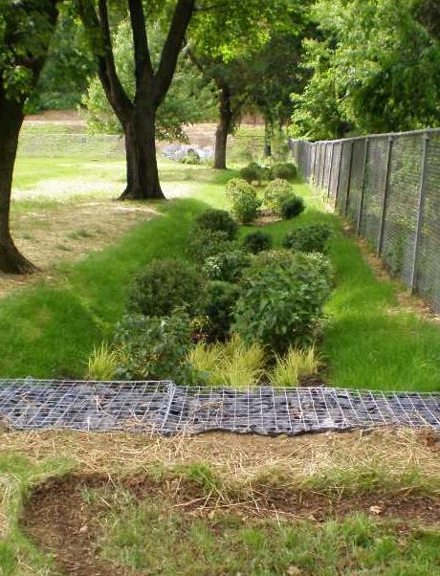
Infiltration Practices
Vegetated Swale
Vegetated Swales: Filter and slow runoff, promote infiltration
DURING
AFTER
Road
Road
Storm Sewer Outlet
Storm Sewer Outlet

Slide 40
Infiltration Practices
Structural Infiltration Practices
Infiltration Beds / Trenches
Infiltration Basins
Vegetated Swales
Rain Gardens
Subsurface Structures
This is not all-inclusive

Slide 41
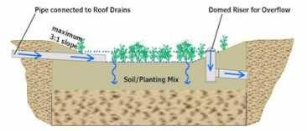
Infiltration Practices
Rain Garden
Rain Gardens
A depressed area in the landscape that collects stormwater from streets and roads to promote infiltration.
Vary widely in size and shape.
Typically planted with native vegetation
Typically used in more urban settings
Storm flow from road
Riser for overflow discharge

Slide 42
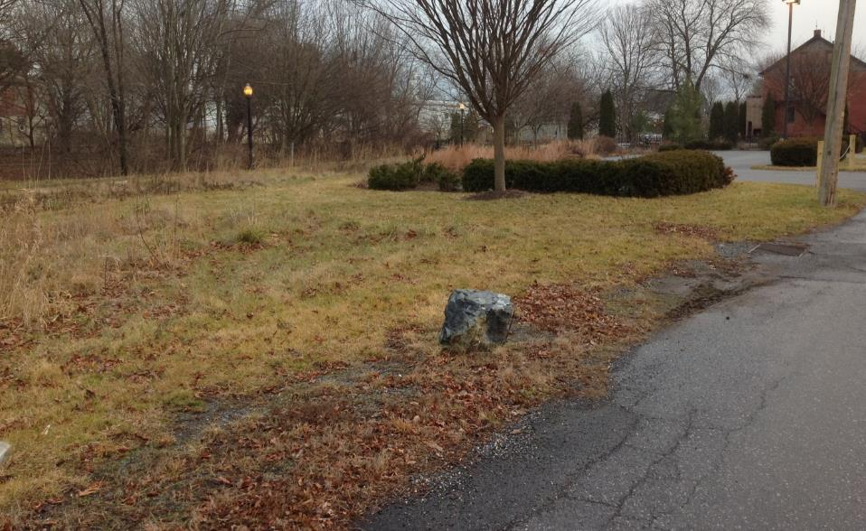
Infiltration Practices
Infiltration Basin – Rain Garden
BEFORE
Drop inlet drains to stream
Proposed rain garden
Cherry Lane, Lancaster County
Rain Garden: A depressed area in the landscape that collects stormwater from streets and roads to promote infiltration.

Slide 43

Infiltration Practices
Infiltration Basin – Rain Garden
AFTER
Rain Garden
Cherry Lane, Lancaster County
Rain Garden: A depressed area in the landscape that collects stormwater from streets and roads to promote infiltration.

Slide 44

Infiltration Practices
Infiltration Basin – Rain Garden
Easterly Parkway Rain Gardens, Centre County
Drainage from both sides of road is directed to a roadside rain garden. Overflow outlets to the storm sewer.

Slide 45

Infiltration Practices
Infiltration Basin – Rain Garden
Easterly Parkway Rain Gardens, Centre County
Native vegetation and weirs are used to slow flow and utilize water.

Slide 46

Infiltration Practices
Rain Garden
Maybe get better pictures, or use different project?
Everhart Street, Chester County

Slide 47

Infiltration Practices
Rain Garden
Outlet Riser
Maybe get better pictures, or use different project?
Everhart Street, Chester County

Slide 48
Infiltration Practices
Structural Infiltration Practices
Infiltration Beds / Trenches
Infiltration Basins
Vegetated Swales
Rain Gardens
Subsurface Structures
This is not all-inclusive

Slide 49

Infiltration Practices
Pervious Pavements
Infiltration bed below road - Montgomery County
Notes:
Clean up this slide and add “Urban Drainage Issues”

Slide 50

Infiltration Practices
Pervious Pavements
Infiltration bed for porous pavement
Reynolds Ave, Lancaster County 3/3

Slide 51


Infiltration Practices
Pervious Pavements
BEFORE
AFTER
Reynolds Ave, Lancaster County 1/3

Slide 52

Infiltration Practices
Pervious Pavements
Pervious Pavement allows water to seep through the road surface to be absorbed by underlying soils.
Pervious Pavement
Porous Rock
Cahill and Associates

Slide 53

Infiltration Practices
Pervious Pavements
Stream
Pavers in sand over porous rock bed allows infiltration
Hoopes Alley, Chester County

Slide 54

Infiltration Practices
Pervious Pavements
All pervious pavements require more specialized maintenance.
Porous Surface will clog over time. How long depends on the amount of loose material: dirt, leaves, salt, cinders.
Specialized vacuum trucks or street sweepers often needed.
https://3rpsinc.com/porous-pavement-sweeping/

Slide 55
Structural Infiltration Practices
Introduction
Practices
DGLVR Project
Examples

Slide 56



Project Walkthrough: Bradford County, Moore Hill Road
2016: $77K Grant, $26K in-kind
Road runoff eroding ditch to PennDOT road and stream
Infiltration swale constructed through field
AFTER

Slide 57



Infiltration Practices
Vegetated Swale
BEFORE
BEFORE
Runoff cut eroded ditch through farm field, flooded PennDOT road, and entered stream
Bradford, Moore Hill 2/5
Low-gradient infiltration swale through field for road runoff

Slide 58


Infiltration Practices
Vegetated Swale
BEFORE
AFTER
Moore Hill Road, Bradford County
“Virtually Flat” drivable Infiltration Swale
Long and wide swale at a low gradient
Eroded ditch filled in
Energy dissipater and/or infiltration bed

Slide 59


Infiltration Practices
Vegetated Swale
DURING
After
Dense vegetation slows, filters, and utilizes stormwater
Moore Hill Road, Bradford County
Drivable or mowable shape
Bradford, Moore Hill 4/5
Low-gradient infiltration swale through field for road runoff

Slide 60

Infiltration Practices
Vegetated Swale
Dense vegetation slows, filters, and utilizes stormwater
Moore Hill Road, Bradford County
Bradford, Moore Hill 5/5
Low-gradient infiltration swale through field for road runoff

Slide 61

Project Walkthrough: Venango County, Wood Rd
Excessive road runoff to single outlet
Installed forebay to grass swale to infiltration basin.
AFTER
BEFORE

Slide 62

Infiltration Practices
Example Project
Forebay
Grass swale
Infiltration Basin
Overflow back to road culvert

Slide 63

DURING
Infiltration Basin
Grass swale
Forebay
Venango, Wood Rd 3/6
Stormwater outlet to forebay, to grassed swale, to infiltration basin
Picture taken from road edge

Slide 64

DURING
Forebay
Road
Grass swale
Infiltration Basin
Venango, Wood Rd 4/6
Stormwater outlet to forebay, to grassed swale, to infiltration basin

Slide 65

DURING
If basin fills, outlets excess to new crosspipe
Infiltration Basin
Venango, Wood Rd 5/6
Stormwater outlet to forebay, to grassed swale, to infiltration basin

Slide 66

AFTER
Infiltration Basin
Grass swale
Forebay
Venango, Wood Rd 6/6
Stormwater outlet to forebay, to grassed swale, to infiltration basin
Picture taken from road edge

Slide 67

Project Walkthrough: Westmoreland County, Newhouse Park Rd
2022: $123K Grant, $22K in-kind
Parking lot runoff washing out road.
Collected runoff in storm sewer.
Directed runoff to forebay (for cleanout) and detention basin
AFTER
BEFORE

Slide 68


BEFORE
BEFORE
Edge of parking lot
Westmoreland, Newhouse 2/9
Berm to collect parking lot and road runoff
Direct runoff to forebay (for cleanout) and detention basin
Drains to storm sewer to stream

Slide 69

BEFORE
AFTER
Collect water from parking lot
Storm Sewer
Forebay
(for cleanout)
Detention Basin

Slide 70

Engineered Plan
Collect water from parking lot
AFTER
Collect water from parking lot
Storm Sewer
Storm Sewer
Forebay
(for cleanout)
Forebay
(for cleanout)
Detention Basin
Detention Basin

Slide 71


BEFORE
Westmoreland, Newhouse 5/9
Berm to collect parking lot and road runoff
Direct runoff to forebay (for cleanout) and detention basin
AFTER
township paved parking lot as in-kind
Paved grade break forces water into inlet
New Stormwater Inlet

Slide 72

AFTER
New Stormwater Inlet
Westmoreland, Newhouse 6/9
Berm to collect parking lot and road runoff
Direct runoff to forebay (for cleanout) and detention basin

Slide 73

AFTER
Discharged to forebay for cleanout
Paved grade break forces water into inlet
New Stormwater Inlet
Getting before/during pics from Rob
Westmoreland, Newhouse 3/4
Installation of detention basin to catch runoff from parking lot and road.
Parking Lot

Slide 74

AFTER
Detention Basin
Storm Sewer Outlet
Westmoreland, Newhouse 8/9
Berm to collect parking lot and road runoff
Direct runoff to forebay (for cleanout) and detention basin
Forebay

Slide 75

AFTER
Forebay
Road
Road
Detention Basin
Westmoreland, Newhouse 9/9
Berm to collect parking lot and road runoff
Direct runoff to forebay (for cleanout) and detention basin

Slide 76

Project Walkthrough: Westmoreland County, Shields Farm Rd
2018: $49K Grant, $11K in-kind
Road collected all runoff from long hill
Installed detention basin
Installed several crosspipes, through the bank pipes, and infiltration trenches
AFTER

Slide 77


BEFORE
Westmoreland, Shields Farm 2/8
Detention Basin on upper site
Crosspipes, through-the-bank pipes, and infiltration basins on bottom of site

Slide 78



BEFORE
AFTER
Crosspipe, to
Through the bank pipe, to
Infiltration Trenches
Overflow outlet
New
Detention
Basin

Slide 79


AFTER
New
Detention
Basin
Pipes to infiltration trenches
Overflow outlet
New
Detention
Basin

Slide 80


AFTER
Infiltration Trenches
Pipes to infiltration trenches
inlet
Overflow outlet
New
Detention
Basin
Westmoreland, Shields Farm 5/8
Detention Basin on upper site
Crosspipes, through-the-bank pipes, and infiltration basins on bottom of site

Slide 81




Infiltration Trench
Courtesy Westmoreland
Conservation District
Outlet Pipe
on contour
Infiltration trench size is site dependent
This one is 3’ x 3’ x 50’
Infiltration Trenches
(on contour)
Westmoreland, Shields Farm 6/8
Detention Basin on upper site
Crosspipes, through-the-bank pipes, and infiltration basins on bottom of site

Slide 82

AFTER
Infiltration Trenches
(on contour)
Westmoreland, Shields Farm 7/8
Detention Basin on upper site
Crosspipes, through-the-bank pipes, and infiltration basins on bottom of site

Slide 83


BEFORE
AFTER
AFTER
Infiltration Trenches
Westmoreland, Shields Farm 8/8
Detention Basin on upper site
Crosspipes, through-the-bank pipes, and infiltration basins on bottom of site

Slide 84

Project Walkthrough: Montgomery County, Webber Rd
2016: $24K Grant, $2K in-kind
Badly eroded ditch along suburban road.
Installed storm sewer, but with grass sale over top to promote infiltration
AFTER

Slide 85


BEFORE
No outlets due to houses, badly eroded ditches
Numerous house and hard drains
The Problem:
Yards and drives drain to road.
Nowhere to outlet ditches.
Montgomery, Webber Rd 2/7
Grass Swale constructed over newly installed storm sewer.

Slide 86

Site Plan:
Drop inlets and storm sewer
Grassed swale over storm pipes to promote infiltration and alleviate landowner concerns
Montgomery, Webber Rd 3/7
Grass Swale constructed over newly installed storm sewer.

Slide 87

BEFORE
Eroded Ditch
Montgomery, Webber Rd 4/7
Grass Swale constructed over newly installed storm sewer.

Slide 88

BEFORE
Eroded Ditch
DURING
Montgomery, Webber Rd 4/7
Grass Swale constructed over newly installed storm sewer.

Slide 89

BEFORE
Eroded Ditch
DURING
AFTER
Grass Swale
Montgomery, Webber Rd 4/7
Drop Inlets
Grass Swale constructed over newly installed storm sewer.

Slide 90

AFTER
Storm Sewer Inlets
Storm Sewer Inlet
Grass Swale
Montgomery, Webber Rd 5/7
Grass Swale constructed over newly installed storm sewer.

Slide 91

AFTER
Storm Sewer Inlets
Grass Swale over storm sewer
Storm Sewer Inlets
Montgomery, Webber Rd 6/7
Grass Swale constructed over newly installed storm sewer.

Slide 92


BEFORE
AFTER
Storm Sewer Inlets
Trees removed
Grass Swale over storm sewer
Constant ditch washouts, erosion into yards
Montgomery, Webber Rd 7/7
Grass Swale constructed over newly installed storm sewer.

Slide 93

Project Walkthrough: Lancaster County, North Lane
2019: $14K Grant, $3K in-kind
Stormwater in borough piped to stream
Rain garden installed to filter sediment and infiltrate runoff
AFTER
BEFORE
Paved swale piped to stream

Slide 94


BEFORE
PLAN
Lancaster, North Lane 2/4
Rain garden installed between road and walking trail before stream.

Slide 95

DURING
Rain Garden
Overflow Outlet
Lancaster, North Lane 3/4
Rain garden installed between road and walking trail before stream.

Slide 96

AFTER
Rain Garden
Overflow Outlet
Lancaster, North Lane 4/4
Rain garden installed between road and walking trail before stream.

Slide 97

Project Walkthrough: Dauphin County, 31st Street
2019: $85K Grant, $0 in-kind
Road runoff washing out rail trail below into stream
Installed drop inlets to “cascading” subsurface infiltration structures
AFTER
BEFORE

Slide 98


BEFORE
Water from two roads ran down road, washed out rail trail and into stream
Dauphin, 31st St 2/7
Installed drop inlets to “cascading” subsurface infiltration structures

Slide 99

BEFORE
AFTER
Drop Inlets
subsurface infiltration beds
Dauphin, 31st St 3/7
Installed drop inlets to “cascading” subsurface infiltration structures

Slide 100

4 Drop Inlets
Road Surface
Dauphin, 31st St 4/7
Installed drop inlets to “cascading” subsurface infiltration structures
1/4

Slide 101

4 Drop Inlets
Road Surface
Dauphin, 31st St 4/7
Installed drop inlets to “cascading” subsurface infiltration structures
2/4

Slide 102
4 Drop Inlets
Road Surface
Dauphin, 31st St 4/7
Installed drop inlets to “cascading” subsurface infiltration structures
3/4

Slide 103
4 Drop Inlets
Dauphin, 31st St 4/7
Installed drop inlets to “cascading” subsurface infiltration structures
4/4

Slide 104


Bank of drop inlets installed at top of project to capture all runoff
Dauphin, 31st St 5/7
Installed drop inlets to “cascading” subsurface infiltration structures

Slide 105


Excavation and filling of lower subsurface infiltration beds
Dauphin, 31st St 6/7
Installed drop inlets to “cascading” subsurface infiltration structures

Slide 106


AFTER
subsurface infiltration beds
Drop Inlets
Dauphin, 31st St 7/7
Installed drop inlets to “cascading” subsurface infiltration structures

Slide 107
Infiltration Practices
Introduction
Structural Infiltration practices:
Any structure designed to capture stormwater runoff and allow it to slowly seep into the soil.
Infiltration Basin
Rain Garden
Detention Basin
Infiltration Trench
Infiltration Swale
Stilling Basin
Bio-Swale
Grassed Waterway
Permeable Pavement
Constructed Wetland
Examples: too many types and sizes to cover them all

Slide 108

Structural Infiltration Practices
QUESTIONS?
ADDITIONAL RESOURCES:
Your Conservation District
Your Municipal Engineer
PA Stormwater Best Management Practices: Specifically chapter 6 on “Structural BMPs”
PA MS4: DEP stormwater management resources.
next chapter:
DSA
Helpful References:
(Municipal Separate Storm Sewer System)

