Slide 1
Low Volume Road Traffic Counts
Toggle Fullscreen
mode with this button
above
Use Chat box to ask Questions
http://metrocount.com
If you are reading this, then you are successfully seeing the webinar video. In addition to audio on the webinar, we have opened a phone conference line to allow attendees to listen and ask questions directly: 866-823-7699. Please use either the webinar audio or conference line, but not both (will produce feedback)
For audio, call conference line: 866-823-7699
For assistance, call: 814-865-5355

Slide 2
LVR Traffic Counts
Webinar, including Q&A, will be recorded and available later. www.dirtandgravelroads.org

Slide 3
Low Volume Road Traffic Counts
Note this is essentially the same presentation given at 2014 Maintenance Workshop
We will answer any logistical questions possible, but focus is on policy.
http://metrocount.com

Slide 4
Driving Surface Aggregate
Introduction
LVR Traffic Counts
Overview
Policy
Use of Existing Data
Level 1 Count
Level 2 Count
Miscellaneous
For audio, call conference line: 866-823-7699
For assistance, call: 814-865-5355

Slide 5
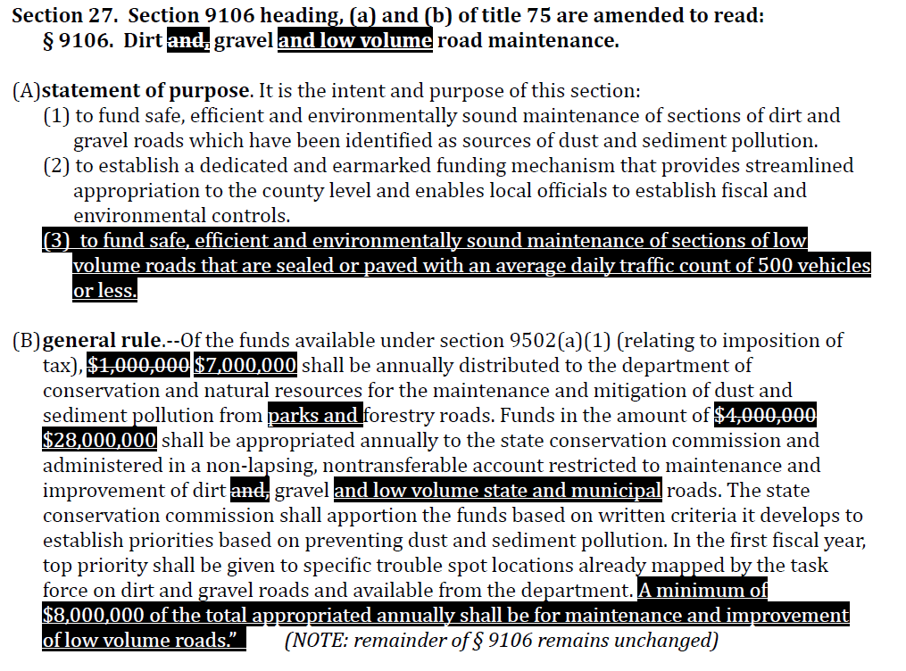
LVR Traffic Counts
Overview
DGLVR Law:

Slide 6
LVR Traffic Counts
Overview
DGLVR Law:
“ To fund safe, efficient, and environmentally sound maintenance of sections of low volume roads that are sealed or paved with an average daily traffic count of 500 vehicles or less.”
(Unpaved road do not need traffic counts!)
For audio, call conference line: 866-823-7699
For assistance, call: 814-865-5355

Slide 7
LVR Traffic Counts
Overview
Traffic Counts are not quite as straightforward as they sound:
FHWA has a standard method, recommends a 48 hour count.
Nobody, including PennDOT, really uses the FHWA method directly.
EVERY STATE has their own methods and policies.
For audio, call conference line: 866-823-7699
For assistance, call: 814-865-5355

Slide 8
LVR Traffic Counts
Overview
Traffic Counts are not quite as straightforward as they sound:
100%
90%
80%
For illustration only, not actual numbers.
Confidence in count
hours
days
weeks
months
Length of count

Slide 9
LVR Traffic Counts
Overview
Traffic Counts, Our Goal:
Verify within reason a road has <500 vehicles per day.
Simple, and accurate enough.
For audio, call conference line: 866-823-7699
For assistance, call: 814-865-5355

Slide 10
LVR Traffic Counts
Overview
Traffic Counts, Our Goal:
Verify within reason a road has <500 vehicles per day.
Simple, and accurate enough.
AADT
Average Annual Daily Traffic
For audio, call conference line: 866-823-7699
For assistance, call: 814-865-5355

Slide 11
Driving Surface Aggregate
Introduction
LVR Traffic Counts
Overview
Policy
Use of Existing Data
Level 1 Count
Level 2 Count
Miscellaneous
For audio, call conference line: 866-823-7699
For assistance, call: 814-865-5355

Slide 12
LVR Traffic Counts
Overview
Responsibility:
Applicant is responsible for providing traffic counts before a contract can be signed.
Conservation District is responsible for verifying that a count exists, and that the count meets the criteria established in state and local policy.
For audio, call conference line: 866-823-7699
For assistance, call: 814-865-5355

Slide 13
LVR Traffic Counts
Overview
Program Policy (adopted 9/9/14 by SCC):
Use existing data.
Level 1 count (2 hour).
Level 2 count (24 hour).
For audio, call conference line: 866-823-7699
For assistance, call: 814-865-5355

Slide 14
LVR Traffic Counts
Overview
Program Policy (adopted 9/9/14 by SCC):
This policy sets the minimum statewide Program standard.
Your County can enact stricter count standards.
More to come on this at the end
For audio, call conference line: 866-823-7699
For assistance, call: 814-865-5355

Slide 15
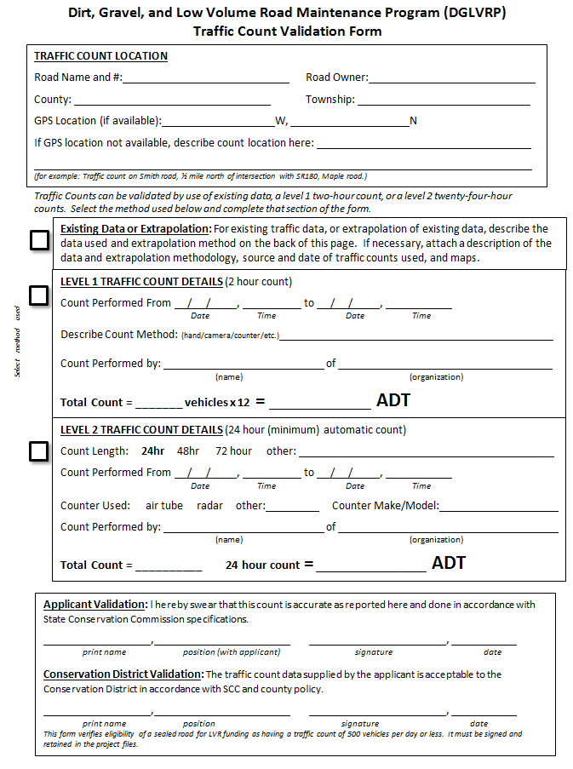
Traffic Count Validation Form:
Standard form
Keep with project files.
For audio, call conference line: 866-823-7699
For assistance, call: 814-865-5355

Slide 16
Traffic Count Validation Form:
Standard form
Keep with project files.
Road Information
Use Existing Traffic Data
Level 1 Count
Level 2 Count
Validation
For audio, call conference line: 866-823-7699
For assistance, call: 814-865-5355

Slide 17
Traffic Count Validation Form:
Standard form
Keep with project files.
Road Information
For audio, call conference line: 866-823-7699
For assistance, call: 814-865-5355

Slide 18
Traffic Count Validation Form:
Road Information
For audio, call conference line: 866-823-7699
For assistance, call: 814-865-5355

Slide 19
Driving Surface Aggregate
Introduction
LVR Traffic Counts
Overview
Policy
Use of Existing Data
Level 1 Count
Level 2 Count
Miscellaneous
For audio, call conference line: 866-823-7699
For assistance, call: 814-865-5355

Slide 20
LVR Traffic Counts
Use Existing Data
Municipal Roads
Less than 5% have actual counts.
Many more have estimates, but estimates cannot be used.
Counts are valid for 5 years.
Check with your planning commission.
For audio, call conference line: 866-823-7699
For assistance, call: 814-865-5355

Slide 21
LVR Traffic Counts
Use Existing Data
PennDOT Roads
Have good traffic data
http://www.dot.state.pa.us/Internet/bureaus/pdplanres.nsf/infoBPRTrafficInfoTrafficVolumeMap
Can be used to extrapolate to local roads
For audio, call conference line: 866-823-7699
For assistance, call: 814-865-5355

Slide 22
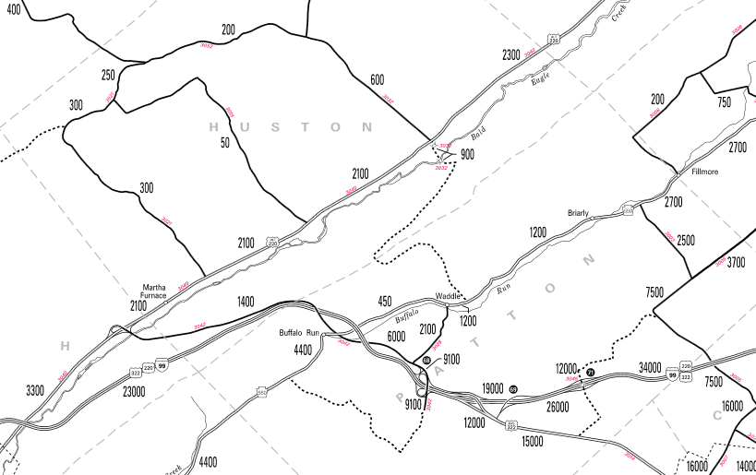
LVR Traffic Counts
Use Existing Data
PennDOT Roads: example map
old 220
99/220/322
For audio, call conference line: 866-823-7699
For assistance, call: 814-865-5355
N. Atherton
P. Matilda
SC

Slide 23
LVR Traffic Counts
Use Existing Data
PennDOT Roads: example map
99/220/322
For audio, call conference line: 866-823-7699
For assistance, call: 814-865-5355
N. Atherton
P. Matilda
SC

Slide 24
LVR Traffic Counts
Use Existing Data
PennDOT Roads: example map
unknown
99/220/322
For audio, call conference line: 866-823-7699
For assistance, call: 814-865-5355
N. Atherton
P. Matilda
SC

Slide 25
LVR Traffic Counts
Use Existing Data
PennDOT Roads: example map
99/220/322
For audio, call conference line: 866-823-7699
For assistance, call: 814-865-5355
N. Atherton
P. Matilda
SC

Slide 26
LVR Traffic Counts
Use Existing Data
PennDOT Roads: example map
< 500
< 500
99/220/322
For audio, call conference line: 866-823-7699
For assistance, call: 814-865-5355
N. Atherton
P. Matilda
SC

Slide 27
Traffic Count Validation Form:
Standard form
Keep with project files.
Use Existing Traffic Data
For audio, call conference line: 866-823-7699
For assistance, call: 814-865-5355

Slide 28
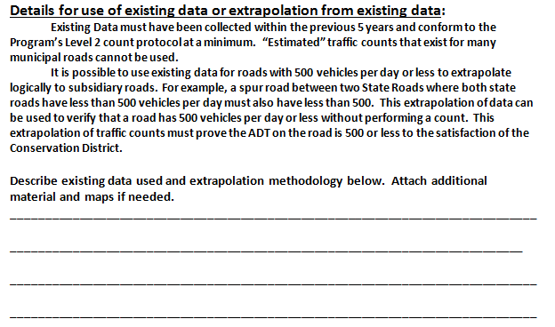
Traffic Count Validation Form:
Existing Data
front
back
For audio, call conference line: 866-823-7699
For assistance, call: 814-865-5355

Slide 29
Driving Surface Aggregate
Introduction
LVR Traffic Counts
Overview
Policy
Use of Existing Data
Level 1 Count
Level 2 Count
Miscellaneous
For audio, call conference line: 866-823-7699
For assistance, call: 814-865-5355

Slide 30
LVR Traffic Counts
Level 1 Counts: 2 hours
Level 1 Counts
Count traffic for two hours at the busiest time of the day (3-6pm) on a Tue, Wed, or Thr.
While not as accurate, it is an “overestimation” of traffic counts.
Counts of <500 mean road is eligible.
For audio, call conference line: 866-823-7699
For assistance, call: 814-865-5355

Slide 31
LVR Traffic Counts
Level 1 Counts: 2 hours
Level 1 Counts
Simple and quick.
Designed to eliminate a lot of the very low volume roads with minimal effort.
Hopefully it will suffice for >75% of the traffic counts we need.
For audio, call conference line: 866-823-7699
For assistance, call: 814-865-5355

Slide 32
LVR Traffic Counts
Level 1 Counts: 2 hours
Level 1 Counts
Types of two Hour Counts
Manual Counts
Video Counts
Use of Counter (might as well do level 2!)
Other?
For audio, call conference line: 866-823-7699
For assistance, call: 814-865-5355

Slide 33
LVR Traffic Counts
Level 1 Counts: 2 hours
Level 1 Counts
Must be done between March 1 and the week before Thanksgiving.
For audio, call conference line: 866-823-7699
For assistance, call: 814-865-5355

Slide 34
LVR Traffic Counts
Level 1 Counts: 2 hours
Level 1 Counts
Between March 1 and the week before Thanksgiving.
On a Tuesday, Wednesday, or Thursday.
Two consecutive hours between 3:00 pm & 6:00 pm.
For audio, call conference line: 866-823-7699
For assistance, call: 814-865-5355

Slide 35
LVR Traffic Counts
Level 1 Counts: 2 hours
Level 1 Counts
Between March 1 and the week before Thanksgiving.
On a Tuesday, Wednesday, or Thursday.
Two consecutive hours between 3:00 pm & 6:00 pm.
No holidays, or the day before or after a holiday.
Direction of travel or type of vehicle does not matter.
The traffic count for the time period will be adjusted to a 24 hour period by simply multiplying the 2 hour count volume times twelve (12)
Only licensed motor vehicles should be counted.
For audio, call conference line: 866-823-7699
For assistance, call: 814-865-5355

Slide 36
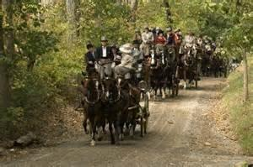
LVR Traffic Counts
Level 1 Counts: 2 hours
Only licensed motor vehicles should be counted...
For audio, call conference line: 866-823-7699
For assistance, call: 814-865-5355

Slide 37
LVR Traffic Counts
Level 1 Counts: 2 hours
Level 1 Counts
A Level 1 count that yields 600 vehicles per day does not disqualify a road since it represents an overestimation.
It simply means that a Level 2 count is needed if they wish to pursue the project.
For audio, call conference line: 866-823-7699
For assistance, call: 814-865-5355

Slide 38
LVR Traffic Counts
Level 1 Counts: 2 hours
Level 1 Counts
Example 1: A count for two consecutive hours between 4:00 & 6:00 pm produces a count of 25.
For audio, call conference line: 866-823-7699
For assistance, call: 814-865-5355

Slide 39
LVR Traffic Counts
Level 1 Counts: 2 hours
Level 1 Counts
Example 1: A count for two consecutive hours between 4:00 & 6:00 pm produces a count of 25. 12 x 25 =300 average daily count.
This worksite would be eligible (no level 2 count needed).
For audio, call conference line: 866-823-7699
For assistance, call: 814-865-5355

Slide 40
LVR Traffic Counts
Level 1 Counts: 2 hours
Level 1 Counts
Example 1: A count for two consecutive hours between 4:00 & 6:00 pm produces a count of 25. 12 x 25 =300 average daily count.
This worksite would be eligible (no level 2 count needed).
Example 2: A traffic count for two consecutive hours between 3:30 pm & 5:30 pm produces a count of 53.
For audio, call conference line: 866-823-7699
For assistance, call: 814-865-5355

Slide 41
LVR Traffic Counts
Level 1 Counts: 2 hours
Level 1 Counts
Example 1: A count for two consecutive hours between 4:00 &6:00 pm produces a count of 25. 12 x 25 =300 average daily count.
This worksite would be eligible (no level 2 count needed).
Example 2: A traffic count for two consecutive hours between 3:30 pm & 5:30 pm produces a count of 53. 12 x 53 = 636 average daily count.
This does not disqualify the road. It simply means that a more accurate Level 2 Count is required if the applicant wants to continue to pursue Program funding.
For audio, call conference line: 866-823-7699
For assistance, call: 814-865-5355

Slide 42
Traffic Count Validation Form:
Standard form
Keep with project files.
Level 1 Counts
For audio, call conference line: 866-823-7699
For assistance, call: 814-865-5355

Slide 43
Traffic Count Validation Form:
Level 1 Counts
For audio, call conference line: 866-823-7699
For assistance, call: 814-865-5355

Slide 44
Driving Surface Aggregate
Introduction
LVR Traffic Counts
Overview
Policy
Use of Existing Data
Level 1 Count
Level 2 Count
Miscellaneous
For audio, call conference line: 866-823-7699
For assistance, call: 814-865-5355

Slide 45
LVR Traffic Counts
Level 2 Counts: 24 hours
Level 2 Counts
24 hour automated count.
Why 24 hours…
For audio, call conference line: 866-823-7699
For assistance, call: 814-865-5355

Slide 46
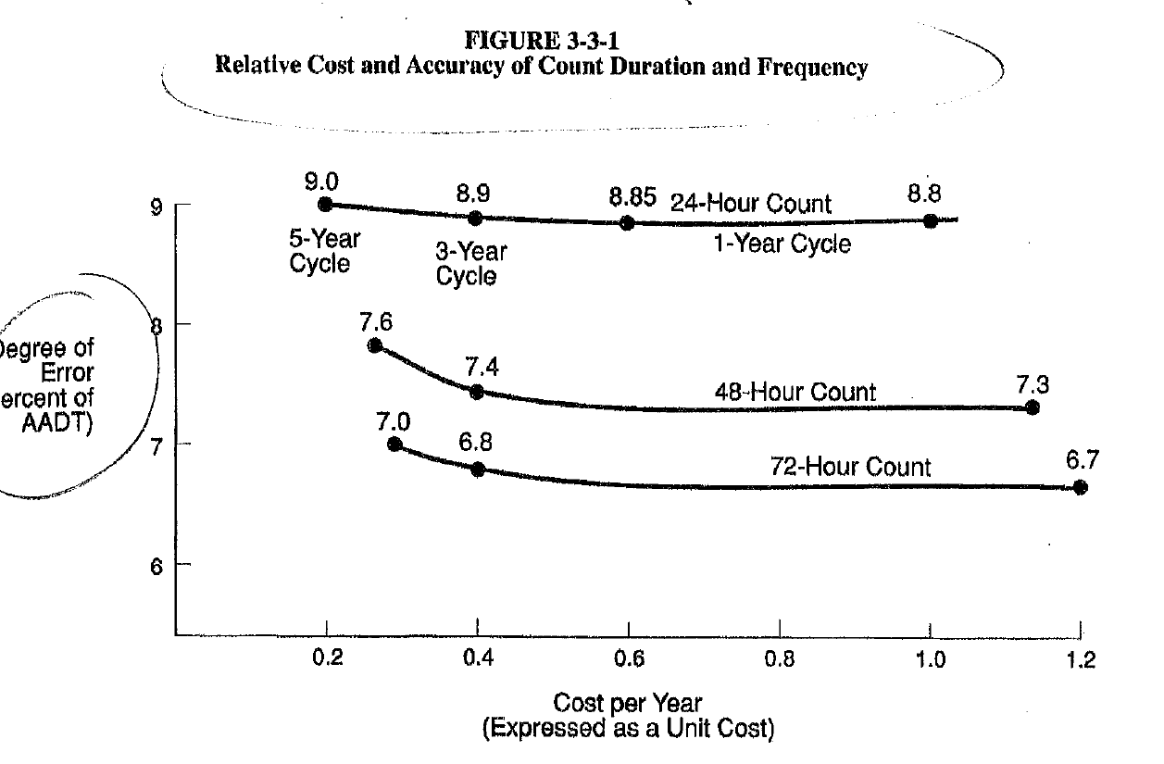
LVR Traffic Counts
Overview
Traffic Counts not quite as straightforward as they sound:
FHWA

Slide 47
LVR Traffic Counts
Overview
Traffic Counts not quite as straightforward as they sound:
24 hour
9% error
48 hour
7.6% error
72 hour
7% error
FHWA

Slide 48
LVR Traffic Counts
Level 2 Counts: 24 hours
Level 2 Counts
Any Counter type. Air tube most common.
Only total traffic is needed, not vehicle type or hourly breakdowns.
For audio, call conference line: 866-823-7699
For assistance, call: 814-865-5355

Slide 49
LVR Traffic Counts
Level 2 Counts: 24 hours
Level 2 Counts
Must be done Between March 1 and the week before Thanksgiving.
For audio, call conference line: 866-823-7699
For assistance, call: 814-865-5355

Slide 50
LVR Traffic Counts
Level 2 Counts: 24 hours
Level 2 Counts
It must be conducted between March 1 and the week before Thanksgiving.
It cannot be conducted on a holiday, or the day before or after a holiday.
For audio, call conference line: 866-823-7699
For assistance, call: 814-865-5355

Slide 51
LVR Traffic Counts
Level 2 Counts: 24 hours
Level 2 Counts
It must be conducted between March 1 and the week before Thanksgiving.
It cannot be conducted on a holiday, or the day before or after a holiday.
It must be conducted between 12 AM Tuesday and 12 AM Friday.
It must be conducted for a minimum of 24 consecutive hours (hourly breakdowns not required).
Only the number of vehicle passes is counted, regardless of direction of travel or type of vehicle.
For audio, call conference line: 866-823-7699
For assistance, call: 814-865-5355

Slide 52
LVR Traffic Counts
Level 2 Counts: 24 hours
Level 2 Counts
A Level 2 count that yields >500 vehicles per day means a road is not eligible.
Multiple Counts??? Up to you locally.
For audio, call conference line: 866-823-7699
For assistance, call: 814-865-5355

Slide 53
LVR Traffic Counts
Level 2 Counts: 24 hours
Level 2 Counts
Can be done by applicant.
Can be contracted.
Could even be done by District
For audio, call conference line: 866-823-7699
For assistance, call: 814-865-5355

Slide 54
LVR Traffic Counts
Level 2 Counts: 24 hours
Cost of Contracted Counts
Two 48 hour counts done for workshop
~$300 each
Company was not local (90 min, added to cost)
Grouping counts will result in cost savings
For audio, call conference line: 866-823-7699
For assistance, call: 814-865-5355

Slide 55
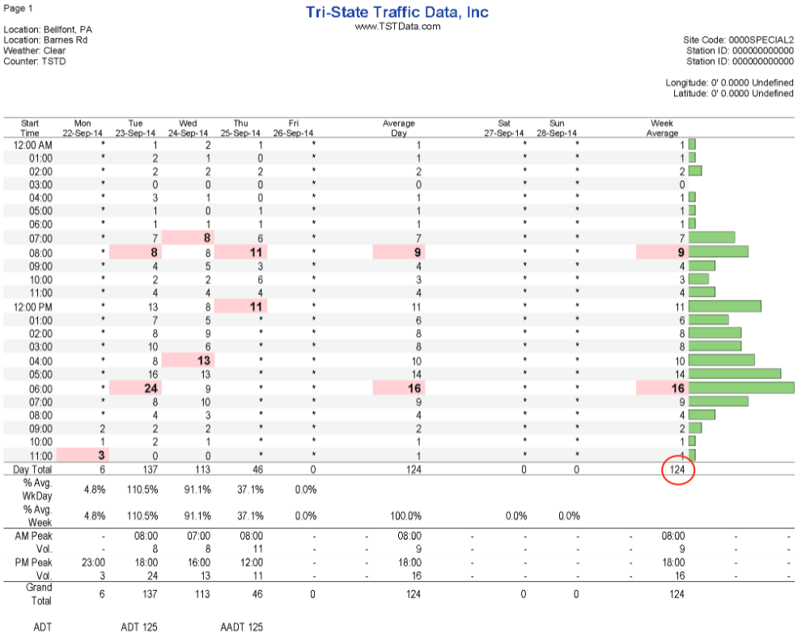
LVR Traffic Counts
Level 2 Counts: 24 hours
Cost of Contracted Counts
125
For audio, call conference line: 866-823-7699
For assistance, call: 814-865-5355
125

Slide 56
Traffic Count Validation Form:
Standard form
Keep with project files.
Level 2 Counts
For audio, call conference line: 866-823-7699
For assistance, call: 814-865-5355

Slide 57
Traffic Count Validation Form:
Level 2 Counts
For audio, call conference line: 866-823-7699
For assistance, call: 814-865-5355

Slide 58
Traffic Count Validation Form:
Standard form
Keep with project files.
Validation
For audio, call conference line: 866-823-7699
For assistance, call: 814-865-5355

Slide 59
Traffic Count Validation Form:
Keep with project files.
For audio, call conference line: 866-823-7699
For assistance, call: 814-865-5355

Slide 60
Driving Surface Aggregate
Introduction
LVR Traffic Counts
Overview
Policy
Use of Existing Data
Level 1 Count
Level 2 Count
Miscellaneous
For audio, call conference line: 866-823-7699
For assistance, call: 814-865-5355

Slide 61
LVR Traffic Counts
Miscellaneous
Conservation Districts may, at their discretion, use administrative and education funding to facilitate or support traffic counts for applicants.
Buying and loaning counters.
Paying for third party counts.
Districts should insure that all potential applicants have equal access to any traffic count facilitation measures they may employ.
For audio, call conference line: 866-823-7699
For assistance, call: 814-865-5355

Slide 62
LVR Traffic Counts
Miscellaneous
NORMAL Traffic Counts
A traffic count survey cannot be conducted in a timeframe or manner that intentionally causes artificially low average daily traffic counts on a particular road segment
Summer recess for a school access road
When access is partially restricted or reduced
Any other timeframe or manner that intentionally causes low average daily traffic counts.
We can’t make a rule for everything. Use common sense.
For audio, call conference line: 866-823-7699
For assistance, call: 814-865-5355

Slide 63
LVR Traffic Counts
Miscellaneous
Sharing Count Data
You may want to partner with your planning commission and/or share data with PennDOT. Note that PennDOT has additional requirements above our Level 2:
24 hours must start and end at midnight
Must include hourly breakdowns
May need vehicle class breakdowns
PennDOT has specific counter vendors
For audio, call conference line: 866-823-7699
For assistance, call: 814-865-5355

Slide 64
LVR Traffic Counts
Miscellaneous
Traffic Count Data
500 vehicles per day is simply a “door” that is open or closed for Program eligibility.
We have not, and don’t recommend, using traffic data to rank sites.
For audio, call conference line: 866-823-7699
For assistance, call: 814-865-5355

Slide 65
LVR Traffic Counts
Miscellaneous
This policy sets the minimum statewide Program standard. Your County can enact stricter count standards.
Level 1 counts on video only?
Only level 2 counts accepted?
48 Hour or longer counts for level 2?
Third party counts only?
CD doing counts?
Must have hourly traffic breakdowns?
Mandatory counts with application?
For audio, call conference line: 866-823-7699
For assistance, call: 814-865-5355

Slide 67
LVR Traffic Counts
Miscellaneous
Webinar, including Q&A, will be recorded and available later. www.dirtandgravelroads.org

Slide 68
LVR Traffic Counts
Miscellaneous
Other webinars planned for Fall / Winter.
Look for future announcements
Quality Assurance Board Issues
DSA: Aggregate Clearinghouse
Stream Crossing Replacement Policy
Developing Application Ranking Criteria
Update and review of new forms.
GIS system updates.
Permitting issues with DGLVR projects.
Specific sections of admin manual.
Pavement / LVR issues.

Slide 69
Low Volume Road Traffic Counts
Q&A
http://metrocount.com
Steve Bloser
PSU Center for Dirt and Gravel Roads
smb201@psu.edu
For audio, call conference line: 866-823-7699
For assistance, call: 814-865-5355

