Slide 1
Recently Completed DGLVR Projects with Assistance from Trout Unlimited
Winter Webinar Series – January 30th 2025
Scott Koser
Program Manager, Pennsylvania Coldwater Habitat Program

Slide 2
TU and the Center for Dirt and Gravel Roads have an extensive partnership dating back to the 1990’s
Notes:
Discuss TU/CDGRS Partnership and history of TU and the beginning of the program

Slide 3
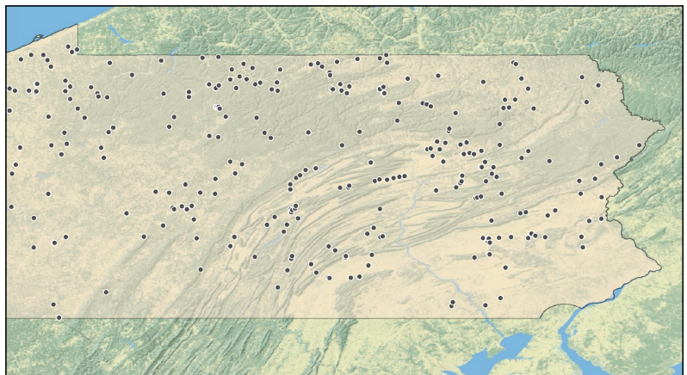
Technical Assistance Site Locations Since 2018
Notes:
Location map of project sites TU has provided some level of assistance since 2018: assisted on 309 Sites, through 414 individual site visits (some for multiple days for construction) since 2018. Resulted in 77 construction oversight projects. 3716’ of restoration. 58 upstream miles of habitat opened, 272 total reconnected miles.

Slide 4
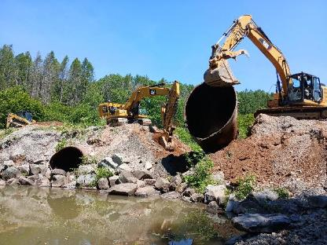
How does TU assist with stream crossings?
Can assist with a longitudinal profile
Assist with site showings and bid meetings
Assist with construction oversight
Grade controls
Habitat/stabilization related structures
Notes:
Common items that TU can provide assistance on. Note that Districts can request from us directly or through the Center. Note that we are available for oversight or project assistance for this coming construction season. We are available also to assist with Long Pro’s for upcoming project applications.

Slide 5
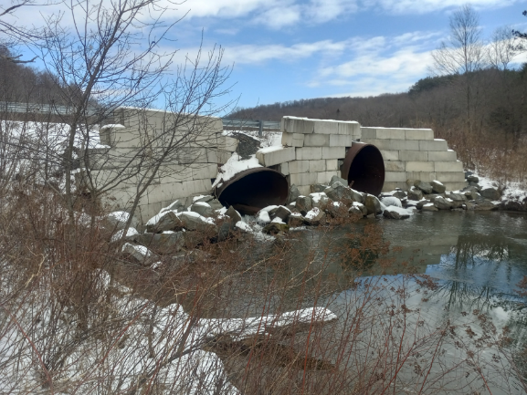
Example Projects From Recent Years – Twin Sluice Summer 2024

Slide 6
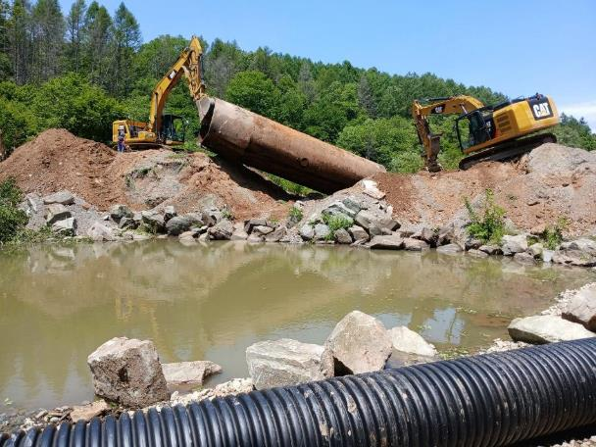
Example Projects From Recent Years
Tioga River – CWF Stocked
BFW 28.7’
New structure was 34.7’
3 GC’s
Habitat structures
154’ of restoration
Notes:
Oversight on installation of three grade control features, six sections of modified mudsill, five rootwad deflectors, and 154' of stream reconstruction through a 34'-8" span, 9'-8" rise open bottom culvert with express concrete footers located on Twin Sluice Road/Tioga River in Ward Township, Tioga County, PA. 9 days TA for construction

Slide 7
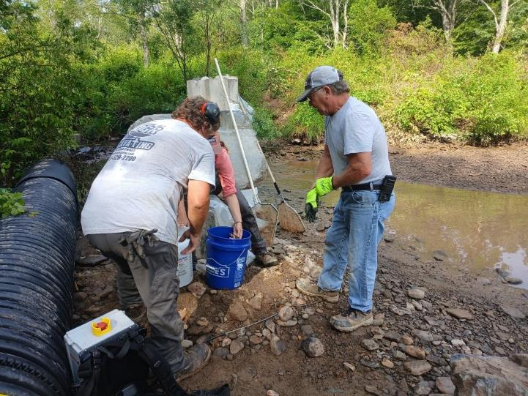
Example Projects From Recent Years
Notes:
This slide shows electrofishing to move trout downstream.
Oversight on installation of three grade control features, six sections of modified mudsill, five rootwad deflectors, and 154' of stream reconstruction through a 34'-8" span, 9'-8" rise open bottom culvert with express concrete footers located on Twin Sluice Road/Tioga River in Ward Township, Tioga County, PA.

Slide 8
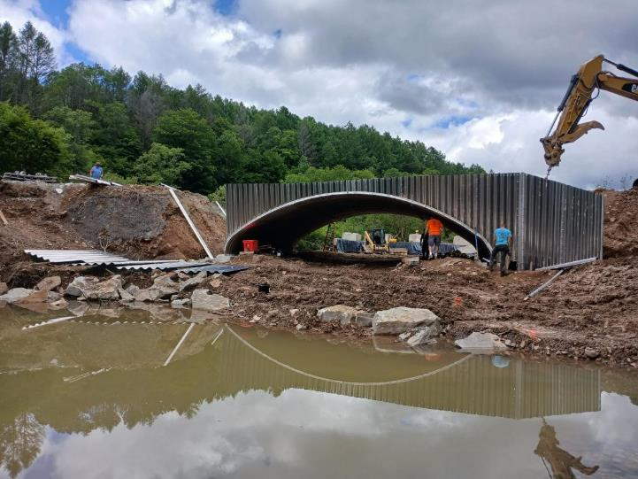
Example Projects From Recent Years
Notes:
Oversight on installation of three grade control features, six sections of modified mudsill, five rootwad deflectors, and 154' of stream reconstruction through a 34'-8" span, 9'-8" rise open bottom culvert with express concrete footers located on Twin Sluice Road/Tioga River in Ward Township, Tioga County, PA.

Slide 9
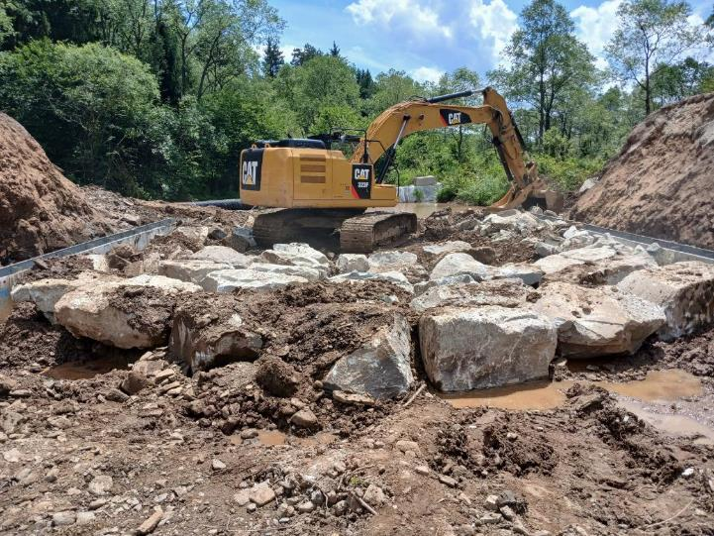
Example Projects From Recent Years
Notes:
Oversight on installation of three grade control features, six sections of modified mudsill, five rootwad deflectors, and 154' of stream reconstruction through a 34'-8" span, 9'-8" rise open bottom culvert with express concrete footers located on Twin Sluice Road/Tioga River in Ward Township, Tioga County, PA.

Slide 10
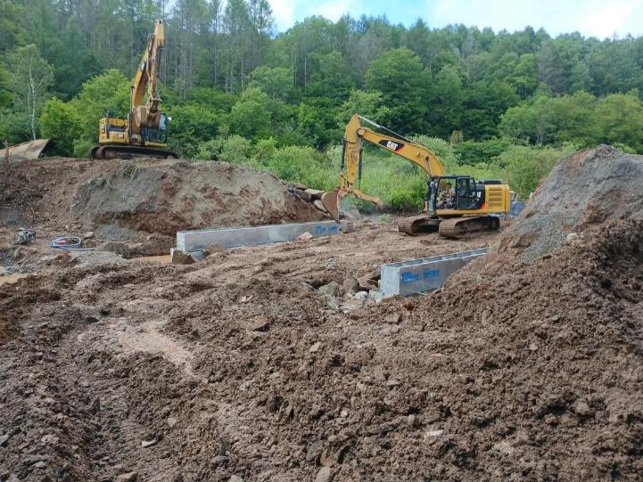
Example Projects From Recent Years
Notes:
Oversight on installation of three grade control features, six sections of modified mudsill, five rootwad deflectors, and 154' of stream reconstruction through a 34'-8" span, 9'-8" rise open bottom culvert with express concrete footers located on Twin Sluice Road/Tioga River in Ward Township, Tioga County, PA.

Slide 11
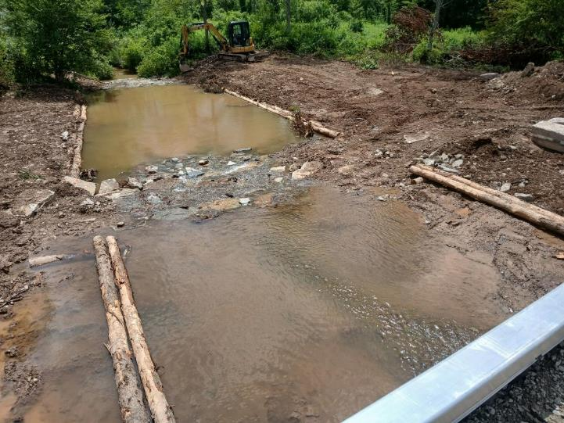
Example Projects From Recent Years
Notes:
Oversight on installation of three grade control features, six sections of modified mudsill, five rootwad deflectors, and 154' of stream reconstruction through a 34'-8" span, 9'-8" rise open bottom culvert with express concrete footers located on Twin Sluice Road/Tioga River in Ward Township, Tioga County, PA.

Slide 12
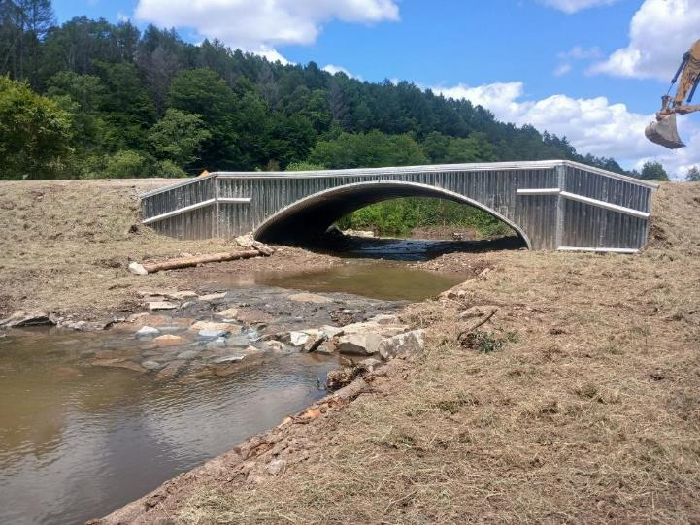
Example Projects From Recent Years
Notes:
Last day of construction

Slide 13
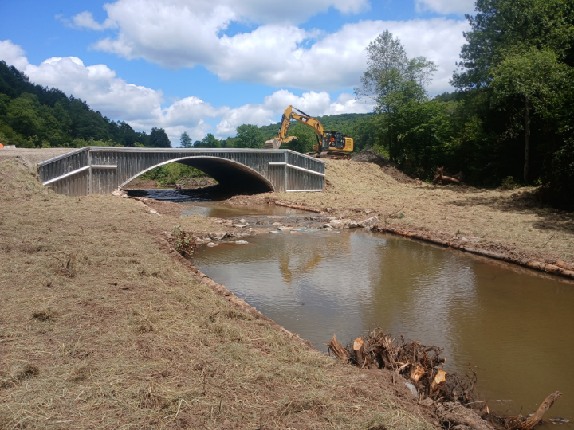
Example Projects From Recent Years
Notes:
Two significant rain events occurred shortly after construction. The first was less than one week after construction. Tioga CD Staff inspected the site on 7/24/24 after a particularly high water event and a reported 3" of rain. Everything looked good from the photos taken and reports from the District. All grade controls and bank margins were intact, streambed material was maintained in the culvert as intended, and no seed or mulch was washed away.
A second and much more severe rain event occurred twenty days after construction was complete. Hurricane/Tropical Storm Debby brought heavy rain to north central PA with 3.5" of rain in the immediate project area on top of already recently saturated conditions. The site was completely flooded and high flows tested the new structure and project site. Some fine material was washed away from the banks and fine streambed material was mobilized downstream. However, the most important components of the project that are intended to hold stream grade, allow for fish passage and create habitat, and components that are intended to maintain integrity of the structure are all still in place and functioning and held up well after the event.

Slide 14
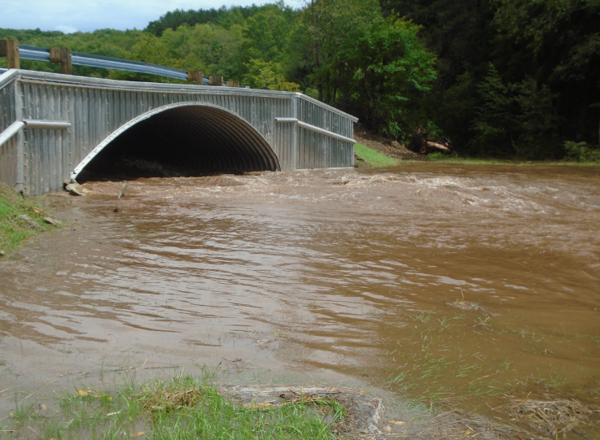
Example Projects From Recent Years
Notes:
Two significant rain events occurred shortly after construction. The first was less than one week after construction. Tioga CD Staff inspected the site on 7/24/24 after a particularly high water event and a reported 3" of rain. Everything looked good from the photos taken and reports from the District. All grade controls and bank margins were intact, streambed material was maintained in the culvert as intended, and no seed or mulch was washed away.
A second and much more severe rain event occurred twenty days after construction was complete. Hurricane/Tropical Storm Debby brought heavy rain to north central PA with 3.5" of rain in the immediate project area on top of already recently saturated conditions. The site was completely flooded and high flows tested the new structure and project site. Some fine material was washed away from the banks and fine streambed material was mobilized downstream. However, the most important components of the project that are intended to hold stream grade, allow for fish passage and create habitat, and components that are intended to maintain integrity of the structure are all still in place and functioning and held up well after the event.

Slide 15
Example Projects From Recent Years
Notes:
Plunge Pool Before Construction

Slide 16
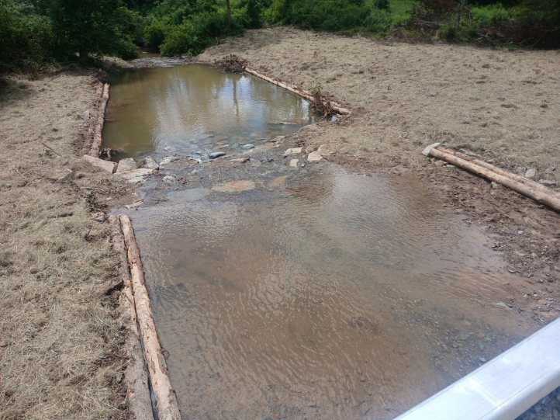
Example Projects From Recent Years
Notes:
Plunge pool after construction

Slide 17
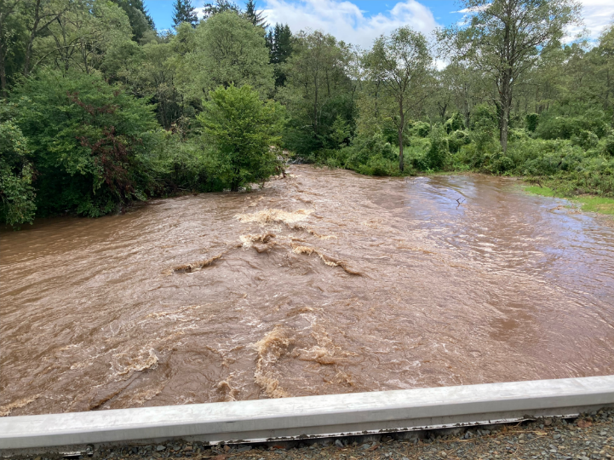
Example Projects From Recent Years
Notes:
Plunge pool during flood

Slide 18
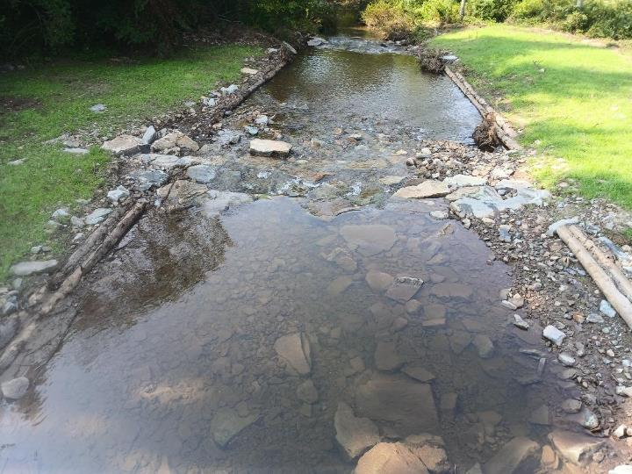
Example Projects From Recent Years
Notes:
Plunge pool just after flood

Slide 19
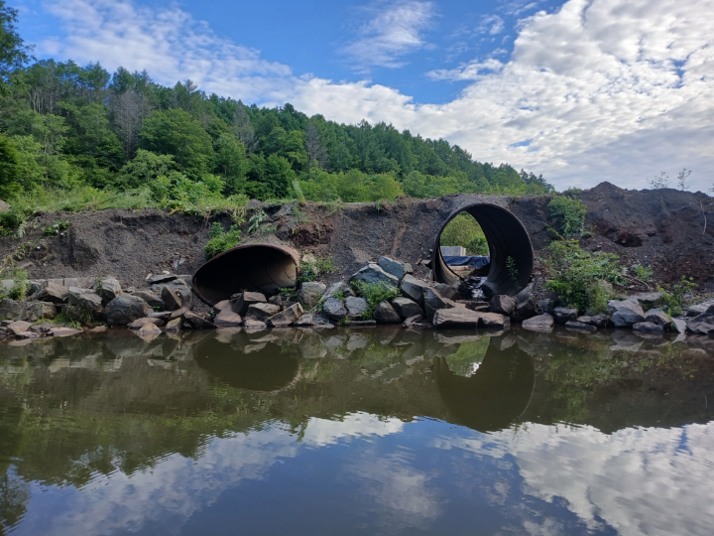
Example Projects From Recent Years
Notes:
More sequence photos from a different angle.

Slide 20
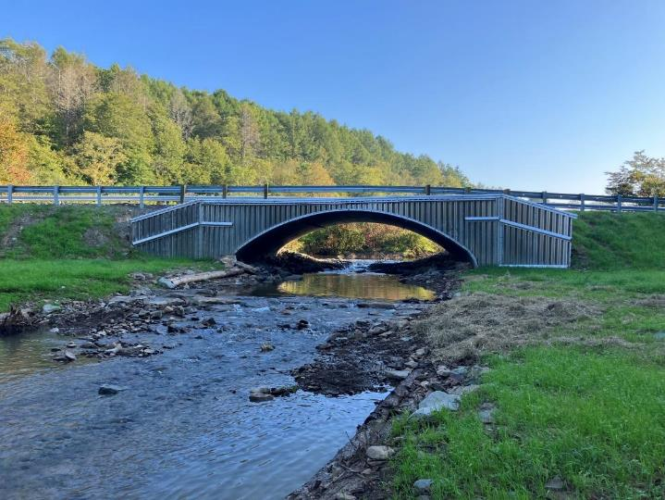
Example Projects From Recent Years
Notes:
More sequence photos from a different angle.

Slide 21
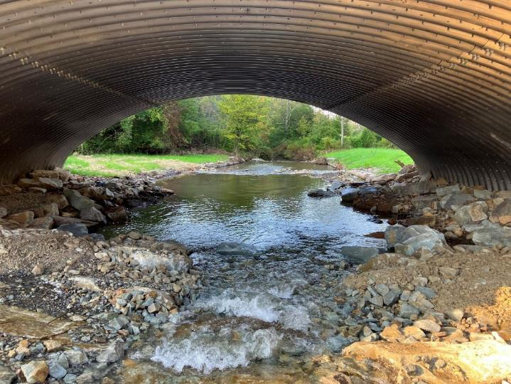
Example Projects From Recent Years
Notes:
More sequence photos from a different angle.

Slide 22
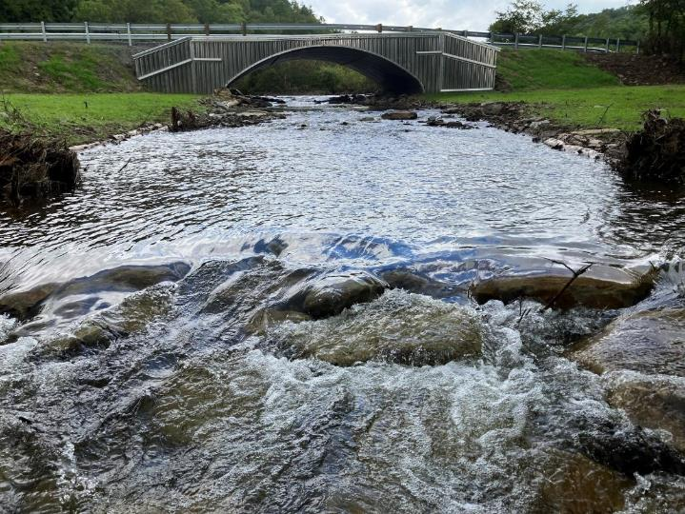
Example Projects From Recent Years
Notes:
More sequence photos from a different angle.

Slide 23
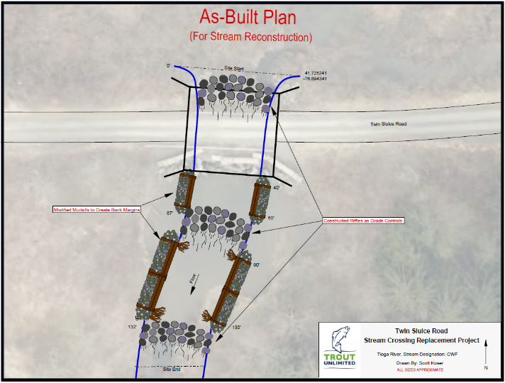
Example Projects From Recent Years
Notes:
Example as-built drawing that we prepare for all construction related projects, included with final reports, explain as-built packages and what Districts get with them
If asked: total project cost was $380,710 with engineering ($48,880)

Slide 24
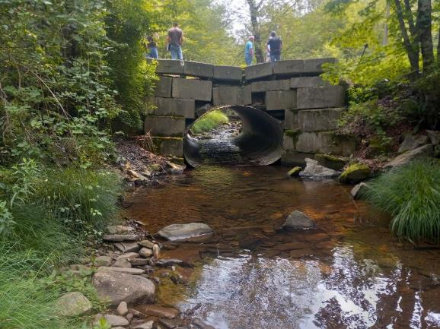
Example Projects From Recent Years – Chase Hill, Fall 2023
Rundall Creek – CWF Wild brook and brown
Old structure was 10’-6”
New structure was 25’- 4’’
4 GC’s
Habitat structures
135’ of restoration
Notes:
TA – 5 days during construction

Slide 25
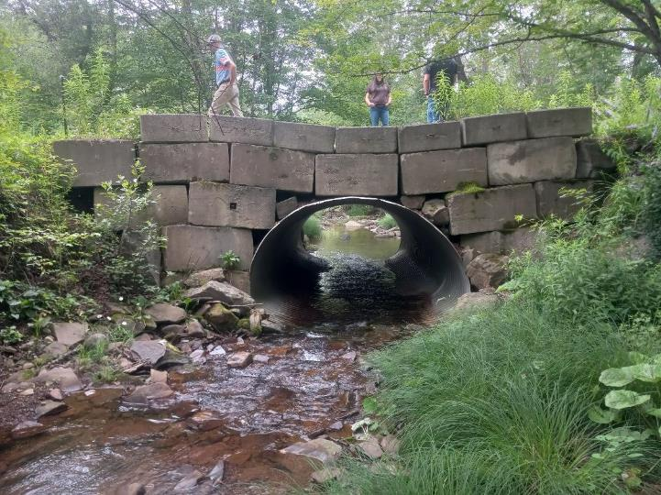
Example Projects From Recent Years
Notes:
Inlet before construction

Slide 26
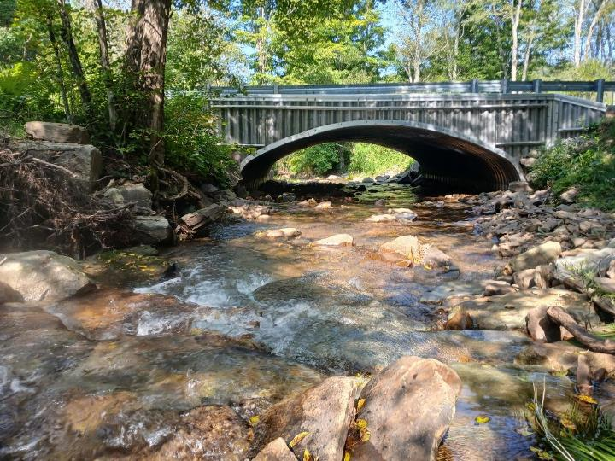
Example Projects From Recent Years
Notes:
Inlet after construction

Slide 27
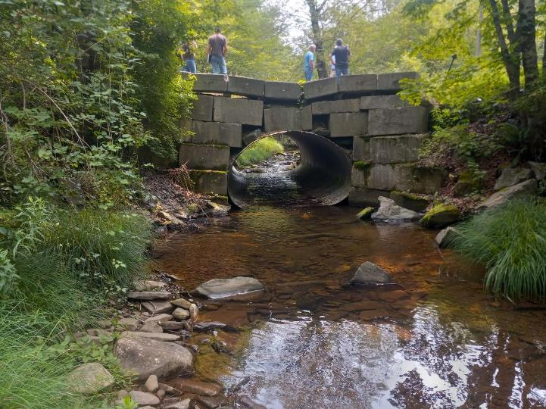
Example Projects From Recent Years
Notes:
Outlet before construction

Slide 28
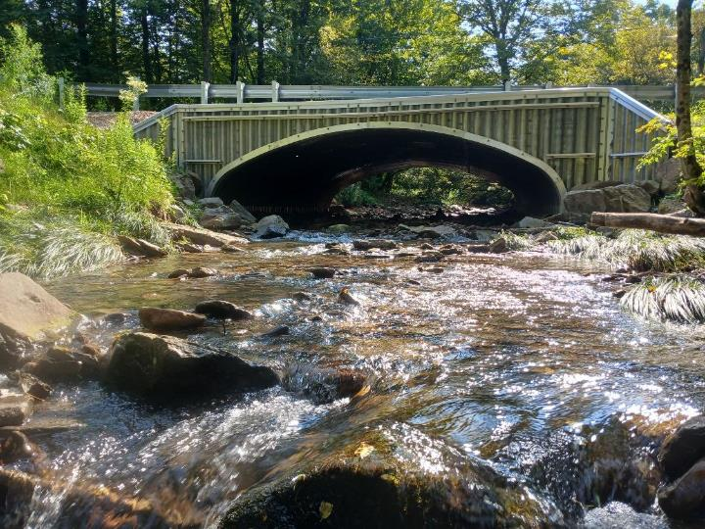
Example Projects From Recent Years
Notes:
Outlet after construction

Slide 29
Example Projects From Recent Years
Notes:
As built from report.
Cost if asked: $310,519 with engineering ($24,560)

Slide 30
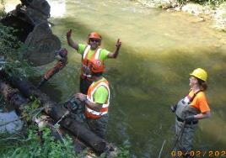
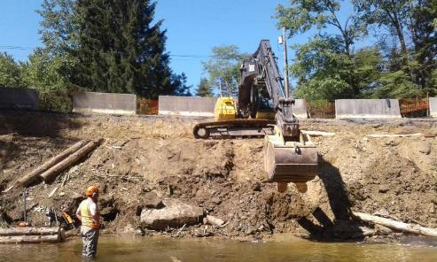
How does TU assist with stream/road bank stabilization?
Can assist with site layout
Assist with site showings and bid meetings
Assist with construction oversight
Directing contractors
Supplying tools and equipment
Supplying staff to assist with construction
Notes:
Common items that TU can provide assistance on. Note that Districts can request from us directly or through the Center. Note that we are available for oversight or project assistance for this coming construction season.

Slide 31
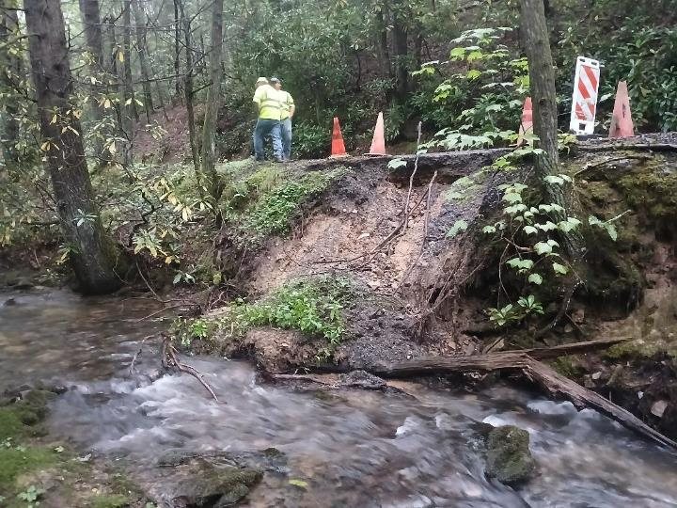
Example Projects From Recent Years
Notes:
Site Evaluation, initial site layout.

Slide 32
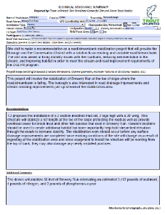
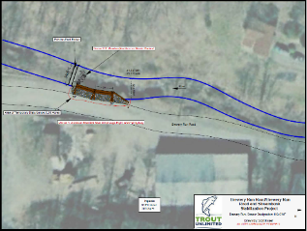
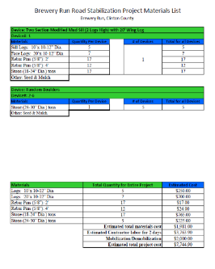
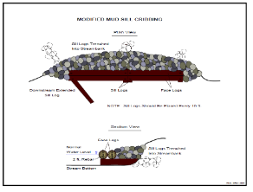
Example Products from Site Evaluations
Notes:
Site Evaluation, initial site layout. Report summary, materials list and cost estimates, plan drawing, structure details, so this is information easily transferred to a DGLVR application for the township/district. Its all the info a District/Township needs for the DGLVR application.

Slide 33
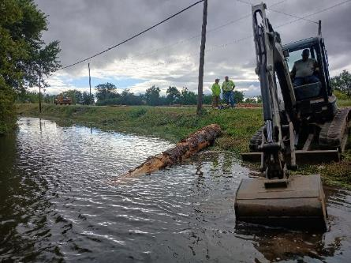
Example Projects From Recent Years – Hoover Road, Summer 2024
Union County – Buffalo Township
Buffalo Creek
Stocked trout
Erosion over 215’
Installed 10 sections of modified mudsill (2 logs high) and one log vane deflector
Notes:
TA – 3 days during construction, Savannah Rhodes assisted greatly

Slide 34
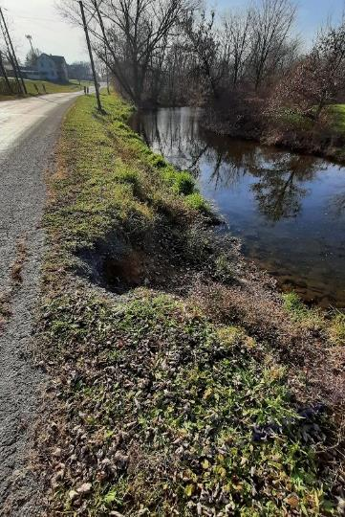
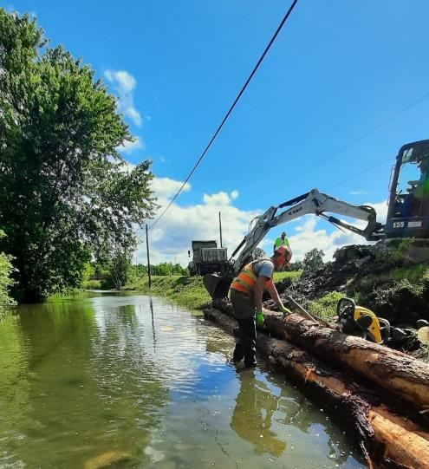
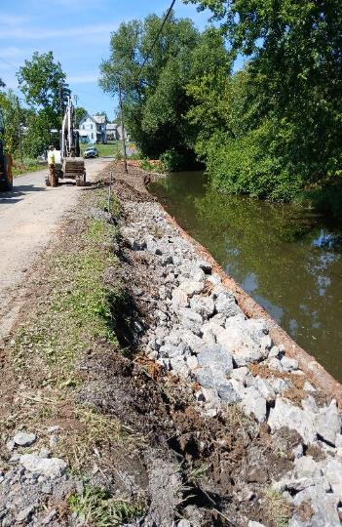
Notes:
Before and during photos

Slide 35
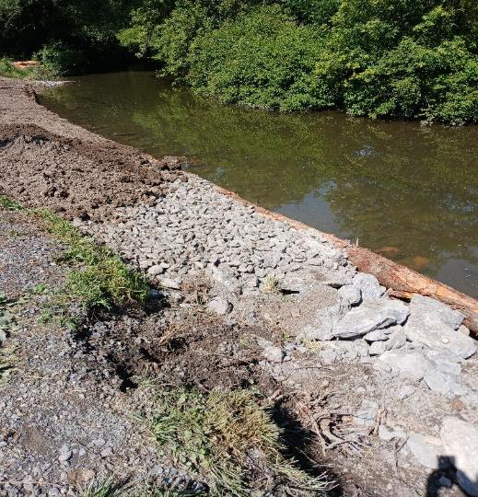
Example Projects From Recent Years
Notes:
Layers to explain the process

Slide 36
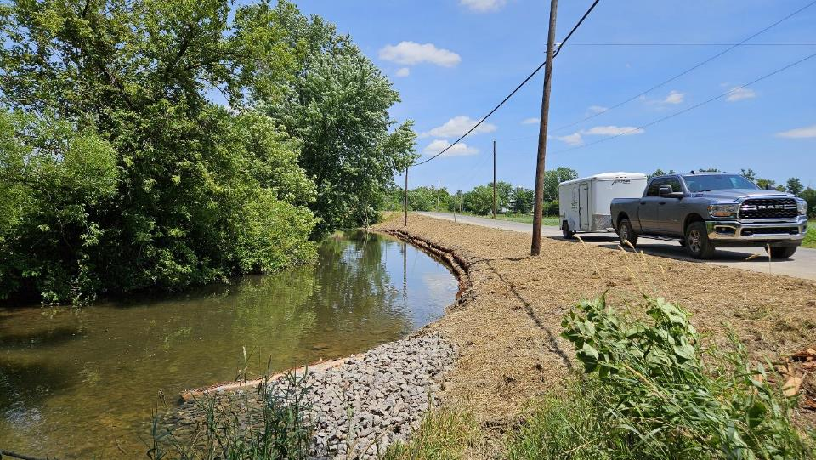
Example Projects From Recent Years
Notes:
Day construction was completed

Slide 37
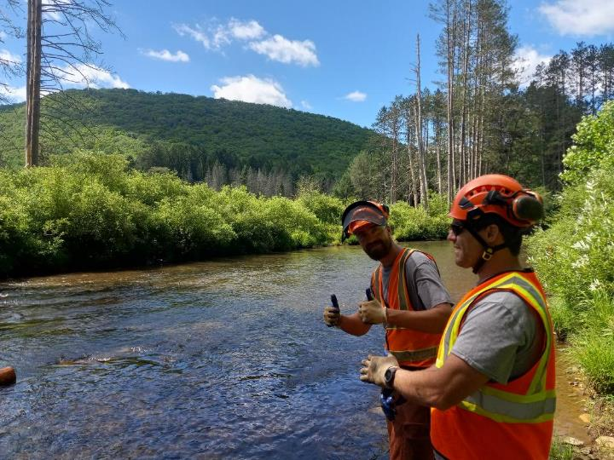
Example Projects From Recent Years
Notes:
Day construction was completed

Slide 38
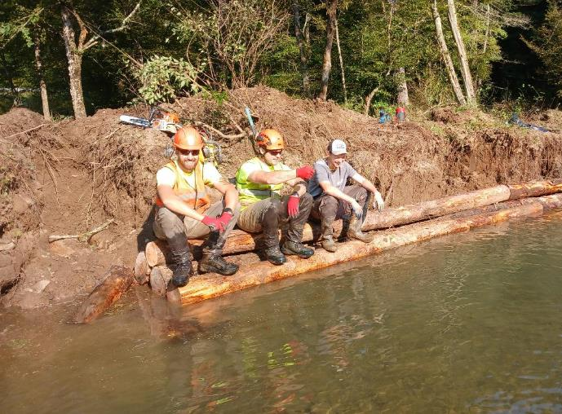
Example Projects From Recent Years
Notes:
Day construction was completed

Slide 39
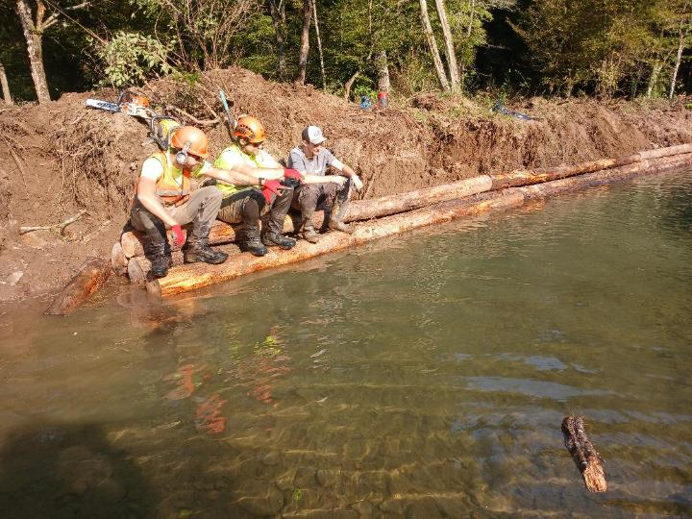
Example Projects From Recent Years
Notes:
Day construction was completed

Slide 40
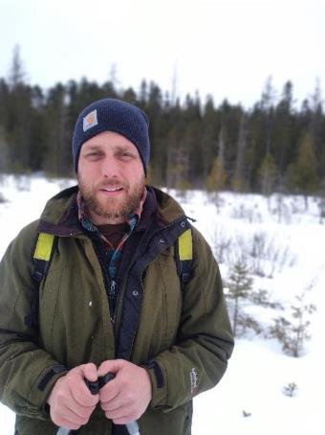
Questions/Discussion
Scott Koser
Program Manager, Pennsylvania Coldwater Habitat Program
570.279.7863
scott.koser@tu.org
Notes:
Note:
We have room in the 2025 construction season, let us know about project ideas, the earlier the better.
We CAN HELP with layouts now

Slide 41
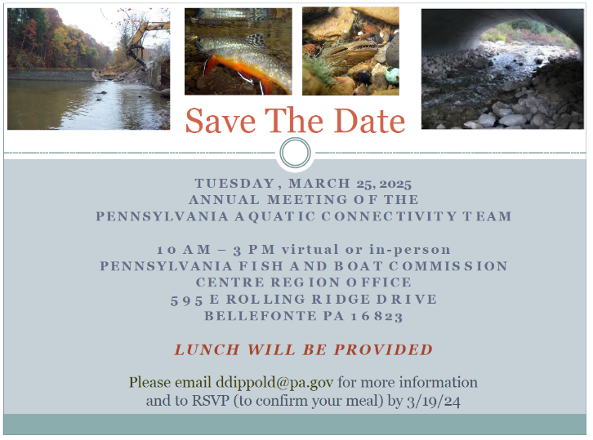
Questions/Discussion
Notes:
Important to note since this audience is working to remove barriers, important to this organization.

