Slide 1
Dirt Gravel and Low Volume Road Program
WEBINAR
GIS Updates:
Topographic Wetness Index / Project Error Checker / Financial
Survey Results
ESM Trainings
Webinars
Longer Remote Trainings
Online training Center
Winter Tech Assists
12/17/20 Starts at 9am
If you are reading this, then you are successfully seeing the webinar video. Webinar audio should be automatic through your computer (or click “join audio”), and options can be accessed in the “audio options” button on the bottom left. If your computer audio is not working, you can listen on your phone by dialing 646-876-9923.

Slide 2
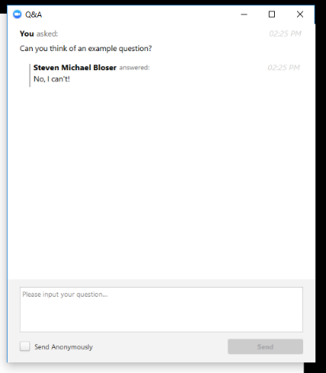
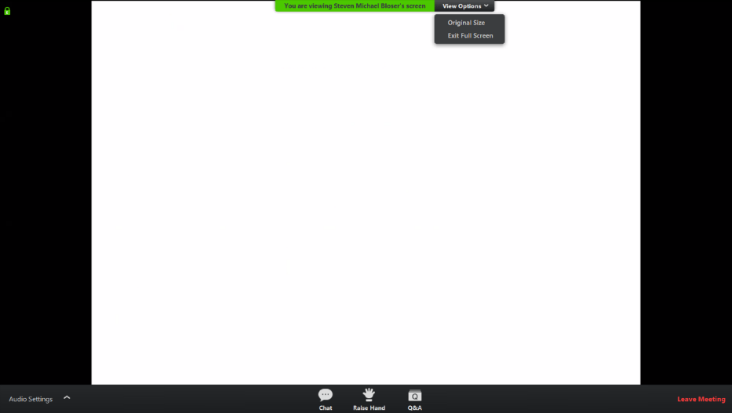
Topographic Wetness Index / Project Error Checker / Financial
GIS Updates:
Note you can ask a question anonymously
Q&A
For audio via phone: 646-876-9923
2

Slide 3
Topographic Wetness Index / Project Error Checker / Financial
GIS Updates:
GIS Updates:
Topographic Wetness Index: New GIS layer that extrapolates soil wetness and make it easier to identify ephemeral streams and areas likely to see collect overland flow
Project Error Checker: New GIS feature to double check the project data entered for worksites for typos or obvious errors.
Financial Update: Brief updates related to administrative and education spending.

Slide 4
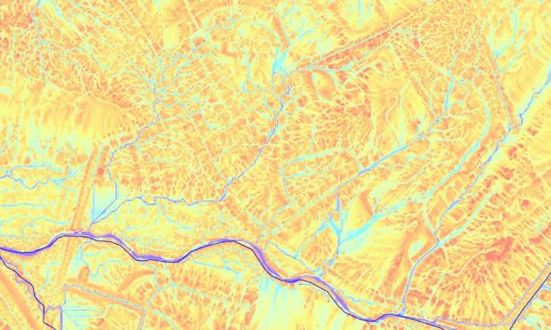
GIS Updates
Topographic Wetness Index (TWI)
Background
Approximates soil moisture and flow channels
It is NOT a direct measurement
What it looks like:

Slide 5
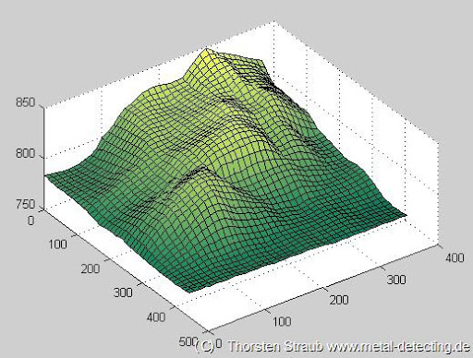
GIS Updates
Topographic Wetness Index (TWI)
Background
Comes from interpretations from LIDAR
LIDAR used to create a detailed “Digital Elevation Model”

Slide 6
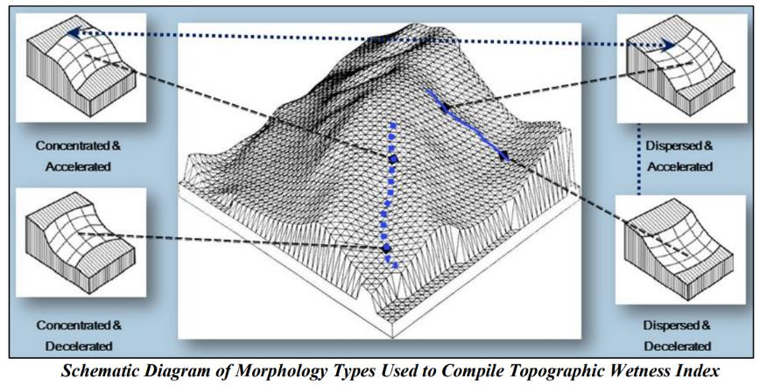
GIS Updates
Topographic Wetness Index (TWI)
Background
TWI is a function of land slope and contributing area

Slide 7
GIS Updates
Topographic Wetness Index (TWI)
Background
The result is dimensionless, and expressed as a color gradient from red (dry) to blue (wet)

Slide 8
GIS Updates
Topographic Wetness Index (TWI)
Uses
Identifying ephemeral streams
Identifying likely overland flow paths with no channel
Features can be identified remotely that may not be visible in the field
DGLVR Program:
Where to put crosspipes
Identifying off-ROW water impacts
Other Programs:
Field runoff patterns
Erosion control

Slide 9
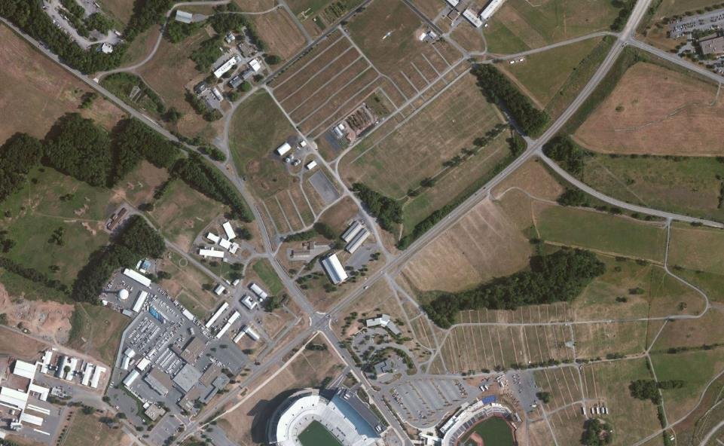
GIS Updates
TWI Example #1

Slide 10
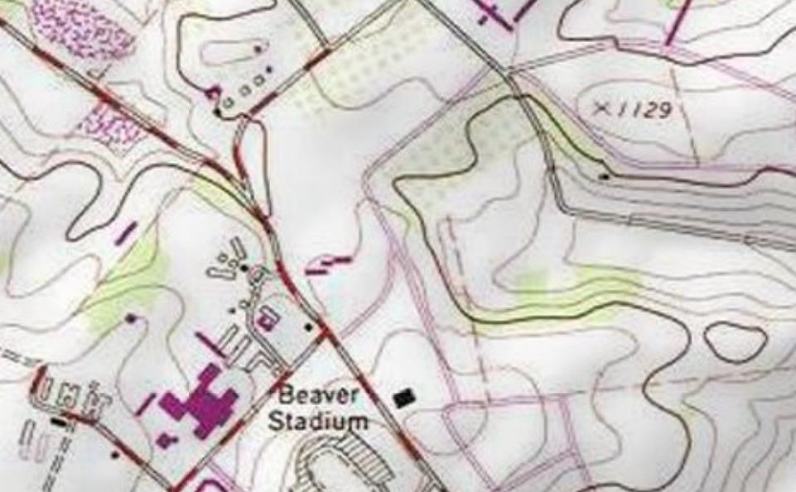
GIS Updates
TWI Example #1

Slide 11
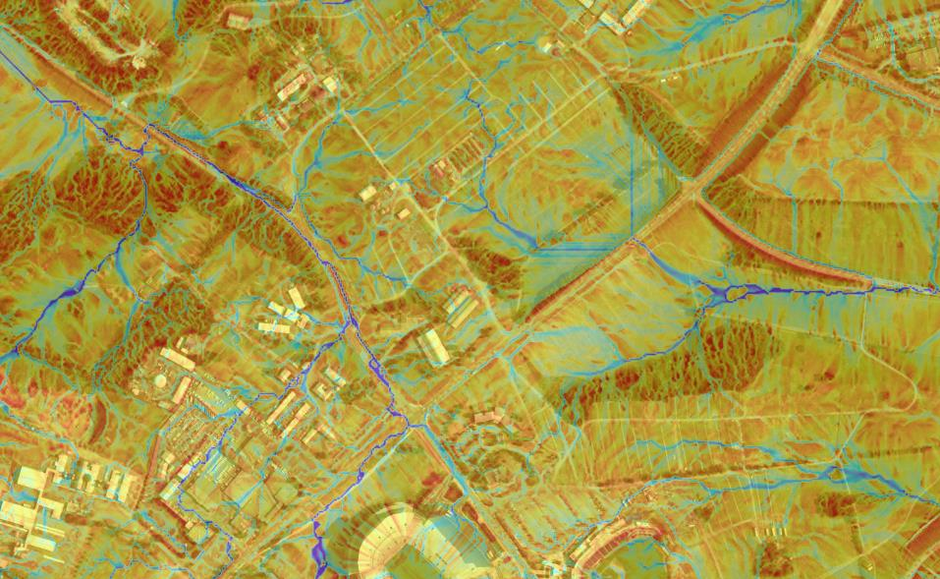
GIS Updates
TWI Example #1

Slide 12
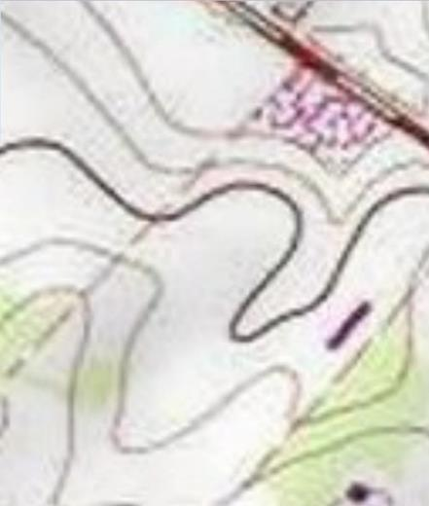
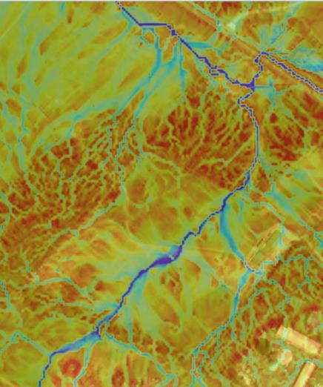
GIS Updates
TWI Example #1
TOPO MAP
TWI

Slide 13
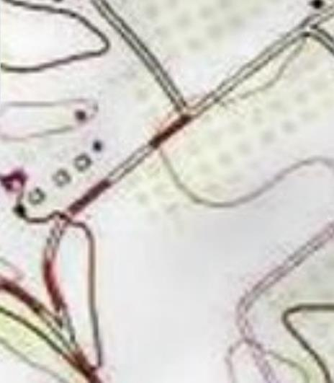
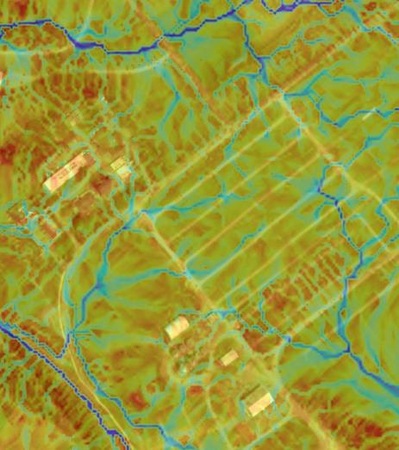
GIS Updates
TWI Example #1
TOPO MAP
TWI

Slide 14
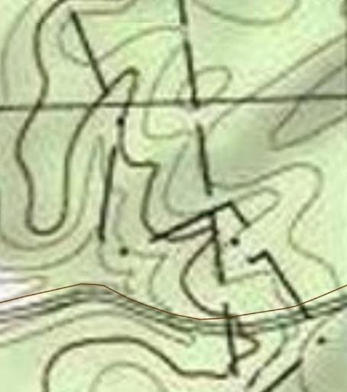
GIS Updates
TWI Example #2: wooded road
TOPO MAP
Red Rose Road
Huntingdon County
No “blueline” stream

Slide 15
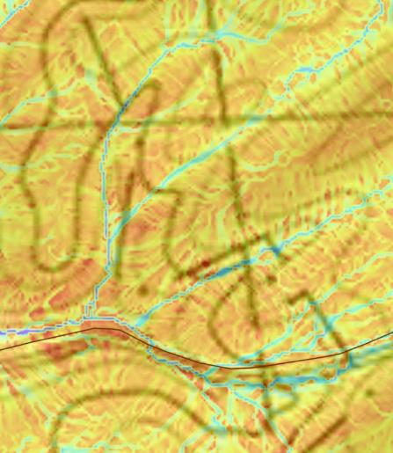
GIS Updates
TWI Example #2: wooded road
TOPO MAP
TWI

Slide 16
GIS Updates
TWI Example #2: wooded road
TOPO MAP
TWI

Slide 17
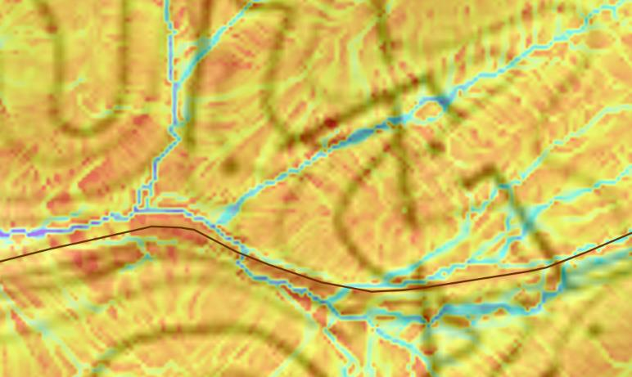
GIS Updates
TWI Example #2: wooded road
TOPO MAP
TWI
Non-blueline
stream Xing
Overland flow path,
no channel

Slide 18
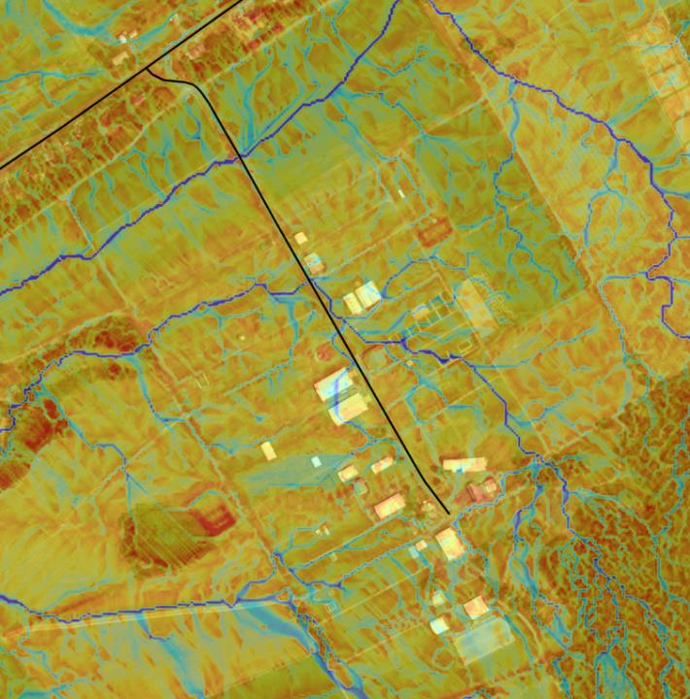
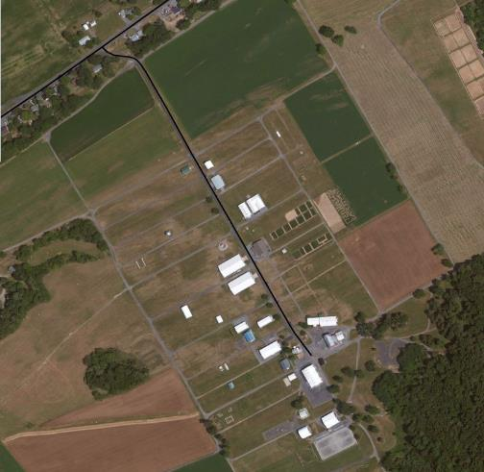
GIS Updates
TWI Example #3: agriculture road
Aerial
Ag Progress Days
Centre County

Slide 19
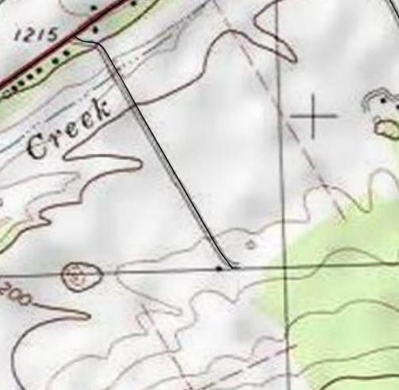
GIS Updates
TWI Example #3: agriculture road
Aerial
TOPO

Slide 20
GIS Updates
TWI Example #3: agriculture road
TWI
TOPO

Slide 21
GIS Updates
Logistics: how to access it
You already have access to it as a GIS layer
DO NOT TURN TWI LAYER ON UNTIL YOU ZOOM IN. It is a large layer and may freeze your computer up if you try to load it for the entire county.
Quick Demo:

Slide 22
Topographic Wetness Index / Project Error Checker / Financial
GIS Updates:
GIS Updates:
Topographic Wetness Index: New GIS layer that extrapolates soil wetness and make it easier to identify ephemeral streams and areas likely to see collect overland flow
Project Error Checker: New GIS feature to double check the project data entered for worksites for typos or obvious errors.
Financial Update: Brief updates related to administrative and education spending.

Slide 23
GIS Updates
Project Errors
All real data:
14 stream crossings replaced (maybe one 14 foot crossing?)
80 cross pipes installed (maybe length reported?)
45 cross pipes replaced (maybe length reported?)
9,000 tons DSA (on a 5,000 foot site? Equates to a 50’ wide placement)
17,000 tons road fill ( on a 1,000 foot site?, Equates to 8’ of fill over entire site)
20,000 cu yd paving ( on a 3,000 ft site, equates to asphalt about 19” in thickness)
Errors remain in database and make annual reports more difficult each year

Slide 24
GIS Updates
Project Errors
Error Checker designed to catch these mistakes.
Run by the CD before Annual Report
Give CD list of potential Errors
Not all potential errors may be true errors
CD must go in and correct data prior to submitting ASR
Ignore non-errors reported as errors

Slide 25
GIS Updates
Project Errors
Potential errors are determined by comparing project totals on assigned cutoff values determined by the Center.
Potential Error if Comparison Value > Cutoff Value
Cutoff values will be provided as a downloadable pdf
Error Comparison Value = Project Total / Site Length (ft)

Slide 26
GIS Updates
Project Errors
Example: A site in the GIS has a length of 850 feet but 12 crosspipes were entered. Would this be flagged as an error?
The cutoff value is 0.01 (this equals 1 crosspipe per 100 feet)
12/850 = 0.014 > 0.01 = Potential Error
Solutions
Is the Project Total entry correct?
Check the units. (i.e., # vs feet, sq ft vs sq yards, English vs Metric)
Typo (i.e., 1 vs 10)
Is the site length in the GIS correct? If it is too short, consider lengthening it.
This is not an error (Site length and project total correct)

Slide 27
GIS Updates
Project Errors
GIS Demo

Slide 28
Topographic Wetness Index / Project Error Checker / Financial
GIS Updates:
GIS Updates:
Topographic Wetness Index: New GIS layer that extrapolates soil wetness and make it easier to identify ephemeral streams and areas likely to see collect overland flow
Project Error Checker: New GIS feature to double check the project data entered for worksites for typos or obvious errors.
Financial Update: Brief updates related to administrative and education spending.

Slide 29
GIS Updates
Financial Updates
Administrative and Education available spending reduced to 1 year (SCC Approved July 2020).
Unless an extension granted by SCC
Includes FY 20/21

Slide 30
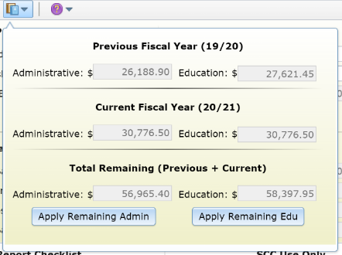
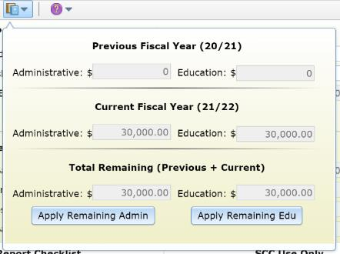
GIS Updates
Financial Updates
What happens July 1, 2021
ALL remaining FY 19/20 and FY 20/21 administrative and education funds are reset to $0. (they roll back into projects)
FY 21/22 funds become available.

Slide 31
GIS Updates
Financial Updates
Come July 1, 2020, you won’t be able to use any prior fiscal year monies for administrative and/or educational expenses.
All remaining monies will simply convert to project funds
What Does This Mean???

Slide 32
GIS Updates
Financial Updates
Using the QR, see how much FY 19/20 and FY 20/21 cap space is remaining.
Budget your remaining cap space through June 30, 2021.
Don’t forget to budget this against expected project expenses to ensure you have enough available funds.
Call Ken with any questions.
How Should I Plan?

Slide 33
Topographic Wetness Index / Project Error Checker / Financial
GIS Updates:
GIS Updates:
Topographic Wetness Index: New GIS layer that extrapolates soil wetness and make it easier to identify ephemeral streams and areas likely to see collect overland flow
Project Error Checker: New GIS feature to double check the project data entered for worksites for typos or obvious errors.
Financial Update: Brief updates related to administrative and education spending.

Slide 34
GIS Updates
Winter Assessments
Unpaved Road Assessments: driving unpaved roads in your county and identifying pollution sites
November through May is the best time to do unpaved road assessments (with <~3” of snow cover)
Webinar 12/22: Assessment Refresher/Primer
Recorded Webinar Training on CDGRS website:
~1.5 hours total, broken into 8 sections
www.dirtandgravelroads.org – education - assessment

Slide 35
GIS Updates
Winter Technical Assistance
Increased availability at CDs, CDGRS, SCC, and TU over winter months.
December through March is the easiest time to get CDGRS/TU/SCC on site for planning (with <~3” of snow cover)
Contact Center/SCC/TU Staff
Not sure who to contact? Contact me: smb201@psu.edu, 814-865-6967

Slide 36
GIS Updates
Photo Contest
Typically held at annual workshop in fall.
Planning to hold one over winter to create April 2021 to March 2022 DGLVR calendar
Submit to Amy (alp90@psu.edu)
Before Picture
After Picture
Project description, 200 word max

Slide 37
Dirt Gravel and Low Volume Road Program
WEBINAR
GIS Updates
Survey Results
ESM Trainings
Webinars
Longer Remote Trainings
Online training Center
Winter Tech Assists
QUESTIONS ?

