Slide 1
DGLVR Advanced Admin Training
PA State Conservation Commission
Sherri Law & Andy Mickey
Dirt, Gravel, and Low Volume Road Program
Notes:
Purpose today: Provide detailed guidance on how to make sure projects turn out well. Will review full project lifecycle.

Slide 2
Outline
Introductions
Policy Review Trivia Game
Intro to Project Management
Pre-application & application
Project administration: contracting through construction
Project completion

Slide 3
Introductions
Go around the room and say:
What CD/organization are you from?
What is your job title/role in the DGLVR Program?
How many years have you been there?
https://www.vhv.rs/download/TiwmRbR_graphic-picture-of-a-meeting-group-work-group/#google_vignette

Slide 4
Outline
Introductions
Policy Review Trivia Game
Intro to Project Management
Pre-application & application
Project administration: contracting through construction
Project completion
Click this link to launch trivia game:
DGLVR Policy Review - Advanced Admin Training - Custom Trivia Quiz Maker

Slide 5
Outline
Introductions
Policy Review Trivia Game
Intro to Project Management
Pre-application & application
Project administration: contracting through construction
Project completion

Slide 6
Project Management
Discussion:
What is “Project Management”?

Slide 7
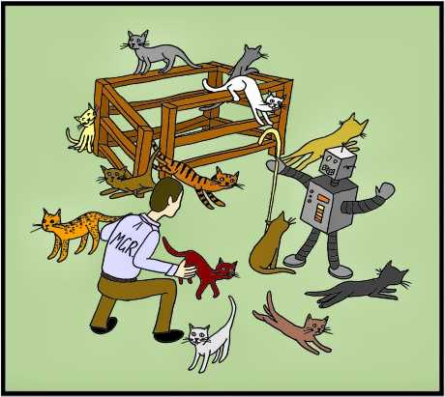
Project Management
Definition:
The art of bringing together a team to successfully complete a project
What does a project manager do?
A project manager leads their team through all phases of a project lifecycle
Not necessarily the direct manager/supervisor of all team members
Responsible for guiding team members and making sure they get the support they need
https://www.forbes.com/advisor/business/what-is-project-management/
https://shaggiuk.blogspot.com/2014/02/herding-cats.html

Slide 8
Project Management
What does a project manager do?
Bring people together to meet a goal
Plan and organize
Break overall goal into smaller tasks
Prioritize and delegate tasks
Set timelines
check in to make sure tasks are being completed in a timely manner
Break down barriers to help team accomplish tasks
Facilitate communication between team members
https://tse4.mm.bing.net/th/id/OIP.7S_bVOyRY9FCR1SY1vNbeQHaHa?w=630&h=630&rs=1&pid=ImgDetMain
Notes:
Baking example: The project manager writes or at least follows the recipe, and makes sure all kitchen helpers are doing the right thing at the right time

Slide 9
Why talk about Project Management?
Discussion:
Why talk about project management?
https://www.vhv.rs/download/TiwmRbR_graphic-picture-of-a-meeting-group-work-group/#google_vignette

Slide 10
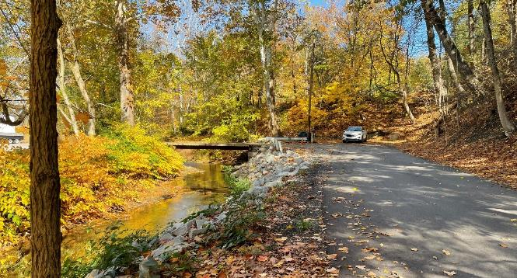
Why talk about Project Management?
To complete road projects as smoothly as possible!
Better Roads, Cleaner Streams
Notes:
CD staff are project managers for DGLVR projects

Slide 11
Project Management
Project:
Temporary endeavor undertaken to create a unique product, service, or result
https://www.pmi.org/about/what-is-a-project

Slide 12
Project Management
Project:
Temporary endeavor undertaken to create a unique product, service, or result
Has a start, end, and specific timeline
https://www.pmi.org/about/what-is-a-project

Slide 13
Project Management
Project:
Temporary endeavor undertaken to create a unique product, service, or result
Has a start, end, and specific timeline
Defined set of deliverables
https://www.pmi.org/about/what-is-a-project

Slide 14
Project Management
Project:
For the DGLVR Program:
Improve a certain section of road
With specific ESM practices
According to a planned budget
In a set amount of time

Slide 15
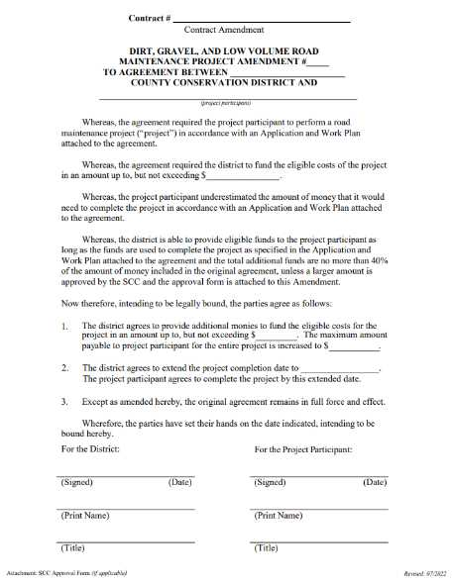
Project Management
Project:
For the DGLVR Program:
Improve a certain section of road
With specific ESM practices
According to a planned budget
In a set amount of time
All defined in the DGLVR contract
and attachments

Slide 16
Project Management
Who is involved in DGLVR projects?
Conservation District
Road Owner
Elected officials
Road master/supervisor
Road crew
Contracted construction crew
Engineer
Adjacent landowners
Solicitor
Other funding sources

Slide 17
Project Management
Who is involved in DGLVR projects?
Conservation District
Road Owner
Elected officials
Road master/supervisor
Road crew
Contracted construction crew
Engineer
Adjacent landowners
Solicitor
Other funding sources
Who is the project manager?

Slide 18
Project Management
Who is involved in DGLVR projects?
Conservation District
Road Owner
Elected officials
Road master/supervisor
Road crew
Contracted construction crew
Engineer
Adjacent landowners
Solicitor
Other funding sources
Who is the project manager?
The Conservation District knows how to successfully complete a DGLVR Project better than anyone else

Slide 19
Additional Resources
Project Management Institute
Home of Project Management | Project Management Institute
Google Foundations of Project Management
Project Management Certificate & Training - Grow with Google

Slide 20
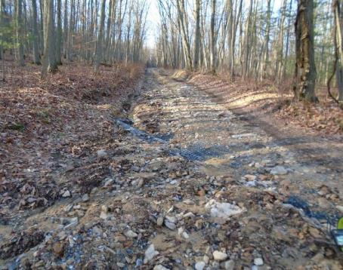
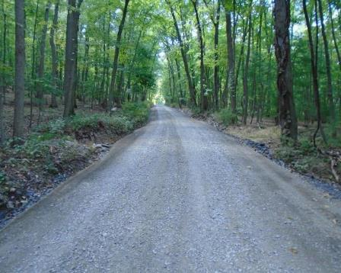
Project Management
Overall goal: build an environmentally sensitive road
How to get from before to after?

Slide 21
Project Management
Break up the overall goal into smaller steps
Put the steps in order (Prioritize and/or chronological order)
Set timelines & deadlines for each step
Identify tasks needed to complete each step
Assign team members to complete each task
Hold people accountable to completing their task correctly and on time
Throughout each step, offer support as needed to team members

Slide 22
Project Management
Break up the overall goal into smaller steps
Put the steps in order (Prioritize and/or chronological order)
Set timelines & deadlines for each step
Identify tasks needed to complete each step
Assign team members to complete each task
Hold people accountable to completing their task correctly and on time
Throughout each step, offer support as needed to team members
There is a template for DGLVR Projects

Slide 23
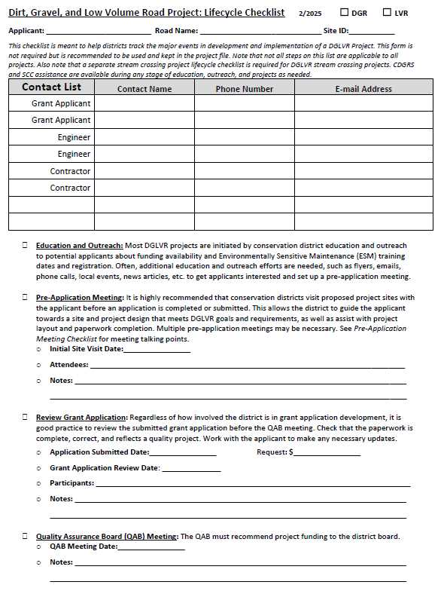
Project Life Cycle
DGLVR Project Life Cycle Checklist
Blank Forms - Center for Dirt and Gravel Road Studies (psu.edu)

Slide 24
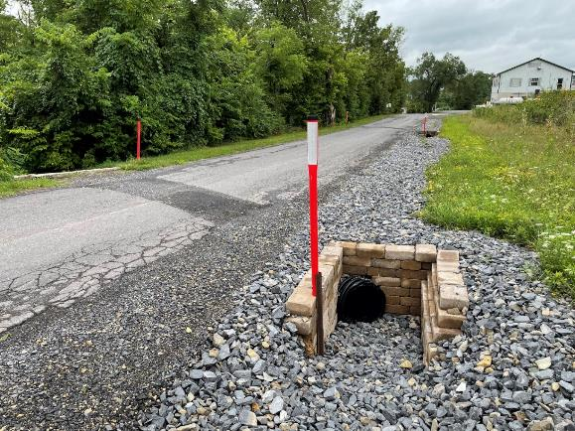
Project Life Cycle
Education and outreach
Pre-application meeting
Receive & review application
QAB meeting
CD Board meeting
Contracting
Preparing for Construction
If applicable: Design, permitting, bidding
Pre-construction meeting
Construction
Completion

Slide 25
Project Life Cycle
Task | Who is involved
Education and outreach | CD Staff
Pre-application meeting | CD Staff, road owner, designer/engineer
Receive & review application | CD Staff
QAB meeting | CD Staff, QAB
CD Board meeting | CD Staff, CD Board
Contracting | CD Staff, road owner
Additional design / engineering | Road owner, engineer/consultant, CD staff
Permitting | Road owner, engineer/consultant, CD staff
Bidding | Road owner, engineer/consultant, CD staff
Pre-construction meeting | Road owner, road crew and/or contractor, engineer/consultant, CD staff
Construction | Road owner, road crew and/or contractor, engineer/consultant, CD staff
Final Inspection | Road owner, road crew and/or contractor, engineer/consultant, CD staff
Completion Report | CD staff, road owner

Slide 26
Project Management
Key to successful DGLVR Projects:
Communication
More district involvement throughout the project lifecycle
=
better projects

Slide 27
Effective Communication
There are 2 parties in any communication
Information
You can only control your side of the conservation, but it’s important to be aware of both
https://en.wikipedia.org/wiki/File:Happy_Man_Throwing_Money_Cartoon.svg
Notes:
Communication is conveying information from one person to another
2 parts: sending and receiving
Needs to be conveyed in an understandable way
Audience needs to be receptive *** this is key and we often forget this part

Slide 28
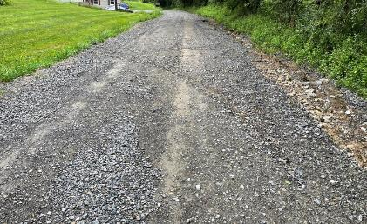
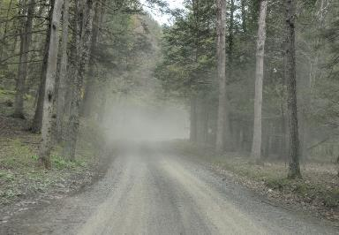
Effective Communication
Know your audience
What does the road owner care about?
Start with why, not what
Explain how you can solve a problem for your audience
https://en.wikipedia.org/wiki/File:Happy_Man_Throwing_Money_Cartoon.svg

Slide 29
Effective Communication
Know your audience
What does the road owner already know?
Consider word choice
Define any terms your audience may not be familiar with
Don’t assume program participants already know DGLVR details
Provide all of the info they will need

Slide 30
Effective Communication
Building trust helps the working relationship
Listen
Be reliable
Complete tasks you commit to
Follow up in a timely manner
Be honest
Connect them to additional resources when you don’t know the answer

Slide 31
Effective Communication
Short and direct:
Be clear about the most important points you’re trying to communicate
Don’t take too long to get there or provide too much detail
Summarize key points
Ask your audience to explain what they learned to confirm you’re on the same page
End conversations by reviewing what the next step is and who needs to do what

Slide 32
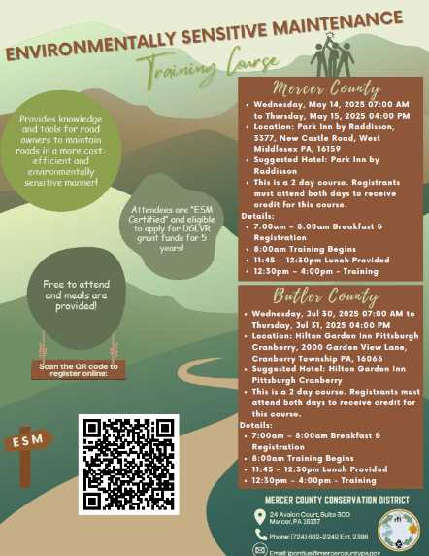
Effective Communication
Written Communication:
Provide information for future reference in a written format
Present information in an organized and visually appealing way
Use bullet points
Use different fonts, color, bold/underline, etc.
Use pictures

Slide 33
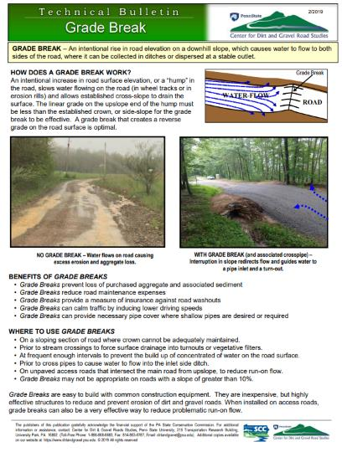
Effective Communication
Use visual aids whenever possible
Example projects
ESM practices
What landowners can expect from a project
Project sketches
Diagrams and construction details
And more!

Slide 34
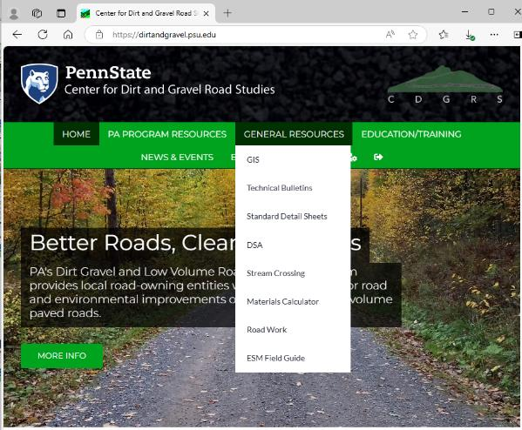
Tools – Visual Aids
Technical Bulletins
Standard Detail Sheets
ESM Field Guide
Stream Continuity Flyers
Flyers for potential grant applicants
Annual Summary Reports

Slide 35
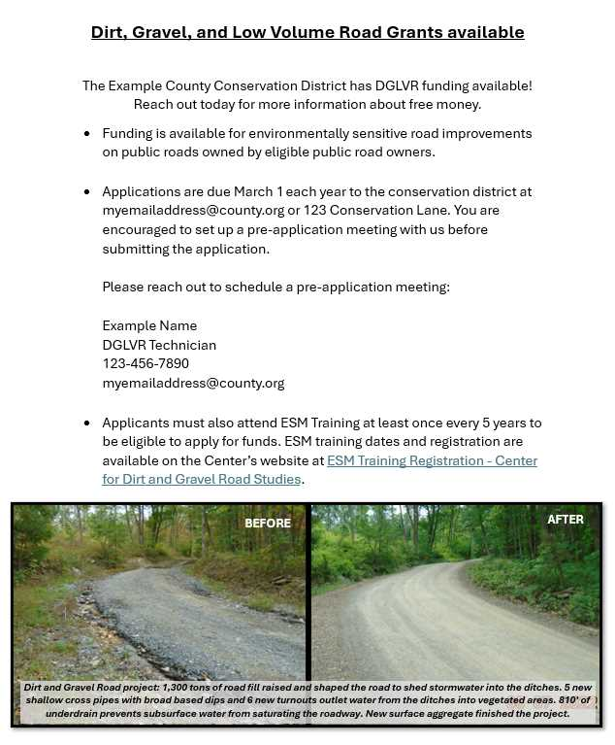
Effective Communication

Slide 36
Project Life Cycle
Education and outreach
Pre-application meeting
Receive & review application
QAB meeting
CD Board meeting
Contracting
Preparing for Construction
If applicable: Design, permitting, bidding
Pre-construction meeting
Construction
Completion
Notes:
Not going to talk in detail about education and outreach since there are recorded webinars and we just talked about communication tips in general

Slide 37
Project Life Cycle
Recorded webinar: January 16, 2025: Education and Outreach Ideas for CDs
With constant municipal turnover, education and outreach at the District level is a vital component of the Program. This webinar built on material presented at the 2024 workshop, and provided ideas, tips, and tricks learned from CDs.
Webinar Download (74.3 MB): MP4 format (~44 minutes)
Presentation Downloads:
Adobe PDF (4.09 MB)
MS Powerpoint (7.85 MB)
Flyers for Outreach
DGLVR Handout for New Participants: This 2-page flyer provides a brief overview and introduction to the DGLVR Program.
Example DGLVR Projects: This 2-page flyer shows example before and after pictures of completed DGLVR projects and frequent issues addressed by the DGLVR Program.

Slide 38
Why talk about Project Management?
Discussion
Education & Outreach
Now’s the time to show any educational materials you brought to share, ask for feedback, etc.
Discussion: communication and education tips and tricks?
Types of education events
Outreach to solicit program participation & pre-application meetings
https://www.vhv.rs/download/TiwmRbR_graphic-picture-of-a-meeting-group-work-group/#google_vignette

Slide 39
Outline
Introductions
Policy Review Trivia Game
Intro to Project Management
Pre-application & Application
Project Administration: Contracting through Construction
Project Completion

Slide 40
Project Life Cycle
Education and outreach
Pre-application meeting
Receive & review application
QAB meeting
CD Board meeting
Contracting
Preparing for Construction
If applicable: Design, permitting, bidding
Pre-construction meeting
Construction
Completion

Slide 41
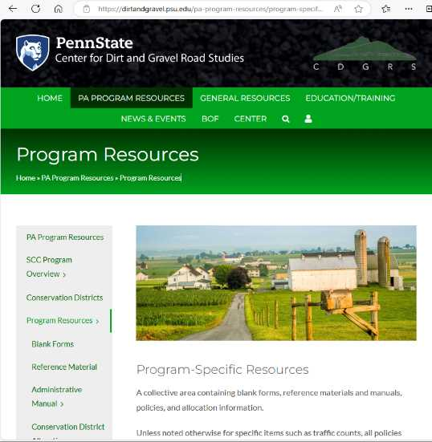
Tools - checklists
Checklists available on Blank Forms - Center for Dirt and Gravel Road Studies (psu.edu)
DGLVR Project Life Cycle
Pre-application meeting
Bid package review
Pre-construction meeting
Remember – stream crossing projects have a separate set of checklists:
Stream Crossing - Center for Dirt and Gravel Road Studies (psu.edu)

Slide 42
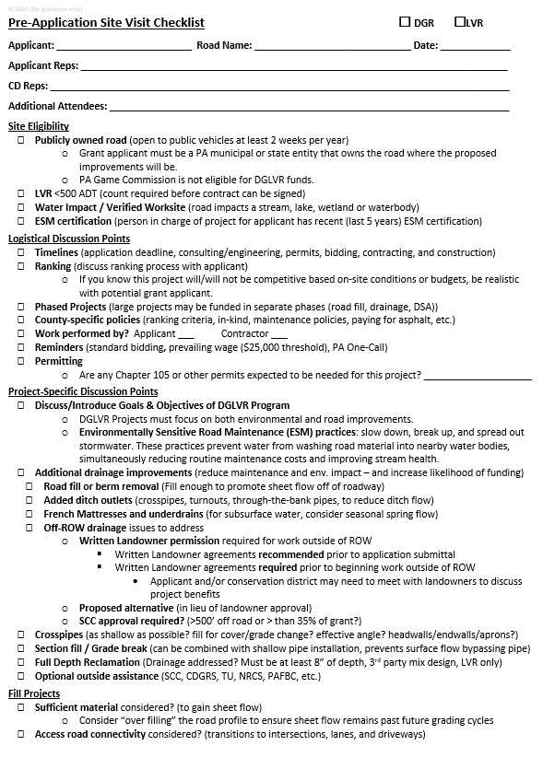
Prep for Pre-application meeting
Review meeting checklist before the site visit
Checklist is not all-inclusive of policy manual: refresh as needed
Reach out to Center/SCC with questions

Slide 43
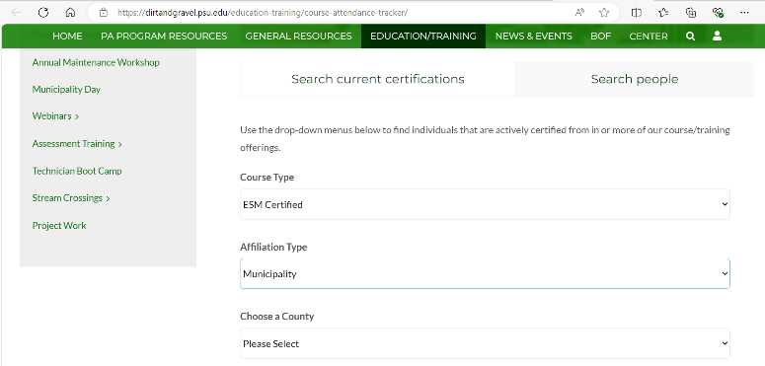
Prep for Pre-application meeting
Learn about the road owner
Review who, if anyone, is ESM Certified for the road owning entity you’re visiting
When does their ESM Cert expire?
What was the last project they completed?
https://dirtandgravel.psu.edu/education-training/course-attendance-tracker/

Slide 44
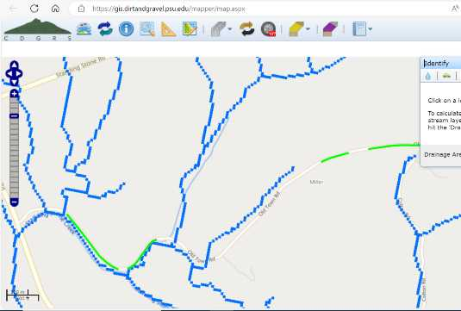
Prep for Pre-application meeting
Research potential sites before visit, if possible
Directions
Print a map of municipal road(s) to reference during meeting
Imagery, topography, roads
Location of streams, potential sites, past projects
Look up stream info
Wetness index & StreamStats show more channels than stream layer
Use StreamStats to delineate drainage areas
Chapter 93 & trout stream status, impairments
Soils, landowners, traffic data, etc.

Slide 45
Prep for Pre-application meeting
Steer the road owner to their best potential sites
Review roads ahead of meeting
Proximity to resource, quality of resource, likelihood of environmental impact
Discuss sites with road owner
Visit multiple sites and narrow down from there
You want to give your district good sites to select from and give the road owner their best chance of receiving funding.

Slide 46
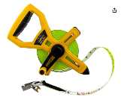
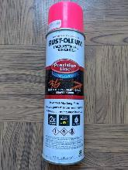
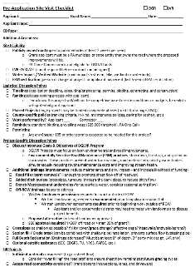
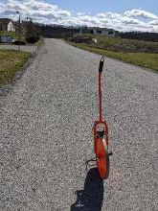
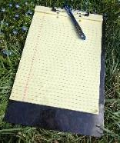
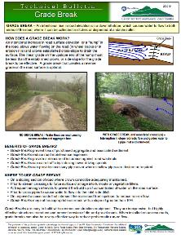
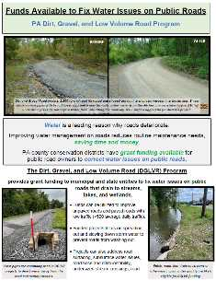
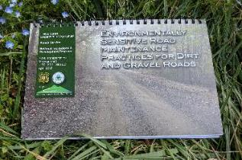
Prep for Pre-application meeting
Bring paperwork and field supplies

Slide 47
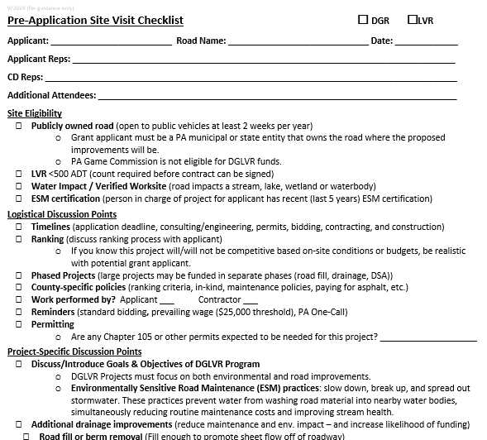
Pre-application meeting
During the meeting, use the checklist to guide conversation (covers 3 main topics)
Program Outreach
Program goals
Focus on reduced maintenance benefits
Eligibility
Site and applicant
Steer applicants towards good projects and ESM practices
Project design
Site diagnostic
ESM practices

Slide 48
Pre-application meeting
Determine a potential start and end point for the project.
Focus on the segment length that is most likely to rank.
Record coordinates or a landmark so the stationing can be recreated when needed.
Wheel the road with the road owner to create a plan to address the existing issues. Record stations of proposed ESM practices and existing drainage features.
Both parties should record the plan.
Keep all issues in mind and what is needed to create a comprehensive project that reduces environmental impact and maintenance.
Drainage disconnection, infiltration, detention, stabilization

Slide 49
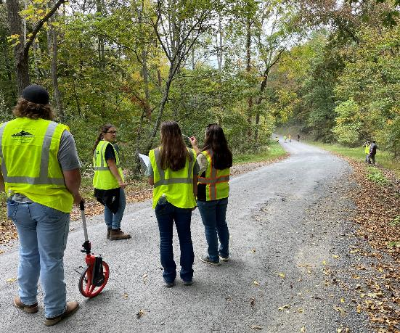
Pre-application meeting
Site Diagnostics
What does the site need?
If difficult, reach out to the Center for technical assistance
An engineer may be necessary for some projects
Landslides, stream crossings, stormwater BMPs, etc.
Important for including engineering in grant request
If you want to do something outside the box, contact the SCC

Slide 50
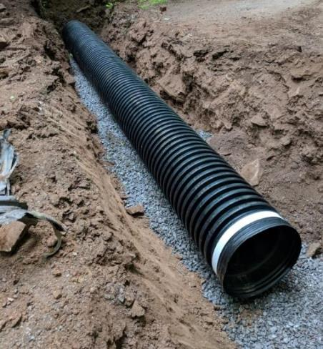
Pre-application meeting
Multiple pre-app meetings may be needed
Make sure you get enough information for the application and/or ranking
Stationing
Create work plan
Get enough info to estimate quantities
Measurements in all 3 dimensions
Take pictures
Depth
Width
Length

Slide 51
Pre-application meeting
After the pre-application meeting:
Type up the workplan*
Material and Cost Estimating
Estimate materials to provide to the road owner
Estimate costs (don’t forget engineering) to get a realistic idea as to if the entire project can be done under one contract or if the site length needs to be reduced or the project needs to be phased Can the applicant complete the scope under one contract in a reasonable amount of time?
Reducing scope vs. phasing should be based on project quality. Staff should steer this conversation with the road owner.
Where will materials come from? What type of material is best?
Get to know your quarries and material suppliers.

Slide 52
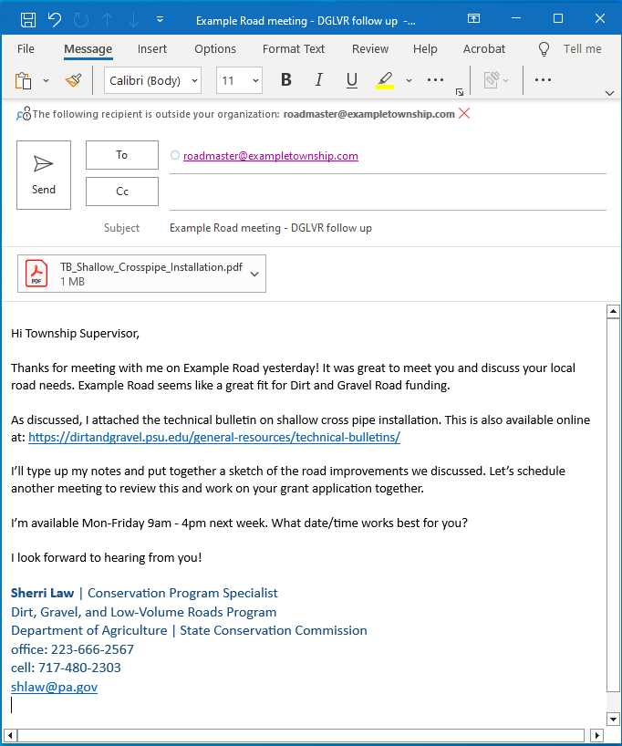
Pre-application meeting
Follow up with the road owner
Answer any questions not answered during the meeting
Provide notes/sketch/tech bulletins/standard drawings/etc.
Tell them their next step
Set due dates
Schedule follow up meeting
Remind them of grant application deadline
Send ESM training registration link

Slide 53
Project Life Cycle
Education and outreach
Pre-application meeting
Receive & review application
QAB meeting
CD Board meeting
Contracting
Preparing for Construction
If applicable: Design, permitting, bidding
Pre-construction meeting
Construction
Completion

Slide 54
Reviewing Applications
Remote Learning Center
Filling out grant application paperwork (92.4 MB) (~43 minutes) Intended audience: Potential Applicants (and CD staff). This presentation walks through how to fill out the grant application paperwork.
Reviewing grant applications (98.5 MB) (~53 minutes) Intended audience: Conservation Districts. This presentation explains what conservation districts should do after DGLVR grant applications are received and before the QAB meeting where applications are ranked.
Better Grant Applications (75.6 MB) (~47 minutes) This webinar discussed some common shortcomings of grant applications from applicants and considerations for improvement. (1/2023)

Slide 55
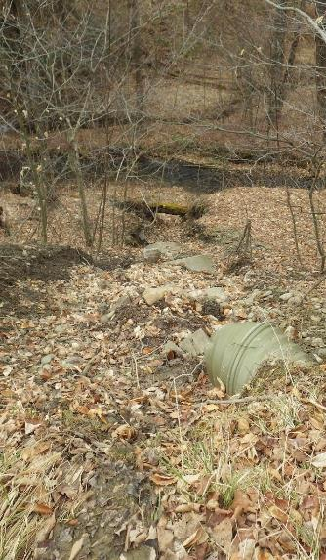
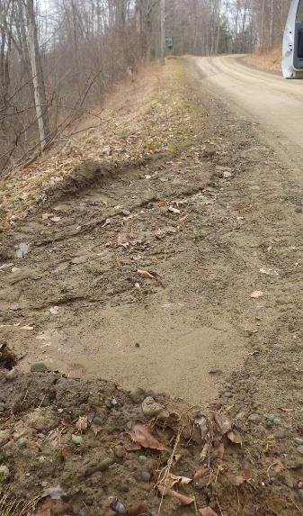
Example Site: Dogtown Road, Genesee Twp

Slide 56
Example Site: Dogtown Road, Genesee Twp

Slide 57
Example Site: Dogtown Road, Genesee Twp

Slide 58
Example Site: Dogtown Road, Genesee Twp

Slide 59
Example Site: Dogtown Road, Genesee Twp

Slide 60
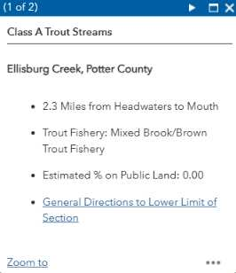
Example Site: Dogtown Road, Genesee Twp

Slide 61
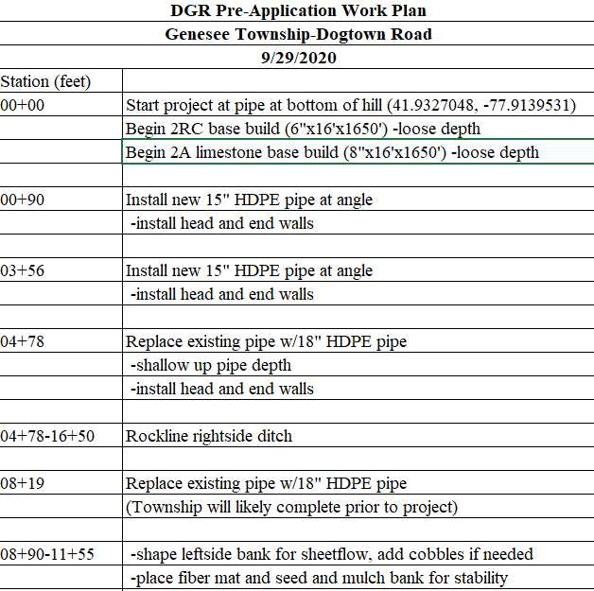
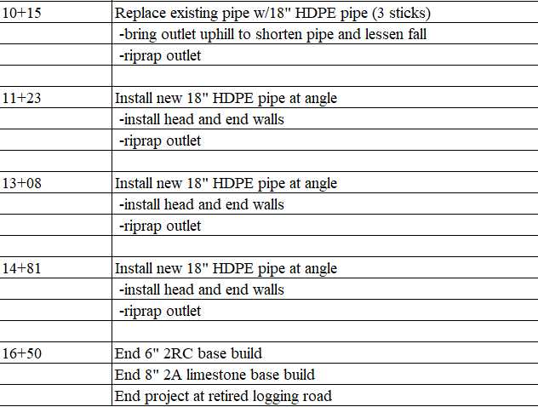
Example Site: Dogtown Road, Genesee Twp

Slide 63
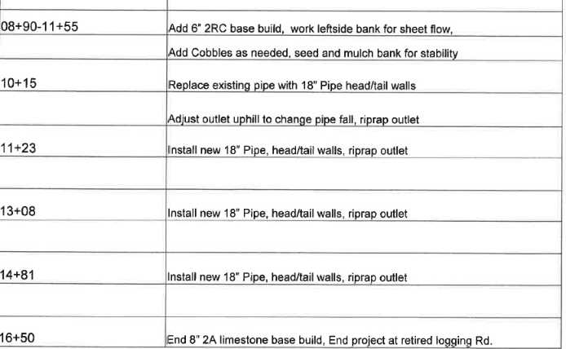

Slide 64
Example Site: Dogtown Road, Genesee Twp

Slide 65
Example Site: Dogtown Road, Genesee Twp
Activity
Application Review
You are the conservation district that received an application for Dogtown Rd.
Review the application for eligibility, meeting DGLVR requirements, and consistency with the pre-app meeting
Compile a list of questions/comments for the township
https://www.vhv.rs/download/TiwmRbR_graphic-picture-of-a-meeting-group-work-group/#google_vignette

Slide 67
Example Site: Dogtown Road, Genesee Twp

Slide 69
Example Site: Dogtown Road, Genesee Twp

Slide 70
Example Site: Dogtown Road, Genesee Twp

Slide 71
Example Site: Dogtown Road, Genesee Twp

Slide 72
Example Site: Dogtown Road, Genesee Twp

Slide 73
Outline
Introductions
Policy Review Trivia Game
Intro to Project Management
Pre-application & application
Project administration: contracting through construction
Project completion

Slide 74
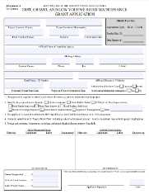
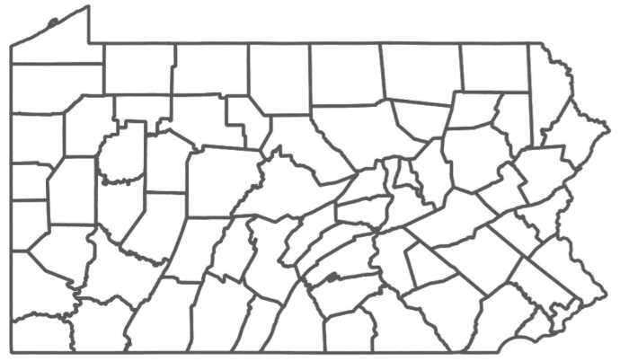
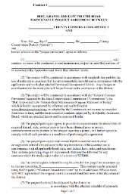
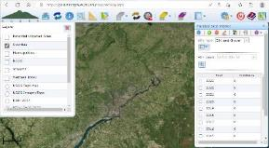
Ranking and Contracting
County Conservation District
Quality Assurance Board
Grant Application
Conservation District Board
County Conservation District
Contract
Notes:
Briefly remind audience of procedure to fund contracts. This is covered in detail in basic admin training. Answer any questions but otherwise move on quickly.

Slide 75
Ranking and Contracting
County Conservation District
Quality Assurance Board
No payments or project work can happen until there is a fully signed contract
Grant Application
Conservation District Board
County Conservation District
Contract

Slide 76
Ranking and Contracting
Discussion:
Ranking, Local Policy, & Contracting
Now’s the time to share materials you brought related to QAB meetings, ranking, and contracting
https://www.vhv.rs/download/TiwmRbR_graphic-picture-of-a-meeting-group-work-group/#google_vignette

Slide 77
Project Life Cycle - Timing
Education and outreach
Pre-application meeting
Receive & review application
QAB meeting
CD Board meeting
Contracting
Preparing for Construction
If applicable: Design, permitting, bidding
Pre-construction meeting
Construction
Completion
The time of year you do these steps can make a big difference!

Slide 78
Project Life Cycle - Timing
Education and outreach
Pre-application meeting
Receive & review application
QAB meeting
CD Board meeting
Contracting
Preparing for Construction
If applicable: Design, permitting, bidding
Pre-construction meeting
Construction
Completion
Annual allocations
typical timeline
Approved by SCC in May
State Budget passes 7/1
Advances available late summer/early fall
Districts have 2 years to spend funds

Slide 79
Project Life Cycle - Timing
#1 Tip for running an effective local DGLVR Program:
Run an annual program
Where you award DGLVR grants ASAP when annual allocations are received

Slide 80
Project Life Cycle - Timing
Be ready to contract projects with new FY funds as soon as the funds are available (Fiscal Year: July 1 – June 30)
2022 2023 2024 2025 2026 2027
July 1
Use 2025 to prepare for projects that will be constructed in 2026
FY 2025-26 funds

Slide 81
Project Life Cycle - Timing
2025
2026
2027
Today
Jan April July Oct Jan April July Oct Jan April July Oct Jan

Slide 82
Project Life Cycle - Timing
2025
2026
2027
Today
Jan April July Oct Jan April July Oct Jan April July Oct Jan
Pre-app meetings (start previous fall)
QAB & CD board meetings
Contract 25-26 funds
Design, permitting, bidding
construction
Completion & final payment

Slide 83
Project Life Cycle - Timing
2025
2026
2027
Today
Jan April July Oct Jan April July Oct Jan April July Oct Jan
Pre-app meetings (start previous fall)
Pre-app meetings
QAB & CD board meetings
Apps due
Rank apps
QAB & CD board meetings
Contract 25-26 funds
Contract 26-27 funds
Design, permitting, bidding
Prep for & complete construction
Completion & final payment
construction
Completion & final payment
Notes:
Sample Timeline
Summer/Fall 2025 – Complete pre-application meetings
Winter 2025-26 – Accept applications
Spring 2026 – Rank project applications
May 2026 – find out FY 25-26 allocation
June/July 2026
Once new allocation amount is known, hold QAB meeting and recommend projects for funding
Approve projects at District Board meeting
Contract the new projects with FY 25-26 funds
July 2026 – October 2027 – Complete Construction
November/December 2027 – Close out project including reimbursement to project participant

Slide 84
Project Life Cycle - Timing
2025
2026
2027
Today
Jan April July Oct Jan April July Oct Jan April July Oct Jan
Pre-app meetings
QAB & CD board meetings
Contract 24-25 funds
Prep for & complete construction
Completion & final payment

Slide 85
Project Life Cycle - Timing
2025
2026
2027
Today
Jan April July Oct Jan April July Oct Jan April July Oct Jan
Pre-app meetings
Note when contracting projects in the spring – you are about to get more funding!
QAB & CD board meetings
Contract 24-25 funds
Prep for & complete construction
Completion & final payment

Slide 86
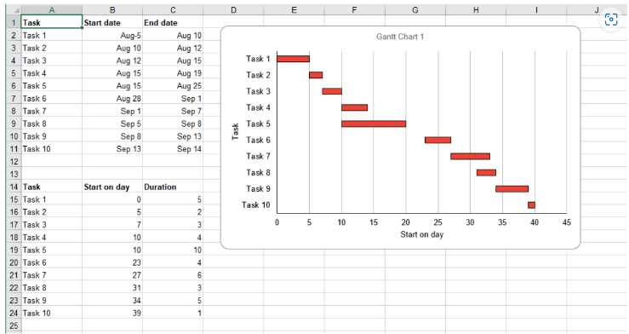
Project Management
Gantt Chart: a horizontal bar chart used to display the start date and duration of each task that makes up a project.
Provides quick view of:
List of tasks
Start and end dates for each task
Dependencies between tasks
https://www.forbes.com/advisor/business/software/what-is-a-gantt-chart/

Slide 87
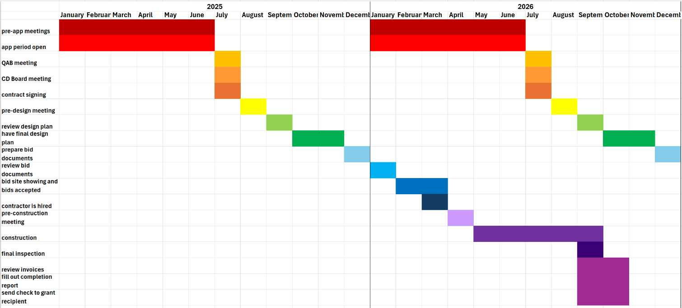
Project Management

Slide 88
Project Life Cycle - Timing
Discussion:
What is your local DGLVR Program timeline?
Deadlines – show of hands
Once / year?
Twice / year?
Rolling basis?
Pros and cons of each?
https://www.vhv.rs/download/TiwmRbR_graphic-picture-of-a-meeting-group-work-group/#google_vignette

Slide 89
Preparing for Construction
Education and outreach
Pre-application meeting
Receive & review application
QAB meeting
CD Board meeting
Contracting
Preparing for Construction
If applicable: Design, permitting, bidding
Pre-construction meeting
Construction
Completion

Slide 90
Preparing for Construction
Choosing an engineer
Does the project need engineering or additional design?
Does the grant recipient have an engineer on staff or retainer?
What is that engineer’s specialty and are they comfortable with the type of project you’re working on?
Consider soliciting proposals for engineering services

Slide 91
Preparing for Construction
Communicating with engineers
Provide detailed description of the work needed, including DGLVR requirements
Pre-design meeting
Request for Proposals (RFP) template available for DGLVR stream crossings
Require the engineer to provide district staff the design to make sure it meets DGLVR requirements
Note CDs are not asked to do engineering on projects.

Slide 92
Preparing for Construction
Example engineered plan review
Notes from pre-app meeting:
Install 2 rain garden bump outs on either side of the avenue
Use existing storm sewer inlets for overflow instead of having risers in the rain gardens
Excerpt from engineer’s plan
Montgomery CCD
Notes:
Discuss how these 2 design ideas are represented well on the plan sheet

Slide 93
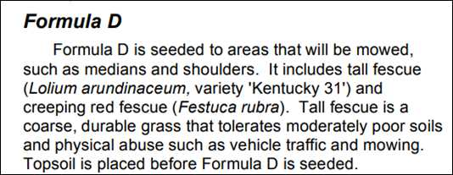
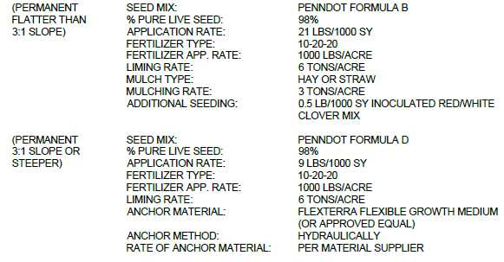
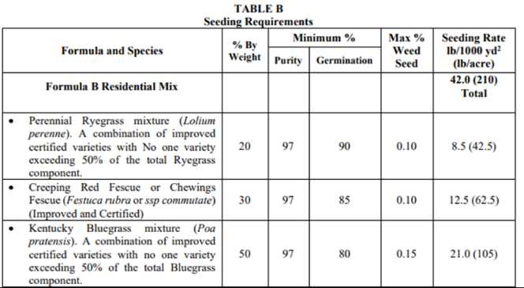
Preparing for Construction
Example engineered plan review
Notes from pre-app meeting:
Include native plantings (including shrubs) in the rain gardens
Excerpt from engineer’s plan
Montgomery CCD
Notes:
Discuss how the proposed permanent seed mixes don’t include the recommended native shrubs

Slide 94
Preparing for Construction
Example notes to send engineer:
Overflow: It looks like the plans incorporated the CD’s recommendation to utilize the existing storm sewer system inlets as overflow instead of risers for the rain garden bump outs. Thank you.
Plantings/seed mix: The permanent seed mix listed isn’t consistent with the discussion from the pre-app meeting. We recommend adding native plantings.
The Permanent seed mix is listed as PennDOT Formula B (flatter than 3:1 slope) and PennDOT Formula D (3:1 slope or steeper)
Formula B info is in PennDOT Pub 408 and it appears to be grasses only for residential settings. We had difficulty finding Formula D in the Pub408 but found a 2007 Penn State factsheet listing that Formula D is for areas that will be mowed, such as medians and shoulders. Screenshots and link to the fact sheet below.
The borough staff we met with during the pre-app meeting spoke about including native herbaceous and small shrub plantings based on their landscaping experience. We talked about things like shading and light requirements for the plants selected, etc. The borough said they didn’t want to have to do much routine maintenance on the vegetation in the rain gardens over the course of the year, so using a seed mix that is intended to be mowed wouldn’t be consistent with that plan.
Montgomery CCD
Notes:
Discuss the type of feedback that can be provided to the engineer.

Slide 95
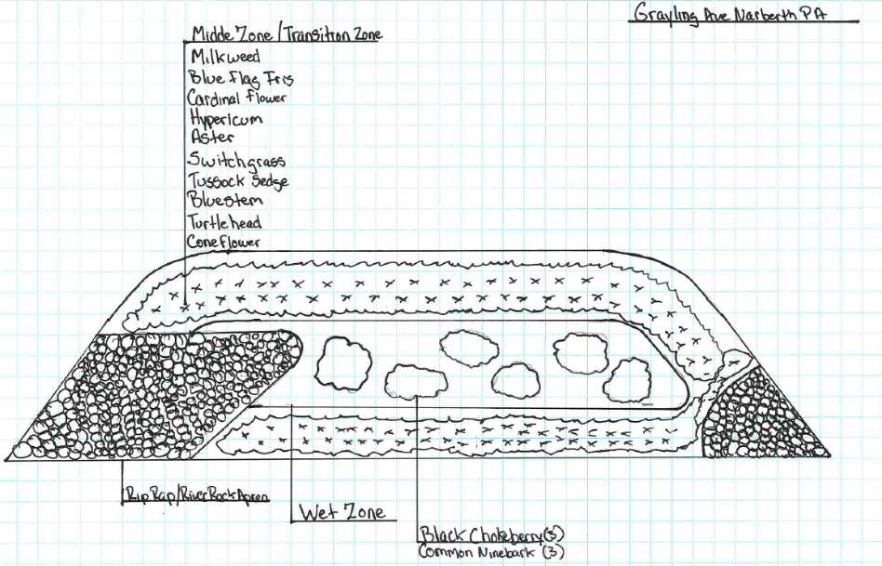
Preparing for Construction
Montgomery CCD

Slide 96
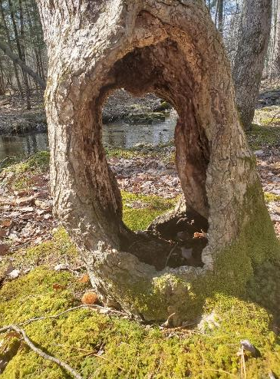
Preparing for Construction
Permitting tips
Reach out to DEP early if you think permitting might be needed
Include DEP in pre-app meeting or set up pre-permit app meeting
Discuss CD 105 delegation
Photo: Monroe CCD

Slide 97
Preparing for Construction
Discussion:
Working with Engineers/Designers
& Permitting
Now’s the time to share materials you brought related to these topics
https://www.vhv.rs/download/TiwmRbR_graphic-picture-of-a-meeting-group-work-group/#google_vignette

Slide 98
Preparing for Construction
Bidding – recorded webinars
April 14, 2020: Municipal Bidding
This webinar reviewed various aspects of the municipal bidding process as it relates to municipal projects funded through the DGLVR Program. It covered an overview of the bidding process and provided additional resources.
Webinar Download (66.3 MB): MP4 format (~ 1 hour 8 minutes)
Presentation Downloads:
Adobe PDF (8.81 MB)
MS Powerpoint (16.9 MB)
June 9, 2020: COSTARS and Purchasing
As part of the 4/14/20 “Municipal Bidding” webinar, there was some discussion and a request for more information about the COSTARS program, a cooperative purchasing program designed to make purchasing both easier and price competitive for public entities. Felicia Campbell & Kim Bullivant, two representatives from COSTARS, presented information and answered available for questions.
Webinar Download (178 MB): MP4 format (~ 1 hour 19 minutes)
Presentation Downloads:
Adobe PDF (7.3 MB)
MS Powerpoint (8.72 MB)

Slide 99
Preparing for Construction
Bidding considerations
Each grant recipient’s experience level with bidding will vary.
Ask what their experience with bidding is and who they plan to have manage their bidding:
Themselves, engineer, municipal services rep, etc.
Provide assistance within your comfortability level
Ex. project narrative, prevailing wage, technical bulletins, technical specifications, completion dates

Slide 100
Preparing for Construction
Bidding considerations
Time of year – winter/spring is best
Bidding during the construction season is possible, but many contractors may have limited availability at that point
Amount of detail
Need enough to get the project you want
Not enough or too much detail will result in fewer and/or expensive bids

Slide 101
Preparing for Construction
Bidding considerations
CDs should always review bid documents to make sure they meet DGLVR requirements
Note that CDs do not have to oversee bidding for the grant recipient.
Review bid docs before the bid packages go out to bidders. Make sure road owner knows this early.

Slide 102
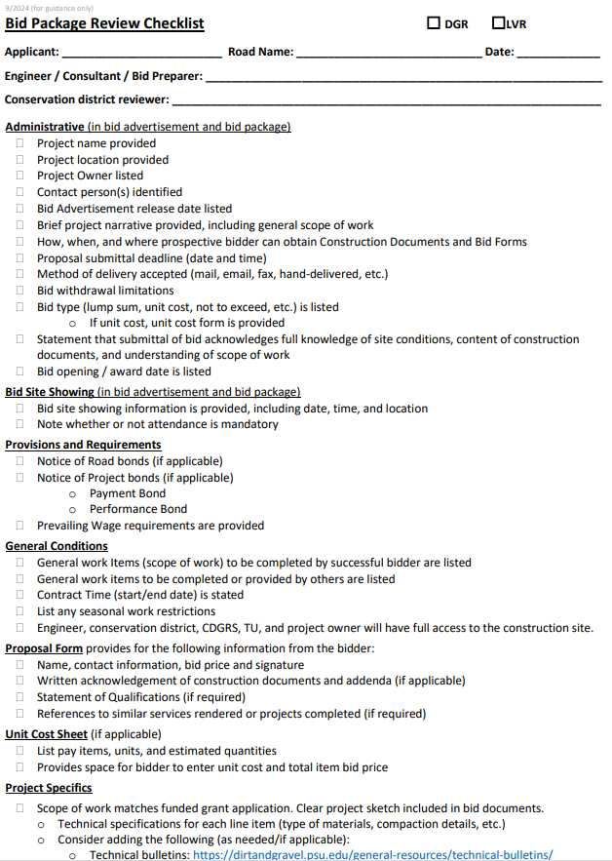
Preparing for Construction
Bidding considerations
Ensure essential details in bid docs match DGLVR contract, including:
Start/end dates
Sketch/scope of work/quantities
Use the DSA Request For Quote (RFQ) for DSA projects
Road fill RFQ available as well

Slide 103
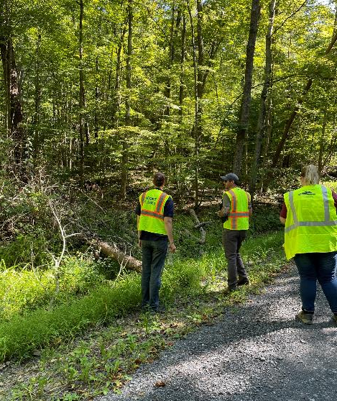
Preparing for Construction
Bidding tips
Site showings – good ideas
Pros/cons of mandatory site showing
If there is a site showing, CD should always be there to answer questions pertaining to grant requirements

Slide 104
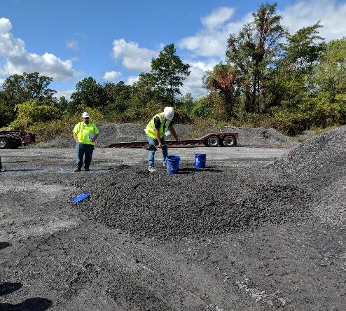
Preparing for Construction
Bidding tips
Ask road owner to inform you ASAP when low bid is chosen.
Consider attending the bid opening
If it’s a DSA project, find out what quarry the material is coming from and submit DSA notification to Center ASAP.
Find out the proposed construction timeframe and remind them to notify you before construction starts and update you if the schedule changes.

Slide 105
Preparing for Construction
Discussion:
Bidding
Now’s the time to share materials you brought related to these topics
https://www.vhv.rs/download/TiwmRbR_graphic-picture-of-a-meeting-group-work-group/#google_vignette

Slide 106
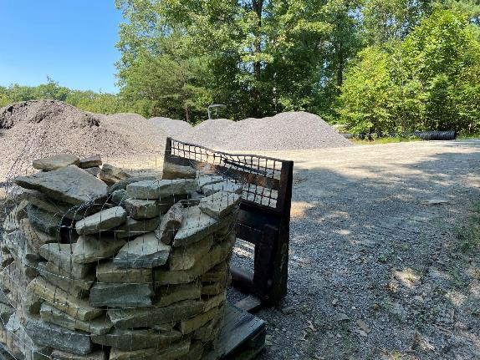
Preparing for Construction
For Municipal Workforce Projects
Was an annual stone bid put out and awarded for the year or was a project specific material bid completed?
When do materials need to be ordered to be onsite in time for construction?
Does equipment need to be rented?

Slide 107
Preparing for Construction
Pre-construction Meeting
Review scope of work
Construction stakeout
Construction Schedule
Notice of Construction Start
Stabilization
Does material need to be stockpiled?
Who will coordinate with the quarry on material delivery?

Slide 108
Project Life Cycle
Preparing for Construction
Done by twp labor
Bid out materials / bid out project work
Pre-construction meeting
Walk site: maybe it’s been a year between pre-app and pre-con
Flag/paint where practices will go
Pipe inlet AND outlet locations, talk about pipe angles, headwall/endwall construction, any other stabilization

Slide 109
Preparing for Construction
Discussion:
Pre-construction meetings
Now’s the time to share materials you brought related to these topics
https://www.vhv.rs/download/TiwmRbR_graphic-picture-of-a-meeting-group-work-group/#google_vignette

Slide 110
Preparing for Construction
Construction inspection
Be onsite as often as possible
Critical Stages
First day of construction and when practices change
Ask for paperwork/documentation as soon as it’s available
More likely to get a copy when the grant recipient is thinking about it
Speeds up final payment later
Proof of permits, 811 serial number, prevailing wage documentation, DSA Certifications, etc.
Photo: Monroe CCD

Slide 111
Project Life Cycle - Timing
Discussion:
Construction Inspections
Working with Contractors and road crews
Now’s the time to share materials you brought related to these topics
https://www.vhv.rs/download/TiwmRbR_graphic-picture-of-a-meeting-group-work-group/#google_vignette

Slide 112
Outline
Introductions
Policy Review Trivia Game
Intro to Project Management
Pre-application & application
Project administration: contracting through construction
Project completion

Slide 113
Example Site: Dogtown Road, Genesee Twp
Final Inspection
What do you if you show up on site and see this?
Notes:
Final inspection is required before final payment
Often easy if CD staff is on site often during construction

Slide 114
Notes:
Final inspection is required before final payment
Often easy if CD staff is on site often during construction

Slide 115
Example Site: Dogtown Road, Genesee Twp
Final Inspection
What do you if you show up on site and see this?
Photo: Monroe CCD
Notes:
Final inspection is required before final payment
Often easy if CD staff is on site often during construction

Slide 116
Example Site: Dogtown Road, Genesee Twp
Discussion
Final Inspection
Does the road owner, contractor, engineer, participate?
Are there often items that need to be fixed?
How do you make sure remediation is done?
As-built notes or drawing?
https://www.vhv.rs/download/TiwmRbR_graphic-picture-of-a-meeting-group-work-group/#google_vignette

Slide 117
Example Site: Dogtown Road, Genesee Twp

Slide 118
Example Site: Dogtown Road, Genesee Twp
Notes:
Final inspection is required before final payment
Often easy if CD staff is on site often during construction

Slide 119
Example Site: Dogtown Road, Genesee Twp
Notes:
Final inspection is required before final payment
Often easy if CD staff is on site often during construction

Slide 120
Example Site: Dogtown Road, Genesee Twp
Notes:
Final inspection is required before final payment
Often easy if CD staff is on site often during construction

Slide 121
Example Site: Dogtown Road, Genesee Twp
Notes:
Final inspection is required before final payment
Often easy if CD staff is on site often during construction

Slide 122
Example Site: Dogtown Road, Genesee Twp
Notes:
Final inspection is required before final payment
Often easy if CD staff is on site often during construction

Slide 123
Example Site: Dogtown Road, Genesee Twp
Notes:
Final inspection is required before final payment
Often easy if CD staff is on site often during construction

Slide 124
Example Site: Dogtown Road, Genesee Twp
Notes:
Final inspection is required before final payment
Often easy if CD staff is on site often during construction

Slide 125
Project Completion
Final paperwork
Reminder: required documentation is listed on DGLVR File Checklist

Slide 126
Example Site: Dogtown Road, Genesee Twp
Discussion
Invoices
What do you look for when reviewing invoices?
https://www.vhv.rs/download/TiwmRbR_graphic-picture-of-a-meeting-group-work-group/#google_vignette
Notes:
Date
Supplier
Bill to/supplied to
Item
Quantity
Total price

Slide 127
Example Site: Dogtown Road, Genesee Twp
Discussion
Invoices
Do you use an expense tracker?
https://www.vhv.rs/download/TiwmRbR_graphic-picture-of-a-meeting-group-work-group/#google_vignette
Notes:
Date
Supplier
Bill to/supplied to
Item
Quantity
Total price

Slide 128
Example Site: Dogtown Road, Genesee Twp
Discussion
Invoices & Completion Report
Do you fill out the report, ask the grant recipient to fill it out, or work together on it?
Do you complete this in the field, office, or both?
What common issues do you see on invoices and encounter on the completion report?
https://www.vhv.rs/download/TiwmRbR_graphic-picture-of-a-meeting-group-work-group/#google_vignette

Slide 129
Example Site: Dogtown Road, Genesee Twp
Activity
Invoice Review
You’ve done the final inspection and now are reviewing invoices to make the final grant payment.
Review the invoices for eligibility, meeting DGLVR requirements, and consistency with construction.
Compile a list of questions/comments for the township.
https://www.vhv.rs/download/TiwmRbR_graphic-picture-of-a-meeting-group-work-group/#google_vignette

Slide 130
Example Site: Dogtown Road, Genesee Twp
Activity
Invoice Review
What issues did you find with the financial documentation?
https://www.vhv.rs/download/TiwmRbR_graphic-picture-of-a-meeting-group-work-group/#google_vignette

Slide 131
Example Site: Dogtown Road, Genesee Twp

Slide 132
Example Site: Dogtown Road, Genesee Twp
Activity
Invoice Review
Review additional documentation
https://www.vhv.rs/download/TiwmRbR_graphic-picture-of-a-meeting-group-work-group/#google_vignette

Slide 133
Example Site: Dogtown Road, Genesee Twp
https://www.vhv.rs/download/TiwmRbR_graphic-picture-of-a-meeting-group-work-group/#google_vignette

Slide 134
Example Site: Dogtown Road, Genesee Twp
Activity
Filling out the completion report
Now that the final inspection and invoice review are complete, ensure the completion report is filled out correctly.
https://www.vhv.rs/download/TiwmRbR_graphic-picture-of-a-meeting-group-work-group/#google_vignette

Slide 135
Project Completion
Generate Comp Report form in GIS
Review with road owner
Both parties sign
GIS:
Enter final payment
Mark project as complete

Slide 136
Project Completion

Slide 137
Project Completion
Any last questions?
Please fill out the survey!

