Slide 1
Financial Training Dirt, Gravel, and Low Volume Road Program
PA State Conservation Commission
Sherri Law

Slide 2
Introduction
Why talk about finances?
Practicality
Keeping track of money tells us how much we have left to spend
Accountability
Grant funding must be spent responsibly to continue receiving funds
Be responsible with tax dollars
To help conservation districts do good work
Funding is required to pay staff, pay bills, and fund projects
Helping districts track and use funds appropriately helps achieve the conservation goals we care about
Notes:
Ask the audience why is it important to talk about finances, then go over the main points on the slide

Slide 3
Introduction
Improve local land use AND water quality
Notes:
Ultimately, appropriate use of funds allows the funding to be continued to be used for the conservation work we care about

Slide 4
Introduction
Notes:
Back in 2005 – 06 State funding to all conservation districts combined totaled $ 30,000,000
For FY 18/19 it totaled $ 70,000,000
“With great [funding] comes great responsibility” … and more attention from the public, legislators, etc.

Slide 5
Introduction
Need for Accountability
Simplicity and Local Control
https://outdoors.com/most-dangerous-tightrope-walks-in-the-world/
Notes:
As we talk about finances today, keep in mind that it’s important to balance accountability with simplicity and local control.

Slide 6
Introduction

Slide 7
Introduction

Slide 8
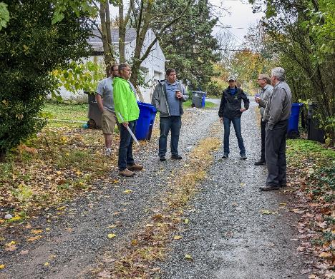
Introduction
Quality Assurance/Quality Control (QAQC)
SCC reviews each County Conservation District DGLVR Program once every 3 years
Review is conducted in multiples remote and in person sessions
Review consists of 3 main parts:
Projects
Administrative / Functionality
Finances

Slide 9
Introduction
Quality Assurance/Quality Control (QAQC)
Educational opportunity:
Allows SCC to assess district staff understanding of Program goals, policies, technical skills, etc.
Districts are educated about what they are doing well and areas for improvement
SCC learns areas for Programmatic improvement
Districts provide feedback to SCC on how the Program is working

Slide 10
Introduction
How to make sure your conservation district does well on the financial portion of your QAQC:
Follow the guidance in this training!
Notes:
We aren’t going to spend a lot of time during this training specifically discussing QAQCs since the whole training provides guidance on high quality financial practices. If you follow the guidance in this training, it will help the financial portion of your QAQC go smoothly.

Slide 11
Outline
DGLVR Program Overview
DGLVR Policy and Tracking Funds
Documenting DGLVR Funds
Reconciling Accounts
Budgeting and Spending Requirements

Slide 12
Outline
DGLVR Program Overview
DGLVR Policy and Tracking Funds
Documenting DGLVR Funds
Reconciling Accounts
Budgeting and Spending Requirements

Slide 13
DGLVR Program
Provides grant funding for public roads that impact streams
Focuses on managing water on roads
Prevent road material from washing into streams
Reduces maintenance needs and costs
Improves water quality

Slide 14
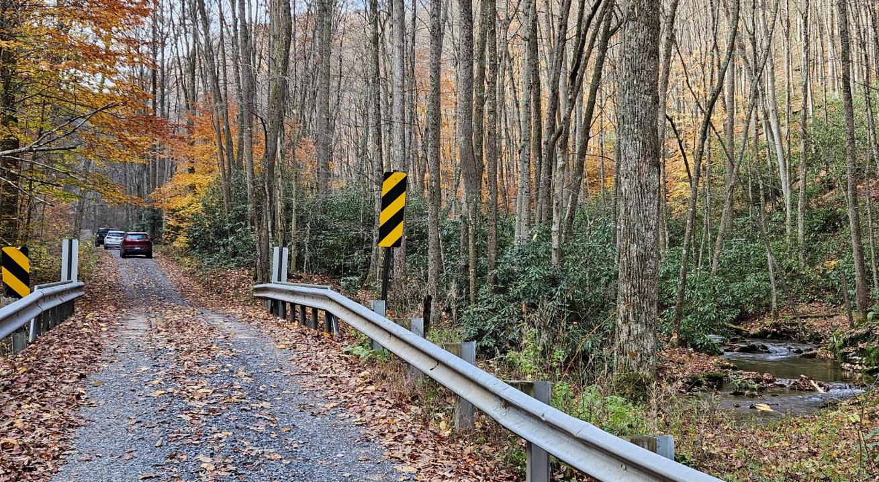
“Dirt and Gravel” roads are not paved

Slide 15
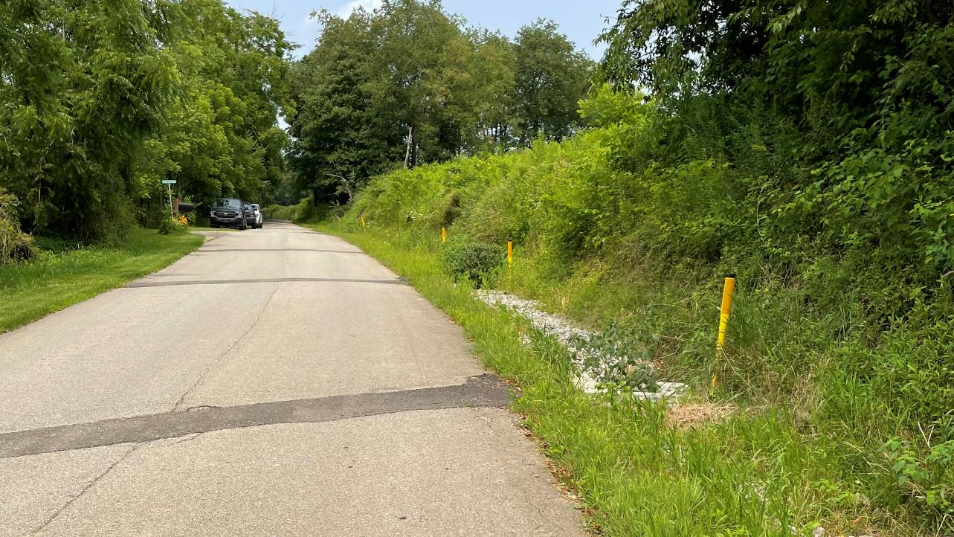
“Low Volume” roads are paved and have low traffic volume
(500 or less vehicles per day)

Slide 16
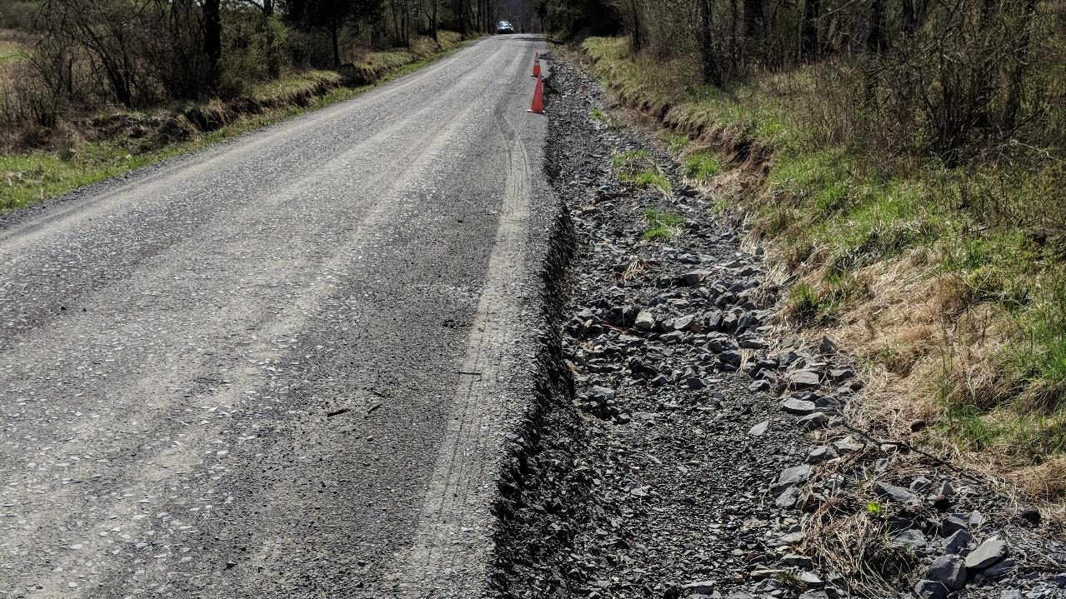

Slide 17
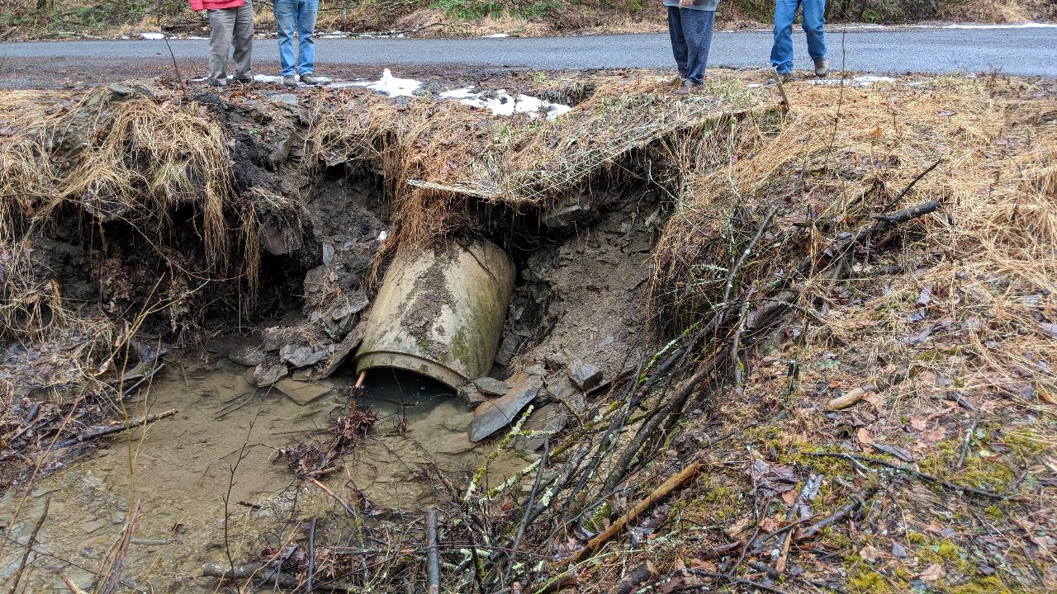

Slide 18
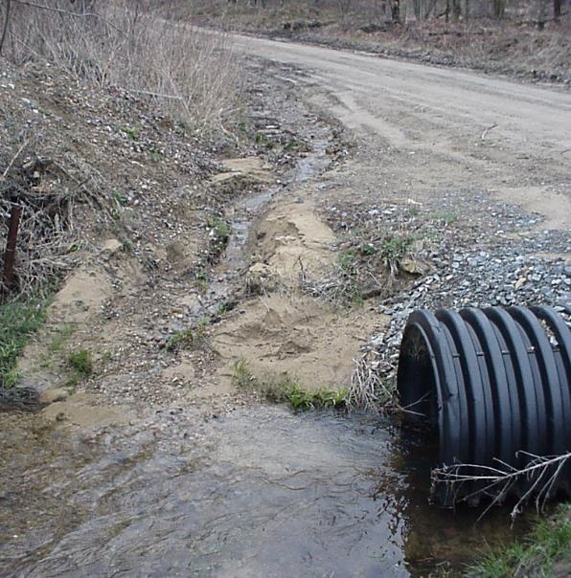
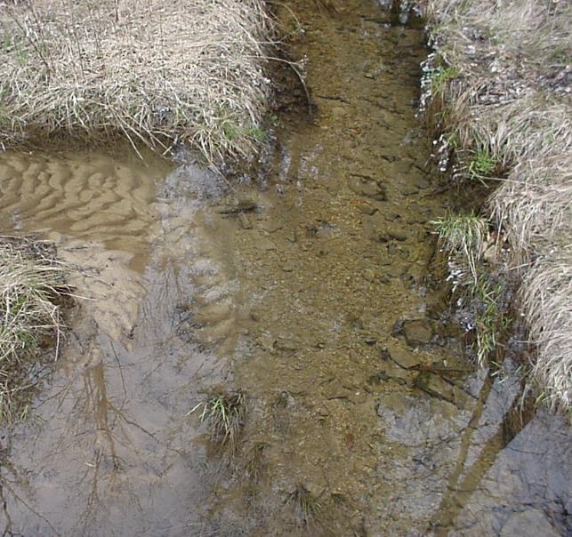
Notes:
Many Pennsylvania roads are near streams
Stormwater collects along roads and can wash them away
Road material and soil from the ditches wash into these nearby streams
Sediment
Extra sediment in streams is a pollutant
Smothers fish and insect habitat
Changes flow paths and causes flooding
Expensive to remove from drinking water
Road damage is dangerous and expensive to fix

Slide 19
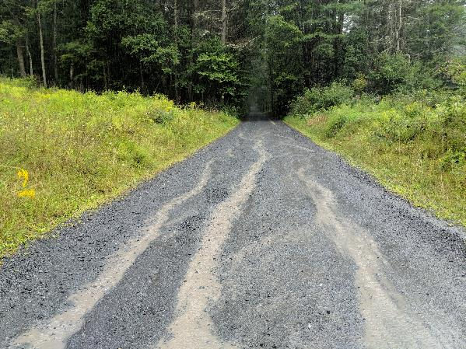
Solutions
Stream
BEFORE
Water Flow
Notes:
Spread out storm water
Slow down runoff
Encourage infiltration
Install larger stream crossing structures and restore streams through them
Environmentally Sensitive Road Maintenance (ESM) Practices

Slide 20
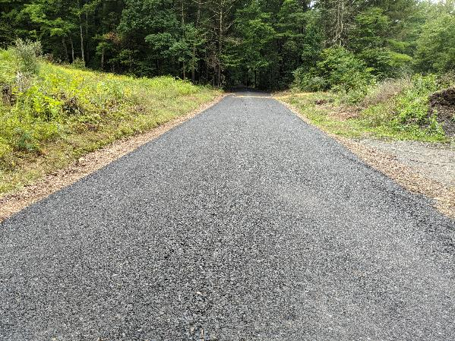
Solutions
BEFORE
AFTER
Water Flow
Water Flow
Notes:
An example DGR Project:

Slide 21
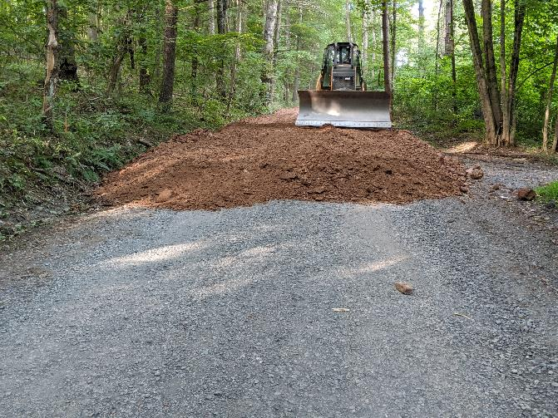
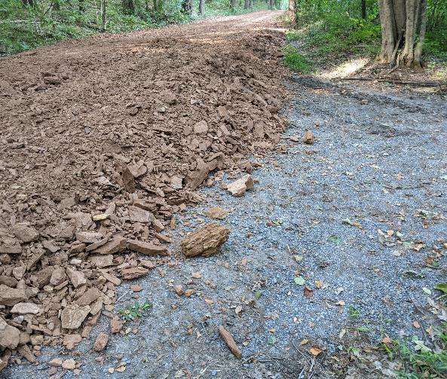
Solutions
Notes:
Road fill raises the road and establishes appropriate shape (road crown) to allow water to drain from the road.

Slide 22
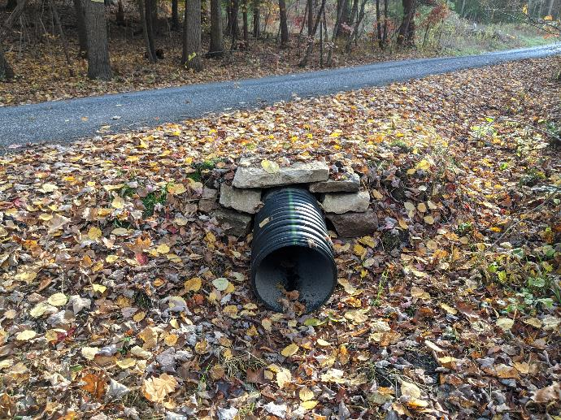
Solutions
Notes:
Shallow cross pipes do not cause erosion at the outlet of the pipe

Slide 23
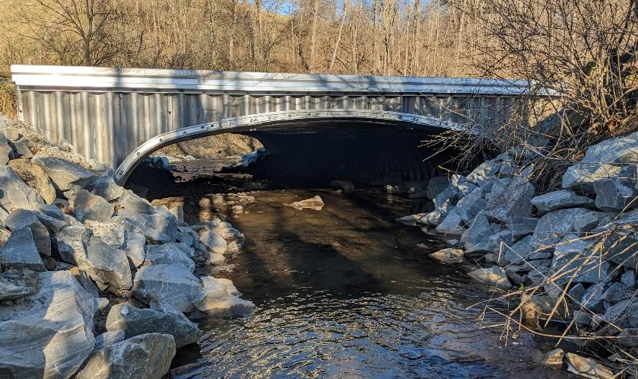
Solutions
Notes:
Stream crossings that are big enough to allow the stream to flow through unimpeded, even when the banks are full of water

Slide 24
DGLVR Program
The DGLVR Program was created to fund environmentally sensitive road maintenance
Public roads owned by state or local public entities
Mostly townships
DGLVR funding is managed by the State Conservation Commission and allocated to county conservation districts
Road owners apply to their county conservation district for grant funds

Slide 25
Outline
DGLVR Program Overview
DGLVR Policy and Tracking Funds
Documenting DGLVR Funds
Reconciling Accounts
Budgeting and Spending Requirements

Slide 26
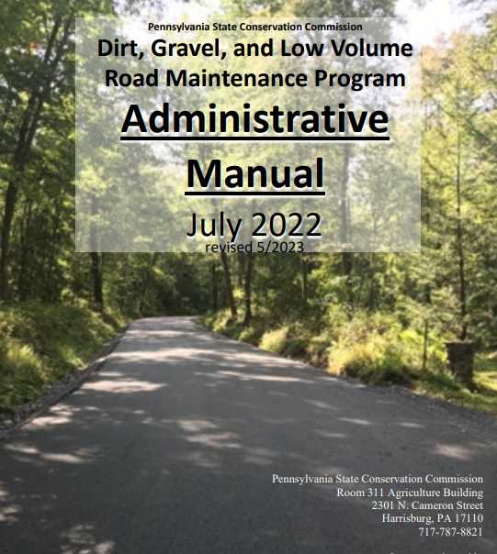
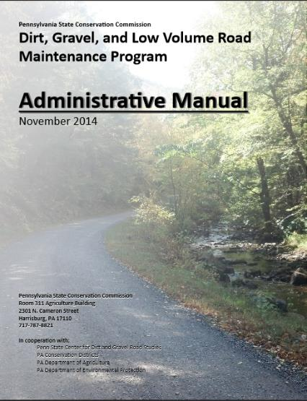
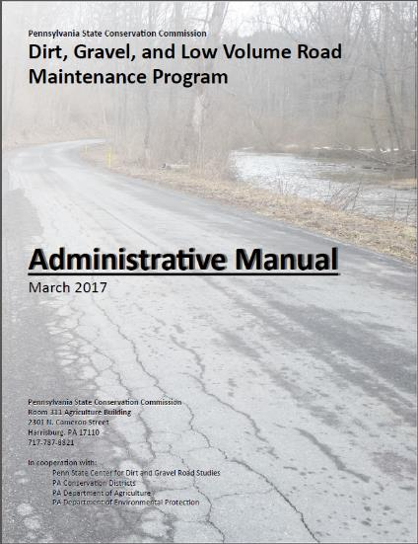
Administrative Manual
Introduction
DGLVR Administrative Manual
Approved by SCC 5/10/22
Revised May 2023 (DSA spec update)
Introduction
SCC Role
Conservation District Role
Quality Assurance Board Role
Applicant Role
Center for Dirt and Gravel Roads
Additional Policies
Permits and Other Requirements
Appendices
Available online.
Hard copies sent on request.

Slide 27
Administrative Manual
Introduction
DGLVR Administrative Manual
Approved by SCC 5/10/22
Revised May 2023 (DSA spec update)
Introduction
SCC Role
Conservation District Role
Quality Assurance Board Role
Applicant Role
Center for Dirt and Gravel Roads
Additional Policies
Permits and Other Requirements
Appendices
Available online.
Hard copies sent on request.
3) District Role
Over ½ of manual
Receiving Funds
Accounting for Funds
Dispersing Funds to Grantees
CD Educational Opportunities
Education/Training by CDs
Program Eligibility
Administering Projects
GIS system
Quarterly Reports
Annual Reports

Slide 28
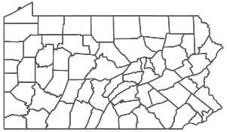
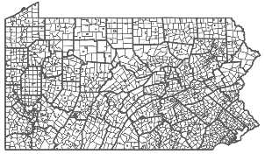
State Conservation Commission:
provides funding to county conservation districts
Establishes statewide DGLVR policy
$
County Conservation Districts:
Receives funds from SCC
Establishes local policy and runs local grant program
Uses funds for eligible expenses
Pays project funds to grant recipients
$
Local Road Owners:
Apply to conservation district for DGLVR grants
Constructs project or hires a contractor
Receive grant funds from conservation district
Buys supplies, pays contractors, etc.

Slide 29
Penn State Center for Dirt and Gravel Road Studies:
Receives funding from SCC DGLVR Program
$
$
training
Provides education and outreach for the DGLVR Program, including:
Environmentally Sensitive Maintenance (ESM) Training
Stream Crossing Training
individual technical assistance for CDs
$
training
Notes:
Penn State CDGRS provides education and technical assistance to conservation districts and grant applicants
Penn State CDGRS receives funding and guidance from SCC

Slide 30
Outline
DGLVR Policy and Tracking Funds
Receiving funds from the State Conservation Commission
Accounting for funds at conservation districts
Eligible expenses – Admin, Edu, Cost allocation methods (CAMs)
Paying funds to grant recipients

Slide 31
Funding source
Section 9106 of the PA Vehicle Code establishes the Dirt, Gravel, and Low Volume Road (DGLVR) Maintenance Program.
A non-lapsing annual allocation of $28 million goes to the State Conservation Commission (SCC).
$8 million of this funding is for low volume roads
Defined as “sealed or paved [roads] with an average daily traffic count of 500 vehicles or less.”
Act 89 of 2013
DGR and LVR funds are allocated to conservation districts and tracked separately

Slide 32
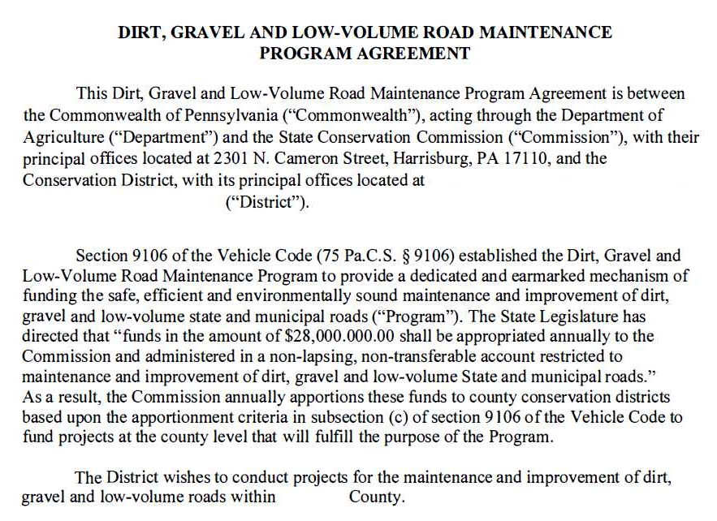
Five-Year Agreements
Conservation Districts enter into 5-year Agreements with the SCC to administer the DGLVR Program at the county level
The 5-year agreement allows districts to receive annual allocations of DGLVR funds without signing a new agreement each year

Slide 33
Allocations
Annual allocations
State fiscal year runs July 1 – June 30
SCC approves annual allocations at May or July meeting each year
Allocation formulas consider miles of eligible roads and proximity to streams
Formulas available online at: https://dirtandgravel.psu.edu/pa-program-resources/program-specific-resources/conservation-district-allocations/

Slide 34
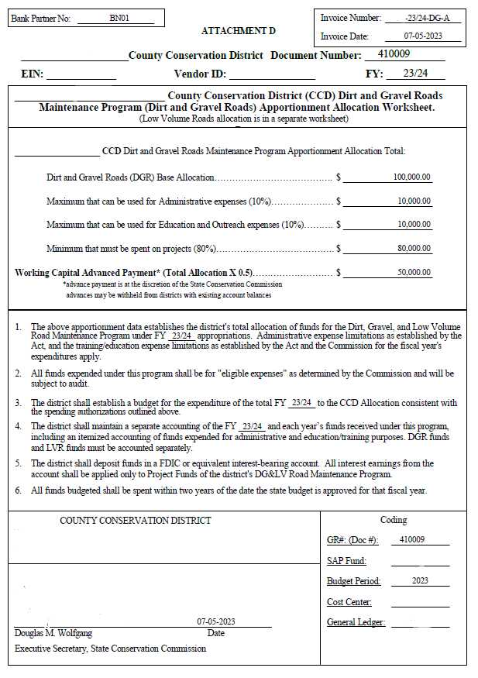
Schedule D
Form that shows important financial information

Slide 35
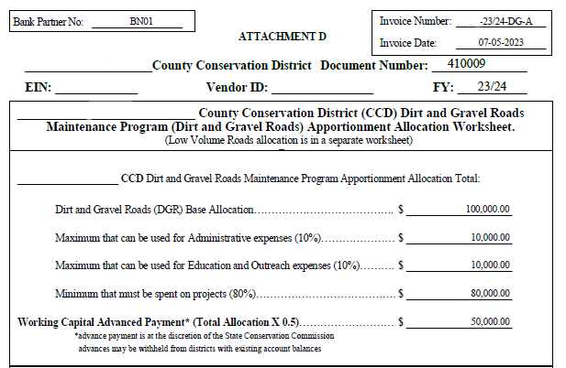
Schedule D

Slide 36
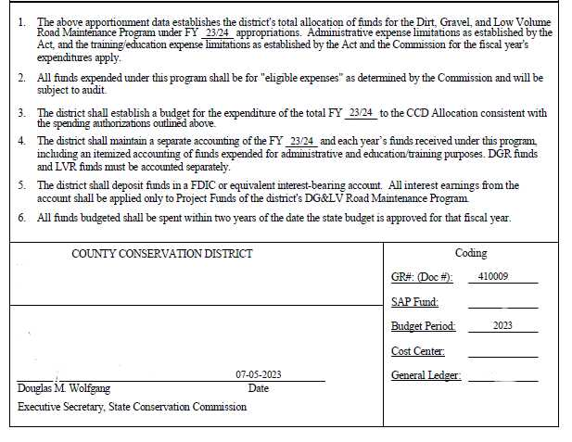
Schedule D
Form that shows important financial information

Slide 37
Understanding flow of DGLVR funds
The DGLVR Program does NOT reimburse conservation districts
We do something better!
We provide funds before conservation districts spend it

Slide 38
Replenishments vs Reimbursements
Replenishments & Advances
Advances & replenishments typically pay for future expenses
Districts receive DGLVR funds before spending on expenses
No out-of-pocket expenses
Often, replenishments are the same amount as reported expenses, but not always
Reimbursements
Reimbursements pay for past expenses
Funds are received after expenses are paid for out-of-pocket
Reimbursements are the same amount as the out-of-pocket expense

Slide 39
Type of Payments
Advances
50% of each district’s annual allocation is provided as an advance payment at the beginning of each fiscal year (after July 1).
As districts spend the advance on eligible expenses, they report expenses in the quarterly report and are eligible to receive a “replenishment” of funds from the remaining 50% of the allocation in Harrisburg.
While replenishments are typically payments in the same amount as reported expenses, replenishments are not meant to pay for those expenses.

Slide 40
Understanding flow of DGLVR funds
Hey Roy, would you buy me $10 worth of ice cream cones?
Five-year Agreement
Sure!
State Conservation Commission
The Roy County Conservation District

Slide 41
Understanding flow of DGLVR funds
Great! Here’s $5 to get the first ice cream cone
Advance Payment
State Conservation Commission
The Roy County Conservation District

Slide 42
Understanding flow of DGLVR funds
Here’s your ice cream!
Thanks!
State Conservation Commission
The Roy County Conservation District

Slide 43
Understanding flow of DGLVR funds
Here’s $5 to get another ice cream cone tomorrow!
Replenishment
State Conservation Commission
The Roy County Conservation District

Slide 44
Replenishments - Example
Conservation District’s DGR allocation is $100,000

Slide 45
Replenishments - Example
Conservation District’s DGR allocation is $100,000
District
Harrisburg
Description | income | expense | local balance
advance | $ 50,000 |  | $ 50,000
Project advances |  | $ 40,000 | $ 10,000
replen 1 | $ 40,000 |  | $ 50,000
Final project payment |  | $ 12,000 | $ 38,000
replen 2 | $ 10,000 |  | $ 48,000
Description | payment amount | Harrisburg balance
allocation |  | $ 100,000.00
advance | $ 50,000 | $ 50,000.00
replen 1 | $ 40,000 | $ 10,000.00
replen 2 | $ 10,000 | $ -

Slide 46
Replenishments - Example
Conservation District’s DGR allocation is $100,000
District
Harrisburg
Description | income | expense | local balance
advance | $ 50,000 |  | $ 50,000
Project advances |  | $ 40,000 | $ 10,000
replen 1 | $ 40,000 |  | $ 50,000
Final project payment |  | $ 12,000 | $ 38,000
replen 2 | $ 10,000 |  | $ 48,000
Description | payment amount | Harrisburg balance
allocation |  | $ 100,000.00
advance | $ 50,000 | $ 50,000.00
replen 1 | $ 40,000 | $ 10,000.00
replen 2 | $ 10,000 | $ -

Slide 47
Replenishments - Example
Conservation District’s DGR allocation is $100,000
District
Harrisburg
Description | income | expense | local balance
advance | $ 50,000 |  | $ 50,000
Project advances |  | $ 40,000 | $ 10,000
replen 1 | $ 40,000 |  | $ 50,000
Final project payment |  | $ 12,000 | $ 38,000
replen 2 | $ 10,000 |  | $ 48,000
Description | payment amount | Harrisburg balance
allocation |  | $ 100,000.00
advance | $ 50,000 | $ 50,000.00
replen 1 | $ 40,000 | $ 10,000.00
replen 2 | $ 10,000 | $ -

Slide 48
Replenishments - Example
Conservation District’s DGR allocation is $100,000
District
Harrisburg
Description | income | expense | local balance
advance | $ 50,000 |  | $ 50,000
Project advances |  | $ 40,000 | $ 10,000
replen 1 | $ 40,000 |  | $ 50,000
Final project payment |  | $ 12,000 | $ 38,000
replen 2 | $ 10,000 |  | $ 48,000
Description | payment amount | Harrisburg balance
allocation |  | $ 100,000.00
advance | $ 50,000 | $ 50,000.00
replen 1 | $ 40,000 | $ 10,000.00
replen 2 | $ 10,000 | $ -

Slide 49
Replenishments - Example
Conservation District’s DGR allocation is $100,000
District
Harrisburg
Description | income | expense | local balance
advance | $ 50,000 |  | $ 50,000
Project advances |  | $ 40,000 | $ 10,000
replen 1 | $ 40,000 |  | $ 50,000
Final project payment |  | $ 12,000 | $ 38,000
replen 2 | $ 10,000 |  | $ 48,000
Description | payment amount | Harrisburg balance
allocation |  | $ 100,000.00
advance | $ 50,000 | $ 50,000.00
replen 1 | $ 40,000 | $ 10,000.00
replen 2 | $ 10,000 | $ -
Total income $ 100,000
Total spent
$ 52,000
Total remaining
$ 48,000
Total Payments $ 100,000
$ 100,000

Slide 50
Replenishments
Automatically generated by quarterly reports
Replenishments may be less than spending reported for a quarter depending on how much of the district’s funds are left in Harrisburg.
Once the district has received 100% of their allocation, they will not be able to receive any more payments until the following fiscal year.
This means that several quarterly reports a year may report expenses but generate a replenishment request of $0
If the district has already received all of their funds

Slide 51
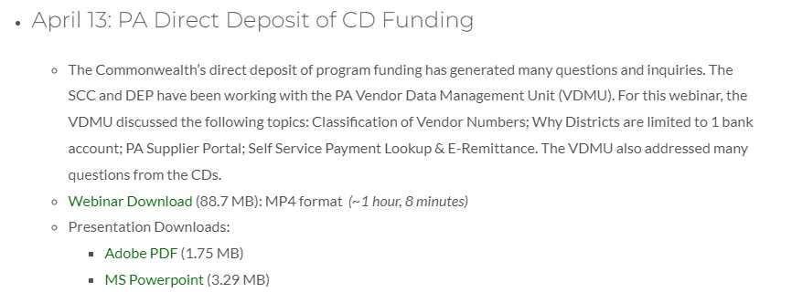
Receiving DGLVR funds
Note that direct deposit (ACH) is required
Cannot send a paper check
Vendors are limited to receiving all payments in one bank account
Recorded webinar hosted on DGLVR website:
https://dirtandgravel.psu.edu/education-training/webinars/past-webinars/

Slide 52
E-Remittance
The Office of the Budget offers 3 ways to receive paperless remittance (e-remittance) information:
Email
Electronic Addenda
Self-Service Payment Lookup tool
More information on e-remittance tools, including links to enroll in each, is available online at: https://www.budget.pa.gov/Services/ForVendors/Pages/Direct-Deposit-and-e-Remittance.aspx
Notes:
Discussion or tips from attendees?
Copied from the linked website:
The Office of the Budget offers 3 ways to receive paperless payment remittance information. Paperless remittance information is the standard process to receive this information as paper-based remittances are being phased out. 1. Email remittance 2. Electronic addenda 3. Self-Service Payment Lookup tool
Email Remittance: Receive remittance notification emails on or before the payment date. Emails are delivered to the person(s) or email account(s) of your choice by completing the sign-up form. If this form is not completed, the remittance email will be sent to your email address used to send invoices to the commonwealth.
If you have not updated your email delivery preferences, please complete the Payment Remittance Email Notification Sign-Up Form found here and return it to our office using the email submit function located on the form. Two email addresses are available.
Remittance Email Notification Sign-Up FormOpens In A New Window
View e-remittance email example (PDF)
Electronic Addenda: An ACH Addenda record allows additional information (vendor's invoice number) to be sent to your financial institution along with the payment. This information can be viewed on your transaction history and/or statement to allow for better reconciliation of your accounts receivable balances.
To sign up for Electronic Addenda, complete the form found here.
Direct Deposit Enrollment FormOpens In A New Window - Use this form to add a new bank account, change an existing bank account, stop an existing bank account, or add electronic addenda (online banking paperless payment remittance information) on the vendor record.
Self-Service Payment Lookup tool: The invoice status self-service tool displays the most recent 60 days of information pertaining to:Invoices In Process
Invoice Payments
Go to the Self-Service Payment Lookup Tool on the main Services for Vendors page for access to these reports. Self Service Payment Lookup

Slide 53
E-Remittance
E-remittance email example from PA Office of the Budget Website:
Notes:
Discussion or tips from attendees?
Copied from the linked website:
Email Remittance: Receive remittance notification emails on or before the payment date. Emails are delivered to the person(s) or email account(s) of your choice by completing the sign-up form. If this form is not completed, the remittance email will be sent to your email address used to send invoices to the commonwealth.
If you have not updated your email delivery preferences, please complete the Payment Remittance Email Notification Sign-Up Form found here and return it to our office using the email submit function located on the form. Two email addresses are available.
Remittance Email Notification Sign-Up FormOpens In A New Window
View e-remittance email example (PDF)

Slide 54
E-Remittance
Electronic Addenda:
An ACH Addenda record allows additional information (vendor's invoice number) to be sent to your financial institution along with the payment.
This information can be viewed on your transaction history and/or statement to allow for better reconciliation of your accounts receivable balances.
Self-Service Payment Lookup tool: The invoice status self-service tool displays the most recent 60 days of information pertaining to:
Invoices In Process
Invoice Payments
Notes:
Discussion or tips from attendees?
Copied from the linked website:
Electronic Addenda: An ACH Addenda record allows additional information (vendor's invoice number) to be sent to your financial institution along with the payment. This information can be viewed on your transaction history and/or statement to allow for better reconciliation of your accounts receivable balances.
To sign up for Electronic Addenda, complete the form found here.
Direct Deposit Enrollment FormOpens In A New Window - Use this form to add a new bank account, change an existing bank account, stop an existing bank account, or add electronic addenda (online banking paperless payment remittance information) on the vendor record.
Self-Service Payment Lookup tool: The invoice status self-service tool displays the most recent 60 days of information pertaining to:Invoices In Process
Invoice Payments
Go to the Self-Service Payment Lookup Tool on the main Services for Vendors page for access to these reports. Self Service Payment Lookup

Slide 55
Updating Vendor information
Vendors update information with Vendor Services
Online at the PA Office of the Budget
Once you update this info, inform the DGLVR Program so we can update our records to match:
Vendor name
Vendor address
Bank partner number

Slide 56
Outline
DGLVR Policy and Tracking Funds
Receiving funds from the State Conservation Commission
Accounting for funds at conservation districts
Eligible expenses – Admin, Edu, Cost allocation methods (CAMs)
Paying funds to grant recipients

Slide 57
What to do with funds once they are received
https://commons.wikimedia.org/wiki/File:Cartoon_Woman_Proudly_Showing_Off_The_Money_She_Earned_Online.svg https://commons.wikimedia.org/wiki/File:Cartoon_Woman_Giving_Away_A_Bag_Of_Money.svg
https://en.wikipedia.org/wiki/File:Happy_Man_Throwing_Money_Cartoon.svg https://commons.wikimedia.org/wiki/File:Cartoon_Woman_Looking_Enjoying_The_Flying_Money_Around_Her.svg

Slide 58
Accounting for funds at the District
DGLVR funds must be in an interest-bearing Federal Deposit Insurance Corporation or equivalent insured account
Districts must ensure that account balances in excess of $250,000 are also insured or otherwise collateralized

Slide 59
Accounting for funds at the District
Separate Accounting
Dirt and Gravel Road funds are not the same as Low Volume Road Funds
Conservation districts must keep track of each type of funding independently
Recommended (not required) to keep DGR funds and LVR funds in individual bank accounts
Similar but different policy requirements for DGR and LVR funds

Slide 60
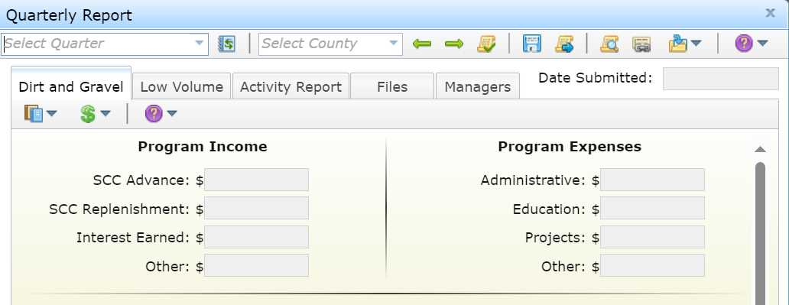
Accounting for funds at the District
Types of income and expenses to track are required by policy/law
Listed in quarterly report

Slide 61
Accounting for funds at the District
Accounting methods
Cash Basis
Revenue is recognized when payment is received
Expenses are recognized when paid out
Accrual Basis
Revenues are reported when they are earned
Expenses are reported when they are incurred
Notes:
Cash-basis accounting method: An accounting method in which revenue is recognized when payment is received, and expenses are recognized when paid out
Good for small businesses
Can be more complex than accrual basis accounting
Not supposed to have accounts receivable or payable
Need to really understand tracking bills and invoices, what should be on cash basis reports.
For both cash basis and accrual – producing cash flow reports and projections are valuable
Pros: simple to use, focused on what’s happening in the present
Cons: does not provide a full picture of the business activities, can’t be used everywhere) (ex: inventory, offering credit to customers, etc.)
Able to see at a glance where money is
Accrual method of accounting: revenues are reported when they are earned and expenses are reported when they are incurred
Requires more detail
Pro: Provides a fuller picture of the company’s financial condition
Con: more complicated method to use
Realistic to what the business is: can have bills that are outstanding and invoices that are outstanding, but you account for the month that you bill it.
Hybrid accounting: a combination of the cash-basis and accrual method of accounting
Can use cash basis to track revenue and expense and use accrual to track inventory
Key to using this method is consistency. For example, consistently use cash method for revenue and expenses and don’t switch to accrual for revenue and expenses
One reason to use this is to accommodate state requirements for paying sales tax – if you are on cash basis but the state requires you to pay sales tax on invoices that aren’t paid yet, then need to do report and pay sales tax on an accrual basis.
Extra steps to make sure you’re accounting and paying things properly
In sales tax example, switch to accrual basis just to run report for sales tax. A little extra work but easy to do once you know what to do.

Slide 62
Accounting for funds at the District
What counts as a DGLVR expense?
An expense is when DGLVR funds leave your Program account
An admin/edu expense has been paid with Program funds
A check has been written to the grant recipient
DGLVR quarterly reports are on a cash basis of accounting
https://www.istockphoto.com/photos/paying-for-ice-cream

Slide 63
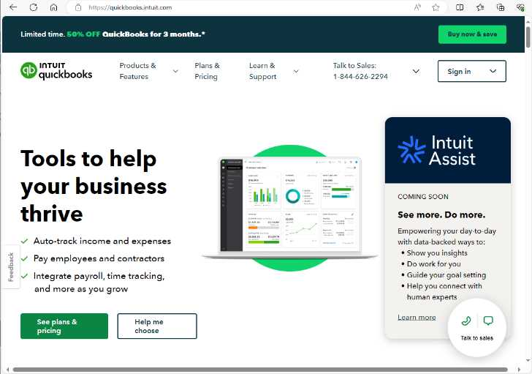
Accounting for funds at the District
Accounting Software
Several options
QuickBooks is popular
Accounting software made by Intuit

Slide 64
Accounting for funds at the District
QuickBooks
Simplifies accounting
Can automatically generate reports
Standard reports (profit and loss, balance sheet, etc.)
Customized reports
Simplifies reconciliation
Reconciling accounts: comparing 2 sets of numbers to check that the figures match
QuickBooks trainings available on Clean Water Academy
https://pacleanwateracademy.remote-learner.net/
Notes:
Note that journals and software like QuickBooks are similar to spreadsheets in that people type in the numbers → potential for error

Slide 65
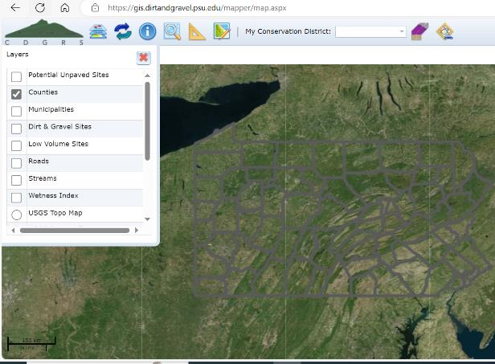
Geographic Information System (GIS)
Interactive online map
Tracks DGLVR Program information
Projects
Dates
Paperwork
deliverables
Finances
Allocations
Spending Requirements
Quarterly Reports
Income and expenses
Replenishments

Slide 66
Geographic Information System (GIS)
Information input by conservation district staff
Access gained by completing training with Ken Corradini (CDGRS)

Slide 67
Geographic Information System (GIS)
3 types of GIS access
Full access
create and edit contracts
edit quarterly reports
access other financial tools
Manager access
Edit and submit quarterly reports
Access other financial tools
Financial access
Edit quarterly reports
Access other financial tools

Slide 68
DGLVR Quarterly Reports
Submitted via GIS Program
Due 2 weeks after the end of each quarter
Quarters end: March 31, June 30, September 30, December 31
QRs due: April 15, July 15, October 15, January 15
Can start filling in the report as soon as the previous report is approved

Slide 69
Outline
DGLVR Policy and Tracking Funds
Receiving funds from the State Conservation Commission
Accounting for funds at conservation districts
Eligible expenses – Admin, Edu, Cost allocation methods (CAMs)
Paying funds to grant recipients

Slide 70
Eligible Expenses
Administration and Education
Must be spent on eligible expenses as they are incurred.
Must be incurred within the allotted fiscal year (1 year spending limit)
“Banking” of funds is not permitted

Slide 71
3.4.3 & 3.4.4: Admin / Education Funds
Chap 3. CD Role
Admin and Edu funds are not the same
Admin
Edu
Primarily to ensure adequate funding for technical staff who work on the Program
Primarily to allow
the district to attend and provide trainings and educational events

Slide 72
Eligible Expenses
Expenses that can be paid for with Admin funds:
Equipment for CD use
Levels, tape measures, survey equipment, safety equipment, etc.
Office Expenses
Includes computers, printers, internet service, office supplies like paper, etc.
Overhead costs (insurance, utilities, rent)
Aggregate testing
Consulting services
Typically paid with project funds for specific projects
For consulting services needed outside of a standard project contract, contact the SCC

Slide 73
Eligible Expenses
Expenses that can be paid for with Admin funds:
Salaries & benefits associated with those salaries
This includes technical staff, support staff, and management salaries related to administering the Program.
Example administration activities include:
Site inspections, meetings, completing paperwork, communications, etc. related to DGLVR Projects.
QAB meetings and Conservation District Board of Director meetings.
Reviewing DGLVR applications.
Follow up visits to previously contracted DGLVR worksites for the purpose of ranking new grant applications or implementing local policies.

Slide 74
Eligible Expenses
Expenses that can be paid for with Edu funds:
Salary & benefits associated with those salaries
This includes technical staff, support staff, and management salaries related to DGLVR educational activities.
DGLVR educational activities include:
Training new conservation district staff on DGLVR topics.
Attending or hosting trainings, conferences, field days, workshops, technical assistance, or other outreach activities.
Teaching individuals or small groups about the DGLVR Program in regard to potential DGLVR Project sites without a current contract for DGLVR funds. This includes working with potential grant applicants to develop an application for DGLVR funds, such as pre-application meetings.
Teaching individuals or small groups about the DGLVR Program on completed DGLVR sites.

Slide 75
Eligible Expenses
DGLVR educational activities do not include:
Administering DGLVR Projects with a current DGLVR Contract
Ranking received applications.
Administering the DGLVR Program, including QAB meetings, Conservation District Board of Director meetings, and reviewing DGLVR applications.

Slide 76
Eligible Expenses
Salary and Benefits:
Salary can only be claimed for time spent working directly on administration or education/training efforts for the DGLVR program.
Tracking can be done on an hourly basis, a percent effort basis, or some other method that allocates salary in accordance with time spent on the Program.
Conservation districts must be able to document that staff time claimed as administrative time is spent on eligible administrative activities and staff time claimed as education time is spent on eligible education activities.

Slide 77
Eligible Expenses
Staff time tracking:
This should be a time sheet and/or report that includes details of the activity, including:
the date
activity description
staff member(s)
amount of time
road name & road owner
how the activity qualifies as a DGLVR admin or edu activity
or some other method that documents that admin or edu time is spent on eligible admin or edu activities, respectively.
Notes:
Staff time tracking:
Discussion
How does your district track time?
Suggestions on software/time sheets?
Pros/cons of different methods?

Slide 78
Eligible Expenses
Expenses that can be paid for with Edu funds:
Equipment for loan/rental to applicants
Note that equipment for applicants to own is not an eligible DGLVR Expense
Training Costs
Including facility rental, food, educational materials, providing transportation, etc.
Promotional Materials
Advertisements, reports, websites, project signage
Promotional items (pens, hats, etc. given away to Program participants)
limited to $1,000/yr (proposed to be $1,500/year with items costing $50 or less)
Participation Incentives
Paying travel costs related to education activities for applicants or QAB members

Slide 79
Eligible Expenses
Expenses that can be paid for with Admin or Edu funds:
Travel
Admin funds can be used to pay for all travel expenses related to Program administration
Travel to field sites, meetings, trainings, vehicle costs, per-diems, parking, etc.
Edu funds can be used to pay for all travel expenses directly related to education activities for the Program such as:
travel to training and workshops, and travel to set up trainings, workshops, and demonstrations for local stakeholders.

Slide 80
Eligible Expenses
Expenses that can be paid for with Admin or Edu funds:
Travel
Note that the federal mileage rate is based on the average costs of operating a vehicle in the United States
intended to cover expenses including, but not limited to:
fuel, tires, maintenance, registration, and insurance.
When mileage driven for the DGLVR Program is compensated using the mileage rate method, individual vehicle expenses are not eligible DGLVR expenses, and vice versa.

Slide 81
Eligible Expenses
Expenses that can be paid for with Admin or Edu funds:
Demonstration Projects
Does not require typical application submittal and ranking process.
Must follow all other DGLVR requirements
Must showcase new technology and be used as an education site, etc.
Only education or administrative funds (not project funds) can be used.
Contact Center or Commission staff before contracting a Demo project.
Note that you can do “education and outreach” efforts on any project.

Slide 82
3.4.2 Cost Allocation Method
Chap 3. CD Role
Some expenses will be 100% eligible DGLVR expenses:
folders for DGLVR files
mileage to a DGLVR project site
QAB newspaper ad
Etc.
Some expenses will be shared with other programs:
File folders for any district staff to use
Vehicle maintenance for a shared district vehicle
Newsletter that covers all district programs
Etc.

Slide 83
3.4.2 Cost Allocation Method
Chap 3. CD Role
How do we determine what portion of shared expenses are eligible DGR and LVR expenses?
Cost Allocation Method (CAM):
Method for splitting shared costs proportionately between multiple programs
Splitting a dinner bill with friends is a cost allocation method
You only pay for what you ate

Slide 84
3.4.2 Cost Allocation Method
Chap 3. CD Role
Justin ate ½ slice of pizza
How much of the pizza does Justin pay for?
Justin pays for 1/16 of the pizza

Slide 85
3.4.2 Cost Allocation Method
Chap 3. CD Role
Cost Allocation Method (CAM):
Must be utilized for shared district expenses, such as:
Vehicles
Rent
Office Supplies
Phone/Internet
Etc.
Must be available to the SCC upon request

Slide 86
Eligible Expenses
Cost Allocation Method Policy
The cost allocation method used must be based on how much of the shared expense is actually used for the DGLVR Program.
The percent of shared expenses that are eligible DGR expenses are equal to the percent of the expense used for DGR activities.
The percent of shared expenses that are eligible LVR expenses are equal to the percent of the expense used for LVR activities.

Slide 87
Eligible Expenses
CAM based on staff time
The percent of shared expenses that are eligible DGR expenses are equal to the percent of staff time spent on DGR activities.
The percent of staff time spent on DGR activities must be calculated compared to the total staff time spent on all programs/activities sharing the expense.
Same for LVR:
The percent of shared expenses that are eligible LVR expenses are equal to the percent of staff time spent on LVR activities.
The percent of staff time spent on LVR activities must be calculated compared to the total staff time spent on all programs/activities sharing the expense.

Slide 88
Eligible Expenses
It looks like they claimed 50% of his time for Nutrient Management
It looks like they claimed 50% of his time for 102/105
It looks like they claimed 50% of his time for Dirt and Gravel
That’s allowed
That’s allowed
That’s allowed

Slide 89
Eligible Expenses
It looks like they claimed 50% of his time for Nutrient Management
It looks like they claimed 50% of his time for 102/105
It looks like they claimed 50% of his time for Dirt and Gravel
That’s allowed
That’s allowed
That’s allowed

Slide 90
3.4.2 Cost Allocation Method
Chap 3. CD Role
Examples of cost allocation methods that meet the policy outlined above are available in appendix E.
These are not the only acceptable cost allocation methods.
Contact the SCC for assistance in developing a cost allocation method or with any other policy questions/assistance needs.
The SCC is there to help you understand and follow policy

Slide 91
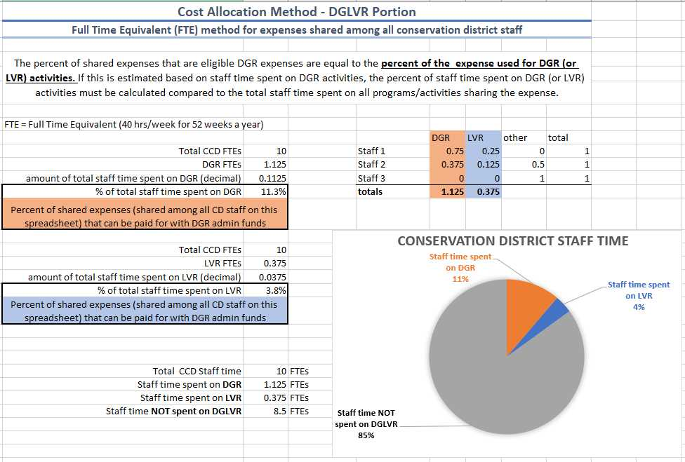
Eligible Expenses
Cost Allocation Method Spreadsheet
Accompanies Admin Manual Appendix E
Can be edited and used by CDs:
develop their own CAMs
Calculate how much of actual expenses are eligible DGLVR expenses
Document the CAMs
Template Available as an Excel Document

Slide 92
Cost Allocation Method examples
Chap 3. CD Role
Appropriate CAM? Yes or No
1 out of 5 district staff members spend all of their time on DGR activities. 20% of the electricity bill for the district’s office is paid with DGR funds.
YES!

Slide 93
Cost Allocation Method examples
Chap 3. CD Role
Appropriate CAM? Yes or No
District utilizes DGLVR program funds to purchase a vehicle and pay for all vehicle expenses. The vehicle is shared by all district programs.
NO

Slide 94
Cost Allocation Method examples
Chap 3. CD Role
Appropriate CAM? Yes or No
District technician spends 10% of their time on DGR and 10% of their time on LVR. 50% of their salary and benefits are paid for with DGLVR funds
NO

Slide 95
Cost Allocation Method examples
Chap 3. CD Role
Appropriate CAM? Yes or No
A district technician spends 1/3 of their time on DGLVR and 2/3 of their time on E&S. 33% of a new desk for the technician is paid with DGLVR funds.
YES!

Slide 96
Cost Allocation Method examples
Chap 3. CD Role
Appropriate CAM? Yes or No
A district technician spends 1/3 of their time on DGLVR and 2/3 of their time on E&S. 33% of the district’s rent is paid with DGLVR funds.
NO

Slide 97
Cost Allocation Method examples
Chap 3. CD Role
Appropriate CAM? Yes or No
A District spends 15% of their total staff time on DGR activities. 15% of a drill seeder is paid for with DGR funds.
NO

Slide 98
Cost Allocation Method examples
Chap 3. CD Role
Appropriate CAM? Yes or No
A district has $2,000 of LVR education funds left over. The district pays for their annual newsletter with $2,000 of LVR funds and $750 in general funds. One out of 15 pages of the newsletter is about the DGLVR Program, and the rest of the newsletter is about different district programs.
NO

Slide 99
Cost Allocation Methods (CAMs)
Pros and Cons
Pro: funding is used appropriately for an eligible expense
Con: it can take time and effort to develop a CAM
Pro: once a CAM is developed, it can save time

Slide 100
Cost Allocation Methods (CAMs)
Considerations:
If the staff time it takes to develop and implement a CAM will cost more than the CAM will allow the district to receive in funding, does it still make sense to use the CAM?
From a profit standpoint: No. If alternate funding is available that does not require a CAM, use that funding instead.
From a responsibility standpoint: Yes. If policy requires a CAM to be used to receive funding, the CAM is not optional.

Slide 101
Cost Allocation Methods (CAMs)
Considerations:
If a CAM is being used and does not seem reasonable:
Start tracking use of expense/staff time more closely
If a district pays direct expenses and they are always the same:
consider using a CAM to streamline expenses

Slide 102
Cost Allocation Methods (CAMs)
Considerations:
How long does a district need to track staff time in order to develop a CAM?
What is reasonable for the type of CAM you’re trying to develop?
Due to the seasonal nature of conservation work: at least 1 year

Slide 103
Cost Allocation Methods (CAMs)
Considerations:
Districts that utilize CAMs should regularly reassess them
Check in with staff once a year to see if percentages of time spent on different programs are still reasonable
If number of staff change, reassess CAM
If existing staff time spent on different programs change, reassess CAM
If expenses or funding sources change, reassess CAM
Reassessing does not always result in a change

Slide 104
Outline
DGLVR Policy and Tracking Funds
Receiving funds from the State Conservation Commission
Accounting for funds at conservation districts
Eligible expenses – Admin, Edu, Cost allocation methods (CAMs)
Paying funds to grant recipients

Slide 105
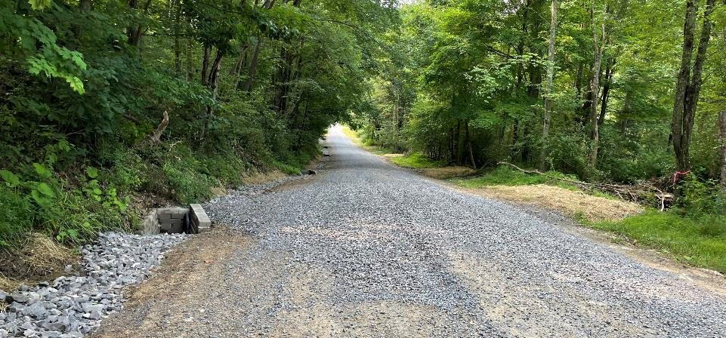
Paying funds to grant recipients
At least 80% of funds must go to projects.
Interest earned on all DGLVR Funds must be spent on projects

Slide 106
Paying funds to grant recipients
Technical CD staff are checking that project expenses are eligible throughout the project
CD staff involved in application, design, construction, etc.
Details on eligible project expenses available in other DGLVR trainings and resources
Admin Training, ESM Training, Stream Crossing Training
Technical Bulletins, Standards & Specifications, Admin Manual

Slide 107
Paying funds to grant recipients
Role of financial staff in project payments
Writing checks and accounting for funds
Recommend that managers and/or financial CD staff check math on project receipts/invoices
Be aware of DGLVR project payment requirements
Can only be made at certain times throughout the project
Must be within allowable percentages
Specific paperwork is required

Slide 108
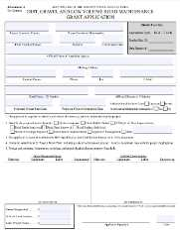
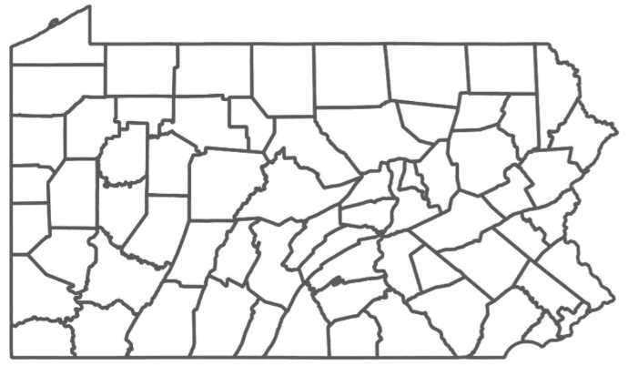
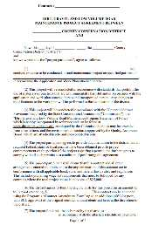
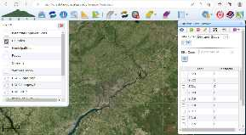
Chap 3. CD Role
3.4.5: Project Funds
County Conservation District
Quality Assurance Board
Grant Application
Conservation District Board
County Conservation District
Contract
Notes:
Road owners submit grant applications to the county conservation district
The CD meets with their QAB to rank applications. The QAB recommends which projects should be funded.
The CD Board of Directors reviews the QAB recommendations and takes action on how to allocate DGLVR project funds
Once the Board has approved funding, the conservation district can generate DGLVR contracts in the GIS
Then the district and grant recipient sign the contract and the project can begin

Slide 109
Chap 3. CD Role
3.4.5: Project Funds
County Conservation District
Quality Assurance Board
Grant Application
No payments or project work can happen until there is a fully signed contract
Conservation District Board
County Conservation District
Contract

Slide 110
Administrative Manual
Chapter 3
3.8.5 Contracting
All contracts must be generated in the GIS
Signature required by conservation district and grant recipient
No work done before a DGLVR contract is signed can be paid for with DGLVR funds
Preparation or design costs such as engineering or surveying that are incurred before the contract is signed are not eligible for grant reimbursement but can be counted as in-kind.

Slide 111
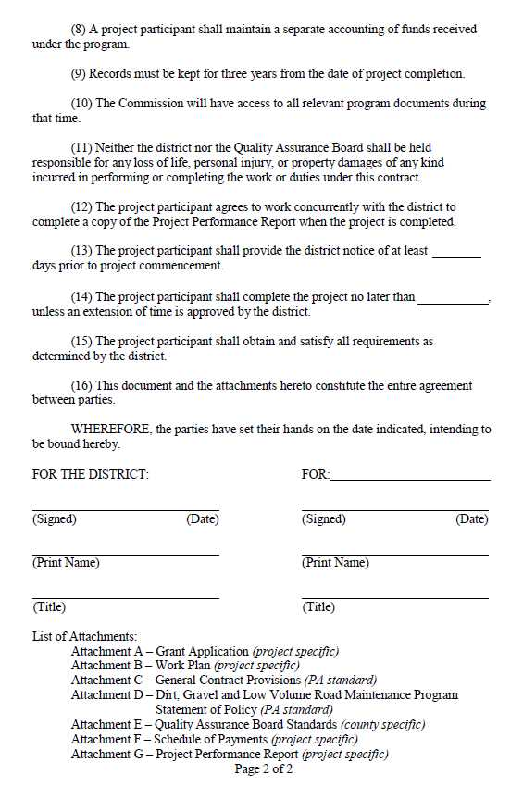
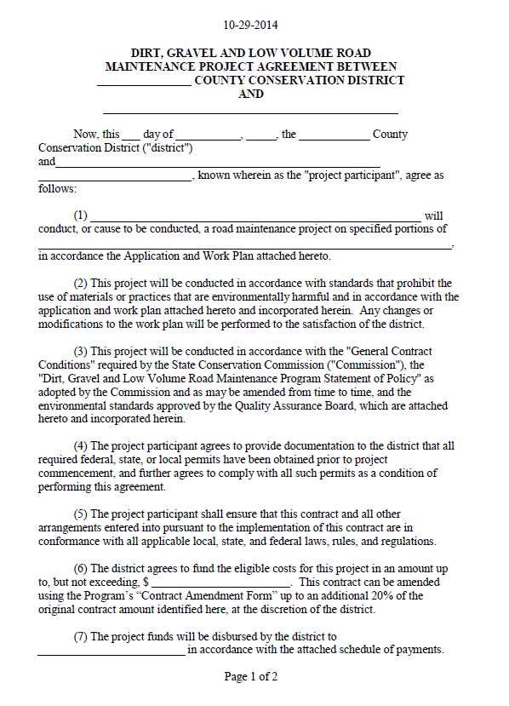
Contract
Grant App Instructions, Sample Sketch
Chap 3. CD Role
Available at
https://dirtandgravel.psu.edu/ and generated in GIS

Slide 112
Chap 3. CD Role
3.5 Dispersing Funds to Grant Recipients
Dispersing Funds to Grant Recipients
Districts can advance up to 50% of contract amount to grant recipients
At least 30% of contract amount must be retained until project completion
Conservation districts should develop individual policies regarding payment to grantees
Written schedule of payments is included in contract

Slide 113
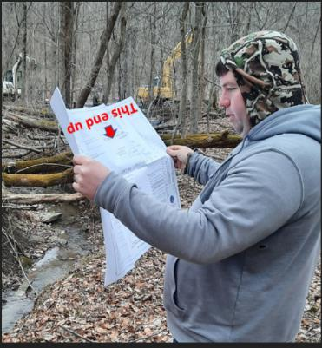
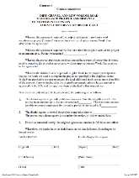
Chap 3. CD Role
3.4.5: Project Funds
Advance Payment
(up to 50% of contract)
Contract(signed)
Start Project
Partial Payment?
(up to 70% of contract on a cash expended basis)
Contract Amendments?
Notes:
Starting a project can include a variety of activities
Additional design work and permitting, bidding, pre-construction meeting, and construction

Slide 114
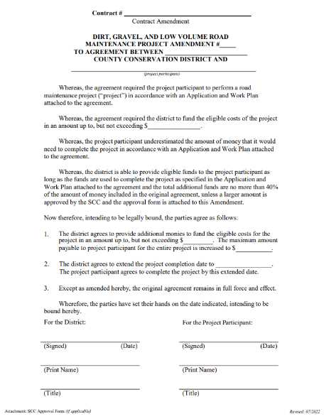
Contract Amendment
Chap 3. CD Role
If needed, a simple one-page amendment form can be used to:
increase contract by up to 40% (total of original contract)
Or more with SCC permission
extend completion date
Increase both funds and time
Must Generate in GIS
Available at
https://dirtandgravel.psu.edu/ and generated in GIS

Slide 115
Paying funds to grant recipients
Partial Project Payments
Grant funding can be provided to the grant recipient once project work is underway on a cash expended basis.
Total project payments cannot exceed 70% until after project completion.
The project participant must provide documentation to the conservation district that advanced funds and additional cash expended were spent on eligible expenses in order to receive subsequent payments.

Slide 116
Paying funds to grant recipients
Example:
$100,000 total contract amount
$50,000 is advanced
District receives receipts for $20,000 in materials costs.
Can you provide another payment for $20,000?
NO!
Because the grant recipient still has $30,000 of the original advance
An additional payment at this point would essentially be another advance, which is not allowed

Slide 117
Paying funds to grant recipients
Example:
$100,000 total contract amount
$50,000 is advanced
District receives receipts for $70,000 in materials costs.
Can you provide another payment for $20,000?
YES!
Because the grant recipient has spent the original advance, plus an additional $20,000

Slide 118
Paying funds to grant recipients
Example:
$100,000 total contract amount
$50,000 is advanced
District receives receipts for $80,000 in materials costs.
Can you provide another payment for $30,000?
NO!
Because you have to retain at least 30% of the contract for final payment
You can make a partial payment of $20,000.
The other $10,000 is part of the final payment.

Slide 119
Chap 3. CD Role
3.4.5: Project Funds
?
Construction with conservation district inspection/oversight
Final Payment
(at least 30% of contract)

Slide 120
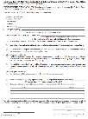
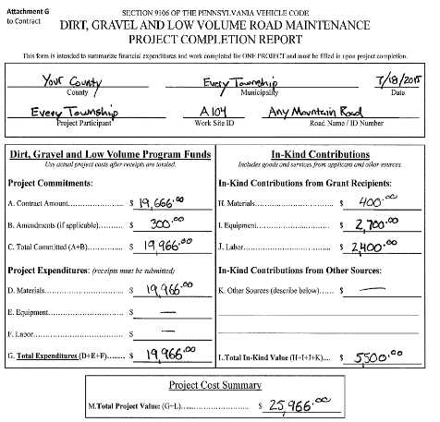
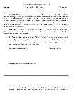
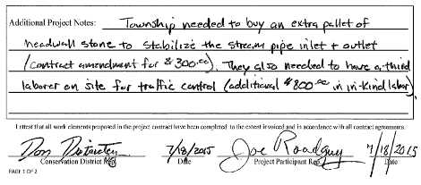
Chap 3. CD Role
3.4.5: Project Funds
Construction with conservation district inspection/oversight
Final Payment
(at least 30% of contract)
Adjustments on site as needed
Final inspection
ALL Paperwork in CD file
Notes:
Note that conservation districts should not wait to start paperwork until after construction is complete
It is beneficial to discuss required paperwork with the grant recipient early in the project lifecycle so they understand what kind of documentation they need to keep track of and provide to the conservation district.
It is often easier to collect documentation as soon as it’s available: example, add a copy of the permit approval letter as soon as the road owner receives it, don’t wait to ask for this until months later when construction is done.

Slide 121
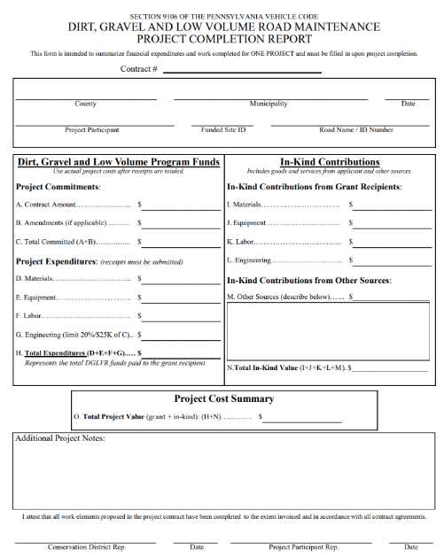
Paying funds to grant recipients
Completion Report
Filled out by CD working with grant recipient
Summarizes final finances and project deliverables
Generated/filled out in GIS
Signed by CD and grant recipient
Required before making final payment
Recommended that manager/financial staff double check this
Being updated in 2024

Slide 122
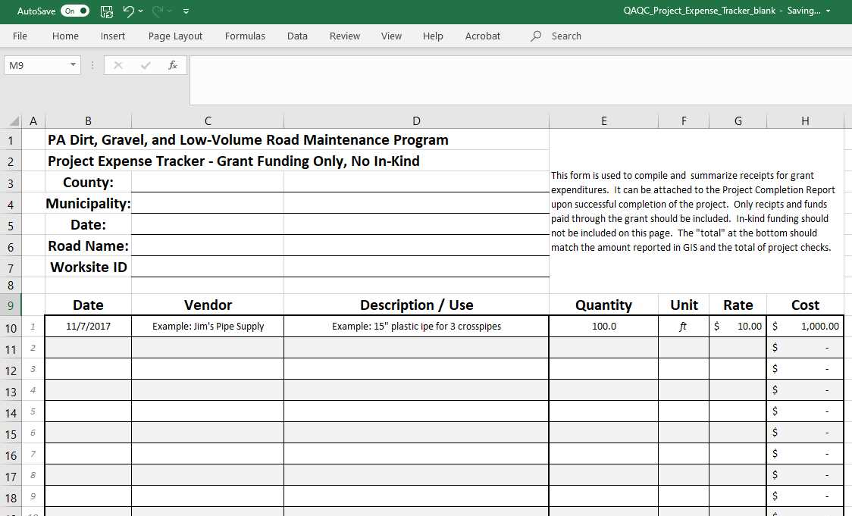
Paying Funds to grant recipients
Project Expense Tracker spreadsheet
Template Available as an Excel Document

Slide 123
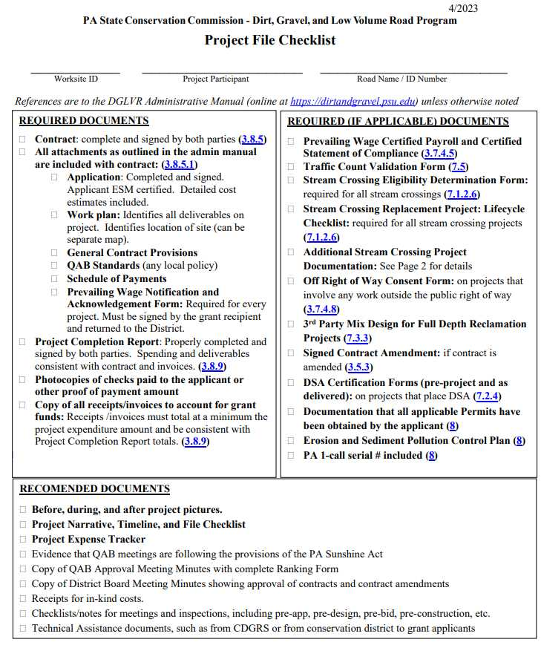
Paying funds to grant recipients
Other required documentation is summarized on the File checklist:

Slide 124
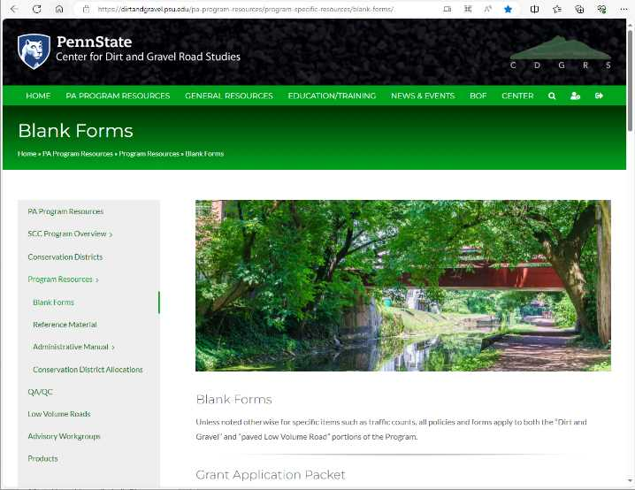
Paying funds to grant recipients
Blank Forms
on Center for Dirt and Gravel Road Studies Website
https://dirtandgravel.psu.edu/pa-program-resources/program-specific-resources/blank-forms/

Slide 125
Outline
DGLVR Program Overview
DGLVR Policy and Tracking Funds
Documenting DGLVR Funds
Reconciling Accounts
Budgeting and Spending Requirements

Slide 126
Documenting DGLVR Funds
The district is responsible for keeping accurate and detailed records of what was paid for with DGLVR funds for a minimum of seven years from the end of the fiscal year in which the expenses were incurred.
This documentation must be available to the SCC upon request.
The district is responsible for properly reporting income and expenditures in the GIS Program.

Slide 127
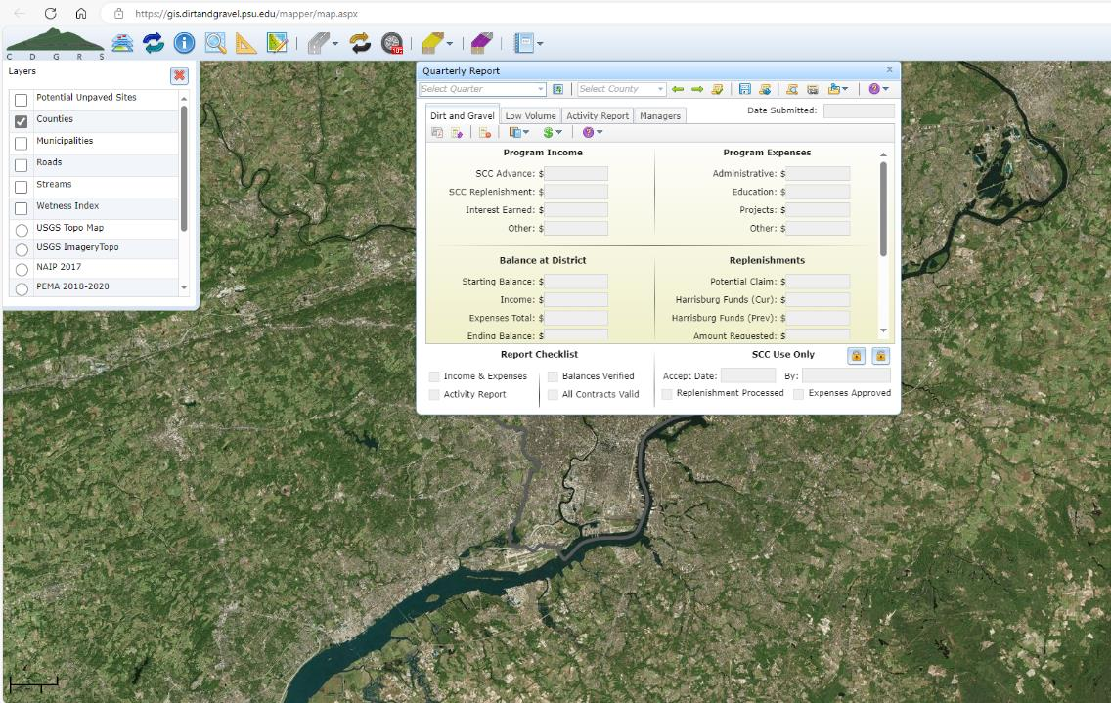
Documenting DGLVR Funds
GIS Demo – Quarterly Reports

Slide 128
Documenting DGLVR Funds
DGLVR Quarterly Report “Quick Guide” now available

Slide 129
Documenting DGLVR Funds
Show where the income and expenses numbers in your quarterly report came from
Many conservation districts summarize quarterly expenses on a 1-page document or spreadsheet
Backed up by more other, more detailed documentation
Can show income on same summary page
A QuickBooks transaction report is a great place to start

Slide 130
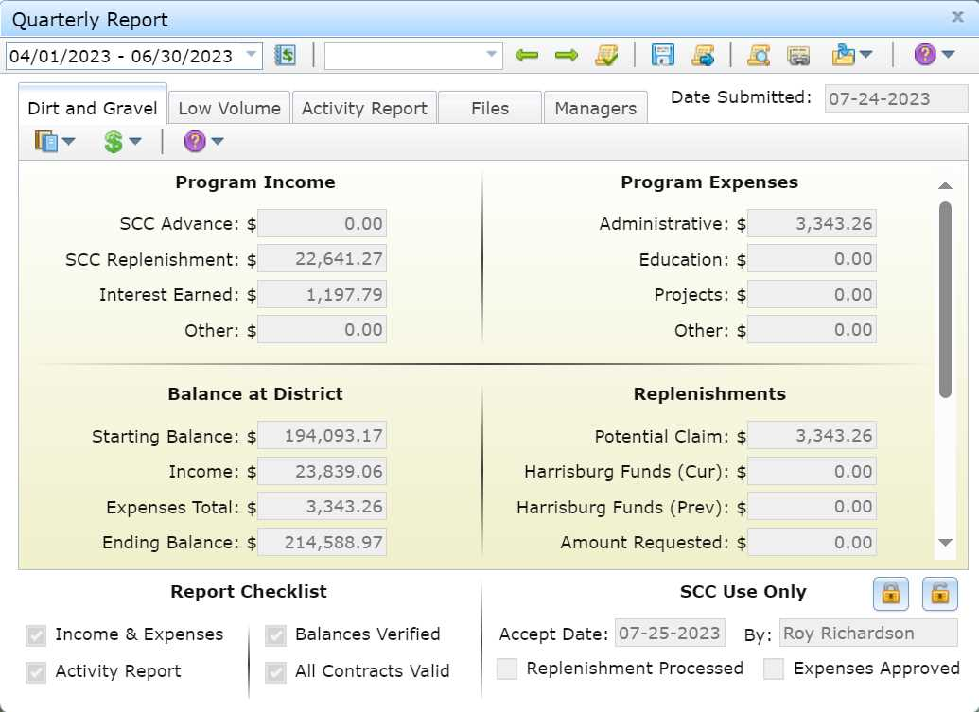

Slide 131
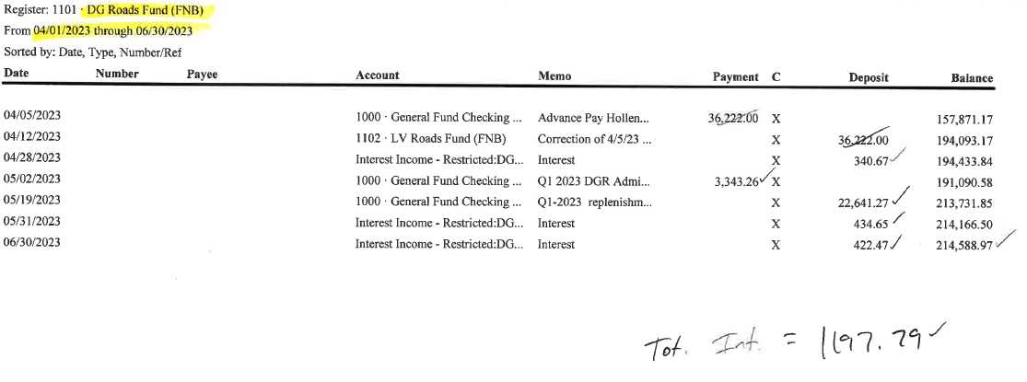
Notes:
Every time you receive or spend DGLVR funds, record individual transactions in your books. This provides the information we ask you to summarize in the quarterly report.

Slide 132
Documenting DGLVR Funds
Be able to explain and back up what each transaction is, especially the expenses.
Can include written description, receipts/invoices, spreadsheets, etc.

Slide 133
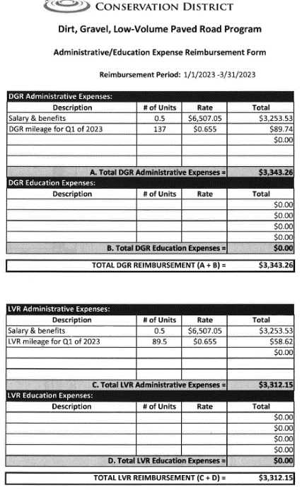
Notes:
It is often helpful to summarize quarterly information on some sort of internal form or spreadsheet to help you fill out your quarterly report. Note that this document explains the transactions but will often have additional back up as well.

Slide 134
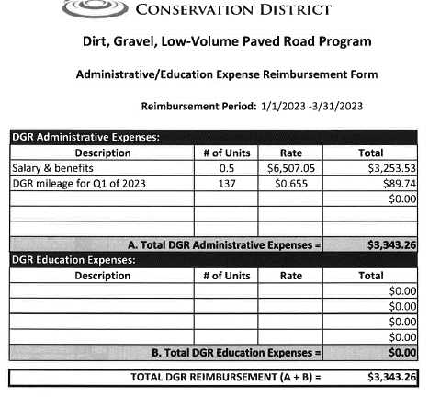
Notes:
For example, this form shows the admin expenses reported by this CD for the Jan-March 2023 quarter. To show that the $3,253.53 in salary and benefits is an eligible expense, time sheets or other documentation of salary and benefits is kept on file and provided as needed.

Slide 135
Notes:
Note that this district uses a cost allocation method to pay for the DGLVR/Ag technician’s salary and benefits.

Slide 136
Notes:
Similarly, mileage sheets show mileage driven for the DGR Program.

Slide 138
Example mileage tracking
Notes:
Note this example is not meant to match the numbers on the previous slide

Slide 139
Notes:
Bank statements should match the transactions logs. It is good practice to reconcile the books with the bank account monthly.
Note this example is not meant to match the numbers on the previous slides – this is just provided as a visual example of a bank statement

Slide 141
Documenting DGLVR Funds
Example time tracking and mileage logs
Notes:
There is variation in how DGLVR expenses can be documented.

Slide 142
Example Staff Time Documentation
Template Available as an Excel Document

Slide 143
Example Time Tracking
Week 1
Week 2
Week 3
Week 4
Week 5
Week 6
Week 7
Week 8
Week 9
Week 10
Week 11
Week 12
Week 13

Slide 144
Example Staff Time Documentation
Additional Activity Report not pictured here

Slide 145
Example Staff Time Documentation

Slide 146
Documenting DGLVR Funds
Example quarterly summary sheets
Notes:
There is variation in how DGLVR expenses can be documented.

Slide 147
Example Quarterly Summary Sheet

Slide 148
Justin Roy Sherri Andy
Justin Roy Sherri Andy
Example Quarterly Summary Sheet

Slide 149
Example Quarterly Summary Sheet

Slide 150
Example Quarterly Summary Sheet

Slide 151
Example Quarterly Summary Sheet

Slide 152
Example Quarterly Summary Sheet

Slide 153
Documenting DGLVR Funds
Administrative and Education purchases
Retain receipts
Document how much of the receipt is a DGLVR expense and why

Slide 154
Documenting DGLVR Funds
Documenting cost allocation methods (CAM)
Record what the CAM is
Explain how you came up with the CAM
Document that you followed the CAM
Ways to document these items:
Narrative
Spreadsheet
Receipts

Slide 156
Summary report backed up with Receipts
Employee 1
Employee 1
Employee 2
Employee 2
Employee 3

Slide 157
Summary report backed up with Receipts
$131.10 x 0.05 = $6.55
5% of staff time is spent on DGR activities
5% of shared expenses are paid for with DGR admin funds

Slide 158
Outline
DGLVR Program Overview
DGLVR Policy and Tracking Funds
Documenting DGLVR Funds
Reconciling Accounts
Budgeting and Spending Requirements

Slide 159
Reconciling Accounts
How to verify balances:
If income and expenses are properly reported in GIS, then the “Ending Balance” in GIS should match the conservation district’s local DGR (or LVR) bank account balance as of the last day of the quarter.
Review your bank statement (for the last month of the quarter) and your quarterly report:
If the end balances match, check the “balances verified box” and move on to the next portion of your quarterly report.
If the end balances don’t match, reconcile accounts
1/1/2024 – 3/31/2024
This number should match the conservation district DGR (or LVR) bank account balance as of the last day of the quarter (3/31/2024 in this example) to the penny. If the account balances do not match, do NOT check the “balances verified” checkbox

Slide 160
Reconciling Accounts
DO NOT check the “balances verified” box if the Ending Balance in GIS does not match your local account balance.
It’s better to submit the report late and correctly than to check this box incorrectly.
The SCC and Ken Corradini are available for assistance in verifying account balances.
There is a flow chart in the GIS Quick Guide to help

Slide 161
Verifying Balances in the DGLVR Quarterly Report
Does the “ending balance” in the QR match your local bank account balance to the penny as of the last day of the quarter?
Yes
No
Included in Quarterly Report Quick Guide
Click the “Balances Verified” box on the quarterly report.
Congratulations!
You’re done verifying balances.
Do you know why the balances do not match?
Yes
No
Yes
Can you fix it?
No
Make the necessary transactions, edits to the quarterly report, etc. as needed to make the account balances match.
Once the corrections are made and the balances match, Click the “Balances Verified” box on the quarterly report.
For example, a DGLVR project check has not been cashed by the grant recipient yet. If the balances match when accounting for these outstanding checks, then click the “Balances Verified” box on the quarterly report.
See Account Reconciliation Checklist
A template Excel spreadsheet for comparing conservation district financial documentation to the quarterly report is available for use.
Contact Ken Corradini or the SCC with questions or for assistance.
Do not check the “balances verified” QR box until the GIS and local account(s) are reconciled.

Slide 162
Reconciling Accounts
Common reasons local accounts and DGLVR GIS do not match:
typos – accidentally typing the wrong number
When completing quarterly reports
When doing math
When making journal entries
When making transfers

Slide 163
Reconciling Accounts
Common reasons local accounts and DGLVR GIS do not match:
Timing
Report income when it is deposited in the DGLVR account(s)
Report project checks when they are written
Report admin and edu expenses when DGLVR funds are used to pay for them

Slide 164
Reconciling Accounts
Remember what counts as a DGLVR admin/edu expense:
An admin/edu expense is when DGLVR funds leave your Program account
An admin/edu expense has been paid with Program funds
DGLVR quarterly reports are on a cash basis of accounting
https://www.istockphoto.com/photos/paying-for-ice-cream

Slide 165
Reconciling Accounts
Common reasons local accounts and DGLVR GIS do not match:
Incorrect transfers (less common)
DGR income/expenses being transferred into/out of the LVR account
LVR income/expenses being transferred into/out of the DGR account
DGLVR income/expenses being transferred into/out of non-DGLVR accounts

Slide 166
Reconciling Accounts
If the GIS is higher than the local account:
You may have forgotten to report an expense
You may have reported a replenishment or advance before depositing it into your local DGLVR account(s)
A project check was not put in GIS but was cashed
If the GIS is lower than the local account:
You may have forgotten to transfer funds out of the DGR (LVR) account for admin and edu expenses
You may not have reported all replenishments/advances yet
A project check was put in GIS but was not cashed yet

Slide 167
Account Balance Reconciliation Checklist
1. Check for typos
Were all income and expenses entered into the GIS correctly?
Were all income and expenses properly calculated before entering them in GIS?
If correcting mathematical errors and typos does not reconcile the accounts, then:
2. Check that the correct transactions were made.
Identify the last time that the local and GIS accounts matched.
Review all transfers of funds into and out of the local account since the last time that accounts matched to see if any errors were made.
Were the correct amounts transferred?
Was the funding transferred to/from the correct accounts?
Was the funding transferred during the quarter it was reported?
Quarterly report income and expenses can be downloaded from GIS as a spreadsheet. A template Excel spreadsheet is available to assist in comparing GIS data to local documentation.
If transaction errors were made, corrections may be needed in the GIS and/or the local accounts.
3. Reach out for assistance
If you cannot identify why the local and GIS account balances do not match, the SCC and Center for Dirt and Gravel Road Studies GIS staff can assist.
Included in Quarterly Report Quick Guide

Slide 168
Reconciling Accounts
Recommend using a spreadsheet during your financial review because it allows you to check your work
Example reconciliation spreadsheet
GIS Demo – downloading the QR spreadsheet for use in reconciliation

Slide 169
Reconciling Accounts
Once you’ve identified the reason for the discrepancies, make sure they are corrected.
May require:
Bank transfers
Adjusting journal entries
edits in quarterly reporting
May need to request that Ken or SCC unlocks the QR
Upload documentation in GIS once the corrections are made
Make notes in the “other” section of the quarterly report activity report

Slide 170
Outline
DGLVR Program Overview
DGLVR Policy and Tracking Funds
Documenting DGLVR Funds
Reconciling Accounts
Budgeting and Spending Requirements

Slide 171
Budgeting and Spending Requirements
Big picture planning
Using grant funds wisely includes more than spending money on eligible expenses and tracking funds properly

Slide 172
Budgeting and Spending Requirements
3 spending requirements to remember
annual allocation: 2 years

Slide 173
Budgeting and Spending Requirements
Annual allocations + 2 year spending requirement = overlapping financial tracking
2021 2022 2023 2024 2025 2026

Slide 174
Budgeting and Spending Requirements
PA Fiscal Year runs July 1 – June 30
2021 2022 2023 2024 2025 2026
FY 2021-22
FY 2022-23
FY 2023-24

Slide 175
Budgeting and Spending Requirements
Annual allocations + 2 year spending requirement = overlapping financial tracking
2021 2022 2023 2024 2025 2026
FY 2021-22 funds
FY 2022-23 funds
FY 2023-24 funds
today

Slide 176
Budgeting and Spending Requirements
SCC assesses 2-year spending requirements 9 months after the requirement
2021 2022 2023 2024 2025 2026
FY 2020-21 funds
3/31/2023: check to see if districts met 6/30/2022 spending requirement
FY 2021-22 funds
FY 2022-23 funds
FY 2023-24 funds
Actual 2-year spending requirement
When we check the 2-year spending requirement

Slide 177
Budgeting and Spending Requirements
How to figure out spending requirements?
GIS
Annual Summary Report
Budget Tool
Allocation History Tool
GIS DEMO –
2-year spending requirements

Slide 178
Budgeting and Spending Requirements
3 spending requirements to remember
annual allocation: 2 years
Admin/edu: 1 year

Slide 179
Budgeting and Spending Requirements
Admin/edu funds available for 1 fiscal year
July 1 – June 30
2021 2022 2023 2024 2025 2026
FY 2021-22 funds
Admin/Edu
FY 2022-23 funds
Admin/Edu
FY 2023-24 funds
Admin/Edu

Slide 180
Budgeting and Spending Requirements
How to know how much admin/edu funds remain?
GIS
Tool in quarterly report
GIS DEMO – admin/edu remaining

Slide 181
Budgeting and Spending Requirements
3 spending requirements to remember
Admin/edu: 1 year
annual allocation: 2 years
End of 5-year agreements

Slide 182
3.4.2-7 CD Spending Categories
Chap 3. CD Role
Districts and SCC enter new agreement every 5 years

Slide 183
Budgeting and Spending Requirements
Five Year Agreement
Provides 6 years to spend 5 year’s DGLVR allocations
Extra year maintains 2-year spending requirement
2019 2020 2021 2022 2023 2024
FY 2018-19 funds
FY 2019-20 funds
FY 2020-22 funds
FY 2021-22 funds
FY 2022-23 funds
FY 2023-24 funds

Slide 184
Budgeting and Spending Requirements
How to track 5-year spending requirements?
GIS
Quarterly report
GIS DEMO –
5-year spending requirements

Slide 185
Budgeting and Spending Requirements
How to keep up with spending requirements?

Slide 186
Budgeting and Spending Requirements
How to keep up with spending requirements?
Budget
Run an annual grant program

Slide 187
Budgeting and Spending Requirements
Each 2-year period spans 1 calendar year and 1 construction season
2021 2022 2023 2024 2025 2026
FY 2021-22 funds
FY 2022-23 funds
FY 2023-24 funds

Slide 188
Budgeting and Spending Requirements
#1 tip for keeping up with spending requirements:
Run an annual grant program
Act like you have 1 year to spend project funds instead of 2

Slide 189
Budgeting and Spending Requirements
Prepare projects the calendar year before they go to construction
Use 2023 to prepare for projects that will be constructed in 2024

Slide 190
Budgeting and Spending Requirements
Complete pre-app meetings, application due date, QAB meeting, CD Board approval in 2023 for projects to be constructed in 2024 with FY 2023-24 funds
Use 2023 to prepare for projects that will be constructed in 2024

Slide 191
Budgeting and Spending Requirements
How to budget DGLVR funds
annually
Because CDs receive new DGLVR funds every year
Because CDs have 1 year to spend admin/edu funds
Helps CDs stay on track to meet spending requirements

Slide 192
Budgeting and Spending Requirements
How to budget DGLVR funds
?
Total allocation
projects

Slide 193
Budgeting and Spending Requirements
How to budget DGLVR funds
Total allocation
– expected admin/edu spending
= available for projects

Slide 194
Budgeting and Spending Requirements
How to budget DGLVR funds
Total allocation – expected admin/edu spending = available for projects
Allocations are available in several places:
GIS

Slide 195
Budgeting and Spending Requirements
How to budget DGLVR funds
Total allocation – expected admin/edu spending = available for projects
Allocations are available in several places:
GIS
Center’s Website
https://dirtandgravel.psu.edu/pa-program-resources/program-specific-resources/conservation-district-allocations/
SCC meeting materials/email from Program

Slide 196
Budgeting and Spending Requirements
How to budget DGLVR funds
Total allocation – expected admin/edu spending = available for projects
Check schedule D for how much you’re allowed to spend on admin/edu
How much admin/edu do you spend over 12 months?
Review last year’s expenses
Adjust for expected changes
Add a safety factor?
ALSO
Annual Summary Report in GIS includes how
much admin/edu was spent per calendar year

Slide 197
Budgeting and Spending Requirements

Slide 198
Budgeting and Spending Requirements
How to budget DGLVR funds
Total allocation – expected admin/edu spending = available for projects
What else is going on that could impact funds available for new projects?
Amendments needed for existing contracts?
Projects coming in under budget?
Contracts being cancelled?
Interest accrued must be spent on projects
Leftover admin/edu funds from last year/previous years

Slide 199
Slide from “FY 2022-23 Updates” webinar
Quarterly Reports: Budget Tool
Helps with simple budgeting
Resets after each quarter but has a tool to import the previous quarter’s values
Important to have the income and expenses current in the QR in order for the budget to be accurate
GIS DEMO – Budget tool QR

Slide 200
Budgeting and Spending Requirements
How to budget DGLVR funds
Use budgeting tool in quarterly report
Revisit regularly or at least once a year
Reach out to SCC for assistance

Slide 201
Budgeting and Spending Requirements
How to stay on track with spending requirements
Budget well so you don’t have extra money leftover
Treat the program like you have 1 year to spend money instead of 2
Be up front with program participants about the required timelines
Fund projects that can be completed in the allotted time
Fund a variety of project types
If anything comes in underbudget, reallocate that funding ASAP

Slide 202
Budgeting and Spending Requirements
What do you consider “spent”?
For DGLVR Program: when DGLVR Funds leave your Program account
An admin/edu expense has been paid with Program funds and reported in quarterly report
A check has been written to the grant recipient and entered in GIS
Advances, partial payments, final payments

Slide 203
Budgeting and Spending Requirements
How do I know what my spending requirements are?
GIS
2-year spending requirements tracked in Annual Summary Report
5-year spending tracked in Quarterly Report
Only in the fiscal year following the end of a 5-year agreement

Slide 204
Outline
DGLVR Program Overview
DGLVR Policy and Tracking Funds
Documenting DGLVR Funds
Reconciling Accounts
Budgeting and Spending Requirements
What’s Next?

Slide 205
DGLVR Financial wrap up
Apply what you’ve learned
Conservation Districts can update their financial tracking, reporting, and usage at any time!
If you have questions or would like more detail on anything mentioned today, don’t hesitate to reach out.
Prepare for your next quarterly report and QAQC
Share suggestions for improving this training
shlaw@pa.gov

Slide 206
DGLVR QAQC Process
QAQC Financial Review
Primarily conducted remotely
Financial documentation is provided to SCC electronically
SCC checks:
That documentation matches quarterly reports
That funds were spent on eligible expenses

Slide 207
QAQC Financial Review
SCC will request information to be provided before the visit:
Documentation of all DGR and LVR income and expenses reported in the 4 most recent quarterly reports.
Documentation that each admin and education expense in this timeframe is eligible.
Often includes staff timesheets, vehicle mileage log, and receipts/invoices as needed.
Bank statement(s) showing the DGR and LVR account balances at the end of the most recently completed quarter.
12/31/2023, 3/31/2024, 6/30/2024, or 9/30/2024
A list of all cost allocation methods (CAM) used to determine eligible DGLVR admin and edu expenses and an explanation of how each cost allocation method was determined/developed.

Slide 208
QAQC Resources
Website
https://dirtandgravel.psu.edu/pa-program-resources/qa-qc/

Slide 209
Financial QAQC Review
How to make sure your conservation district does well on the financial portion of your QAQC:
Follow the guidance in this training!

