Slide 1

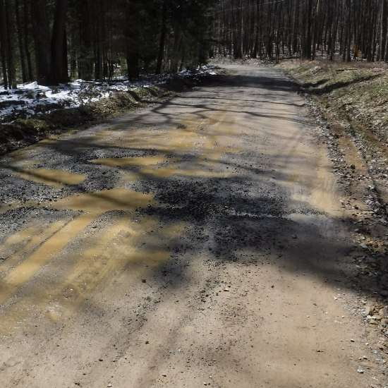
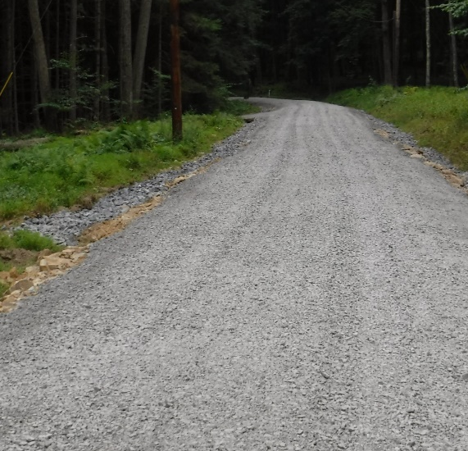
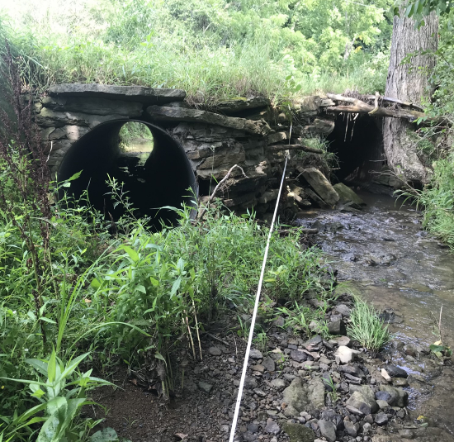
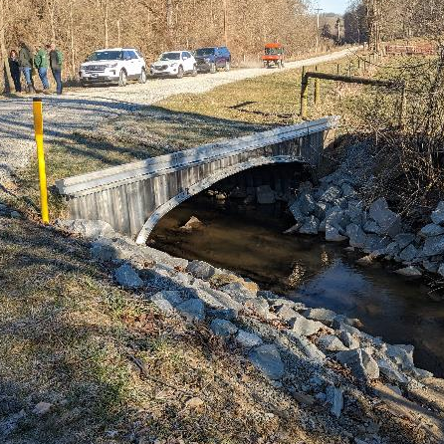
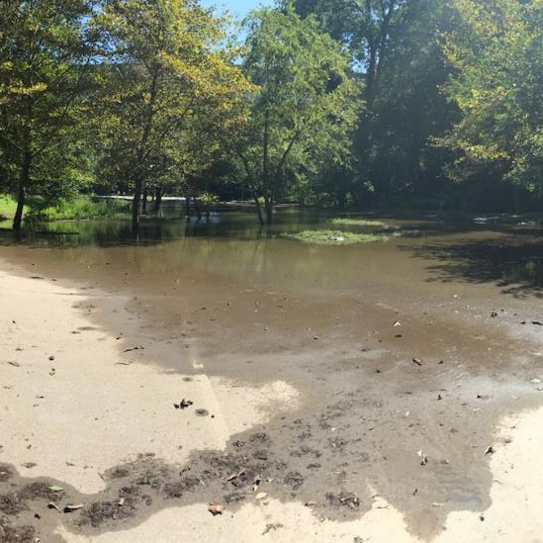
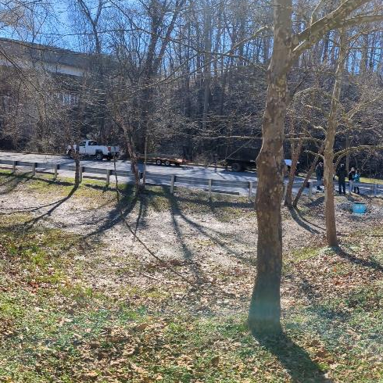
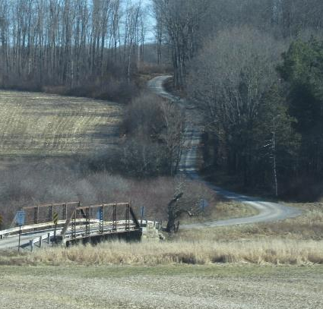
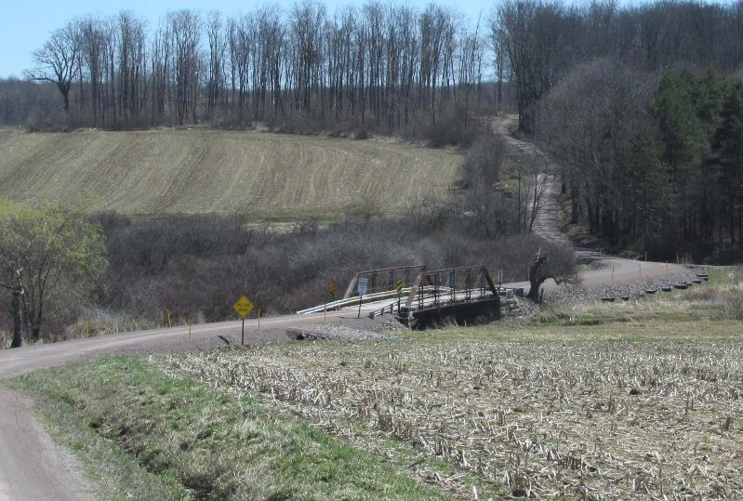
What is the DGLVR Program?
Pennsylvania’s Dirt, Gravel, and Low Volume Road (DGLVR) Program provides education, technical assistance, and grant funding to local public-road-owning entities throughout the state. The Program dedicates $20 million to unpaved roads and $8 million to paved low volume roads (LVRs) traveled by fewer than 500 vehicles per day. The Program’s goal is to implement Environmentally Sensitive Maintenance Practices aimed at reducing the environmental impacts of public roads while reducing long-term maintenance costs. The PA State Conservation Commission (SCC) administers the program at the state level and allocates funding to conservation districts in 66 counties throughout Pennsylvania. Owners of public roads apply for grants at their local county conservation district, and work with them to complete projects. The Penn State Center for Dirt and Gravel Road Studies provides education, outreach, and technical assistance for the Program. More information is available at: www.dirtandgravelroads.org.
Jefferson County, Heath Twp.
Spring Creek Road - unpaved
Roadside springs saturated the existing road and ditches, causing them to become soft, unstable, and rutted. Multiple underdrains and two French Mattresses were installed to handle subsurface drainage. Geotextile fabric was utilized along with over a foot of new road base to stabilize the road surface.
BEFORE
AFTER
Washington County, Donegal Twp.
Wilhelm Road – paved LVR
This existing multi-pipe stream crossing was prone to clogging and flooding. A new 16’ wide bottomless aluminum box culvert was installed. The streambed was reconstructed through the structure including a low-flow channel, stream bank margins, and three riffles for grade control.
BEFORE
AFTER
Delaware County, Newton Twp.
Paper Mill Road - paved LVR
This project was located at an intersection of two low volume roads that was prone to flooding and washouts. A vegetated stormwater basin was created to handle road runoff issues. The basin outlets using a 24” riser with a trash rack and backflow preventer to prevent flooding from the adjacent stream.
BEFORE
AFTER
Somerset County, Stoneycreek Twp.
Yonai Road - unpaved
This road is located in a floodplain that is frequently inundated by backwater from a nearby stream confluence. A large French Mattress with a bank of pipes was installed to allow floodwater to pass under the road and raise the road out of the floodplain, providing traffic support.
BEFORE
AFTER

Slide 2
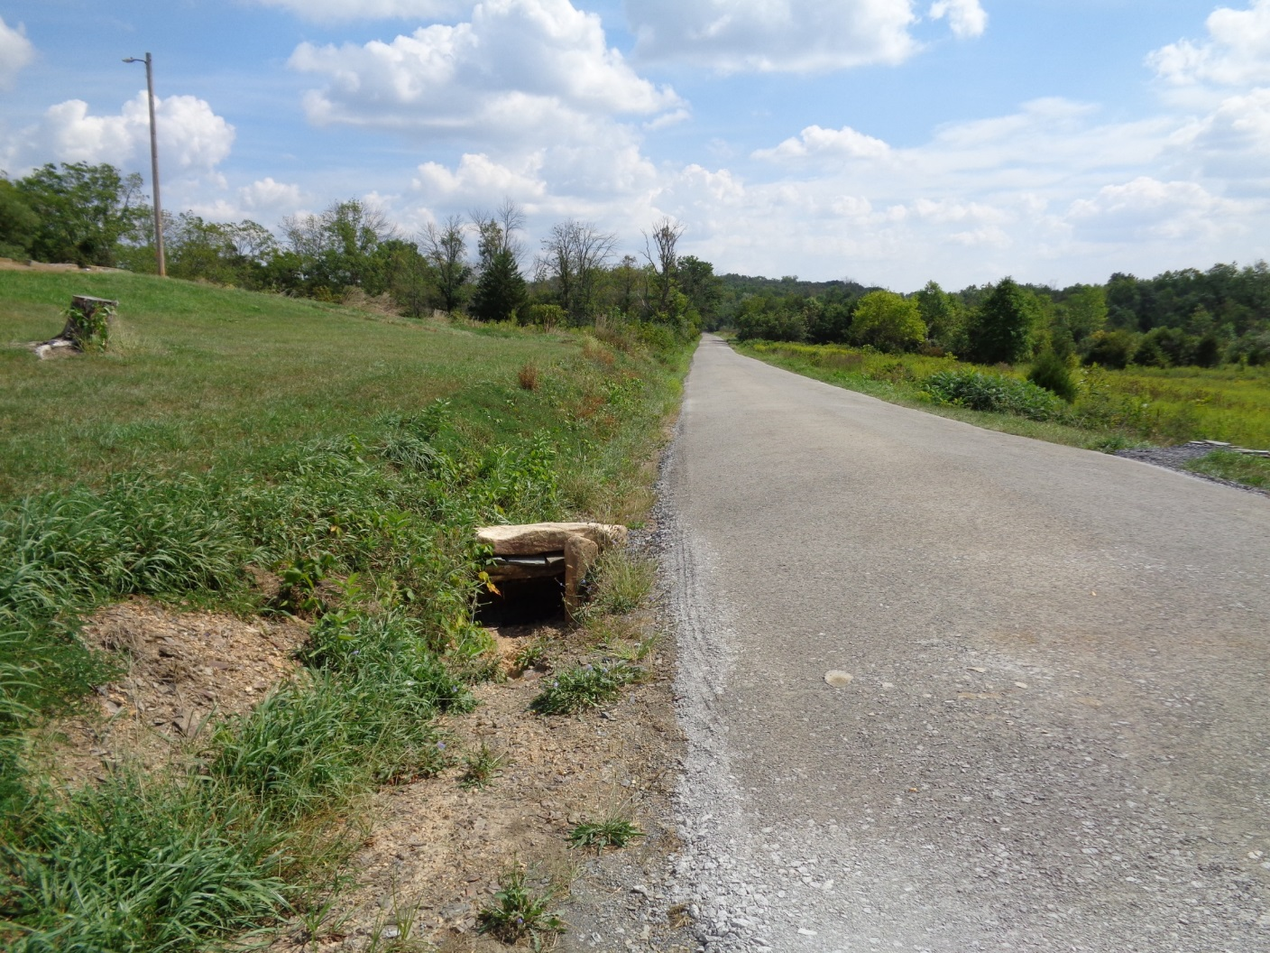
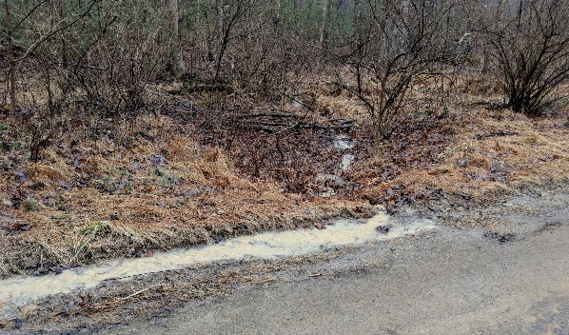
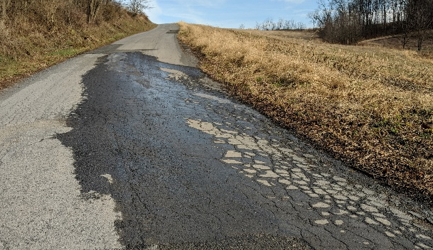
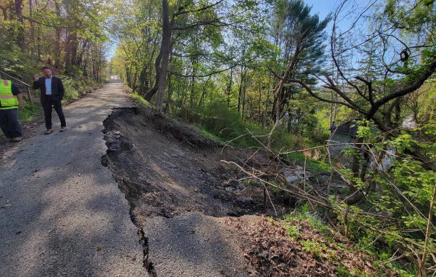
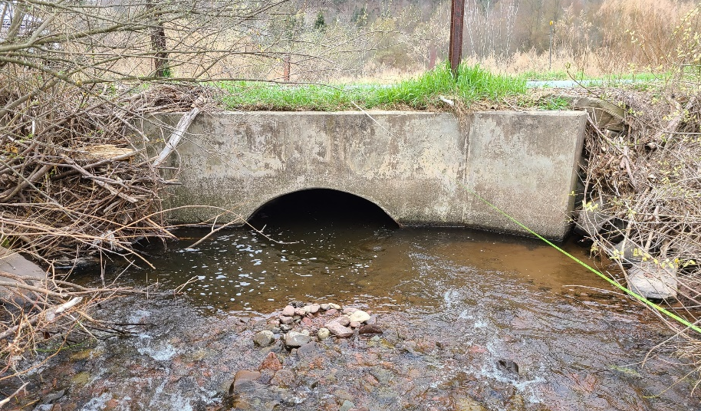
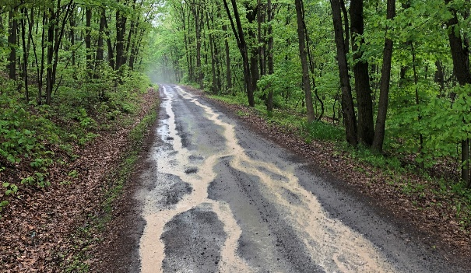


Frequent Issues Addressed by the DGLVR Program
Direct Drainage to Streams:
The “simplified” purpose of the DGLVR Program since its inception in 1997 is to “keep the mud out of the streams”. Unfortunately, road ditches often wash soil and road material directly to streams that lie at low points of the landscape. The Program implements a wide variety of practices to break up concentrated water runoff, spread it out, encourage it to soak into the ground, and keep road sediment out of the stream.
Springs and Seeps:
Pennsylvania is blessed with a plentiful supply of groundwater. Unfortunately, this groundwater often creates problems on both paved and unpaved roads by saturating and weakening the road base and surface. Practices such as underdrains and French mattresses can be used to intercept this subsurface water before it impacts the road.
Landslides:
Slides can be a common problem, especially on steep slopes. They are frequently caused by poor soils and oversaturation of the road base. Left unaddressed, slides can lead to unsafe conditions, road failures, or road closures. Fixes for slides vary greatly in scope and cost, but can include retaining walls, base excavation and rebuilding with geotextile fabric, sheet piling, or installation of soil nails or screws.
Undersized Stream Pipes:
Stream pipes and bridges are often undersized to save on initial construction costs. Unfortunately, this often results in additional long term maintenance costs, along with a host of other environmental issues, over the life of the structure. Since 2015, the Program has limited stream crossing replacements to undersized crossings and has implemented policy to guide new structure installation. See page 3 inside for more details.
Inadequate Road Base and Shape
Road material is expensive, and often unpaved or low traffic paved roads are neglected in favor of resurfacing higher traffic routes. Practices such as adding competent road base material, raising the road profile, French mattresses, underdrains, and Driving Surface Aggregate (DSA) can be used to make the road the high point so water drains off of it while supporting the weight of traffic.
This document was prepared jointly by the PA State Conservation Commission (SCC) and the PSU Center for Dirt and Gravel Road Studies through a contract with the SCC. Figures are based on GIS data supplied by conservation districts in January 2024. For more information, visit www.dirtandgravelroads.org.

